Slide 1
A Comprehensive ETL Workflow with Python for Data Engineers
Name : Manan Gupta
Batch : DE-WE-E-B2

Slide 2
Problem Statement
Organizations often deal with data in diverse formats like CSV, JSON, and XML.
Traditional ETL processes are manual, time-consuming, and prone to human error.

Slide 3
Project Objectives
Extract structured and semi-structured data from CSV, JSON, and XML files.
Transform the extracted data through:
Unit conversions (e.g., inches to meters, pounds to kilograms).
Data cleaning and standardization.
Load the transformed data
Implement logging for traceability, debugging, and auditing across all ETL stages.

Slide 4
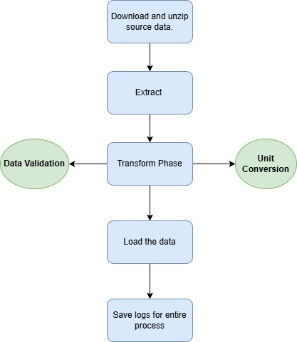
ETL Process Overview
1. Download and Unzip data
2. Extract data
3. Transform data
4. Load data
5. Logging

Slide 5
Thank you

