Slide 1
Dmart Data analysis using pYspark
Name : Manan Gupta
Batch : DE-WE-E-B2

Slide 2
The Problem
Dmart generates massive transactional data.
Business needs insights to improve performance.
Traditional tools can’t handle scale efficiently.

Slide 3
Project Objective
Perform large-scale data analysis using PySpark.
Clean, transform, and join customer, product, and sales datasets.
Extract meaningful business Insights.

Slide 4
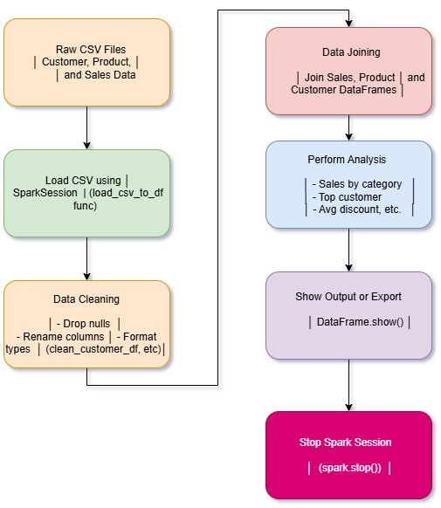
Workflow

Slide 5
Thank you

