Slide 1
Enhanced ETL Workflow with Python, AWS S3, and RDS
Name : Manan Gupta
Batch : DE-WE-E-B2

Slide 2
Problem Statement
Organizations often deal with data in diverse formats like CSV, JSON, and XML.
Traditional ETL processes are manual, time-consuming, and prone to human error.
Managing large-scale data workflows without cloud-native tools is inefficient.
There's a pressing need for a scalable, secure, and automated ETL pipeline that leverages cloud technologies.

Slide 3
Project Objectives
Extract structured and semi-structured data from CSV, JSON, and XML files.
Transform the extracted data through:
Unit conversions (e.g., inches to meters, pounds to kilograms).
Data cleaning and standardization.
Load the transformed data into:
AWS S3 (for storage and archiving).
AWS RDS (for querying and analytics).
Implement logging for traceability, debugging, and auditing across all ETL stages.

Slide 4
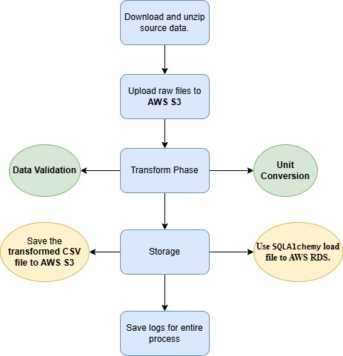
ETL Process Overview
1. Download and Unzip data
2. Upload raw files to S3
3. Extract & Transform with Python
4. Load to RDS & S3
5. Logging

Slide 5
Thank you

