Slide 1
Chetak
Advertising
M. 7906479460
NH-58

Slide 2
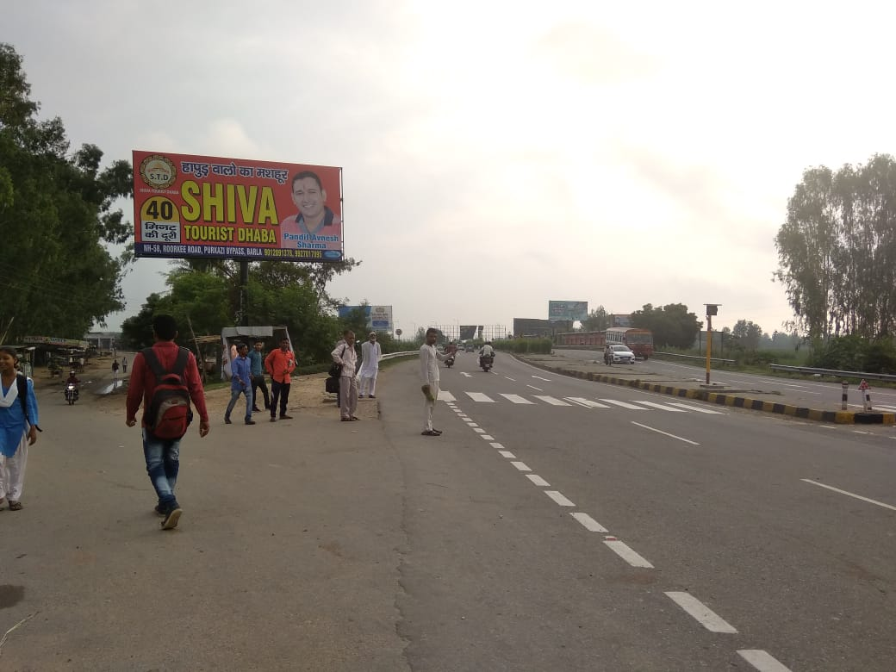
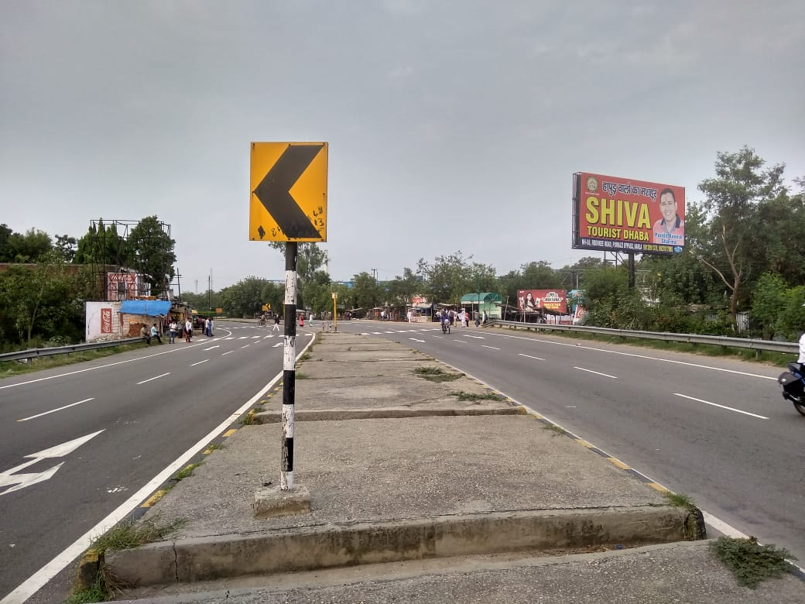
NH-58 SAKOTI
MEERUT TO MUZAFFAR NAGAR
Size : 30X15 Facing : Both side
Lit : Non Lit

Slide 3
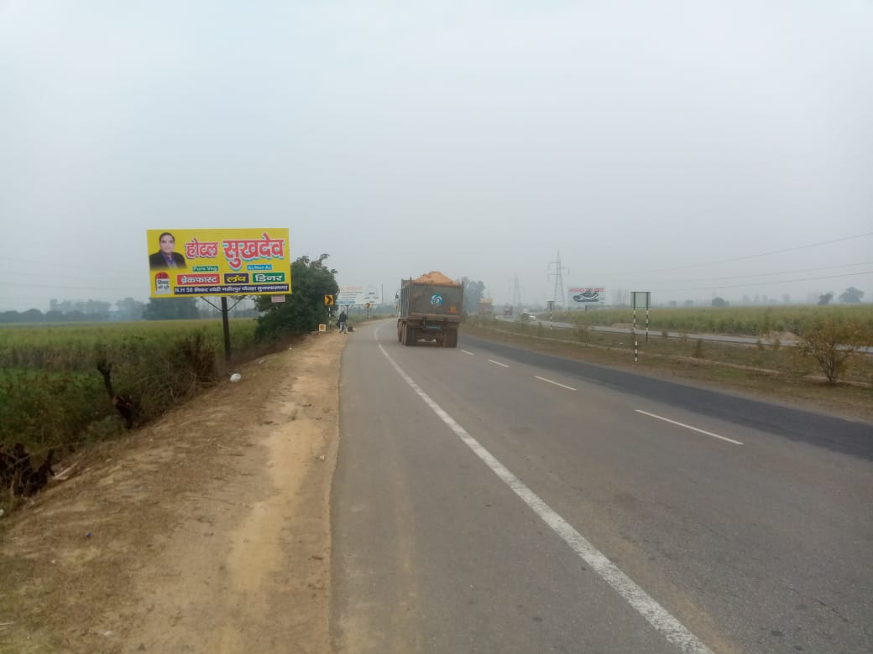
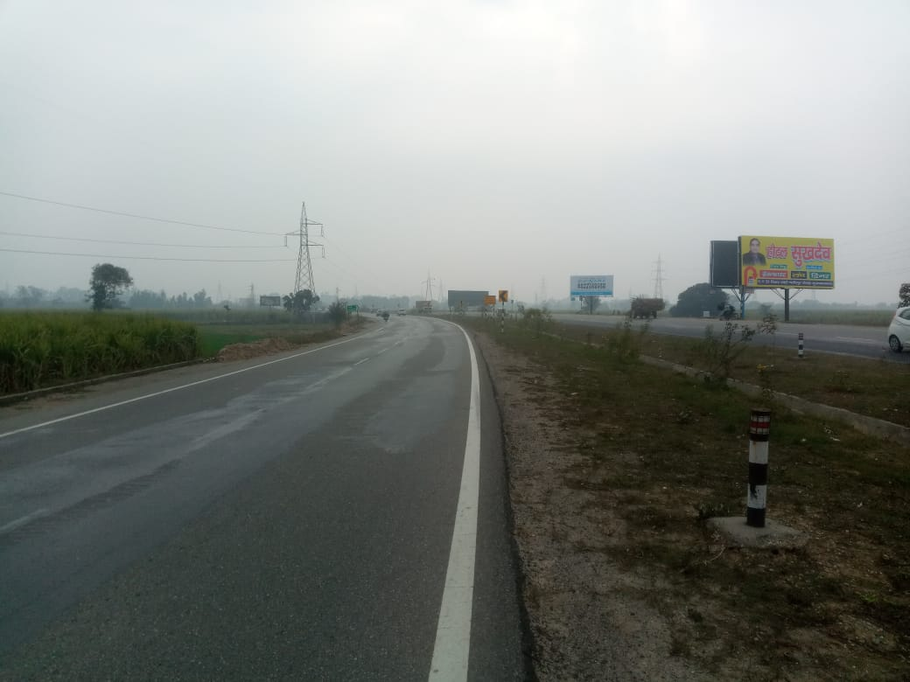
NH-58 KHATOALI BYPASS
MEERUT TO MUZAFFARNAGAR
Size : 30X15 Facing : Both side
Lit : Non Lit

Slide 4
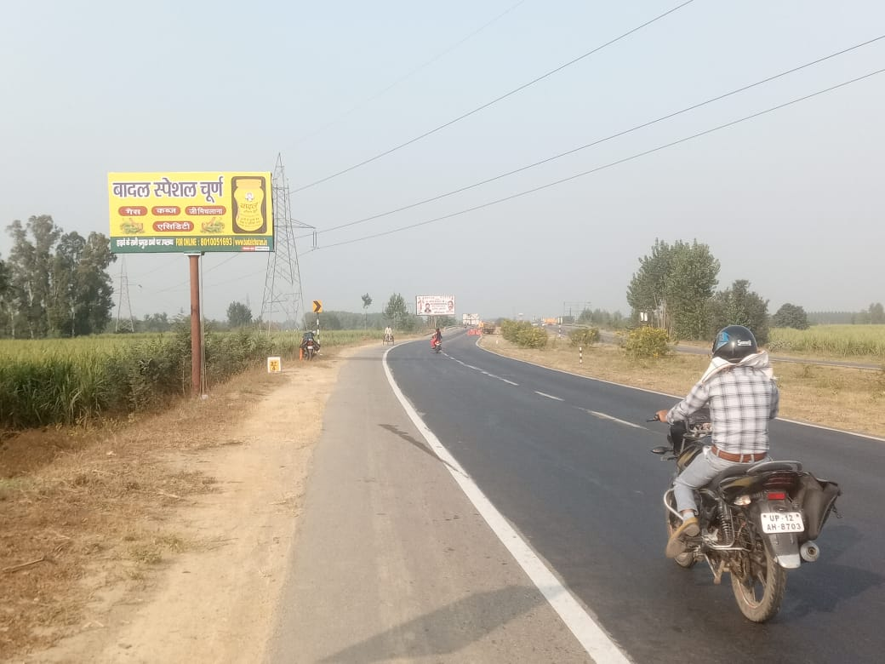
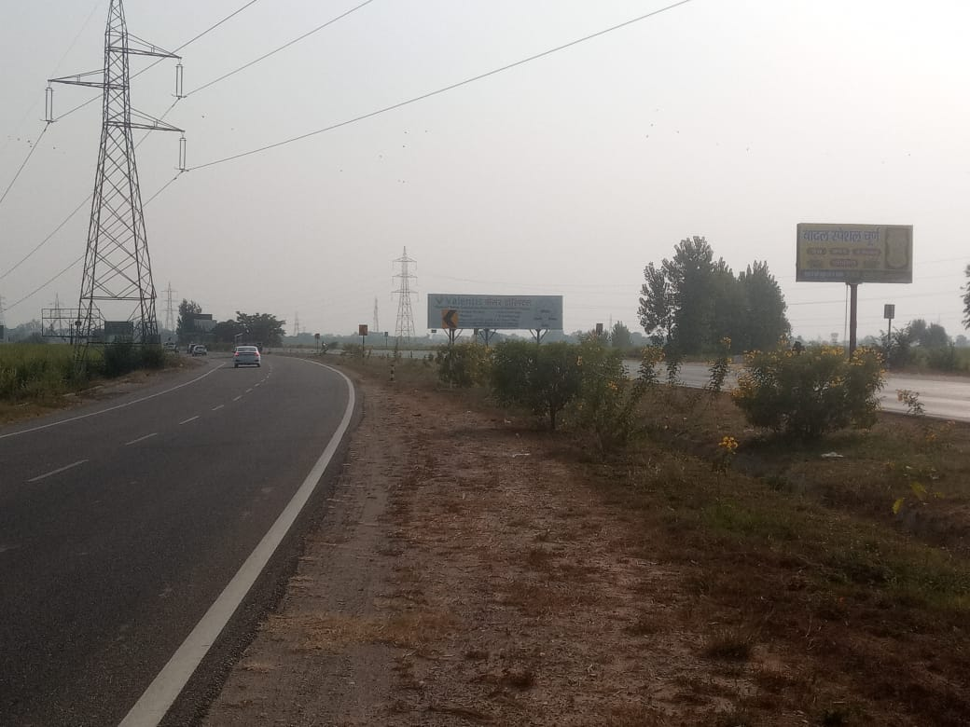
NH-58 KHATOALI BYPASS
MEERUT TO MUZAFFARNAGAR
Size : 20X10 Facing : Both side
Lit : Non Lit

Slide 5
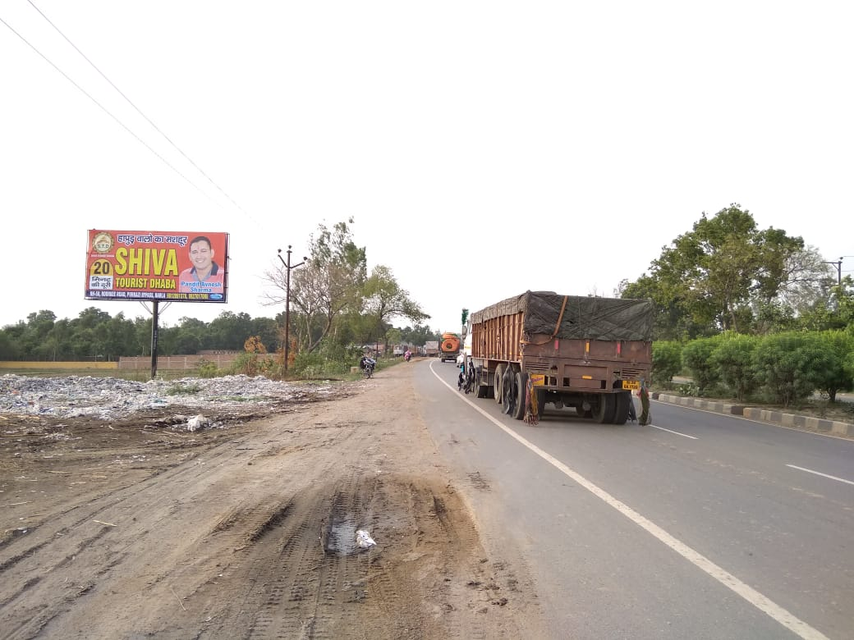
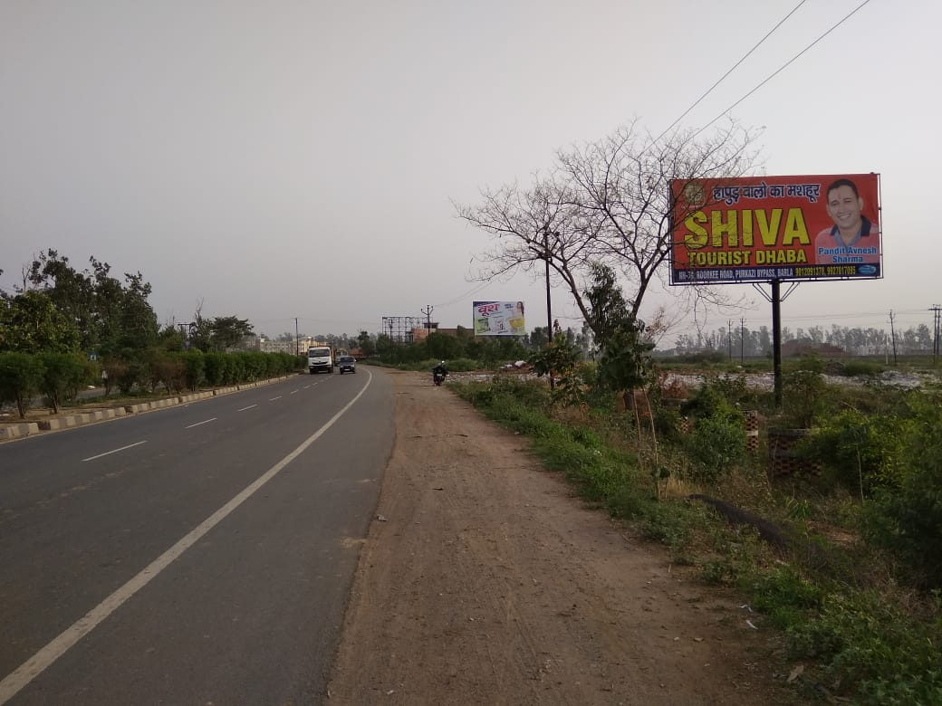
NH-58 MUZAFFAR NAGAR BYPASS
MUZAFFAR NAGAR TO RURKI
Size : 30X15 Facing : Both side
Lit : Non Lit

Slide 6
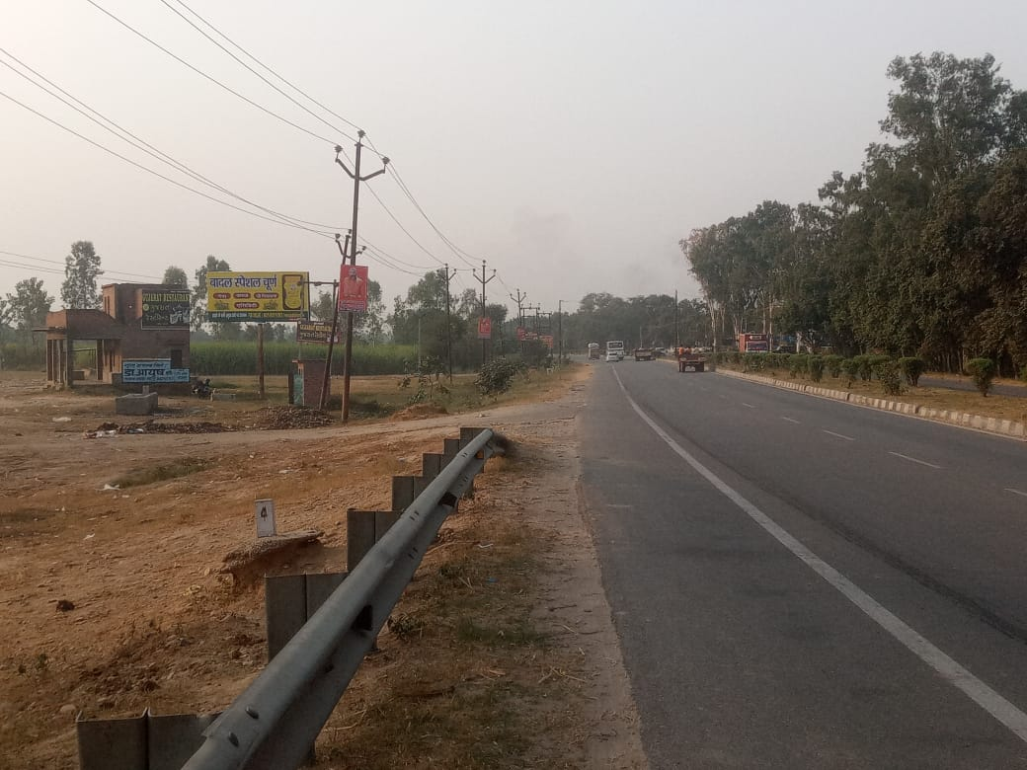
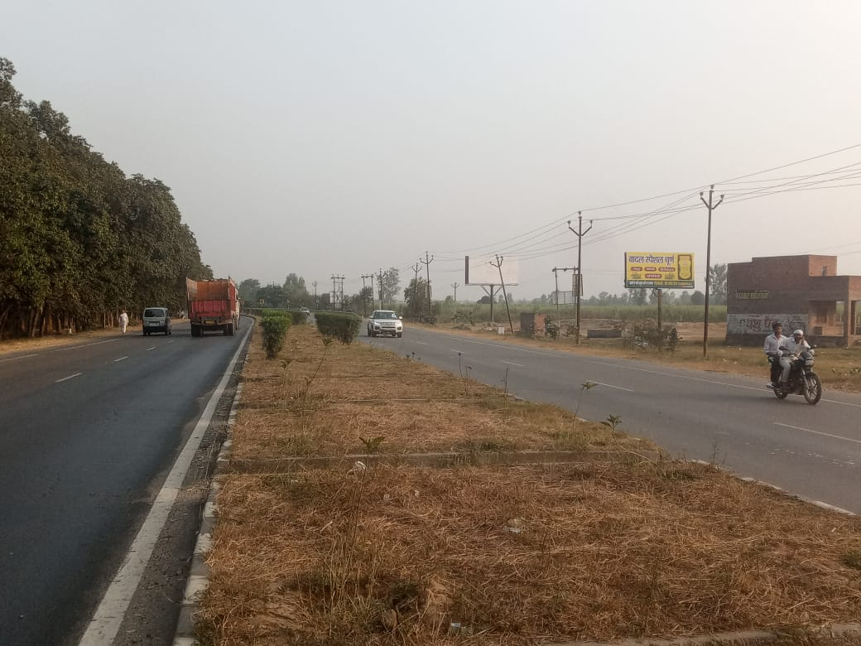
NH-58 NASIRPUR CHORAHA
MUZAFFARNAGAR TO HARIDUWAR
Size : 20X10 Facing : Both side
Lit : Non Lit

Slide 7
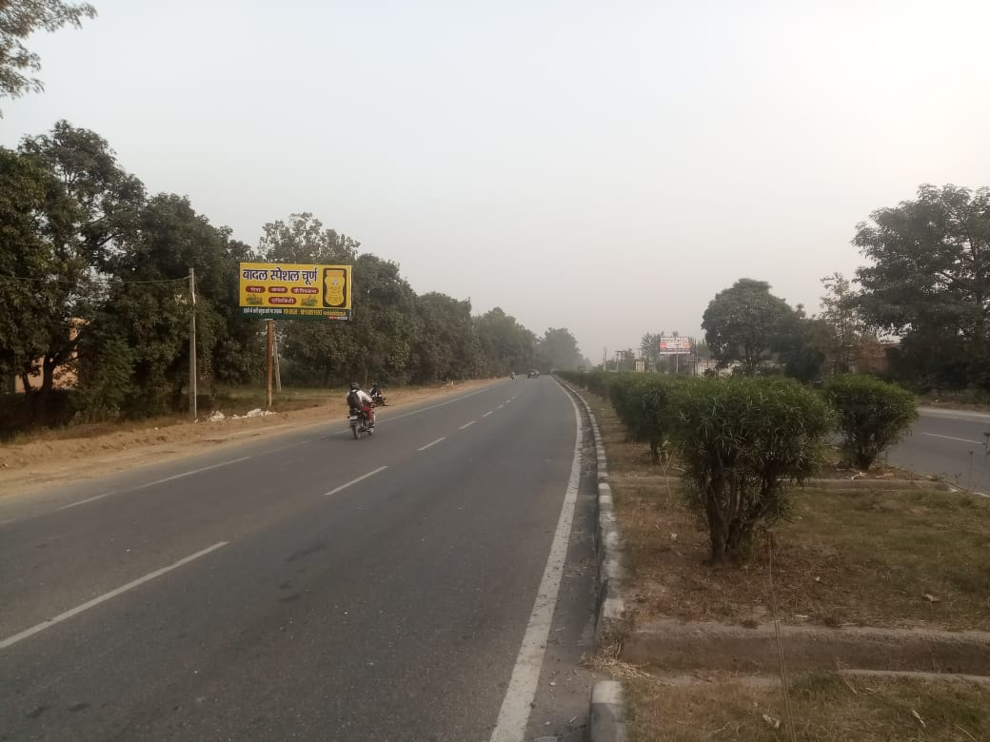
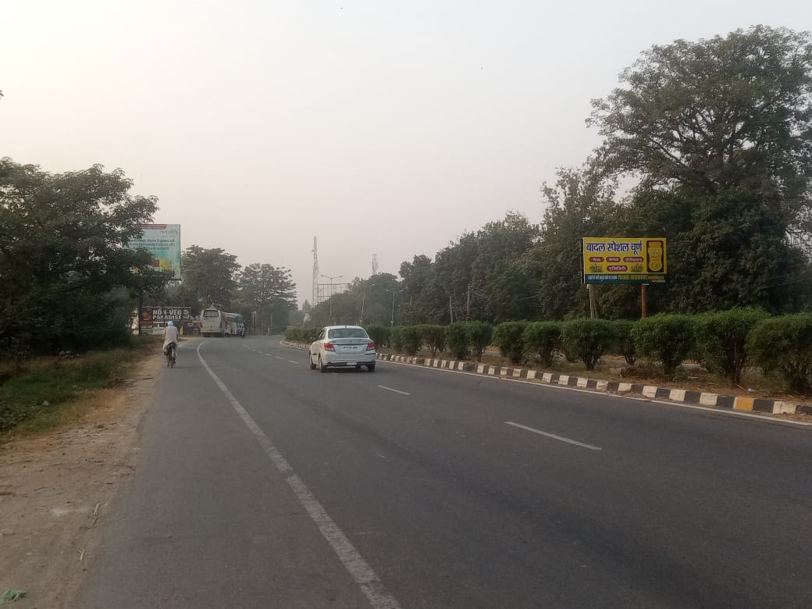
NH-58 NEAR GANPATI DHABA
HARIDUWAR TO MUZAFFARNAGAR
Size : 20X10 Facing : Both side
Lit : Non Lit

Slide 8
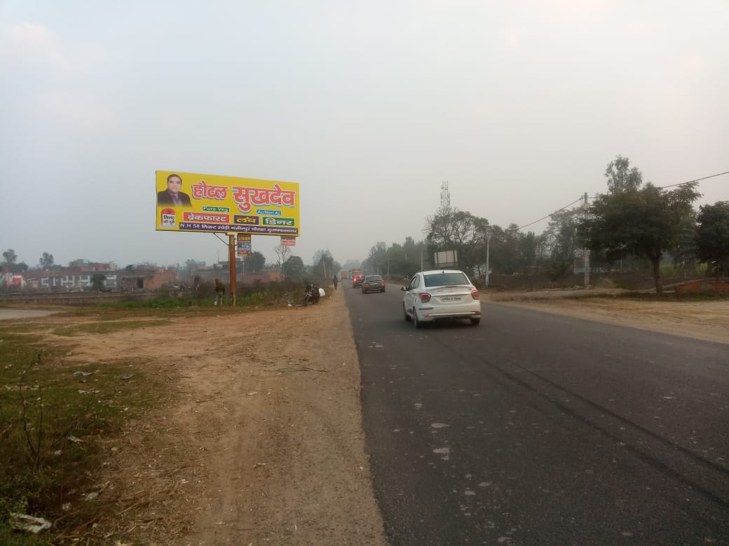
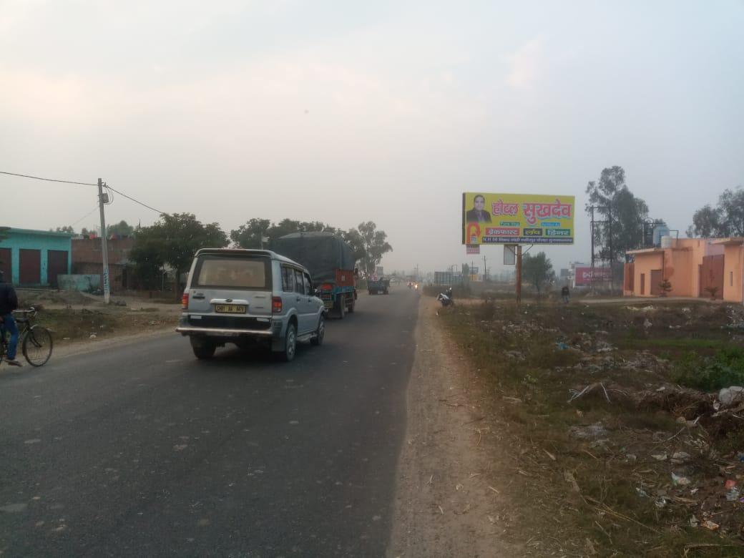
NH-58 RAMPUR TEERAHA
MUZAFFARNAGAR TO DEHRADUN
Size : 25X10 Facing : Both side
Lit : Non Lit

Slide 9
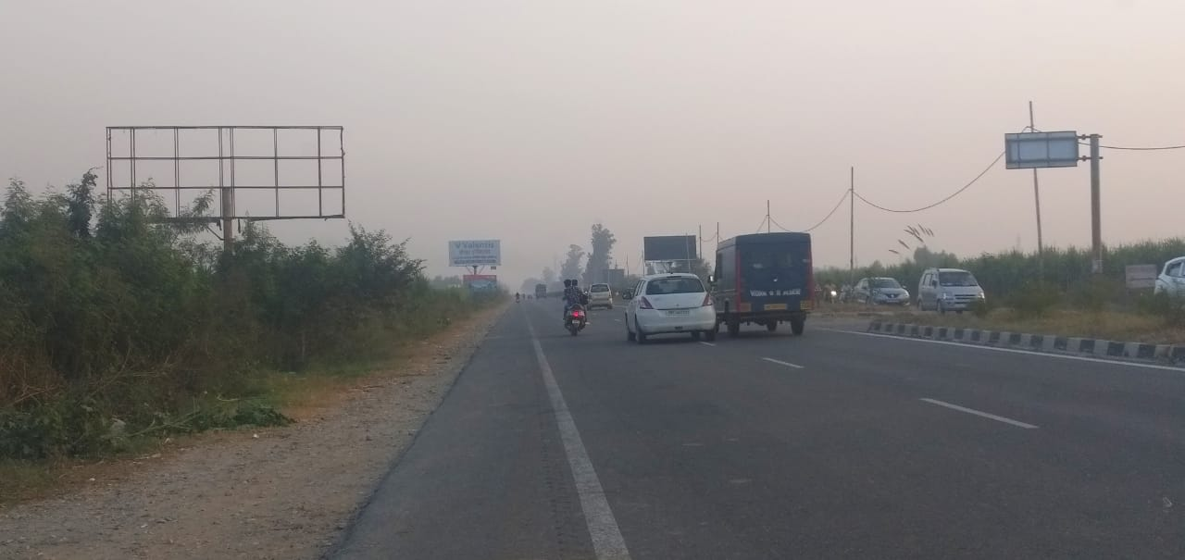
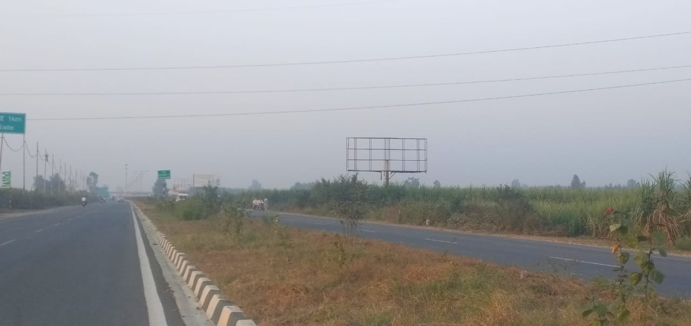
NH-58 NEAR RUHANA TOLL TAX
DEHRADUN TO MUZAFFARNAGAR
Size : 25X10 Facing : Both side
Lit : Non Lit

Slide 10
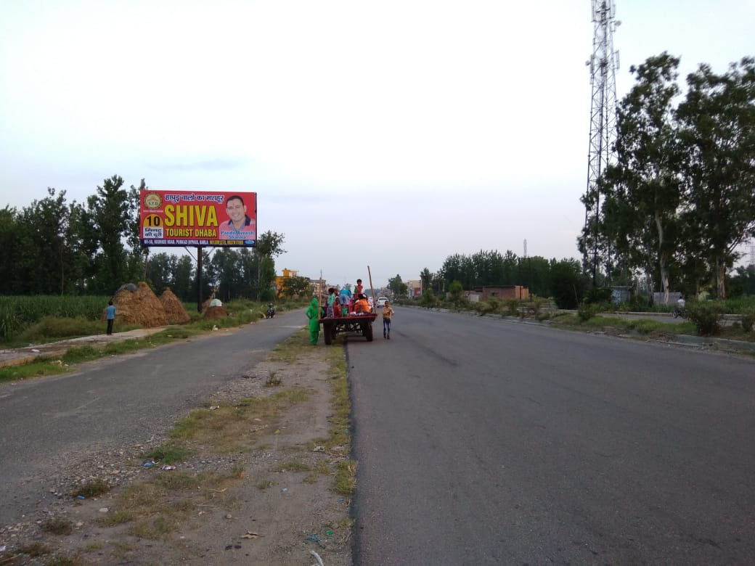
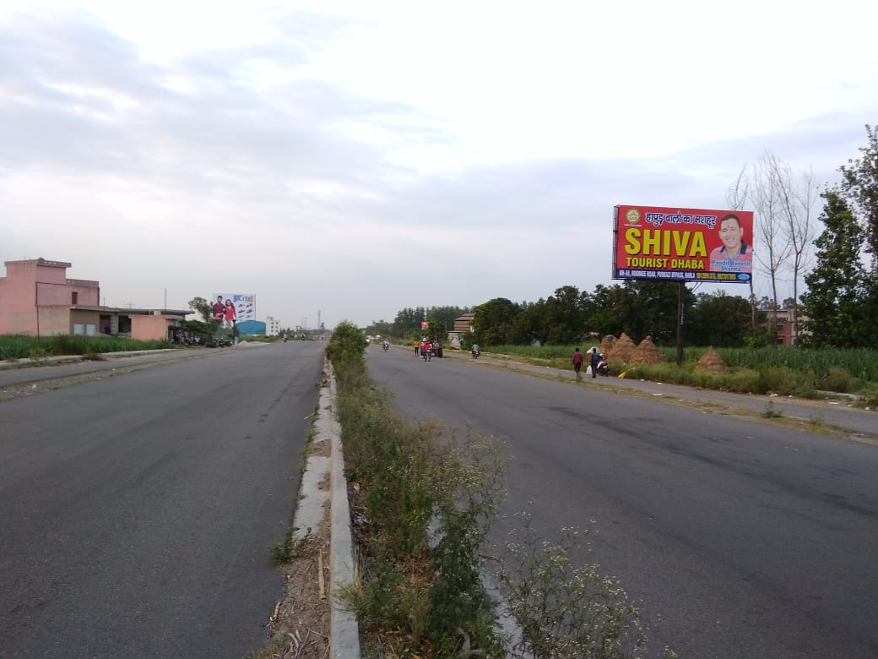
NH-58 VILL. SISONA
MUZAFFAR NAGAR TO HARIDWAR
Size : 30X15 Facing : Both side
Lit : Non Lit

Slide 11
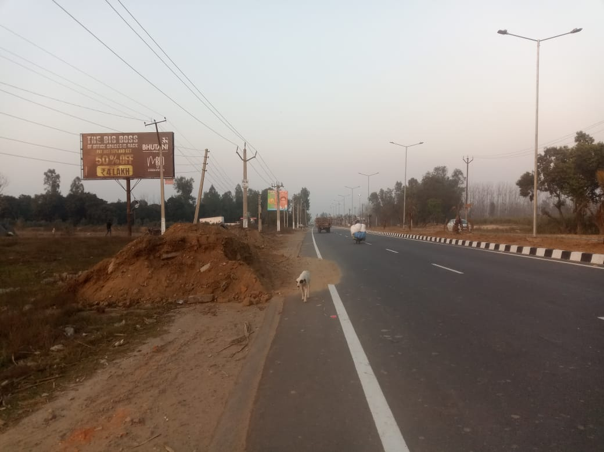
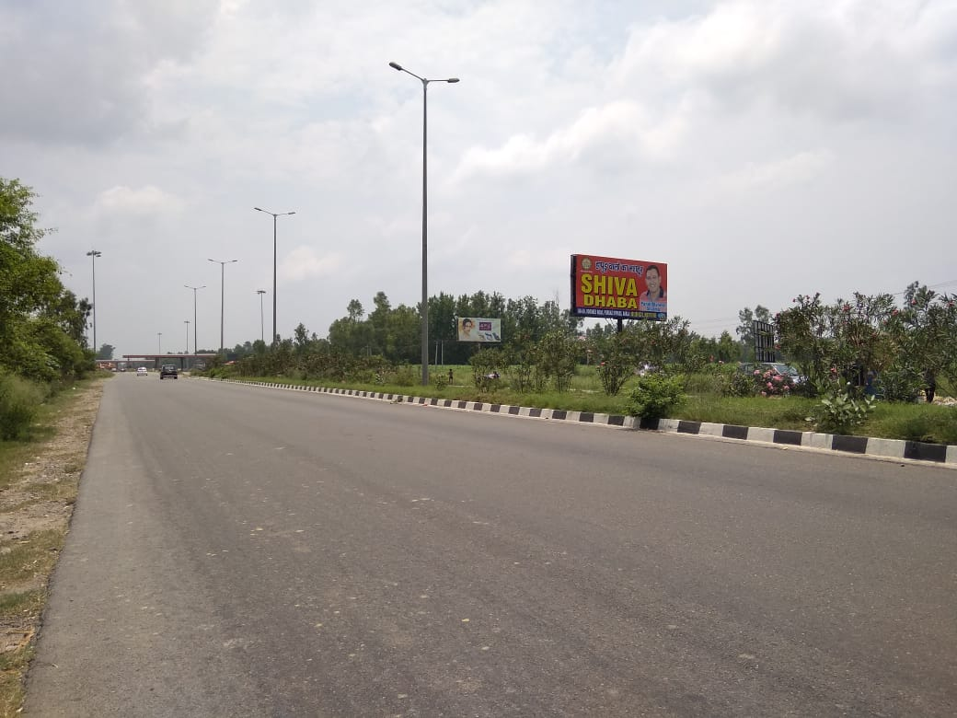
NH-58 NEAR CHAPPAR TOLL TAX
MUZAFFAR NAGAR TO HARIDWAR
Size : 30X15 Facing : Both side
Lit : Non Lit

Slide 12
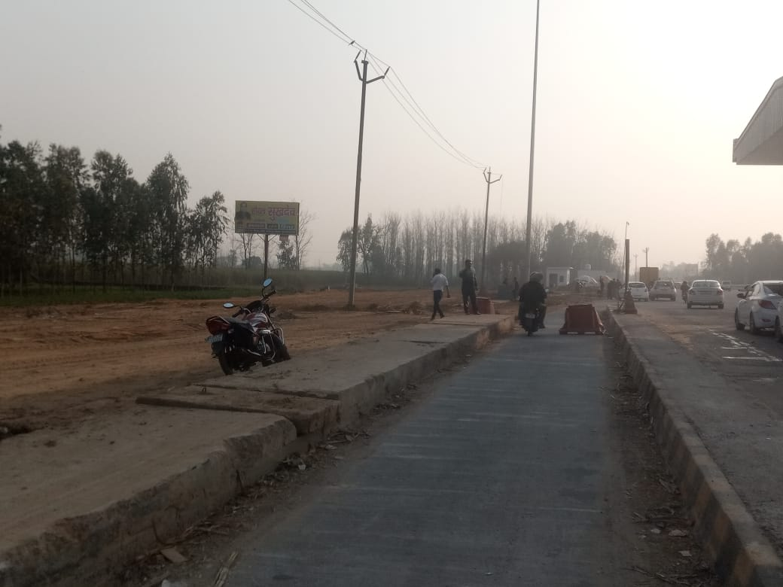
NH-58 CHAPPAR TOLL TAX
HARIDWAR TO MUZAFFAR NAGAR
Size : 20X10 Facing : Both side
Lit : Non Lit

Slide 13
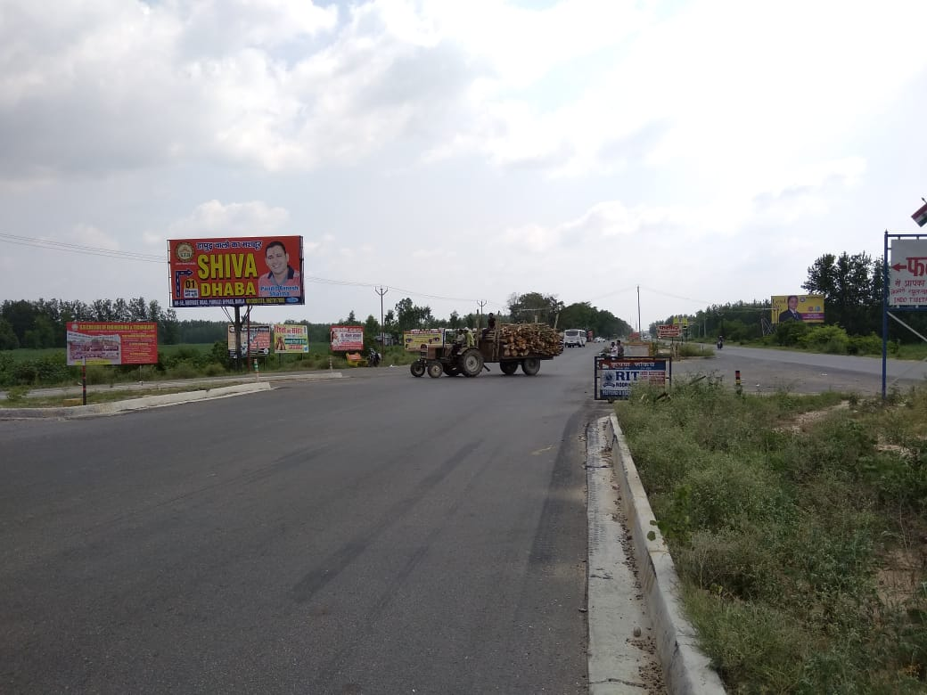
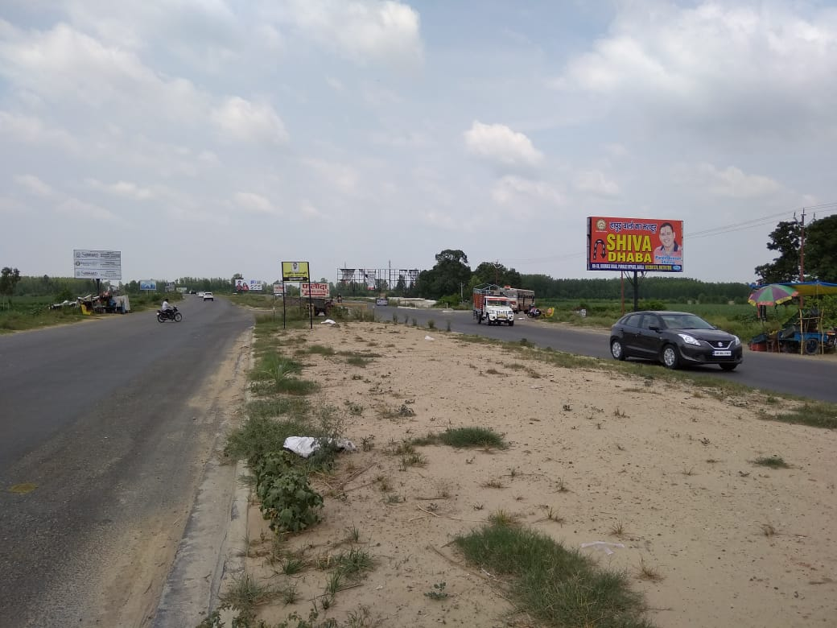
NH-58 PURKAZI ENTRY
HARIDWAR TO MUZAFFAR NAGAR
Size : 30X15 Facing : Both side
Lit : Non Lit

Slide 14
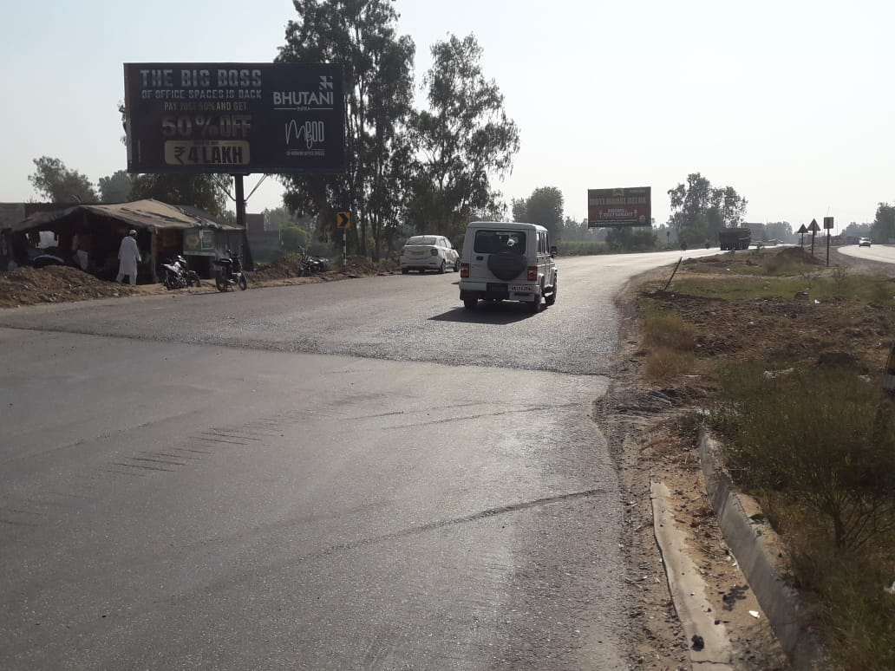
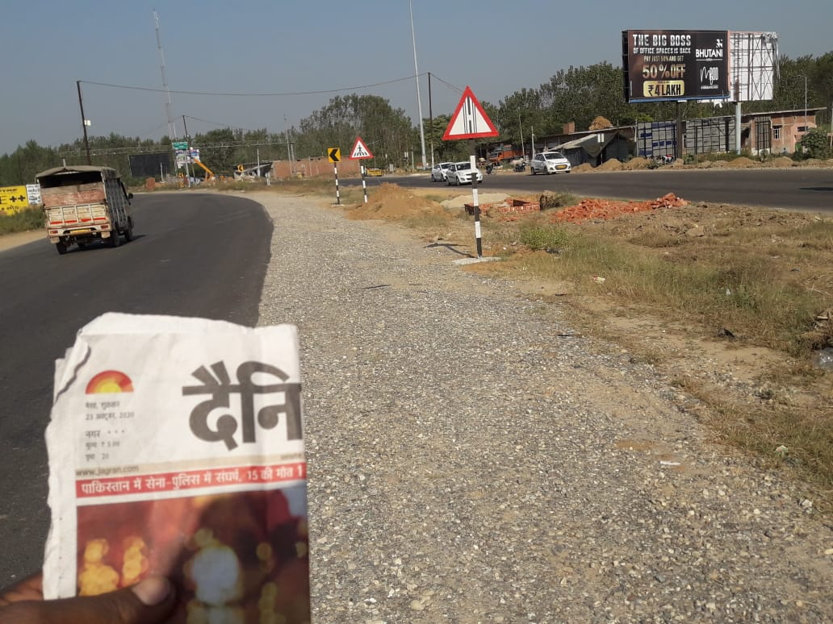
NH-58 PURKAZI BOADER
HARIDWAR TO MUZAFFAR NAGAR
Size : 30X15 Facing : Both side
Lit : Non Lit

Slide 15
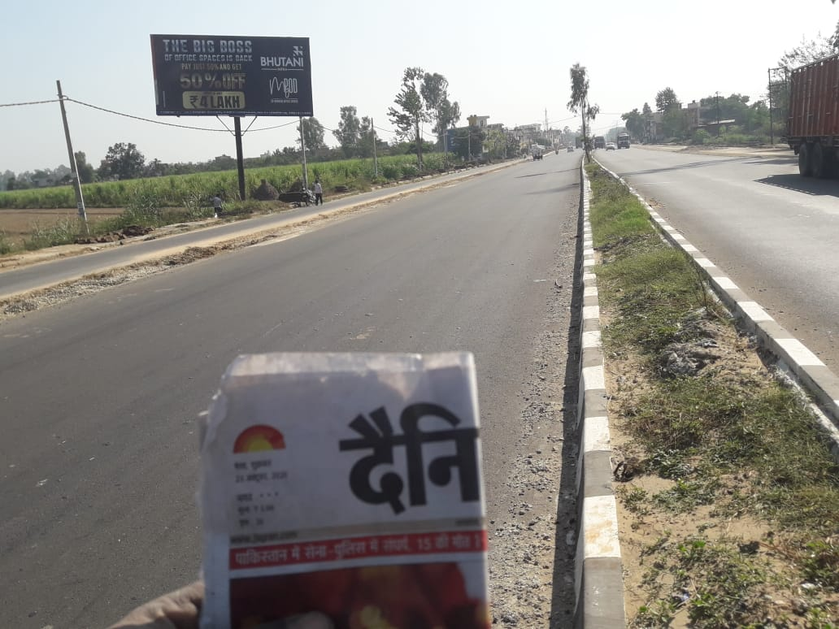
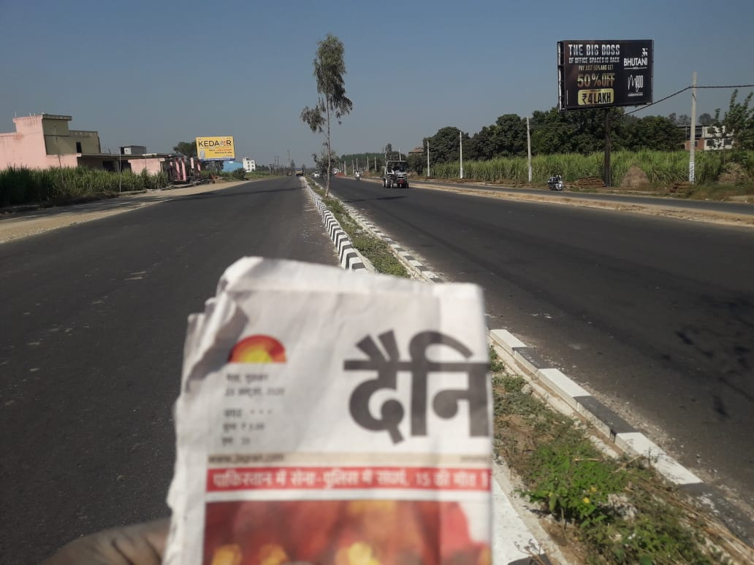
NH-58 MANDWALI VILLEG
HARIDWAR TO MUZAFFAR NAGAR
Size : 30X15 Facing : Both side
Lit : Non Lit

