Slide 1
QR Based Restaurant

Slide 2
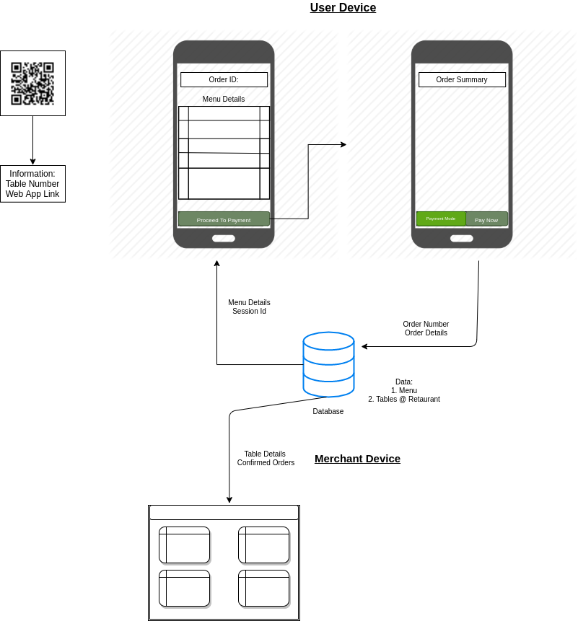
Basic Flow

Slide 3
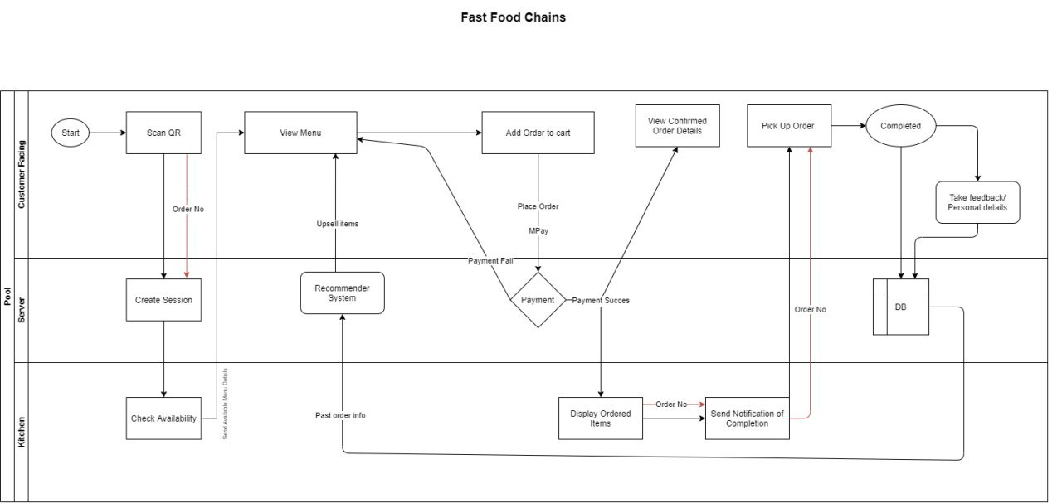
QSR Flow diagram

Slide 4
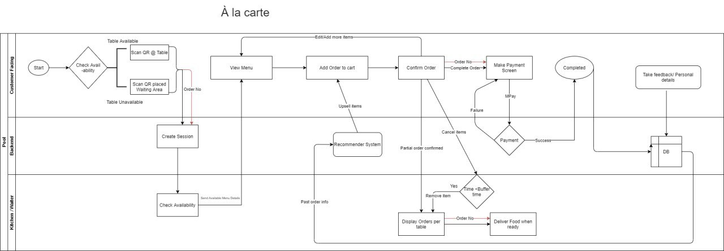
A la carte Flow diagram

Slide 5
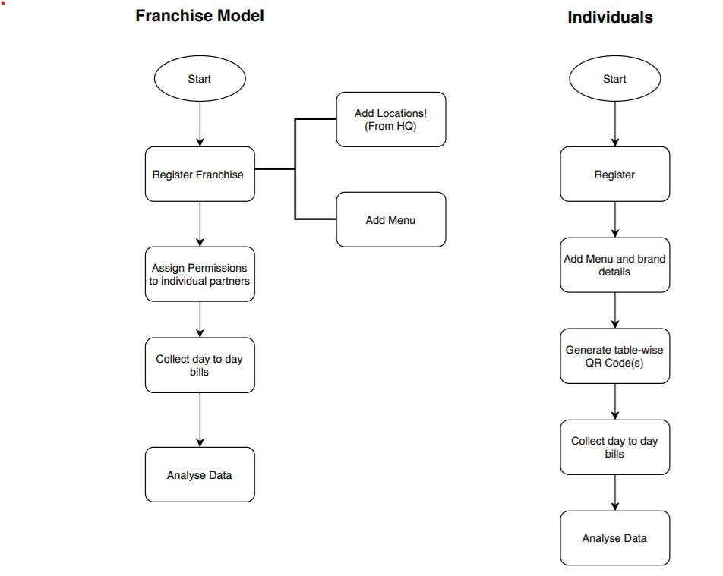
Merchant onboarding

Slide 6
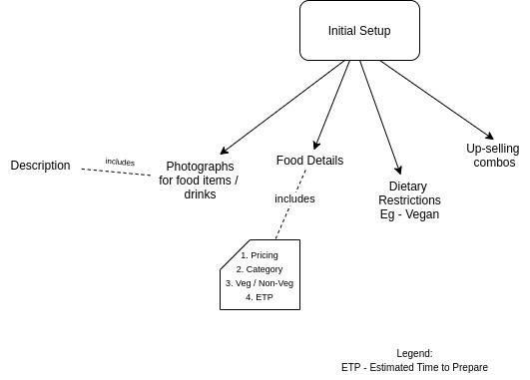
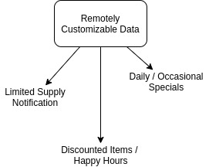
Menu Customization Options

