Slide 1
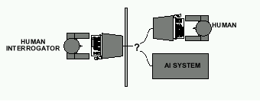
Last Time: Acting Humanly: The Full Turing Test
Alan Turing's 1950 article Computing Machinery and Intelligence discussed conditions for considering a machine to be intelligent
“Can machines think?” ←→ “Can machines behave intelligently?”
The Turing test (The Imitation Game): Operational definition of intelligence.
Computer needs to possess: Natural language processing, Knowledge representation, Automated reasoning, and Machine learning
Problem: 1) Turing test is not reproducible, constructive, and amenable to mathematic analysis. 2) What about physical interaction with interrogator and environment?
Total Turing Test: Requires physical interaction and needs perception and actuation.

Slide 2
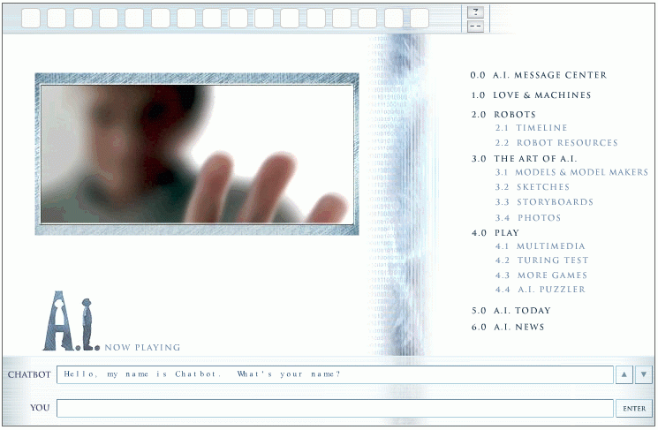
Last time: The Turing Test
http://aimovie.warnerbros.com
http://www.ai.mit.edu/projects/infolab/

Slide 3

Last time: The Turing Test
http://aimovie.warnerbros.com
http://www.ai.mit.edu/projects/infolab/

Slide 4

Last time: The Turing Test
http://aimovie.warnerbros.com
http://www.ai.mit.edu/projects/infolab/

Slide 5

Last time: The Turing Test
http://aimovie.warnerbros.com
http://www.ai.mit.edu/projects/infolab/

Slide 6

Last time: The Turing Test
FAILED!
http://aimovie.warnerbros.com
http://www.ai.mit.edu/projects/infolab/

Slide 7
This time: Outline
Intelligent Agents (IA)
Environment types
IA Behavior
IA Structure
IA Types

Slide 8
What is an (Intelligent) Agent?
An over-used, over-loaded, and misused term.
Anything that can be viewed as perceiving its environment through sensors and acting upon that environment through its effectors to maximize progress towards its goals.

Slide 9
What is an (Intelligent) Agent?
PAGE (Percepts, Actions, Goals, Environment)
Task-specific & specialized: well-defined goals and environment
The notion of an agent is meant to be a tool for analyzing systems,
It is not a different hardware or new programming languages

Slide 10
Intelligent Agents and Artificial Intelligence
Example: Human mind as network of thousands or millions of agents working in parallel. To produce real artificial intelligence, this school holds, we should build computer systems that also contain many agents and systems for arbitrating among the agents' competing results.
Distributed decision-making and control
Challenges:
Action selection: What next action to choose
Conflict resolution
Agency
sensors
effectors

Slide 11
Agent Types
We can split agent research into two main strands:
Distributed Artificial Intelligence (DAI) – Multi-Agent Systems (MAS) (1980 – 1990)
Much broader notion of "agent" (1990’s – present)
interface, reactive, mobile, information

Slide 12
Rational Agents
How to design this?
Sensors
percepts
Environment
?
Agent
actions
Effectors

Slide 13
A Windshield Wiper Agent
How do we design a agent that can wipe the windshields
when needed?
Goals?
Percepts?
Sensors?
Effectors?
Actions?
Environment?

Slide 14
A Windshield Wiper Agent (Cont’d)
Goals: Keep windshields clean & maintain visibility
Percepts: Raining, Dirty
Sensors: Camera (moist sensor)
Effectors: Wipers (left, right, back)
Actions: Off, Slow, Medium, Fast
Environment: Inner city, freeways, highways, weather …

Slide 15
Interacting Agents
Collision Avoidance Agent (CAA)
Goals: Avoid running into obstacles
Percepts ?
Sensors?
Effectors ?
Actions ?
Environment: Freeway
Lane Keeping Agent (LKA)
Goals: Stay in current lane
Percepts ?
Sensors?
Effectors ?
Actions ?
Environment: Freeway

Slide 16
Interacting Agents
Collision Avoidance Agent (CAA)
Goals: Avoid running into obstacles
Percepts: Obstacle distance, velocity, trajectory
Sensors: Vision, proximity sensing
Effectors: Steering Wheel, Accelerator, Brakes, Horn, Headlights
Actions: Steer, speed up, brake, blow horn, signal (headlights)
Environment: Freeway
Lane Keeping Agent (LKA)
Goals: Stay in current lane
Percepts: Lane center, lane boundaries
Sensors: Vision
Effectors: Steering Wheel, Accelerator, Brakes
Actions: Steer, speed up, brake
Environment: Freeway

Slide 17
Conflict Resolution by Action Selection Agents
Override: CAA overrides LKA
Arbitrate: if Obstacle is Close then CAA else LKA
Compromise: Choose action that satisfies both agents
Any combination of the above
Challenges: Doing the right thing

Slide 18
The Right Thing = The Rational Action
Rational Action: The action that maximizes the expected value of the performance measure given the percept sequence to date
Rational = Best ?
Rational = Optimal ?
Rational = Omniscience ?
Rational = Clairvoyant ?
Rational = Successful ?

Slide 19
The Right Thing = The Rational Action
Rational Action: The action that maximizes the expected value of the performance measure given the percept sequence to date
Rational = Best Yes, to the best of its knowledge
Rational = Optimal Yes, to the best of its abilities (incl.
Rational ≠ Omniscience its constraints)
Rational ≠ Clairvoyant
Rational ≠ Successful

Slide 20
Behavior and performance of IAs
Perception (sequence) to Action Mapping: f : P* → A
Ideal mapping: specifies which actions an agent ought to take at any point in time
Description: Look-Up-Table, Closed Form, etc.
Performance measure: a subjective measure to characterize how successful an agent is (e.g., speed, power usage, accuracy, money, etc.)
(degree of) Autonomy: to what extent is the agent able to make decisions and take actions on its own?

Slide 21
Look up table
Distance | Action
10 | No action
5 | Turn left 30 degrees
2 | Stop
obstacle
sensor
agent

Slide 22
Closed form
Output (degree of rotation) = F(distance)
E.g., F(d) = 10/d (distance cannot be less than 1/10)

Slide 23
How is an Agent different from other software?
Agents are autonomous, that is, they act on behalf of the user
Agents contain some level of intelligence, from fixed rules to learning engines that allow them to adapt to changes in the environment
Agents don't only act reactively, but sometimes also proactively

Slide 24
How is an Agent different from other software?
Agents have social ability, that is, they communicate with the user, the system, and other agents as required
Agents may also cooperate with other agents to carry out more complex tasks than they themselves can handle
Agents may migrate from one system to another to access remote resources or even to meet other agents

Slide 25
Environment Types
Characteristics
Accessible vs. inaccessible
Deterministic vs. nondeterministic
Episodic vs. nonepisodic
Hostile vs. friendly
Static vs. dynamic
Discrete vs. continuous

Slide 26
Environment Types
Characteristics
Accessible vs. inaccessible
Sensors give access to complete state of the environment.
Deterministic vs. nondeterministic
The next state can be determined based on the current state and the action.
Episodic vs. nonepisodic (Sequential)
Episode: each perceive and action pairs
The quality of action does not depend on the previous episode.

Slide 27
Environment Types
Characteristics
Hostile vs. friendly
Static vs. dynamic
Dynamic if the environment changes during deliberation
Discrete vs. continuous
Chess vs. driving

Slide 28
Environment types
Environment | Accessible | Deterministic | Episodic | Static | Discrete
Operating System
Virtual Reality
Office Environment
Mars

Slide 29
Environment types
Environment | Accessible | Deterministic | Episodic | Static | Discrete
Operating System | Yes | Yes | No | No | Yes
Virtual Reality
Office Environment
Mars

Slide 30
Environment types
Environment | Accessible | Deterministic | Episodic | Static | Discrete
Operating System | Yes | Yes | No | No | Yes
Virtual Reality | Yes | Yes | Yes/no | No | Yes/no
Office Environment
Mars

Slide 31
Environment types
Environment | Accessible | Deterministic | Episodic | Static | Discrete
Operating System | Yes | Yes | No | No | Yes
Virtual Reality | Yes | Yes | Yes/no | No | Yes/no
Office Environment | No | No | No | No | No
Mars

Slide 32
Environment types
Environment | Accessible | Deterministic | Episodic | Static | Discrete
Operating System | Yes | Yes | No | No | Yes
Virtual Reality | Yes | Yes | Yes/no | No | Yes/no
Office Environment | No | No | No | No | No
Mars | No | Semi | No | Semi | No
The environment types largely determine the agent design.

Slide 33
Structure of Intelligent Agents
Agent = architecture + program
Agent program: the implementation of f : P* → A, the agent’s perception-action mapping function Skeleton-Agent(Percept) returns Action memory ← UpdateMemory(memory, Percept) Action ← ChooseBestAction(memory) memory ← UpdateMemory(memory, Action) return Action
Architecture: a device that can execute the agent program (e.g., general-purpose computer, specialized device, beobot, etc.)

Slide 34
Using a look-up-table to encode f : P* → A
Example: Collision Avoidance
Sensors: 3 proximity sensors
Effectors: Steering Wheel, Brakes
How to generate?
How large?
How to select action?
obstacle
sensors
agent

Slide 35
Using a look-up-table to encode f : P* → A
Example: Collision Avoidance
Sensors: 3 proximity sensors
Effectors: Steering Wheel, Brakes
How to generate: for each p ∈ P_{l} × P_{m} × P_{r} generate an appropriate action, a ∈ S × B
How large: size of table = #possible percepts times # possible actions = |P_{l} | |P_{m}| |P_{r}| |S| |B| E.g., P = {close, medium, far}³ A = {left, straight, right} × {on, off} then size of table = 27 rows
Total possible combinations 27*3*2=162
How to select action? Search.
obstacle
sensors
agent

Slide 36
Agent types
Reflex agents
Reflex agents with internal states
Goal-based agents
Utility-based agents

Slide 37
Agent types
Reflex agents
Reactive: No memory
Reflex agents with internal states
W/o previous state, may not be able to make decision
E.g. brake lights at night.
Goal-based agents
Goal information needed to make decision

Slide 38
Agent types
Utility-based agents
How well can the goal be achieved (degree of happiness)
What to do if there are conflicting goals?
Speed and safety
Which goal should be selected if several can be achieved?

Slide 39
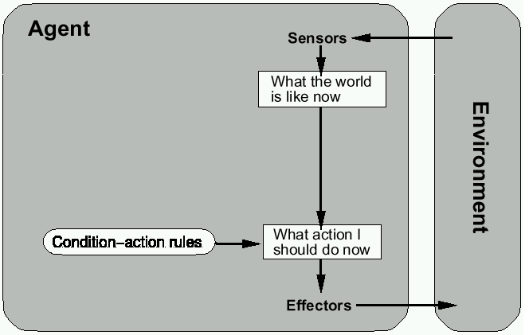
Reflex agents

Slide 40
Reactive agents
Reactive agents do not have internal symbolic models.
Act by stimulus-response to the current state of the environment.
Each reactive agent is simple and interacts with others in a basic way.
Complex patterns of behavior emerge from their interaction.
Benefits: robustness, fast response time
Challenges: scalability, how intelligent? and how do you debug them?

Slide 41
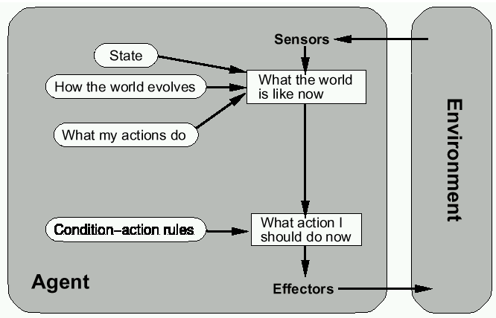
Reflex agents w/ state

Slide 42
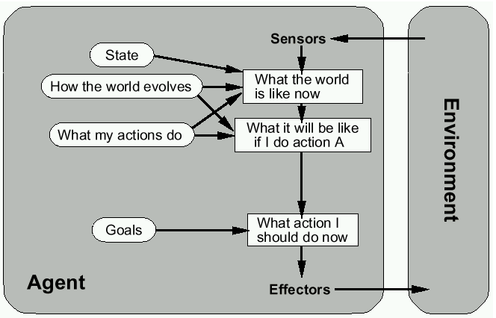
Goal-based agents

Slide 43
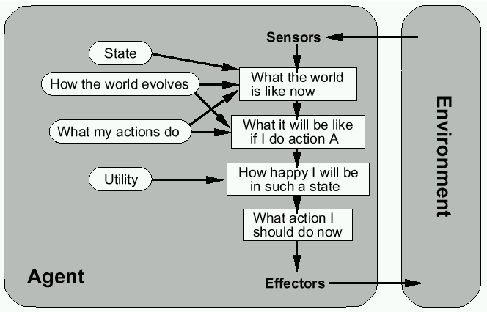
Utility-based agents

Slide 44
Summary
Intelligent Agents:
Anything that can be viewed as perceiving its environment through sensors and acting upon that environment through its effectors to maximize progress towards its goals.
PAGE (Percepts, Actions, Goals, Environment)
Described as a Perception (sequence) to Action Mapping: f : P* → A
Using look-up-table, closed form, etc.
Agent Types: Reflex, state-based, goal-based, utility-based
Rational Action: The action that maximizes the expected value of the performance measure given the percept sequence to date

