Slide 1
Inference in First-Order Logic
Proofs
Unification
Generalized modus ponens
Forward and backward chaining
Completeness
Resolution
Logic programming

Slide 2
Inference in First-Order Logic
Proofs – extend propositional logic inference to deal with quantifiers
Unification
Generalized modus ponens
Forward and backward chaining – inference rules and reasoning
program
Completeness – Gödel’s theorem: for FOL, any sentence entailed by
another set of sentences can be proved from that set
Resolution – inference procedure that is complete for any set of
sentences
Logic programming

Slide 3
Logic as a representation of the World
entails
Representation: Sentences
Sentence
Refers to
(Semantics)
follows
Fact
World
Facts

Slide 4
Desirable Properties of Inference Procedures
derivation
Sentences
entail
Sentence
Follows – from⁻¹
Fact
Facts
Notes:
need for derivation and entailment to align
system does derivation
explain importance of alignment because computer operates formally, i.e., without crossing the semantic wall, i.e., without access to interpretation (symbol meaning)>

Slide 5
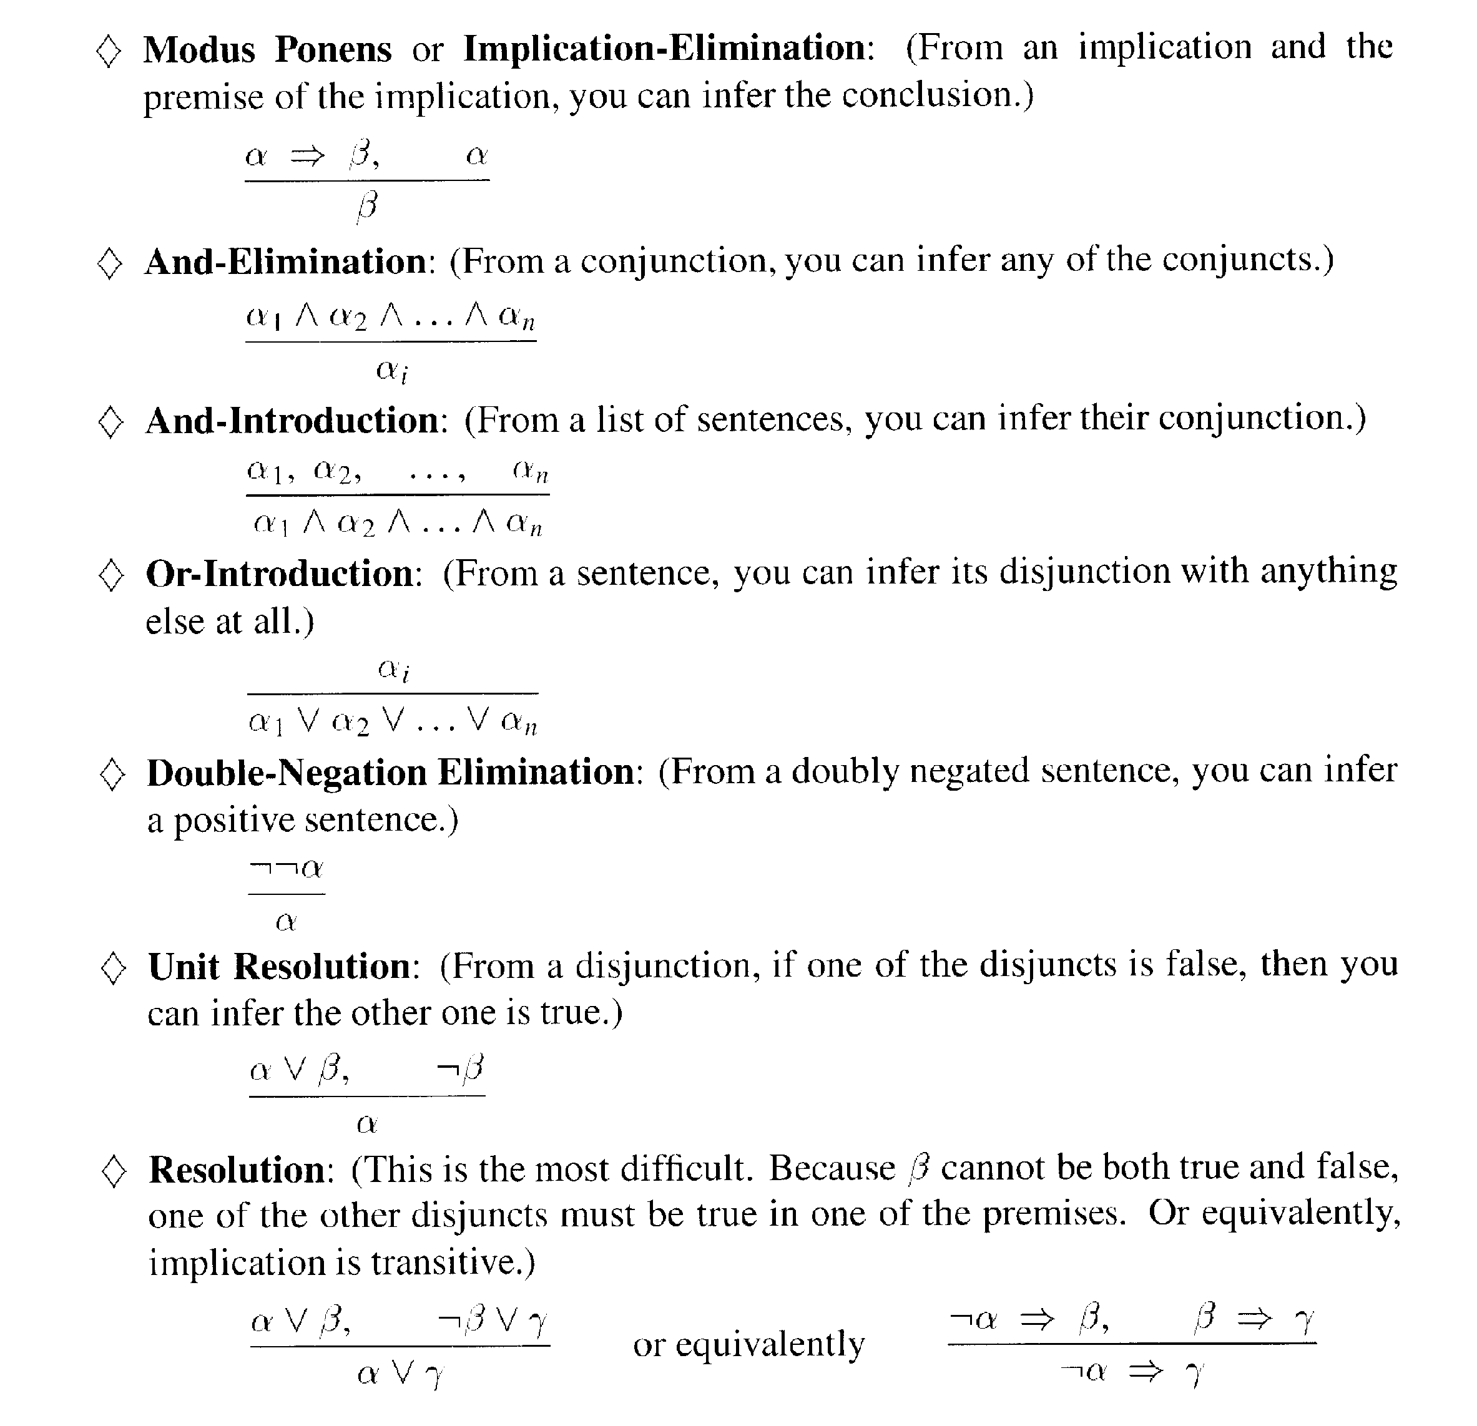
Remember: propositional logic

Slide 6
Reminder
Ground term: A term that does not contain a variable.
A constant symbol
A function applies to some ground term
{x/a}: substitution/binding list

Slide 7
Proofs

Slide 8
Proofs
The three new inference rules for FOL (compared to propositional logic) are:
Universal Elimination (UE):
for any sentence α, variable x and ground term τ,
∀x α
α{x/τ}
Existential Elimination (EE):
for any sentence α, variable x and constant symbol k not in KB,
∃x α
α{x/k}
Existential Introduction (EI):
for any sentence α, variable x not in α and ground term g in α,
α
∃x α{g/x}

Slide 9
Proofs
The three new inference rules for FOL (compared to propositional logic) are:
Universal Elimination (UE):
for any sentence α, variable x and ground term τ,
∀x α e.g., from ∀x Likes(x, Candy) and {x/Joe}
α{x/τ} we can infer Likes(Joe, Candy)
Existential Elimination (EE):
for any sentence α, variable x and constant symbol k not in KB,
∃x α e.g., from ∃x Kill(x, Victim) we can infer
α{x/k} Kill(Murderer, Victim), if Murderer new symbol
Existential Introduction (EI):
for any sentence α, variable x not in α and ground term g in α,
α e.g., from Likes(Joe, Candy) we can infer
∃x α{g/x} ∃x Likes(x, Candy)

Slide 10
Example Proof

Slide 11
Example Proof

Slide 12
Example Proof

Slide 13
Example Proof
4 & 5

Slide 14
Search with primitive example rules

Slide 15
Unification
Goal of unification: finding σ

Slide 16
Unification

Slide 17
Extra example for unification
P | Q | σ
Student(x) | Student(Bob) | {x/Bob}
Sells(Bob, x) | Sells(x, coke) | {x/coke, x/Bob} Is it correct?

Slide 18
Extra example for unification
P | Q | σ
Student(x) | Student(Bob) | {x/Bob}
Sells(Bob, x) | Sells(y, coke) | {x/coke, y/Bob}

Slide 19
More Unification Examples
VARIABLE term
1 – unify(P(a,X), P(a,b)) σ = {X/b}
2 – unify(P(a,X), P(Y,b)) σ = {Y/a, X/b}
3 – unify(P(a,X), P(Y,f(a)) σ = {Y/a, X/f(a)}
4 – unify(P(a,X), P(X,b)) σ = failure
Note: If P(a,X) and P(X,b) are independent, then we can replace X with Y and get the unification to work.
Notes:
To avoid failure like in (4) it is important to “standardize variables apart”
unify(P(a,x),P(y,b)) can be done with substitution {x/b,y/a}
the trickiest part of unification is dealing with functions; in particular, cannot replace a variable by a term containing that variable; i.e., cannot replace x by f(x). [this is referred to as “occurs check”]
constraints on unification: every occurrence of a variable has the same term substituted for it
in section, probably next week, will do some unification practice

Slide 20
Generalized Modus Ponens (GMP)

Slide 21
Soundness of GMP

Slide 22
Properties of GMP
Why is GMP and efficient inference rule?
- It takes bigger steps, combining several small inferences into one
- It takes sensible steps: uses eliminations that are guaranteed
to help (rather than random UEs)
- It uses a precompilation step which converts the KB to canonical
form (Horn sentences)
Remember: sentence in Horn from is a conjunction of Horn clauses
(clauses with at most one positive literal), e.g.,
(A ∨ ¬B) ∧ (B ∨ ¬C ∨ ¬D), that is (B ⇒ A) ∧ ((C ∧ D) ⇒ B)

Slide 23
Horn form
We convert sentences to Horn form as they are entered into the KB
Using Existential Elimination and And Elimination
e.g., ∃x Owns(Nono, x) ∧ Missile(x) becomes
Owns(Nono, M)
Missile(M)
(with M a new symbol that was not already in the KB)

Slide 24
Forward chaining

Slide 25
Forward chaining example

Slide 26
Backward chaining

Slide 27
Backward chaining example

Slide 28
Another Example (from Konelsky)
Nintendo example.
Nintendo says it is Criminal for a programmer to provide emulators to people. My friends don’t have a Nintendo 64, but they use software that runs N64 games on their PC, which is written by Reality Man, who is a programmer.

Slide 29
Forward Chaining
The knowledge base initially contains:
Programmer(x) ∧ Emulator(y) ∧ People(z) ∧ Provide(x,z,y) ⇒ Criminal(x)
Use(friends, x) ∧ Runs(x, N64 games) ⇒
Provide(Reality Man, friends, x)
Software(x) ∧ Runs(x, N64 games) ⇒ Emulator(x)

Slide 30
Forward Chaining
Programmer(x) ∧ Emulator(y) ∧ People(z) ∧ Provide(x,z,y) ⇒ Criminal(x) (1)
Use(friends, x) ∧ Runs(x, N64 games)
⇒ Provide(Reality Man, friends, x) (2)
Software(x) ∧ Runs(x, N64 games)
⇒ Emulator(x) (3)
Now we add atomic sentences to the KB sequentially, and call on the forward-chaining procedure:
FORWARD-CHAIN(KB, Programmer(Reality Man))

Slide 31
Forward Chaining
Programmer(x) ∧ Emulator(y) ∧ People(z) ∧ Provide(x,z,y)
⇒ Criminal(x) (1)
Use(friends, x) ∧ Runs(x, N64 games)
⇒ Provide(Reality Man, friends, x) (2)
Software(x) ∧ Runs(x, N64 games)
⇒ Emulator(x) (3)
Programmer(Reality Man) (4)
This new premise unifies with (1) with
subst({x/Reality Man}, Programmer(x))
but not all the premises of (1) are yet known, so nothing further happens.

Slide 32
Forward Chaining
Programmer(x) ∧ Emulator(y) ∧ People(z) ∧ Provide(x,z,y) ⇒ Criminal(x) (1)
Use(friends, x) ∧ Runs(x, N64 games)
⇒ Provide(Reality Man, friends, x) (2)
Software(x) ∧ Runs(x, N64 games)
⇒ Emulator(x) (3)
Programmer(Reality Man) (4)
Continue adding atomic sentences:
FORWARD-CHAIN(KB, People(friends))

Slide 33
Forward Chaining
Programmer(x) ∧ Emulator(y) ∧ People(z) ∧ Provide(x,z,y) ⇒ Criminal(x) (1)
Use(friends, x) ∧ Runs(x, N64 games)
⇒ Provide(Reality Man, friends, x) (2)
Software(x) ∧ Runs(x, N64 games)
⇒ Emulator(x) (3)
Programmer(Reality Man) (4)
People(friends) (5)
This also unifies with (1) with subst({z/friends}, People(z)) but other premises are still missing.

Slide 34
Forward Chaining
Programmer(x) ∧ Emulator(y) ∧ People(z) ∧ Provide(x,z,y) ⇒ Criminal(x) (1)
Use(friends, x) ∧ Runs(x, N64 games)
⇒ Provide(Reality Man, friends, x) (2)
Software(x) ∧ Runs(x, N64 games)
⇒ Emulator(x) (3)
Programmer(Reality Man) (4)
People(friends) (5)
Add:
FORWARD-CHAIN(KB, Software(U64))

Slide 35
Forward Chaining
Programmer(x) ∧ Emulator(y) ∧ People(z) ∧ Provide(x,z,y)
⇒ Criminal(x) (1)
Use(friends, x) ∧ Runs(x, N64 games)
⇒ Provide(Reality Man, friends, x) (2)
Software(x) ∧ Runs(x, N64 games)
⇒ Emulator(x) (3)
Programmer(Reality Man) (4)
People(friends) (5)
Software(U64) (6)
This new premise unifies with (3) but the other premise is not yet known.

Slide 36
Forward Chaining
Programmer(x) ∧ Emulator(y) ∧ People(z) ∧ Provide(x,z,y)
⇒ Criminal(x) (1)
Use(friends, x) ∧ Runs(x, N64 games)
⇒ Provide(Reality Man, friends, x) (2)
Software(x) ∧ Runs(x, N64 games)
⇒ Emulator(x) (3)
Programmer(Reality Man) (4)
People(friends) (5)
Software(U64) (6)
Add:
FORWARD-CHAIN(KB, Use(friends, U64))

Slide 37
Forward Chaining
Programmer(x) ∧ Emulator(y) ∧ People(z) ∧ Provide(x,z,y)⇒ Criminal(x) (1)
Use(friends, x) ∧ Runs(x, N64 games) ⇒ Provide(Reality Man, friends, x) (2)
Software(x) ∧ Runs(x, N64 games) ⇒ Emulator(x) (3)
Programmer(Reality Man) (4)
People(friends) (5)
Software(U64) (6)
Use(friends, U64) (7)
This premise unifies with (2) but one still lacks.

Slide 38
Forward Chaining
Programmer(x) ∧ Emulator(y) ∧ People(z) ∧ Provide(x,z,y)⇒ Criminal(x) (1)
Use(friends, x) ∧ Runs(x, N64 games) ⇒ Provide(Reality Man, friends, x) (2)
Software(x) ∧ Runs(x, N64 games) ⇒ Emulator(x) (3)
Programmer(Reality Man) (4)
People(friends) (5)
Software(U64) (6)
Use(friends, U64) (7)
Add:
FORWARD-CHAIN(Runs(U64, N64 games))

Slide 39
Forward Chaining
Programmer(x) ∧ Emulator(y) ∧ People(z) ∧ Provide(x,z,y)⇒ Criminal(x) (1)
Use(friends, x) ∧ Runs(x, N64 games) ⇒ Provide(Reality Man, friends, x) (2)
Software(x) ∧ Runs(x, N64 games) ⇒ Emulator(x) (3)
Programmer(Reality Man) (4)
People(friends) (5)
Software(U64) (6)
Use(friends, U64) (7)
Runs(U64, N64 games) (8)
This new premise unifies with (2) and (3).

Slide 40
Forward Chaining
Programmer(x) ∧ Emulator(y) ∧ People(z) ∧ Provide(x,z,y)⇒ Criminal(x) (1)
Use(friends, x) ∧ Runs(x, N64 games) ⇒ Provide(Reality Man, friends, x) (2)
Software(x) ∧ Runs(x, N64 games) ⇒ Emulator(x) (3)
Programmer(Reality Man) (4)
People(friends) (5)
Software(U64) (6)
Use(friends, U64) (7)
Runs(U64, N64 games) (8)
Premises (6), (7) and (8) satisfy the implications fully.

Slide 41
Forward Chaining
Programmer(x) ∧ Emulator(y) ∧ People(z) ∧ Provide(x,z,y)⇒ Criminal(x) (1)
Use(friends, x) ∧ Runs(x, N64 games) ⇒ Provide(Reality Man, friends, x) (2)
Software(x) ∧ Runs(x, N64 games) ⇒ Emulator(x) (3)
Programmer(Reality Man) (4)
People(friends) (5)
Software(U64) (6)
Use(friends, U64) (7)
Runs(U64, N64 games) (8)
So we can infer the consequents, which are now added to the knowledge base (this is done in two separate steps).

Slide 42
Forward Chaining
Programmer(x) ∧ Emulator(y) ∧ People(z) ∧ Provide(x,z,y)⇒ Criminal(x) (1)
Use(friends, x) ∧ Runs(x, N64 games) ⇒ Provide(Reality Man, friends, x) (2)
Software(x) ∧ Runs(x, N64 games) ⇒ Emulator(x) (3)
Programmer(Reality Man) (4)
People(friends) (5)
Software(U64) (6)
Use(friends, U64) (7)
Runs(U64, N64 games) (8)
Provide(Reality Man, friends, U64) (9)
Emulator(U64) (10)
Addition of these new facts triggers further forward chaining.

Slide 43
Forward Chaining
Programmer(x) ∧ Emulator(y) ∧ People(z) ∧ Provide(x,z,y)⇒ Criminal(x) (1)
Use(friends, x) ∧ Runs(x, N64 games) ⇒ Provide(Reality Man, friends, x) (2)
Software(x) ∧ Runs(x, N64 games) ⇒ Emulator(x) (3)
Programmer(Reality Man) (4)
People(friends) (5)
Software(U64) (6)
Use(friends, U64) (7)
Runs(U64, N64 games) (8)
Provide(Reality Man, friends, U64) (9)
Emulator(U64) (10)
Criminal(Reality Man) (11)
Which results in the final conclusion: Criminal(Reality Man)

Slide 44
Forward Chaining
Forward Chaining acts like a breadth-first search at the top level, with depth-first sub-searches.
Since the search space spans the entire KB, a large KB must be organized in an intelligent manner in order to enable efficient searches in reasonable time.

Slide 45
Backward Chaining
The algorithm (available in detail in textbook):
a knowledge base KB
a desired conclusion c or question q
finds all sentences that are answers to q in KB or proves c
if q is directly provable by premises in KB, infer q and remember how q was inferred (building a list of answers).
find all implications that have q as a consequent.
for each of these implications, find out whether all of its premises are now in the KB, in which case infer the consequent and add it to the KB, remembering how it was inferred. If necessary, attempt to prove the implication also via backward chaining
premises that are conjuncts are processed one conjunct at a time

Slide 46
Backward Chaining
Question: Has Reality Man done anything criminal?
Criminal(Reality Man)
Possible answers:
Steal(x, y) ⇒ Criminal(x)
Kill(x, y) ⇒ Criminal(x)
Grow(x, y) ∧ Illegal(y) ⇒ Criminal(x)
HaveSillyName(x) ⇒ Criminal(x)
Programmer(x) ∧ Emulator(y) ∧ People(z) ∧ Provide(x,z,y) ⇒Criminal(x)

Slide 47
Backward Chaining
Question: Has Reality Man done anything criminal?
Criminal(x)

Slide 48
Backward Chaining
Question: Has Reality Man done anything criminal?
Criminal(x)
Steal(x,y)

Slide 49
Backward Chaining
Question: Has Reality Man done anything criminal?
FAIL
Criminal(x)
Steal(x,y)

Slide 50
Backward Chaining
Question: Has Reality Man done anything criminal?
FAIL
Criminal(x)
Steal(x,y)
Kill(x,y)

Slide 51
Backward Chaining
Question: Has Reality Man done anything criminal?
FAIL FAIL
Criminal(x)
Steal(x,y)
Kill(x,y)

Slide 52
Backward Chaining
Question: Has Reality Man done anything criminal?
FAIL FAIL
Criminal(x)
Steal(x,y)
Kill(x,y)
grows(x,y)
Illegal(y)

Slide 53
Backward Chaining
Question: Has Reality Man done anything criminal?
FAIL FAIL FAIL FAIL
Criminal(x)
Steal(x,y)
Kill(x,y)
grows(x,y)
Illegal(y)

Slide 54
Backward Chaining
Question: Has Reality Man done anything criminal?
FAIL FAIL FAIL FAIL
Backward Chaining is a depth-first search: in any knowledge base of realistic size, many search paths will result in failure.
Criminal(x)
Steal(x,y)
Kill(x,y)
grows(x,y)
Illegal(y)

Slide 55
Backward Chaining
Question: Has Reality Man done anything criminal?
We will use the same knowledge as in our forward-chaining version of this example:
Programmer(x) ∧ Emulator(y) ∧ People(z) ∧ Provide(x,z,y)⇒ Criminal(x)
Use(friends, x) ∧ Runs(x, N64 games) ⇒ Provide(Reality Man, friends, x)
Software(x) ∧ Runs(x, N64 games) ⇒ Emulator(x)
Programmer(Reality Man)
People(friends)
Software(U64)
Use(friends, U64)
Runs(U64, N64 games)

Slide 56
Backward Chaining
Question: Has Reality Man done anything criminal?
Criminal(x)

Slide 57
Backward Chaining
Question: Has Reality Man done anything criminal?
Yes, {x/Reality Man}
Criminal(x)
Programmer(x)

Slide 58
Backward Chaining
Question: Has Reality Man done anything criminal?
Yes, {x/Reality Man} Yes, {z/friends}
Criminal(x)
Programmer(x)
People(Z)

Slide 59
Backward Chaining
Question: Has Reality Man done anything criminal?
Yes, {x/Reality Man} Yes, {z/friends}
Criminal(x)
Programmer(x)
Emulator(y)
People(Z)

Slide 60
Backward Chaining
Question: Has Reality Man done anything criminal?
Yes, {x/Reality Man} Yes, {z/friends}
Yes, {y/U64}
Criminal(x)
Programmer(x)
Emulator(y)
People(z)
Software(y)

Slide 61
Backward Chaining
Question: Has Reality Man done anything criminal?
Yes, {x/Reality Man} Yes, {z/friends}
Yes, {y/U64} yes, {}
Criminal(x)
Programmer(x)
Emulator(y)
People(z)
Software(y)
Runs(U64, N64 games)

Slide 62
Backward Chaining
Question: Has Reality Man done anything criminal?
Yes, {x/Reality Man} Yes, {z/friends}
Yes, {y/U64} yes, {}
Criminal(x)
Programmer(x)
Emulator(y)
People(z)
Provide
(reality man,
U64,
friends)
Software(y)
Runs(U64, N64 games)

Slide 63
Backward Chaining
Question: Has Reality Man done anything criminal?
Yes, {x/Reality Man} Yes, {z/friends}
Yes, {y/U64}
yes, {}
Criminal(x)
Programmer(x)
Emulator(y)
People(z)
Provide
(reality man,
U64,
friends)
Software(y)
Runs(U64, N64 games)
Use(friends, U64)

Slide 64
Backward Chaining
Backward Chaining benefits from the fact that it is directed toward proving one statement or answering one question.
In a focused, specific knowledge base, this greatly decreases the amount of superfluous work that needs to be done in searches.
However, in broad knowledge bases with extensive information and numerous implications, many search paths may be irrelevant to the desired conclusion.
Unlike forward chaining, where all possible inferences are made, a strictly backward chaining system makes inferences only when called upon to answer a query.

Slide 65
Field Trip – Russell’s Paradox (Bertrand Russell, 1901)
Your life has been simple up to this point, lets see how logical negation and self-referencing can totally ruin our day.
Russell's paradox is the most famous of the logical or set-theoretical paradoxes. The paradox arises within naive set theory by considering the set of all sets that are not members of themselves. Such a set appears to be a member of itself if and only if it is not a member of itself, hence the paradox.
Negation and self-reference naturally lead to paradoxes, but are necessary for FOL to be universal.
Published in Principles of Mathematics (1903).

Slide 66
Field Trip – Russell’s Paradox
Basic example:
Librarians are asked to make catalogs of all the books in their libraries.
Some librarians consider the catalog to be a book in the library and list the catalog in itself.
The library of congress is asked to make a master catalog of all library catalogs which do not include themselves.
Should the master catalog in the library of congress include itself?
Keep this tucked in you brain as we talk about logic today. Logical systems can easily tie themselves in knots.
See also: http://plato.stanford.edu/entries/russell-paradox/
For additional fun on paradoxes check out “I of Newton” from: The New Twilight Zone (1985) http://en.wikipedia.org/wiki/I_of_Newton

Slide 67
Completeness
As explained earlier, Generalized Modus Ponens requires sentences to be in Horn form:
atomic, or
an implication with a conjunction of atomic sentences as the antecedent and an atom as the consequent.
However, some sentences cannot be expressed in Horn form.
e.g.: ∀x ¬ bored_of_this_lecture (x)
Cannot be expressed in Horn form due to presence of negation.

Slide 68
Completeness
A significant problem since Modus Ponens cannot operate on such a sentence, and thus cannot use it in inference.
Knowledge exists but cannot be used.
Thus inference using Modus Ponens is incomplete.

Slide 69
Completeness
However, Kurt Gödel in 1930-31 developed the completeness theorem, which shows that it is possible to find complete inference rules.
The theorem states:
any sentence entailed by a set of sentences can be proven from that set.
=> Resolution Algorithm which is a complete inference method.

Slide 70
Completeness
The completeness theorem says that a sentence can be proved if it is entailed by another set of sentences.
This is a big deal, since arbitrarily deeply nested functions combined with universal quantification make a potentially infinite search space.
But entailment in first-order logic is only semi-decidable, meaning that if a sentence is not entailed by another set of sentences, it cannot necessarily be proven.
This is to a certain degree an exotic situation, but a very real one - for instance the Halting Problem.
Much of the time, in the real world, you can decide if a sentence it not entailed if by no other means than exhaustive elimination.

Slide 71
Completeness in FOL

Slide 72
Historical note

Slide 73
Kinship Example
KB:
(1) father (art, jon)
(2) father (bob, kim)
(3) father (X, Y) ⇒ parent (X, Y)
Goal: parent (art, jon)?
Notes:
First, need to change (3) into CNF:
¬father (x,y) ∨ parent (x,y)
Second, need to negate the Q to get (4)
¬parent (Art,Jon)
Now, do resolutions:

Slide 74
Refutation Proof/Graph
¬parent(art,jon) ¬ father(X, Y) \/ parent(X, Y)
\ /
¬ father (art, jon) father (art, jon)
\ /
[]

Slide 75
Resolution

Slide 76
Resolution inference rule

Slide 77
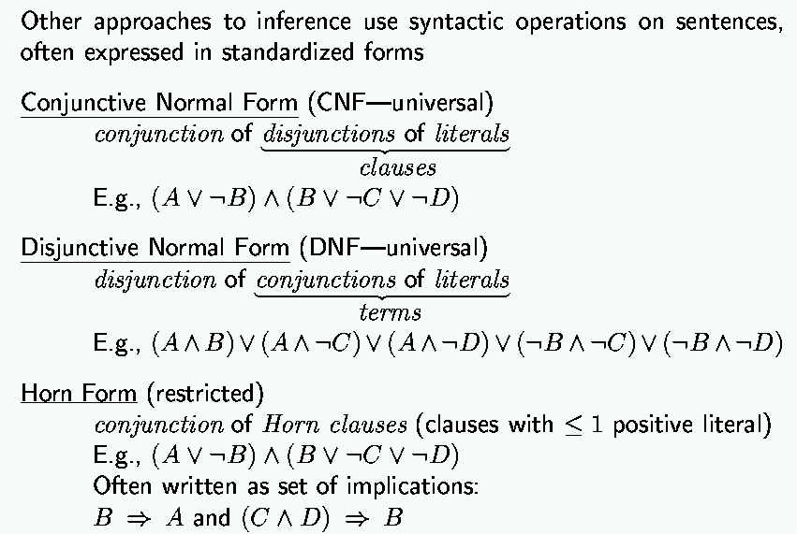
Remember: normal forms
“product of sums of
simple variables or
negated simple variables”
“sum of products of
simple variables or
negated simple variables”

Slide 78
Conjunctive normal form - (how-to is coming up…)

Slide 79
Skolemization
If x has a y we can infer that y exists. However, its existence is contingent on x, thus y is a function of x as H(x).

Slide 80
Examples: Converting FOL sentences to clause form…
Convert the sentence
1. (∀x)(P(x) => ((∀y)(P(y) => P(f(x,y))) ^ ¬(∀y)(Q(x,y) => P(y))))
(like A => B ^ C)
2. Eliminate =>
(∀x)(¬P(x) ∨ ((∀y)(¬P(y) ∨ P(f(x,y))) ^ ¬(∀y)(¬Q(x,y) ∨ P(y))))
3. Reduce scope of negation
(∀x)(¬P(x) ∨ ((∀y)(¬P(y) ∨ P(f(x,y))) ^ (∃y)(Q(x,y) ^ ¬P(y))))
4. Standardize variables
(∀x)(¬P(x) ∨ ((∀y)(¬P(y) ∨ P(f(x,y))) ^ (∃z)(Q(x,z) ^ ¬P(z))))

Slide 81
Examples: Converting FOL sentences to clause form…
(∀x)(¬P(x) ∨ ((∀y)(¬P(y) ∨ P(f(x,y))) ^ (∃z)(Q(x,z) ^ ¬P(z)))) …
5. Eliminate existential quantification
(∀x)(¬P(x) ∨ ((∀y)(¬P(y) ∨ P(f(x,y))) ^ (Q(x,g(x)) ^ ¬P(g(x)))))
6. Drop universal quantification symbols
(¬P(x) ∨ ((¬P(y) ∨ P(f(x,y))) ^ (Q(x,g(x)) ^ ¬P(g(x)))))
7. Convert to conjunction of disjunctions
(¬P(x) ∨ ¬P(y) ∨ P(f(x,y))) ^ (¬P(x) ∨ Q(x,g(x))) ^ (¬P(x) ∨ ¬P(g(x)))

Slide 82
Examples: Converting FOL sentences to clause form…
(¬P(x) ∨ ¬P(y) ∨ P(f(x,y))) ^ (¬P(x) ∨ Q(x,g(x))) ^ (¬P(x) ∨ ¬P(g(x))) …
8. Create separate clauses
¬P(x) ∨ ¬P(y) ∨ P(f(x,y))
¬P(x) ∨ Q(x,g(x))
¬P(x) ∨ ¬P(g(x))
9. Standardize variables
¬P(x) ∨ ¬P(y) ∨ P(f(x,y))
¬P(z) ∨ Q(z,g(z))
¬P(w) ∨ ¬P(g(w))

Slide 83
Getting back to Resolution proofs …

Slide 84
Resolution proof
Note: This is not a
particularly good example
that came from AIMA 1st ed.
AIMA 2nd ed. Ch 9.5 has
much better ones.
Want to prove

Slide 85
Inference in First-Order Logic
Canonical forms for resolution
Conjunctive Normal Form (CNF) Implicative Normal Form (INF)

Slide 86
Example of Refutation Proof (in conjunctive normal form)
Cats like fish
Cats eat everything they like
Josephine is a cat.
Prove: Josephine eats fish.
¬cat (x) ∨ likes (x,fish)
¬cat (y) ∨ ¬likes (y,z) ∨ eats (y,z)
cat (jo)
eats (jo,fish)

Slide 87
Refutation
Negation of goal wff: ¬ eats(jo, fish)
¬ eats(jo, fish) ¬ cat(y) ∨ ¬likes(y, z) ∨ eats(y, z)
θ = {y/jo, z/fish}
¬ cat(jo) ∨ ¬likes(jo, fish) cat(jo)
θ = ∅
¬ cat(x) ∨ likes(x, fish) ¬ likes(jo, fish)
θ = {x/jo}
¬ cat(jo) cat(jo)
⊥ (contradiction)

Slide 88
Forward chaining
cat (jo) ¬cat (X) ∨ likes (X,fish)
\ /
likes (jo,fish) ¬cat (Y) ∨ ¬likes (Y,Z) ∨ eats (Y,Z)
\ /
¬cat (jo) ∨ eats (jo,fish) cat (jo)
\ /
eats (jo,fish)

Slide 89
Backward chaining
Is more problematic and seldom used…

