Slide 1
This time: Fuzzy Logic and Fuzzy Inference
Why use fuzzy logic?
Tipping example
Fuzzy set theory
Fuzzy inference

Slide 2
What is fuzzy logic?
A super set of Boolean logic
Builds upon fuzzy set theory
Graded truth. Truth values between True and False. Not everything is either/or, true/false, black/white, on/off etc.
Grades of membership. Class of tall men, class of far cities, class of expensive things, etc.
Lotfi Zadeh, UC/Berkely 1965. Introduced FL to model uncertainty in natural language. Tall, far, nice, large, hot, …
Reasoning using linguistic terms. Natural to express expert knowledge. If the weather is cold then wear warm clothing

Slide 3
Why use fuzzy logic?
Pros:
Conceptually easy to understand w/ “natural” maths
Tolerant of imprecise data
Universal approximation: can model arbitrary nonlinear functions
Intuitive
Based on linguistic terms
Convenient way to express expert and common sense knowledge
Cons:
Not a cure-all
Crisp/precise models can be more efficient and even convenient
Other approaches might be formally verified to work

Slide 4
Tipping example
The Basic Tipping Problem: Given a number between 0 and 10 that represents the quality of service at a restaurant what should the tip be? Cultural footnote: An average tip for a meal in the U.S. is 15%, which may vary depending on the quality of the service provided.

Slide 5
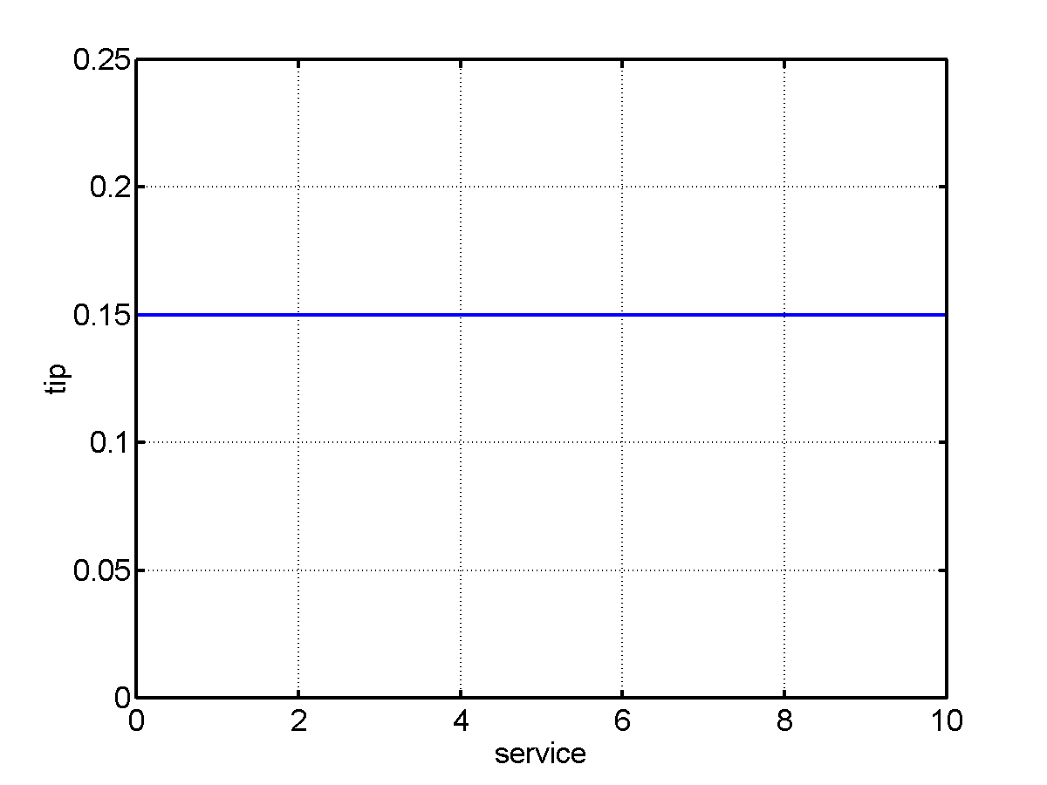
Tipping example: The non-fuzzy approach
Tip = 15% of total bill
What about quality of service?

Slide 6
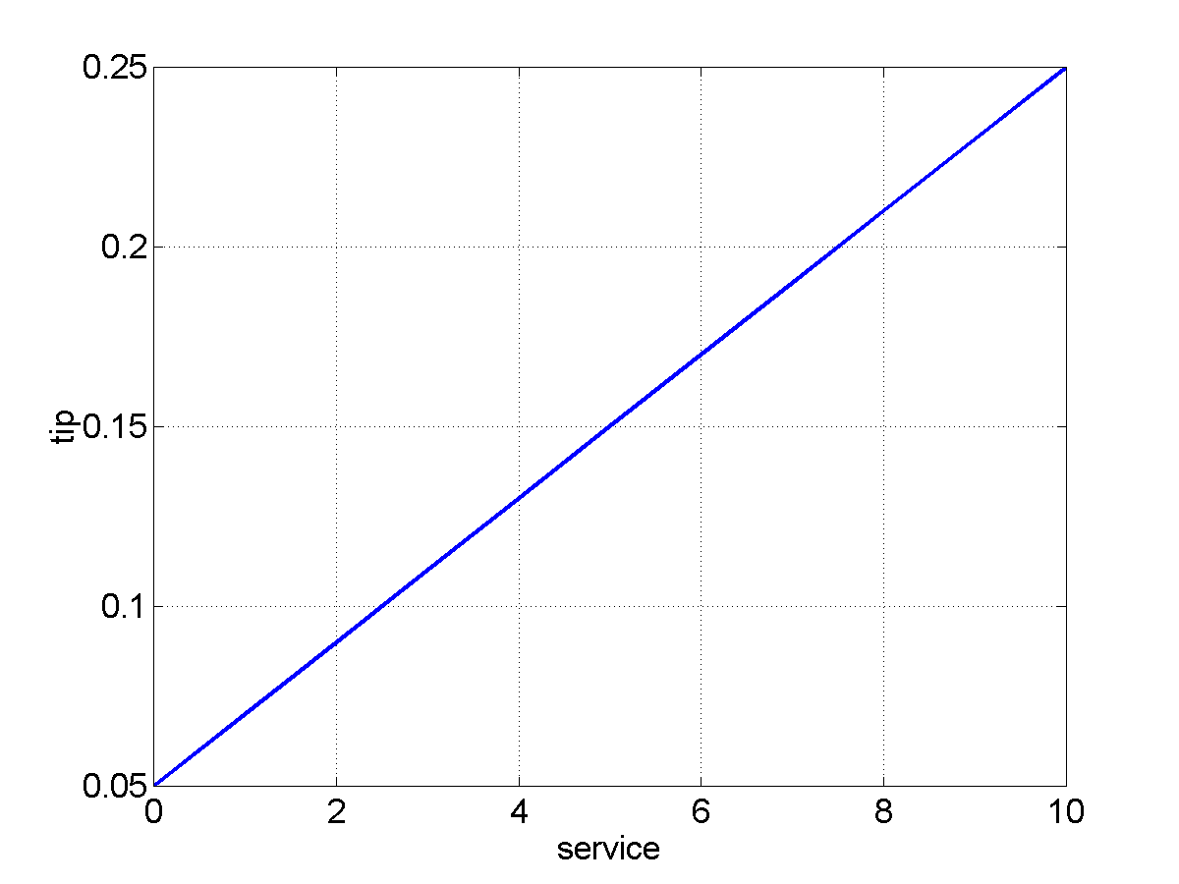
Tipping example: The non-fuzzy approach
Tip = linearly proportional to service from 5% to 25% tip = 0.20/10*service+0.05
What about quality of the food?

Slide 7
Tipping example: Extended
The Extended Tipping Problem: Given a number between 0 and 10 that represents the quality of service and the quality of the food, at a restaurant, what should the tip be? How will this affect our tipping formula?

Slide 8
Tipping example: The non-fuzzy approach
Tip = 0.20/20*(service+food)+0.05
We want service to be more important than food quality. E.g., 80% for service and 20% for food.

Slide 9
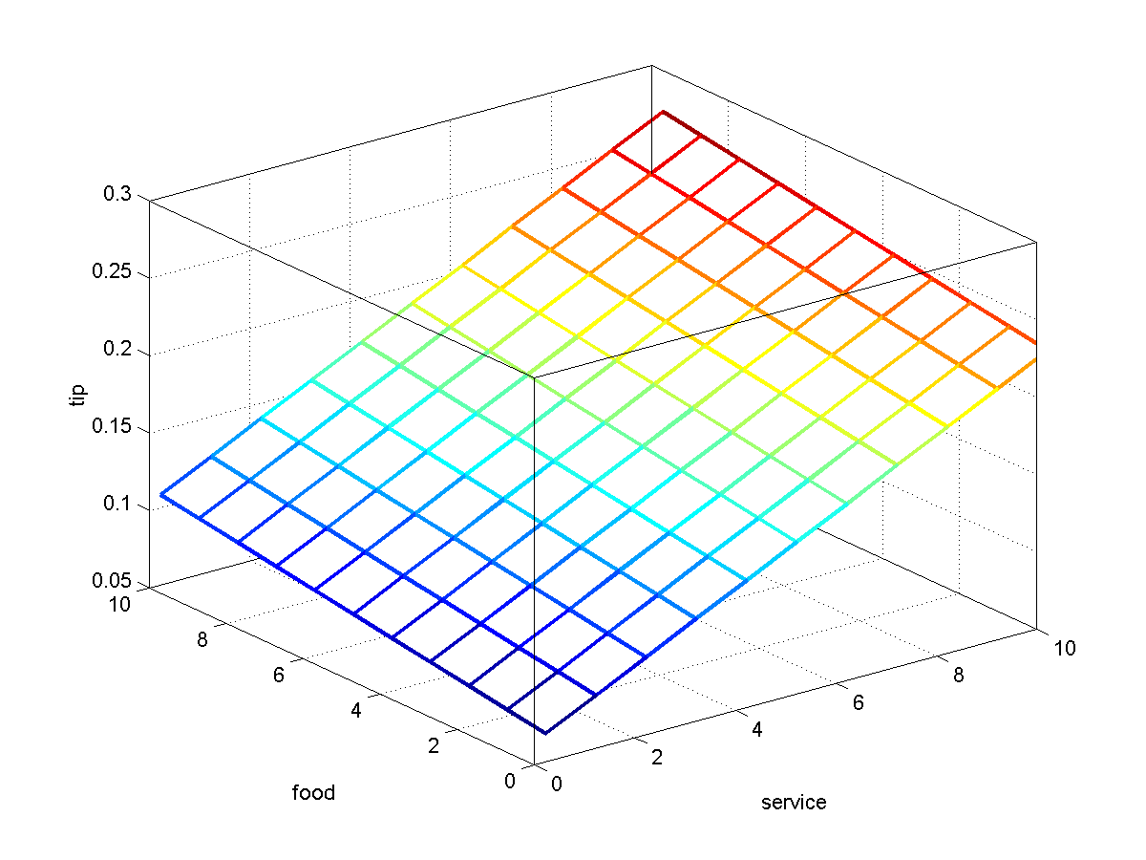
Tipping example: The non-fuzzy approach
Tip = servRatio*(.2/10*(service)+.05) + servRatio = 80% (1-servRatio)*(.2/10*(food)+0.05);
Seems too linear. Want 15% tip in general and deviation only for exceptionally good or bad service.

Slide 10
Tipping example: The non-fuzzy approach
if service < 3,
tip(f+1,s+1) = servRatio*(.1/3*(s)+.05) + ... (1-servRatio)*(.2/10*(f)+0.05);
elseif s < 7,
tip(f+1,s+1) = servRatio*(.15) + ...
(1-servRatio)*(.2/10*(f)+0.05);
else,
tip(f+1,s+1) = servRatio*(.1/3*(s-7)+.15) + ...
(1-servRatio)*(.2/10*(f)+0.05);
end;

Slide 11
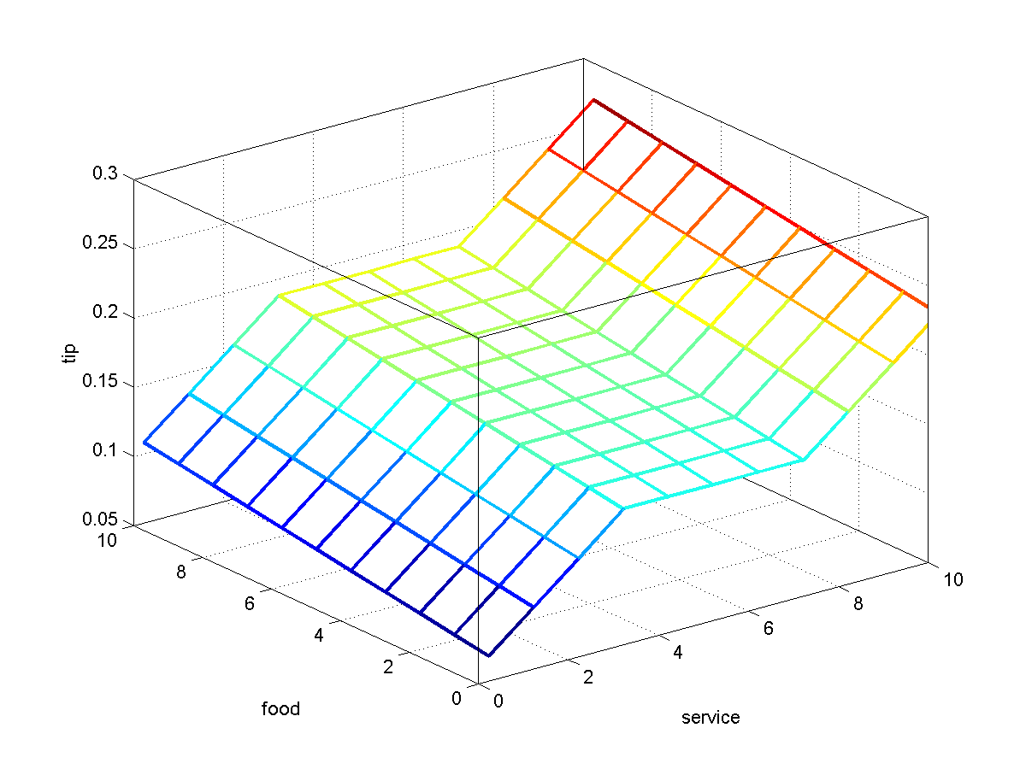
Tipping example: The non-fuzzy approach
Nice plot but
‘Complicated’ function
Not easy to modify
Not intuitive
Many hard-coded parameters
Not easy to understand

Slide 12
Tipping problem: the fuzzy approach
What we want to express is:
If service is poor then tip is cheap
If service is good the tip is average
If service is excellent then tip is generous
If food is rancid then tip is cheap
If food is delicious then tip is generous
or
If service is poor or the food is rancid then tip is cheap
If service is good then tip is average
If service is excellent or food is delicious then tip is generous
We have just defined the rules for a fuzzy logic system.

Slide 13
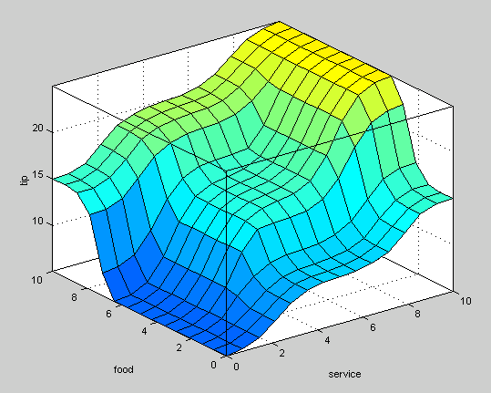
Tipping problem: fuzzy solution
Decision function generated using the 3 rules.

Slide 14
Tipping problem: fuzzy solution
Before we have a fuzzy solution we need to find out
how to define terms such as poor, delicious, cheap, generous etc.
how to combine terms using AND, OR and other connectives
how to combine all the rules into one final output

Slide 15
Fuzzy sets
Boolean/Crisp set A is a mapping for the elements of S to the set {0, 1}, i.e., A: S → {0, 1}
Characteristic function:
μ_{A}(x) =
{
1 if x is an element of set A
0 if x is not an element of set A
Fuzzy set F is a mapping for the elements of S to the interval [0, 1], i.e., F: S → [0, 1]
Characteristic function: 0 ≤ μ_{F}(x) ≤ 1
1 means full membership, 0 means no membership and anything in between, e.g., 0.5 is called graded membership

Slide 16
Example: Crisp set Tall
Fuzzy sets and concepts are commonly used in natural language John is tall Dan is smart Alex is happy The class is hot
E.g., the crisp set Tall can be defined as {x | height x > 1.8 meters} But what about a person with a height = 1.79 meters? What about 1.78 meters? … What about 1.52 meters?

Slide 17
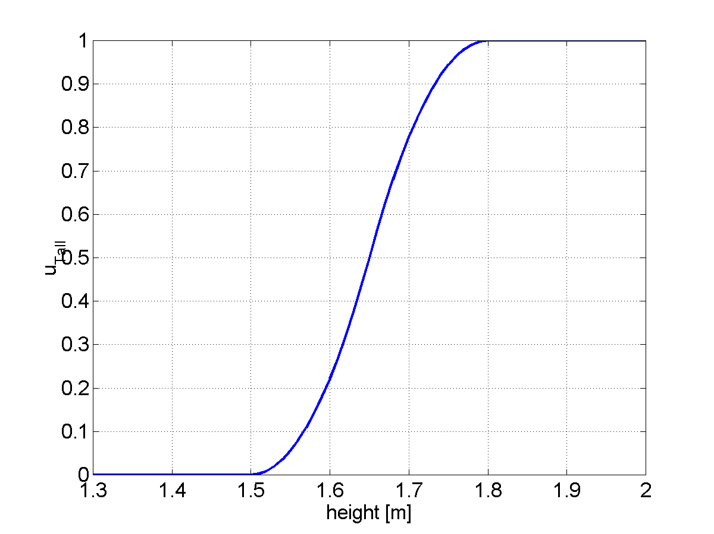
Example: Fuzzy set Tall
In a fuzzy set a person with a height of 1.8 meters would be considered tall to a high degree A person with a height of 1.7 meters would be considered tall to a lesser degree etc.
The function can change for basketball players, Danes, women, children etc.

Slide 18
Membership functions: S-function
The S-function can be used to define fuzzy sets
S(x, a, b, c) =
0 for x ≤ a
2(x-a/c-a)² for a ≤ x ≤ b
1 – 2(x-c/c-a)² for b ≤ x ≤ c
1 for x ≥ c
a
b
c

Slide 19
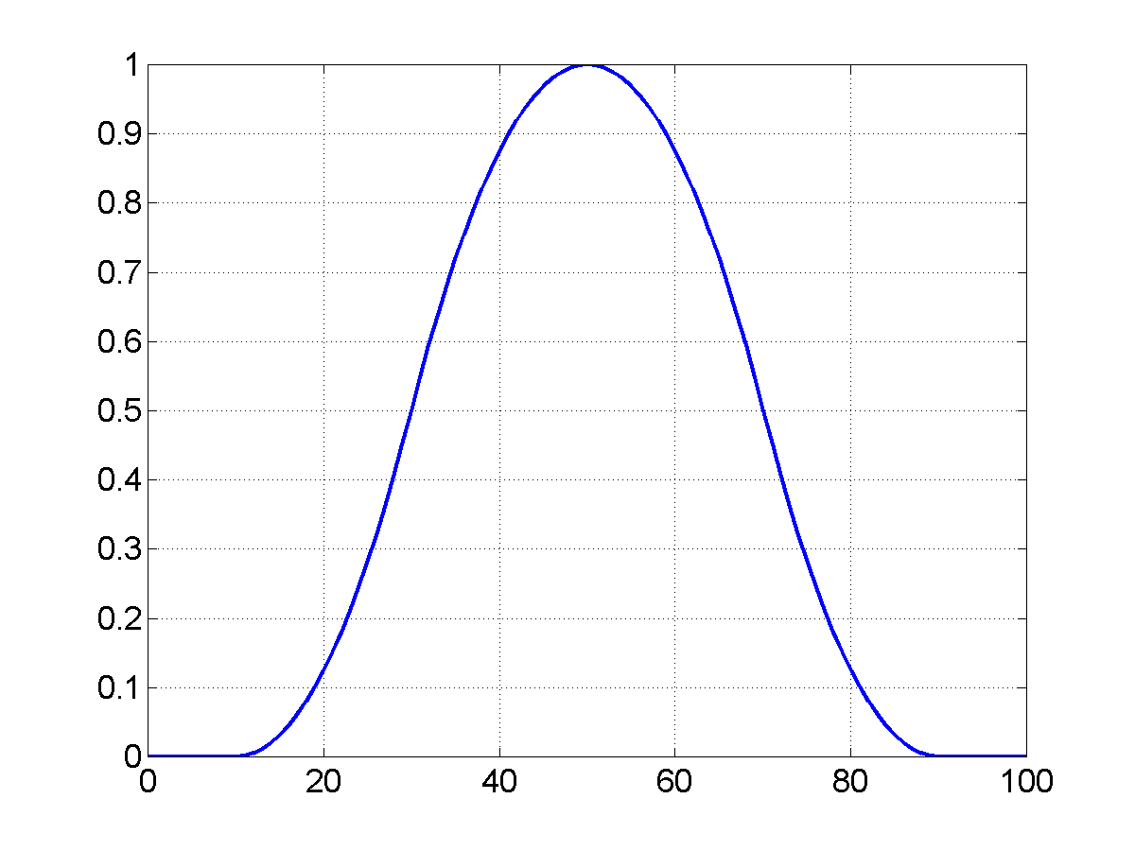
Membership functions: Π−Function
Π(x, a, b) =
S(x, b-a, b-a/2, b) for x ≤ b
1 – S(x, b, b+a/2, a+b) for x ≥ b
E.g., close (to a)
a
b-a
b-a/2
a
b+a/2
b+a

Slide 20
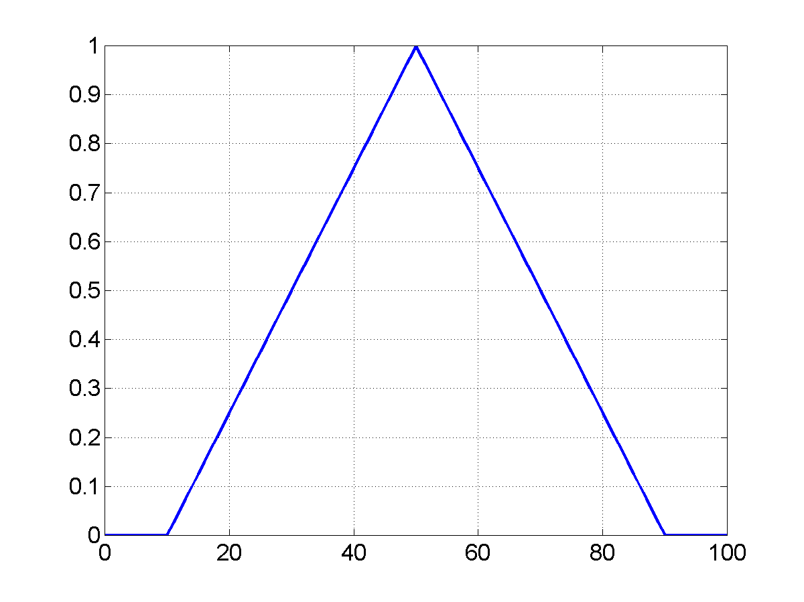
Simple membership functions
Piecewise linear: triangular etc.
Easier to represent and calculate ⇒ saves computation

Slide 21
Fuzzy Sets
Membership Grade μ
1
Cold
Mild
Warm
0
30
60
°F

Slide 22
Observation
An observed temperature of 38 is cold with a belief of 0.14,
Mild with a belief of 0.85 and warm with a belief of 0
μ
1
0.85
Cold
Mild
Warm
0.14
0
30
60
°F
38°

Slide 23
Other representations of fuzzy sets
A finite set of elements: F = μ₁/x₁ + μ₂/x₂ + … μ_{n}/x_{n} + means (Boolean) set union
For example: TALL = {0/1.0, 0/1.2, 0/1.4, 0.2/1.6, 0.8/1.7, 1.0/1.8}

Slide 24
Fuzzy set operators
Equality A = B μ_{A} (x) = μ_{B} (x) for all x ∈ X
Complement A’ μ_{A’} (x) = 1 - μ_{A}(x) for all x ∈ X
Containment A ⊆ B μ_{A} (x) ≤ μ_{B} (x) for all x ∈ X
Union A ∪B μ_{A ∪ B} (x) = max(μ_{A} (x), μ_{B} (x)) for all x ∈ X
Intersection A ∩ B μ_{A ∩ B} (x) = min(μ_{A} (x), μ_{B} (x)) for all x ∈ X

Slide 25
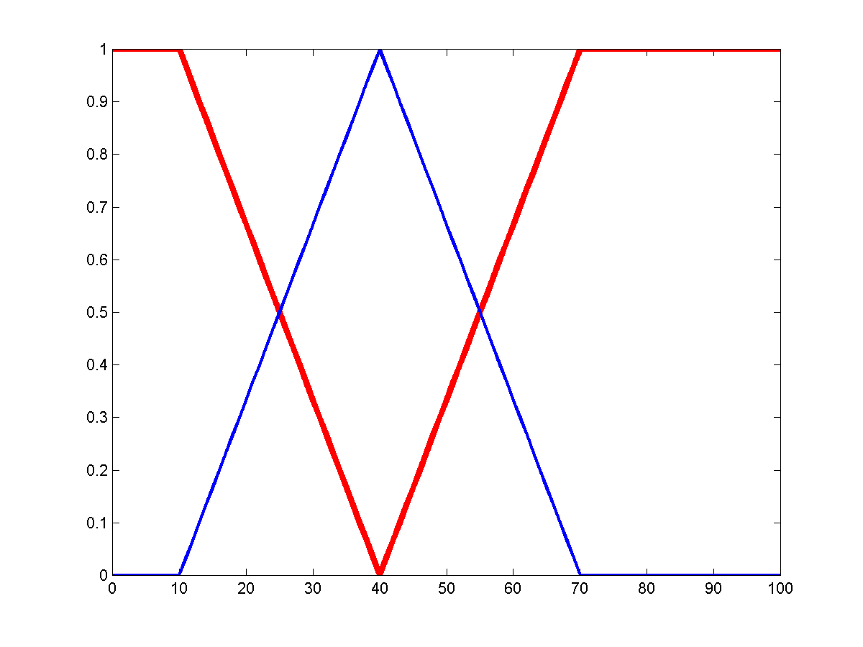
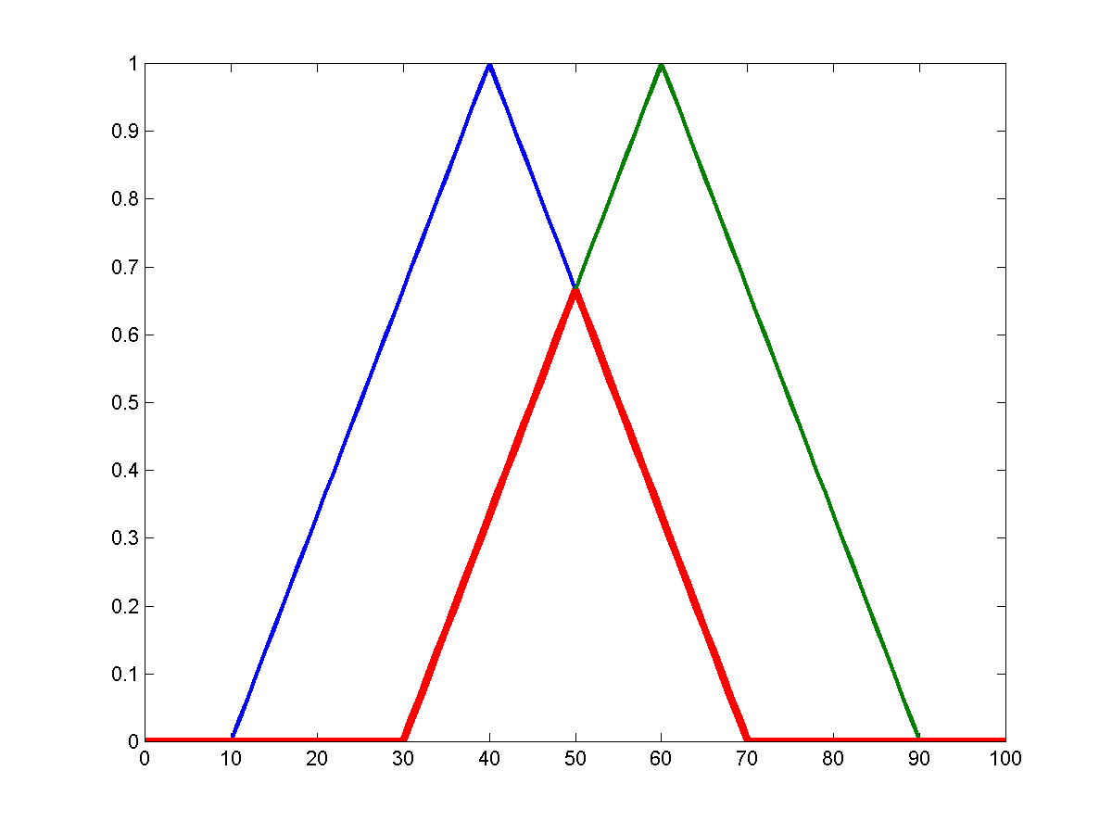
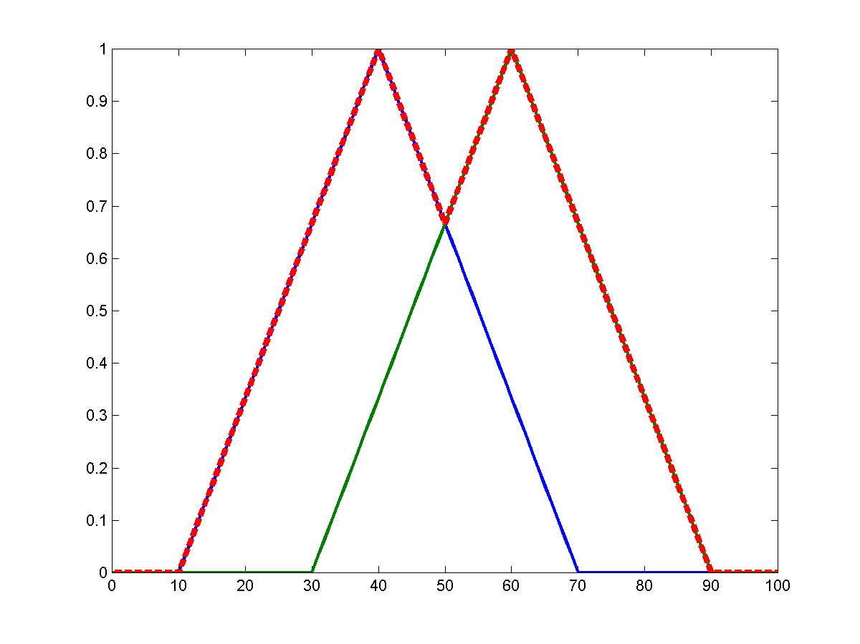
Example fuzzy set operations
A’
A
A ∩ B
A ∪ B
A
B

Slide 26
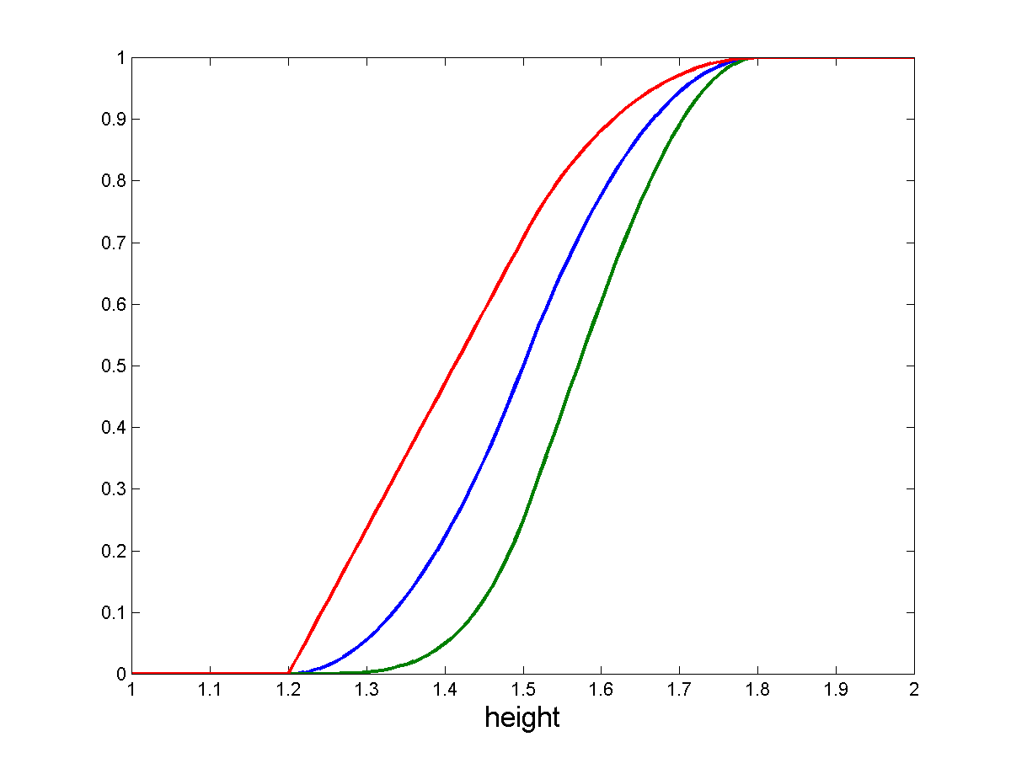
Linguistic Hedges
Modifying the meaning of a fuzzy set using hedges such as very, more or less, slightly, etc.
“Very F “= F ²
“More or less F “= F ^{1/2}
etc.
tall
More or less tall
Very tall

Slide 27
Fuzzy relations
A fuzzy relation for N sets is defined as an extension of the crisp relation to include the membership grade. R = {μ_{R}(x₁, x₂, … x_{N})/(x₁, x₂, … x_{N}) | x_{i} ∈ X, i=1, … N}
which associates the membership grade, μ_{R} , of each tuple.
E.g. Friend = {0.9/(Manos, Nacho), 0.1/(Manos, Dan), 0.8/(Alex, Mike), 0.3/(Alex, John)}

Slide 28
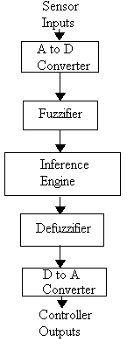
Fuzzy inference
Fuzzy logical operations
Fuzzy rules
Fuzzification
Implication
Aggregation
Defuzzification

Slide 29
Fuzzy logical operations
AND, OR, NOT, etc.
NOT A = A’ = 1 - μ_{A}(x)
A AND B = A ∩ B = min(μ_{A} (x), μ_{B} (x))
A OR B = A ∪ B = max(μ_{A} (x), μ_{B} (x))
From the following truth tables it is seen that fuzzy logic is a superset of Boolean logic.
min(A,B)
max(A,B)
1-A
A B A and B
0 0 0
0 1 0
0 0
1 1 1
A B A or B
0 0 0
0 1 1
0 1
1 1 1
A not A
0 1
1 0

Slide 30
If-Then Rules
Use fuzzy sets and fuzzy operators as the subjects and verbs of fuzzy logic to form rules.
if x is A then y is B
where A and B are linguistic terms defined by fuzzy sets on the sets X and Y respectively.
This reads
if x == A then y = B

Slide 31
Evaluation of fuzzy rules
In Boolean logic: p ⇒ q if p is true then q is true
In fuzzy logic: p ⇒ q if p is true to some degree then q is true to some degree. 0.5p => 0.5q (partial premise implies partially)
How?

Slide 32
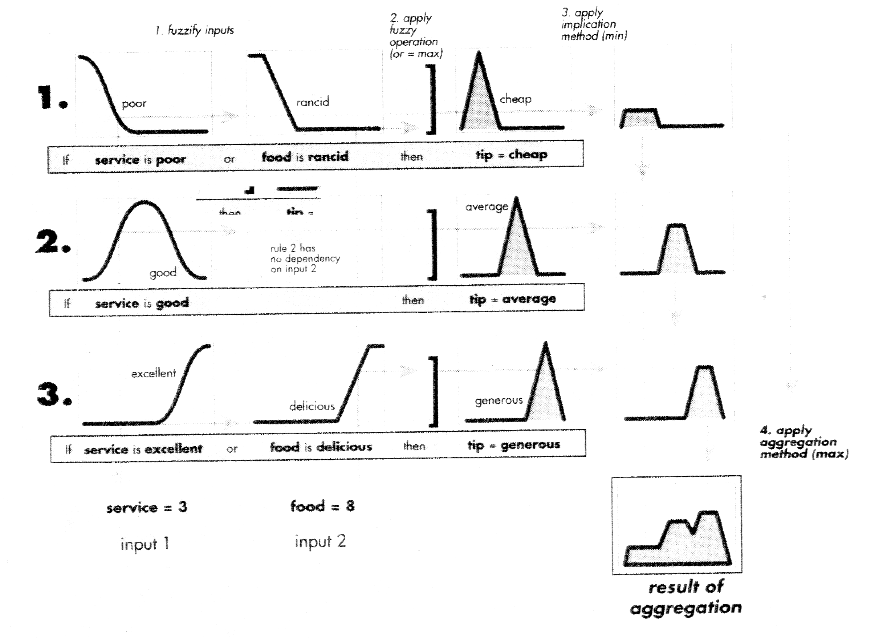
Fuzzy inference overview
Tip = 16.7 %
Result of defuzzification
(centroid)

Slide 33
Fuzzy Rules
Example: “If our distance to the car in front is small, and the distance is decreasing slowly, then decelerate quite hard”
Fuzzy variables in blue
Fuzzy sets in red
QUESTION: Given the distance and the change in the distance, what acceleration should we select?

Slide 34
Fuzzification: Set Definitions
v. small
small
perfect
big
v. big
brake
slow
present
fast
fastest
distance
acceleration
<<
<
=
>
>>
Delta (distance change)

Slide 35
Fuzzification: Instance
observation
v. small
small
perfect
big
v. big
brake
slow
present
fast
fastest
distance
acceleration
????
<<
<
=
>
>>
Distance could be considered small or perfect
Delta could be stable or growing
What acceleration?
delta
observation

Slide 36
Fuzzification: Instance
v. small
small
perfect
big
v. big
o.55
distance
IF distance is Small THEN Slow Down

Slide 37
Rule Evaluation
small
brake
slow
present
fast
fastest
o.55
distance
acceleration
Distance is small, then you slow down.
Question: What is the weight to slow down?

Slide 38
Rule Evaluation
small
slow
o.55
distance
acceleration
Clipping approach (others are possible):
Clip the fuzzy set for “slow” (the consequent) at the height given by our belief in the premises (0.55)
We will then consider the clipped AREA (orange) when making our final decision
Rationale: if belief in premises is low, clipped area will be very small
But if belief is high it will be close to the whole unclipped area

Slide 39
Fuzzification: Instance
<<
<
=
>
>>
0.75
delta
IF change in distance is = THEN Keep the speed

Slide 40
Rule Evaluation
=
brake
slow
present
fast
fastest
0.75
delta
acceleration
Distance is not growing, then keep present acceleration

Slide 41
Rule Evaluation
=
present
0.75
delta
acceleration
Distance is not growing, then keep present acceleration

Slide 42
Rule Aggregation
How do we make a final decision? From each rule we have
Obtained a clipped area. But in the end we want a single
Number output: our desired acceleration
slow
present
acceleration
acceleration
From distance
From delta (distance change)

Slide 43
Rule Aggregation
slow
present
acceleration
acceleration
In the rule aggregation step, we merge all clipped areas into
One (taking the union).
Intuition: rules for which we had a strong belief that their premises were satisfied
Will tend to “pull” that merged area towards their own central value, since their
Clipped areas will be large

Slide 44
Defuzzification
slow
present
acceleration
acceleration
-2.3m/s^2
In the last step, defuzzification, we return as our acceleration
Value the x coordinate of the center of mass of the merged area

Slide 45
Rule Aggregation: Another case
Convert our belief into action
For each rule, clip action fuzzy set by belief in rule
present
slow
acceleration
acceleration
fast
acceleration

Slide 46
Rule Aggregation: Another case
Convert our belief into action
For each rule, clip action fuzzy set by belief in rule
slow
present
fast
acceleration

Slide 47
Matching for Example
Relevant rules are:
If distance is small and delta is growing, maintain speed
If distance is small and delta is stable, slow down
If distance is perfect and delta is growing, speed up
If distance is perfect and delta is stable, maintain speed

Slide 48
Matching for Example
For first rule, distance is small has 0.75 truth, and delta is growing has 0.3 truth
So the truth of the and is 0.3
Other rule strengths are 0.6, 0.1 and 0.1

Slide 49
AND/OR Example
IF Distance Small AND change in distance negative THEN high deceleration
v. small
small
perfect
big
v. big
o.55
distance
<<
<
=
>
>>
0.0
delta

Slide 50
AND/OR Example
IF Distance Small AND change in distance = THEN slow deceleration
v. small
small
perfect
big
v. big
o.55
distance
0.55
<<
<
=
>
>>
0.75
delta

Slide 51
AND/OR Example
IF Distance Small AND change in distance = THEN slow deceleration
small
brake
slow
present
fast
fastest
o.55
distance
acceleration

Slide 52
Scaling vs. Clipping
Instead of clipping, another approach is to scale the fuzzy set
By the belief in the premises
present
slow
Clipping:
acceleration
acceleration
present
slow
Scaling:
acceleration
acceleration

Slide 53
Summary: If-Then rules
Fuzzify inputs: Determine the degree of membership for all terms in the premise. If there is one term then this is the degree of support for the consequence.
Apply fuzzy operator: If there are multiple parts, apply logical operators to determine the degree of support for the rule.

Slide 54
Summary: If-Then rules
3. Apply implication method:
Use degree of support for rule to shape output fuzzy set of the consequence.
How do we then combine several rules?

Slide 55
Multiple rules
We aggregate the outputs into a single fuzzy set which combines their decisions.
The input to aggregation is the list of truncated fuzzy sets and the output is a single fuzzy set for each variable.
Aggregation rules: max, sum, etc.
As long as it is commutative then the order of rule exec is irrelevant.

Slide 56
Defuzzify the output
Take a fuzzy set and produce a single crisp number that represents the set.
Practical when making a decision, taking an action etc.
Center of gravity

Slide 57
Fuzzy inference overview
Tip = 16.7 %
Result of defuzzification
(centroid)

Slide 58
Limitations of fuzzy logic
How to determine the membership functions? Usually requires fine-tuning of parameters
Defuzzification can produce undesired results

Slide 59
Fuzzy tools and shells
Matlab’s Fuzzy Toolbox
FuzzyClips
Etc.

