Slide 1

Artificial Neural Networks and AI
Artificial Neural Networks provide…
A new computing paradigm
A technique for developing trainable classifiers, memories, dimension-reducing mappings, etc
A tool to study brain function
CS 561, Session 22

Slide 2
Converging Frameworks
Artificial intelligence (AI): build a “packet of intelligence” into a machine
Cognitive psychology: explain human behavior by interacting processes (schemas) “in the head” but not localized in the brain
Brain Theory: interactions of components of the brain -
- computational neuroscience
- neurologically constrained-models
and abstracting from them as both Artificial intelligence and Cognitive psychology:
- connectionism: networks of trainable “quasi-neurons” to provide “parallel distributed models” little constrained by neurophysiology
- abstract (computer program or control system) information processing models
CS 561, Session 22

Slide 3
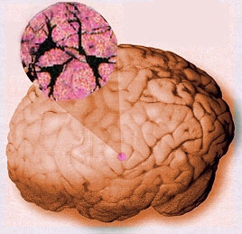
CS 561, Session 22

Slide 4
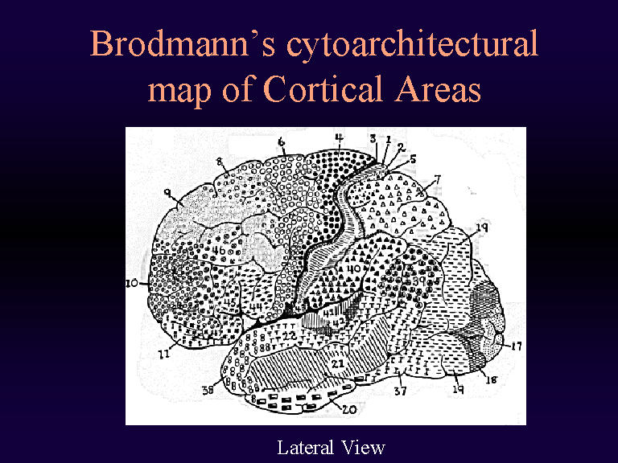
CS 561, Session 22

Slide 5
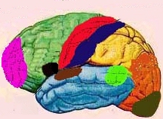
Major Functional Areas
Primary motor: voluntary movement
Primary somatosensory: tactile, pain, pressure, position, temp., mvt.
Motor association: coordination of complex movements
Sensory association: processing of multisensory information
Prefrontal: planning, emotion, judgement
Speech center (Broca’s area): speech production and articulation
Wernicke’s area: comprehen-
sion of speech
Auditory: hearing
Auditory association: complex
auditory processing
Visual: low-level vision
Visual association: higher-level
vision
CS 561, Session 22

Slide 6
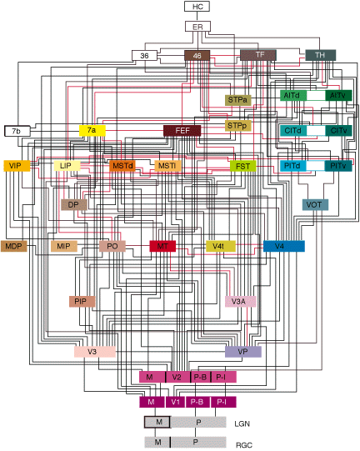
Interconnect
Felleman & Van Essen, 1991
CS 561, Session 22

Slide 7
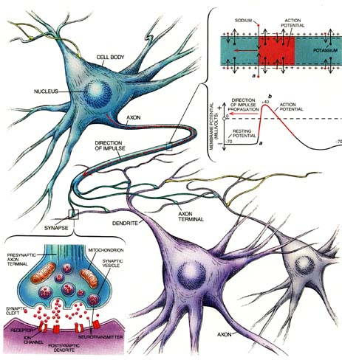
Remember? Neurons & synapses
Key terms:
Axon
Dendrites
Synapses
Soma (cell body)
CS 561, Session 22

Slide 8
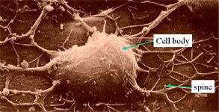
Electron Micrograph of a Real Neuron
CS 561, Session 22

Slide 9
Approaches to neural modeling
Biologically-realistic, detailed models
E.g., cable equation, multi-compartment models
The Hodgkin-Huxley model
Simulators like NEURON (Yale) or GENESIS (Caltech)
More abstract models, still keeping realism in mind
E.g., integrate & fire model, simple and low detail but preserves spiking behavior
Highly abstract models, neurons as operators
E.g., McCulloch & Pitts model
Classical “neural nets” modeling
CS 561, Session 22

Slide 10
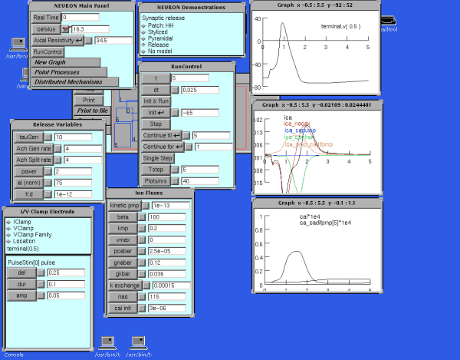
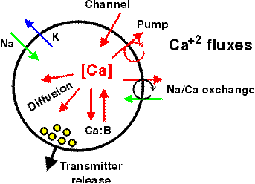
Detailed Neural Modeling
A simulator, called “Neuron” has been developed at Yale to simulate the Hodgkin-Huxley equations, as well as other membranes/channels/etc. See http://www.neuron.yale.edu/
CS 561, Session 22

Slide 11
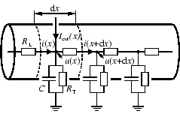
The Cable Equation
See
http://diwww.epfl.ch/~gerstner/SPNM/SPNM.html
for excellent additional material (some reproduced here).
Just a piece of passive dendrite can yield complicated differential equations which have been extensively studied by electronicians in the context of the study of coaxial cables (TV antenna cable):
CS 561, Session 22

Slide 12
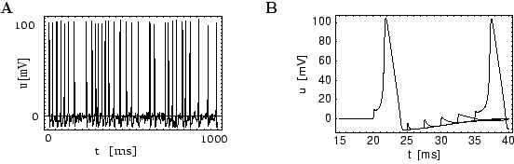
The Hodgkin-Huxley Model
Example spike trains obtained…
CS 561, Session 22

Slide 13
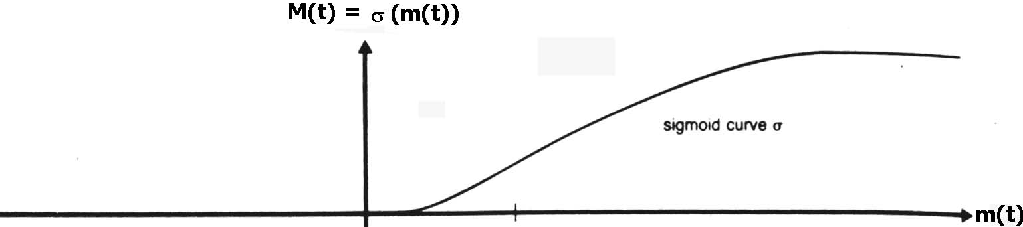
Leaky Integrator Neuron
The simplest "realistic" neuron model is a continuous time model based on using the firing rate (e.g., the number of spikes traversing the axon in the most recent 20 msec.) as a continuously varying measure of the cell's activity
The state of the neuron is described by a single variable, the membrane potential.
The firing rate is approximated by a sigmoid, function of membrane potential.
CS 561, Session 22

Slide 14
Leaky Integrator Model
m(t)
τ = - m(t) + h
has solution m(t) = e^{-t/τ} m(0) + (1 - e^{-t/τ})h
→ h for time constant τ > 0.
We now add synaptic inputs to get the
Leaky Integrator Model:
τ = - m(t) + Σ _{i} w_{i} X_{i}(t) + h
where X_{i}(t) is the firing rate at the i^{th} input.
Excitatory input (w_{i} > 0) will increase
Inhibitory input (w_{i} < 0) will have the opposite effect.
X(t) = g(m(t)) with g() a sigmoid relates output to membrane potential
m(t)
m(t)
CS 561, Session 22

Slide 15
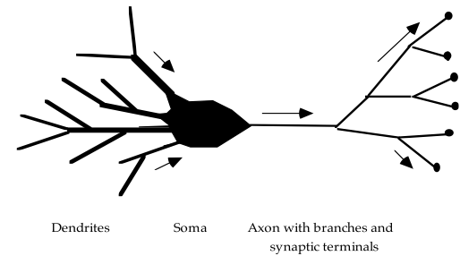
The "basic" biological neuron
The soma and dendrites act as the input surface; the axon carries the outputs.
The tips of the branches of the axon form synapses upon other neurons or upon effectors (though synapses may occur along the branches of an axon as well as the ends). The arrows indicate the direction of "typical" information flow from inputs to outputs.
CS 561, Session 22

Slide 16

Vision, AI and ANNs
1940s: beginning of Artificial Neural Networks
McCullogh & Pitts, 1942
Σ_{i} w_{i}x_{i} ≥ θ
Perceptron learning rule (Rosenblatt, 1962)
Backpropagation
Hopfield networks (1982)
Kohonen self-organizing maps
…
CS 561, Session 22

Slide 17
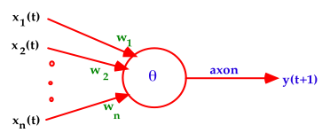
Warren McCulloch and Walter Pitts (1943)
A McCulloch-Pitts neuron operates on a discrete time-scale, t = 0,1,2,3, ... with time tick equal to one refractory period
At each time step, an input or output is
on or off — 1 or 0, respectively.
Each connection or synapse from the output of one neuron to the input of another, has an attached weight.
CS 561, Session 22

Slide 18
Excitatory and Inhibitory Synapses
We call a synapse
excitatory if w_{i} > 0, and
inhibitory if w_{i} < 0.
We also associate a threshold θ with each neuron
A neuron fires (i.e., has value 1 on its output line) at time t+1 if the weighted sum of inputs at t reaches or passes θ:
y(t+1) = 1 if and only if Σ w_{i}x_{i}(t) ≥ θ
CS 561, Session 22

Slide 19
From Logical Neurons to Finite Automata
1
Brains, Machines, and
AND
1.5
Mathematics, 2nd Edition,
1987
1
Boolean Net
1
→
X Y
OR
0.5
1
NOT
X
0
Finite
-1
Automaton
Y
Q
CS 561, Session 22

Slide 20
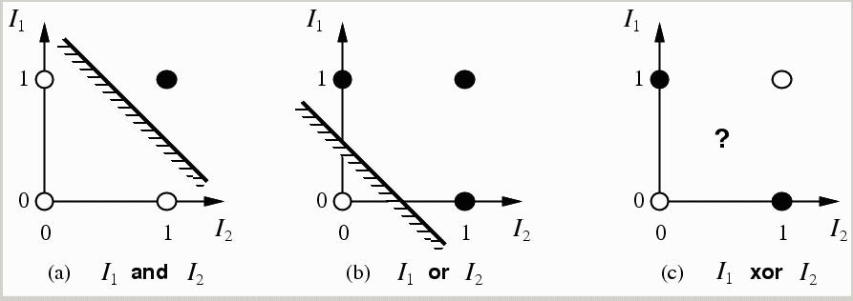
limitations of a single layer perceptron and linear separability problem
a single layer perceptron can only represent linearly separable functions which follows from the inequalities that determine its firing (Minsky & Papert(1969))
y(t+1) = 1 if and only if Σ w_{i}x_{i}(t) ≥ θ else y(t+1) = 0
i.e. input space is divided in 2
CS 561, Session 22

Slide 21
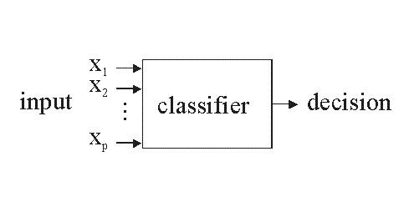
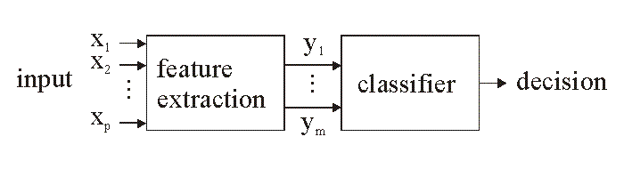
Classifiers
http://www.electronicsletters.com/papers/2001/0020/paper.asp
1-stage approach
2-stage
approach
CS 561, Session 22

Slide 22
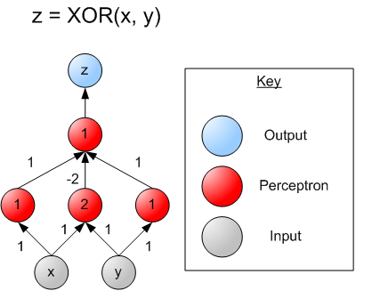
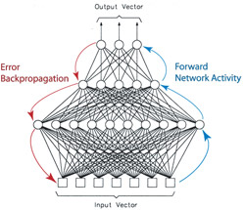
multi-layer perceptrons
single layer perceptrons can only represent linear decision surfaces
multi-layer perceptrons can represent non-linear decision surfaces.
CS 561, Session 22
22

Slide 23
training a multilayer network
http://ams.egeo.sai.jrc.it/eurostat/Lot16-SUPCOM95/node7.html
CS 561, Session 22

Slide 24
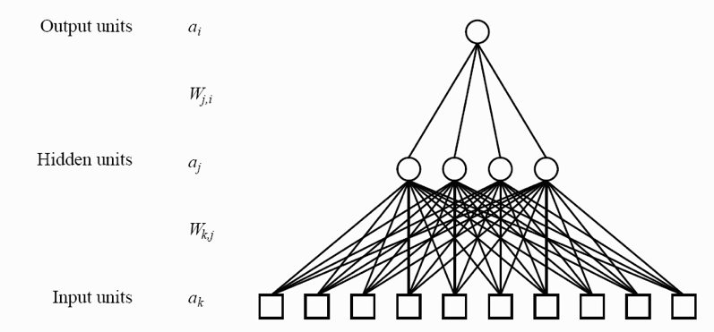




training a multilayer network using Backpropogation
CS 561, Session 22

Slide 25
Increasing the Realism of Neuron Models
The McCulloch-Pitts neuron of 1943 is important
as a basis for
logical analysis of the neurally computable, and
current design of some neural devices (especially when augmented by learning rules to adjust synaptic weights).
However, it is no longer considered a useful model for making contact with neurophysiological data concerning real neurons.
CS 561, Session 22

Slide 26
Hopfield Networks
A paper by John Hopfield in 1982 was the catalyst in attracting the attention of many physicists to "Neural Networks".
In a network of McCulloch-Pitts neurons
whose output is 1 iff Σwij sj ≥ θ_{i} and is otherwise 0,
neurons are updated synchronously: every neuron processes its inputs at each time step to determine a new output.
CS 561, Session 22

Slide 27
Hopfield Networks
A Hopfield net (Hopfield 1982) is a net of such units subject to the asynchronous rule for updating one neuron at a time:
"Pick a unit i at random.
If Σwij sj ≥ θ_{i}, turn it on.
Otherwise turn it off."
Moreover, Hopfield assumes symmetric weights:
wij = wji
CS 561, Session 22

Slide 28
“Energy” of a Neural Network
Hopfield defined the “energy”:
E = - ½ Σ _{ij} s_{i}s_{j}w_{ij} + Σ _{i} s_{i}θ_{i}
If we pick unit i and the firing rule (previous slide) does not change its s_{i}, it will not change E.
CS 561, Session 22

Slide 29
si: 0 to 1 transition
If s_{i} initially equals 0, and Σ w_{ij}s_{j} ≥ θ_{i}
then s_{i} goes from 0 to 1 with all other s_{j} constant,
and the "energy gap", or change in E, is given by
ΔE = - ½ Σ_{j} (w_{ij}s_{j} + w_{ji}s_{j}) + θ_{i}
= - (Σ _{j} w_{ij}s_{j} - θ_{i}) (by symmetry)
≤ 0.
CS 561, Session 22

Slide 30
si: 1 to 0 transition
If s_{i} initially equals 1, and Σ w_{ij}s_{j} < θ_{i}
then s_{i} goes from 1 to 0 with all other s_{j} constant
The "energy gap," or change in E, is given, for symmetric w_{ij}, by:
ΔE = Σ_{j} w_{ij}s_{j} - θ_{i} < 0
On every updating we have ΔE ≤ 0
CS 561, Session 22

Slide 31
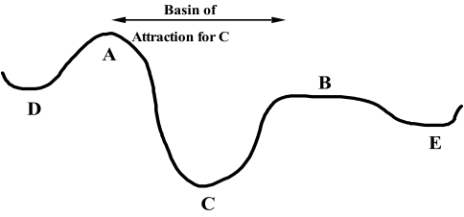
Minimizing Energy
On every updating we have ΔE ≤ 0
Hence the dynamics of the net tends to move E toward a minimum.
We stress that there may be different such states — they are local minima. Global minimization is not guaranteed.
CS 561, Session 22

Slide 32
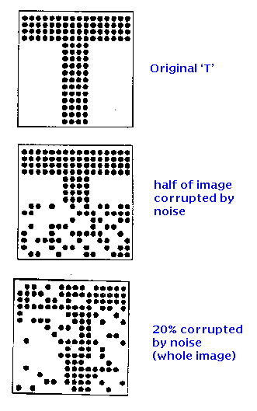
Associative Memories
http://www.shef.ac.uk/psychology/gurney/notes/l5/l5.html
Idea: store:
So that we can recover it if presented
with corrupted data such as:
Or:
CS 561, Session 22

Slide 33
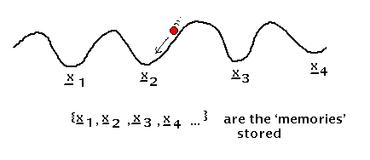
Associative memory with Hopfield nets
Setup a Hopfield net such that local minima correspond
to the stored patterns.
Issues:
- because of weight symmetry, anti-patterns (binary reverse) are stored as well as the original patterns (also spurious local minima are created when many patterns are stored)
- if one tries to store more than about 0.14*(number of neurons) patterns, the network exhibits unstable behavior
- works well only if patterns are uncorrelated
CS 561, Session 22

Slide 34
Applications: Classification
Business
Credit rating and risk assessment
Insurance risk evaluation
Fraud detection
Insider dealing detection
Marketing analysis
Mailshot profiling
Signature verification
Inventory control
Security
Face recognition
Speaker verification
Fingerprint analysis
Medicine
General diagnosis
Detection of heart defects
Engineering
Machinery defect diagnosis
Signal processing
Character recognition
Process supervision
Process fault analysis
Speech recognition
Machine vision
Speech recognition
Radar signal classification
Science
Recognising genes
Botanical classification
Bacteria identification
CS 561, Session 22

Slide 35
Applications: Modelling
Business
Prediction of share and commodity prices
Prediction of economic indicators
Insider dealing detection
Marketing analysis
Mailshot profiling
Signature verification
Inventory control
Engineering
Transducer linerisation
Colour discrimination
Robot control and navigation
Process control
Aircraft landing control
Car active suspension control
Printed Circuit auto routing
Integrated circuit layout
Image compression
Science
Prediction of the performance of drugs from the molecular structure
Weather prediction
Sunspot prediction
Medicine
. Medical imaging and image processing
CS 561, Session 22

Slide 36
Applications: Forecasting
Future sales
Production Requirements
Market Performance
Economic Indicators
Energy Requirements
Time Based Variables
CS 561, Session 22

Slide 37
Applications: Novelty Detection
Fault Monitoring
Performance Monitoring
Fraud Detection
Detecting Rate Features
Different Cases
CS 561, Session 22

Slide 38
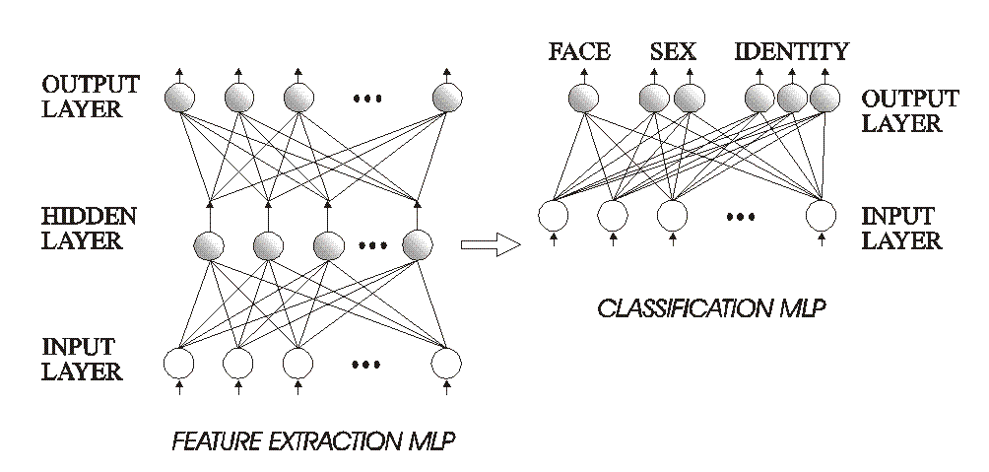
Example: face recognition
Here using the 2-stage approach:
CS 561, Session 22

Slide 39
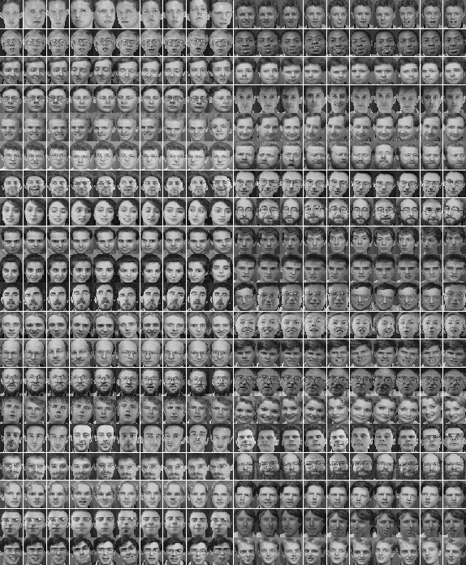
Training
http://www.neci.nec.com/homepages/lawrence/papers/face-tr96/latex.html
CS 561, Session 22

Slide 40
Learning rate
CS 561, Session 22

Slide 41
Testing / Evaluation
Look at performance as a function of network complexity
CS 561, Session 22

Slide 42
Testing / Evaluation
Comparison with other known techniques
CS 561, Session 22

Slide 43
Capabilities and Limitations of Layered Networks
Issues:
what can given networks do?
What can they learn to do?
How many layers required for given task?
How many units per layer?
When will a network generalize?
What do we mean by generalize?
…
CS 561, Session 22

Slide 44
Capabilities and Limitations of Layered Networks
What about boolean functions?
Single-layer perceptrons are very limited:
- XOR problem
- etc.
But what about multilayer perceptrons?
We can represent any boolean function with a network with just one hidden layer.
How??
CS 561, Session 22

Slide 45
Capabilities and Limitations of Layered Networks
To approximate a set of functions of the inputs by a layered network with continuous-valued units and sigmoidal activation function…
Cybenko, 1988: … at most two hidden layers are necessary, with arbitrary accuracy attainable by adding more hidden units.
Cybenko, 1989: one hidden layer is enough to approximate any continuous function.
Intuition of proof: decompose function to be approximated into a sum of localized “bumps.” The bumps can be constructed with two hidden layers.
Similar in spirit to Fourier decomposition. Bumps = radial basis functions.
CS 561, Session 22

Slide 46
Optimal Network Architectures
How can we determine the number of hidden units?
genetic algorithms: evaluate variations of the network, using a metric that combines its performance and its complexity. Then apply various mutations to the network (change number of hidden units) until the best one is found.
Pruning and weight decay:
- apply weight decay (remember reinforcement learning) during training
- eliminate connections with weight below threshold
- re-train
- How about eliminating units? For example, eliminate units with total synaptic input weight smaller than threshold.
CS 561, Session 22

Slide 47
For further information
See
Hertz, Krogh & Palmer: Introduction to the theory of neural computation (Addison Wesley)
In particular, the end of chapters 2 and 6.
CS 561, Session 22

