Slide 1
Uncertainty
Uncertainty
Probability
Syntax
Semantics
Inference rules

Slide 2
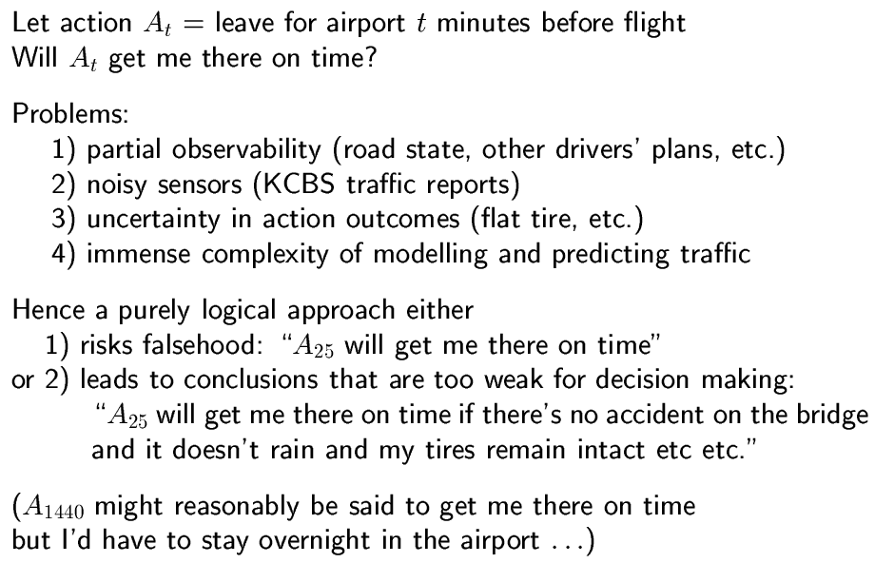
Uncertainty

Slide 3
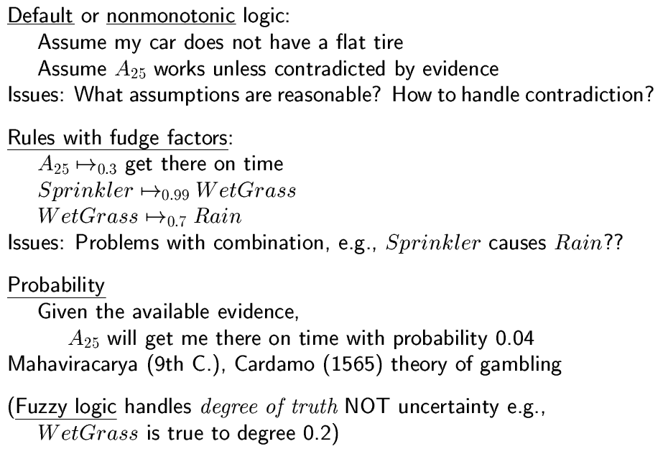
Methods for handling uncertainty

Slide 4
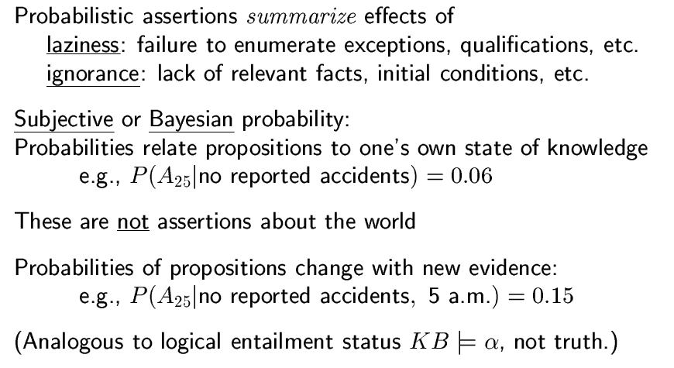
Probability

Slide 5
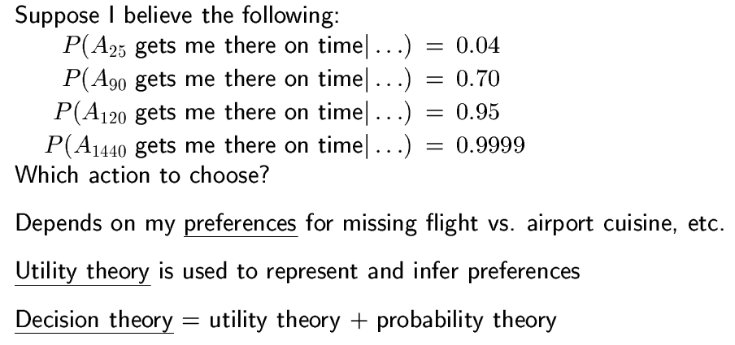
Making decisions under uncertainty

Slide 6
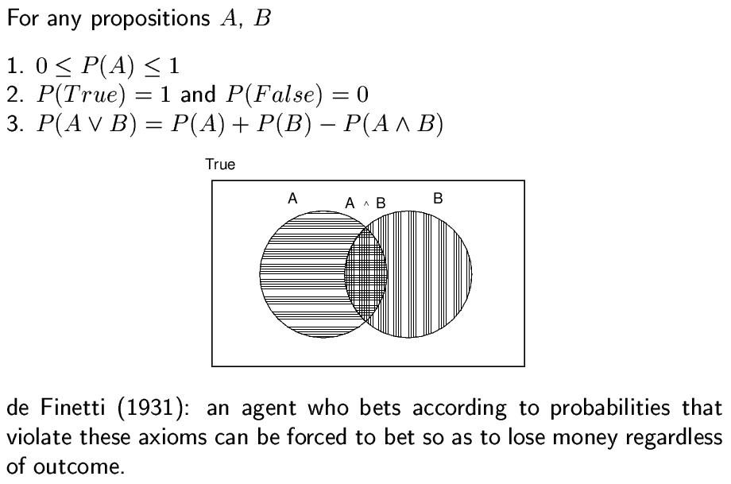
Axioms of probability

Slide 7
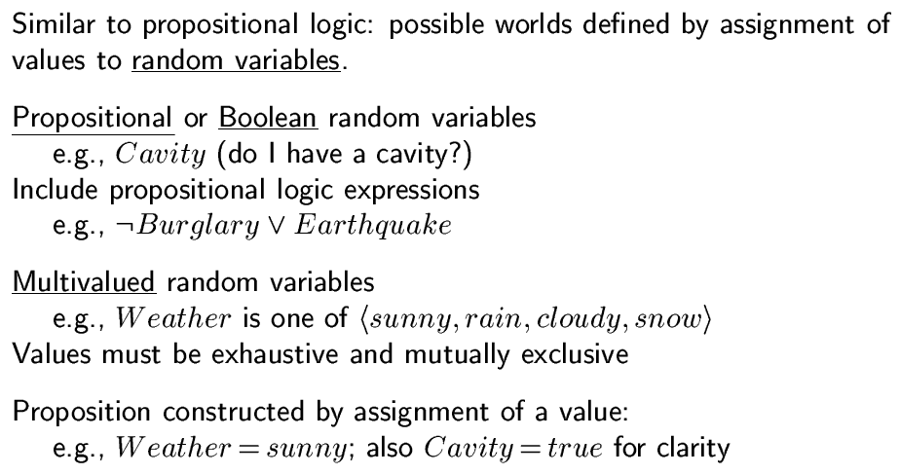
Syntax

Slide 8
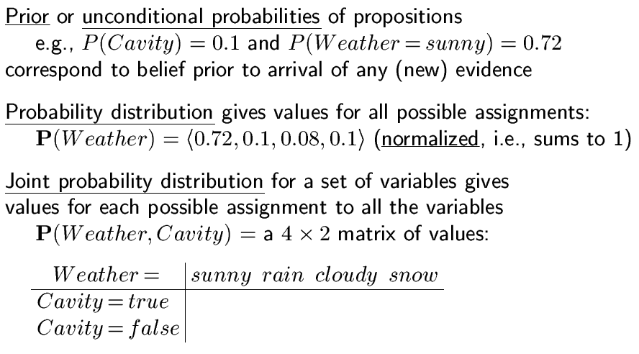
Syntax

Slide 9
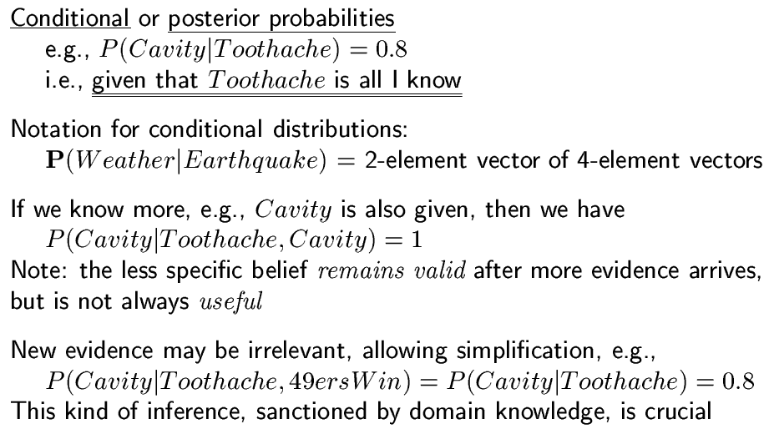
Syntax

Slide 10
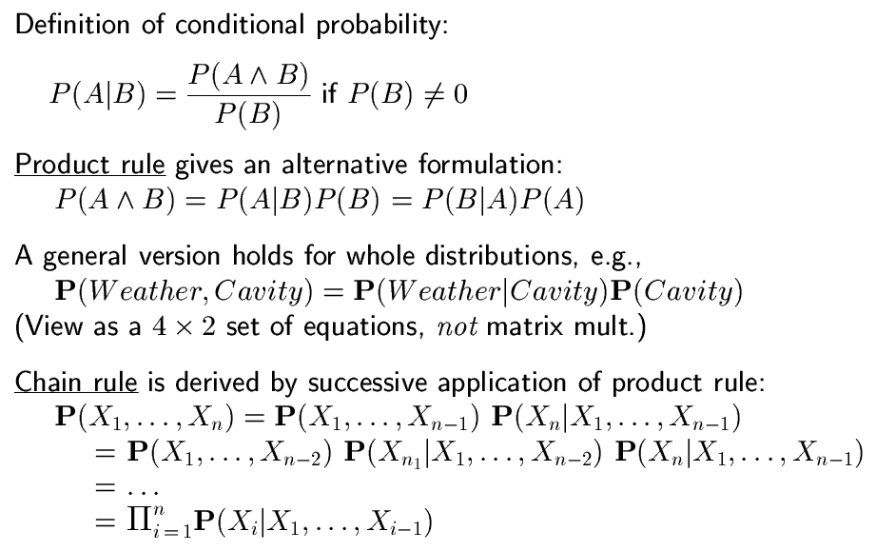
Conditional probability

Slide 11
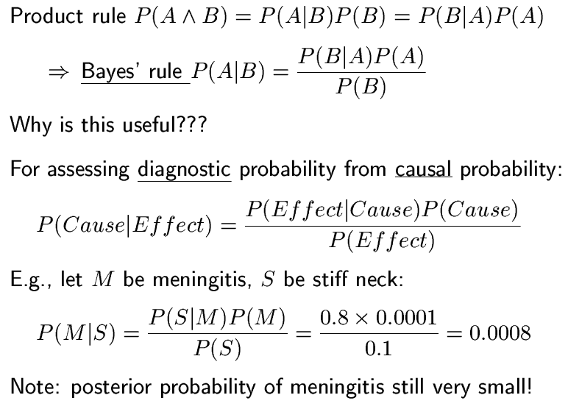
Bayes’ rule

Slide 12
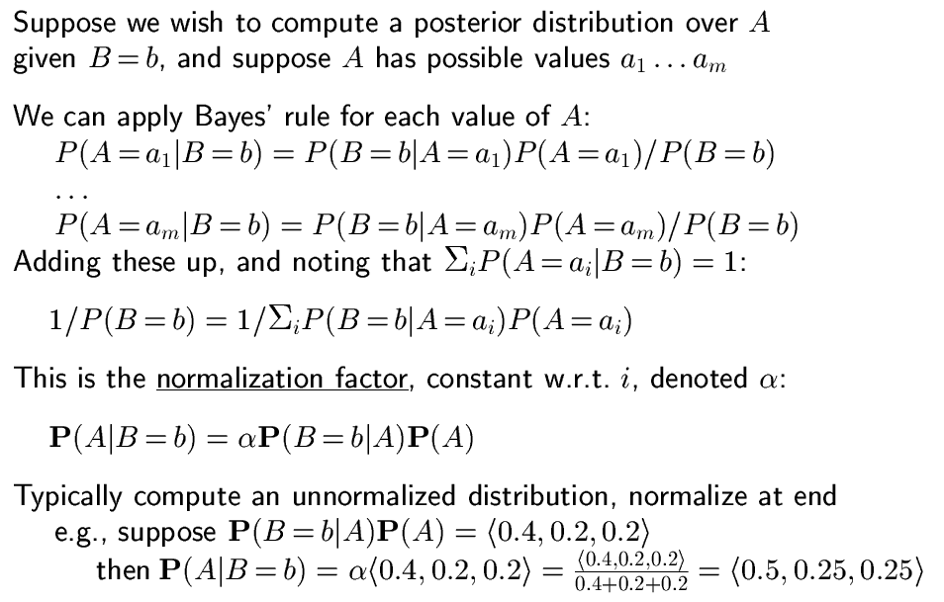
Normalization

Slide 13
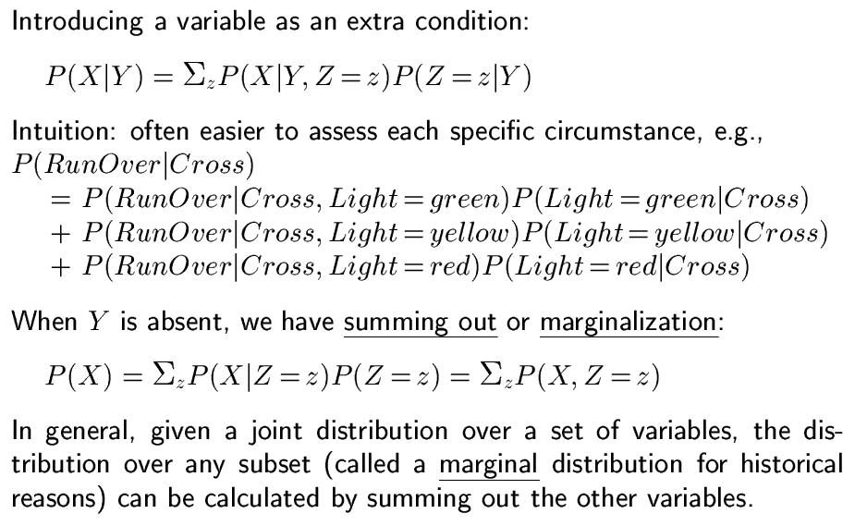
Conditioning

Slide 14
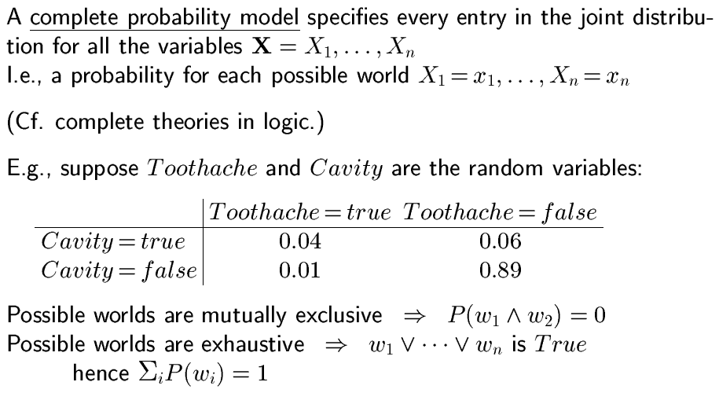
Full joint distributions

Slide 15
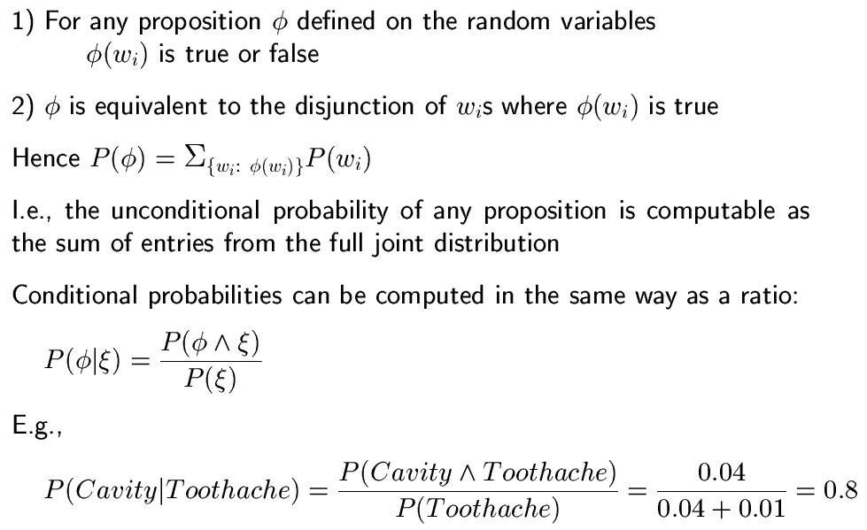
Full joint distribution

Slide 16
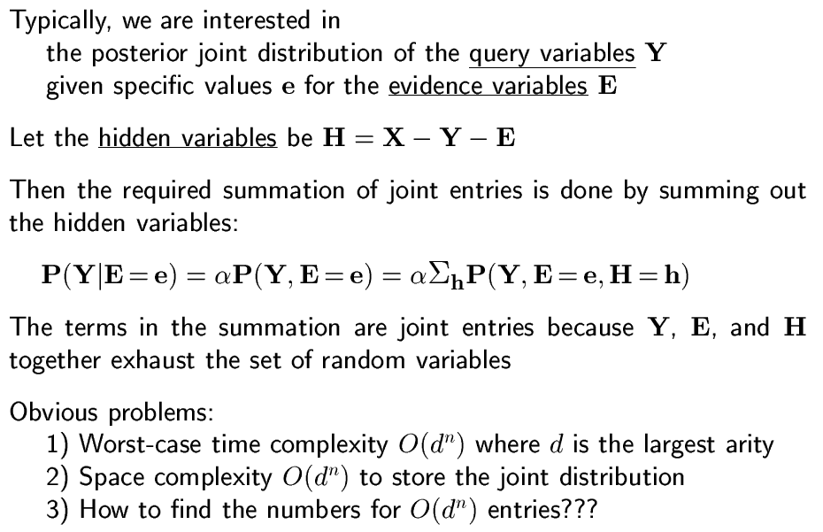
Inference from joint distributions

Slide 17
Example
Assume the full joint distribution:
toothache ¬toothache
catch ¬catch catch ¬catch
cavity 0.108 0.012 0.072 0.008
¬cavity 0.016 0.064 0.144 0.576
Y=Cavity: we want to know whether we have a cavity
E=Toothache: we know we have a toothache
H=Catch: we don’t know whether probe would catch or not
P(Y|e) = α P(Y, e) = α Σ P(Y, e, h)
h

Slide 18
Belief networks
Conditional independence
Syntax and semantics
Exact inference
Approximate inference

Slide 19
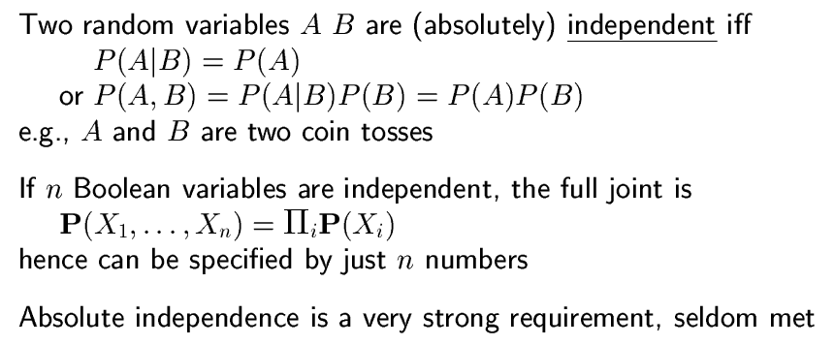
Independence

Slide 20
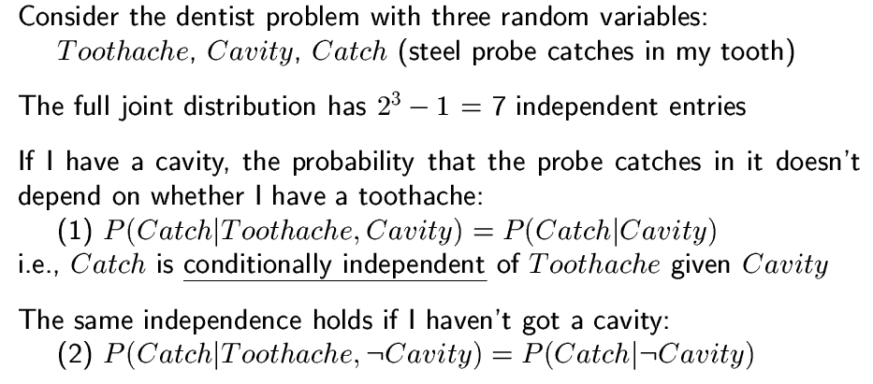
Conditional independence

Slide 21

Conditional Independence
Cavity
Toothache
Catch
Other interactions may exist, but they are either insignificant, unknown or irrelevant. We leave them out.

Slide 22

Conditional Independence
Cavity
Toothache
Catch
We assume that a “catch” is not influenced by a toothache and visa versa.

Slide 23
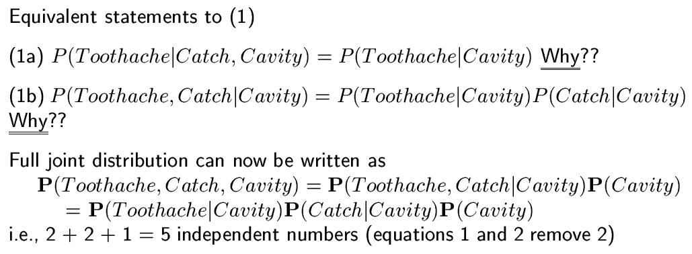
Conditional independence

Slide 24
Conditional Independence
Cavity
Catch
Cavity
=
Toothache
Toothache
(1a) Since Catch does not affect Toothache
P(Toothache|Catch,Cavity) = P(Toothache|Cavity)

Slide 25
Conditional Independence
Cavity
Cavity
Cavity
=
Toothache
Catch
Toothache
Catch
(1b) Algebraically these statements are equivalent
P(Toothache,Catch|Cavity) = P(Toothache|Cavity)P(Catch|Cavity)

Slide 26
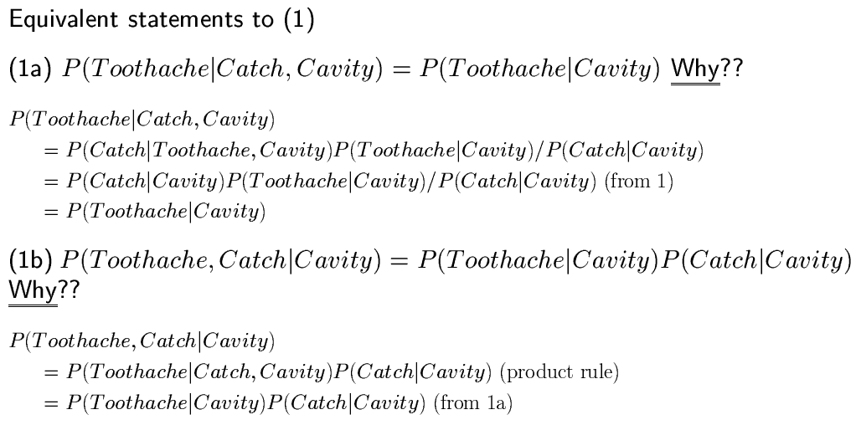
Conditional independence

Slide 27
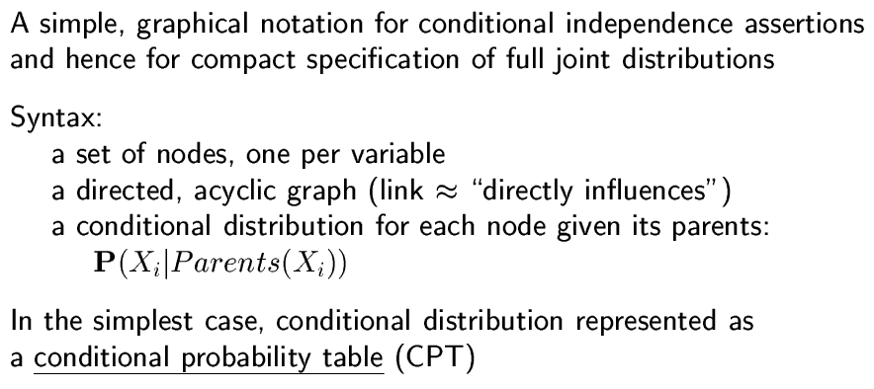
Belief networks

Slide 28
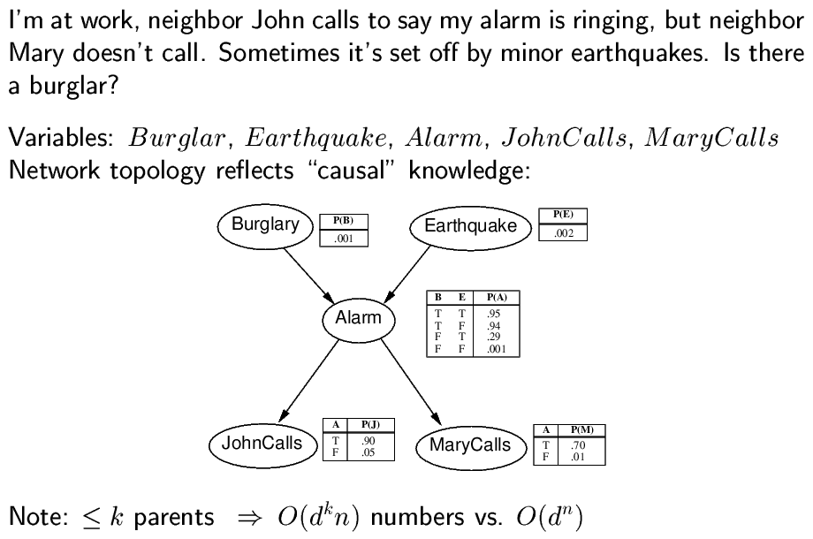
Example

Slide 29
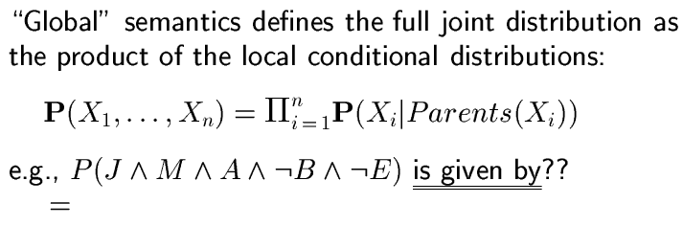
Semantics

Slide 30
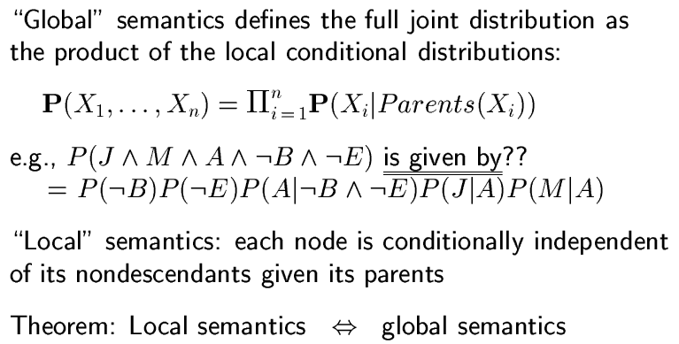
Semantics

Slide 31
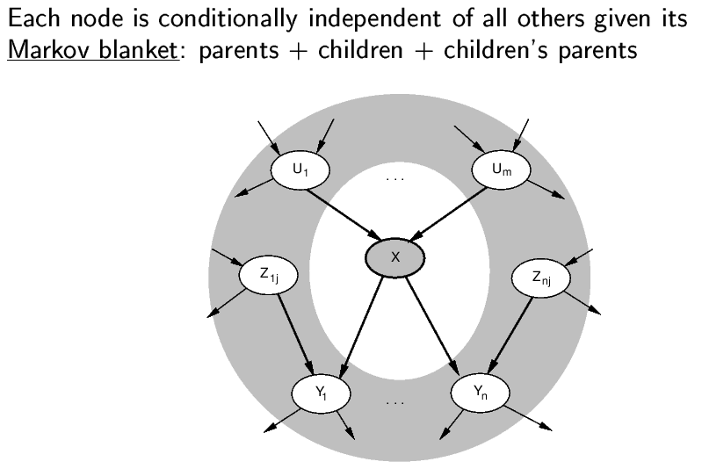
Markov blanket

Slide 32
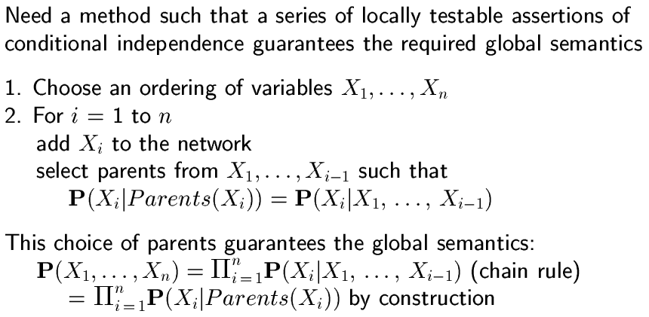
Constructing belief networks

Slide 33
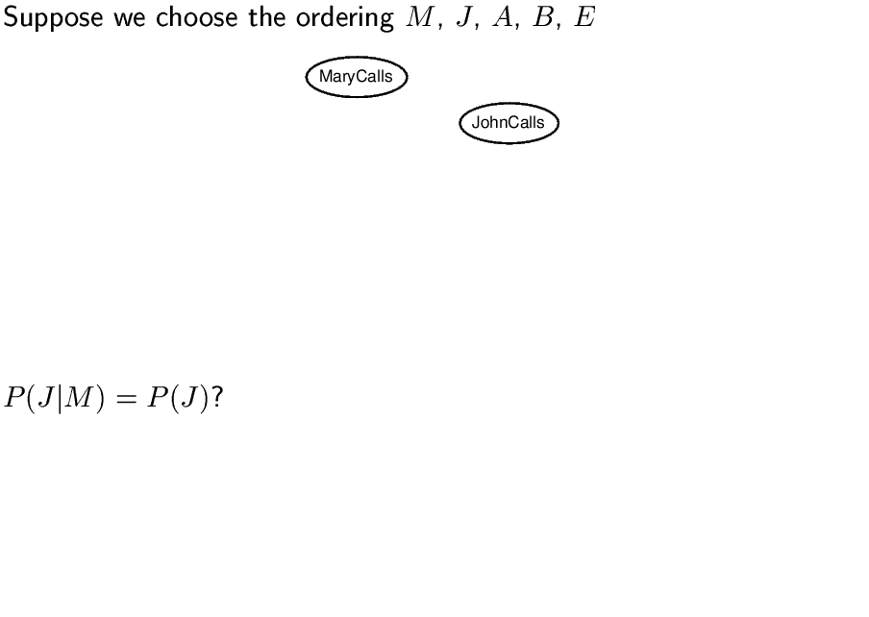
Example

Slide 34
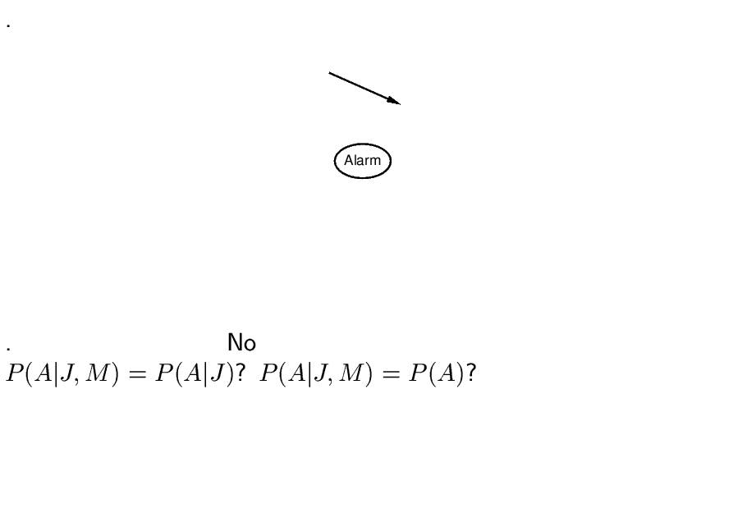

Slide 35
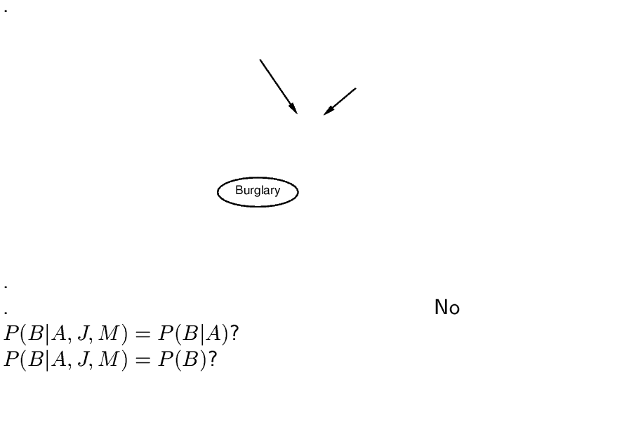

Slide 36
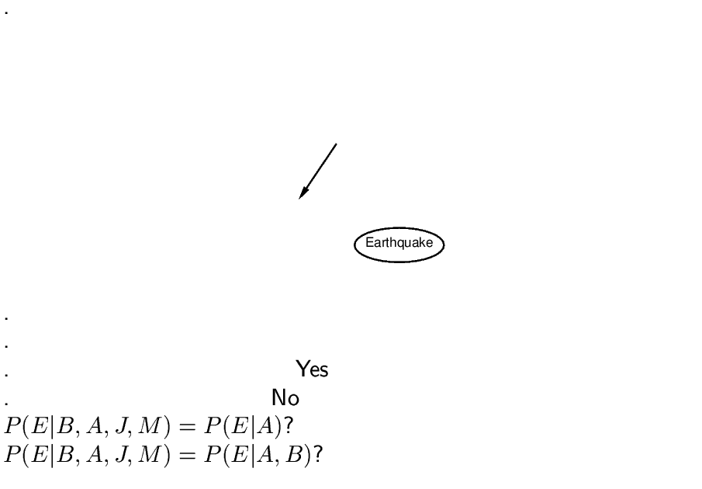

Slide 37
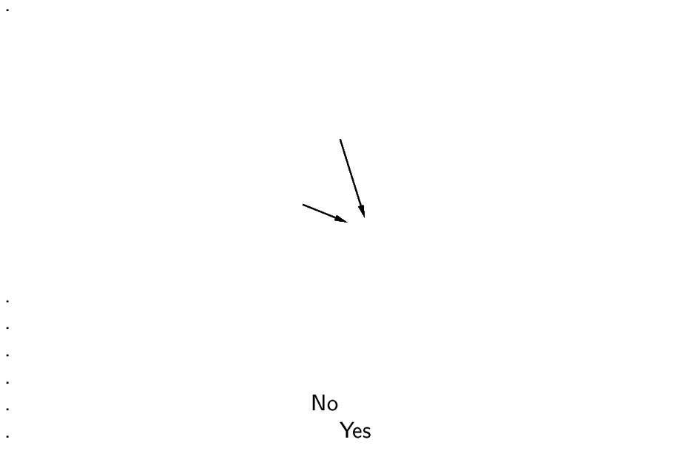

Slide 38
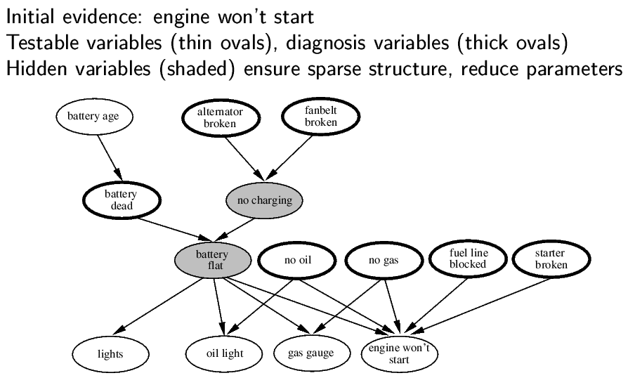
Example: car diagnosis

Slide 39
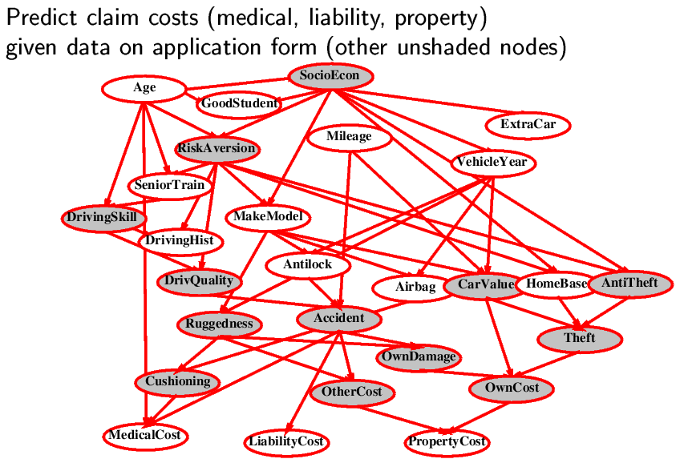
Example: car insurance

Slide 40
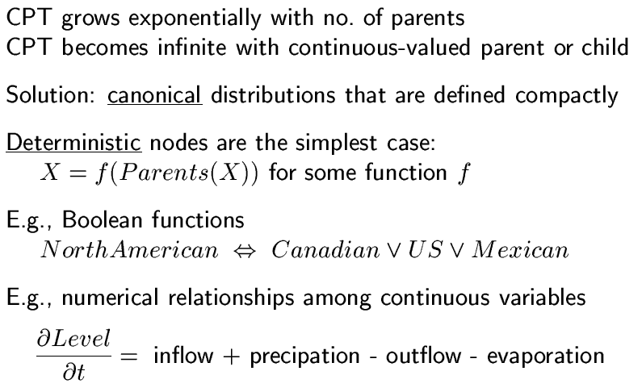
Compact conditional distributions

Slide 41
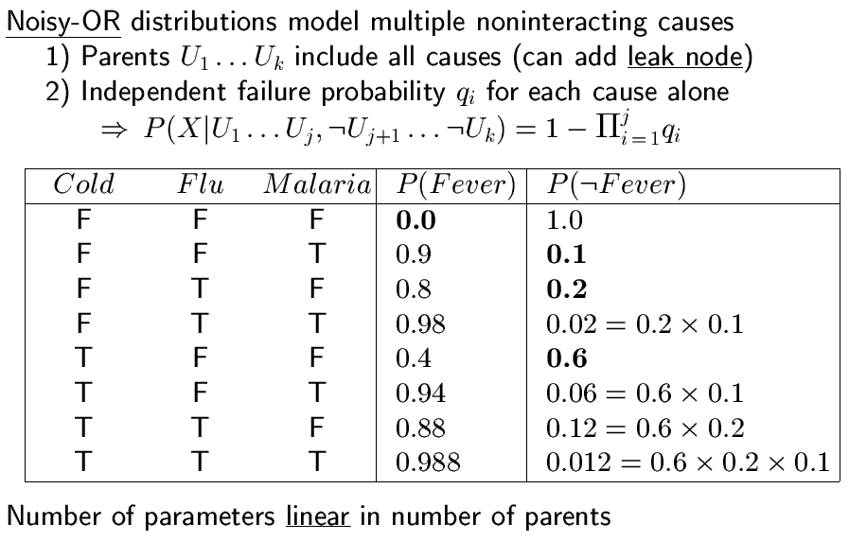
Compact conditional distributions

Slide 42
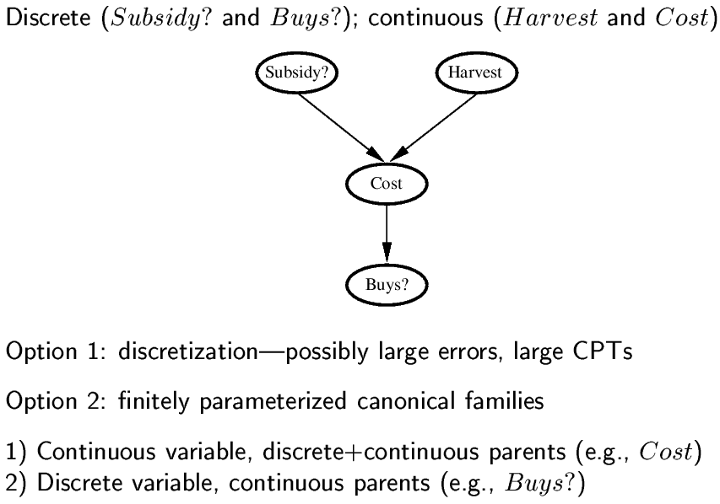
Hybrid (discrete+continuous) networks

Slide 43
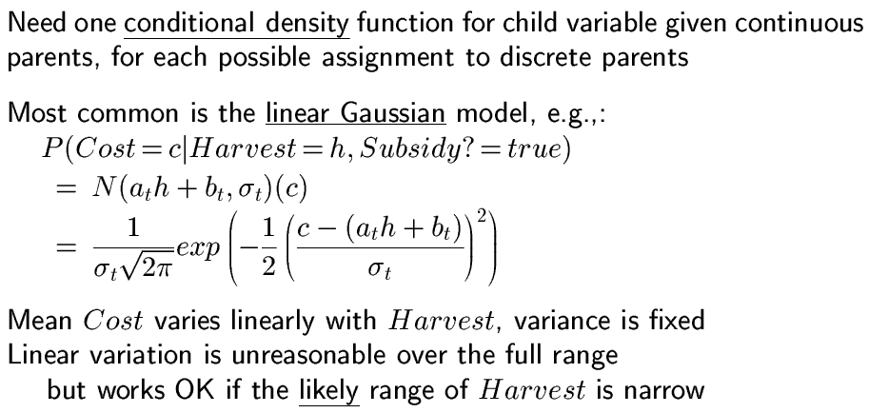
Continuous child variables

Slide 44
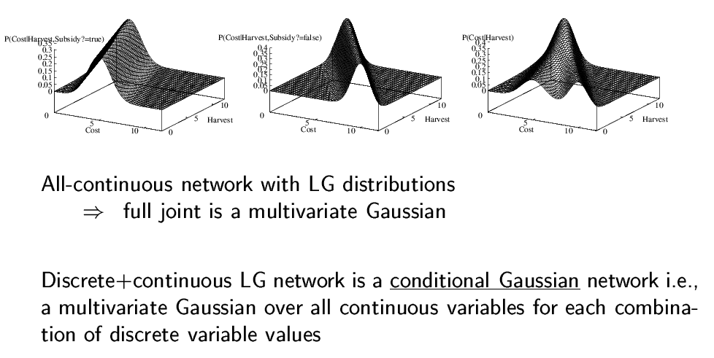
Continuous child variables

Slide 45
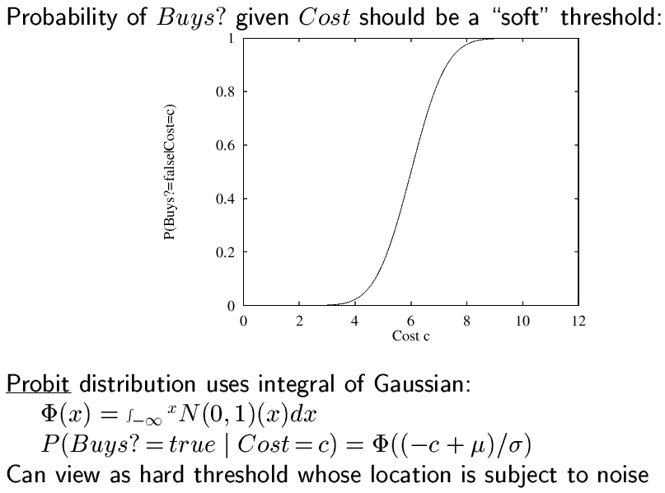
Discrete variable w/ continuous parents

Slide 46
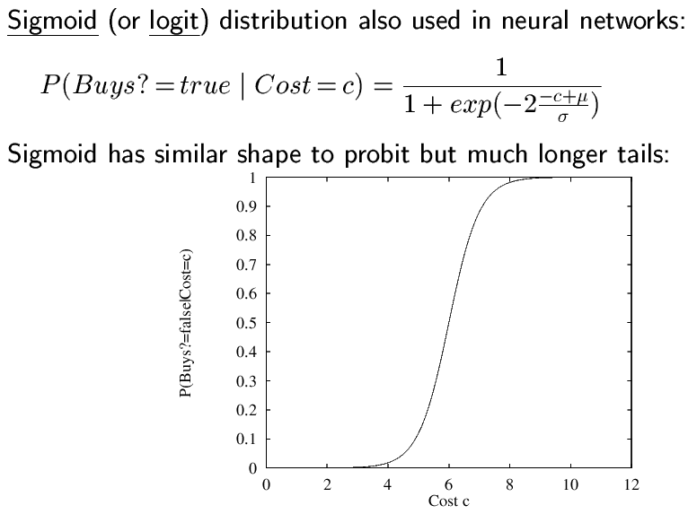
Discrete variable

Slide 47
Inference in belief networks
Exact inference by enumeration
Exact inference by variable elimination
Approximate inference by stochastic simulation
Approximate inference by Markov chain Monte Carlo (MCMC)

