Slide 1


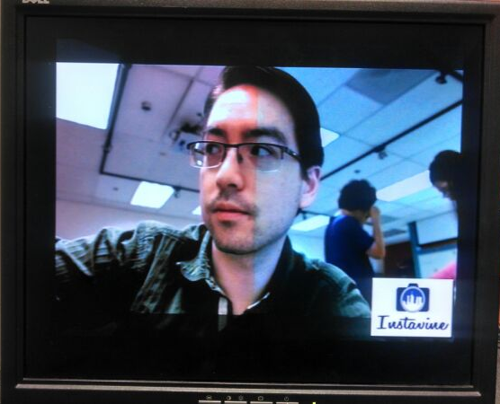
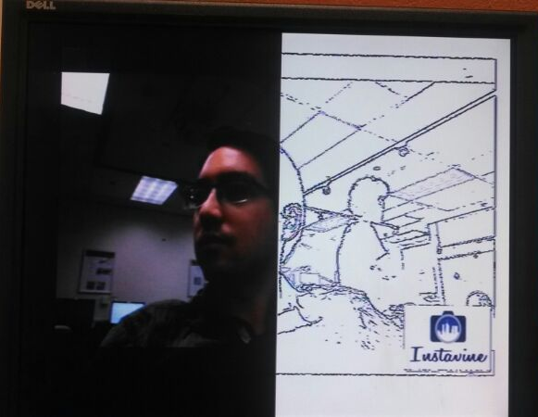
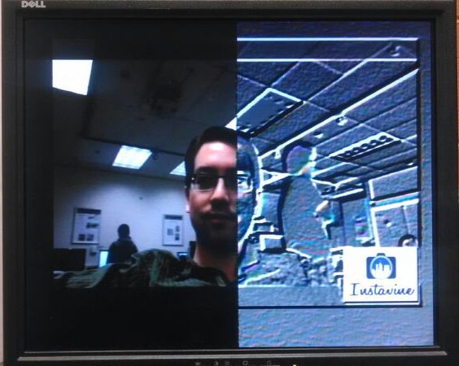
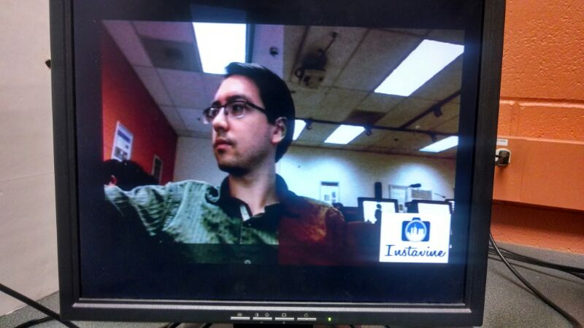
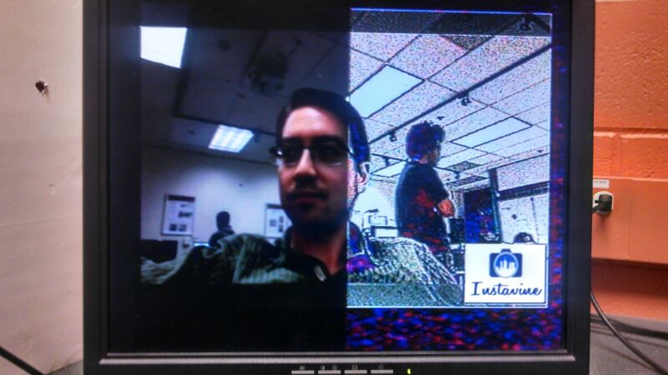
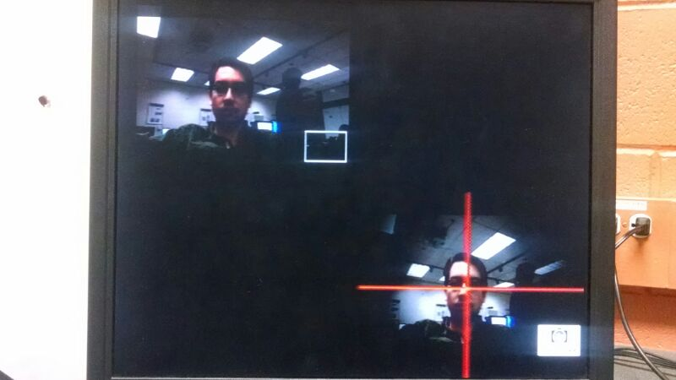
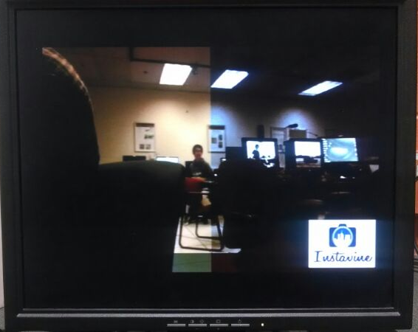
Manan Vyas
Nicholas Yingst
Shruti Sharma
Motivation:
The aim of this project is to take the features of the famous image editing app, Instagram, one step further and create a real-time video version of the filters. We have named it InstaVine.
Filters:
The filters implemented on the video are image filters applied to each frame of the video. Due to the algorithms running in real-time and without manual intervention, the filters are adaptive.
Following are the filters that InstaVine includes:
White Balance Correction
Algorithm: Histogram
Stretching
Pencil Sketch
Algorithm: Adaptive Canny
Edge Detection
Metallic Emboss
Algorithm: Convolution
with a Mask
Sepia
Algorithm: Color Channel
Cross Mixing +
Gamma Correction
Other filters:
Color Temperature
(Warm)
Colored Foreground
with
Grayscale Background
Comic Book
Algorithm: Edge Sharpening
Using Convolution
Vignette
Algorithm: Skin Color
Segmentation + Faded
Mask Overlay
Color Temperature
(Cool)
Algorithm: Color Mixing +
Luminance Preservation

