Slide 1

Manan Vyas
Nicholas Yingst
Shruti Sharma

Slide 2
Introduction
The aim of this project is to take the features of the famous image editing app, Instagram, one step further and create a real-time video version of the filters. We have named it InstaVine.
The filters implemented on the video are image filters applied to each frame of the video. Due to the algorithms running in real-time and without manual intervention, the filters are adaptive.

Slide 3
Hardware and Setup
DSP Board: We chose DM6437 because:
- 720x480i I-O Video resolution (Better Quality)
- can connect to external displays (Helps in demo)
Drawbacks:
- internal memory: 256kB
- clock speed: 600MHz
Camera: Canon 7D
User Interface: Combination of DIP switches on the board will select various filters

Slide 4
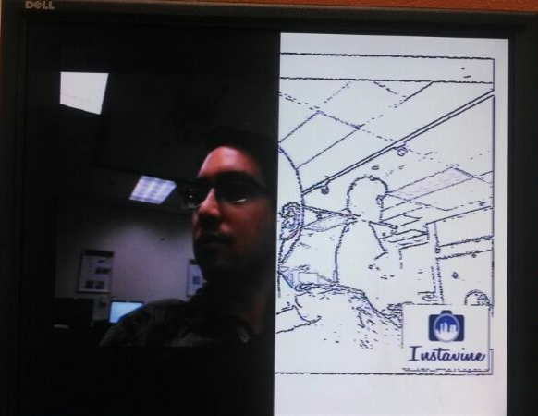
Pencil Sketch
Algorithm: Edge Detection Using Adaptive Canny
Result:

Slide 5
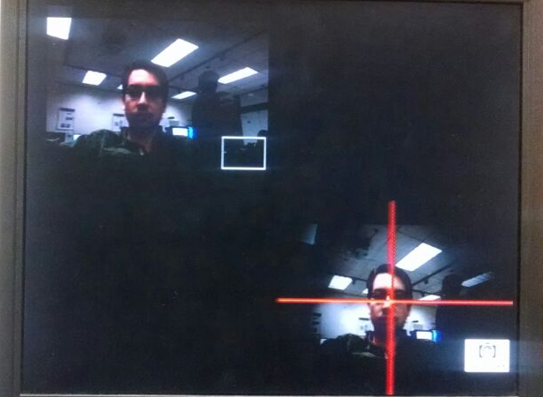
Vignette
Algorithm: Skin Color Segmentation + Faded Mask Overlay
Result:

Slide 6
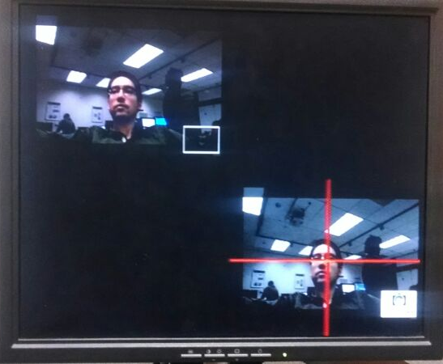
Colored Foreground with Grayscale Background
Algorithm: Skin Segmentation + Faded Grayscale Mask Overlay
Result:

Slide 7
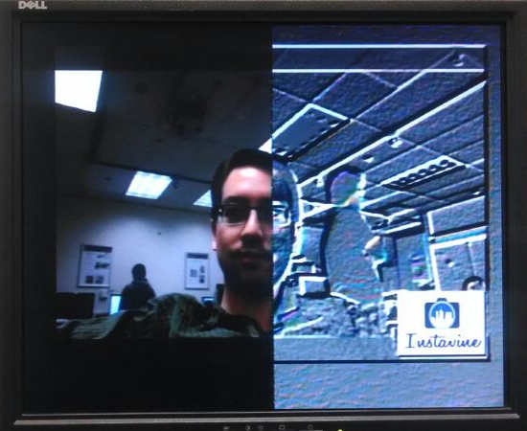
Metallic Emboss
Algorithm: The emboss filter gives a 3D shadow effect to the image, essentially by taking the bump-map of the frames along the diagonal.
Complexity : O(MN)
Results:

Slide 8
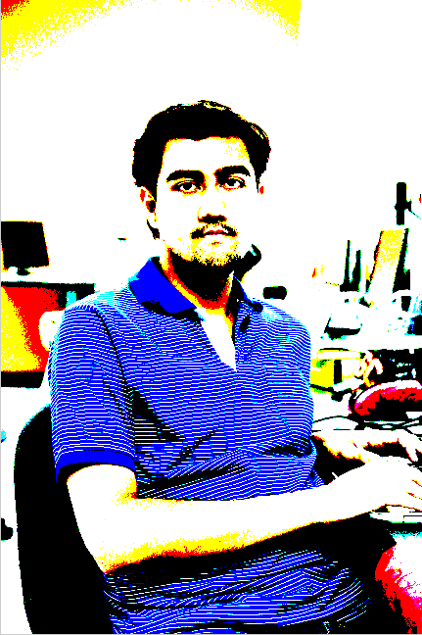
Error Diffusion and Dithering
Algorithm: Halftoning using the thresholding matrix. Error Diffusion : Distribute the quantization residual to neighboring un-processed.
Serpentine Scanning to ensure proper error distribution
Complexity : O(MN)
Results:

Slide 9
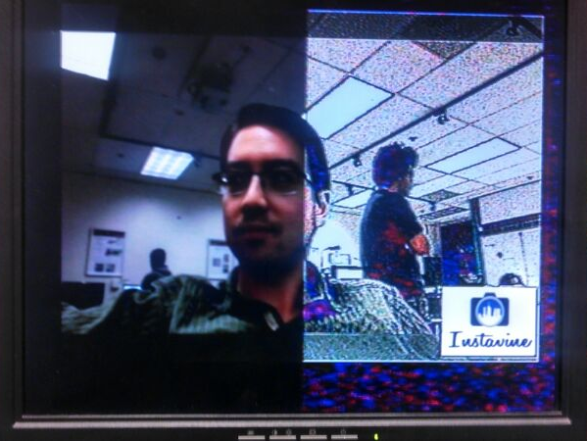
Comic Book
Algorithm: Add the original image to edge enhanced (sharperned) image while preserving the brightness.
Decided to use the “sharpen” as the actual Comic Book Effect for the demo as it “visibly” better than Error Diffusion
Complexity : O(MN)
Results:
Notes:
MxN Image Dimensions

Slide 10
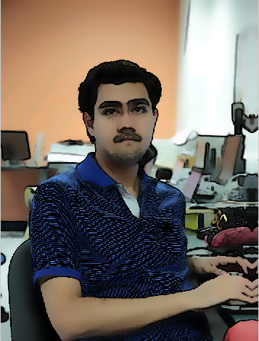
Cartoonize:
Algorithm: Add adaptive egde map to the bilateral filtered image.
Complexity of Bilateral : O(|N|.log(σ))
Complexity of Adaptive Edge Map : O(MN. Log(MN))
Too complex and slow to run on the board even after optimizations !
Results:
Notes:
|N| = No of pixels in the image MxN = Dimensions of the image

Slide 11
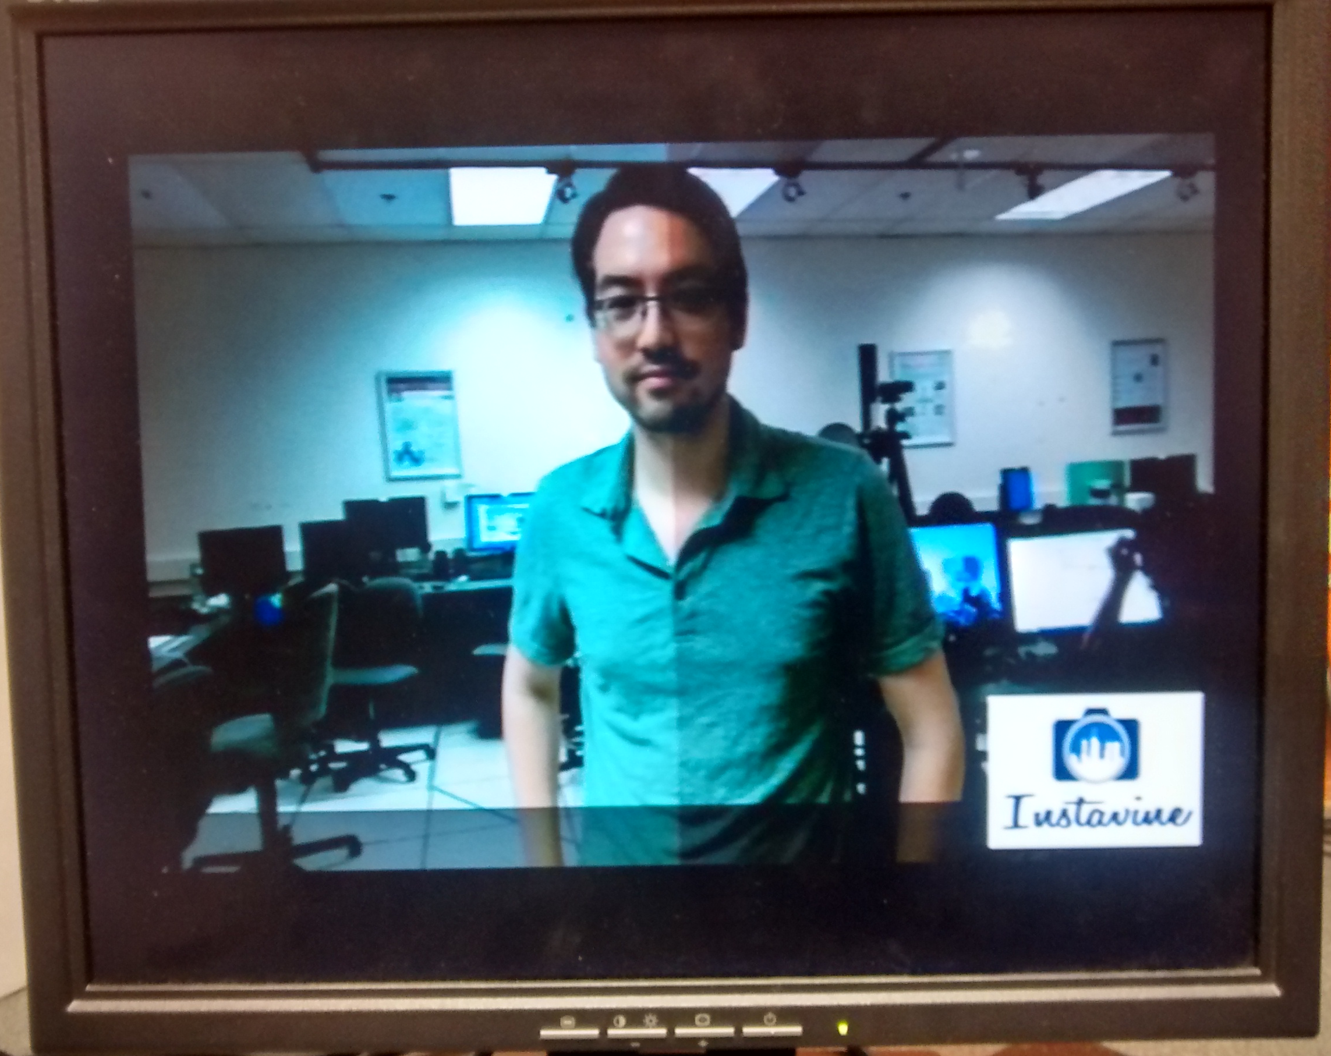
White Balance Correction
Algorithm: Histogram Stretching
Result:

Slide 12
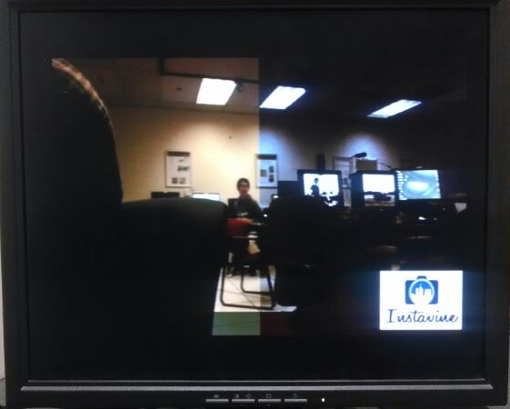
Color Temperature
Algorithm: Color Mixing + Luminance Preservation
Result:

Slide 13
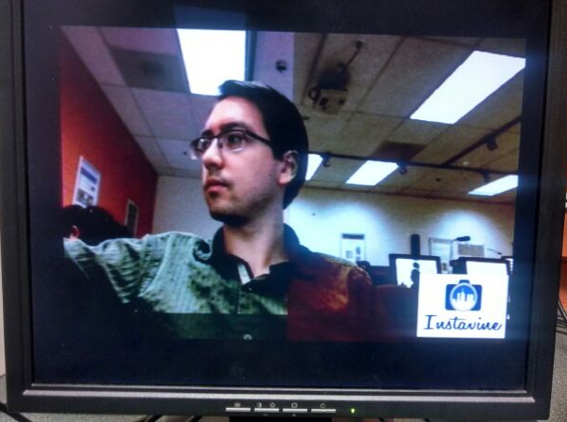
Sepia
Algorithm: Color Channel Cross Mixing + Gamma Correction
Result:

Slide 14
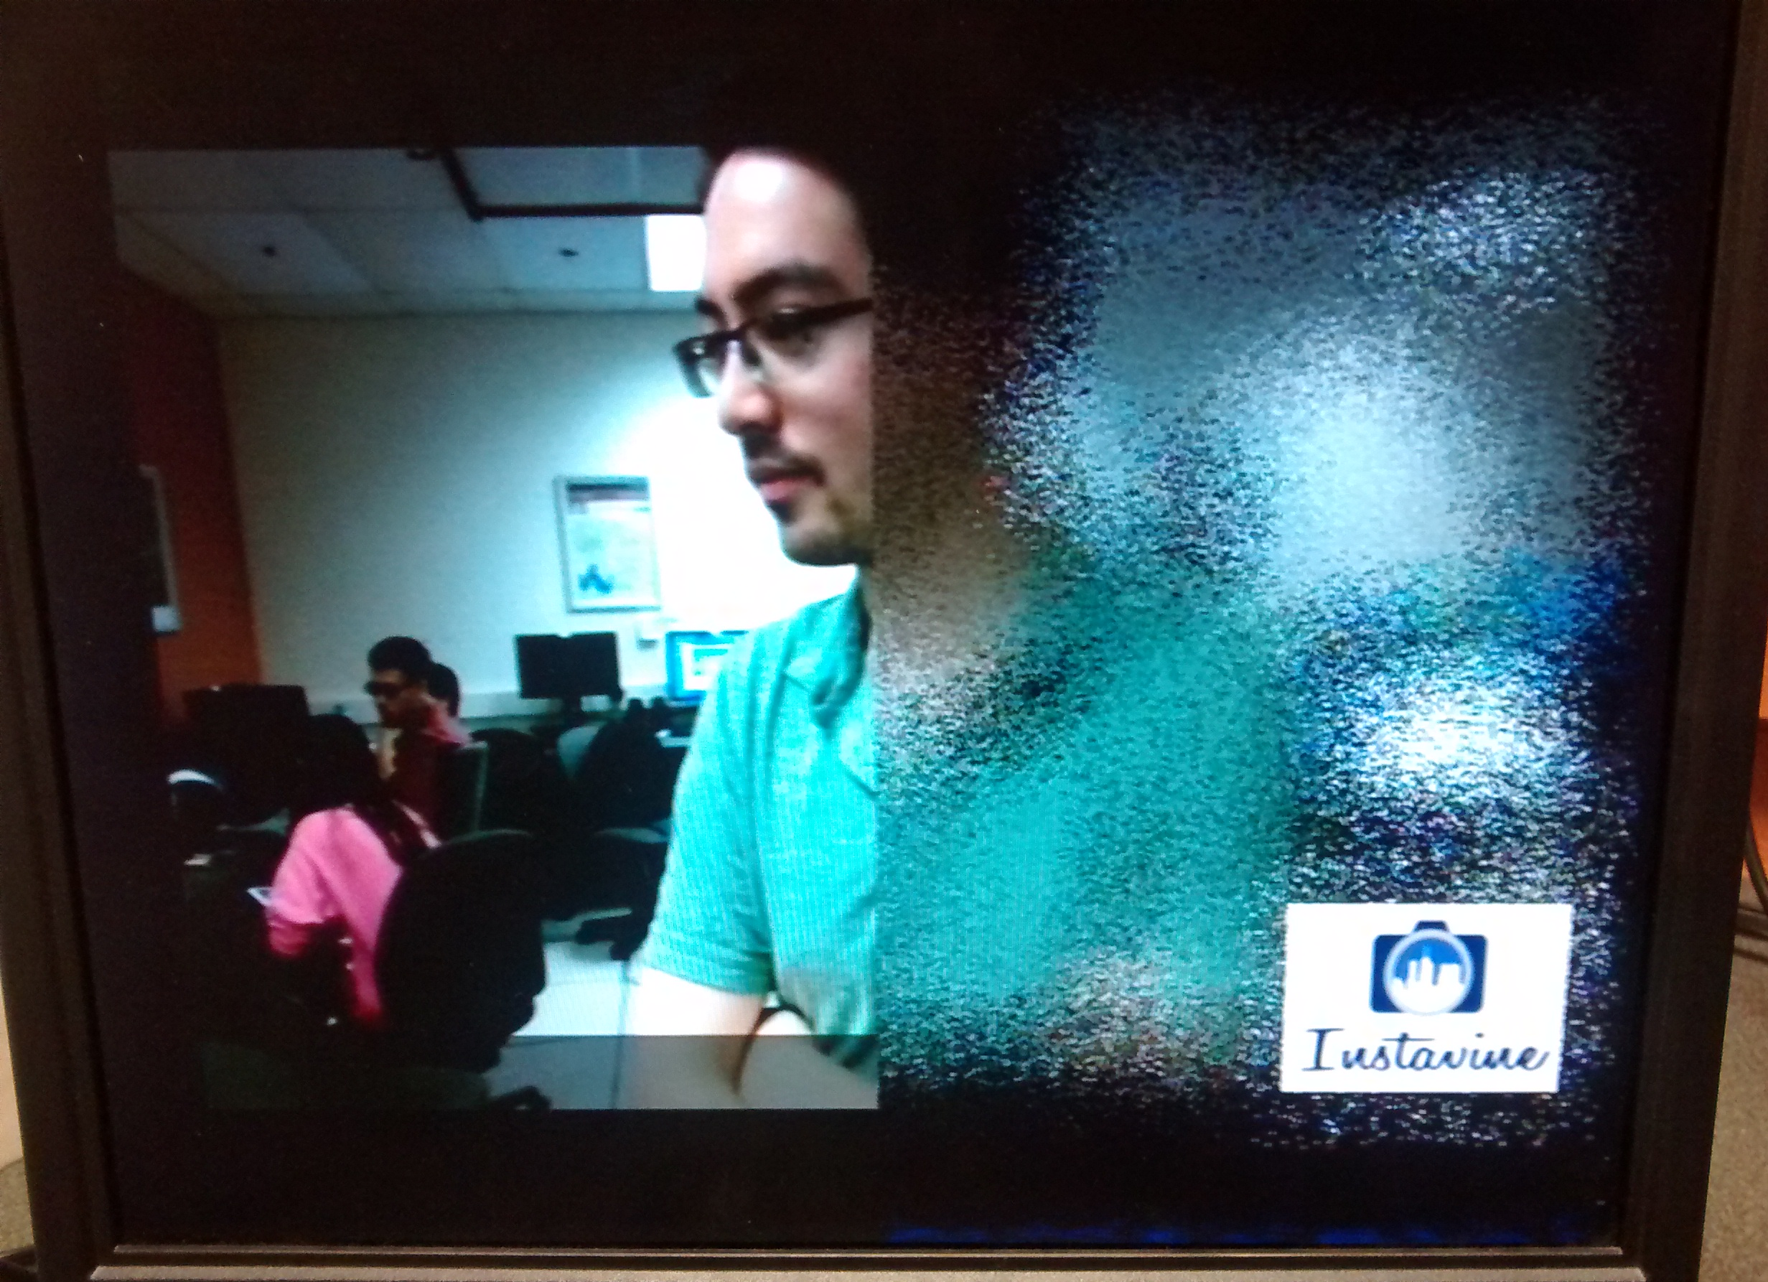
Dissolve
Result:

Slide 15
Optimization Techniques
Integer math
Look-up tables
Pre-fetching pixels/blocks of pixels

Slide 16
Checklist
Promised | Delivered
Pencil Sketch | Pencil Sketch
White balance correction +Contrast Enhancement | White balance correction + contrast enhancement
Foreground-background separation | Skin color segmentation + Vignette and grayscale effects
Vignette
Comic-book effect | Comic-book effect
Oil Painting | Sepia - tone
 | Emboss effect
 | Dissolve effect
 | Color temperature conversion

Slide 17
References:
[1] Y.; Cetin A.E. Akarun, L.; Yardunci. Canny edge detection codec using vlib on davinci series dsp. In International Conference on Computer Science and Service System (CSSS), pages 221,224, 11-13 August 2012.
[2] Y.; Cetin A.E. Akarun, L.; Yardunci. Adaptive methods for dithering color images. In IEEE Transactions on IEEE, vol.6, no.7, pages 950,955, Jan 1997.
[3] A.U.; Allebach J.P. Baqai, F.A.; Je-Ho Lee; Agar. Digital color halftoning. In Signal Processing Magazine,IEEE,vol. 22, pages 87,96, Jan 2005.
[4] K. J. Sungkuk Chun. Oil painting rendering changeable by light eect. Soongsil University, HCI Lab.
[5] Luo Tao; Xi feng Zheng; Ding Tie-fu. Self-adaptive threshold canny operator in color image edge detection. In 2nd International Congress on Image and Signal Processing, CISP '09, pages 1,4, 17-19 October 2009.
[6] Theo; Weijer Joost V.D. Gijsenij, Arjan; Gevers. Computational color constancy: Survey and experiments. In IEEE Transactions On Image Processing, 2010.[ August 1996].

