Slide 1
Project Presentation of Industry Oriented Hands on Experience (22CS422)
On
HOSTEL MANAGEMENT SYSTEM
Manan Jindal
2210991871
Supervised By
Mrs. Preeti Saini
Department of Computer Science and Engineering,
Chitkara University, Punjab

Slide 2
Hostel Management System Using PHP and MySQL

Slide 3
ABSTRACT
As the name specifies “HOSTEL MANAGEMENT SYSTEM” is software developed for managing various activities in the hostel. For the past few years the number of educational institutions is increasing rapidly. Thereby the number of hostels is also increasing for the accommodation of the students studying in this institution. And hence there is a lot of strain on the person who are running the hostel and software’s are not usually used in this context. This particular project deals with the problems on managing a hostel and avoids the problems which occur when carried manually.
Identification of the drawbacks of the existing system leads to the designing of computerized system that will be compatible to the existing system with the system Which is more user friendly and more GUI oriented. We can improve the efficiency of the system, thus overcome the drawbacks of the existing system.
Less human error
Strength and strain of manual labor can be reduced
High security
Data redundancy can be avoided to some extent
Data consistency
Easy to handle
Easy data updating
Easy record keeping
Backup data can be easily generated

Slide 4
INTRODUCTION
Hostel Management System has two Modules i.e. Admin and user
Admin Panel
1. Admin Login
Admin can login through login form.
2. Admin Profile
Admin can manage his own profile. Admin can also change his password
3. Courses
Admin can create add course, edit courses and also delete the course
4. Rooms
Admin can create rooms and allots seater to particular rooms and assign the fees.
5. Registration
Admin can create student profile and allot the rooms.
6. Manage the Registration
Admin can manage the all the student Profile. Take a print out of all profiles and also delete the profile.
7. Complaints
Admin can manage the all the student complaints and take the appropriate action.
8. Feedback
Admin can view the feedback given by students for the hostel.
9. Forgot Password
Admin can also retrieve the password if admin forgot the password.

Slide 5
User Panel
User Registration---- User can register through user registration form
User Login-- User can login through login form
Forgot Password—user can retrieve password through forgot password link
User Dashboard
User Profile—User can manage own profile
Book Hostel – User can book hostel
Room Details- Booked Room Details
Complaint Registration: Student can lodge the complaint.
Registered Complaint: Student can check the registered complaint and their status.
Feedback: Student give their feedback for hostel.
Change Password- User Can change own password
User access log- User can watch last login details

Slide 6
SYSTEM ENVIRONMENT
Hardware Configuration
Pentium IV Processor
512 MB RAM
40GB HDD
1024 * 768 Resolution Color Monitor
Note: This is not the “System Requirements”.
Software Configuration
1. OS : Windows XP
2.PHP Triad (PHP5.6, MySQL, Apache, and PHPMyAdmin)

Slide 7
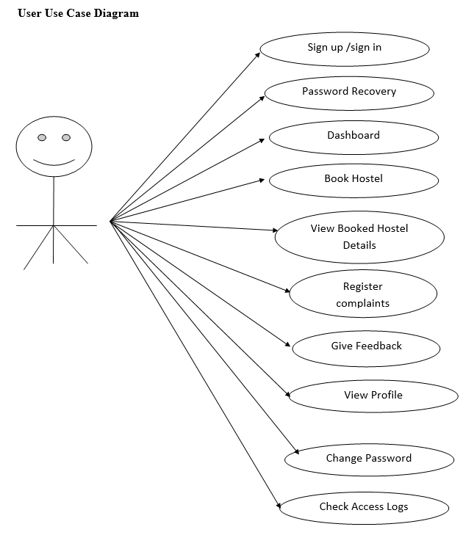
Use Case Diagram

Slide 8
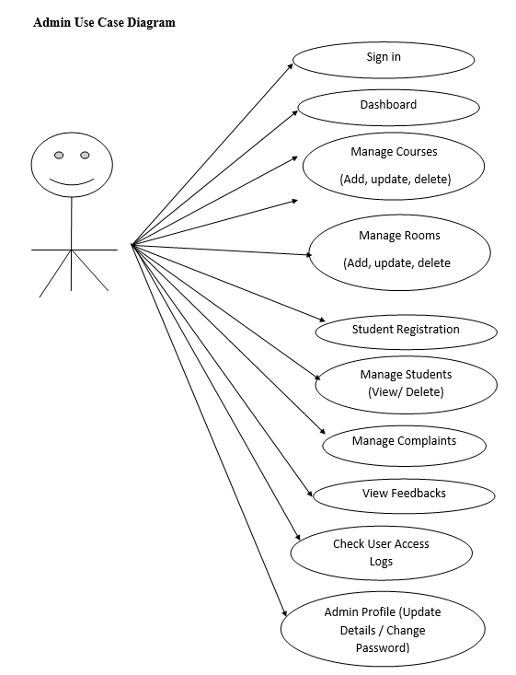

Slide 9
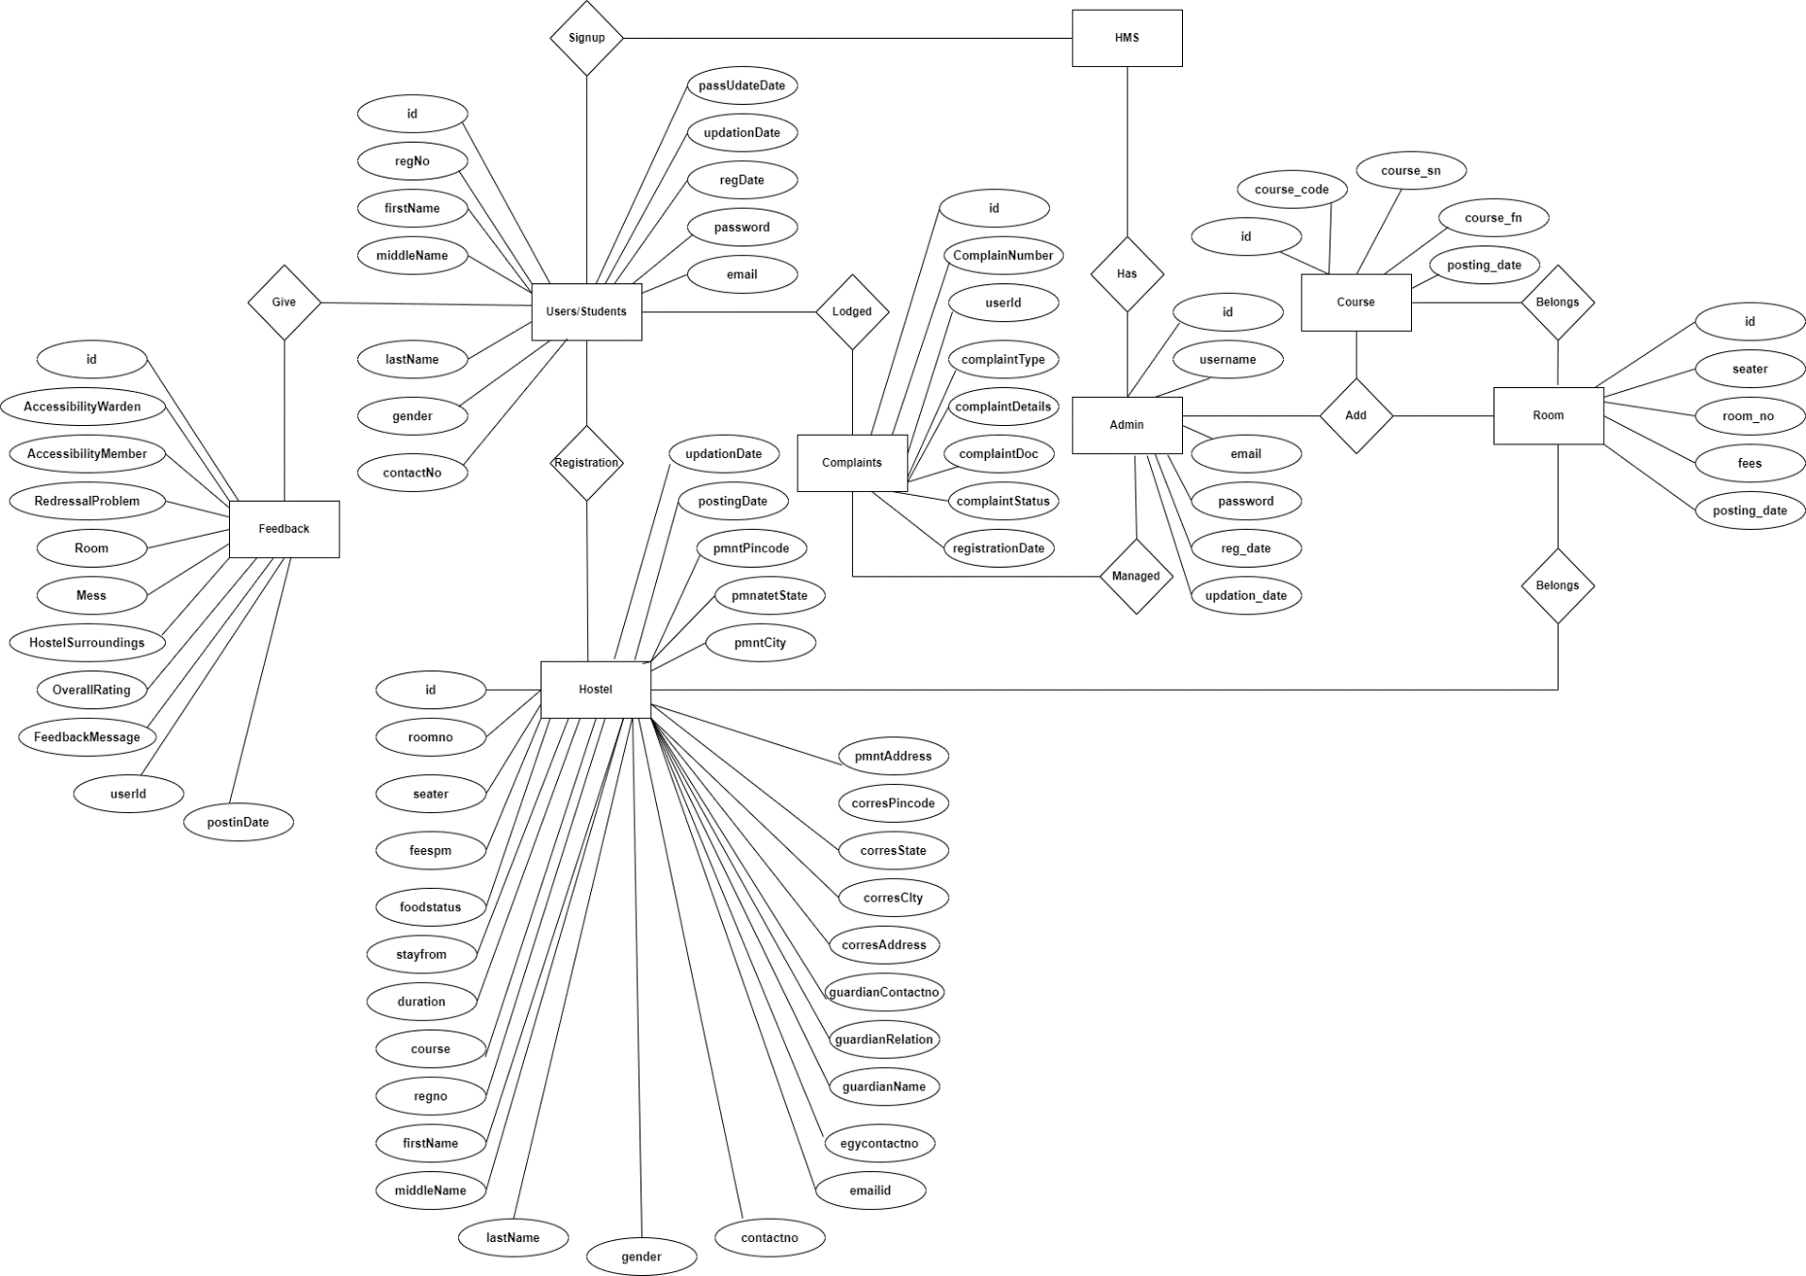
ER Diagram

Slide 10
DATABASE DESIGN
The data in the system has to be stored and retrieved from database. Designing the database is part of system design. Data elements and data structures to be stored have been identified at analysis stage. They are structured and put together to design the data storage and retrieval system.
A database is a collection of interrelated data stored with minimum redundancy to serve many users quickly and efficiently. The general objective is to make database access easy, quick, inexpensive and flexible for the user. Relationships are established between the data items and unnecessary data items are removed. Normalization is done to get an internal consistency of data and to have minimum redundancy and maximum stability. This ensures minimizing data storage required, minimizing chances of data inconsistencies and optimizing for updates. The MySQL database has been chosen for developing the relevant databases.

Slide 11
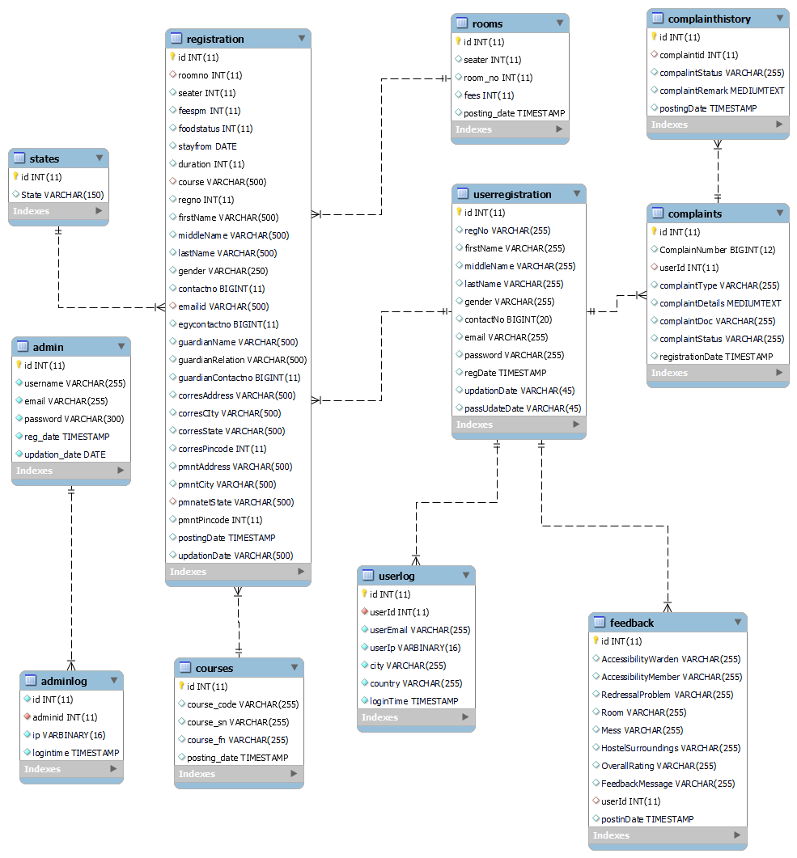
Notes:
Database Table Relationship

Slide 12
Data Flow Diagram (DFD)
A Data Flow Diagram (DFD) is a graphical representation of the "flow" of data through an Information System. A data flow diagram can also be used for the visualization of Data Processing. It is common practice for a designer to draw a context-level DFD first which shows the interaction between the system and outside entities. This context-level DFD is then "exploded" to show more detail of the system being modeled.
A DFD represents flow of data through a system. Data flow diagrams are commonly used during problem analysis. It views a system as a function that transforms the input into desired output. A DFD shows movement of data through the different transformations or processes in the system.
Dataflow diagrams can be used to provide the end user with a physical idea of where the data they input ultimately has an effect upon the structure of the whole system from order to dispatch to restock how any system is developed can be determined through a dataflow diagram. The appropriate register saved in database and maintained by appropriate authorities.

Slide 13
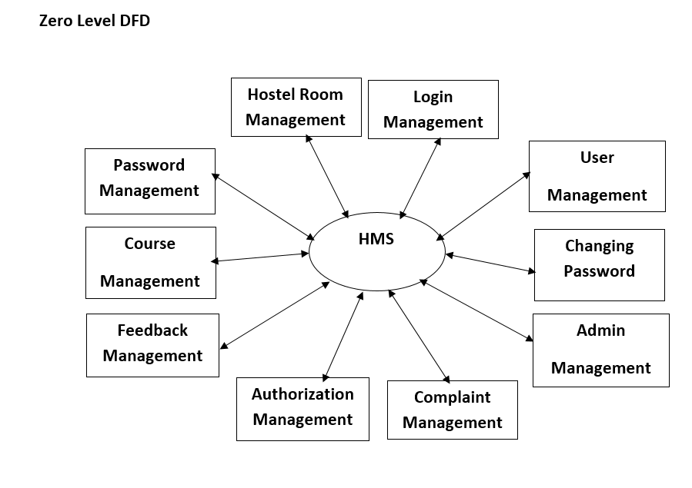

Slide 14
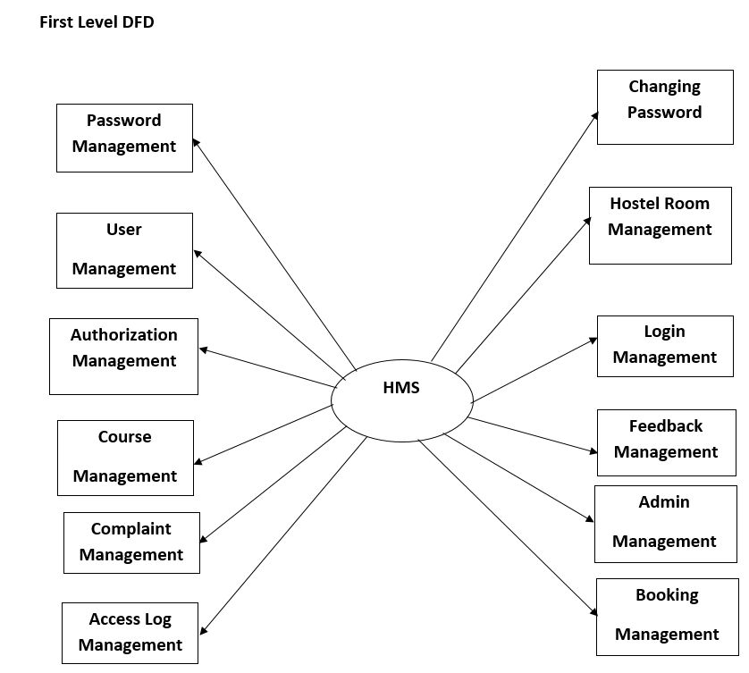

Slide 15
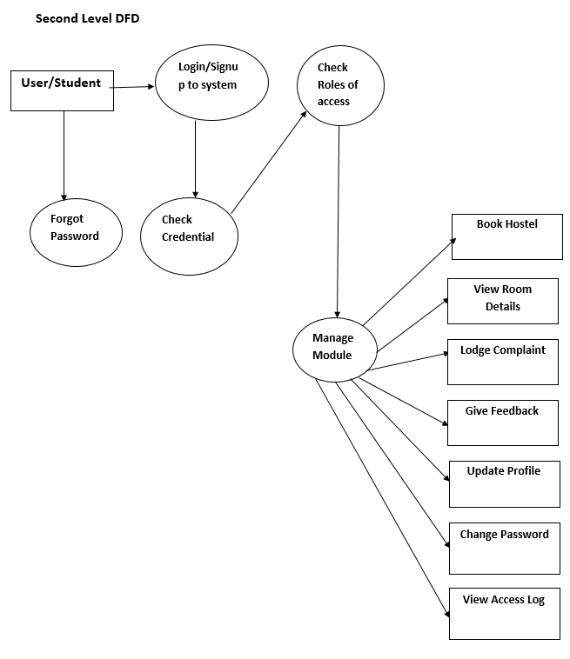

Slide 16
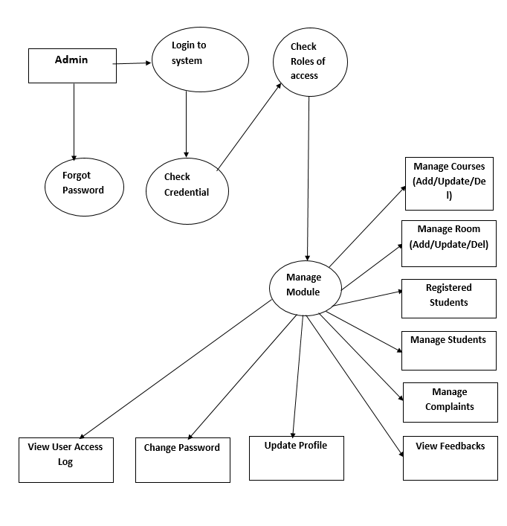

Slide 17
SYSTEM TESTING
System testing is the stage of implementation, which is aimed at ensuring that the system works accurately and efficiently before live operation commences. Testing is the process of executing the program with the intent of finding errors and missing operations and also a complete verification to determine whether the objectives are met and the user requirements are satisfied. The ultimate aim is quality assurance.
Tests are carried out and the results are compared with the expected document. In the case of erroneous results, debugging is done. Using detailed testing strategies a test plan is carried out on each module. The various tests performed in “Network Backup System” are unit testing, integration testing and user acceptance testing.

Slide 18
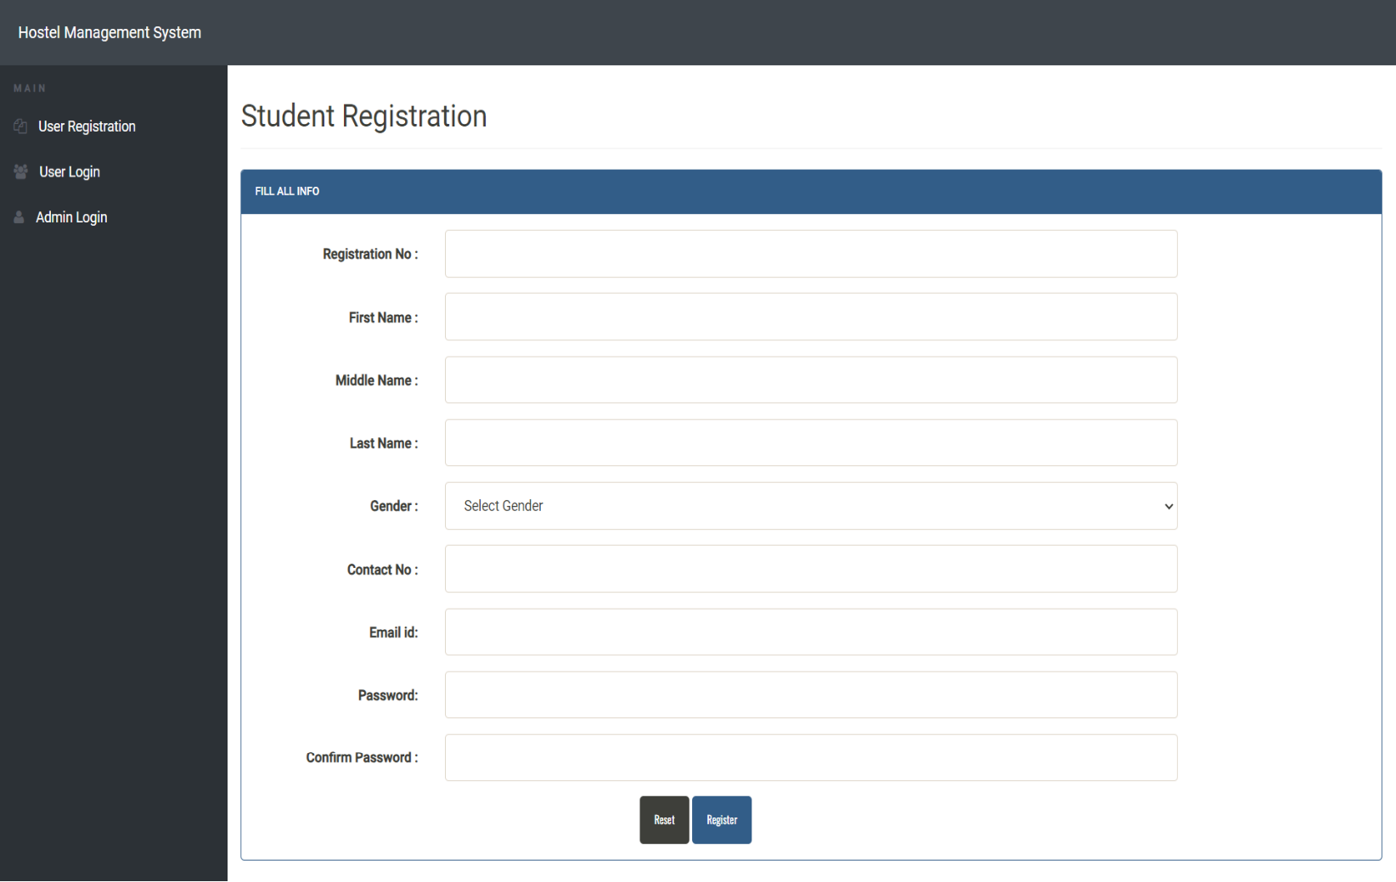
OUTPUT SCREENS
Notes:
Student Registration

Slide 19
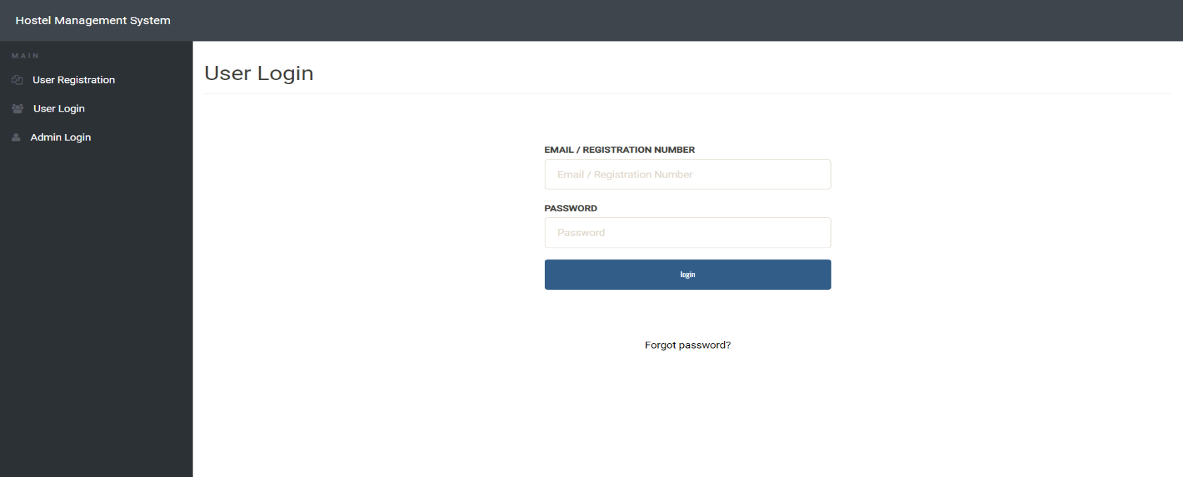
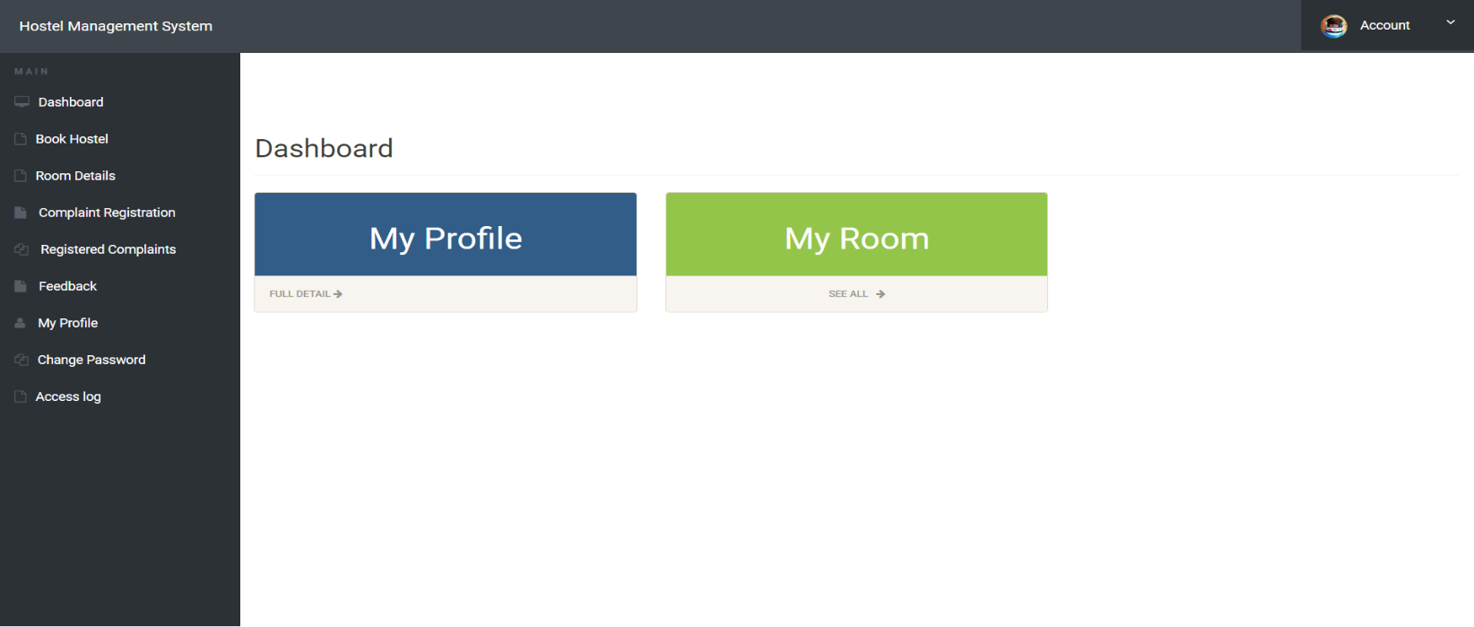

Slide 20
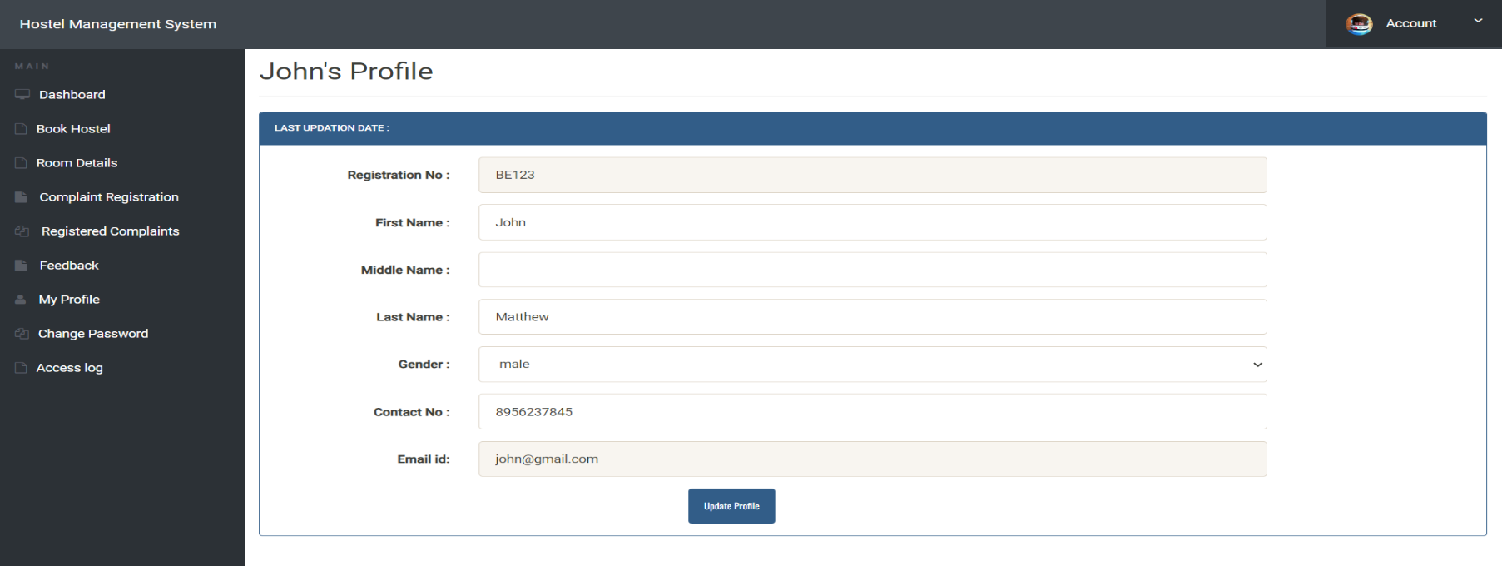
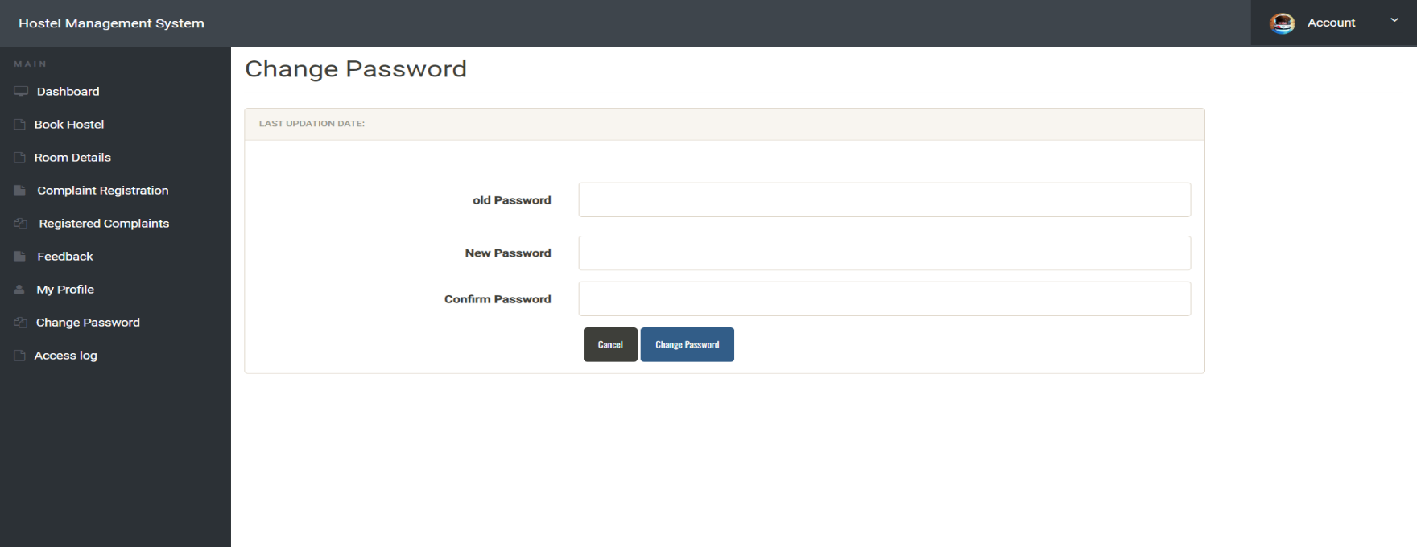

Slide 21
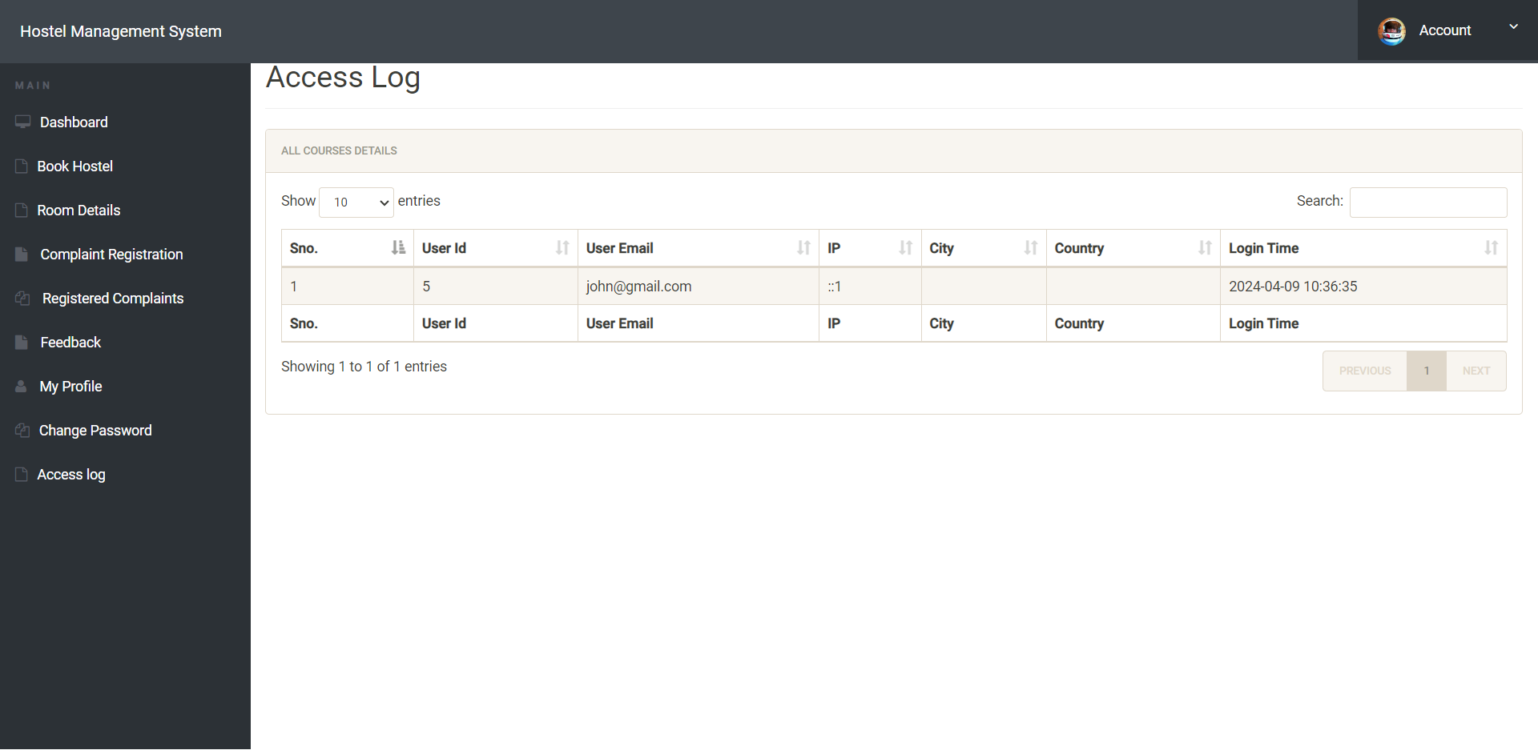

Slide 22
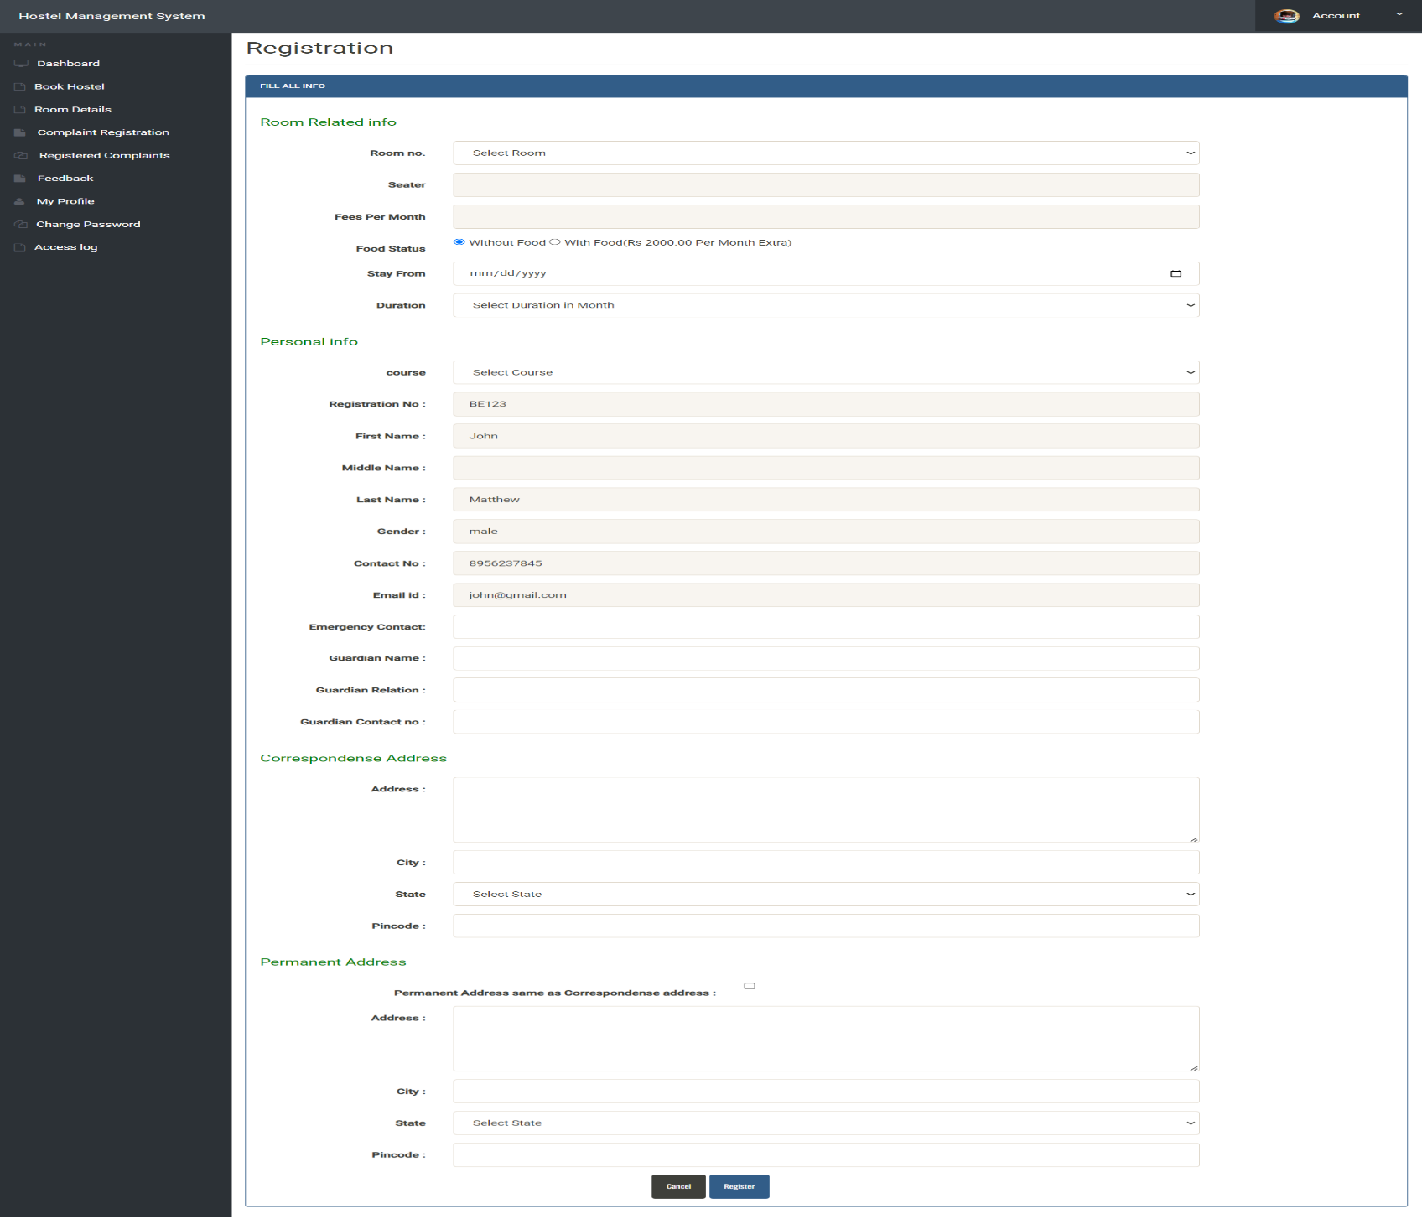

Slide 23
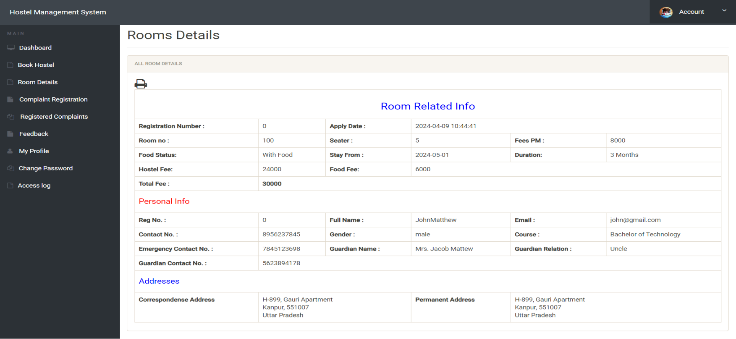
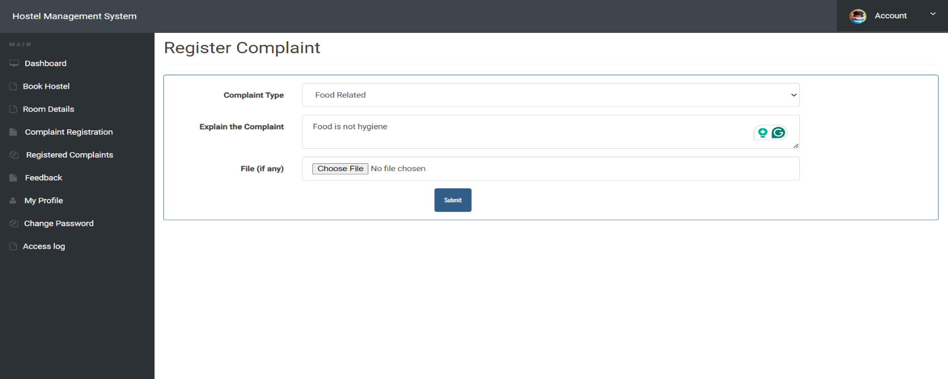

Slide 24

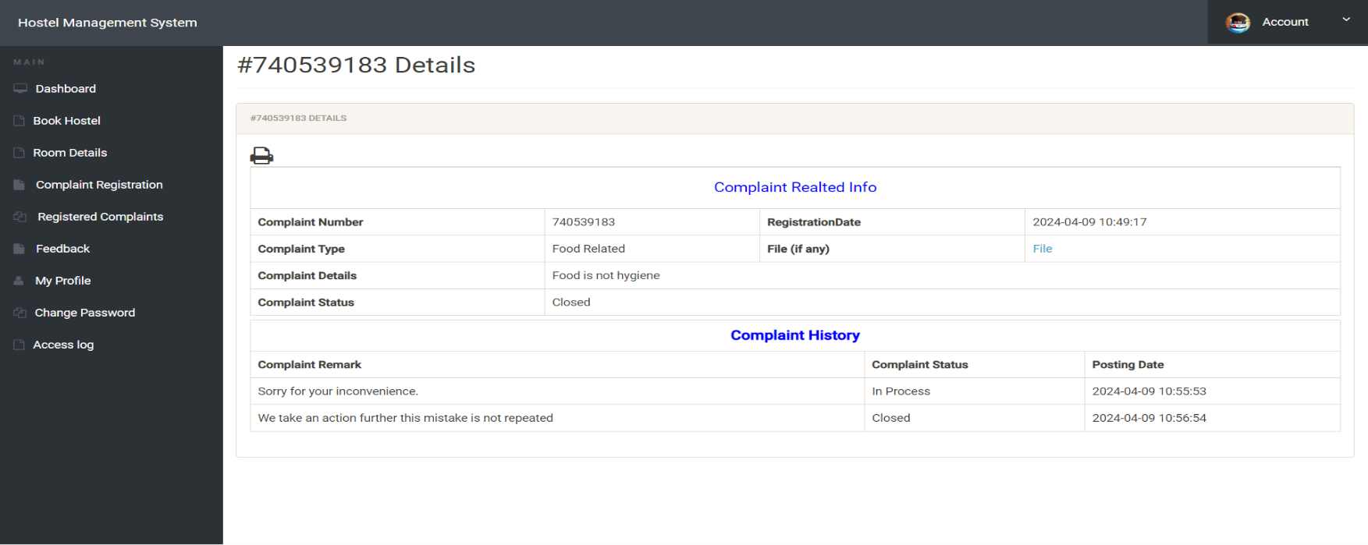

Slide 25
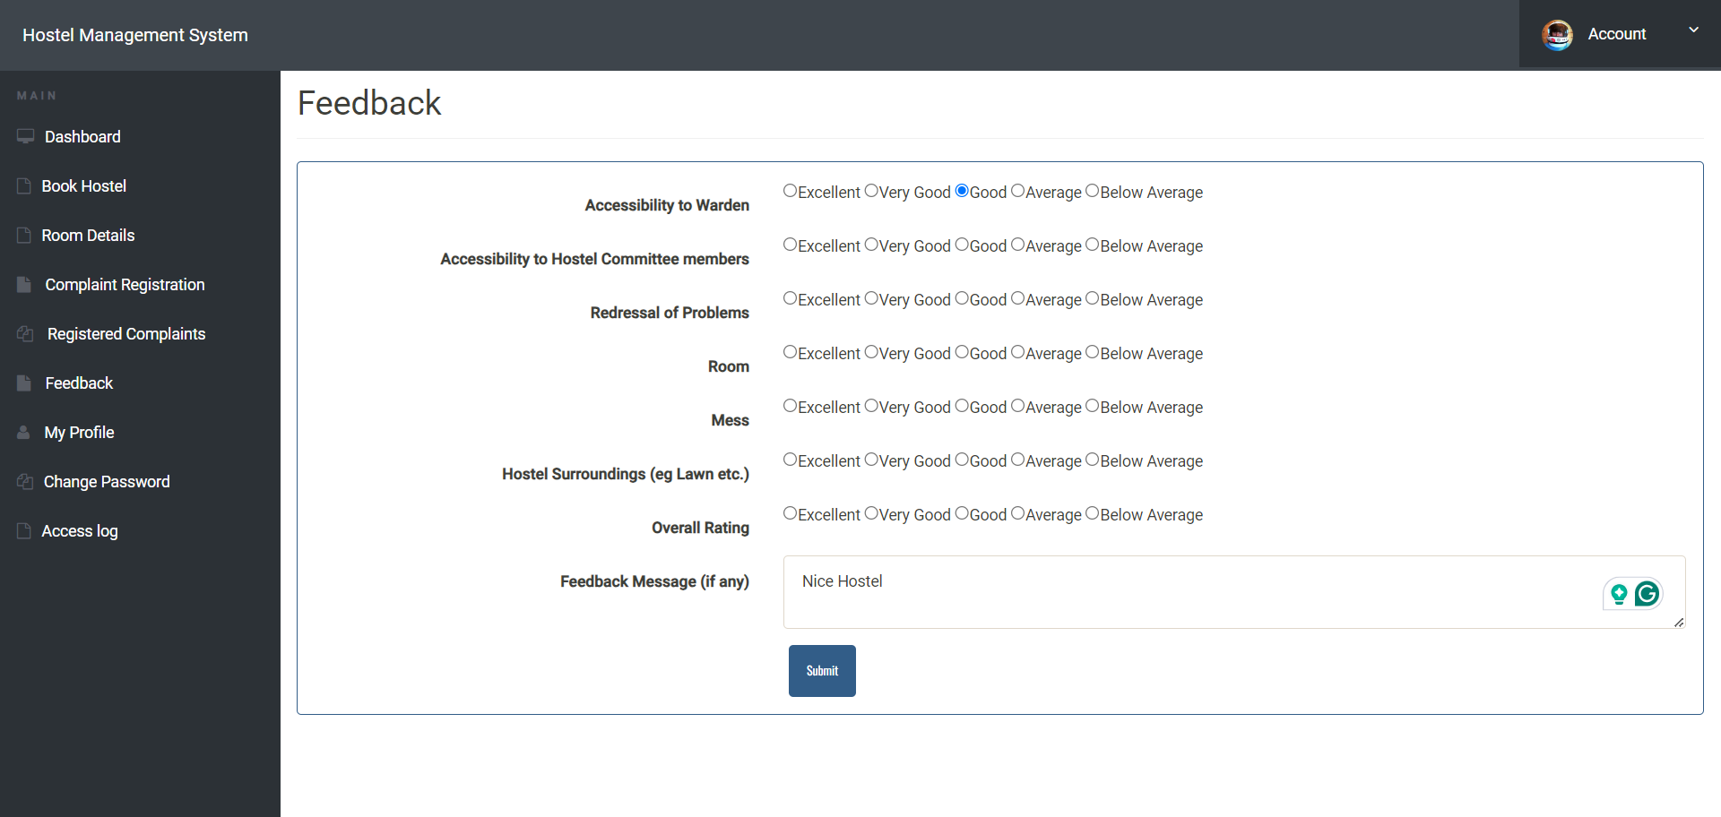
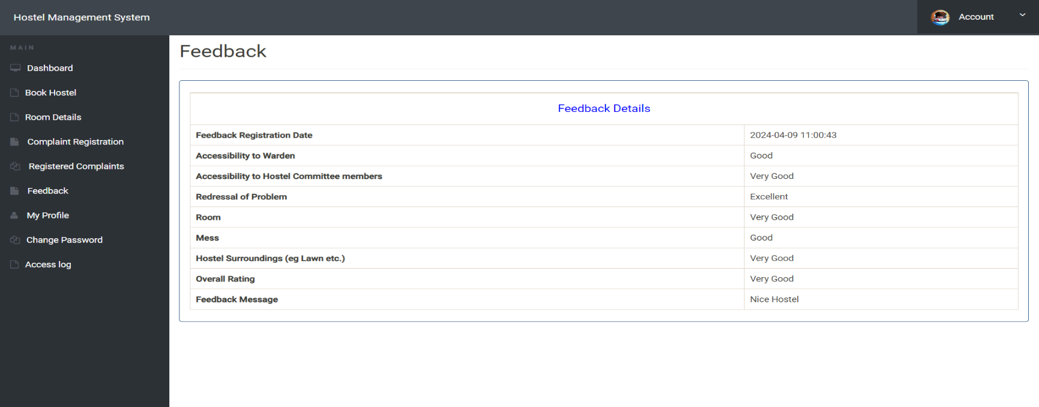

Slide 26



Slide 27
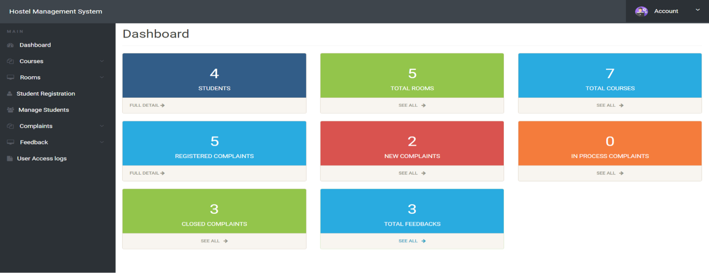
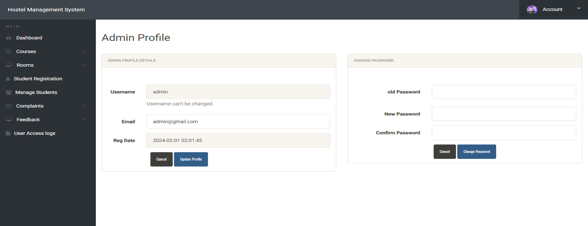

Slide 28
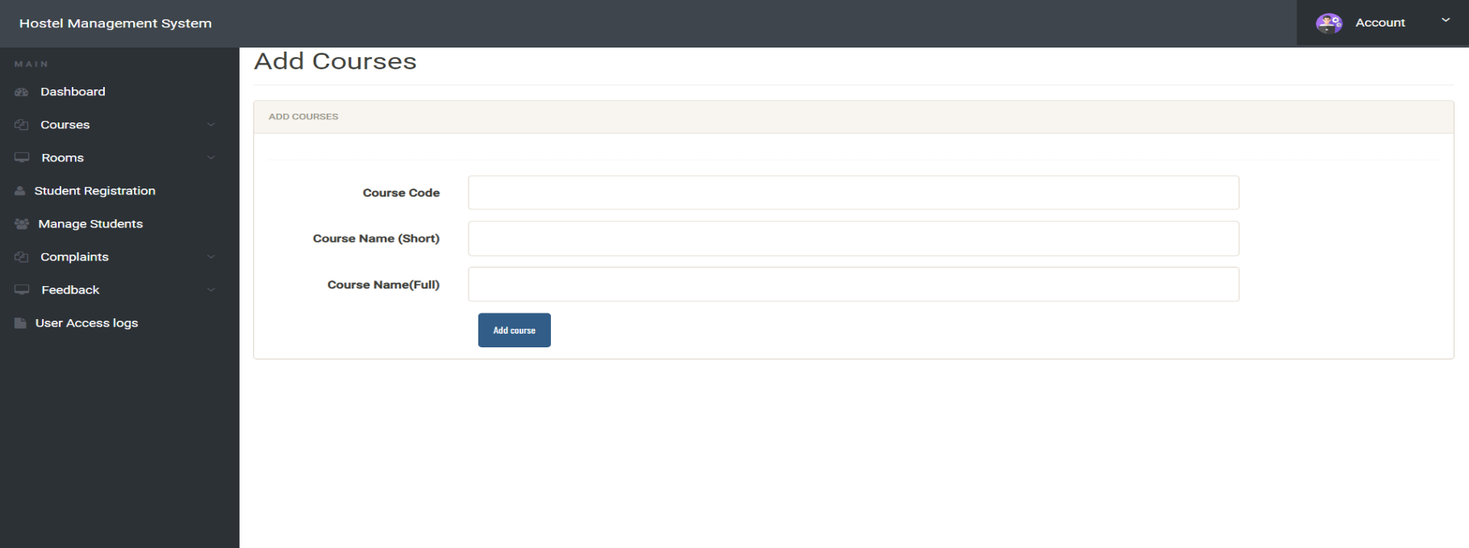
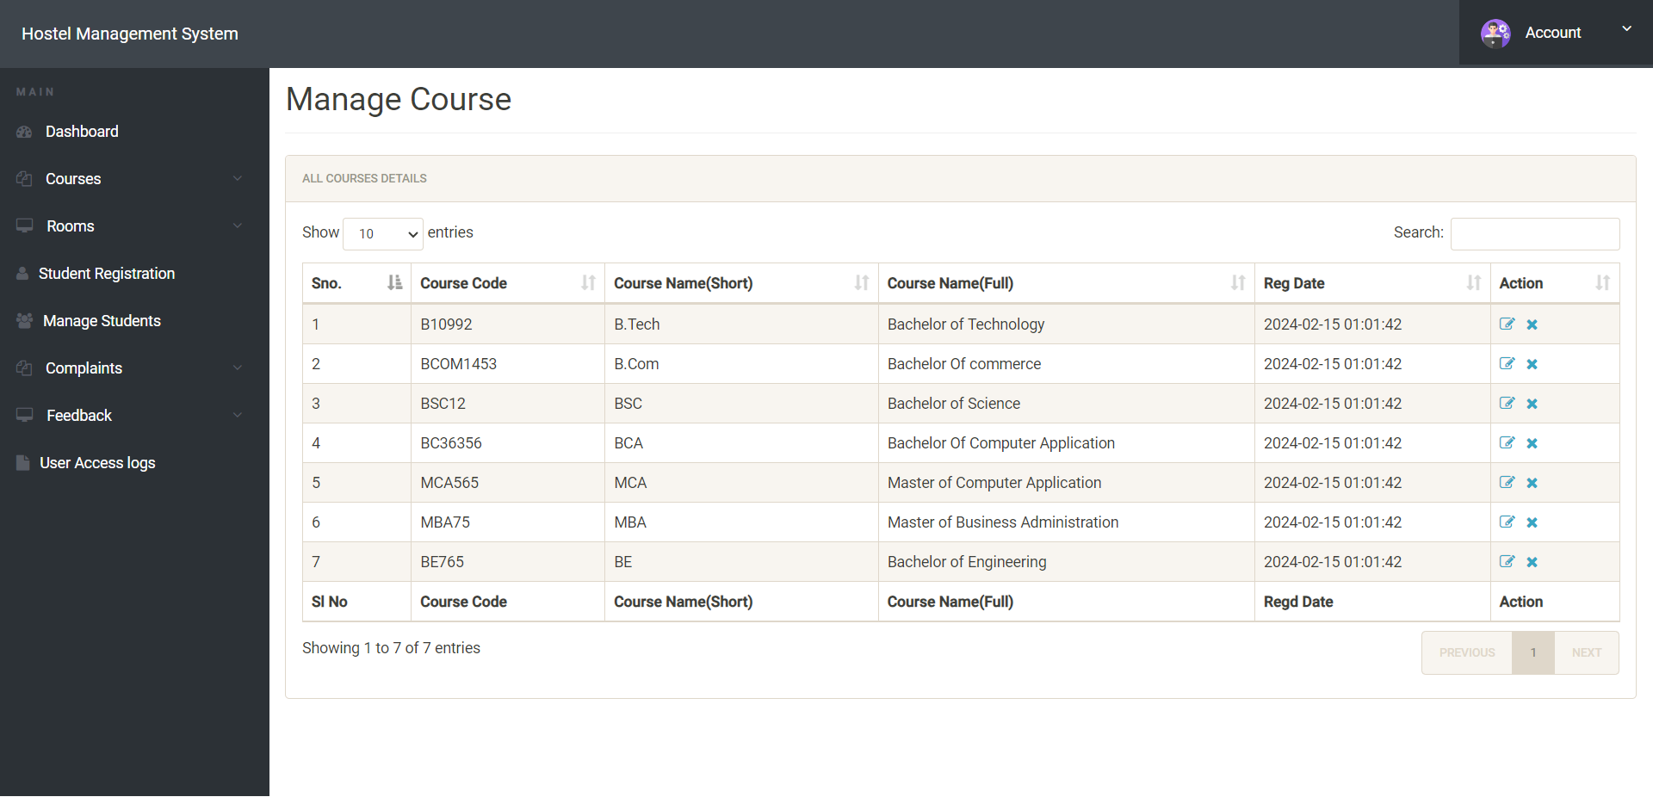

Slide 29



Slide 30
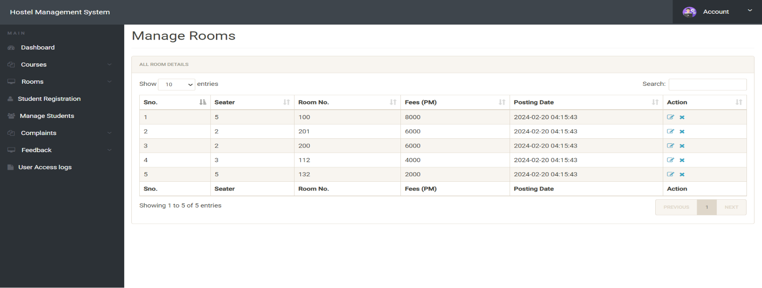


Slide 31
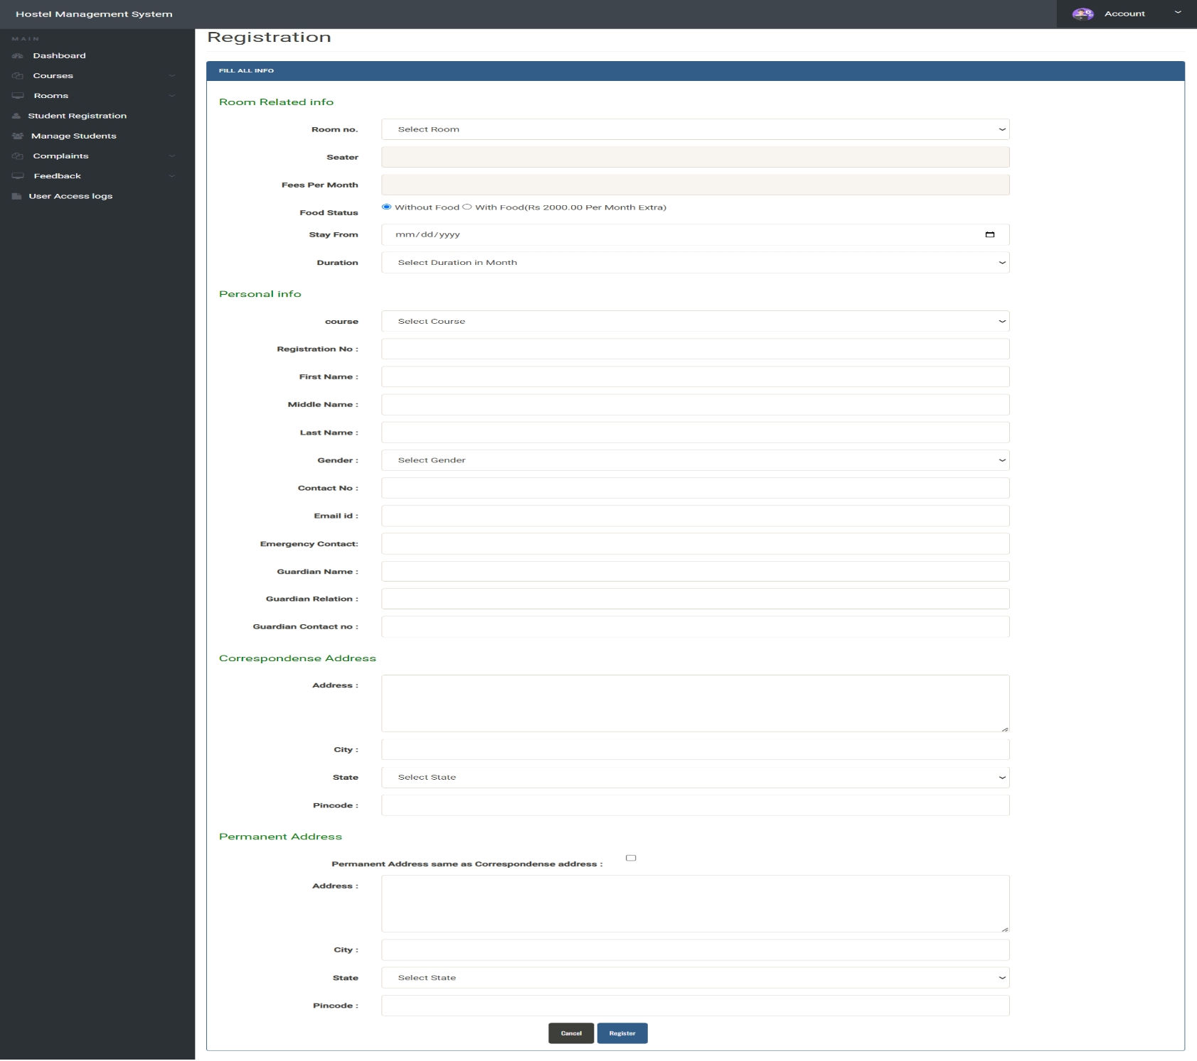

Slide 32
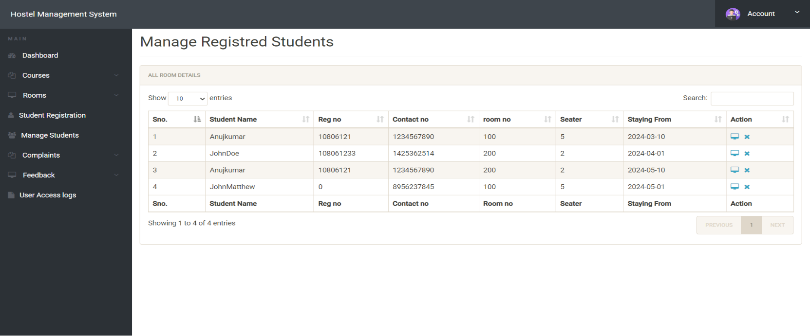

Slide 33
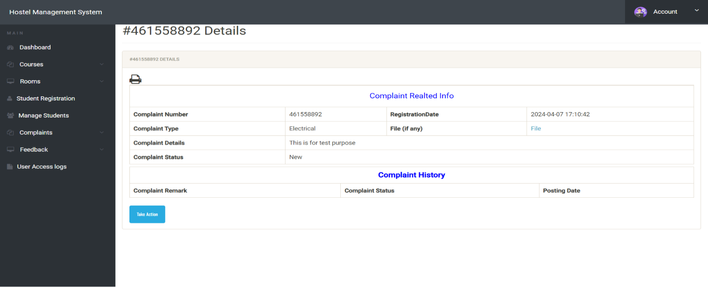
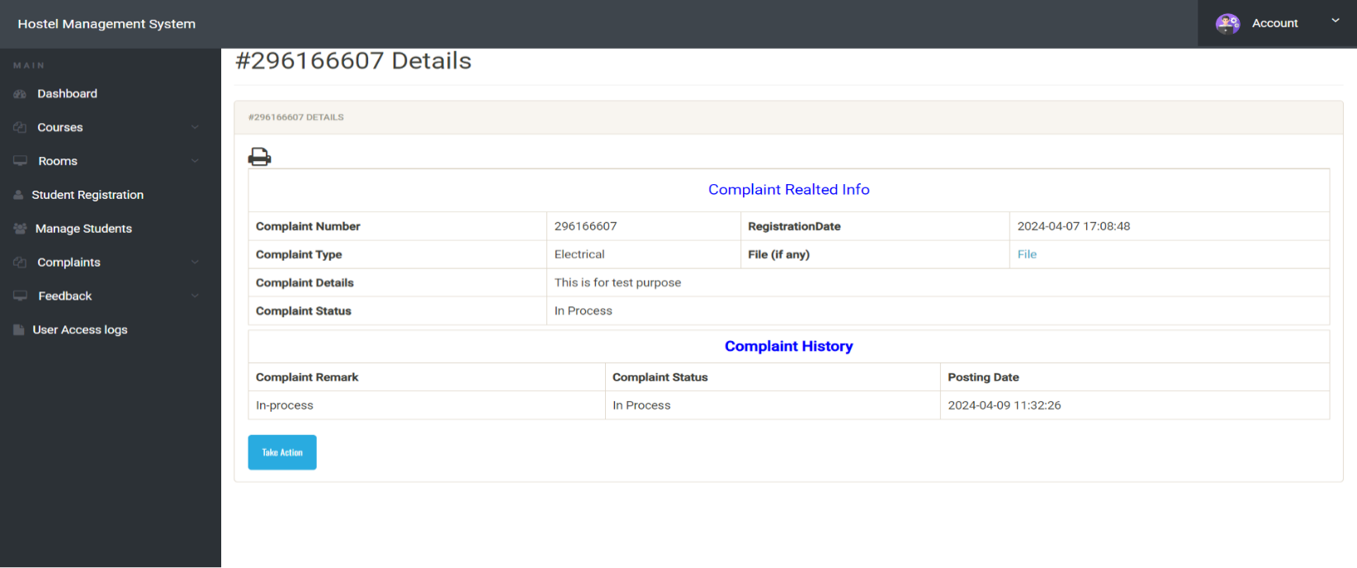

Slide 34
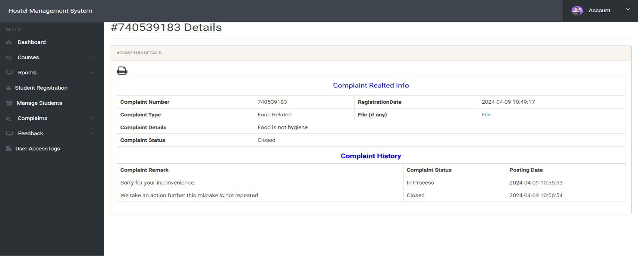
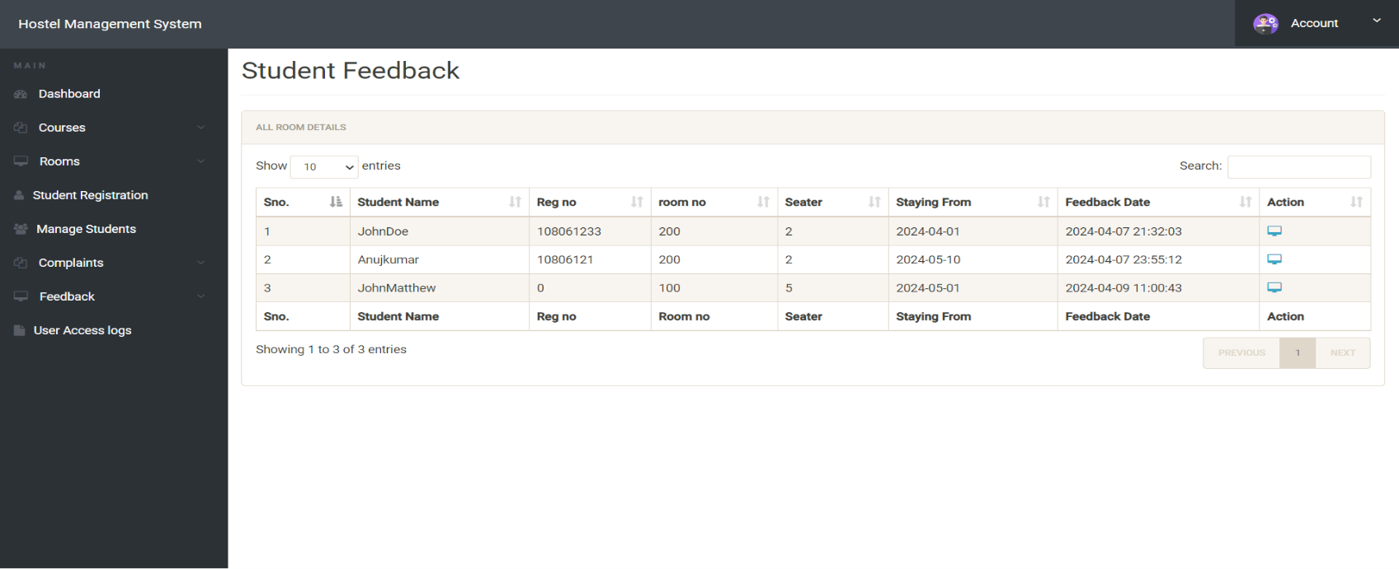

Slide 35
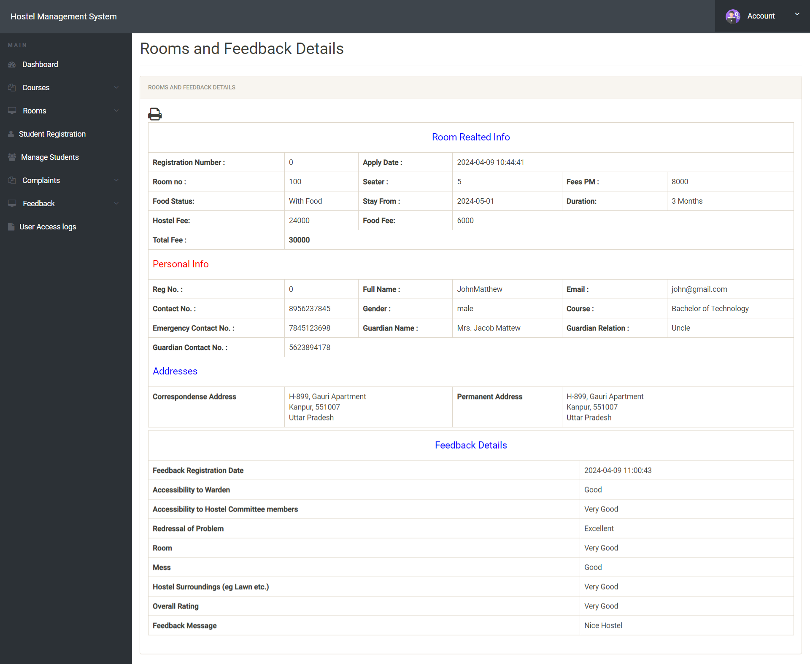

Slide 36
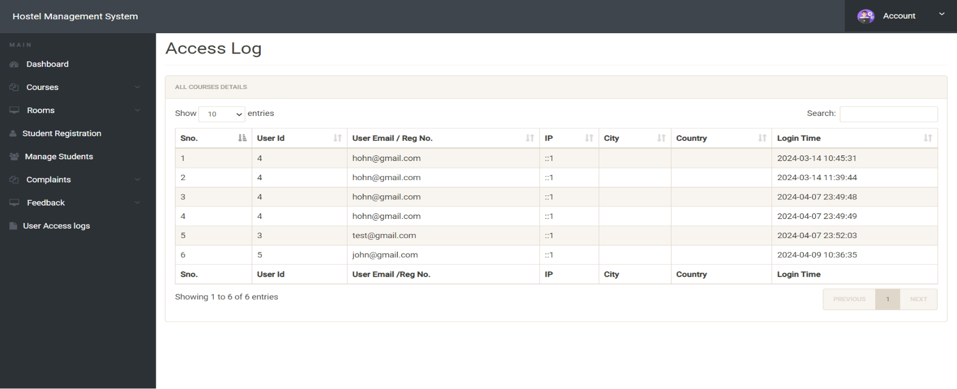

Slide 37
CONCLUSION
To conclude the description about the project : The project, developed using PHP and MySQL is based on the requirement specification of the user and the analysis of the existing system, with flexibility for future enhancement.
The expanded functionality of today’s software requires an appropriate approach towards software development. This hostel management software is designed for people who want to manage various activi-ties in the hostel. For the past few years the number of educational institutions are increasing rapidly.
Thereby the number of hostels are also increasing for the accommodation of the students studying in this institution. And hence there is a lot of strain on the person who are running the hostel and software’s are not usually used in this context. This particular project deals with the problems on managing a hostel and avoids the problems which occur when carried manually.
Identification of the drawbacks of the existing system leads to the designing of computerized system that will be compatible to the existing system with the system which is more user friendly and more GUI oriented.

Slide 38
BIBILIOGRAPHY
www.w3schools.com
in.php.net
en.wikipedia.org/wiki/PHP
www.hotscripts.com/category/php/
www.apache.org/
www.mysql.com/click.php?e=35050

Slide 39
Thank You

