Slide 1
How do annual members and casual riders use Cyclistic bikes differently?
File created by: Manana Mokgoera
on: 03/09/2025

Slide 2
Overview
This report analyzes the ride duration to identify the patterns of annual members and casual riders, and the data used was from the ride logs collected in the first month of 2023 and the first month of 2024.
The key findings:
Average ride length of casual riders is 61,94 minutes in 2023 and 95,78 in 2024, and of annual members is 13,89 minutes in 2023 and 12,68 minutes in 2024.
The annual membership usage decreased and the casual rider usage increased.
More casual riders are using the services than annual members.
The data suggests that the annual membership usage has decreased from 2023 to 2024, indicating that the casual riders are using the Cyclistic bike-share services more. The company should device a strategy to convert casual riders to annual members and to highlight the benefits of being a member.

Slide 3
Introduction
Cyclistic bike-share is a bike program that features more than 5,800 bicycles and 600 docking stations, it offers reclining bikes, hand tricycles and cargo bikes, making bike-share more inclusive to people with disabilities and riders who can’t use a standard two-wheeled bike. The majority of riders opt for traditional bikes; about 8% of riders use the assistive options. It’s users are more likely to ride for leisure, but about 30% use the bikes to commute to work each day.
There are single-ride passes and full-day passes, which are purchased by casual riders, and Cyclistic members who purchase the annual memberships. Annual members are much more profitable than casual riders, the company believes that maximizing the number of annual members would be the key to future growth.
The goal is to design marketing strategies to convert casual riders into annual members. To do this it’s better to understand how annual members and casual riders differ and what would make casual riders buy a membership.

Slide 4
Data description and methodology
The data has been made available by Motivate International Inc. as public data. We used time logs which has start stations and end stations, these time logs were stored in excel spread sheets. Since the data had shown negative durations, time formats were converted from 24 hours to decimal times, filtering blanks and proper labelling of the columns.
The time log data was stored on a spread sheet and converted to excel sheets in order to perform calculations. After cleaning and performing calculations, graphs the where constructed to be able to compare the different types of users.

Slide 5
Analysis and findings
Ride length distribution (times) and outliers
We calculated the minimum and maximum ride length for each year. The negative minimum ride length shows there might have been a time log error or the error occurred during the conversion of the data into excel sheets.
 | Minimum ride length | Maximum ride length
2023 | 1 | 177,200
2024 | -9 | 156,450

Slide 6
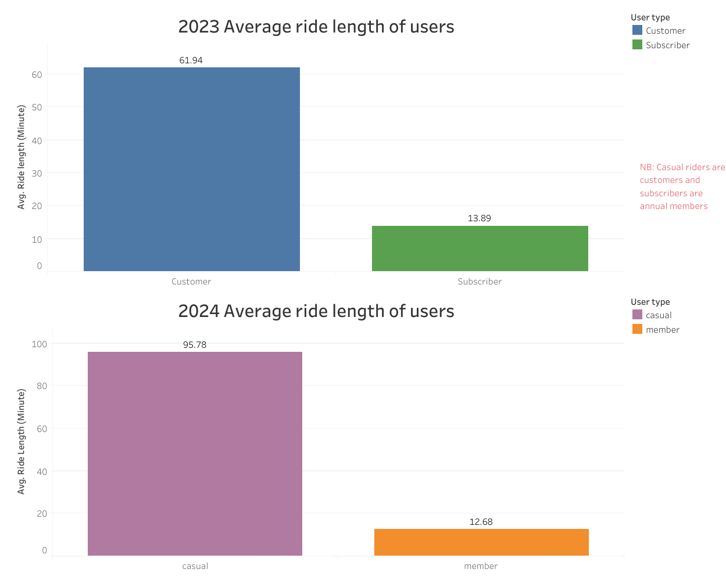
Charts
As the graphs of 2023 and 2024 shows that the casual riders have used the bike service more that the annual members, in fact they have increased from 61,94 to 95,78, that is a 33,84 rise.
There has been a slack from the annual members with a decline from 13,89 to 12,68.

Slide 7
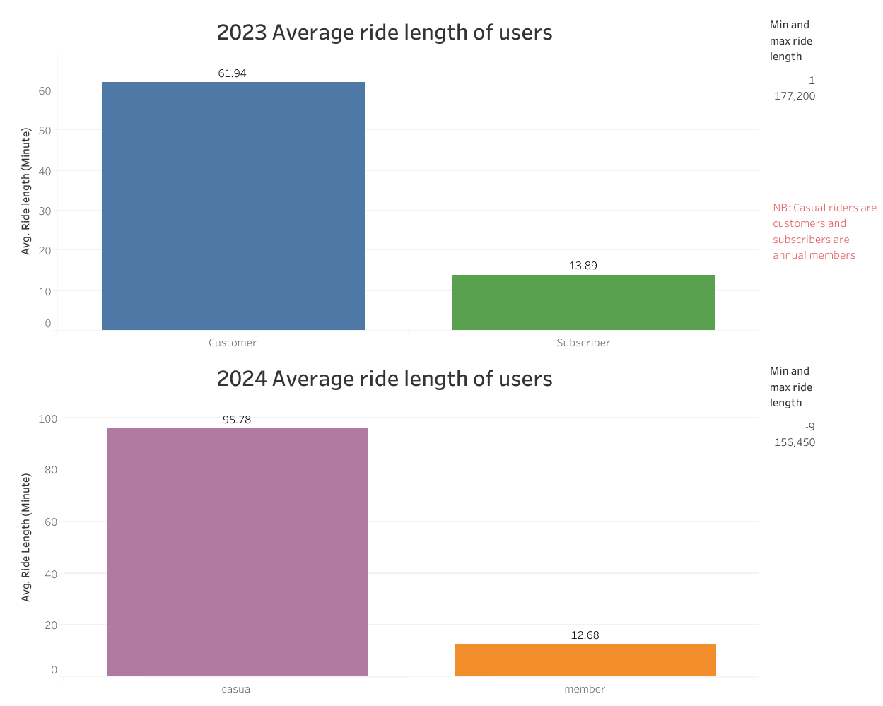

Slide 8
Recommendations
Since there was a significant drop the annual members’ usage, marketing campaigns should target the annual members to use the services more often and to entice the casual riders of the benefits of being an annual member. We can investigate further by looking if casual riders were riding for leisure or commuting to work during that time, and how to better services for them.
Time logging systems should also be improved by determining both the times and distances on each rider, to avoid time logging errors and eliminate any discrepancies in the data logged

Slide 9
Conclusion
In this case study, I used the Cyclistic bike-share company data to evaluate how casual riders and annual members use of the services differently; determine trends and theorize what was causing them. I was then able to device a corrective action plan based on those findings. The investigation has yielded proof that they do use them differently, and there is a huge drop in usage by the annual members.

