Slide 1


Reproducibility Study of On the Importance of Data Size in Probing Fine-tuned Models, [ACL 2022]
Rahul Sharma – G01329939 – rsharm8@gmu.edu
Nakul Padhya – G01288313 – npadhya@gmu.edu
Manankumar Thakkar - G01340764 - mthakkar@gmu.edu

Slide 2
Introduction
The paper addresses the problem that previous work on probing fine-tuned language models has often used relatively small amounts of training data, which may not be representative of real-world use cases. This can lead to incomplete or misleading conclusions about the performance of fine-tuned language models on probing tasks, and make it difficult to determine the optimal amount of training data needed for a given task or application
The main claim of the paper is that the performance of fine-tuned language models on probing tasks is highly dependent on the size of the training data used for fine-tuning, and that using larger amounts of training data can lead to better performance on these tasks. The paper highlights the importance of considering data size when evaluating the performance of fine-tuned language models and suggests that future work should focus on exploring the relationship between data size and model performance in more detail.

Slide 3
Reproducibility
Total four different datasets were used in this paper. We used a pre-trained model Bert and fine tune it on a GLUE benchmark for different number of epochs every time and saved the best checkpoint based on performance on the validation set.
We created multiple training sets of different sizes by subsampling from a larger corpus of text data. We ensured that the subsampled training sets are representative of the larger corpus in terms of genre, domain, and style.
In this paper we fine-tuned the BERT model on four datasets with different training data sizes For model training, we used Google Colab Pro, which has high-RAM and more compute power.
Various software libraries, including PyTorch and Hugging Face Transformers, were also used to implement the models. In terms of both time and people, reproducing the experiments required a collaborative effort from all members.

Slide 4
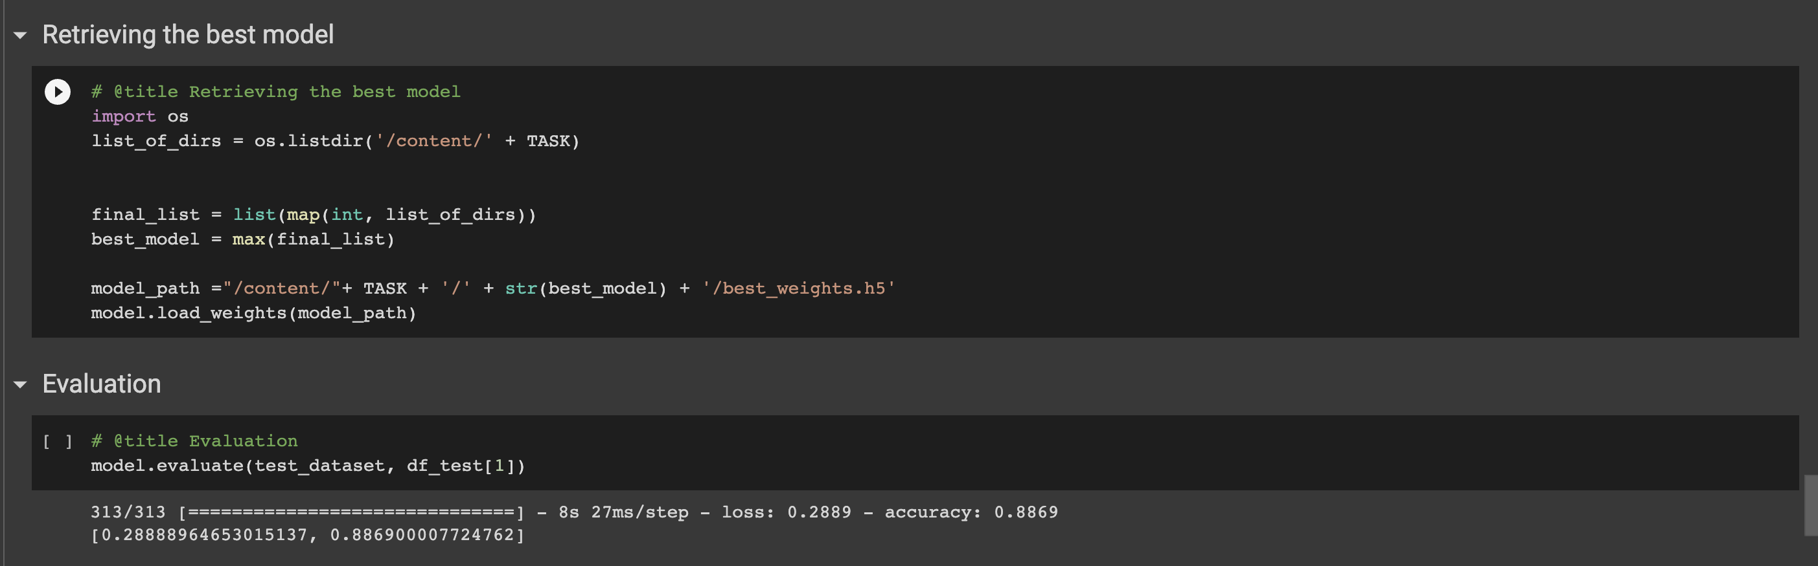
Reproducibility
The quality of the results presented (Mehrafarin et al., 2022) gets better as training data increases. Within this context, we have trained and evaluated a number of BERT-based models that have been fine-tuned on a variety of natural language processing tasks. In addition, it was discovered that larger models generally perform better than smaller ones and that different layers of the models encode different linguistic properties. Lower layers of the models encoded more syntactic features, while higher layers of the models encoded more semantic features.
Figure 1: BigramShift CoLA Full Model size

Slide 5
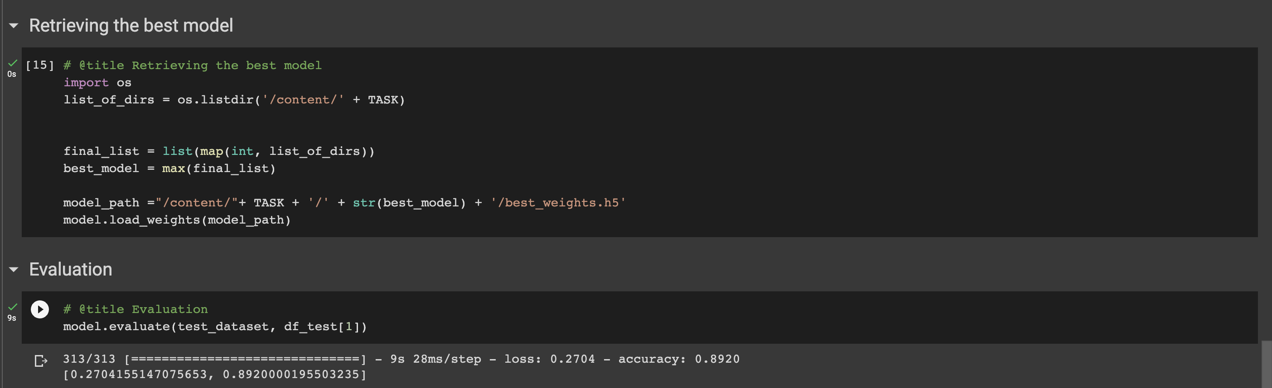
reproducibility
Figure 2: BigramShift CoLA 7k Model size
As can be seen in the figures above, when using Task CoLA and Probe BigramShift, we achieved different levels of accuracy for the Full and 7k Model sizes. The respective values were 88.69 and 89.20 per cent.

Slide 6
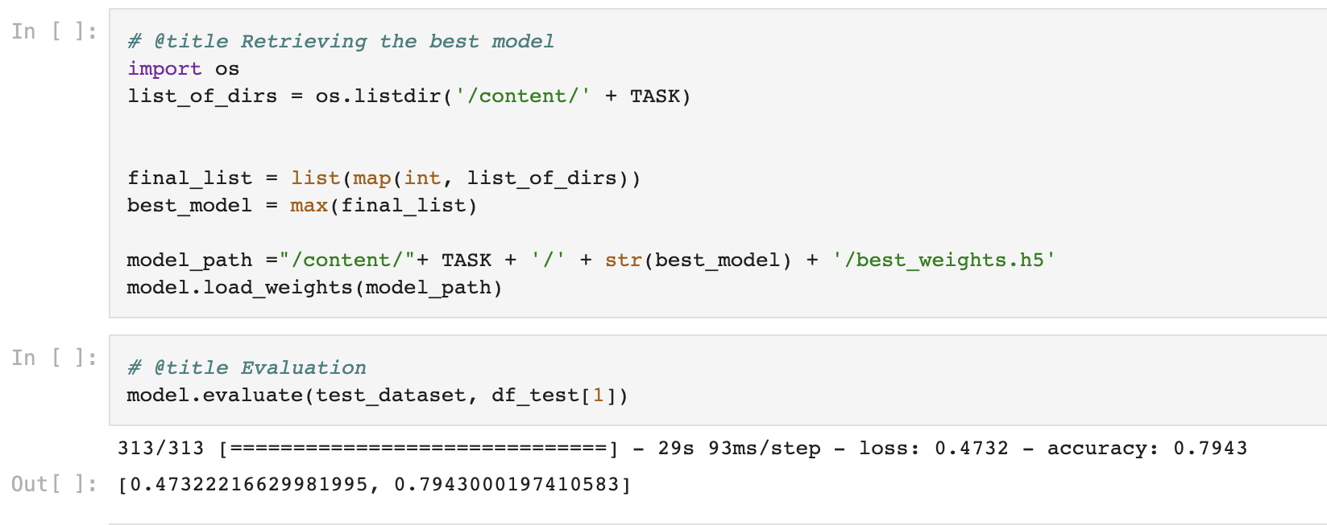
reproducibility
Figure 3: Mehrafarin et al., 2022

Slide 7
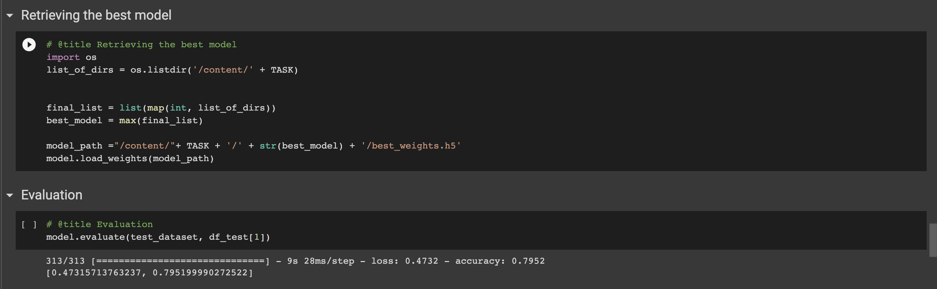
Reproducibility
Figure 4: Our Implementation
The results of the paper (Mehrafarin et al., 2022) were able to be reproduced by us, as can be seen in the figures to the right (Figures 3 and 4).

Slide 8
reproducibility
The original paper’s authors carried out an error analysis to investigate the factors contributing to the decrease in the model’s performance when applied in environments with limited resources. They performed an analysis of the performance of the fine-tuned models using a variety of subsets of the training data and discovered that the models struggle when there is a mismatch between the distributions of the training data and the test data.
They also analysed the errors produced by the models when they were applied to the CoLA dataset(Warstadt et al., 2018). They discovered that the majority of the errors were caused by the model’s inability to capture long-range dependencies and semantic relationships. For instance, the model incorrectly identified as grammatically correct a sentence with subject-verb agreement issues such as ”The cowboys or farmer is ready to leave”. In this sentence, the subject and the verb do not
agree.
One of the instances where we performed the additional error analysis was to investigate the effect of fine-tuning on different layers of the pretrained model. We ran the model on Layer 10. This helped us to identify which layers are more important for downstream tasks and whether fine-tuning all layers is necessary.

Slide 9
robustness
NLP models should be robust enough to handle a variety of data perturbations when being deployed in the real world. There are often errors and ambiguities in real-world data such as noise, misspellings, typos, and grammar mistakes. In spite of being trained on clean, curated data, these factors can significantly impact the performance of NLP models.
A deployed model must be tested on real-world data to ensure its robustness against data perturbations it may encounter. A technique like data augmentation can accomplish this by artificially introducing noise, misspellings, and other data perturbations into the training data.
Behavioral tests can also be used as part of a checklist, as is described in the paper "Beyond Accuracy: Behavioral Testing of NLP Models with CheckList.". A behavioral test evaluates a model's linguistic understanding, including its ability to deal with noise, misreadings, and grammatical errors.
The performance of a model can be improved by testing it on real-world data that includes noise, misspellings, and other kinds of data perturbations. Real-world data may not necessarily reflect a model's performance on clean and curated data. Robustness testing ensures that the model works effectively in real-world scenarios.

Slide 10
Multilinguality
Models need to be effective across a wide range of languages and domains to be effective in NLP. There may have only been a handful of languages tested with the model/paper you reproduced. The model's performance must be tested on other languages and domains, however, in order to make it more widely applicable.
We used BERT's multilingual cased model in order to achieve this. It is capable of understanding the subtleties of language across different language families because it has been trained on a large corpus of text in multiple languages.
We fine-tuned this model on data from other languages and domains, it can be adapted to different tasks and evaluated accordingly.
Adapting an NLP model to a different language or domain can be achieved by using a multilingual pretrained model such as the BERT-based multilingual cased model. For each scenario, the model's performance must be carefully tested and evaluated.

Slide 11
Future Scope
Adapt the model to different languages and domains by using multilingual pre-trained models, such as a BERT-based multilingual cased model.
Evaluate the performance of the model using datasets from a variety of languages and domains.
To ensure the effectiveness of the model, thoroughly test and evaluate each language and domain.
Identify other pre-trained models and techniques that can be used to improve the model's multilinguality and robustness.
Consider creating a domain-specific pre-trained model that can be fine-tuned based on the type of task that is being performed.
Enhance the performance of the model in specific languages and domains by collaborating with linguists and domain experts.
These steps will increase the multilinguality and robustness of the model as well as its applicability across multiple languages and domains.

