Slide 1
Distracted driver detection
Group 3: Vinay Kakkad AU1940012 | Bhavya Peshavaria AU1940204 Mananshi Vyas AU1 940289 | Nandini Bhatt AU1 940283

Slide 2
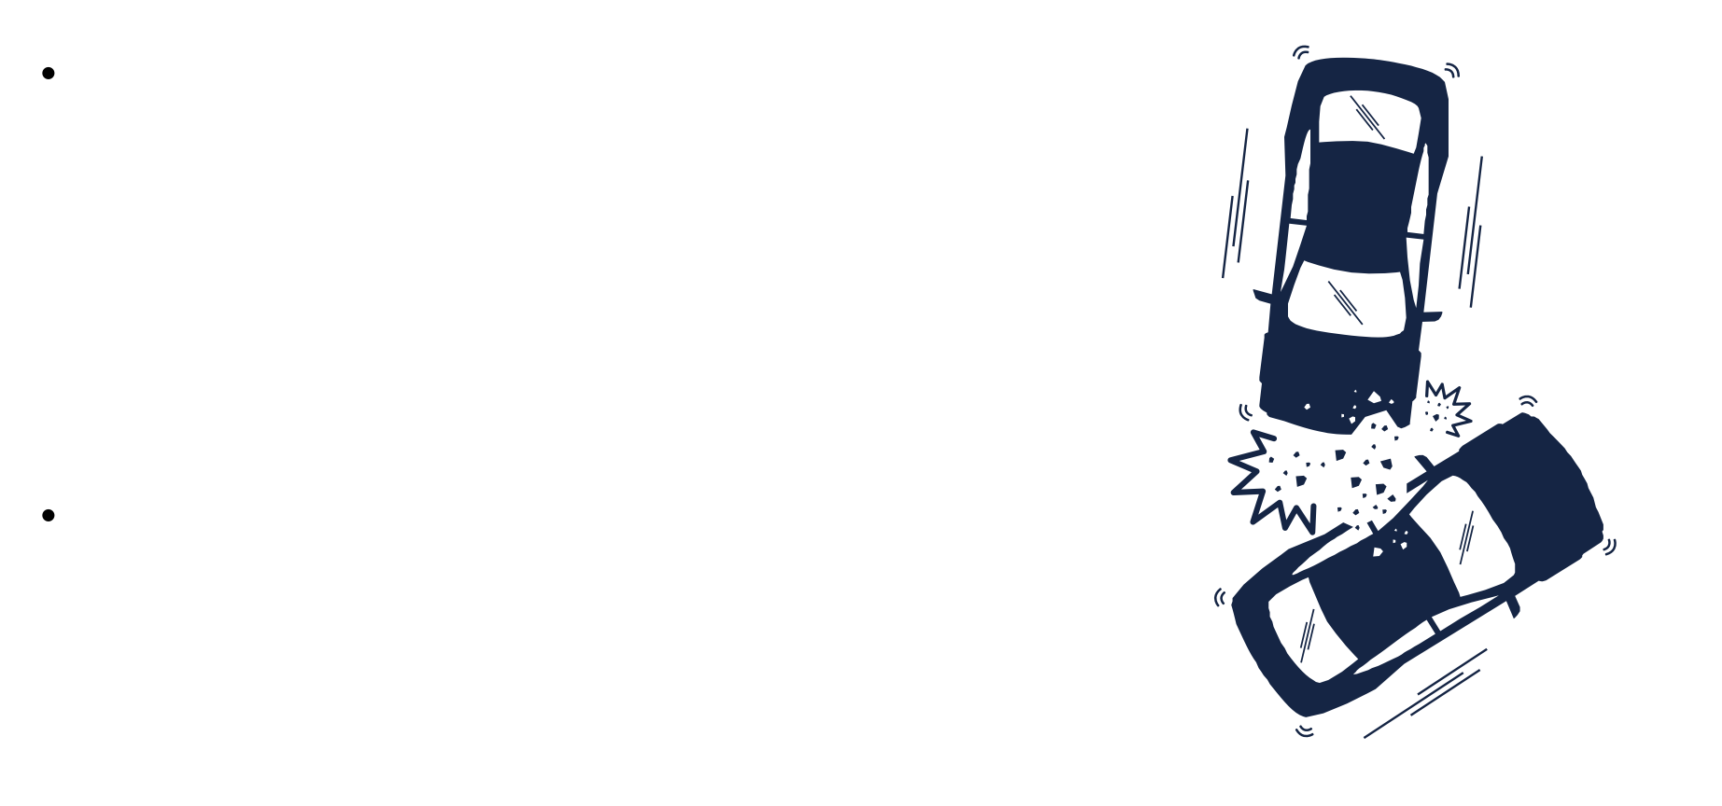
Introduction
With an alarming increase in the rate of traffic accidents
recently, studies are conducted to analyze the situation in depth. Various computer vision techniques were used to study the images of drivers showing that most of these accidents were due to driver distractions.
Through this project, our goal is to predict driver’s distractions through classification notify them in order to control incidents.

Slide 3
About the project
According to the CDC motor vehicle safety division, one in five car accidents is caused by a
driver who is texting, seemingly enraptured by social media, or in a lively hand-held conversation on their phone. Sadly, this translates to 425,000 people injured and 3,000 people killed by distracted driving every year.
We can improve these alarming statistics, by testing whether dashboard cameras can automatically detect drivers engaging in distracting behaviors. Given a dataset of 2D dashboard camera images, we classify each driver's behavior. Are they driving attentively, wearing their seatbelt, or taking a selfie with their friends in the backseat?
https://www.kaggle.com/competitions/state-farm-distracted-driver-detection

Slide 4

Literature Survey
K. He, X. Zhang [1]
residual framework to train deeper nets
evaluated 152 layers deep net on ImageNet
had 3.57% error on the ImageNet test set
Karen Simonyan [2]
used CNN for large scale image recognition
increase in classification with dropouts
Bhakti Baheti [3]
studies the VGG1 6 architectures
used regularization to improve performance (96.31% accuracy)

Slide 5
Our Approach
Dataset
StateFarm's dataset available on kaggle, providing images of 1 0 different classes of distraction
EDA
Plotted various visualisation to build the intuition about the dataset
Pre-Processing
converted the images to lower dimension for faster computation
Model Architecture
using transfer learning We have used ResNet50 pre-trained model
Predicting Results
Achieved an accuracy of 98% (overfitting)
Fine tuning
By changing the parameters of the model

Slide 6
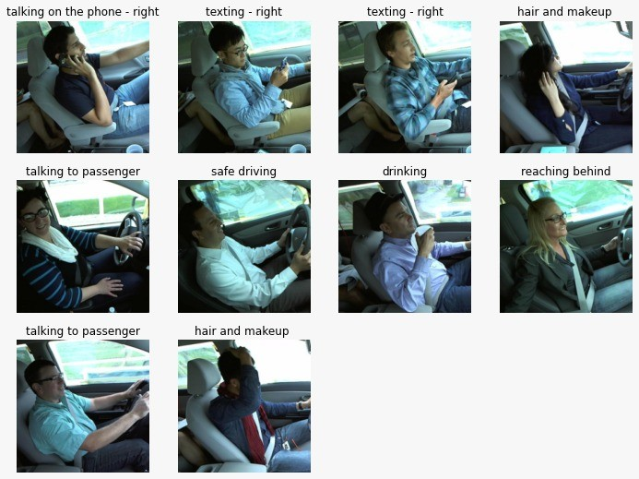

Types of Distraction

Slide 7
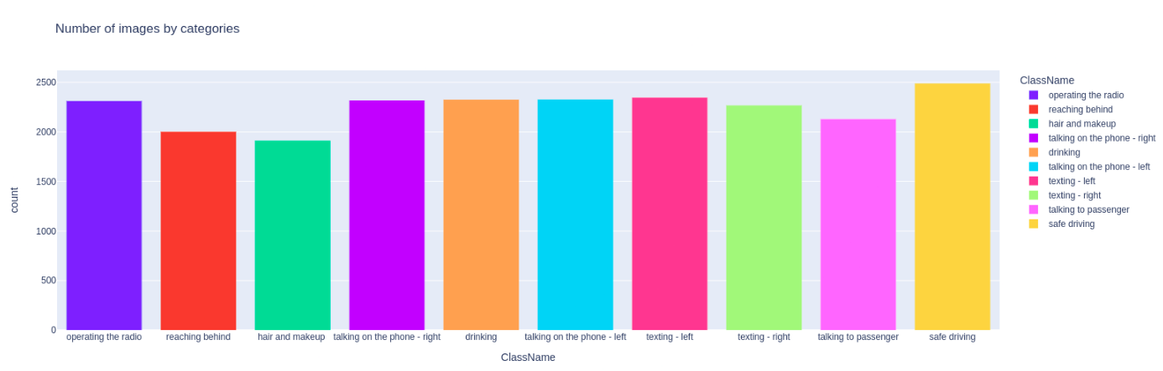
Exploratory Data Analysis
From this, we could infer that the dataset is balanced in terms of the type of distraction

Slide 8
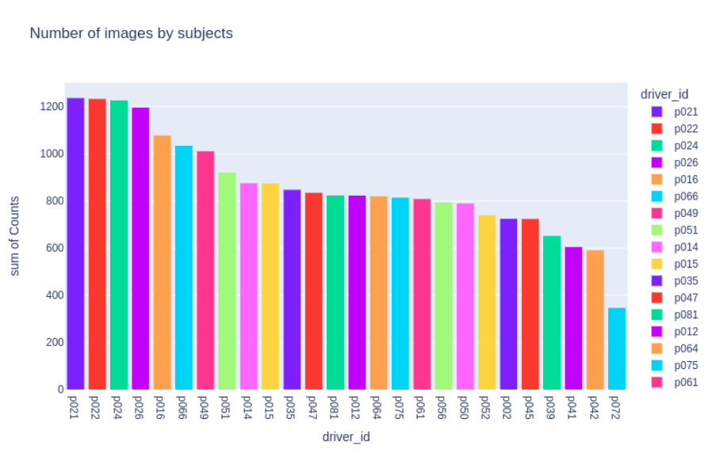
Explorative Data Analysis
From this, we could infer that there is some imbalance in terms of the driver (id)

Slide 9
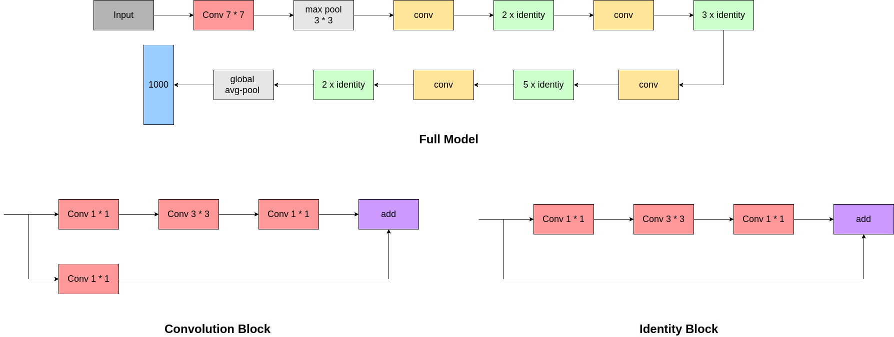
Architecture of the Model
using the resnet-50 convolution neural network
series of convolution and identity blocks followed by fully connected layers

Slide 10
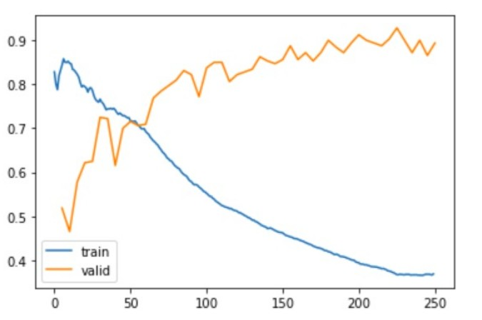
Results
implemented transfer
leaning by finetuning the last layer of resnet-50
size of input images - 200 pixels
number of epochs - 250
Plot of loss v/s epoch

Slide 11
Role of each group member
 | EDA | Data preprocessing | Literature Survey | ResNet | VGG
Bhavya | ✔ | ✔ |  | ✔
Mananshi |  | ✔ | ✔ | ✔
Nandini | ✔ |  | ✔ |  | ✔
Vinay |  | ✔ |  | ✔ | ✔

Slide 12

Future work
We will try to avoid overfitting by: using cross-validation performing data augmentation
using different implementations of transfer learning
We will explore deeper networks like VGG-1 6 to further improve accuracy
Based on the information we have about data, we will perform a transformation on input images that can better handle the complexity of the problem

Slide 13
References
K. He, X. Zhang, S. Ren, and J. Sun, “Deep residual learning for image recognition,” in Proceedings of the IEEE conference on computer vision and pattern recognition, 2016, pp. 770–778.
K. Simonyan and A. Zisserman, “Very deep convolutional networks for large-scale image recognition,” arXiv preprint arXiv:1409.1556, 2014.
B. Baheti, S. Gajre, and S. Talbar, “Detection of distracted driver using convolutional neural network,” in 2018 IEEE/CVF Conference on Computer Vision and Pattern Recognition Workshops (CVPRW), 2018, pp. 1145–11 456.
“State farm distracted driver detection.” [Online]. Available:https: //www.kaggle.com/c/state-farm-distracted-driver-detection
P. Canuma, “Image classification: Tips and tricks,” Nov 2021. [Online]. Available: https://neptune.ai/blog/ image-classification-tips-and-tricks-from-13-kaggle-competitions

Slide 14
Thank you!

