Slide 1


World University Rankings Analysis
Usecase 3
(Project 2)

Slide 2

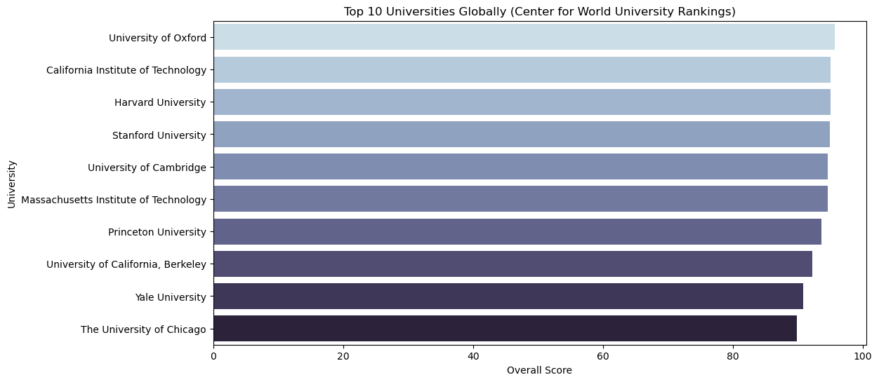
Center for World University Rankings 2022
Which universities are ranked in the top 10 globally?

Slide 3
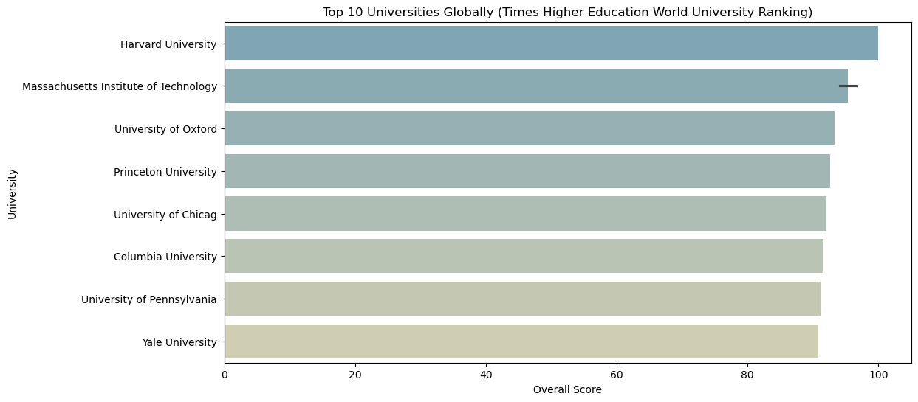
Times Higher Education World University Ranking 2022
Which universities are ranked in the top 10 globally?

Slide 4
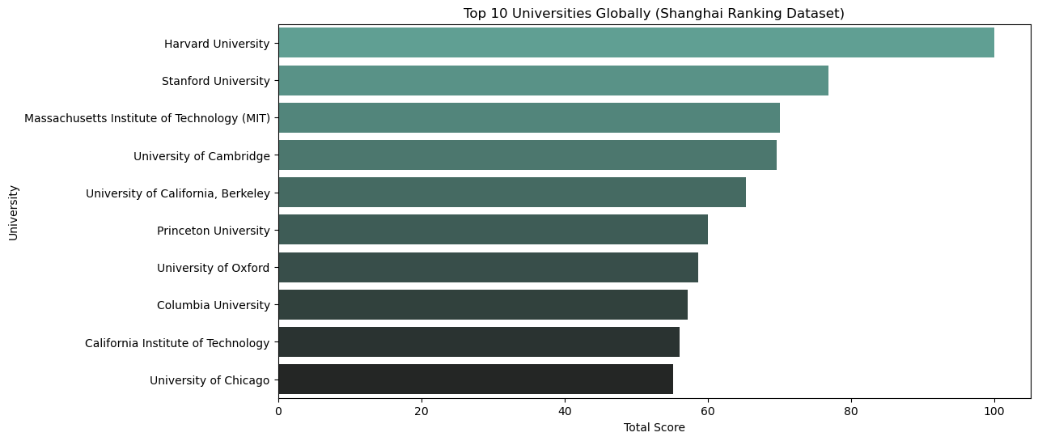
Shanghai Ranking Dataset 2022
Which universities are ranked in the top 10 globally?

Slide 5

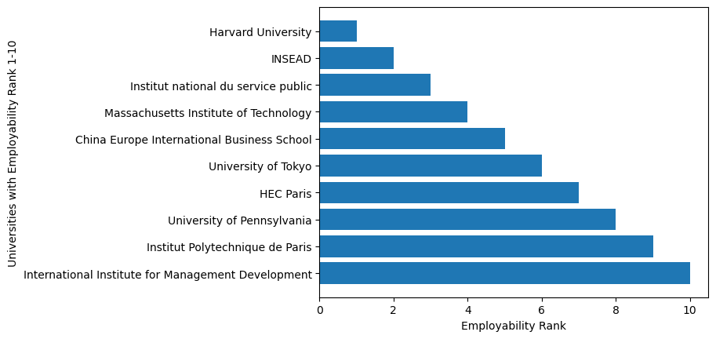
Center for World University Rankings 2022
Which universities are ranked in the top 10 for employment outcomes?

Slide 6


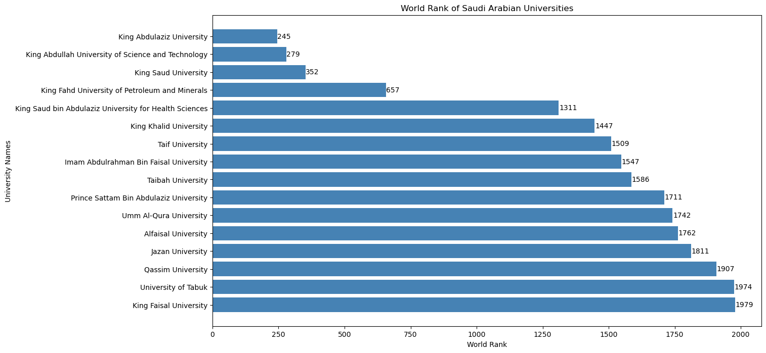
Center for World University Rankings 2022
What positions do universities in Saudi Arabia hold within the global rankings?

Slide 7
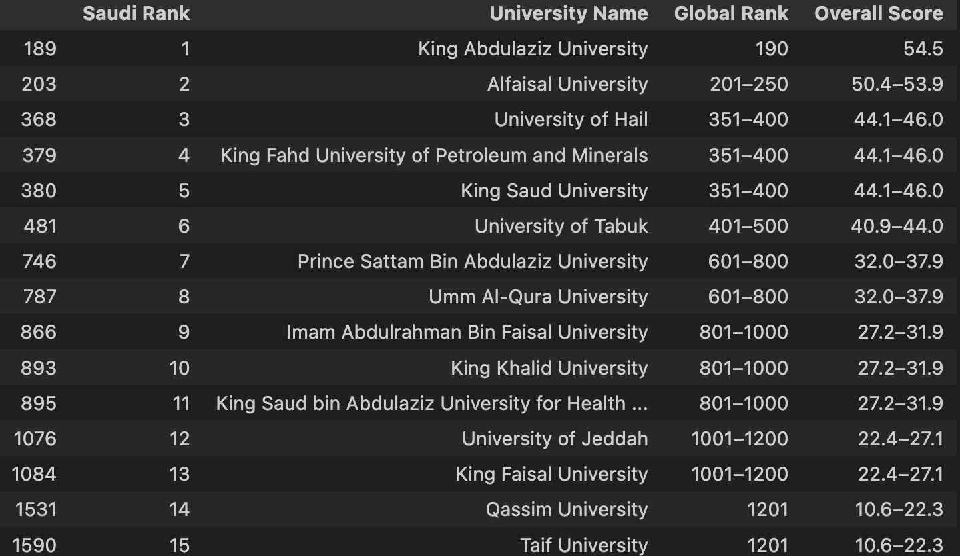
Times Higher Education World University Ranking 2022
What positions do universities in Saudi Arabia hold within the global rankings?

Slide 8

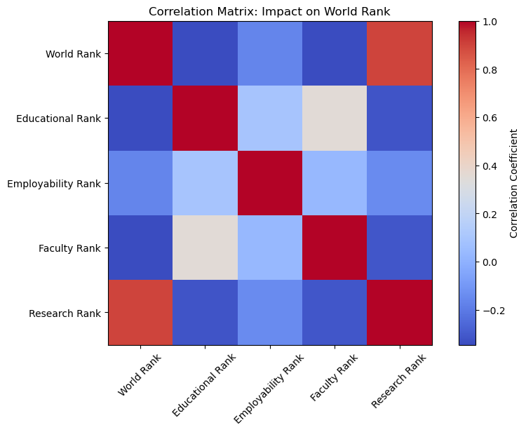
Center for World University Rankings 2022
Considering various factors such as employment rankings,
research rankings, and others, which has the most significant impact on a university's overall ranking?

Slide 9

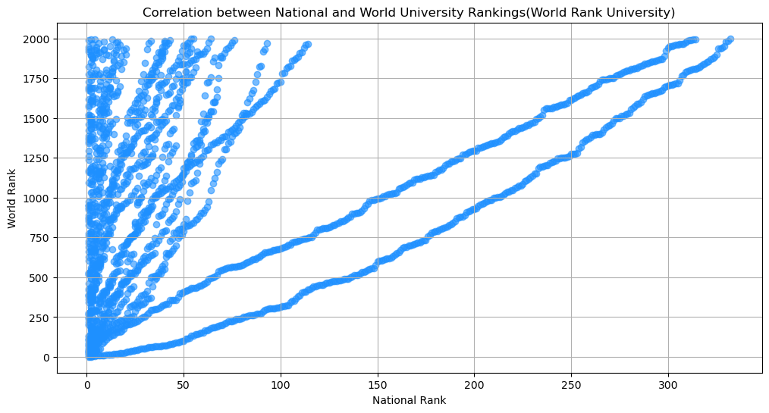
Center for World University Rankings 2022
Is there a correlation between national and global university rankings, and based on this information, can you recommend a country that appears to have a high concentration of top-ranked universities?

Slide 10
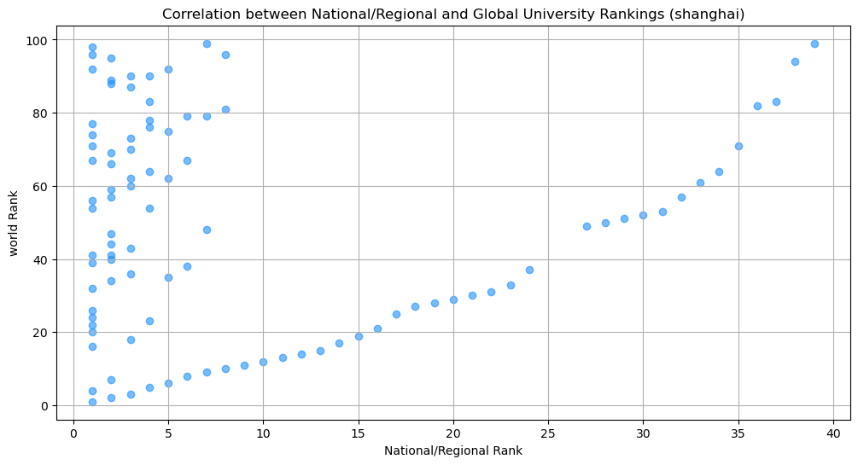
Shanghai Ranking Dataset 2022
Is there a correlation between national and global university rankings, and based on this information, can you recommend a country that appears to have a high concentration of top-ranked universities?

Slide 11
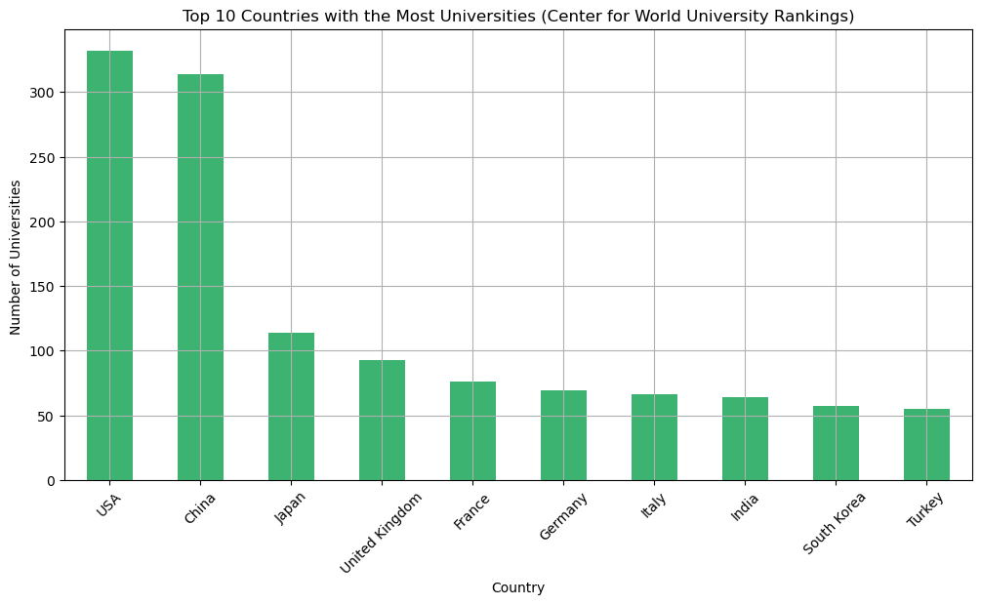
Center for World University Rankings 2022
Is there a correlation between national and global university rankings, and based on this information, can you recommend a country that appears to have a high concentration of top-ranked universities?

Slide 12
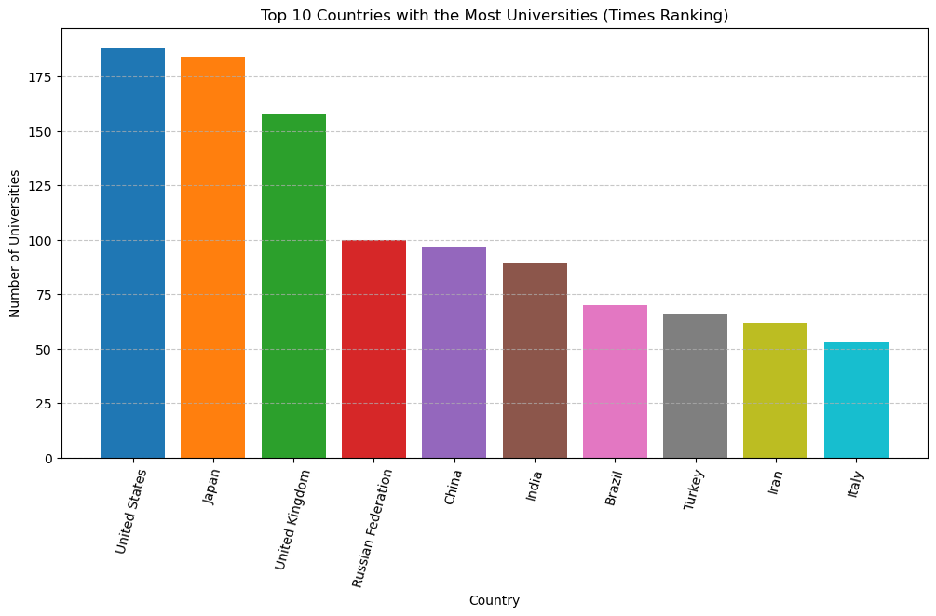
Times Higher Education World University Ranking 2022
Is there a correlation between national and global university rankings, and based on this information, can you recommend a country that appears to have a high concentration of top-ranked universities?

Slide 13
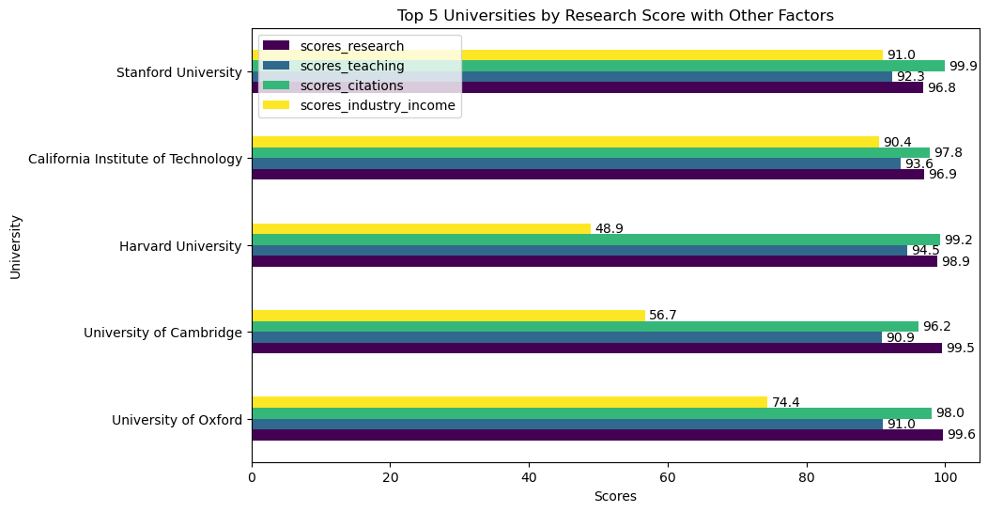
Times Higher Education World University Ranking 2022
Our extra insights :

Slide 14
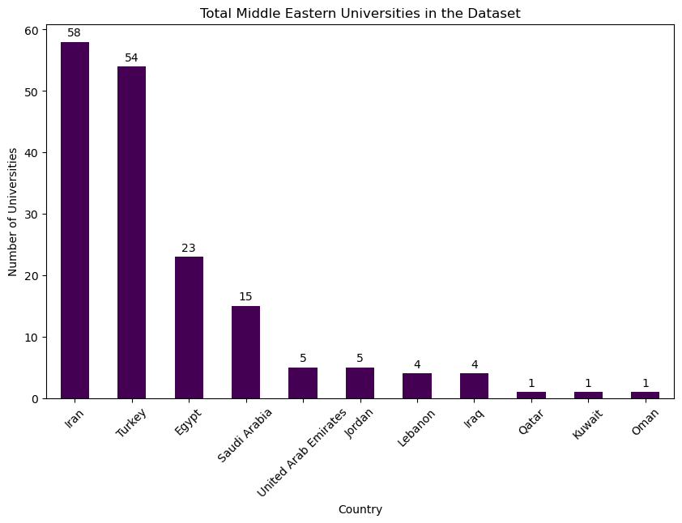
Times Higher Education World University Ranking 2022
Our extra insights :

Slide 15

Team Members
Thank You
Jumanah Alqurashi
Manar AlShaykh (Leader)
Meshal Alsanari
Zaid Alkhathlan

