Slide 1

Med Care

Slide 2
INTRODUCTION
No two disagree about the importance of the pharmacist’s role in our lives.
After completing the diagnosis and receiving treatment, the work of the pharmacist begins, whose duties lie in dispensing medicines to patients and clarifying all matters related to their use, in addition to the tasks he performs such as ordering medicines from companies according to the pharmacy’s consumption

Slide 3
TABLE Of CONTENTS
The reason for building MedCare pharmacy system
What is the meaning of a pharmacy software or system?​
Components of a pharmacy system​​
Advantages of the MedCare pharmacy system​

Slide 4
The reason for building MedCare pharmacy system:
Pharmacy management has recently become in need of an easy-to-use pharmacy software.
The other complications of management. A pharmacy program (Med Cara) allows you to order, track and dispose of the items that you deal in your pharmacy with the highest levels of safety, accuracy and efficiency
It is used to manage most pharmacy related activities in the pharmacy. The main aim of the project is the management of the database of the pharmacy

Slide 5
What is the meaning of a pharmacy software or system?
It is a program or system that is worked by the computer.
It consists of two parts, a front interface that appears in front of the user (the pharmacist), of which operations are carried out (inputs, queries, the implementation of operations and orders in the program), and a back interface is the databases in which all pharmacy data are stored, as well.

Slide 6

UI

Slide 7
Components of a pharmacy system:
1- Home
2- Deals​
3- Personnel​​
4- History

Slide 8
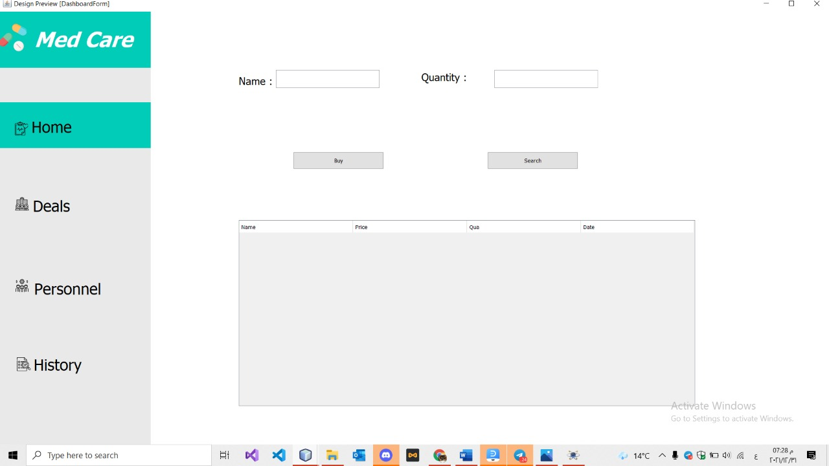
Home

Slide 9
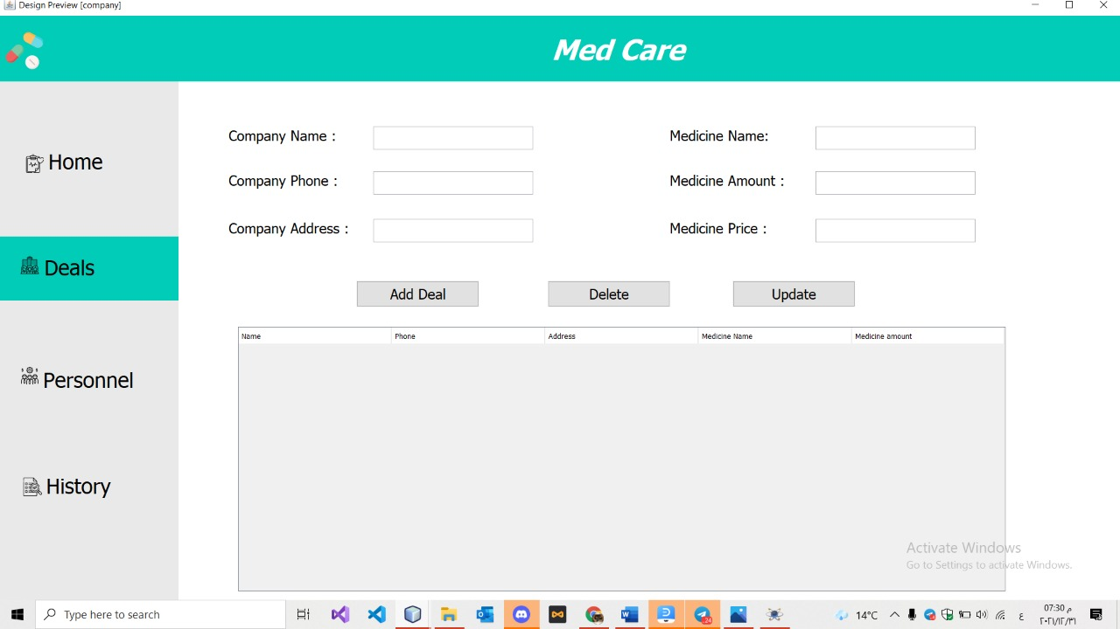
Deals

Slide 10
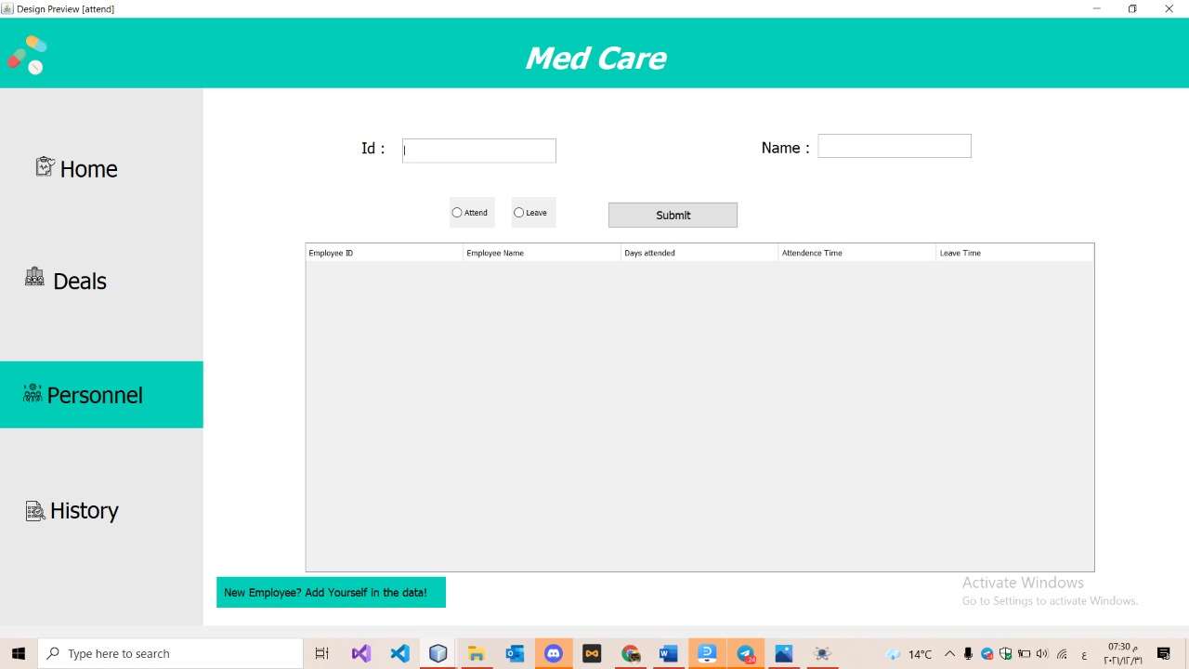
Personnel

Slide 11
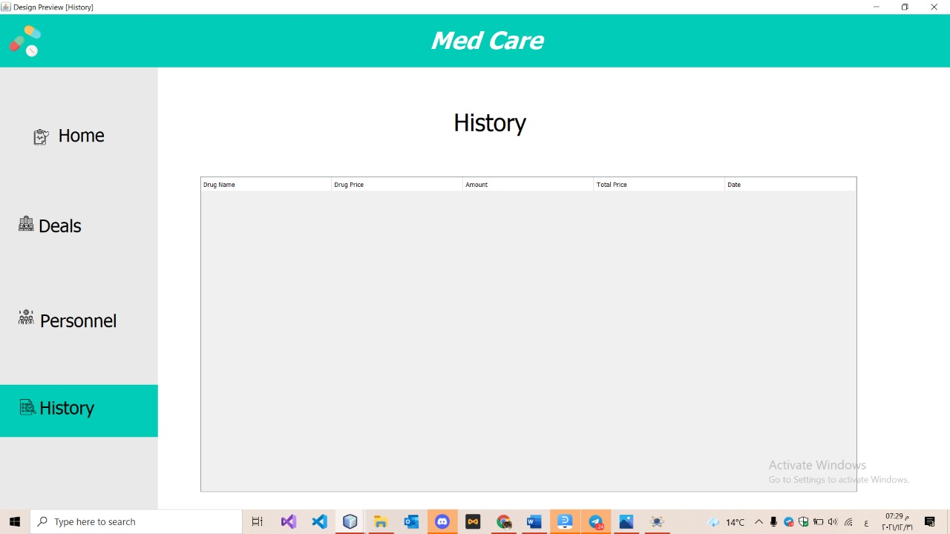
History

Slide 12
Advantages of the MedCare System
1- The software gives you the chance to add, delete, update the details of the medicines using the software gives you the chance to add, delete, update the details of the medicines using the medicine Name.
2- Quick response to user query/user inputs.
3- Ease of maintenance.

Slide 13
Team Member
Nirah Ahmed Ibrahim
Menna Mohammed Ibrahim
Manar Hamada Elsayed
Mona Mohammed Hamdy

Slide 14
THANKS
Do you have any questions?
medcare24@gmail.com
+20 157 199 787

