Slide 1
iTRAQ-based Proteomics Approaches

Slide 2
The Team Member
علياء محمد عبدالحليم
منار عبدالحافظ محمود
احمد يحيا حسين
منار ماهر فتح الله
محمد سالمان محمد
ندي محمود عيد عبدالناصر

Slide 3
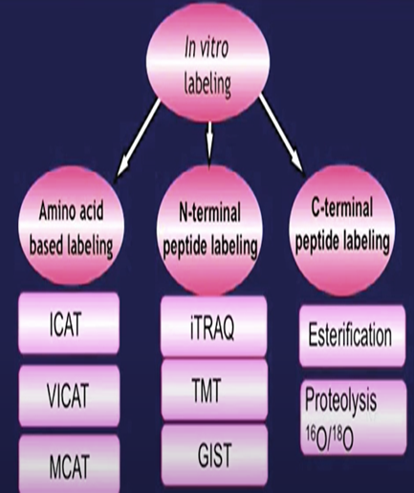
Introduction to iTRAQ
iTRAQ(isobaric Tagging for Relative and Absolute Quantification)
iTRAQ developed by applied Biosystems incorporation in 2004
iTRAQ was developed for both relative and absolute quantification using internal peptide standards.
iTRAQ belongs to labeled vitro
iTRAQ is a isobaric labeling method to determine the amount of proteins from different sources in just one single experiment by mass spectrometry. -

Slide 4
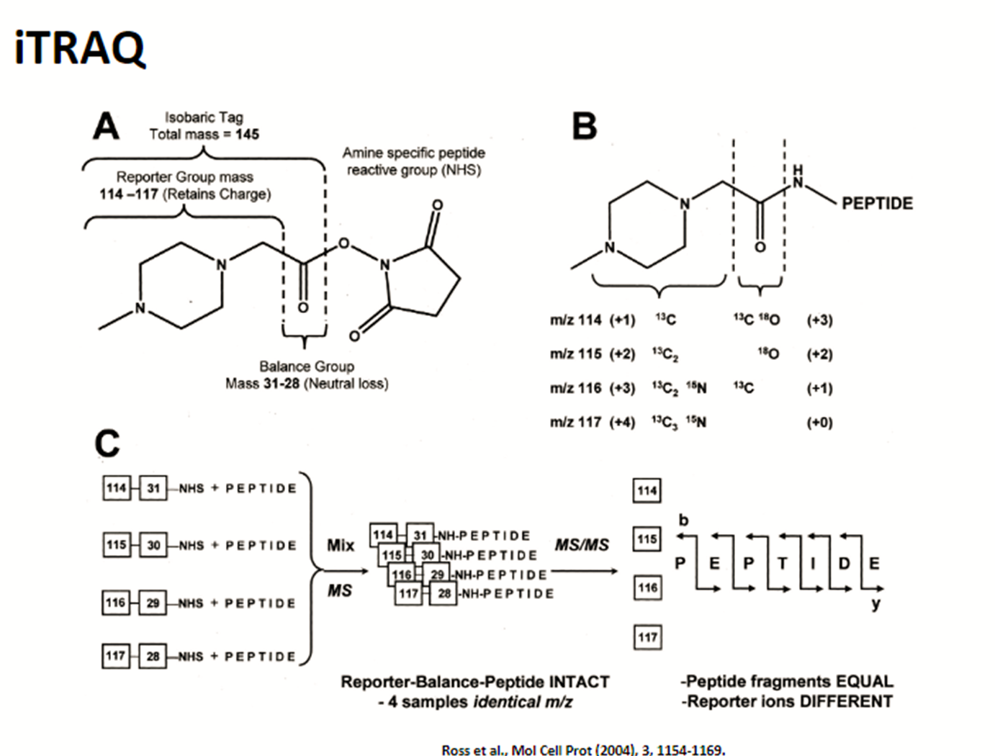
The structure of iTRAQ reagents:
The isobaric tagging reagents consist of a unique charged reporter group, a peptide reactive group ,and a neutral balance group.
the peptide reactive group covalently links an iTRAQ reagent isobaric tag with each lysine side chain and N-terminus group of a peptide, labeling all peptides in a given samples digest .
the neutral balance group ensures the iTRAQ labeled-peptide displays the same mass to maintain an overall mass of 145 Da for 4-plex and 305 Da for 8-plex.

Slide 5
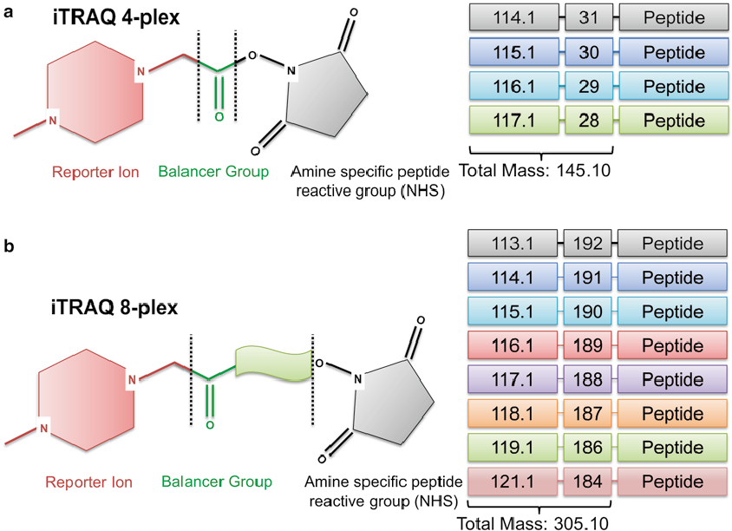
iTRAQ method
There are two types of iTRAQ reagents
4-plex-for processing up to 4 samples
8-plex-for processing up to 8samples

Slide 6
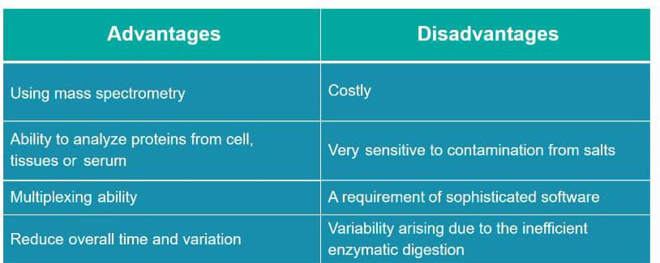
Advantages And Disadvantages

Slide 7
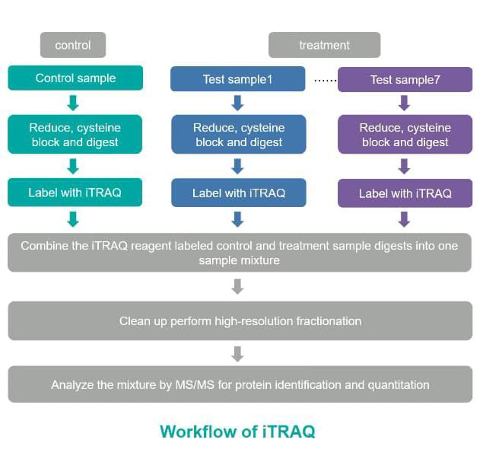
In the general workflow for a night rack experiment each sample is reduced system blocked and digested with trypsin each sample is labeled with a different detract tag in a single tube and then we can combine all at ROC reagent labeled samples mixture for liquid chromatography tandem mass spectrometry analysis

Slide 8
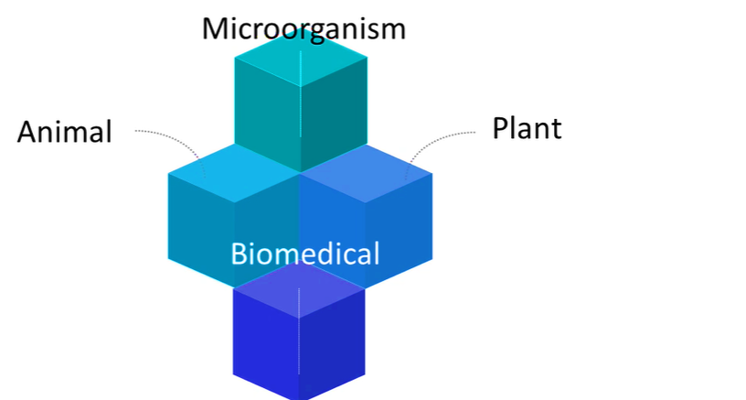
The application of iTRAQ

Slide 9
ITRAQ at creative proteomics
iTRAQ-based proteomics analysis service
TMT-based proteomics analysis service
SILAC-based proteomics analysis service
Absolute quantification (AQUA)service
Label-free quantification service
Semi-quantitative proteomics analysis service

Slide 10
Resources:
https://youtu.be/Rz1YeMZmOc4
https://youtu.be/Rz1YeMZmOc4

Slide 11


