Slide 1


Computational Biology Techniques

Slide 2


Protein
Protein Serine/threonine-protein kinase YPK1

Slide 3


Gene
YPK1

Slide 4
Organism
Organism Saccharomyces cerevisiae (strain ATCC 204508 / S288c) (Baker's yeast)

Slide 5

Link to Uniprot
YPK1 - Serine/threonine-protein kinase YPK1 - Saccharomyces cerevisiae (strain ATCC 204508 / S288c) (Baker's yeast) - YPK1 gene & protein (uniprot.org)

Slide 6
Link to Pride
Label-Free Quantification of Yeast Cellular Proteome (ebi.ac.uk)

Slide 7
FASTA Sequence
>sp|P12688|YPK1_YEAST Serine/threonine-protein kinase YPK1 OS=Saccharomyces cerevisiae (strain ATCC 204508 / S288c) OX=559292 GN=YPK1 PE=1 SV=2
MYSWKSKFKFGKSKEEKEAKHSGFFHSSKKEEQQNNQATAGEHDASITRSSLDRKGTINP
SNSSVVPVRVSYDASSSTSTVRDSNGGNSENTNSSQNLDETANIGSTGTPNDATSSSGMM
TIKVYNGDDFILPFPITSSEQILNKLLASGVPPPHKEISKEVDALIAQLSRVQIKNQGPA
DEDLISSESAAKFIPSTIMLPGSSTLNPLLYFTIEFDNTVATIEAEYGTIAKPGFNKIST
FDVTRKLPYLKIDVFARIPSILLPSKTWQQEMGLQDEKLQTIFDKINSNQDIHLDSFHLP
INLSFDSAASIRLYNHHWITLDNGLGKINISIDYKPSRNKPLSIDDFDLLKVIGKGSFGK
VMQVRKKDTQKVYALKAIRKSYIVSKSEVTHTLAERTVLARVDCPFIVPLKFSFQSPEKL
YFVLAFINGGELFYHLQKEGRFDLSRARFYTAELLCALDNLHKLDVVYRDLKPENILLDY
QGHIALCDFGLCKLNMKDDDKTDTFCGTPEYLAPELLLGLGYTKAVDWWTLGVLLYEMLT
GLPPYYDEDVPKMYKKILQEPLVFPDGFDRDAKDLLIGLLSRDPTRRLGYNGADEIRNHP
FFSQLSWKRLLMKGYIPPYKPAVSNSMDTSNFDEEFTREKPIDSVVDEYLSESVQKQFGG
WTYVGNEQLGSSMVQGRSIR

Slide 8
Trypsin Sequence
CQGDSGGPVVCNGQLQGIVSWGYGCAQKNKPGVYTKVCNYVNWIQQTIAAN
>sp|P00761|TRYP_PIG Trypsin OS=Sus scrofa OX=9823 PE=1 SV=1
FPTDDDDKIVGGYTCAANSIPYQVSLNSGSHFCGGSLINSQWVVSAAHCYKSRIQVRLGE
HNIDVLEGNEQFINAAKIITHPNFNGNTLDNDIMLIKLSSPATLNSRVATVSLPRSCAAA
GTECLISGWGNTKSSGSSYPSLLQCLKAPVLSDSSCKSSYPGQITGNMICVGFLEGGKDS

Slide 9

Code 1
from pyopenms import *
import matplotlib.pyplot as plt
import numpy as np
dig = ProteaseDigestion()
dig.getEnzymeName()
entries=[]
f=FASTAFile()
f.load(r"C:\Users\EL10_gazy\Downloads\final fasta and trypsin for yeast.fasta",entries)

Slide 10
c=0
while c<len(entries)-1:
f=AASequence.fromString(entries[c].sequence)
print("sequence: ",c)
result = []
dig.digest(f, result)
for e in result:
print(e.toString())
print(len(result))
c=c+1

Slide 11


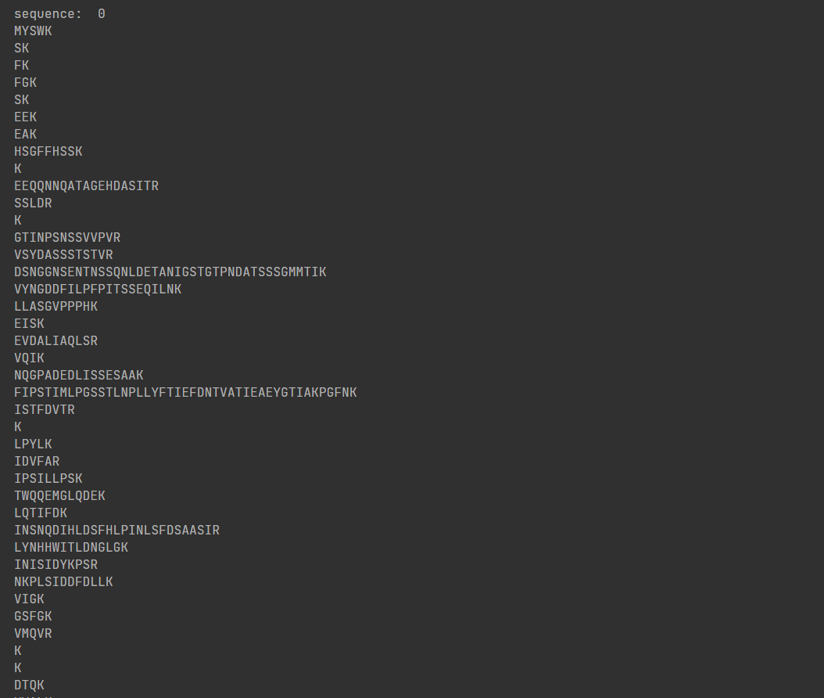
Output

Slide 12
Code 2
lis=[] peptides=[AASequence.fromString(s.toString()) for s in result] for peptide in peptides: tsg=TheoreticalSpectrumGenerator() spec1=MSSpectrum() p=Param() p.setValue("add_b_ions","true") p.setValue("add_y_ions","true") p.setValue("add_metainfo","true") tsg.setParameters(p) tsg.getSpectrum(spec1,peptide,1,1) lis.append(spec1) print("Spectrum 1 of",peptide,"has",lis[0].size(),"peaks")

Slide 13
for ion,peak in zip(lis[0].getStringDataArrays()[0],lis[0]): print(ion.decode(),"is generated at m/z",peak.getMZ()) mz,i = lis[0].get_peaks() annot = lis[0].getStringDataArrays()[0] bars =plt.bar(lis[0].get_peaks()[0], lis[0].get_peaks()[1], snap=False,color=("r","b")) idx = 0 for rect in bars: height = rect.get_height() plt.text(rect.get_x() + rect.get_width() / 2.0, height, annot[idx].decode(), ha='center', va='bottom', rotation=90) idx += 1 plt.ylim(top=1.2) plt.xlabel("m/z") plt.ylabel("intensity")

Slide 14
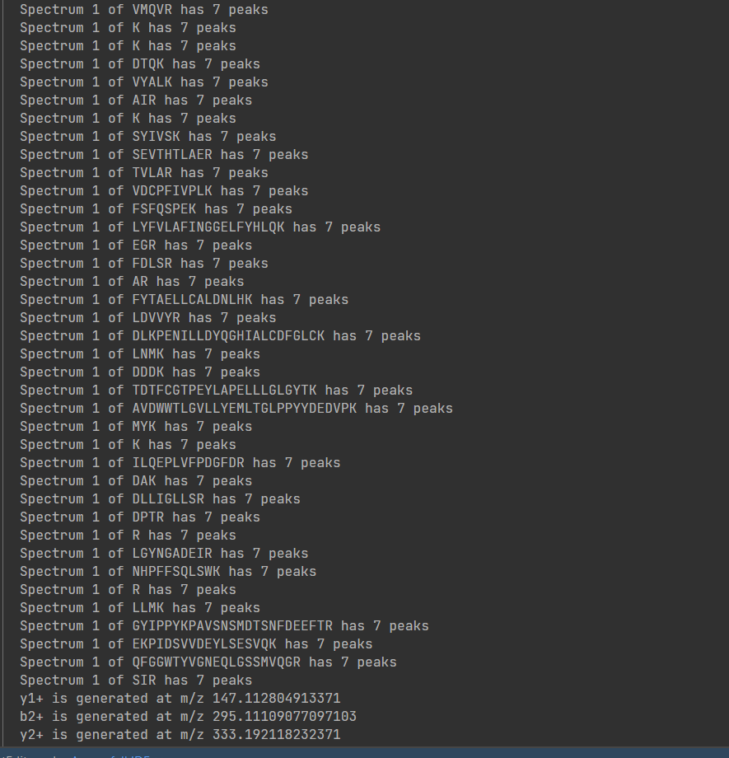
Output

Slide 15
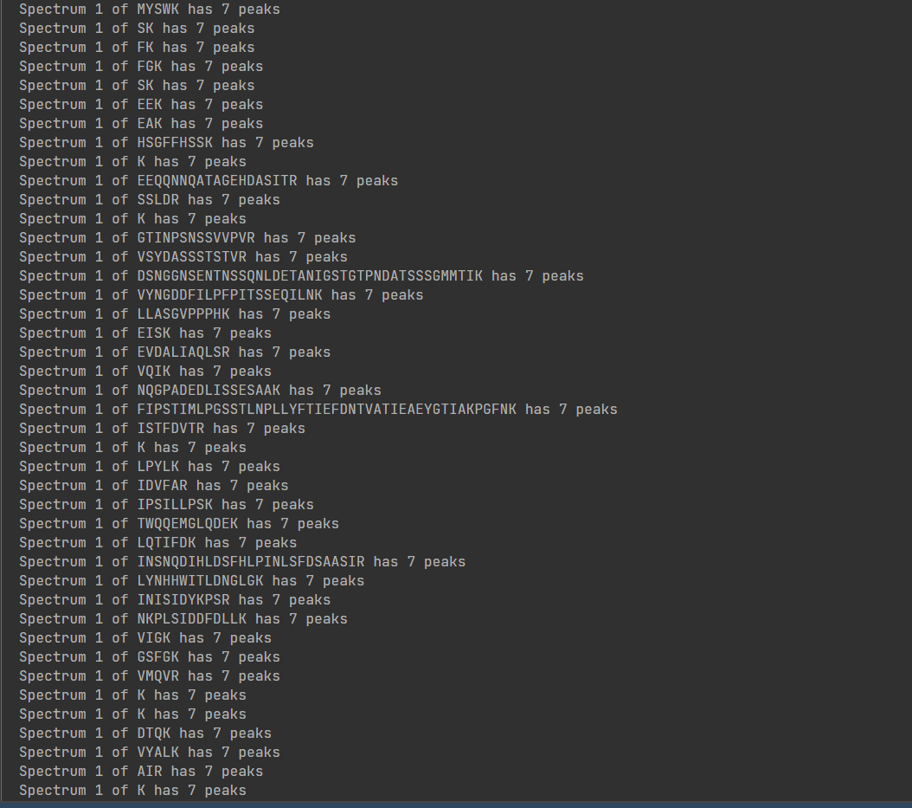
Output

Slide 16
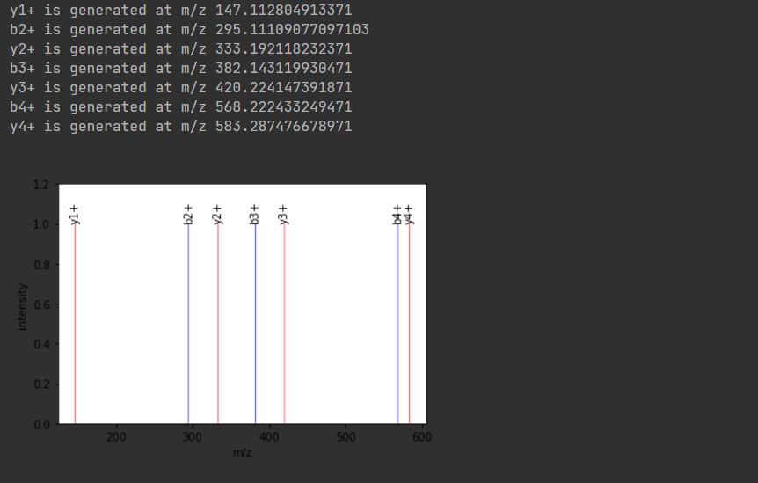
Output

Slide 17
Code 3
from pyopenms import * import matplotlib.pyplot as plt import numpy as np exp = MSExperiment() MzMLFile().load("C:/Users/Electronica Care/Downloads/Fusion_180220_29.mzML", exp) spectra = exp.getSpectra() observed_spectrum = spectra[3]

Slide 18
Code...
import numpy as np from matplotlib import pyplot as plt def mirror_plot(obs_mz, obs_int, theo_mz, theo_int, title): obs_int = [element / max(obs_int) for element in obs_int] # relative intenstiy theo_int = [element * -1 for element in theo_int] # invert the intensity for the mirror plot plt.figure(figsize=(12,8)) plt.bar(obs_mz, obs_int, width = 3.0) plt.bar(theo_mz, theo_int, width = 3.0) plt.title(title) plt.ylabel('intensity') plt.xlabel('m/z') obs_mz, obs_int = observed_spectrum.get_peaks() # The mass-to-charge of our observed spectrum ranges from 200 - 800 m/z print(min(obs_mz)) # 212.012451171875 print(max(obs_mz)) # 795.2837524414062 # We filter the peaks of the theoretical spectrum to fit the range (to reduce image complexity) theo_mz, theo_int = [], [] for mz, intensity in zip(*lis[0].get_peaks()): if mz >= 200.0 and mz <= 800.0: theo_mz.append(mz) theo_int.append(intensity) title = 'Observed vs theoretical spectrum' mirror_plot(obs_mz, obs_int, theo_mz, theo_int, title)

Slide 19
Code...
alignment = [] spa = SpectrumAlignment() p = spa.getParameters() # use 0.5 Da tolerance (Note: for high-resolution data we could also use ppm by setting the is_relative_tolerance value to true) p.setValue("tolerance", 0.5) p.setValue("is_relative_tolerance", "false") spa.setParameters(p) # align both spectra spa.getSpectrumAlignment(alignment, lis[0], observed_spectrum)

Slide 20
Code...
print("Number of matched peaks: " + str(len(alignment))) print("ion\ttheo. m/z\tobserved m/z") for theo_idx, obs_idx in alignment: ion_name = lis[0].getStringDataArrays()[0][theo_idx].decode() ion_charge = lis[0].getIntegerDataArrays()[0][theo_idx] print(ion_name + "\t" + str(ion_charge) + "\t" + str(lis[0][theo_idx].getMZ()) + "\t" + str(observed_spectrum[obs_idx].getMZ()))

Slide 21
Code...
theo_mz, theo_int, obs_mz, obs_int = [], [], [], [] for theo_idx, obs_idx in alignment: theo_mz.append(lis[0][theo_idx].getMZ()) theo_int.append(lis[0][theo_idx].getIntensity()) obs_mz.append(observed_spectrum[obs_idx].getMZ()) obs_int.append(observed_spectrum[obs_idx].getIntensity()) title = 'Observed vs theoretical spectrum (aligned)' mirror_plot(obs_mz, obs_int, theo_mz, theo_int, title)

Slide 22
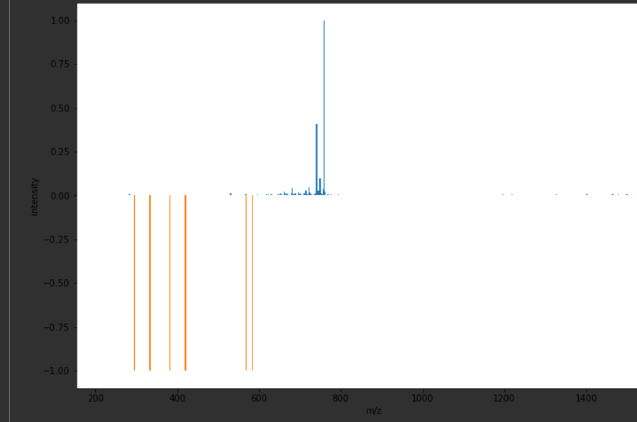
Mirror Output from Fusion_180220_29.mzML

Slide 23
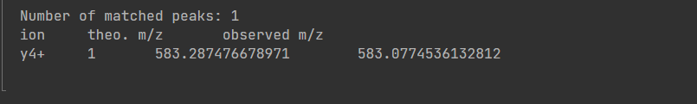
Match peaks Output from Fusion_180220_29.mzML

Slide 24
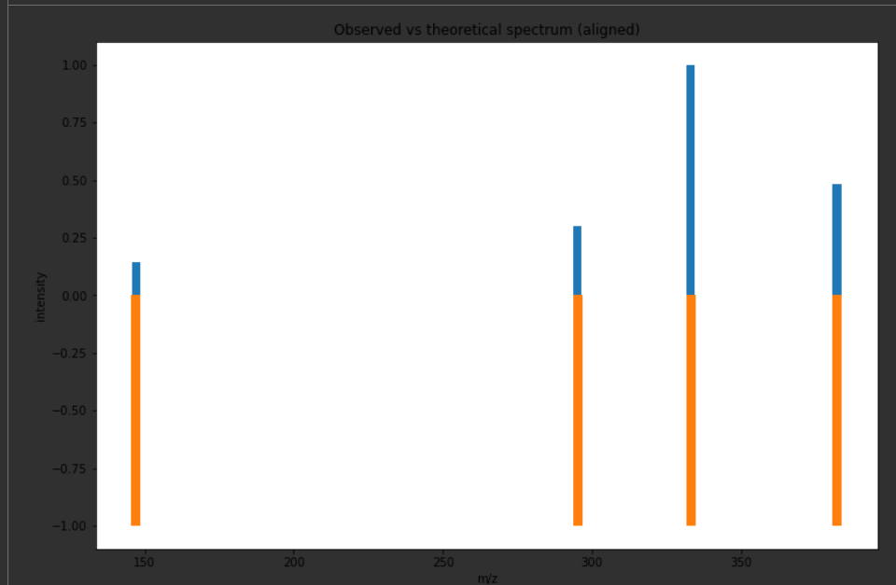
Aligned mirror Output from Fusion_180220_44.mzML

Slide 25
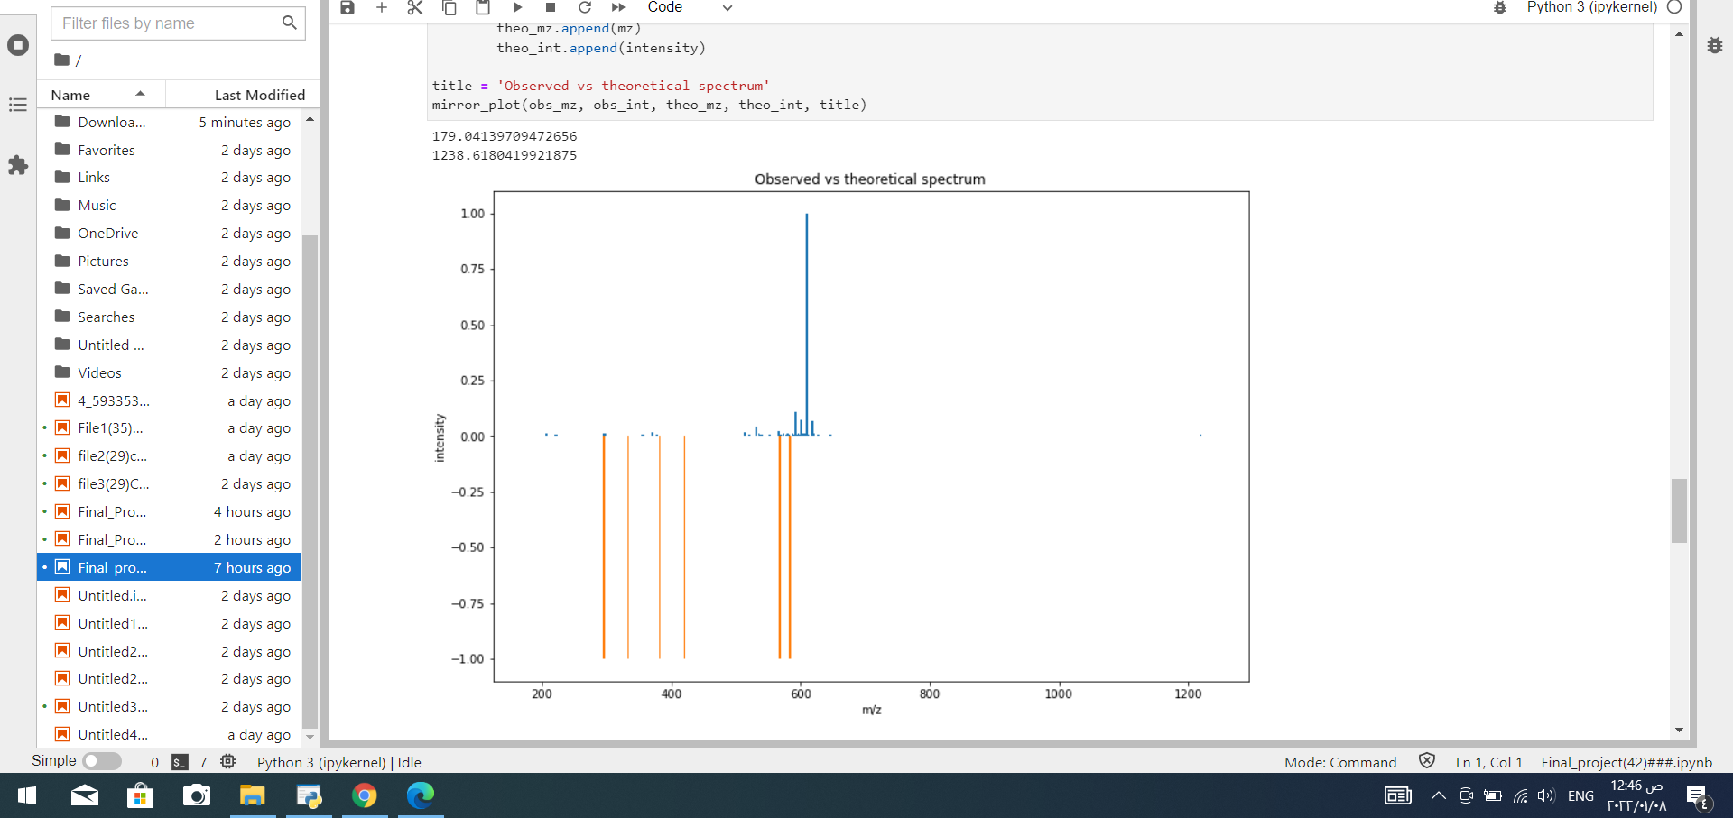
Mirror Output from Fusion_180220_42 .mzML

Slide 26
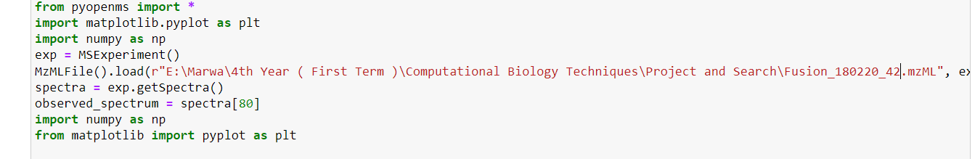
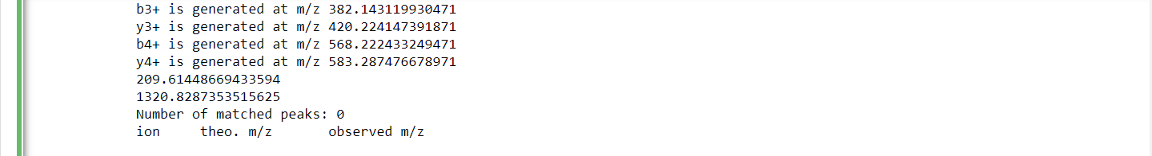
Match peaks Output from Fusion_180220_42 .mzML

Slide 27
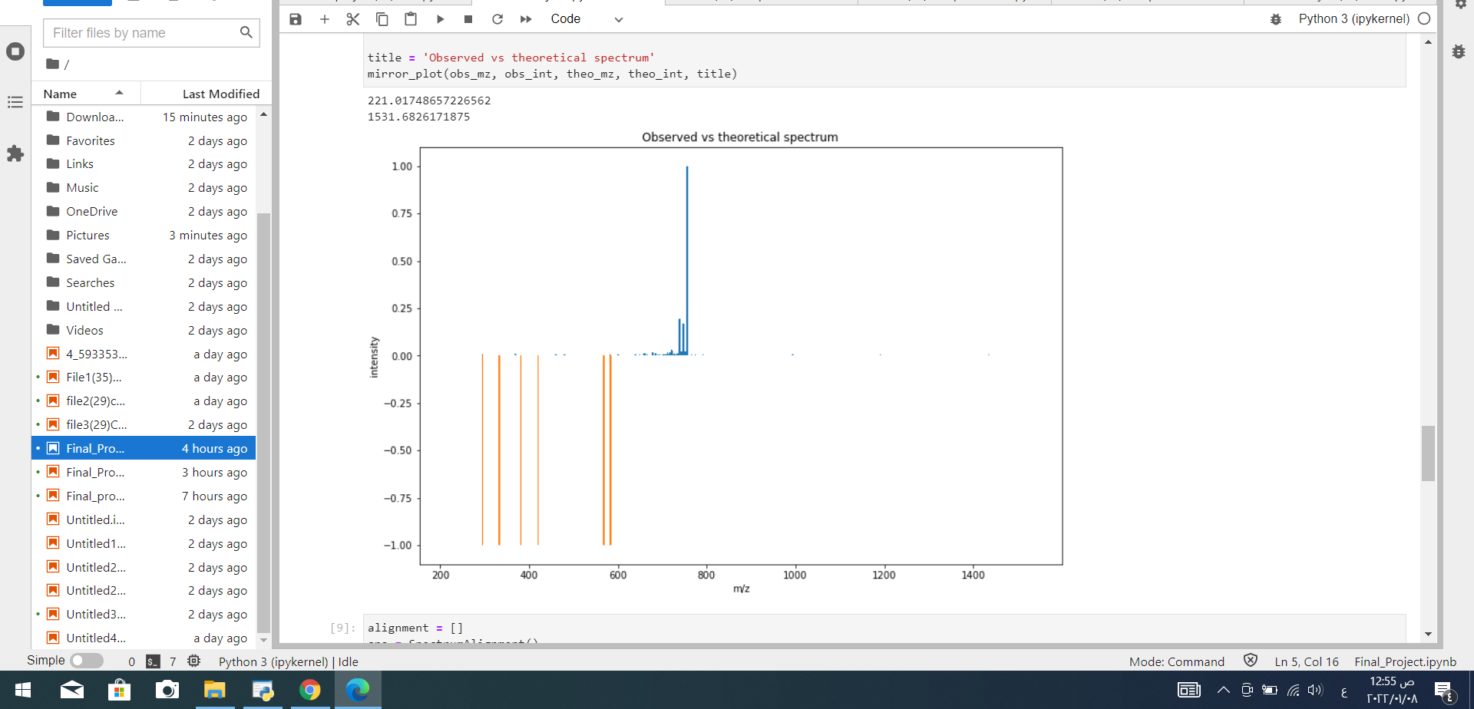
Mirror Output from Fusion_180220_35 .mzML

Slide 28
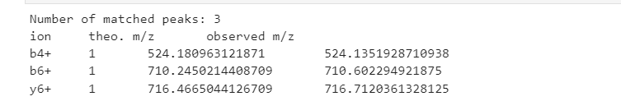
Match peaks Output from Fusion_180220_35 .mzML

Slide 29
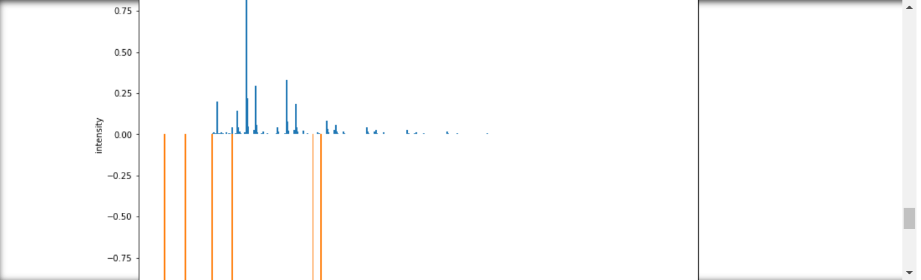
Mirror Output from Fusion_180220_27.mzML

Slide 30
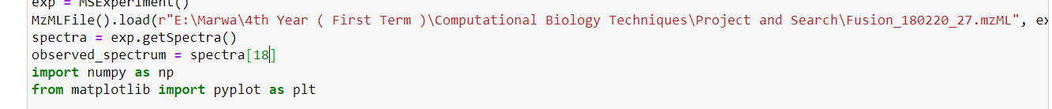
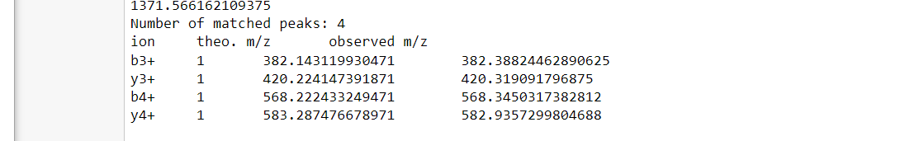
Match peaks Output from Fusion_180220_27.mzML

Slide 31
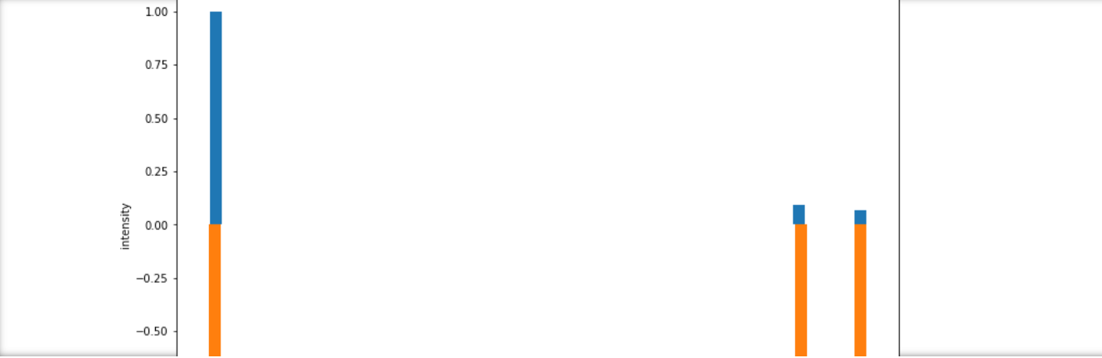
Aligned mirror Output from Fusion_180220_27.mzML

Slide 32
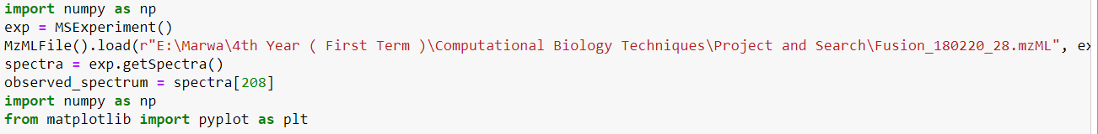
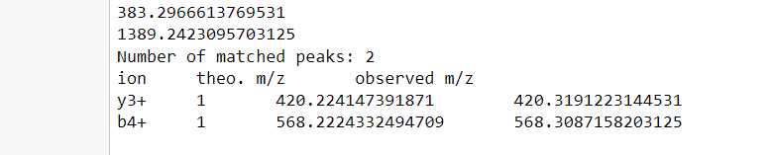
Match peaks Output from Fusion_180220_28.mzML

Slide 33

Mirror Output from Fusion_180220_28.mzML

Slide 34

Team Members
1- Marwa Mohammed Elsayed – Section 6
2- Manar Ahmed Shawky – Section 6
3- Hager Sayed Ahmed – Section 8
Supervised by : Dr. Ibrahim Elawady

