Slide 1

ITRAQ COMPUTATIONAL BIOLOGY techniques

Slide 2

I n t r o d u c t I o n
Isobaric tags for relative and absolute quantitation (iTRAQ) is an isobaric labeling method in MS/MS applied to determine the proteins coming from different sources in a single experiment.
Peptides are covalently labeled with stable isotope molecules with tags of varying mass introduced from iTRAQ specific reagents in the N-terminus and side chain amines of peptides after proteolysis.⁶⁶ iTRAQ reagents are isobaric-mass designed, so differentially labeled peptides appear as single peaks in MS scans, reducing the probability of pear overlapping.

Slide 3
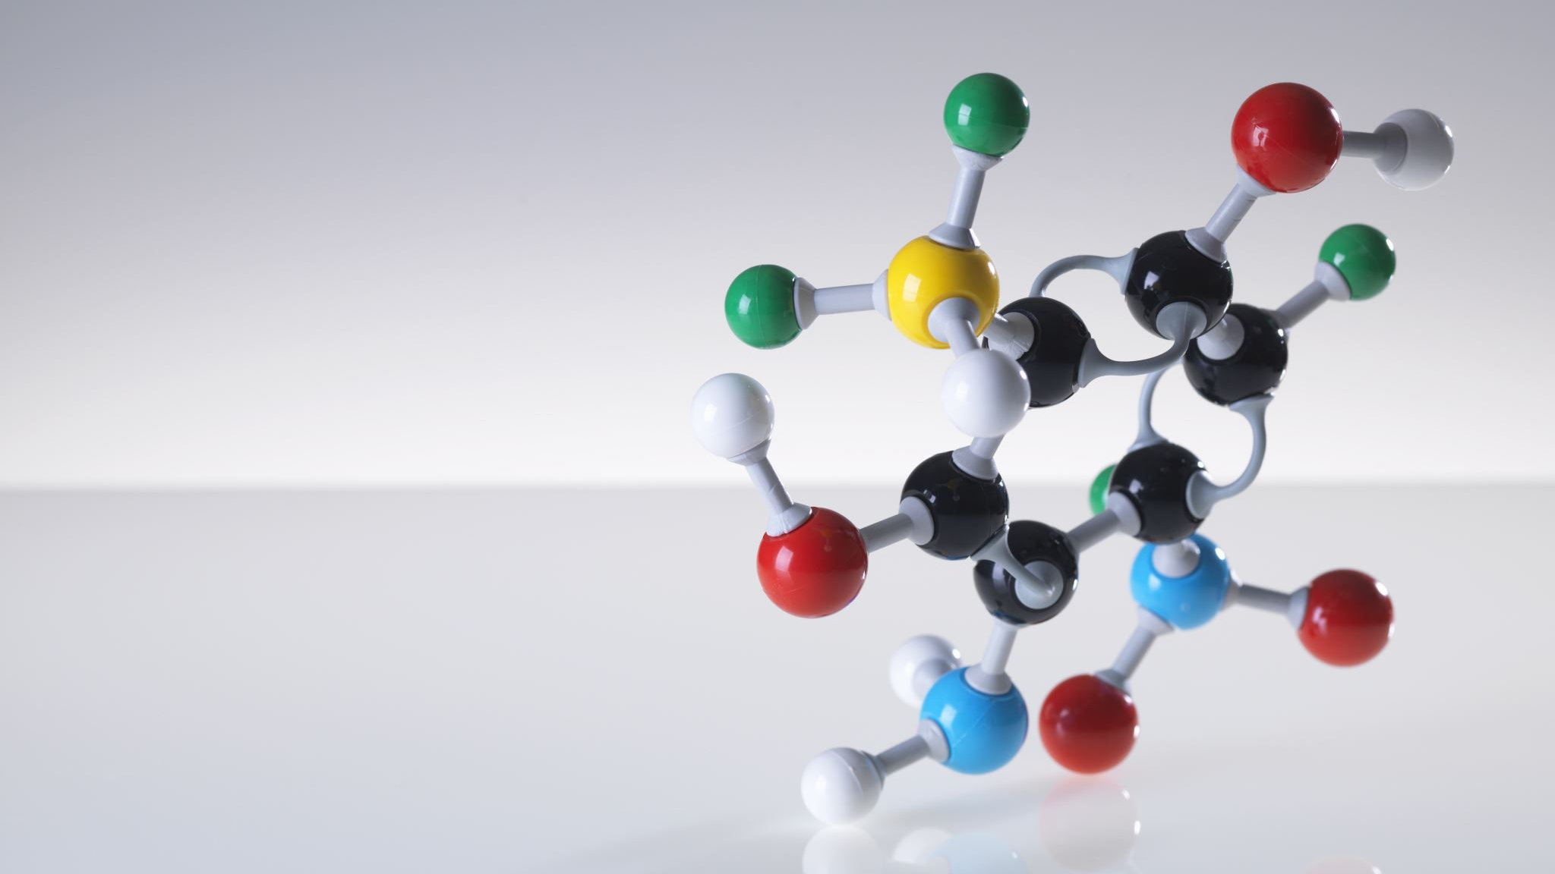
iTRAQ approach is proposed to be best applicable to samples of moderate to low complexity that can be separated by cation-exchange chromatography followed by HPLC. iTRAQ strategy has shown a great propensity to identify proteins of high abundance, which reflects the limited effectiveness of peptide separation and, therefore, a lower probability to identify low-abundance proteins in complex biological samples.68 iTRAQ is useful for protein corona quantification to identify the hard-corona proteins after unbinding proteins from NPs and digesting them for an improved resolution of results. This technique is robust and presents more sensitivity and better accuracy of quantification than 2D-DIGE.69

Slide 4
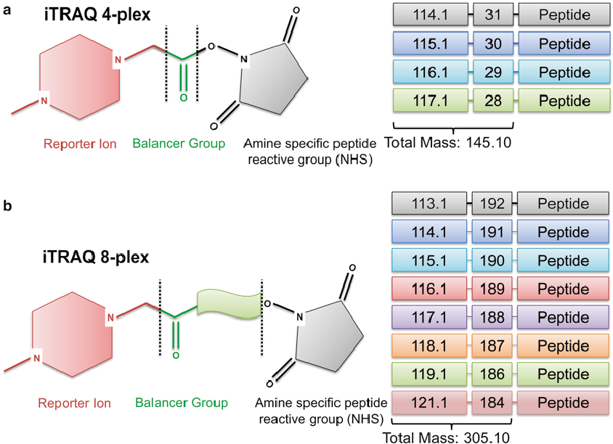

Slide 5
ITRAQ..
iTRAQ is an acronym of Isobaric tag for relative and absolute quantitation, which was developed by Applied Biosystems Incorporation in 2004. It is an isobaric labeling method to determine the amount of proteins from different sources in just .one single experiment by mass spectrometry
iTRAQ-based Proteomics Analysis Creative Proteomics offers iTRAQ protein quantification service suited for unbiased untargeted biomarker discovery. Relative quantification of proteins for biomarker discovery in complex mixtures by mass spectrometry can easily and quickly be achieved using iTRAQ ,technology. iTRAQ is ideally suited for comparing normal ,diseased, and drug-treated samples, time course studies .biological replicates and provides relative quantitation

Slide 6
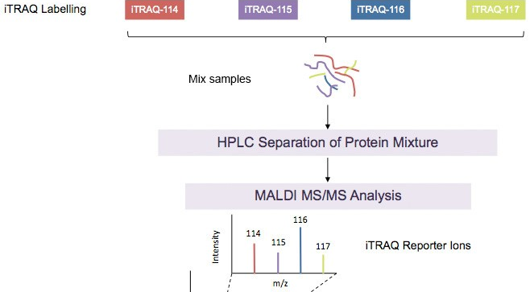

Slide 7
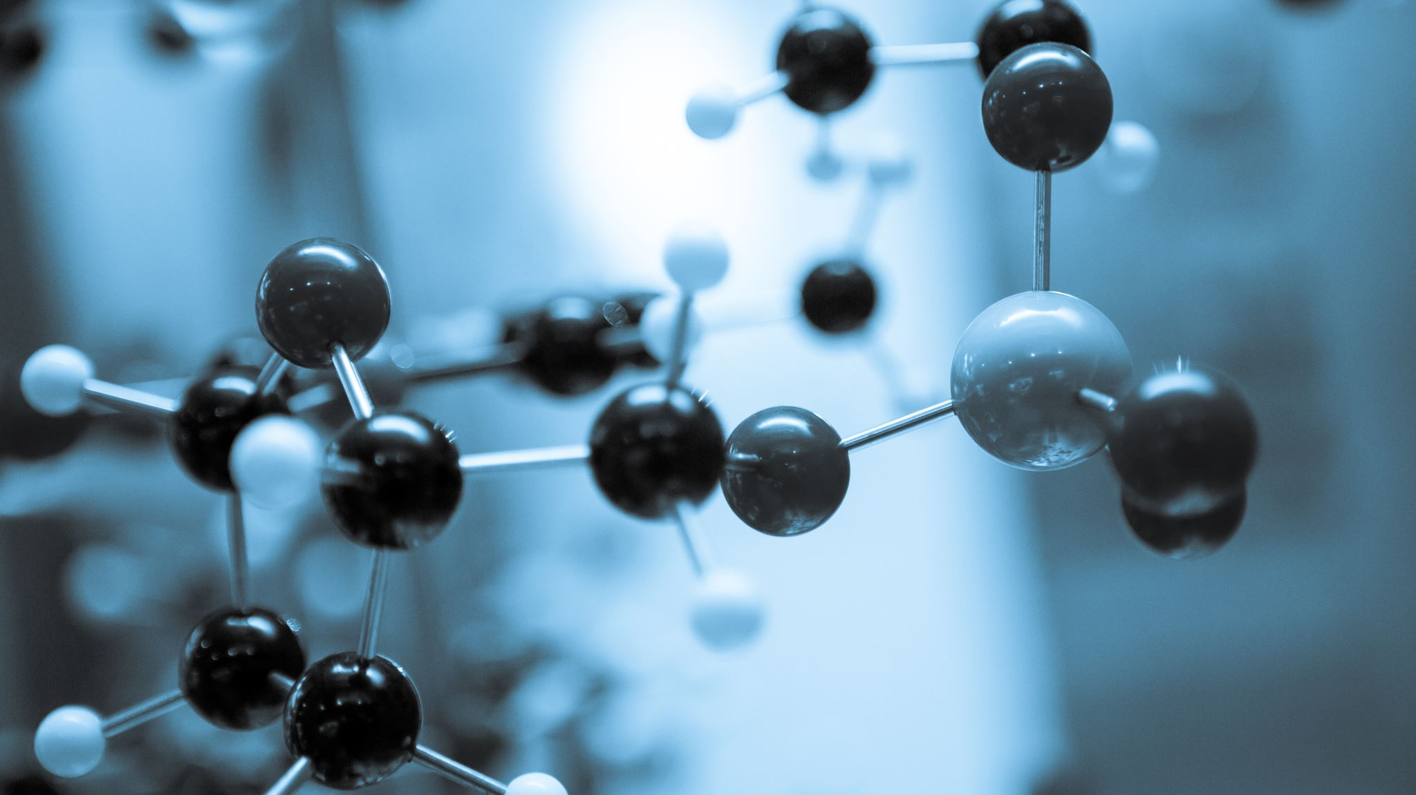
Advantages and disadvantages of iTRAQ
Quantitative proteomics using mass spectrometry-based approach is one of the most important advantages of iTRAQ, especially in the field of clinical proteomics. The progress of metabolism of a particular drug or the progressive concentration of certain biomarkers at different stages of a particular disease can easily be quantified using iTRAQ-based studies. Multiplexing ability is another great advantage of iTRAQ. There are eight reporter ions available that therefore achieve multiplexing at the level of eight samples. Also, iTRAQ can reduce overall time and variation.

Slide 8
Advantages and disadvantages of iTRAQ
On the other hand, iTRAQ reagents are extremely costly and also extremely sensitive to contamination from salts. Moreover, sophisticated software is required for analyzing iTRAQ data. Another disadvantage is the variability arising due to the inefficient enzymatic digestion

Slide 9
Advantage of iTRAQ
• Within recent years, proteomics has been widely used in the life
sciences to detect differentially expressed proteins and novel targets,
and discover the associated mechanisms of action (Lai et al., 2015; Puet al., 2015; Wei et al., 2016).
Isobaric Tags for Relative and Absolute Quantification (iTRAQ) is a novel technique developed by Applied Biosystems Incorporation (ABI) with many advantages, such as high throughput, high sensitivity, and superior accuracy, and has grown to be a robust method in comparative proteomics.

Slide 10
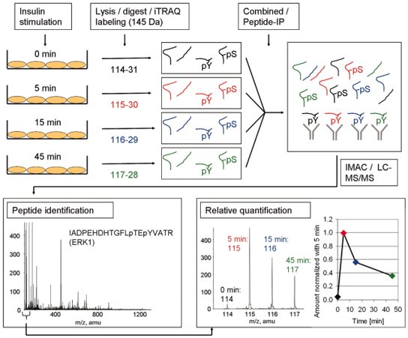
An example of iTRAQ:

Slide 11
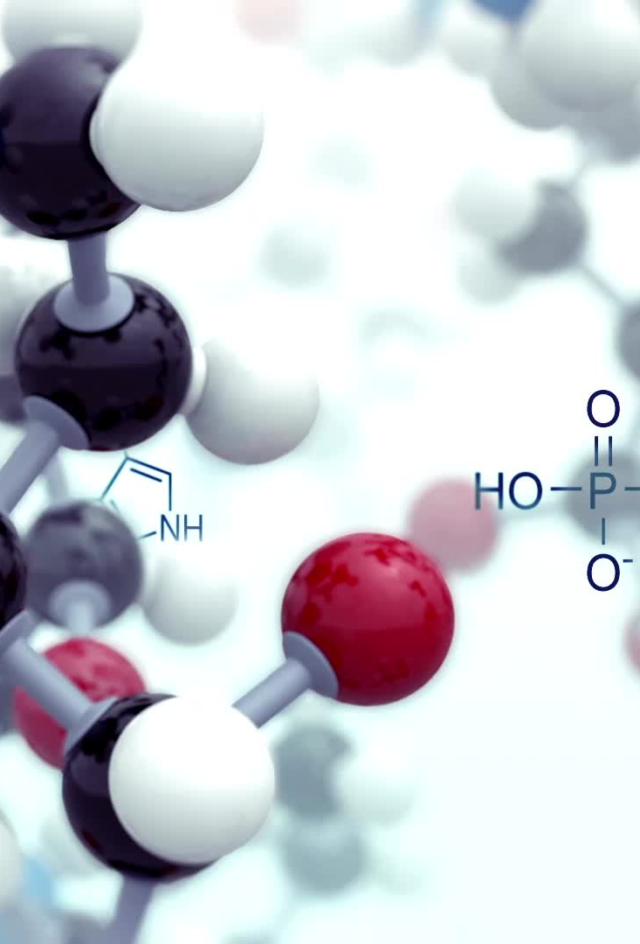
There is an example that iTRAQ was used to identify and quantify tyrosine phosphorylation sites upon insulin stimulation. In this experiment, adipocytes were stimulated with insulin for different times. After cell lysis and digestion, the researchers used iTRAQ to label resulting peptides.
The labeled peptides were combined for further analysis (phosphotyrosine peptide immunoprecipitation, immobilized metal affinity chromatography, and LC-MS/MS)
After LC-MS/MS, the identity of the peptide was determined and the area of the tag masses 114, 115, 116, and 117 mass-to -charge ration (m/z) was used to calculate the ratio of phosphorylated peptides at the different time points compared with 5-min insulin stimulation.

Slide 12
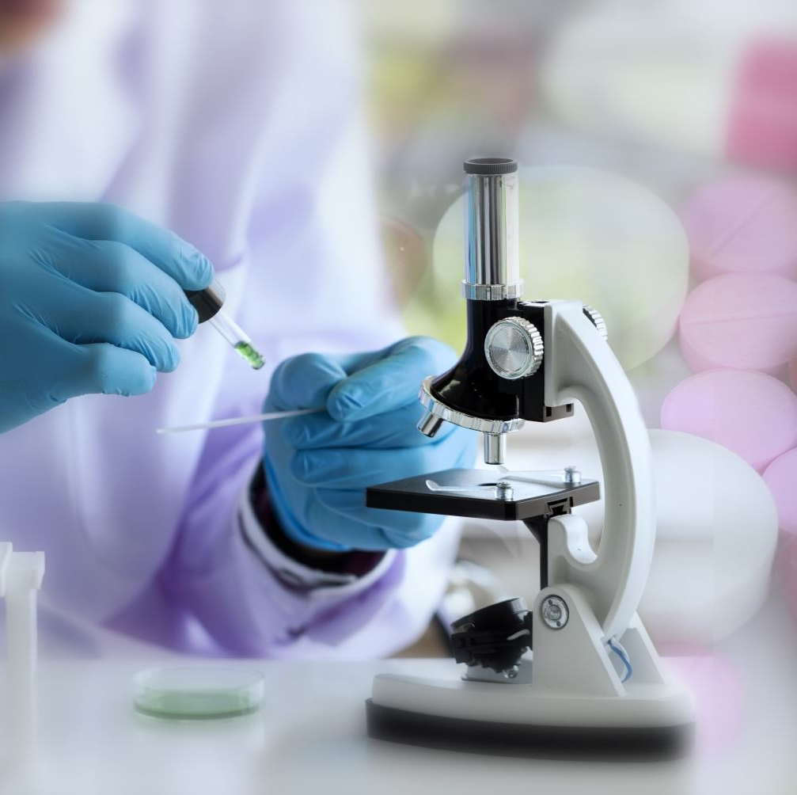
iTRAQ has been widely used for quantitative analysis of proteins and in biomaterials such as microorganism, animal,
plant and biomedical samples. At Creative Proteomics, we are confident to provide professional and reliable iTRAQ services and other proteomics quantification services

Slide 13
ITRAQ Methods
1)Serum protein sample preparation:
A 20-ml volume of peripheral venous blood was withdrawn into coagulation-promoting vacuum tubes prior to MI model establishment and at 1, 2 and 3 h thereafter. The tubes were then rested for 30 min. The serum protein solutions were concentrated by 10 kDa Vivaspin =500 . The protein concentration was measured using the BCA Assay kit (Sigma; Merck KGaA, Darmstadt, Germany).

Slide 14
2) ITRAQ sample preparation:
The ITRAQ reagent-8plex multiplex kit was purchased from AB SCIEX. The clarified supernatants were then transferred to 30 kDa ultrafiltration units. The filters were rinsed three times with 8 M urea followed by incubation with iodoacetamide for 30 min at room temperature.

Slide 15
3) Strong cation exchange (SCX) separation:
The peptide mixture was diluted with the SCX buffer A [10 mM KH2PO4 in 25% acetonitrile (ACN), pH 3.0]. Fractionation was performed using the AKTA Purifier 100 equipped with a polysulfoethyl column (4.6×100 mm, 5 μm, 200 A, PolyLC, Inc., Columbia, MD, USA).

Slide 16
4) Liquid chromatographymass spectrometry (LC-MS) analysis:
All sample fractions were examined by high-performance liquid chromatography using an Easy nLC system (Thermo Fisher Scientific, Inc., Waltham, MA, USA). C18-A2 EASY-columns (10 cm, ID75 μm, 3 μm; Thermo Fisher Scientific, Inc.) were used to separate the peptides. First, all fractions were concentrated using a vacuum centrifuge concentrator and solubilized buffer A (0.1% formic acid in water).

Slide 17
5) Analysis of DEPs
The original data form was prepared in RAW. Mascot 2.2 and Proteome Discoverer 1.4 software were used for peptide and protein identification, and RAW files were converted to Mascot Generic Format (MGF) files with preselected iTRAQ reporter ions. The MGF files were searched against the Uniprot_Canislupusfamiliaris_ 29014_ 20160822.fasta database and the parameters were as follows: Enzyme, trypsin; maximum missed cleavages, two; fixed modifications, carbamidomethyl.

Slide 18
6) Bioinformatics analysis
Functional annotation and enrichment analysis were performed using Gene Ontology (GO) software online. The significance of GO terms was evaluated according to Fisher's exact test, and the common GO terms satisfied P<0.05 in the three comparison groups. All proteins in these common GO terms were defined as critical and subjected to further analysis. The PPI network including the key proteins was constructed using the online STRING database.

Slide 19
7) Western blot analysis:
In order to verify the ITRAQ results, three DEPs, fibrinogen γ chain (FGG), ATP synthase F1 subunit β (ATP5B) and integrator complex subunit 4 (INTS4), were selected for further analysis by western blotting. Equivalent quantitie Equivalent quantities of serum protein sample (3 μl) were initially electrophoresed on 5% stacking SDS-PAGE for 40 min under 60 V, then electrophoresed on 10% separating SDS-PAGE for 80 min under 80 V and transferred onto polyvinylidene fluoride membranes for 80 min under 80 V. at room temperature for 1 h.

Slide 20
8) Statistics analysis
The ITRAQ data were analyzed in Perseus software , other data were analyzed in SPSS software for Windows, version 19.0 .Prior to one way ANOVA, the normality was confirmed using the Shapiro-Wilk test (P>0.05), and the homogeneity of variances using the F test (P>0.05). P<0.05 was considered to indicate a statistically significant difference.

Slide 21

TEAM MEMBERS
Computational Biology Techniques Presentation on ITRAQ
Made by :-
1- Marwa Mohammed Elsayed – Section 6
2- Hager Sayed Ahmed – Section 8
3- Manar Ahmed Shawky – Section 6
Supervised by : Dr. Ibrahim Elawady

Slide 22

References:
https://www.creative-proteomics.com/blog/index.php/introduction-ofisobaric-tag-for-relative-and-absolute-quantitation-itraq/
https://www.frontiersin.org/articles/10.3389/fphar.2017.00099/full

