Slide 1
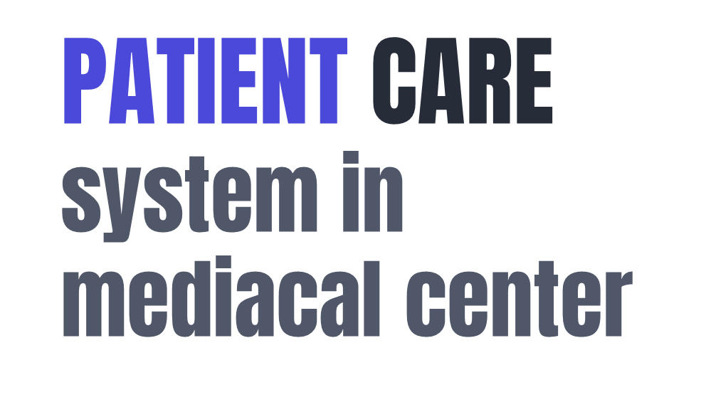


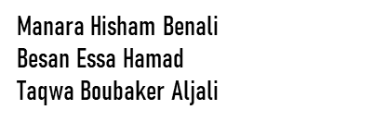

Slide 2
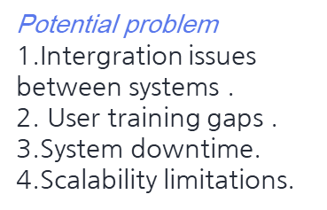
General description of the system
A patient care system in medical center manage all the aspects , and enhance care quality and efficiency, including scheduling ,telemedicine and medication management .
Description of the current and potential system problem:
Current problem :
1.Data fragmentation integration.
2.Medication Error.
3.Communication issues.
4.patient engagement .
5. Data security risks .
The purpose and scope of the study :
Purpose: Enhance patient care .
Scope: Evaluate and optimize all aspects of care delivery.

