Slide 1














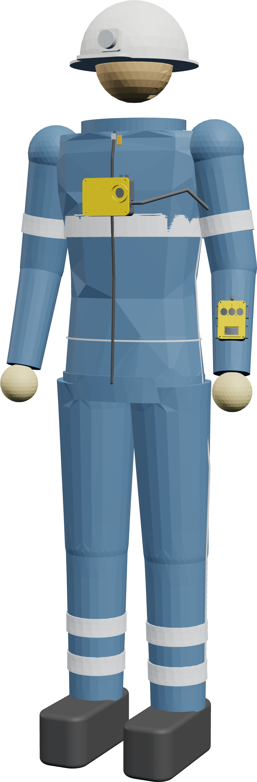
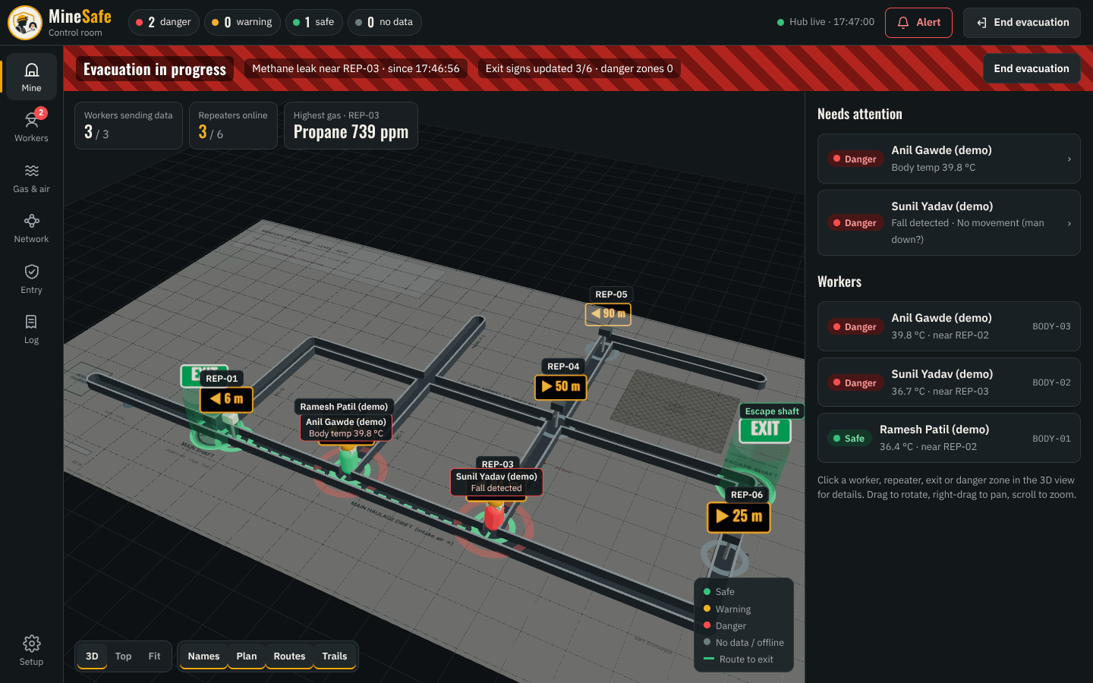
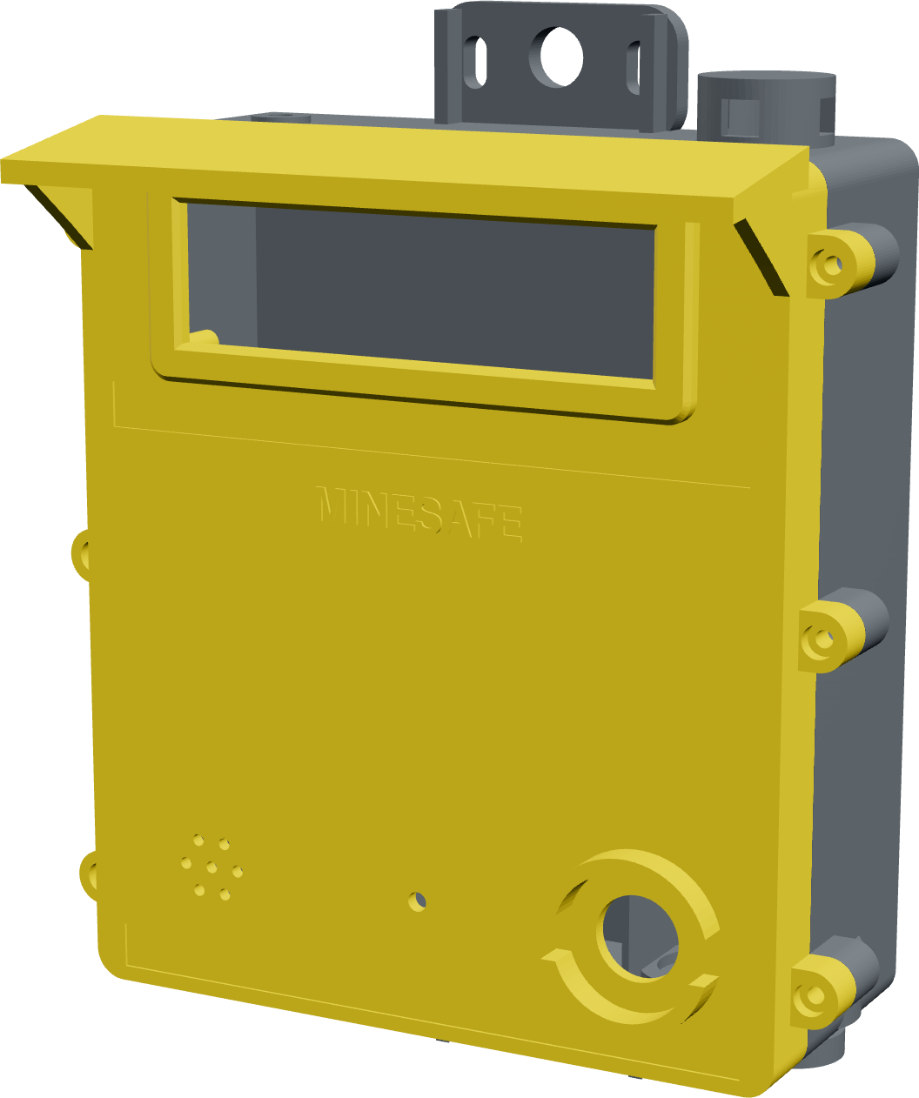
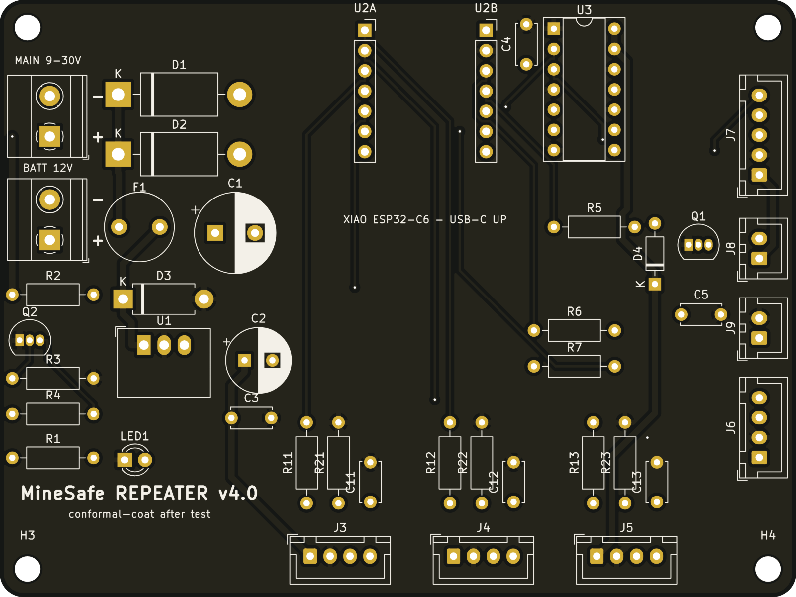
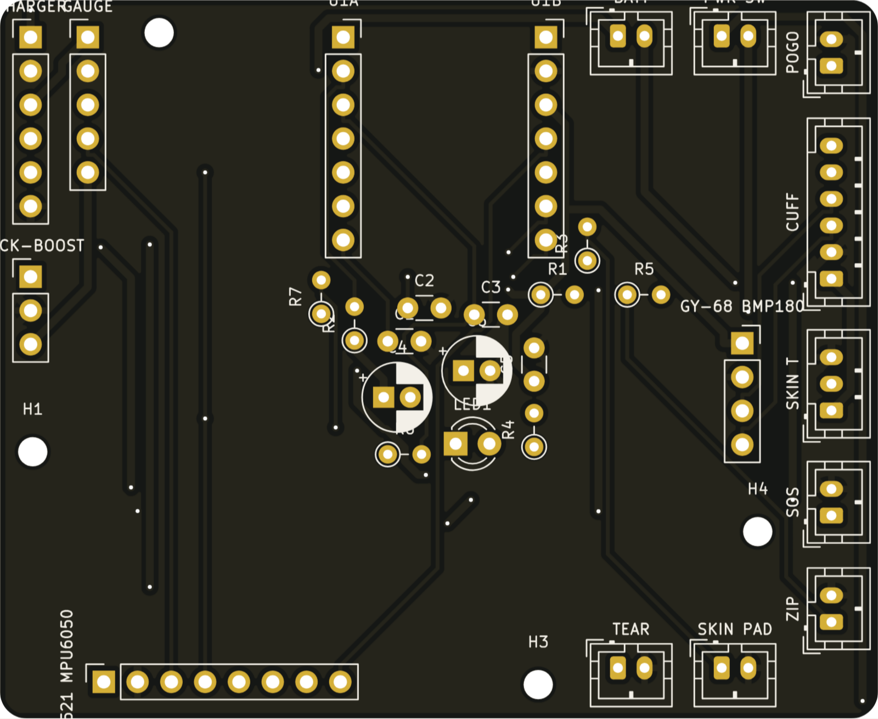
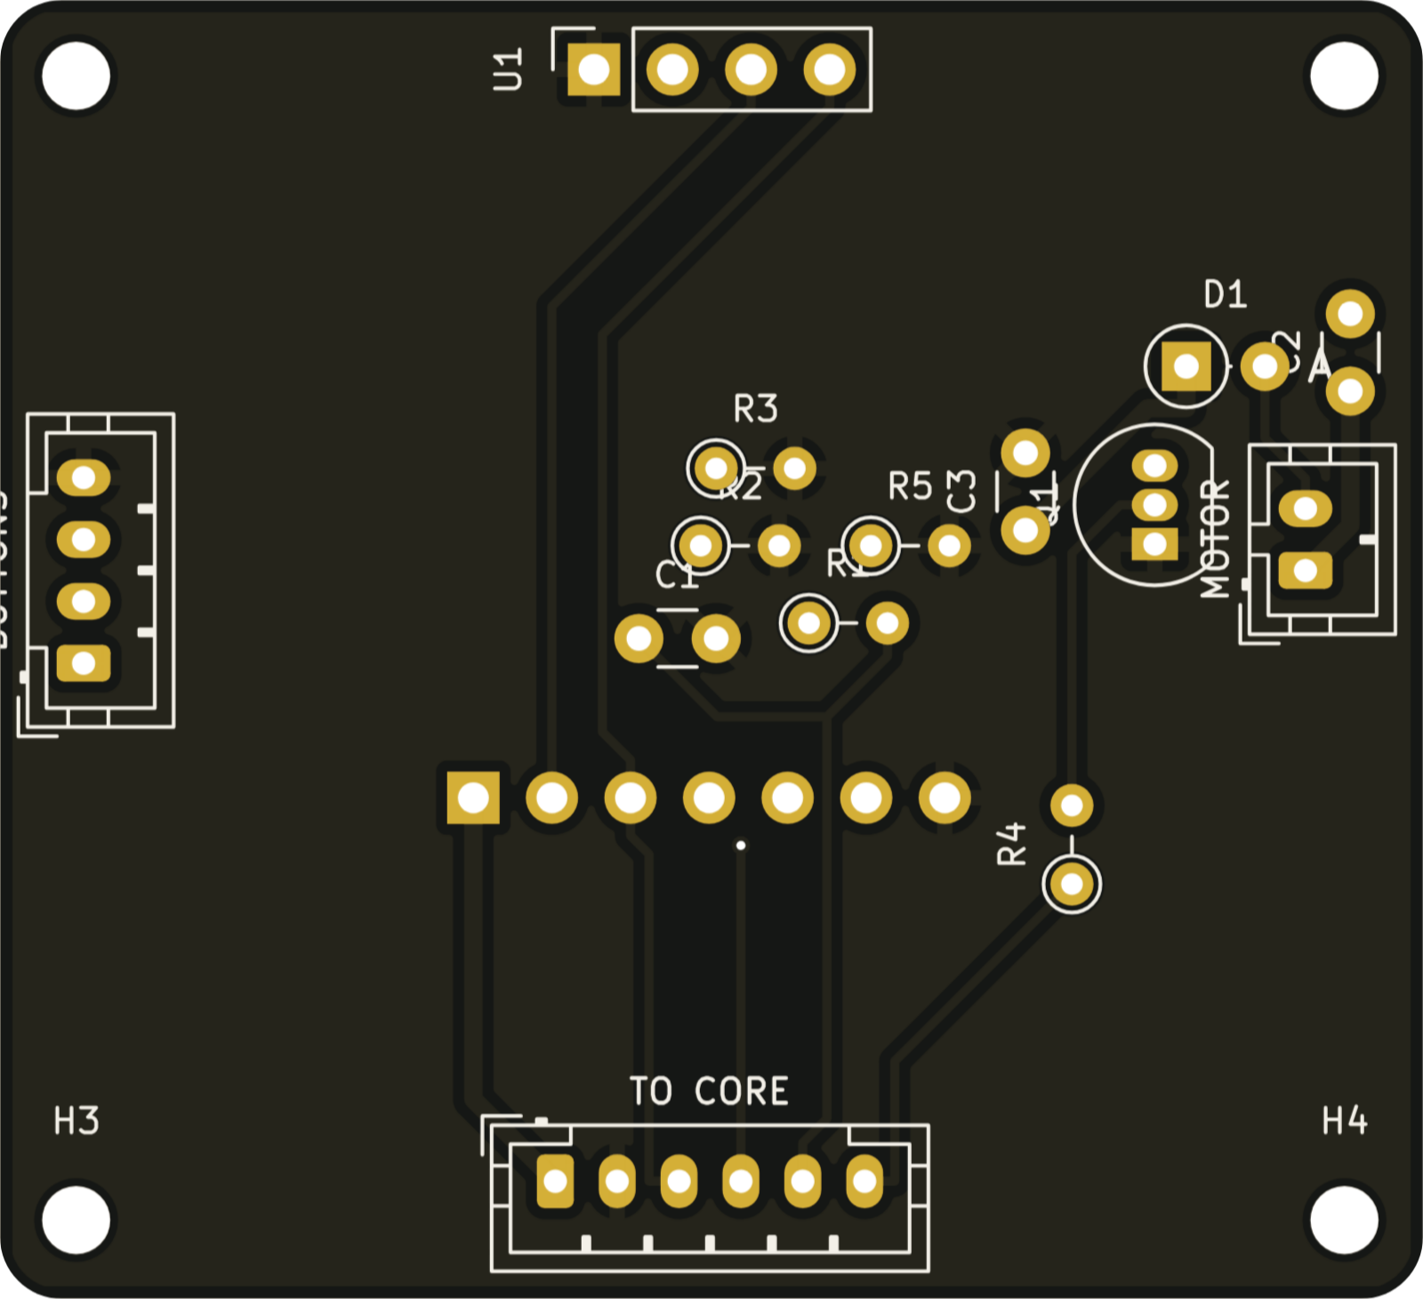
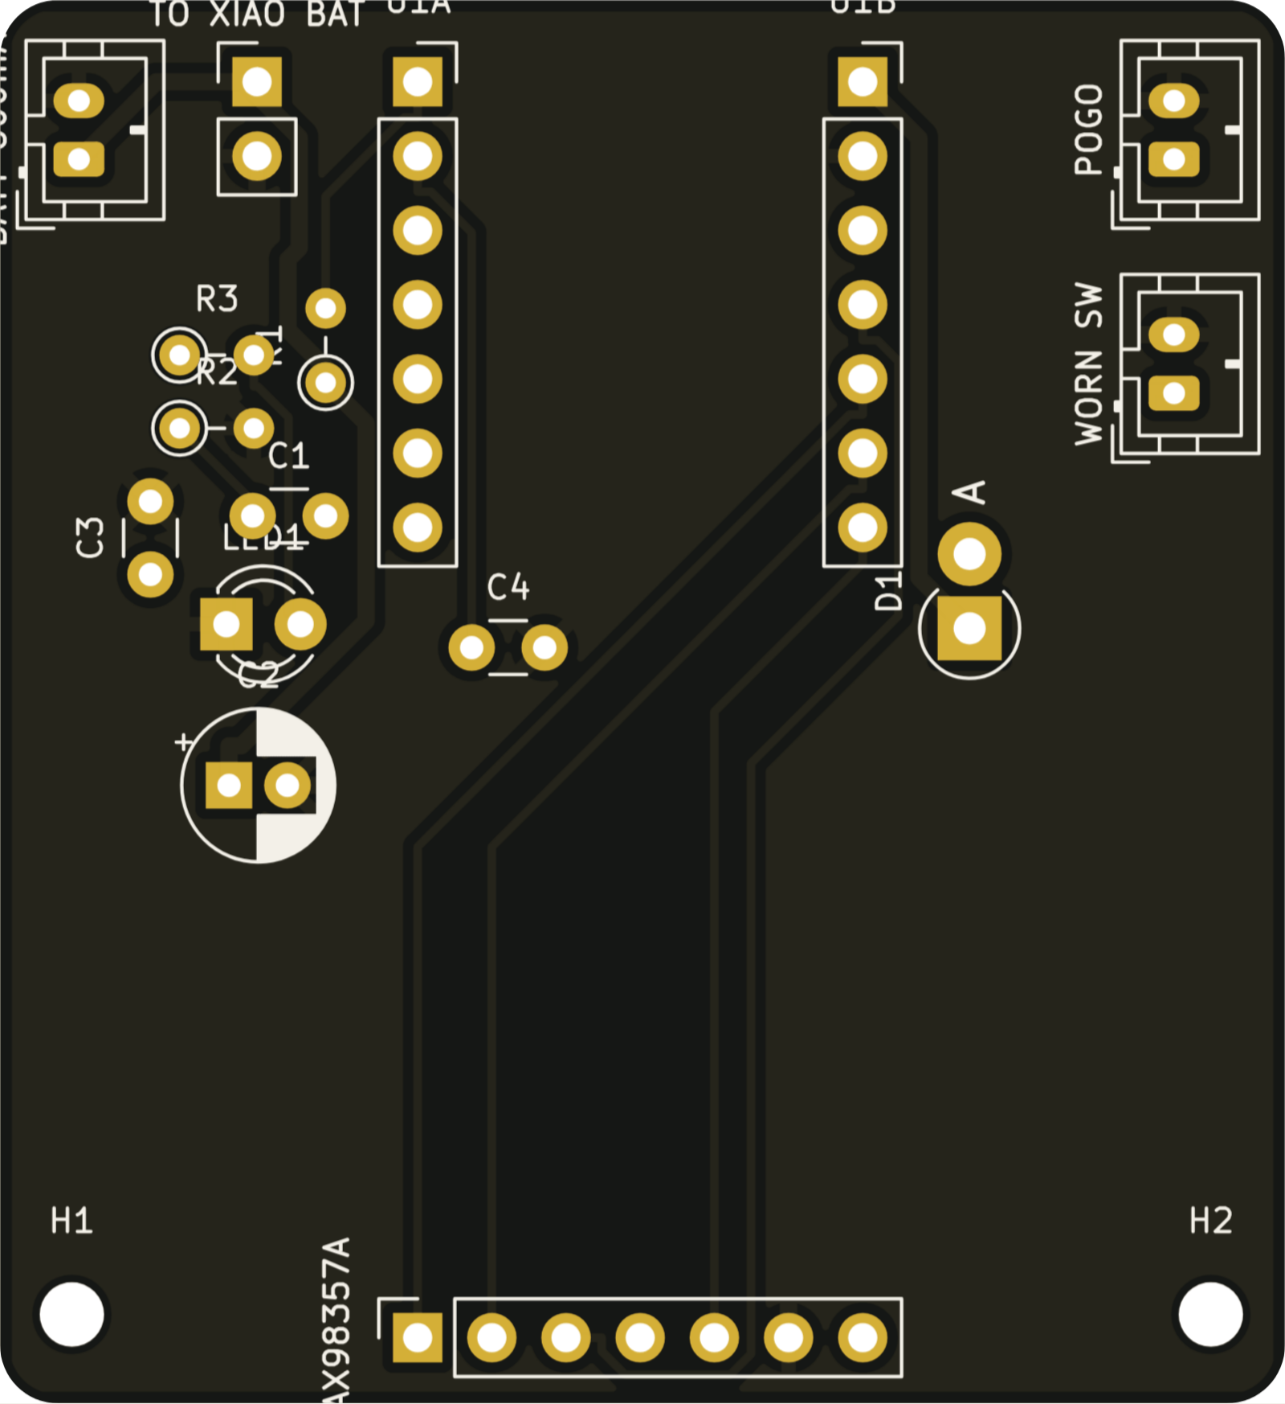
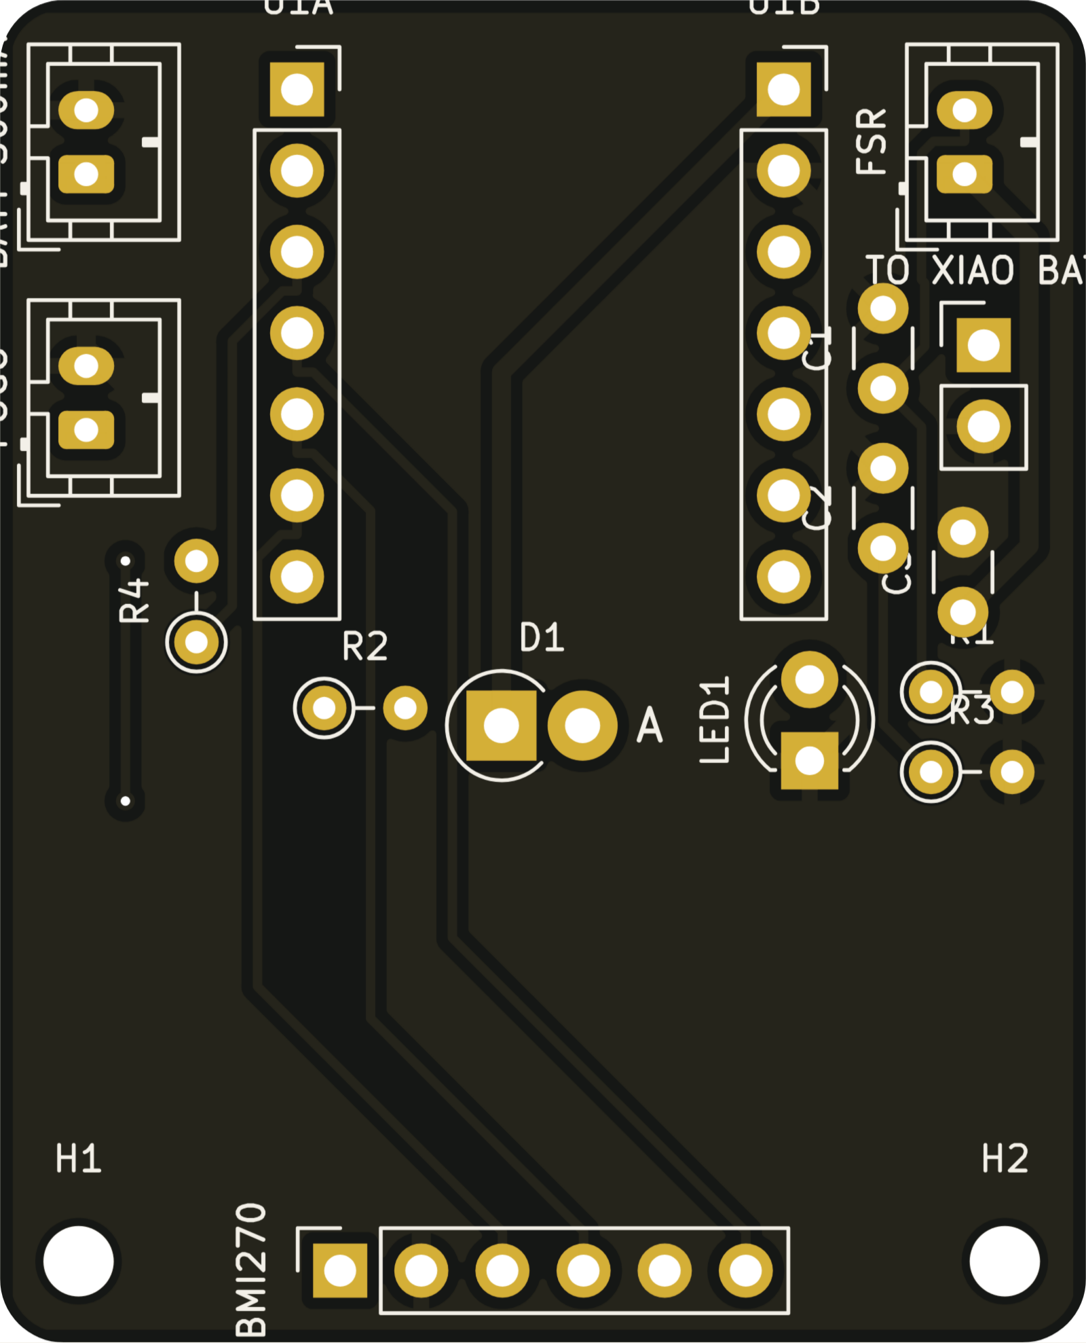
Inter-University Avishkar Research Convention: 2026-27
Slot No.: ____________
Category: Engineering & Technology
Level: UG
MineSafe
No GPS
Intelligent Safety Gear Compliance, Health Monitoring and Navigation System for Underground Miners
No internet
No new cabling
01
THE PROBLEM
02
OBJECTIVES
03
RESEARCH GAP
141
Kit compliance
System | Kit | Vitals | Fall | Location | Gas | Price
MineGuard 360 | ✗ | ✓ | ~ | ~ | ✓ | quote
MineARC GuardIAN | ✗ | ✗ | ~ | zone | ✓ | quote
Leantegra UWB | ✗ | ✗ | ✗ | ✓ | ✓ | quote
Rajant Health | tag | ✓ | ✓ | ~ | ~ | quote
SmartKavach | ✗ | ~ | ✓ | ✗ | ✗ | quote
36Zero + Bodytrak | ~ | ✓ | ✓ | ✗ | ✗ | quote
MineSafe | ✓ | ✓ | ✓ | ✓ | ✓ | ₹12.8k
deaths, 2023–25
RFID / ID card + YOLOv8 photo check at the gate
Health
355
heart rate, SpO₂, temperature, falls, no-movement
GPS-free location
serious accidents
steps + heading, corrected at every repeater
0
Self-healing network
hop-by-hop ESP-NOW, no cabling or internet
GPS or phone signal below ground
Gas and heat
In every rescue: nobody knows who is underground, where, or whether they are alive.
CH₄, CO, H₂S, wet-bulb at every repeater
Low cost
Novelty: the first low-cost system that combines kit check, vitals and GPS-free location in one self-healing network.
< ₹7,000 / repeater · ≈ ₹12,800 / suit
04
METHODOLOGY — ARCHITECTURE AND DATA FLOW
05
V4 SMART SUIT
ESP-NOW
ESP-NOW
ESP-NOW
Wi-Fi
Wi-Fi
Helmet pod
Smart suit
REP-03
REP-02
REP-01
Hub laptop
3D control app
antenna at head height, voice alerts, helmet-on switch
Core pod · chest
4 pods: vitals, fall, kit, steps
gas · air · exit sign
gas · air · exit sign
main repeater
API · AI kit check · evacuation planner
browser or phone, live
ESP32-C6, 3000 mAh, IMU + pressure, SOS
Zip + seams
alerts and evacuation routes return down the same chain · 1 packet / s per worker · data stays on site, no cloud
reed switch, conductive thread: opened or torn = alert
Wrist cuff
WORKER'S SHIFT
screen, 3 glove buttons, vibration, HR + SpO₂
Kit up
Entry check
Kit OK?
yes
Underground
Alarm?
yes
Alert + route
Exit scan
suit self-checks
ID card + YOLOv8 photo
vitals · steps · gas, every 1 s
exit signs, cuff, helmet voice
dock charges
Boot pod
Reflective bands
foot IMU measures every real stride
hi-vis in cap-lamp light
no → rejected, fix kit
no → keep monitoring
Never locked: removal is detected, never prevented
06
LOCATION WITHOUT GPS
07
REPEATER: BUILT FOR THE MINE
08
ELECTRICAL DESIGN AND PCBS
1
Count steps
LED exit sign
CH₄ port on top
Mine 9–30 V
Diode OR
Fuse + TVS
5 V buck
XIAO · 3 MQ · matrix
stride × gyro heading; pressure gives the level
arrow + metres, under a drip hood
methane rises; rain chimney
Battery 12 V
no reset
1.6 A · 36 V
2 A, 90 %
≈ 3.7 W
2
Snap to tunnel
position pulled onto the mine-map centre line
85 dB buzzer
IP65 gasket
3
Reset at repeater
works if the hub is down
silicone cord, 6 × M4
signal ≥ −55 dBm → drift back to zero
CO / H₂S below
Guarded SOS
4
Route around danger
heavier gases; flame arrestors
glove-sized, knock-proof
Repeater
Core
Cuff
Helmet
Boot
Dijkstra from all exits, hazard zone ×1000 cost
Live 3D control app: routes bend around a gas leak, every exit sign updates
5 own 2-layer boards · KiCad + Freerouting · 100 % routed · 0 unconnected pads
09
ENERGY BUDGET
10
COST
11
VALIDATION
12
CONCLUSION
Boot pod
3,270
Test | Pass criterion | Status
PCB DRC, 5 boards | 0 unconnected pads | Passed
CAD fit, 5 cases | no collisions | Passed
Power budget | core pod ≥ 12 h (21 h) | Passed
Repeater chain | self-forms, 3 / 3 | Passed
Gas + local buzzer | alarm at limit | Passed
Distance error | ≤ 5 % over 100 m | In progress
Alert latency | ≤ 3 s for 95 % | Planned
Fall detection | ≥ 90 %, ≤ 1 false / h | Planned
Every worker checked, monitored, located and reachable for the whole shift, on hardware a small mine can install itself.
₹12.8k
per suit
Fabric + sensing
3,040
Core pod
2,790
Working V3 prototype: 3 repeaters, body unit, hub, 3D app
V4: 5 PCBs, 5 mine-rated cases, smart suit
Next: LoRa backbone, certified gas sensors, mine trial
Helmet pod
2,260
Wrist cuff
1,480
Hours on one charge; a shift is 12 h. *duty-cycled radio. Repeater ≈ 3.7 W on mine power.
₹6,862 / repeater · ₹3.26 L for 10 repeaters + 20 suits
SDG 3
Good health
SDG 8
Decent work
SDG 9
Industry
References [1] Ministry of Mines data, ETV Bharat, Aug 2026 · [2] Coal Mines Regulations 2017, reg. 153 · [3] NIOSH Pocket Guide to Chemical Hazards · [4] Bandyopadhyay et al., Wireless Information and Safety System for Mines, JSIR 2009 · [5] IMU-assisted UWB positioning in underground coal mines, Micromachines 2023 · [6] Real-time PPE compliance detection (YOLO), Sustainability 2023

