Slide 1
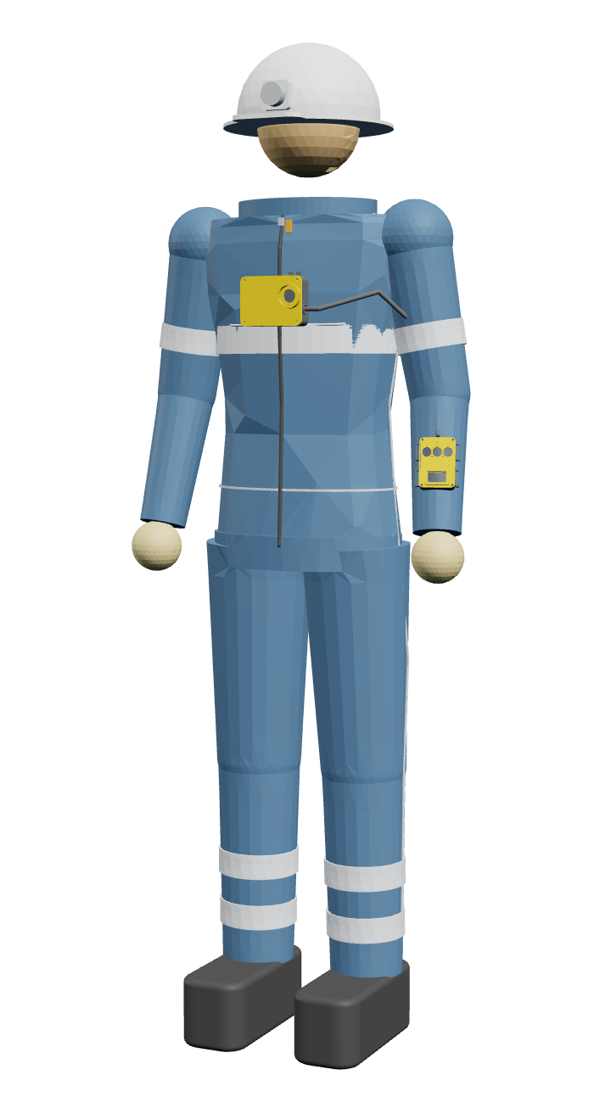
MineSafe
Intelligent Safety Gear Compliance, Health Monitoring and Navigation System for Underground Miners
Slot No.: ________
Category: Engineering and Technology · UG
Notes:
0:00–0:15. Slot number only — do not say your name or college. First-slide fields must match Annexure 2 of the MU Aavishkar rules; adjust if your coordinator gives a different format. The suit on the right is a live 3D model: click and drag to turn it.

Slide 2
Underground, nobody knows who is where or if they are alive
141
SLBC tunnel, Telangana · 2025
8 trapped — radar needed to find them
deaths in Indian coal mines, 2023–25
Umrangso, Assam · 2025
355
flooded mine, 150+ hour search
serious accidents in the same period
Kolihan, Rajasthan · 2024
cage rope snapped, 15 trapped, 1 died
0
Ksan, Meghalaya · 2018
15 trapped, about 80-day search
GPS or mobile signal underground
Manual kit checks at the gate · no health monitoring · gas measured at a few points · evacuation by siren
Notes:
0:15–0:50. Source: Ministry of Mines data (ETV Bharat, Aug 2026). Every rescue shows the same gap: no last known position, no vitals, no way to tell each worker which way to go.

Slide 3
No system combines kit check, vitals and GPS-free location
Product | Kit check | Vitals | Fall alert | GPS-free location | Gas | Public price
Teknovate MineGuard 360 | ✗ | ✓ | ~ | ~ | ✓ | ✗
MineARC GuardIAN | ✗ | ✗ | ~ | zone | ✓ | ✗
Leantegra (UWB) | ✗ | ✗ | ✗ | ✓ | ✓ | ✗
Rajant Health | tag | ✓ | ✓ | ~ | ~ | ✗
EasyM2M SmartKavach | ✗ | ~ | ✓ | ✗ | ✗ | ✗
36Zero + Bodytrak | ~ | ✓ | ✓ | ✗ | ✗ | ✗
MineSafe | ✓ | ✓ | ✓ | ✓ | ✓ | ₹6.9k / ₹12.8k
What is new: one integrated network · location without GPS or new infrastructure · repeaters that are also exit signs · a suit that checks the kit all shift · enterprise features at small-mine prices
Notes:
0:50–1:20. Nine commercial products checked (July 2026). Do not claim to beat Leantegra on positioning — the point is the integration and the cost.

Slide 4
One self-healing network from the gate to the control room
ESP-NOW, 1 packet / s, hop by hop
Smart suit
REP-03
REP-02
REP-01
Control-room hub
Wi-Fi
core, helmet, cuff and boot pods — vitals, fall, kit, steps
gas · air · exit sign
gas · air · exit sign
main repeater
API · AI kit check · map · evacuation planner
alerts and evacuation routes ride back down the chain
Entry station
Wi-Fi: kit verdict and pairing
3D control app
RFID / ID card + AI photo check
browser or phone, live
No GPS, no internet, no cabling
Every repeater measures gas
One dashboard
radio chain forms and heals by itself
CH₄ top, CO / H₂S bottom, air + wet-bulb
who is underground, where, and how they are
Notes:
1:20–1:50. Walk the arrows left to right, then the dashed return path.

Slide 5
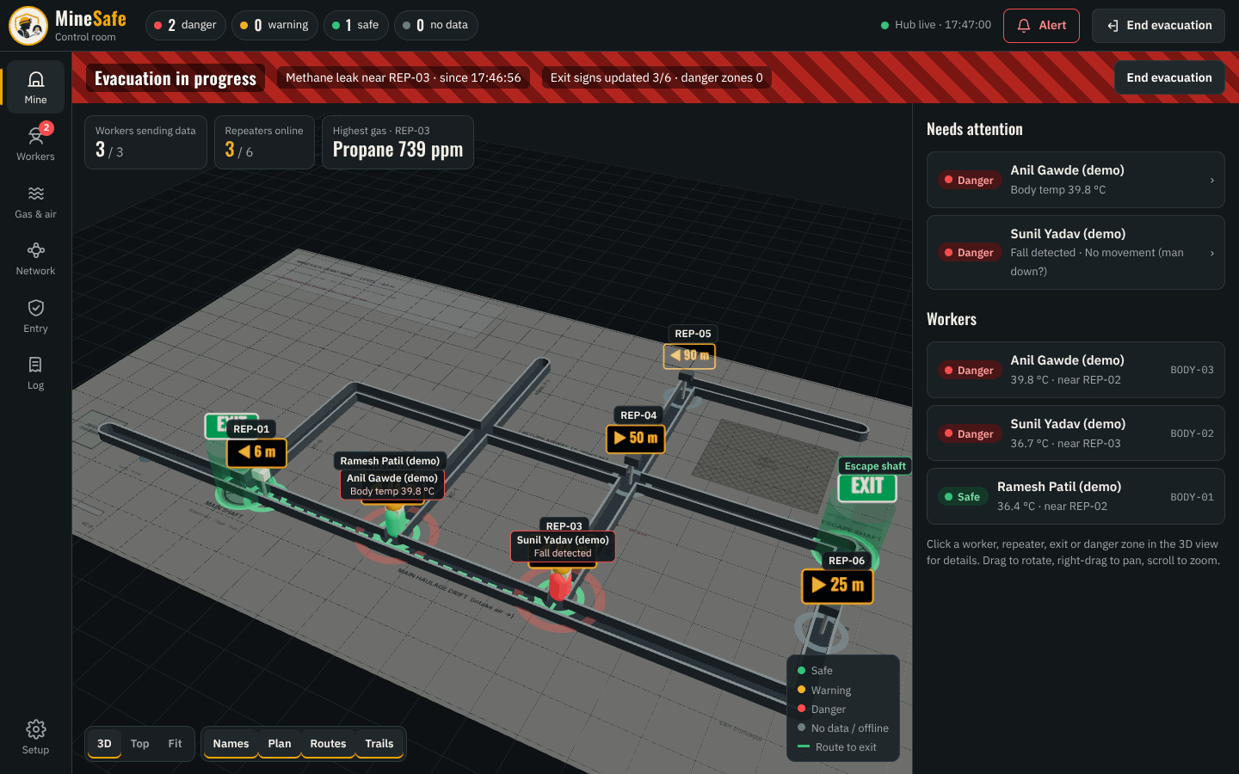
Location without GPS, evacuation without guesswork
1
Count steps
steps × step length along the gyro heading; pressure gives the level
2
Snap to the tunnel
every position is pulled onto the nearest tunnel on the mine map
3
Reset at repeaters
strong signal (≥ −55 dBm) = next to that repeater: drift goes to zero
4
Route around danger
Dijkstra from all exits; tunnels in the hazard zone cost 1000×; each exit sign shows its arrow + distance
Live 3D control room during an evacuation: routes go around the gas leak, exit signs update
Notes:
1:50–2:20. Integrating acceleration drifts ~175 m a minute — that is why we count steps and reset at every repeater. V4 adds a foot IMU that measures each real stride.

Slide 6








Designed for dust, water, methane, heat and blasting
Water and dust
Methane rises
Ignition risk
Heat 30–45 °C
IP65 gasket, drip hood, every opening faces down
CH₄ port on top under a rain chimney; H₂S / CO ports at the bottom
sintered flame-arrestor seat at every gas port
air sensor in its own chamber, away from heaters
Blasting shock
Power cuts
Dark and smoke
Thick gloves
screw bosses, latching connectors, rubber grommets
mine supply + battery, switch-over with no reset
LED exit signs, reflective hi-vis tape
16–22 mm buttons, vibration and voice alerts
Notes:
2:20–2:50. Every hardware decision starts from a mine condition. The suit is never locked — removal is detected, never prevented.

Slide 7
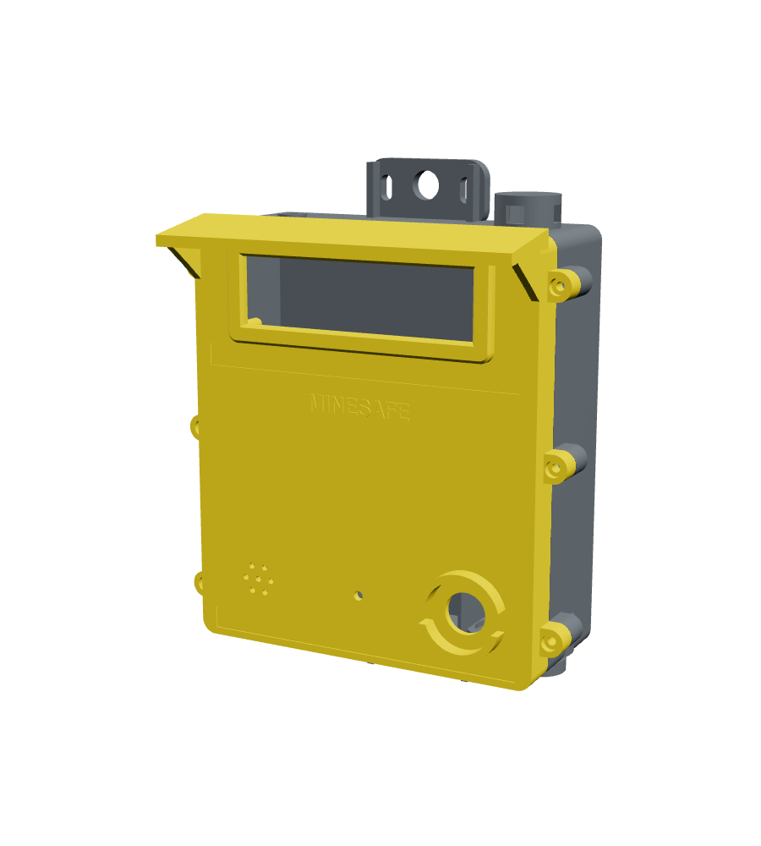
Each repeater is a radio relay, gas station and exit sign
Gas
MQ-4 CH₄ (top) · MQ-7 CO · MQ-136 H₂S (bottom), alarms to Indian limits
Air
temperature, humidity, wet-bulb heat limit 30.5 / 33.5 °C
Exit sign
8×32 LED matrix: arrow + distance to the safe exit
Alarm
85 dB buzzer works even if the control room is down
Power
9–30 V mine supply or battery, ≈ 3.7 W, ≈ 7 h backup
Case
223 × 292 × 118 mm, IP65 target, rock-bolt / chain mount
3D model — click and drag to turn it
Notes:
2:50–3:30. Turn the 3D model to show the CH4 chimney on top and the downward-facing ports. Same board runs as main repeater or tunnel repeater.

Slide 8
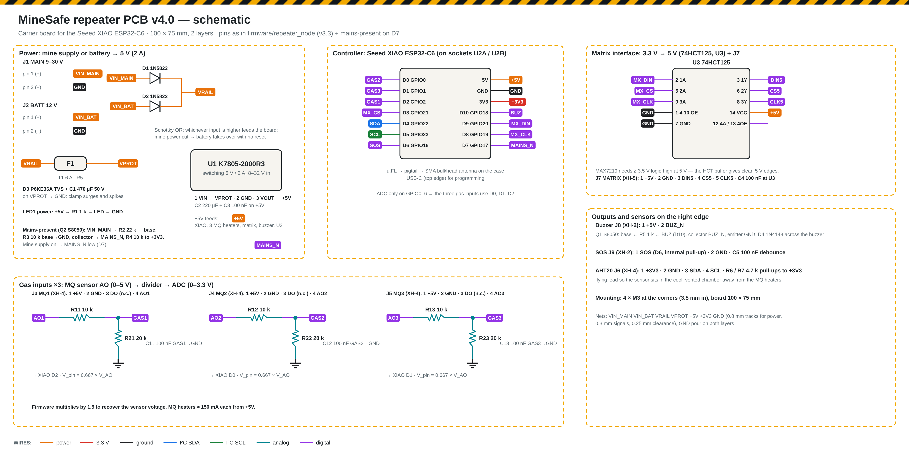
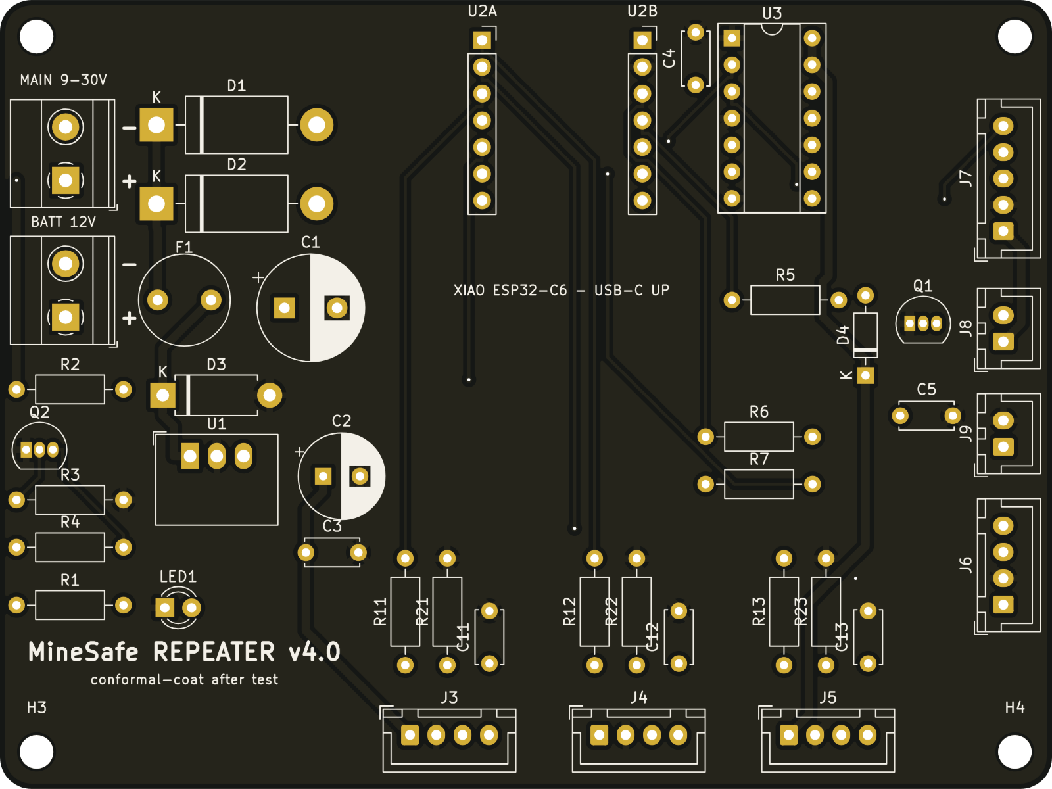
Five own PCBs: 100 % routed, 0 design-rule errors
KiCad 7 + Freerouting, generated by our own script: place, route, ground pour, DRC, Gerbers
Repeater schematic and board (100 × 75 mm)
2-layer, through-hole
Diode-OR power
Suit boards
hand-solderable, modules on sockets
fuse + TVS + 5 V / 2 A switcher
core 66 × 54 · cuff 46 × 42 · helmet 44 × 48 · boot 34 × 42 mm
Notes:
3:30–4:00. Point at the power path: mine supply and battery OR-ed by diodes, so a power cut never resets the repeater.

Slide 9





V4 smart suit: the kit checks itself all shift
Core pod · chest
ESP32-C6, 3000 mAh, motion + pressure, guarded SOS
Helmet pod
antenna at head height, voice alerts, helmet-on switch
Wrist cuff
screen, 3 glove buttons, vibration, heart rate + SpO₂
Boot pod
foot IMU measures each real stride, heel force sensor
Seams and zip
conductive thread + zip switch: torn or opened = alert
Never locked: removal or a tear is detected and reported, never prevented
Notes:
4:00–4:30. Turn the suit to show the helmet pod at the back and the boot pod on the right heel. Helmet and boot talk to the core over ESP-NOW; only the cuff is wired.

Slide 10
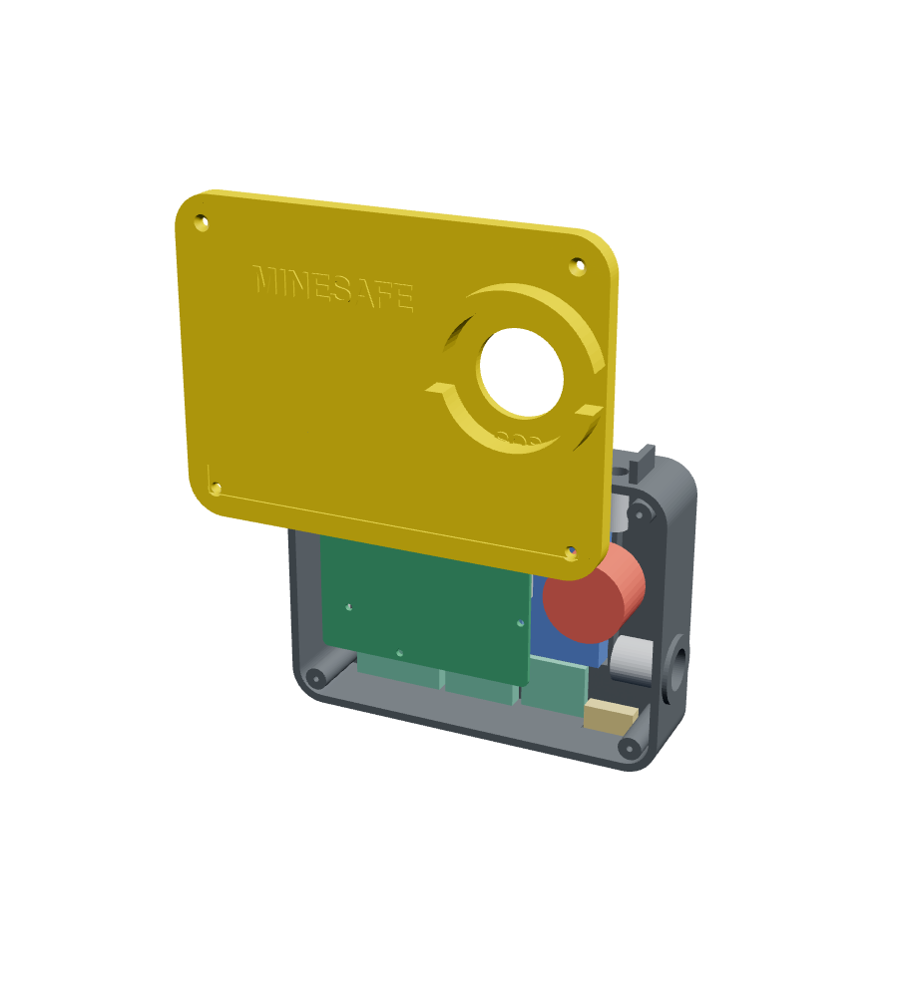
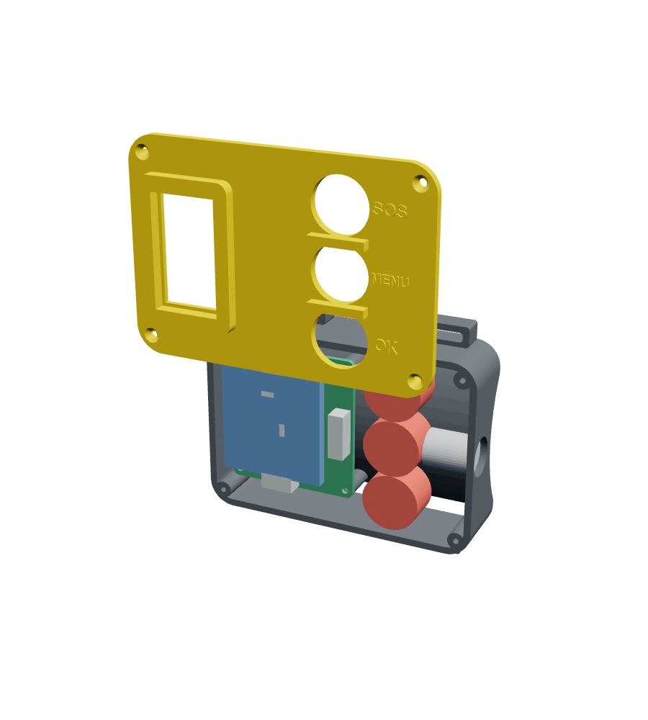
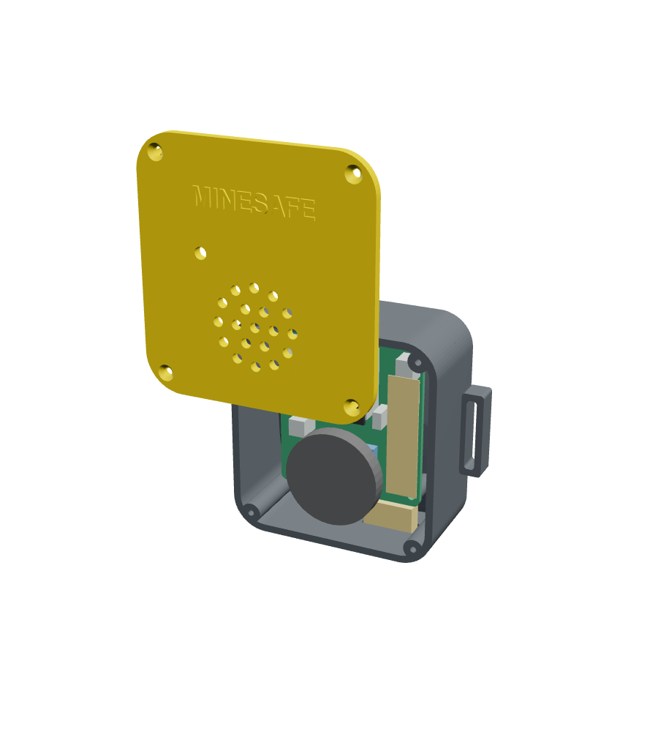
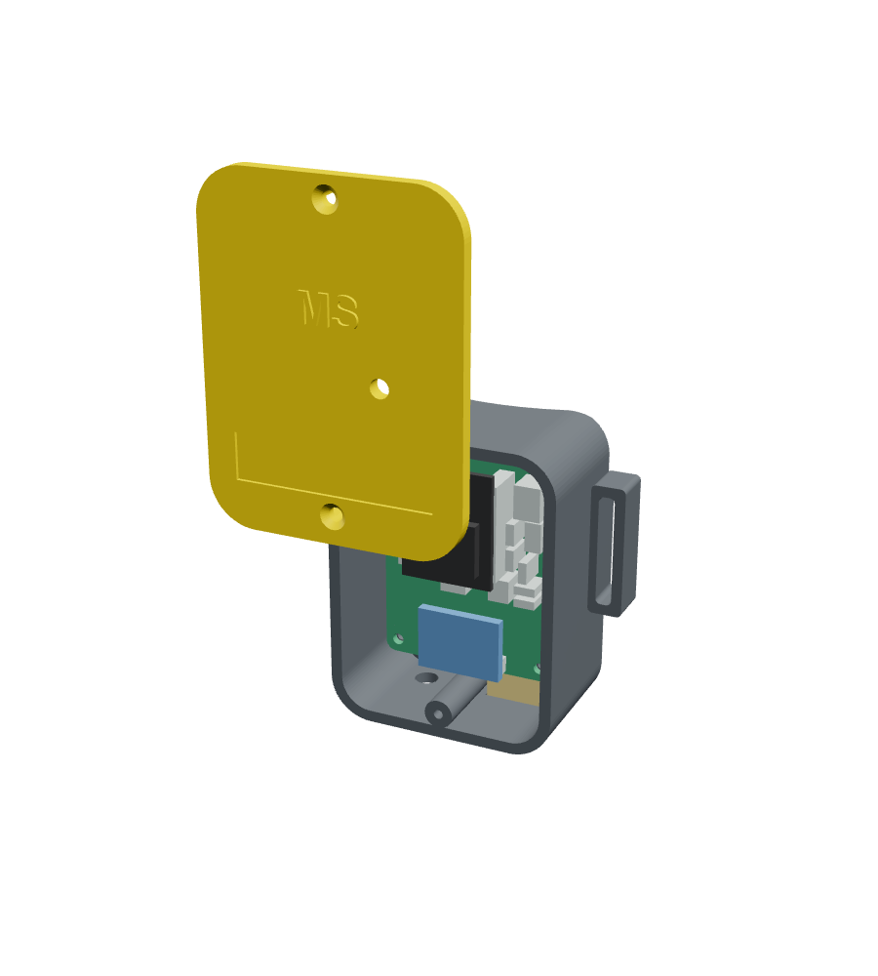
Four pods, each designed around its own board
Core pod
Wrist cuff
Helmet pod
Boot pod
118 × 93 × 44 mm
88 × 75 × 27 mm
75 × 66 × 31 mm
57 × 58 × 29 mm
Notes:
4:30–4:50. Lids shown lifted so the board, battery and modules are visible. Every case was fit-checked in CAD against its real KiCad board.

Slide 11
Energy budget: the core pod lasts almost two shifts
ESP32-C6 (XIAO)
Wi-Fi, BLE, Zigbee + ESP-NOW on one 21 mm board
ESP-NOW, not Zigbee
no re-joining for a moving worker; LoRa later for long tunnels
Step counting, not UWB
UWB ≈ ₹2,000 per tag and anchor; steps cost nothing
Switching regulators
a linear 7805 would waste ≈ 11 W at 24 V
Gas on repeaters only
MQ heaters use 150 mA — wrong for a battery wearable
* with the radio duty-cycled (V4 firmware). Datasheet estimates, to be confirmed by measurement.
Notes:
4:50–5:15. Repeater: ≈ 3.7 W, mostly the three gas-sensor heaters. Core pod: ≈ 112 mA at 3.3 V → ≈ 21 h from 3000 mAh.

Slide 12
Validated in steps: design and bench done, field tests next
Design checks
Bench tests
Field tests (pass criteria)
4 / 4 passed
5 / 6 passed
in progress
PCB DRC: 0 unconnected pads (5 boards)
CAD fit check: no collisions (5 cases)
Power budget: core pod 21 h ≥ 12 h
Signal levels: ADC and 5 V logic in range
Repeater chain forms by itself (3/3)
Air sensing logged (31.3 °C, 62 % RH)
Gas alarm + local buzzer
Hub logic + robustness with simulator
Body sensors: wiring being fixed
Alert to deepest worker ≤ 3 s (95 %)
Distance error ≤ 5 % over 100 m
Falls detected ≥ 90 %, ≤ 1 false / h
HR ± 5 bpm, SpO₂ ± 3 % vs oximeter
Hose test 30 min, 1 m drop, 24 h at 45 °C
Notes:
5:15–5:50. Be honest: V3 is in field calibration. Each field test has a numeric pass criterion; results are logged with screenshots and video.

Slide 13
Affordable for small mines: checked, located, reachable
₹6,860
₹12,800
₹3.3 L
Every commercial system: enterprise quote only
per repeater (PCB + mine case)
per smart suit
site: 10 repeaters + 20 suits
Social
faster rescue with a last known position; falls, gas and heat caught as they happen
SDGs
3 Good health · 8 Decent work · 9 Industry and innovation
Next
LoRa backbone · certified NDIR / electrochemical gas sensors · intrinsic-safety design · field trial with a mine
Thank you
Notes:
5:50–6:30. End on cost and impact (20 of 100 marks are economic efficiency and social relevance). Stop by 6:45 — over 7:15 disqualifies.

