Slide 1


SCS MINI PROJECT
VANITRA
BRIDGING SILENCE, EMPOWERING COMMUNICATION

Slide 2


VISION & MISSION
OUR VISION
To create a world where deaf-mute individuals communicate freely, confidently, and inclusively—empowered by advanced, accessible wearable technology.
OUR MISSION
To design, develop, and deliver an affordable, portable, and intelligent assistive device that bridges the communication gap for deaf-mute users. Through bidirectional translation of sign language to speech and speech to tactile feedback, we aim to foster independence, break social barriers, and enhance quality of life for the deaf-mute community.

Slide 3
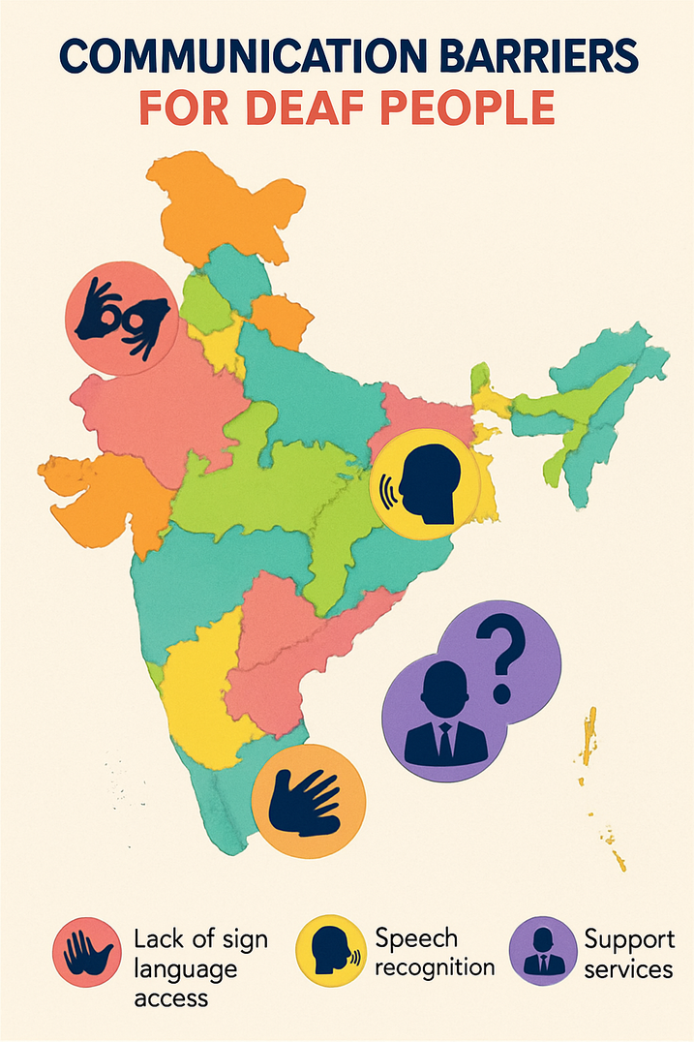
INTRODUCTION & MOTIVATION
Problem Statement
  Globally, 1.5 billion experience hearing loss.
  In India, ~63 million have hearing impairments .
  Deaf-mute people often struggle to communicate with the hearing world due to a lack of interpreters, high costs, and technology dependence.
Solution
affordable, portable, and independent communication Device for deaf-mute community.

Slide 4
LITERATURE SURVEY
AHMED ET AL.
LEE & LEE
Early systems, like those by Ahmed et al., used flex sensors with Arduino to detect finger movements and trigger simple audio responses but were limited to one-way communication and small vocabularies
Enhanced this by combining flex, pressure sensors, and an inertial unit for ASL character recognition, supported by mobile apps but relying on connectivity.
GHOTKAR ET AL.
VIGNESHWARAN ET AL.
Focused on Indian Sign Language using camera-based visual tracking, which reduced portability due to environmental constraints.
Developed flex sensor modules with Hidden Markov Models for English alphabets but mainly addressed static gestures, lacking support for dynamic signs needed for natural interaction.

Slide 5

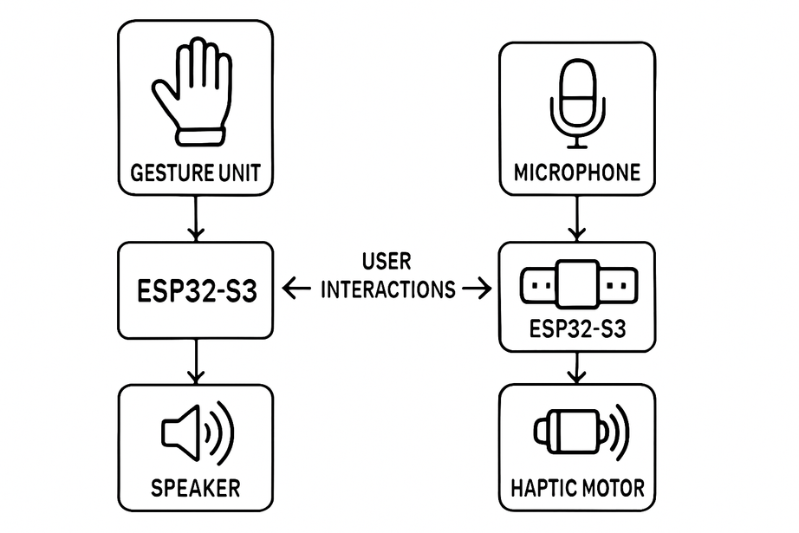
VANITRA
CONSISTS OF TWO WEARABLE MODULES THAT WORK TOGETHER SEAMLESSLY:
  Gesture-to-Speech Glove: Captures sign language gestures using flex sensors, hall effect sensors, magnets, and an IMU. Embedded AI on the ESP32-S3 microcontroller interprets gestures and outputs spoken words via a speaker.
  Speech-to-Haptic Wristband: Receives spoken words via a microphone, converts speech into Morse code, and delivers tactile feedback using a haptic motor. This enables deaf-mute users to receive messages without relying on audio.

Slide 6

ROAD MAP OF OPERATION MANAGEMENT
DEFINE
Understand and define operational goals, processes, and performance metrics to establish a clear direction and purpose.
ANALYSIS
Conduct in-depth analysis of current operations, identify strengths, weaknesses, opportunities, and threats (SWOT analysis), and gather data to inform decision-making.
IMPROVEMENT
Implement strategies, initiatives, and best practices to optimize processes, enhance efficiency, reduce costs, and improve overall performance.
CONTROL
Monitor and control operations by setting standards, implementing quality control measures, and using feedback mechanisms to ensure consistency, quality, and continuous improvement.

Slide 7

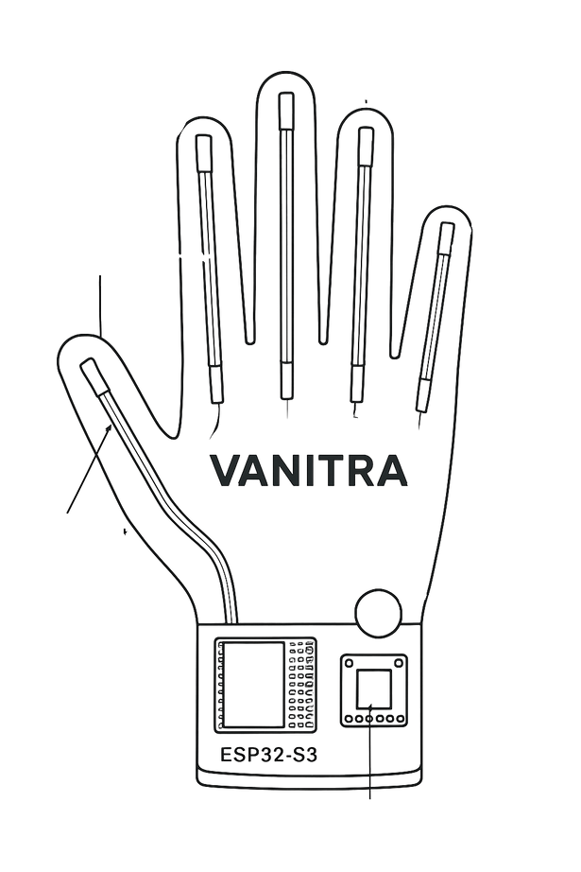
VANITRA-HARDWARE DESIGN
COMPONENTS: GLOVE UNIT
Flex Sensors, Hall Effect Sensors & Magnets, MPU6050 (IMU), ESP32-S3 Microcontroller, Speaker
MAGNETS
HALL EFFECT SENSOR
MPU 6050
Flex Sensor
ESP 32 S3
Speaker
FLEX SENSOR
SPEAKER
Hall Effect
Sensor
IMU
MPU 6050

Slide 8

VANITRA-HARDWARE DESIGN
COMPONENTS: SPEECH UNIT
Microphone, Hall Effect Sensors & Magnets, Haptic Motor (Vibromotor)
HAPTIC
MOTOR
MIC
ESP 32 S3
MIC

Slide 9

METHODOLOGY
Input: Normalized Gesture Data
  Sensor Calibration:
Calibrate flex sensors, hall effect sensors, and MPU6050 IMU to normalize readings and ensure consistency across users.
  Data Collection:
Collect a diverse dataset of hand gestures from multiple users to train machine learning models effectively.
  Embedded Machine Learning:
Deploy a lightweight AI model on the ESP32-S3 to classify gestures in real-time. Convert speech input into Morse code for haptic feedback via a vibromotor.
Input: Audio Signal (Speech)
Feature Extraction
Speech-to-Text Conversion (ML/AI Model)
ML/AI Model (Gesture Classification)
Text-to-Morse Code Encoder (Algorithmic Mapping)
Output: Recognized Word or Phrase
Output: Recognized Word or Phrase

Slide 10

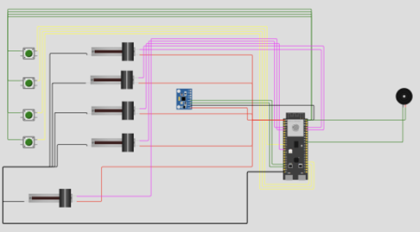
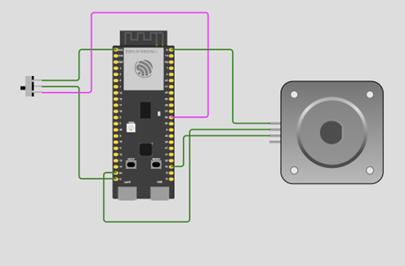
RESULTS
01
  Gesture Recognition Accuracy: Achieved between 90–94% under controlled conditions.
  Speech-to-Morse Recognition Accuracy: Maintained 85–90% accuracy for clear spoken inputs.
  Latency: End-to-end system response times ranged from 350–500 milliseconds, enabling near real-time communication.

Slide 11

IMPROVEMENT
02
  Integrate Force Sensitive Resistors (FSRs) to enable pressure sensitivity for richer gesture detection.
  Develop a smartwatch-like companion module to allow users to easily select sign language and spoken language preferences.
  Expand the gesture vocabulary and language support to increase communication flexibility.
  Conduct extensive real-world user testing to validate system performance and usability in daily scenarios.
SOCIAL IMPACT
  Enables greater independence and autonomy for deaf-mute individuals in daily life.
  Unlocks new opportunities in education, employment, and public engagement for the deaf-mute community.
  Helps bridge communication gaps inclusively, fostering social integration and equal participation.
03

Slide 12
VANITRA
CONCLUSION
Vanitra demonstrates a practical and effective wearable solution for bidirectional communication between deaf-mute individuals and hearing people. By integrating sensor-equipped gloves and a speech-to-haptic wristband, combined with embedded AI on the ESP32-S3, the system enables seamless offline translation of sign language to speech and speech to tactile feedback. Prototype testing shows promising accuracy, responsiveness, and user acceptance. While challenges remain, Vanitra represents a significant step toward empowering deaf-mute communities with greater independence and inclusion through innovative technology.

Slide 13
THANK YOU
FOR YOUR ATTENTION

