Slide 1
GROUP PROJECT | MANAS AND YASHASVEE
Hospital patient flow and bed capacity
Real hospital data, queueing models, simulation, and validation
13 questions across patient stays, arrivals, beds, transfers, and waiting
15-minute presentation
Hospital patient flow | 1 / 10
Notes:
0:00–1:00. Introduce the real problem: unpredictable arrivals and lengths of stay create congestion. Explain that each number in the talk is either an observed dataset summary or a conditional model scenario.

Slide 2
APPLIED STOCHASTIC MODELS
Problem and data
SPARCS: 250,000 inpatient discharges
eICU demo: 2,520 ICU stays
MIMIC-IV: local ICU and transfer extracts
CMS: emergency department benchmark measures
Question: how do variation, capacity, and downstream transfers affect waiting and blocking?
Hospital patient flow | 2 / 10
Notes:
1:00–2:30. Name the four sources and explain that they represent different institutions. We use them for different parts of the analysis; we do not treat them as one hospital. The CMS very-high-volume tier is an external benchmark.

Slide 3
APPLIED STOCHASTIC MODELS
Model pipeline and assumptions
Arrivals: hourly non-homogeneous Poisson profile
Service: empirical stay distributions
Capacity: Erlang-C waiting and Erlang-B blocking
Network: routing plus two-stage ED/ICU simulation
Assumptions matter
Poisson arrivals, steady state, homogeneous beds, and cross-source calibration are simplifications. We report them with each result.
Hospital patient flow | 3 / 10
Notes:
2:30–4:00. Explain the mathematical workflow: estimate inputs, formulate a stochastic process, calculate a theoretical result, simulate, then compare with observed benchmarks. Distinguish loss from waiting systems.

Slide 4
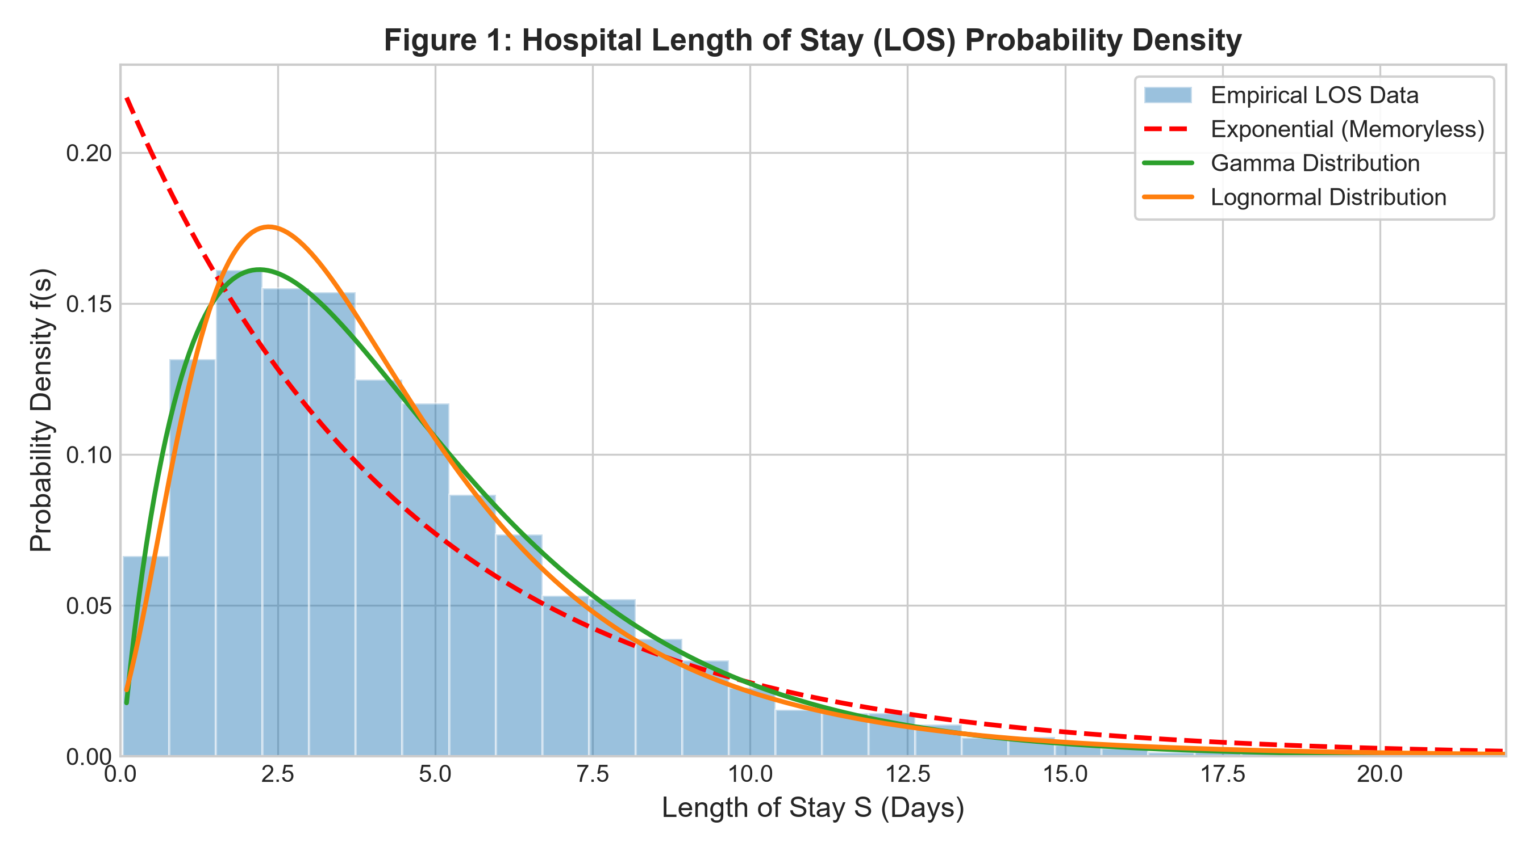
APPLIED STOCHASTIC MODELS
Patient stays are highly variable
SPARCS CV² = 1.991
eICU ICU CV² = 2.025
MIMIC ICU CV² = 2.215
The exponential benchmark has CV² = 1. All three cohorts exceed it.
Hospital patient flow | 4 / 10
Notes:
4:00–5:15. CV squared equals variance divided by mean squared. The processed SPARCS estimate is 1.991. Weibull ranks best by AIC in the eICU fit, but the KS screen rejects an exact fit. Avoid claiming the distribution is clinically validated.

Slide 5
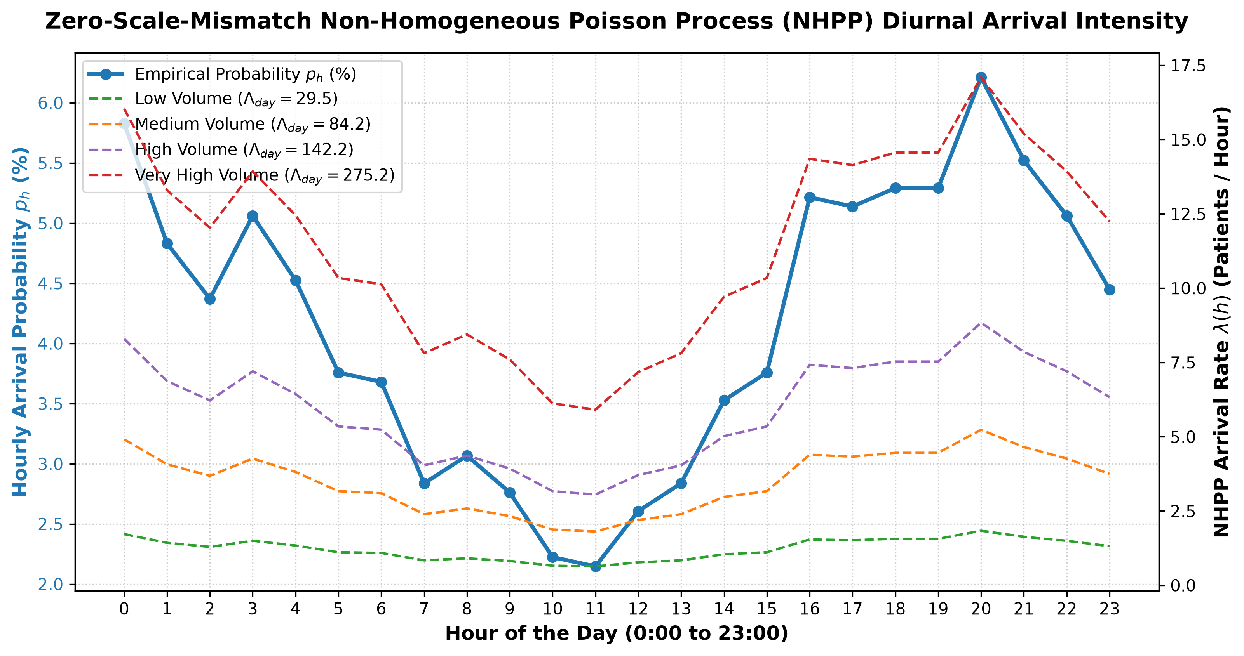
APPLIED STOCHASTIC MODELS
Arrivals change over the day
eICU hourly pattern scaled to a CMS volume tier
Illustrative peak: 17.09 arrivals/hour at 20:00
Illustrative trough: 5.91 arrivals/hour at 11:00
Peak-to-trough ratio: 2.89
Hospital patient flow | 5 / 10
Notes:
5:15–6:30. The hourly shape is from eICU, and the daily volume comes from a CMS hospital tier. These are not matched hospital records. Explain that a non-homogeneous Poisson process changes its rate by hour.

Slide 6
APPLIED STOCHASTIC MODELS
Capacity changes waiting and blocking
Erlang-C scenario: 225 Erlangs
230 beds: 15.55 h mean wait
242 beds: 1.30 h mean wait
Erlang-B scenario: 150 Erlangs
169 beds: 1.03% blocking
170 beds: 0.90% blocking
The 1% target is a chosen planning threshold, not a regulation. Results are conditional on model rates and service assumptions.
Hospital patient flow | 6 / 10
Notes:
6:30–8:30. Show the difference between a waiting system and a loss system. For the loss scenario, the first integer capacity meeting 1% is 170 beds, not 169. Walk through the interpretation of offered load and utilization.

Slide 7
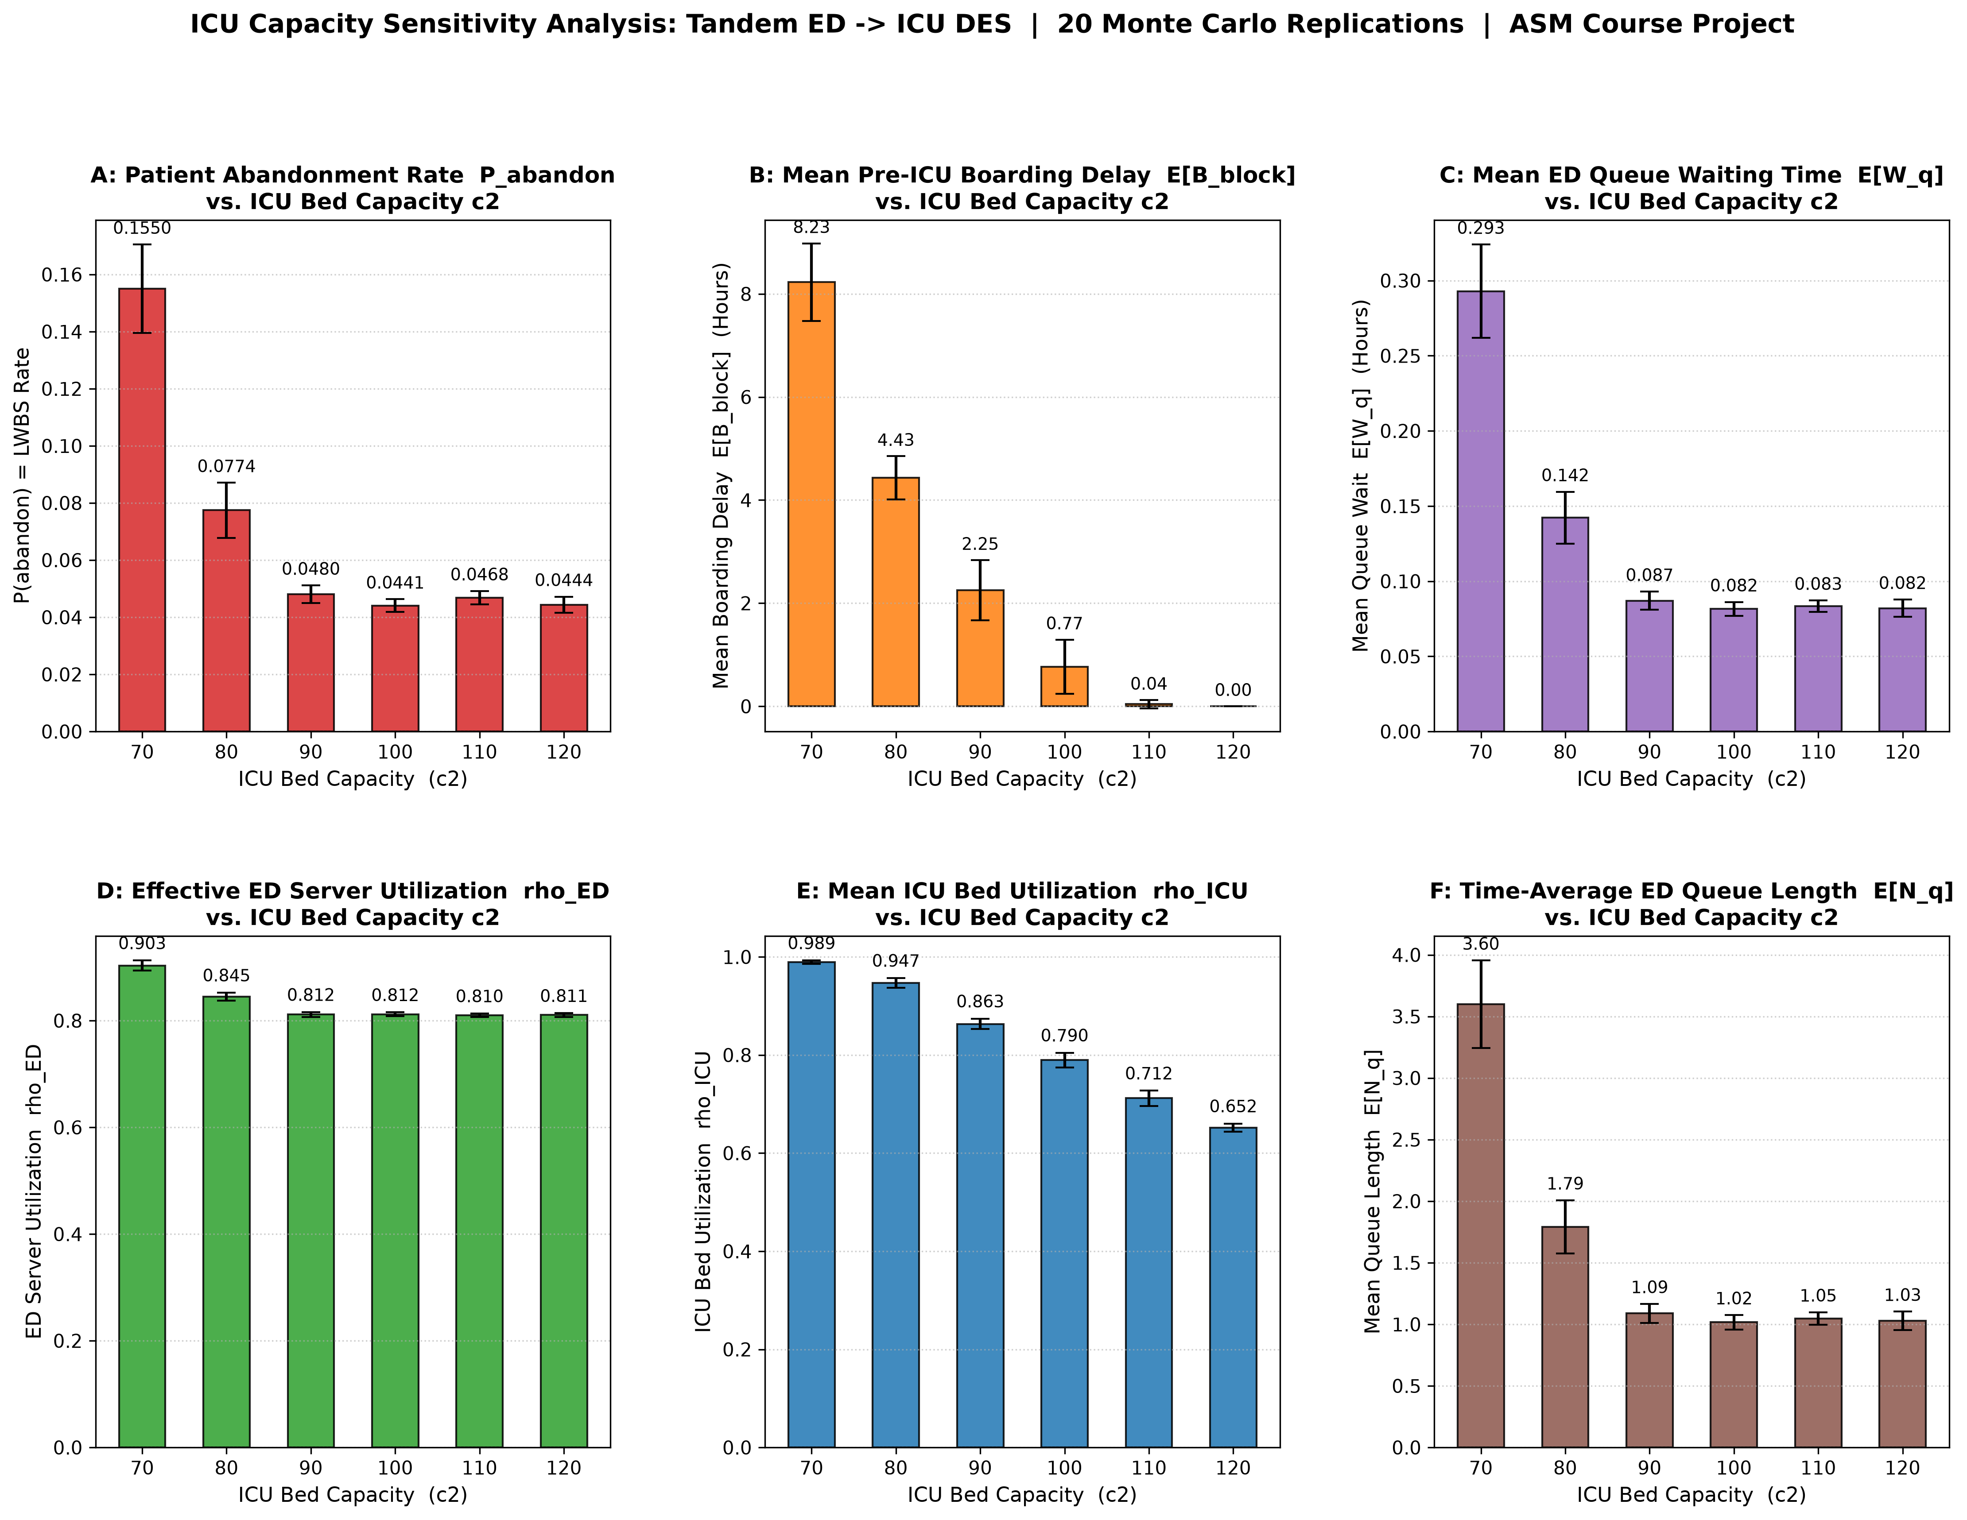
APPLIED STOCHASTIC MODELS
A full ICU can hold an ED bay
Repaired two-stage simulation:
45 ED bays, ICU capacities 70–120
At 90 ICU beds:
4.80% modeled ED abandonment
2.25 h mean delay among boarded patients
86.3% ICU utilization
Hospital patient flow | 7 / 10
Notes:
8:30–10:00. ED patients routed to ICU keep an ED bay until an ICU bed becomes available. The simulation now holds the ICU bed for the complete ICU stay. Its boarding mean is conditional on boarding. Do not call the eICU admission offset directly observed ED boarding.

Slide 8
APPLIED STOCHASTIC MODELS
Validation exposes a remaining mismatch
CMS very-high-volume tier
Partner simulation at 90 ICU beds
ED abandonment: 2.33%
ED sojourn: 202.5 min
ED abandonment: 4.80% ± 0.31%
ED sojourn: 206.7 ± 1.6 min
Both benchmark comparisons fail the reported simulation intervals. This model cannot support a clinical capacity recommendation.
Hospital patient flow | 8 / 10
Notes:
10:00–11:30. Software tests pass, but external empirical validation fails. The theoretical ED calibration matches its target by construction and is not independent validation. Explain the need for a single-facility dataset with matched timestamps.

Slide 9
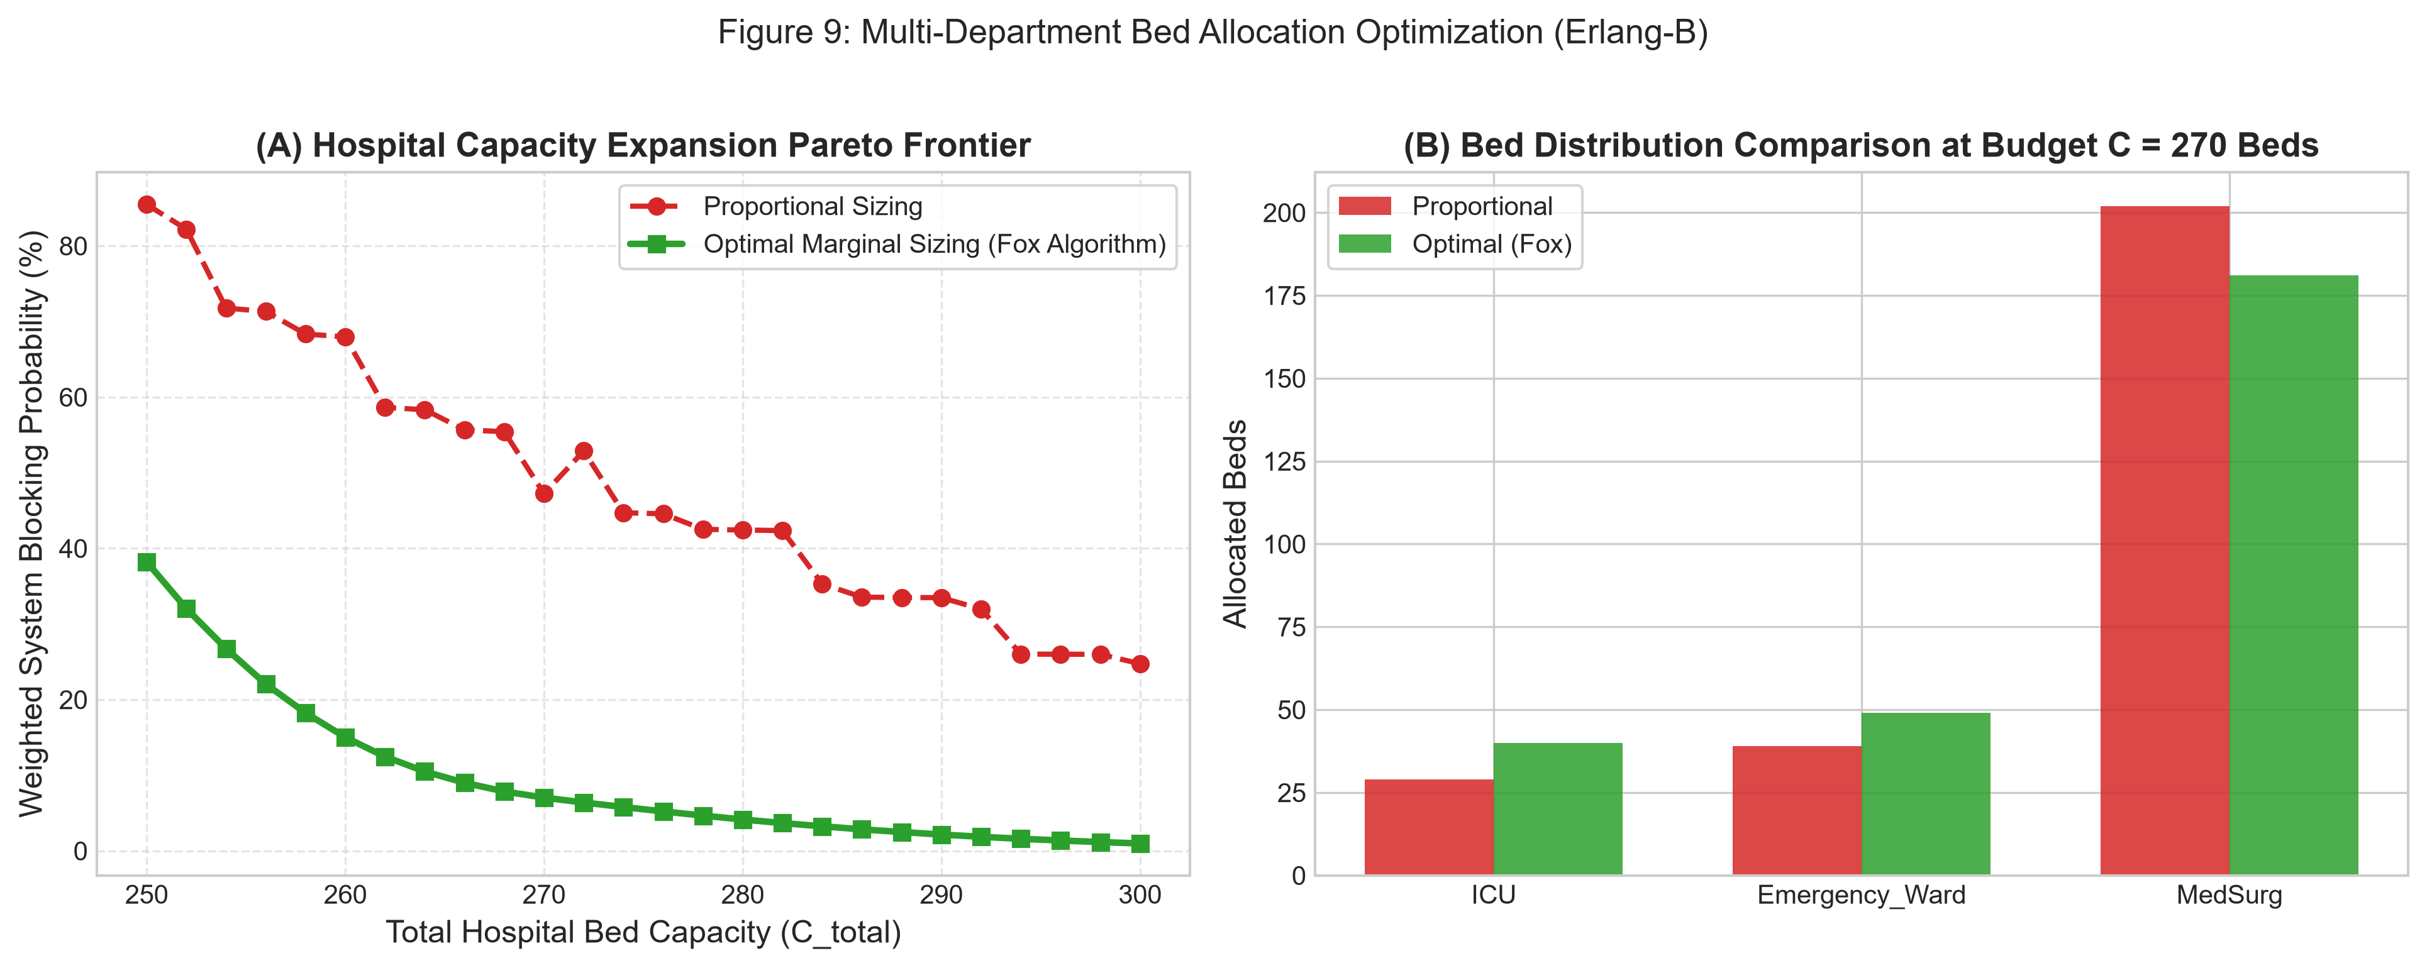
APPLIED STOCHASTIC MODELS
Allocation and staffing scenarios
230-bed allocation example:
Weighted blocking objective falls from 0.40374 to 0.06550 (83.8%).
Pointwise staffing scenario:
Peak modeled wait falls from 41.5 to 1.1 minutes with the same bed-hours.
Hospital patient flow | 9 / 10
Notes:
11:30–13:00. These are conditional model results, not observed patient benefits. The allocation weights are policy inputs. Specialty beds and staff may not be interchangeable. PSA ignores queue carryover between hours.

Slide 10
APPLIED STOCHASTIC MODELS
Demo, limits, and next step
Live demo: streamlit run app.py
Show the 13-question matrix, Erlang-B threshold, and failed ED/ICU validation.
Next: matched single-facility arrivals, bed requests, transfer times, and abandonment records.
Hospital patient flow | 10 / 10
Notes:
13:00–15:00. Demonstrate the app briefly. Contributions: Manas handled the macro SPARCS/MIMIC and queue models; Yashasvee handled eICU/CMS and ED/ICU simulation; both integrated and reviewed the project. Close with the strongest limitation: cross-source calibration and failed external validation. Leave time for questions.

