Slide 1
UTKRISHTA 2026 | SSG × RESEARCH CLUB, IIIT SRI CITY
LFM Radar Pulse Compression & +10 dB SNR Boost for Long-Range Space Target Tracking
Solving the Radar Energy-Resolution Dilemma at 200 km Range with Linear Frequency Modulation
TRACK 1: Radar Signal Processing — Target Detection, Pulse Compression & SNR Enhancement
Curated by: Mr. Rajendra Kumar, Scientist, Radar Division, SDSC SHAR
Team: Spaceship
Members: Manas Vinod Jain, Vikhyat Gupta

Slide 2
TRACK 1: RADAR SIGNAL PROCESSING | SDSC SHAR
Problem Overview & Space-Tracking System Setup
The Long-Range Radar Dilemma
• Mission Requirement: Detect distant, small RCS space objects (R = 200 km, RCS = 1.0 m²) at SDSC SHAR.
• Classical CW Pulse Conflict: Higher detection range requires high pulse energy Et = Pt · tau. But simple pulses tie range resolution directly to pulse duration: dR = c · tau / 2.
• Catastrophic Resolution Loss: A 100 μs unmodulated pulse yields dR = 15 km (unusable for precision tracking).
• The LFM Solution: Linearly chirp the frequency across bandwidth B = 4 MHz. Resolution becomes dR = c / (2B) = 37.5 m, independent of pulse duration!
Assumed S-band Radar Link Specifications
• Carrier Frequency (fc): 3.0 GHz (S-Band, λ = 0.1 m)
• Pulse Repetition Time (PRT): 2.0 ms (PRF = 500 Hz, Runamb = 300 km)
• Chirp Sweep Bandwidth (B): 4.0 MHz (Nominal dR = 37.5 m)
• Pulse Widths Compared: 10 μs (TB = 40) vs 100 μs (TB = 400)
• Transmit Peak Power (Pt): 250 kW (53.98 dBW)
• Antenna Gain (Tx & Rx): 40.0 dBi each (Beamwidth ~ 1.8°)
• Target Range & RCS: R = 200.0 km, RCS = 1.0 m² (0 dBsm)
• Received Power (Pr): 3.95 × 10⁻¹⁴ W (-134.04 dBW)
• Noise Figure & Losses: F = 2.5 dB, System Loss L = 3.0 dB

Slide 3
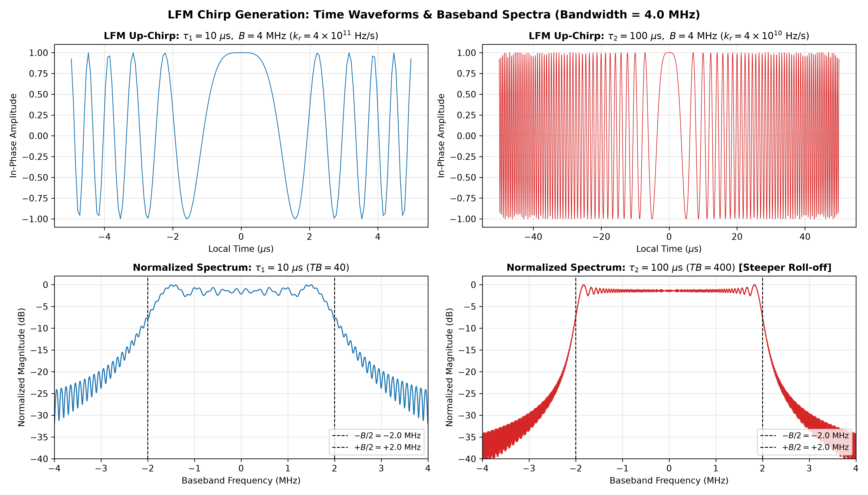
TRACK 1: RADAR SIGNAL PROCESSING | SDSC SHAR
Simulation Methodology & Mathematical Pipeline
Step 1: Signal Synthesis
PRT = 2 ms, B = 4 MHz, fs = 16 MHz. Dual LFM up-chirps: s(t) = rect(t/tau) exp(j π kr t²). Slope kr1 = 4e11 Hz/s vs kr2 = 4e10 Hz/s.
Step 2: Channel & Propagation
Radar Range Equation at R = 200 km (delay 1.333 ms). Circular complex AWGN with discrete-time variance Pn = N0 · fs.
Step 3: Matched Filter (MF)
Zero-padded FFT linear cross-correlation: y(t) = ifft(fft(rx) · conj(fft(ref))). Trims circular convolution artifacts.
Step 4: Detection & CA-CFAR
1-D Cell-Averaging CFAR (Nref=48, Nguard=16, Pfa=1e-6). Link margin verification against Swerling 0 Marcum Q model.

Slide 4
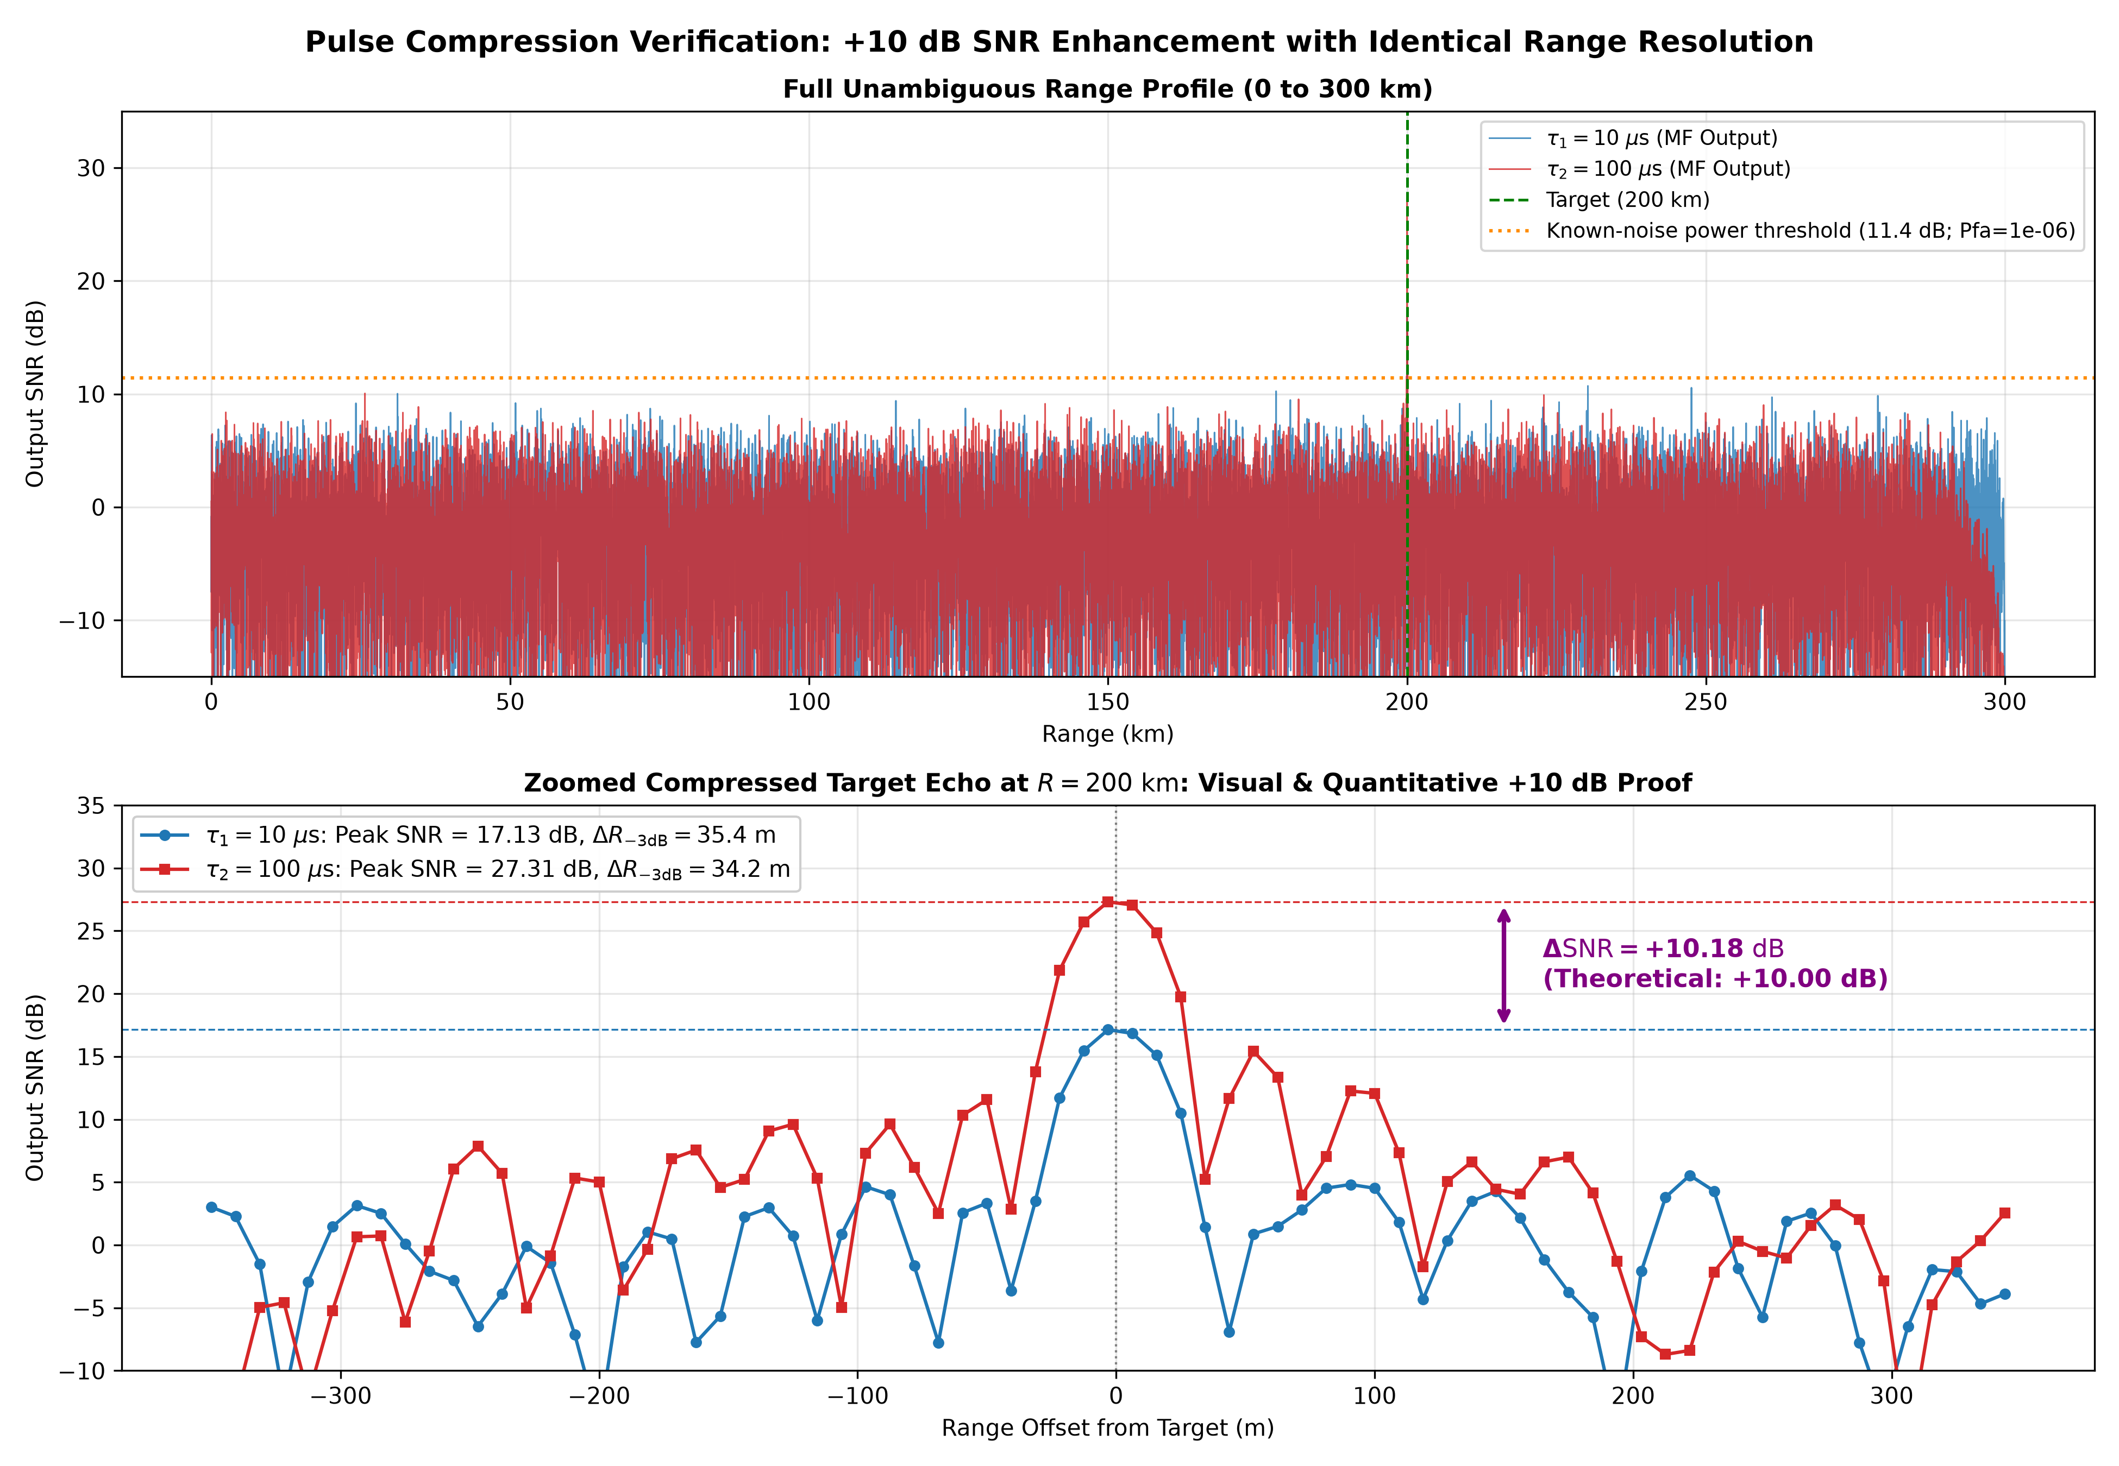
TRACK 1: RADAR SIGNAL PROCESSING | SDSC SHAR
Quantitative Verification & Experimental Plots
Parameter / Metric | Pulse 1 (10 μs) | Pulse 2 (100 μs) | Gain / Ratio
Time-Bandwidth (TB) | 40 (16.0 dB) | 400 (26.0 dB) | +10.0 dB
Radiated Energy | 2.50 J | 25.00 J | +10.0 dB
Theoretical MF SNR | 17.44 dB | 27.44 dB | +10.00 dB
Simulated Peak SNR | 17.13 dB | 27.31 dB | +10.18 dB (Valid!)
Nominal Resolution | 37.50 m | 37.50 m | 1.00x (Identical)
Measured -3dB Width | 35.36 m | 34.17 m | Similar widths
Required SNR (Pd=0.9) | 13.18 dB | 13.18 dB | Marcum Q baseline
Link Margin | +4.25 dB (Marginal) | +14.25 dB (Robust) | +10.00 dB Boost
CA-CFAR Margin | +4.14 dB | +10.08 dB | +5.93 dB Boost

Slide 5
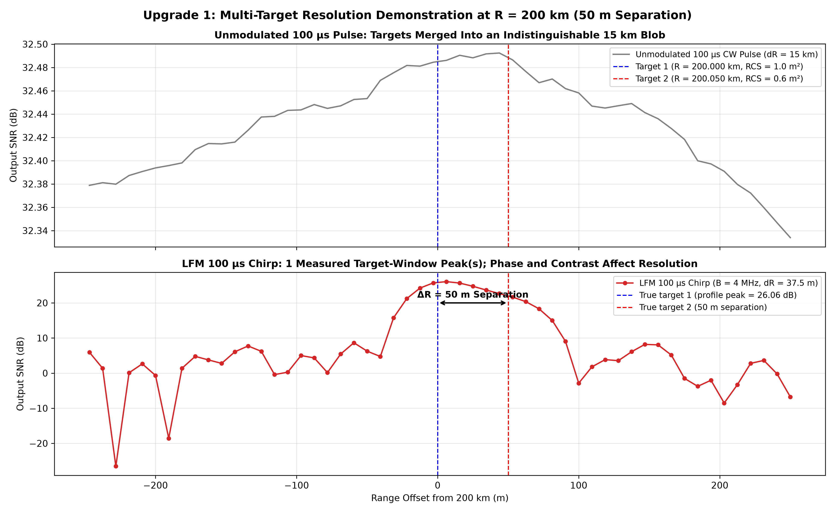
TRACK 1: RADAR SIGNAL PROCESSING | SDSC SHAR
Insights, Bonus Experiments & Conclusion
Operational Insights & Bonus Experiments
• Core Proof Verified: Matched-filter SNR increases by +10.18 dB (theory: +10.00 dB) while range resolution remains invariant at ~35 m for both 10 μs and 100 μs chirps.
• Validation: 200 production trials give mean 9.99 dB; 95% mean CI [9.88, 10.10] dB. Assumed link parameters; correlated MF cells limit nominal CFAR Pfa calibration.
• Bonus Exp 1 (Multi-Target at 200 km): The 50 m pair yields one local peak in this coherent unequal-target realization. Nominal c/(2B) resolution alone does not guarantee separation; phase, contrast and noise matter.
• Bonus Exp 2 (Mach 5 Doppler Coupling): A 1500 m/s rocket induces -112.5 m range bias. We implemented Chirp Diversity (Up/Down chirp pairs), canceling the bias to -3 m and extracting exact velocity (1500 m/s)!

