Slide 1
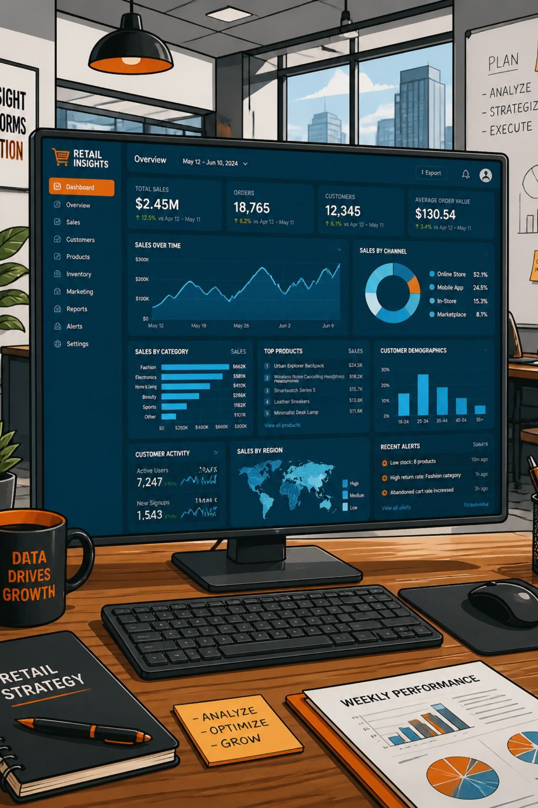
Customer Shopping Behavior Analysis
Insights from 3,900 transactions across demographics, spending patterns, and product preferences to guide strategic decisions.
1

Slide 2
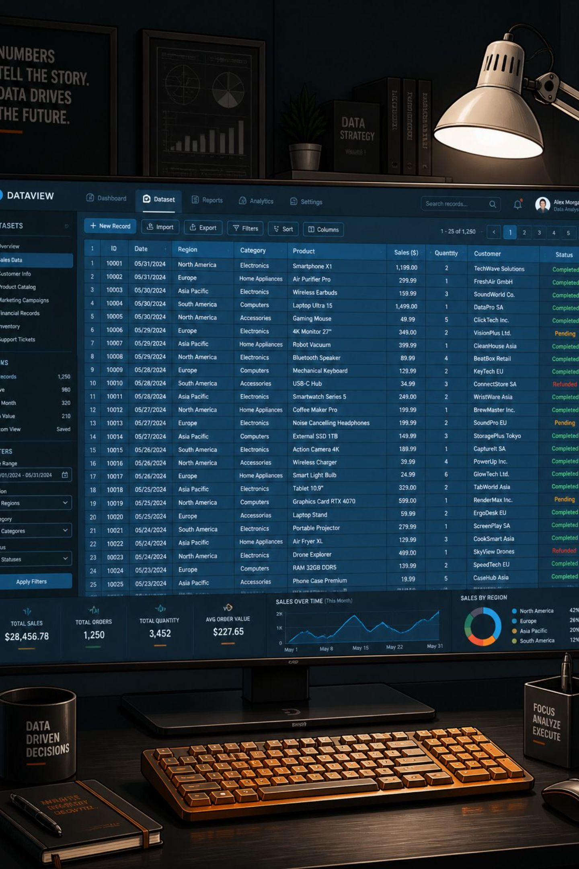
Dataset at a Glance
3,900
18
Purchases
Columns
37
Missing Values
Review Rating only
Demographics
Purchase Details
Age, Gender, Location, Subscription
Item, Category, Amount, Season
Behavior
Discount, Promo, Frequency, Rating
2

Slide 3

Exploratory Data Analysis
Python Prep Steps
Loaded dataset with pandas, ran df.info() & df.describe()
Imputed missing Review Ratings using category median
Engineered age_group & purchase_frequency_days
Dropped redundant promo_code_used column
Loaded cleaned data into PostgreSQL
3

Slide 4
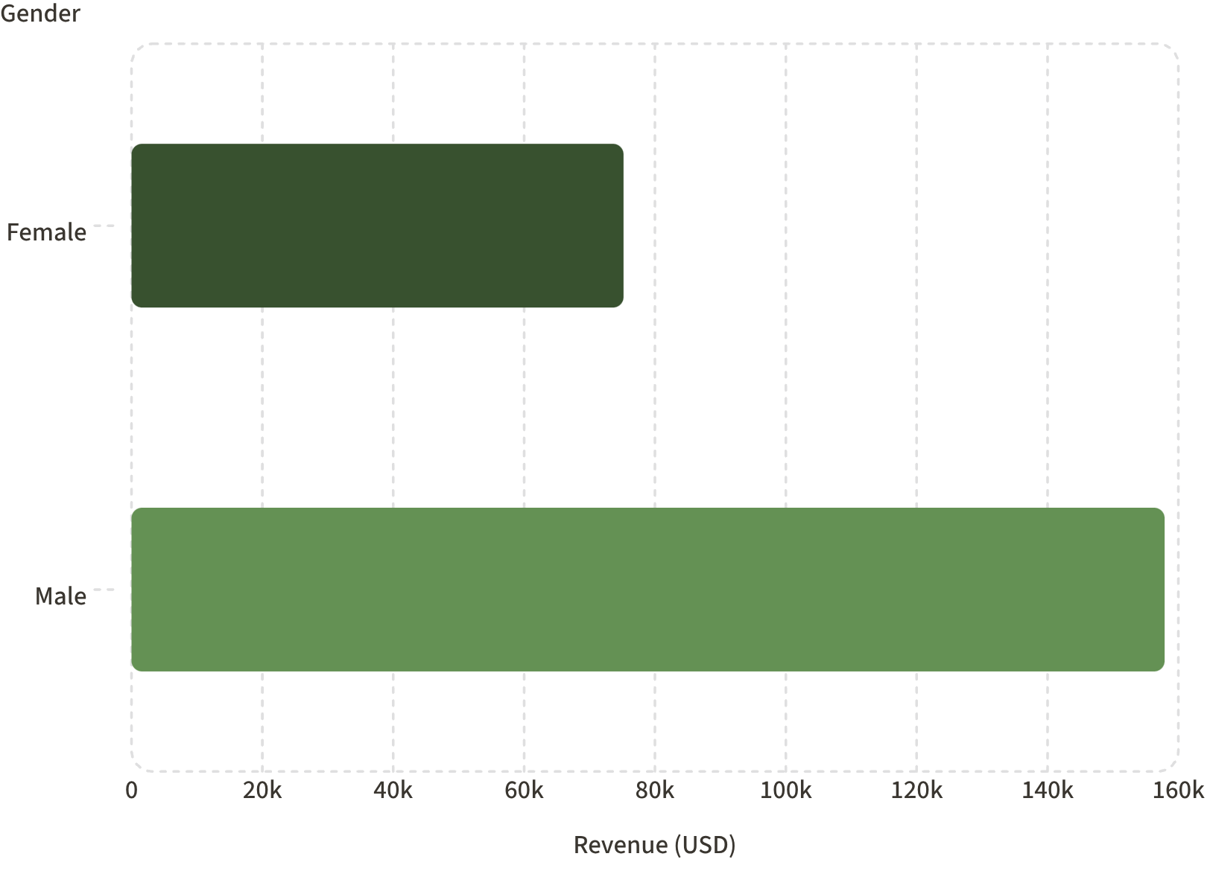
Revenue by Gender
Key Finding
Male customers generate 2.1× more revenue than female customers.
Male Revenue
Female Revenue
$157,890
$75,191
4

Slide 5
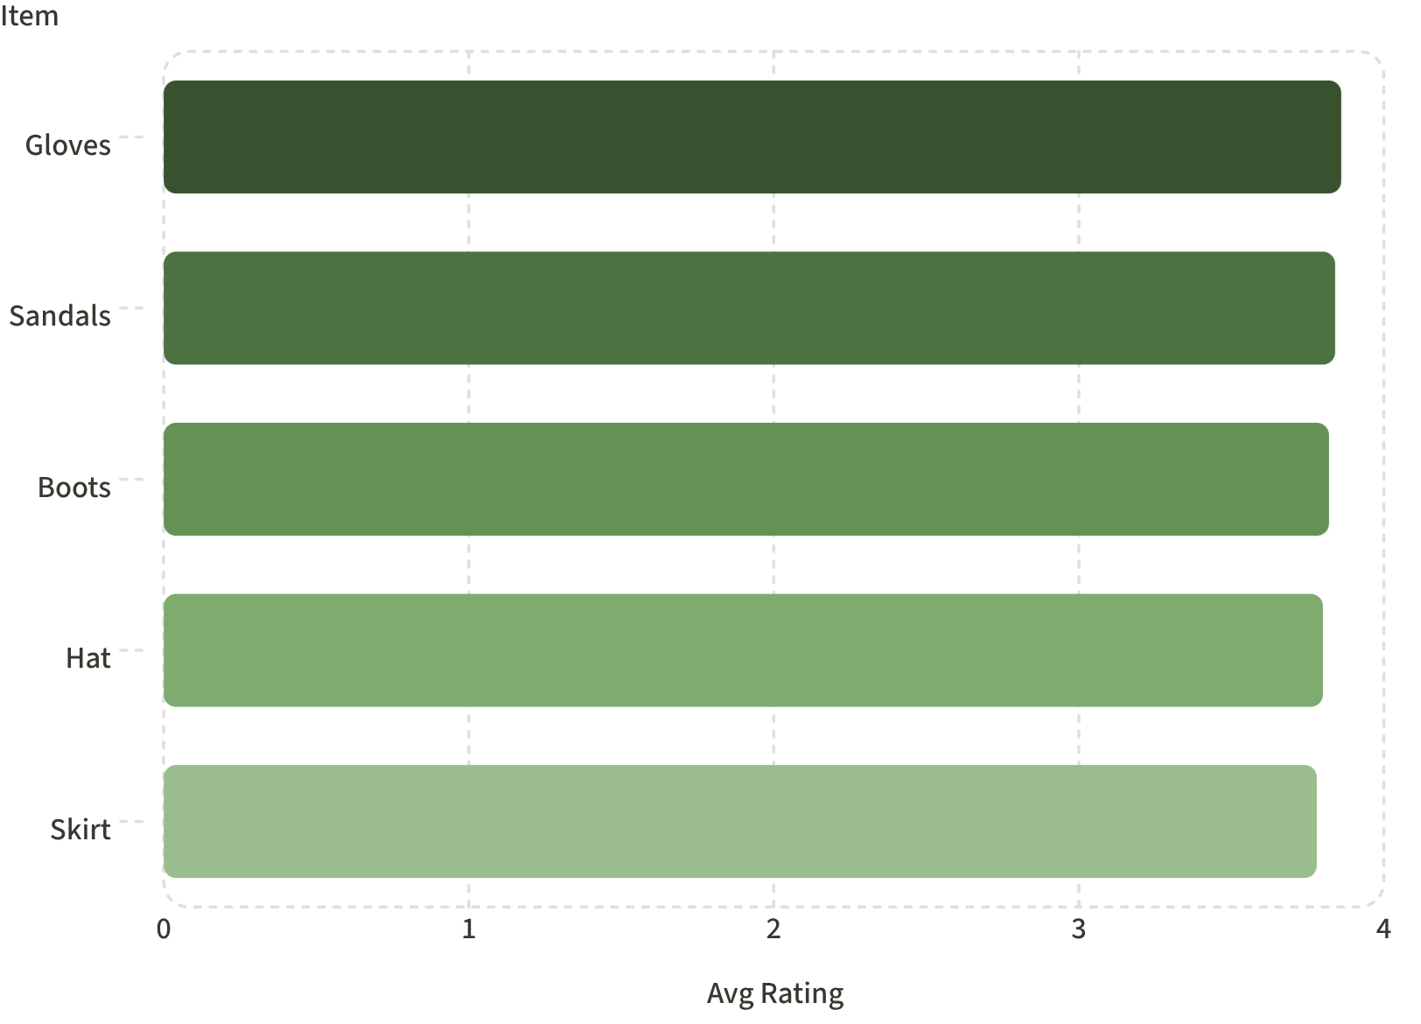
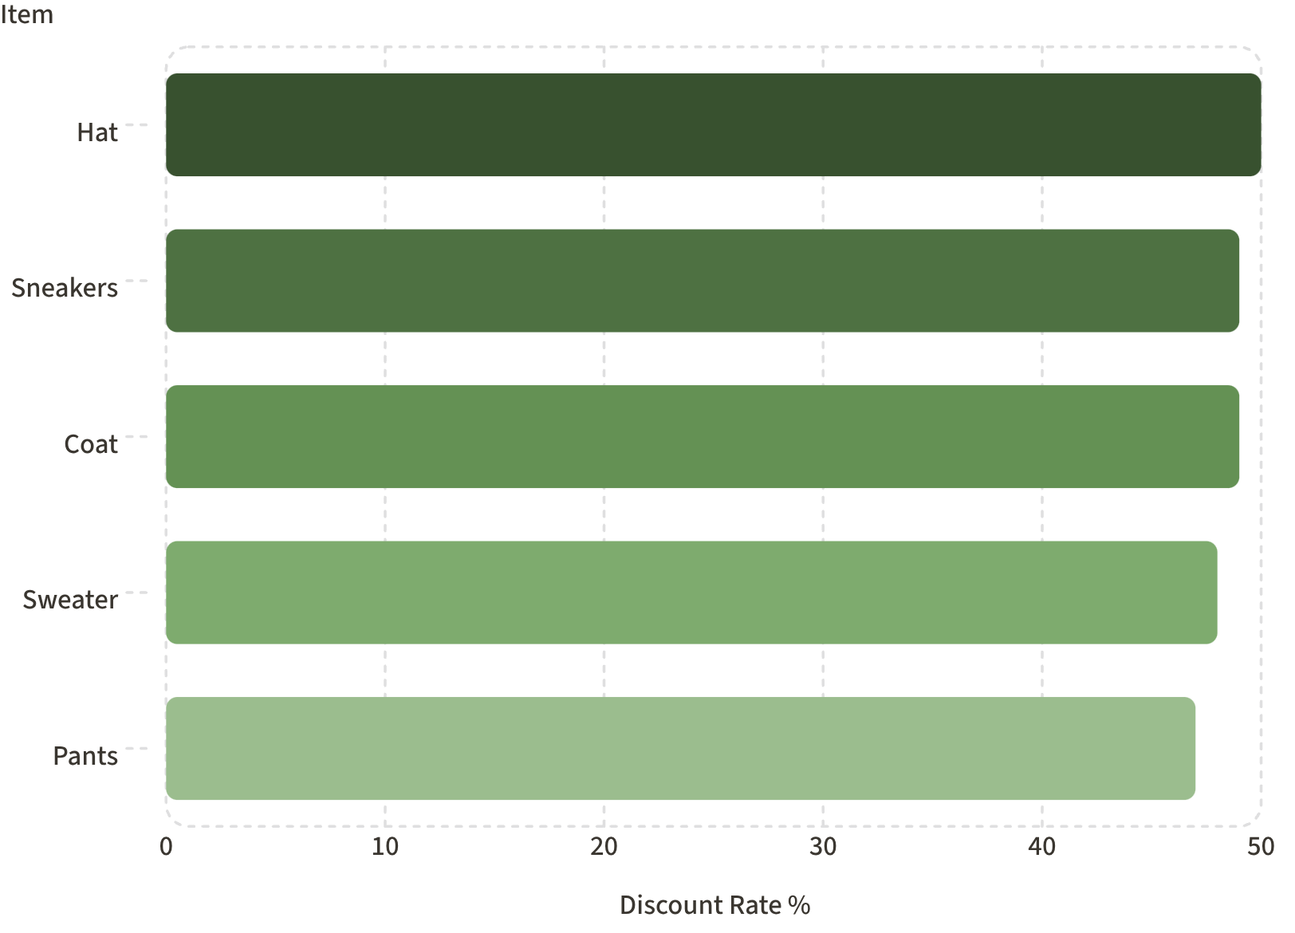
Top Products & Discount Patterns
Top 5 Products by Rating
Most Discounted Products
5

Slide 6
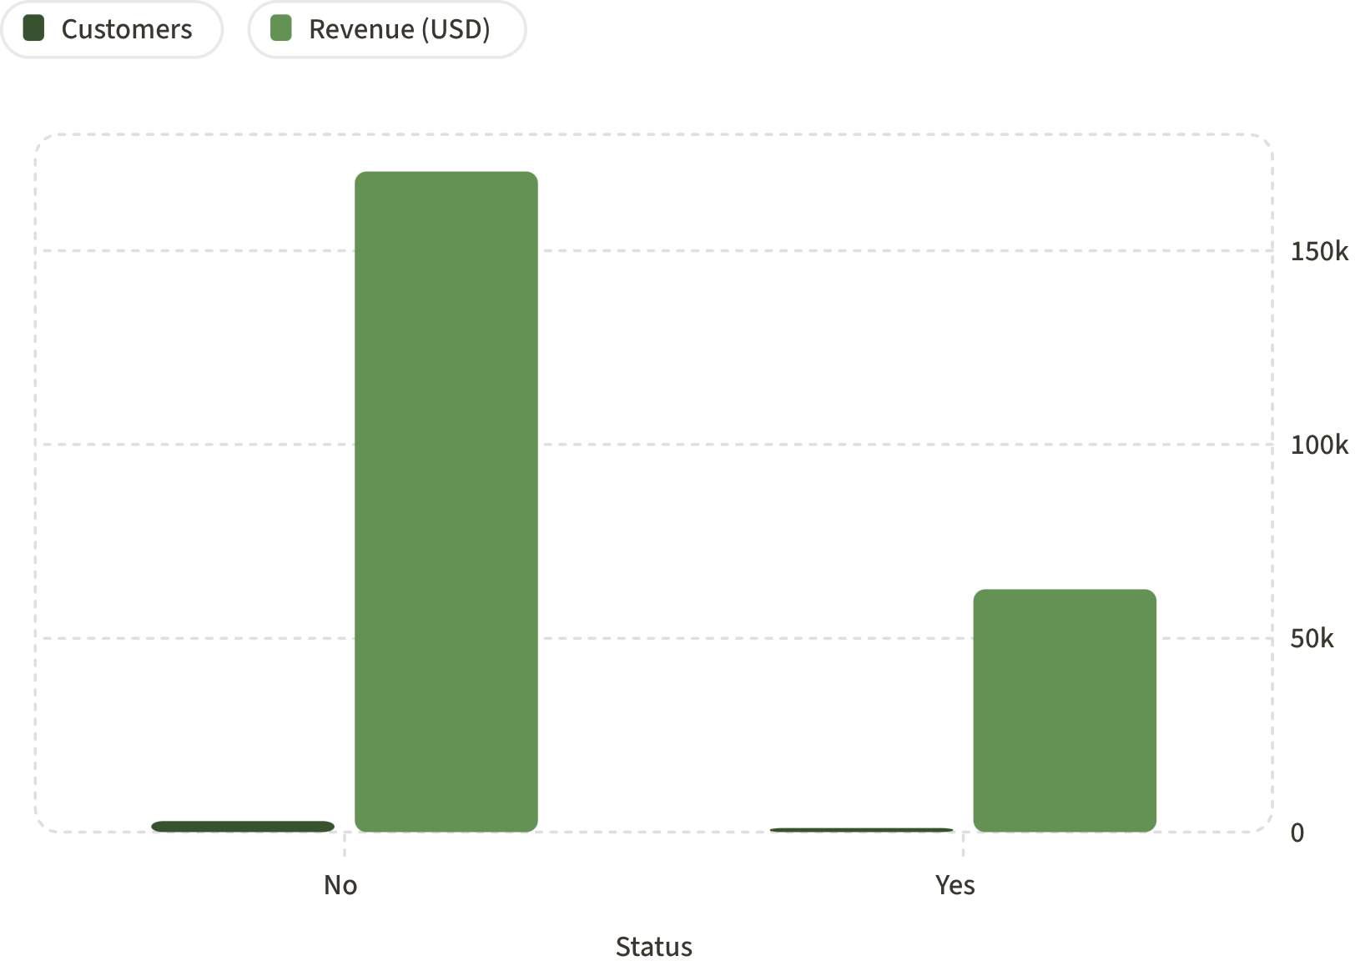
Subscription & Shipping Insights
Subscribers vs Non-Subscribers
Shipping Type Comparison
Standard
Express
$58.46 avg purchase
$60.48 avg purchase
Express buyers spend slightly more — opportunity for upsell.
6

Slide 7
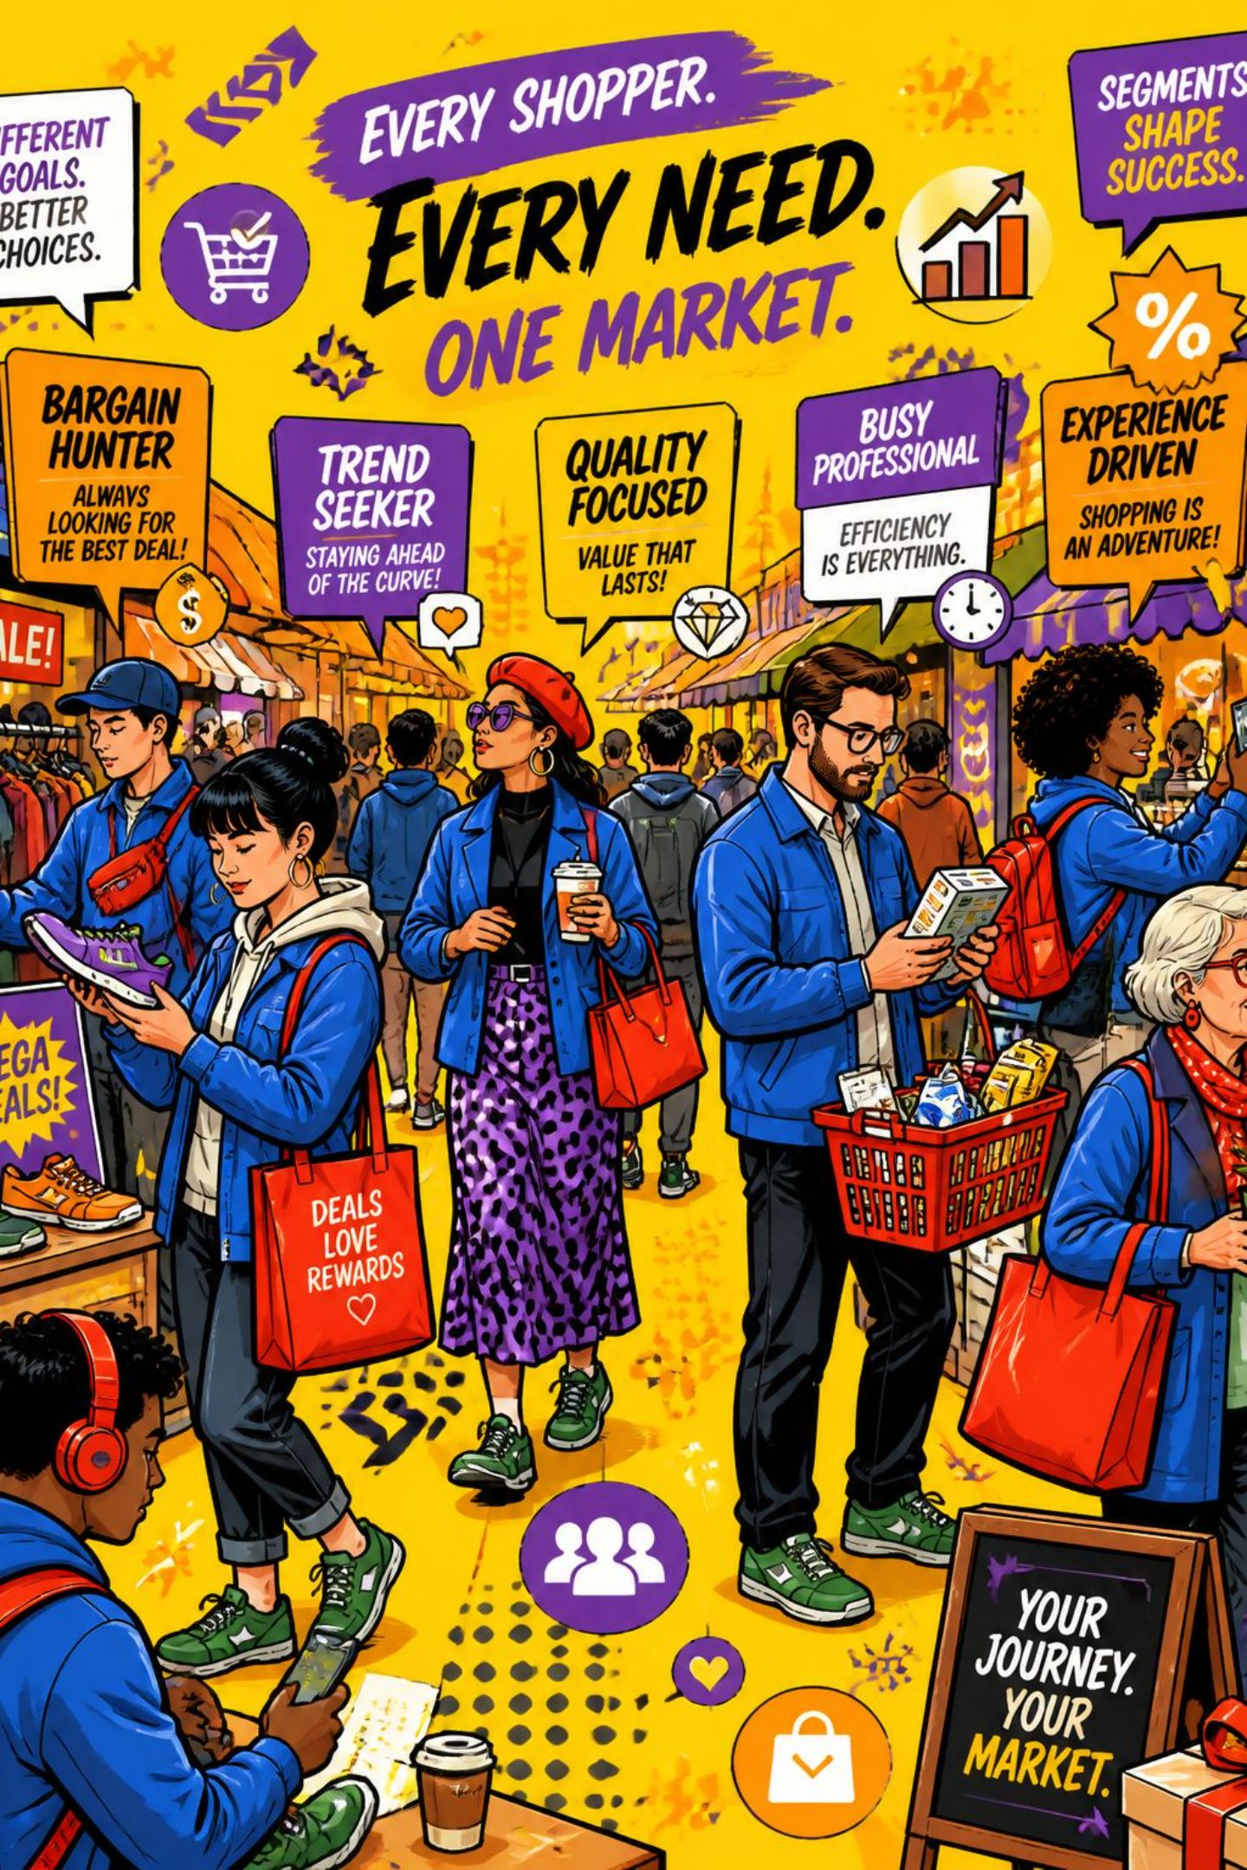

Customer Segmentation
3,116
701
Loyal
Returning
80% of base
18% of base
83
New
2% of base
Of 958 repeat buyers (>5 purchases), most are non-subscribers (2,518 vs 958) — a conversion opportunity.
7

Slide 8
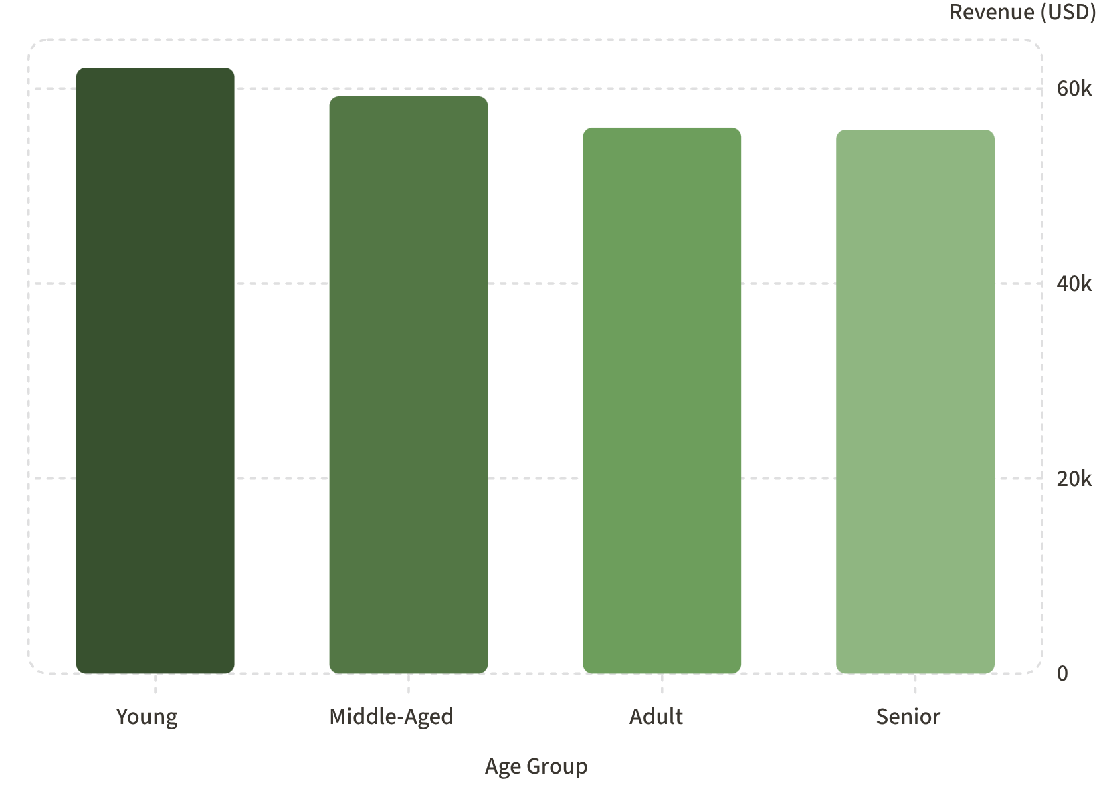
Revenue by Age Group
Takeaway
Young customers generate the highest revenue ($62,143). Revenue is relatively evenly distributed across all age groups.
Young
Middle-Aged
Adult
Senior
$62,143
$59,197
$55,978
$55,763
8

Slide 9

Power BI Dashboard
3.9K Customers
$59.76 Avg Purchase
Total transactions tracked
Overall mean spend
3.75 Avg Rating
Customer satisfaction score
Interactive filters: Subscription Status, Gender, Category, Shipping Type. Visuals include revenue by category, sales by age group, and subscription breakdown (71% No, 29% Yes).
9

Slide 10
Business Recommendations
Boost Subscriptions
Loyalty Programs
Review Discount Policy
Promote exclusive subscriber benefits
Reward repeat buyers toward "Loyal" segment
Balance sales lift with margin control
Targeted Marketing
Product Positioning
Focus on high-revenue age groups & express-shipping users
Highlight top-rated & best-selling products
10

Slide 11
Thank You

