Slide 1

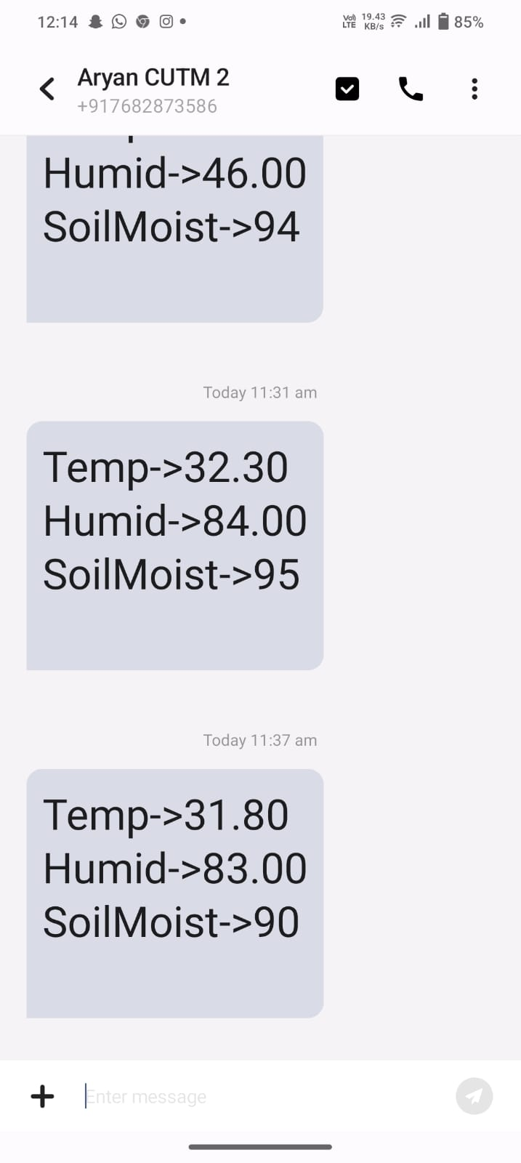
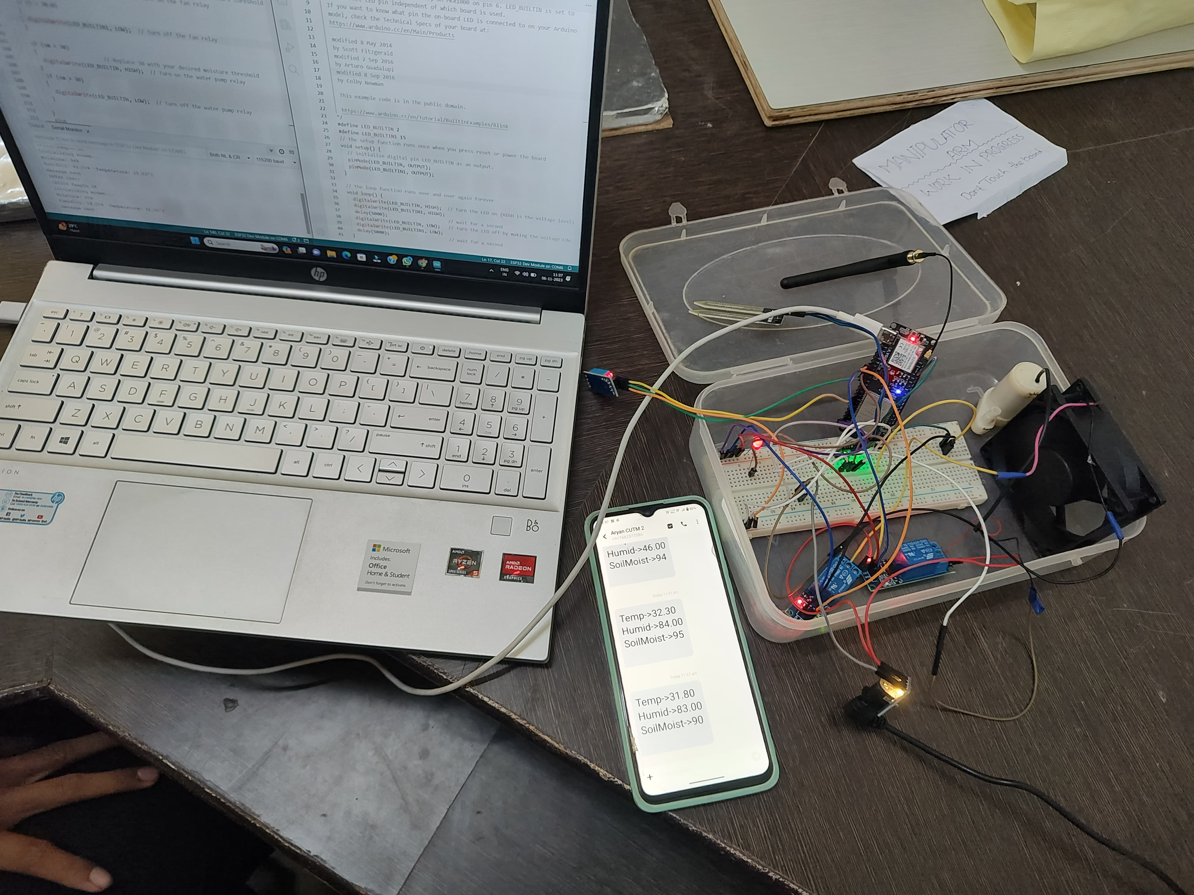
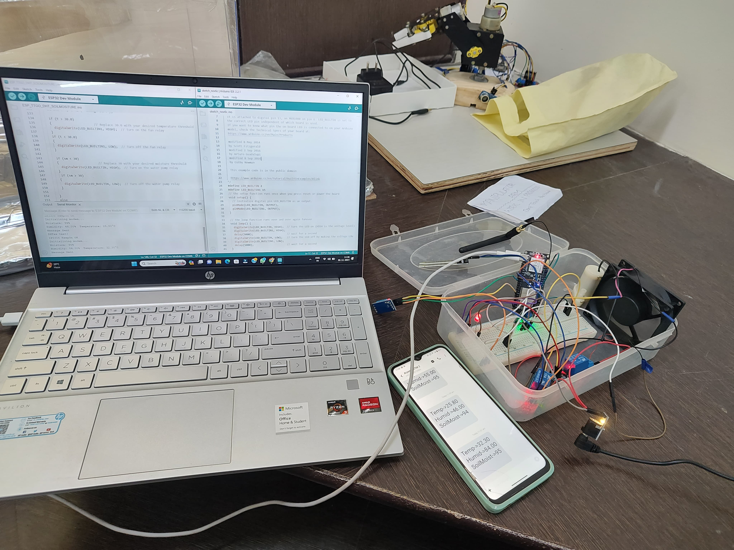
A Remote Measurement & Control System For Greenhouse Based On GSM-SMS
Member: Manas Kumar Muduli
Guided: Prof. Swarna Prabha Jena, Dr. Sujata Chakravarty
Centurion University Of Technology & Management
ABSTRACT
OBJECTIVE
RESULTS
Due to the rapid development in the field of the Automation industry, human life is becoming more advanced and better in all aspects. In the present scenario, Automated systems are being preferred over the non-automated system. In this paper, a prototype and implementation Green house with Wi-Fi technology are demonstrated. TTGO T-call ESP32 800L is used as a Wi-Fi technology. The proposed system consist of a hardware interface and software interface.
Maintain a perfect environment
Improve the quality and yield of crops
Lower the cost of energy
Reduce human labor
METHODOLOGY
DC Fan
DC Motor
INTRODUCTION
Relay Module
Relay Module
GSM based greenhouse environmental monitoring and control is an advanced farming technique. The project can be used in greenhouses for monitoring and controlling various parameters such as humidity, temperature, light and soil moisture. The access to the whole system is given by its admin only to different users. This system is also expandable for controlling various appliances used at home and also for the security and safety purpose of the home through sensors as long as it exists on Wi-Fi network coverage.
Soil Moisture Sensor
TTGO T-call ESP32 800L
Mobile SMS
CONCLUSION
Temperature & Humidity Sensor
In conclusion, the Remote Measurement and Control System for Greenhouse based on GSM offers an efficient solution for monitoring and managing greenhouse conditions. It enables real-time data collection and remote control, enhancing crop yields while conserving resources.
Power Supply
REFERENCES
[1] https://www.academia.edu/download/66724094/remote_measurement_and_control_system_for_greenhouse_based_on_gsm_sms_IJERTV2IS90707.pdf
[2] https://youtu.be/ju51LORqbIw?si=eVqEVUBiBHFgY_w5
[3] Remote Measurement and Control system for Greenhouse based on GSM-SMS (ijert.org)

