Slide 1
Lesion to disconnection to outcome
Does the pattern of severed white-matter connections predict language
outcome better than lesion location?
Status update. The pipeline is complete and the comparison has been run.
Research analysis tool. Not a diagnostic device.

Slide 2
THE QUESTION
Two competing explanations, tested on the same data
A stroke destroys brain tissue. The standard approach describes where the damage is.
An alternative is that outcome depends on which white-matter connections the lesion severs, since a region's function depends on what it connects to.
Both are measurable from the same lesion mask.
A
B
location
463 features
disconnection
80 to 136 features
B better than A: the approach is worth pursuing.
B similar to A: revisit the representation.
B worse than A: check the pipeline.
The comparison was run before building anything on top of it.

Slide 3
CURRENT STATUS
The pipeline is complete and runs end to end
108
228
0.924
203
lesions processed
0 excluded by QC
labelled subjects
mask and WAB-AQ
median Dice
T2w to MNI
tests passing
lint clean
— A single entry point one command takes a lesion mask and returns anatomy, severed tracts, two disconnection matrices, four figures and a predicted score
— Two independent disconnection measures 80 HCP-842 tract volumes, and 479,457 counted streamline endpoints
— One coordinate space, checked in code every pair of volumes is verified to share a grid before being combined
— De-identification verified automatically every file the project writes is scanned for patient identifiers

Slide 4
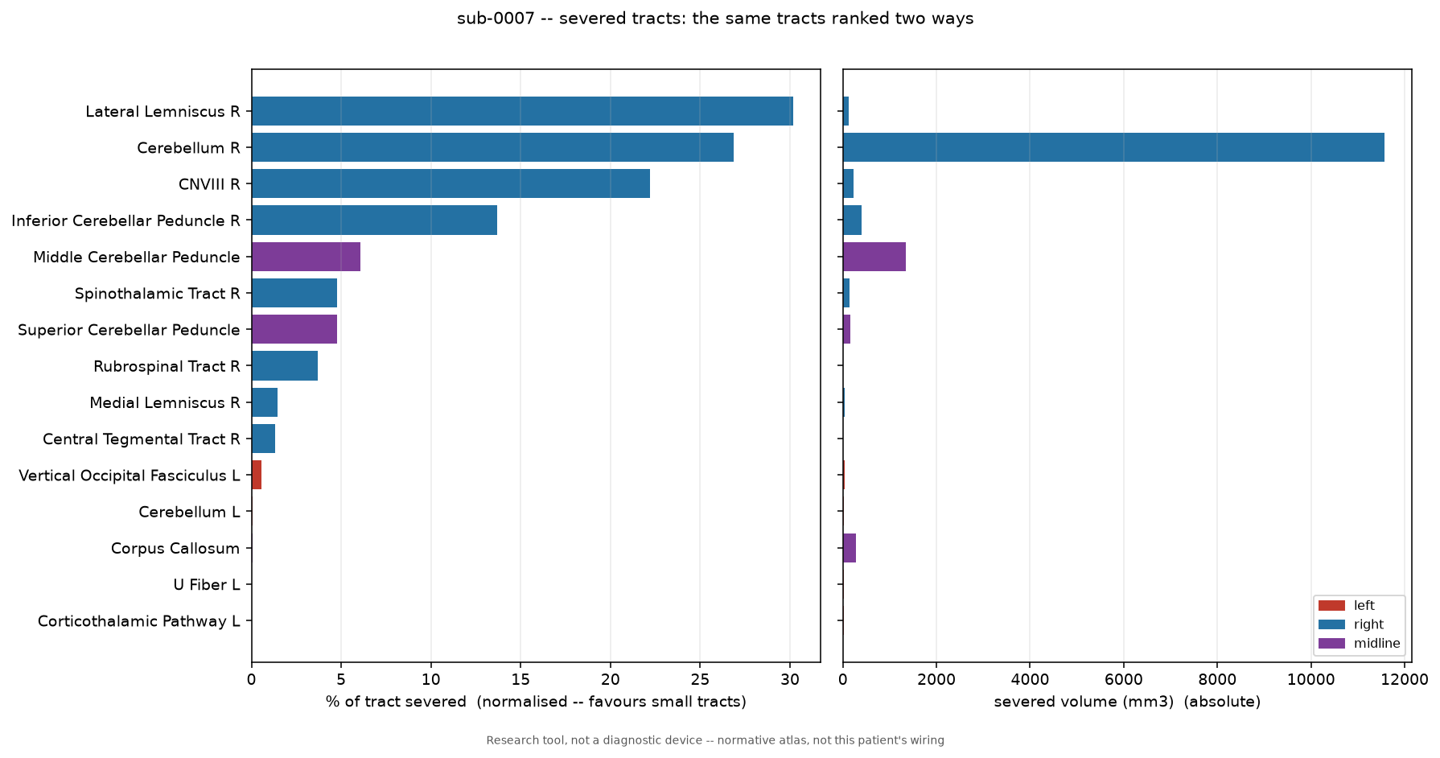
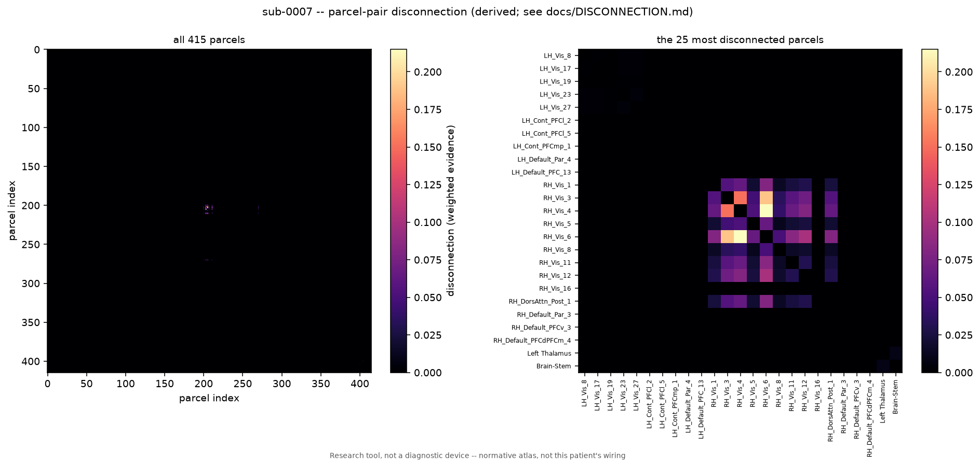
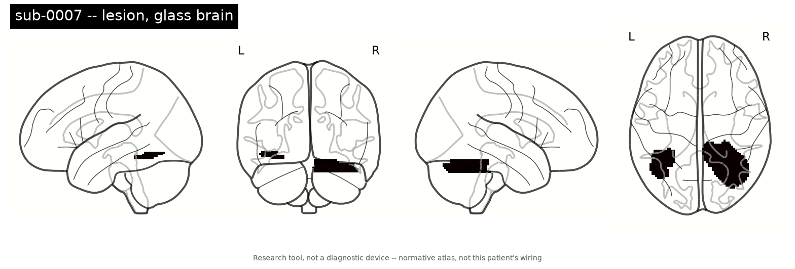
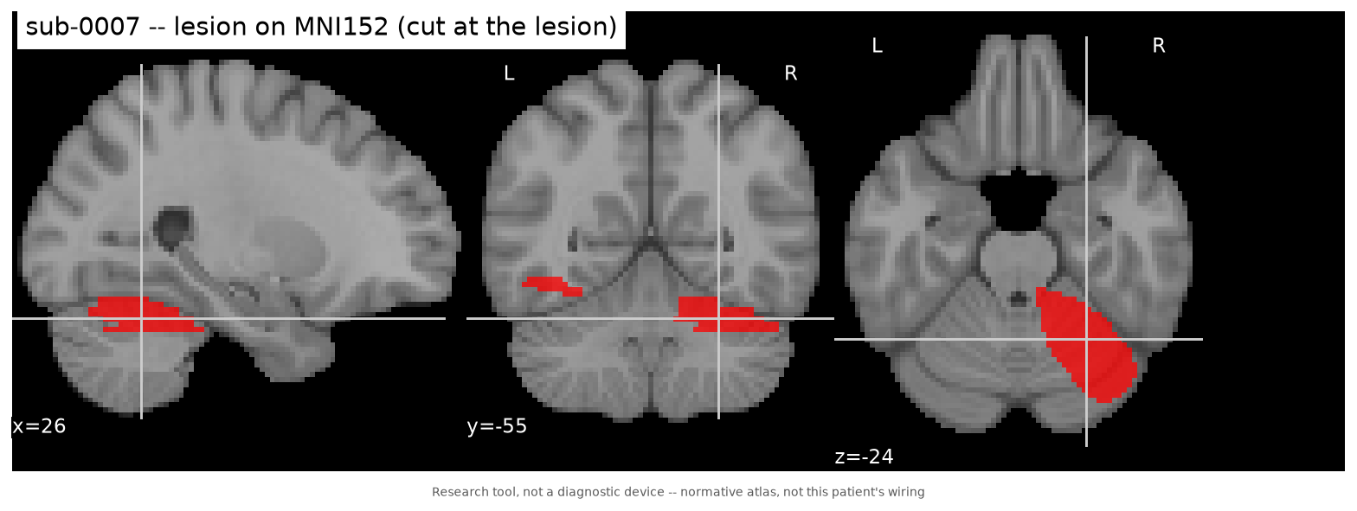
EXAMPLE OUTPUT
One lesion mask produces a complete report
glass brain
lesion on template
severed tracts
disconnection matrix
Subject sub-0007. All subjects are identified by number only. The mapping from original filenames is stored separately and is never included in any output.
Tracts are listed with absolute severed volume alongside percentage severed, because percentage alone favours small tracts: across 108 lesions, none of the six largest tracts was ever ranked first.

Slide 5
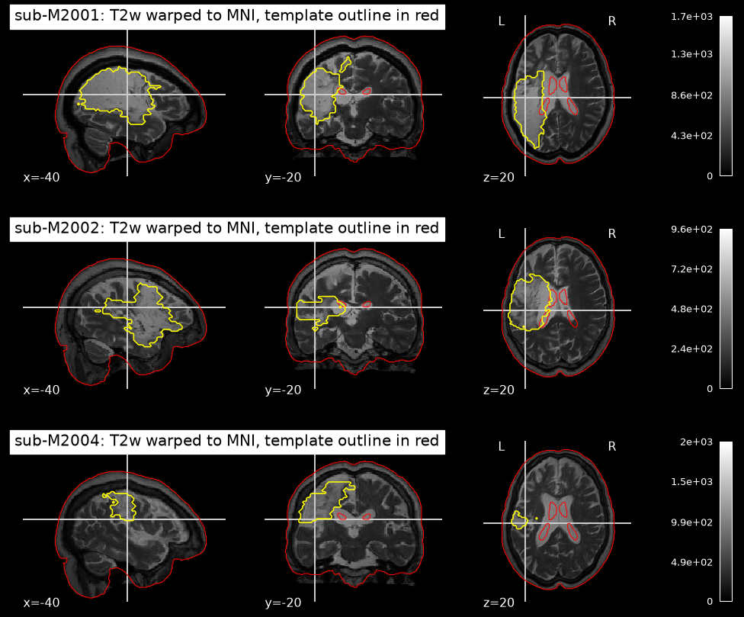
REGISTRATION
Bringing the labelled cohort into a common space
— 228 masks arrived in native space five distinct grids and two orientations. None were aligned to the template.
— Lesion tissue excluded at every stage otherwise the alignment pulls healthy tissue into the lesion and distorts the region being measured.
— Mutual information as the similarity metric the scans and the template differ in contrast, so intensity correlation is not meaningful.
— Median Dice 0.924 minimum 0.901 against the template.
— All 228 lesions left-dominant the key check for an aphasia cohort, since a mirrored result would appear on the right.
A pilot of 8 subjects was reviewed visually before the full batch.

Slide 6
MEASUREMENT RELIABILITY
The two disconnection measures agree only at network level
resolution
median correlation
subjects in agreement
individual parcel pairs (415 nodes)
-0.318
4 of 108
network level (17 groups)
+0.331
104 of 107
Two methods that share no data, no reference dataset and no algorithm agree on which brain systems a lesion disconnects, but disagree on which individual region within them.
Three alternative explanations were tested and ruled out: normalisation, the choice of fraction versus count, and a left-right orientation error. The remaining explanation is resolution. Neighbouring regions are close to interchangeable at this scale.
Implication: individual region-pair connections are not reliable features. Network-level summaries are.

Slide 7
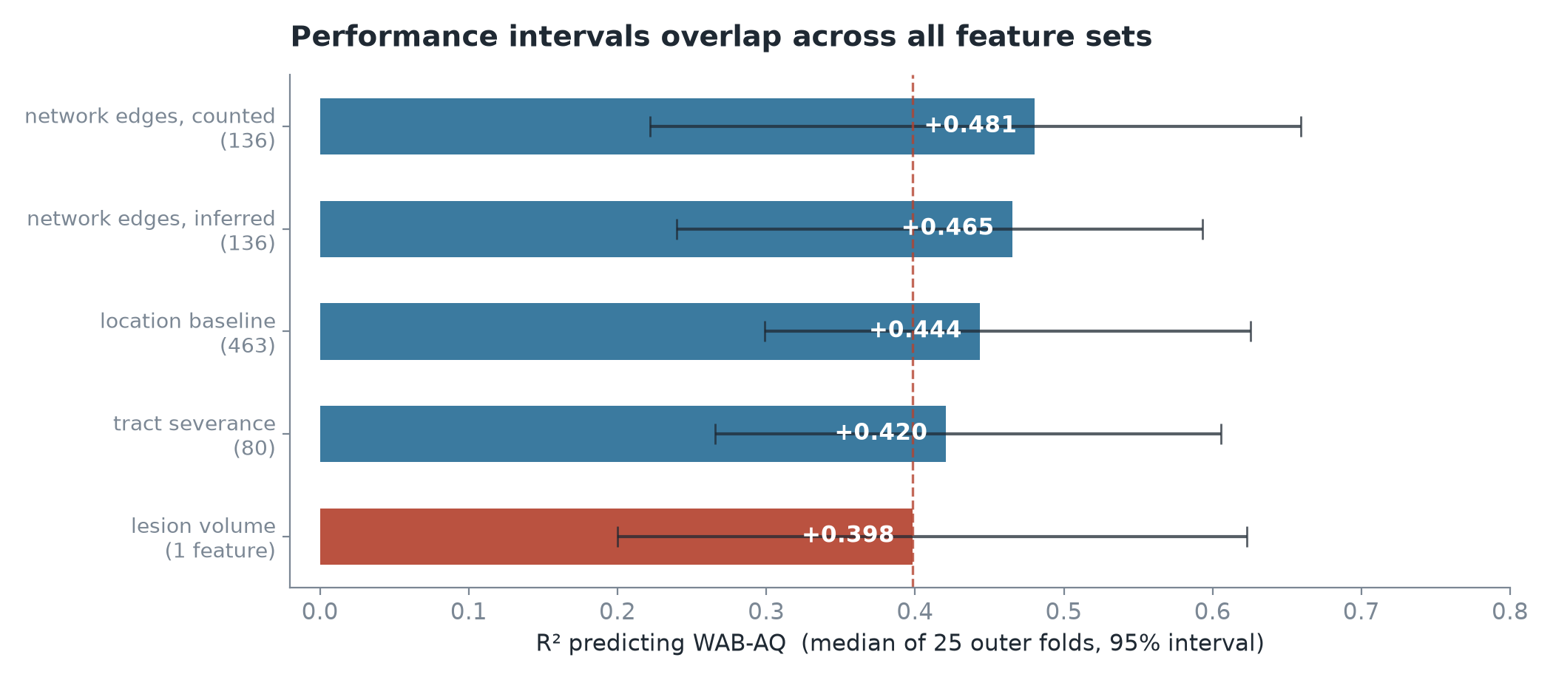
MAIN RESULT
Disconnection does not outperform the location baseline
Ranked by point estimate, disconnection comes first.
That ranking is not reliable. Every model is scored on the same 25 cross-validation folds, and the confidence intervals span roughly 0.4 for all of them.
A paired significance test across those folds, corrected for multiple comparisons, shows no feature set outperforming the location baseline.
The one nominally significant difference is against lesion volume rather than the baseline, and does not survive correction.

Slide 8
LESION VOLUME
A single measurement accounts for most of the performance
Lesion volume alone reaches an R-squared of 0.398. Every other model adds about 0.05.
This was anticipated. Lesion volume can itself be recovered from the disconnection features, so much of what those features carry is a measure of size rather than of connectivity.
0.66
0.47
0.38
1.000
network edges
predicting volume
tract severance
predicting volume
location baseline
predicting volume
positive control
volume from volume
The positive control returning exactly 1.000 confirms the evaluation code is correct end to end.

Slide 9
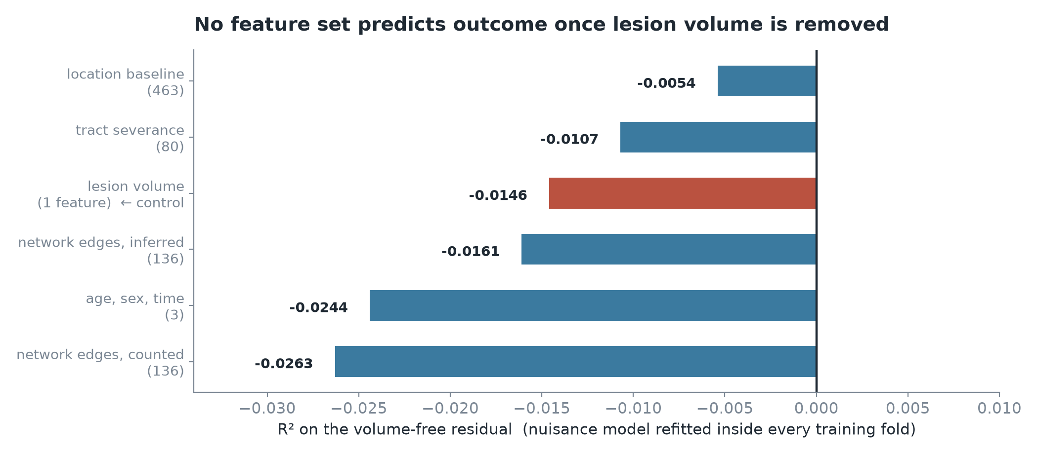
CONTROLLING FOR LESION VOLUME
No feature set predicts outcome once volume is removed
A model of lesion volume is fitted within each training fold and subtracted from the outcome. Each feature set is then scored on what remains.
Fitting that model once across all subjects would leak held-out information and inflate every result.
All feature sets score at or below zero, as do all 18 feature set and model combinations.
The control row confirms the method: lesion volume predicting its own residual scores -0.0146. A value meaningfully above zero there would indicate a leak and would invalidate the table.

Slide 10
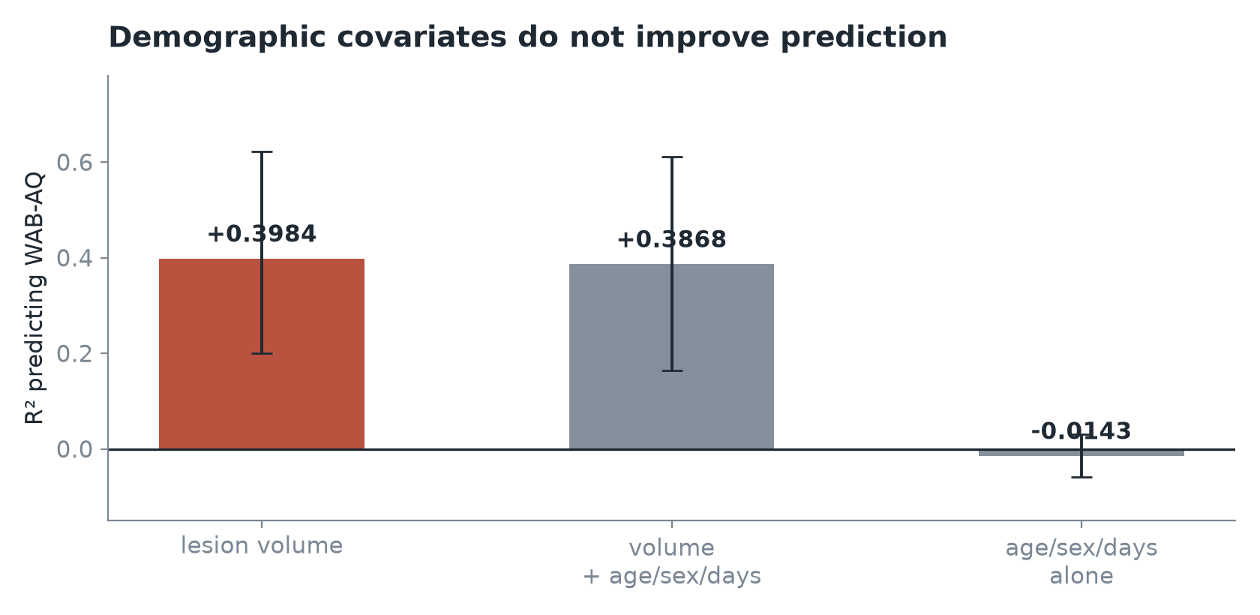
DEMOGRAPHIC COVARIATES
Age, sex and time since stroke add no predictive value
The expectation was that time since stroke would explain variance currently attributed to anatomy.
Its partial correlation with outcome, after accounting for lesion volume, is -0.002.
The cohort is chronic, with a median of 721 days since stroke, so recovery had largely stabilised before assessment. The variable would likely matter in a cohort assessed within weeks.
The apparent sex difference reflects lesion volume. It is significant on its own (r = 0.185, p = 0.005) but not after accounting for volume (p = 0.088), because women in this cohort have smaller lesions on average.

Slide 11
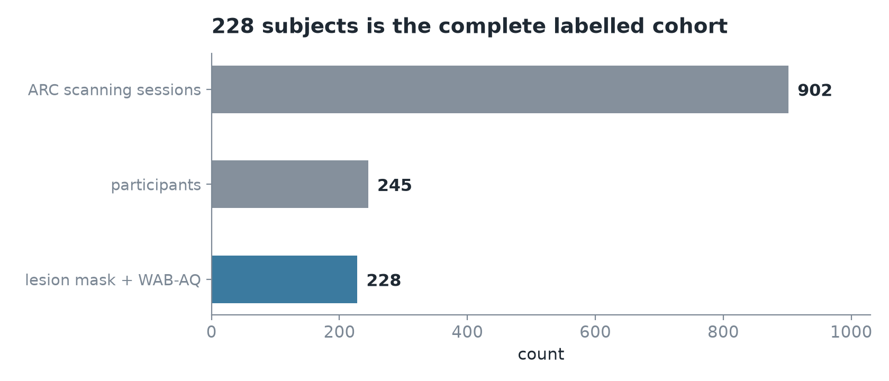
COHORT SIZE
228 subjects is the complete labelled dataset
The project plan recorded 902 available sessions against 228 used, and treated adding subjects as the cheapest way to improve the result.
902 counts scanning sessions, not participants.
The remaining 17 participants have an outcome score but no lesion mask, so they cannot be included.
228 is the full labelled cohort rather than a sample of it. Increasing sample size would require a different dataset, and the larger available dataset does not release outcome scores.

Slide 12
MULTIPLE-COMPARISON CORRECTION
Corrected p-values depend on how many models are compared
comparison
7 comparisons
15 comparisons
network edges vs lesion volume
p = 0.22
p = 0.48
location vs lesion volume
p = 0.94
p = 1.00
Repeating the same measurement with five additional combined models in the same run increases the comparison count from 7 to 15, and every corrected p-value changes with it.
The underlying test statistics are identical between the two runs. Only the correction denominator differs.
Documented rather than adjusted, since reducing the comparison count would move p-values in a favourable direction. No result is significant at either count.

Slide 13
PERMUTATION TEST
Every feature set beats randomised outcomes; the control does not
Each feature set is re-scored 200 times with the outcome scores shuffled between subjects. A model that only appears to work scores the same either way.
FEATURE SET
OBSERVED
SHUFFLED (MEDIAN)
P
network edges, counted (136)
+0.510
-0.204
0.005
network edges, inferred (136)
+0.432
-0.207
0.005
location baseline (463)
+0.449
-0.207
0.005
tract severance (80)
+0.434
-0.206
0.005
lesion volume (1)
+0.416
-0.104
0.005
age, sex, time (3) <- control
-0.135
-0.141
0.453
0.005 is the lowest value 200 shuffles can produce. The control row is the one to read first: age, sex and time since stroke score no better than their own shuffled version, which is what makes the other five readable. This establishes that each feature set carries real signal. It does not rank them against each other.

Slide 14
NEXT STEPS
In priority order
— 1. Threshold the disconnection maps keep only connections present in enough healthy brains. An independent study of 340 patients found unthresholded maps lose to plain lesion masks while thresholded ones win, and our own two measures disagree in a way that says the same thing.
— 2. Hold out a test set the one remaining gap in the analysis. All current figures are cross-validated on the same 228 subjects, and 228 is too few to spend on a holdout without losing the comparison entirely.
— 3. Compare alternative registration methods the current method was accepted on a Dice of 0.924, which does not establish that it is the best option.
— 4. Test lesion-filling during registration a stronger alternative to the current approach.
— 5. Display disconnection results in the viewer the export path has not yet been tested against a running instance.
Completed since this list was written: the permutation test, now run on all six models. Removed from the plan: increasing the ARC sample, which is not possible, and adding demographic covariates, which changed nothing. All three were resolved by measurement.

Slide 15
SUMMARY
What the evidence currently supports
On this cohort and at this sample size, lesion volume accounts for the predictive performance. Neither disconnection nor location adds measurable information beyond it.
The pipeline is complete, instrumented, and produced a clear negative result where the point estimates initially suggested otherwise.
— What could change the conclusion a larger labelled cohort, or a representation that is not primarily a measure of lesion size
— What would not a more complex model on 228 subjects with confidence intervals this wide
Research analysis tool. Not a diagnostic device.

