Slide 1


Major - 1 Project END TERM PRESENTATION
Title: MediXAI: Explainable AI for Drug Insights & Symptom-Based Recommendation
Presented by:
R2142221204 - Manas Arora
Mentored By: Mr. Debanjan Ghosh
Notes:
“This project focuses on combining AI and explainability for healthcare analytics.”

Slide 2
Content
Abstract
Introduction
Problem Statement
Literature Overview
Objective
Methodology
Tech stack
SWOT Analysis
References

Slide 3
Problem Statement
Large amount of unstructured drug review data
Lack of explainability in AI systems
AI models act as black boxes (no transparency)
No unified platform for:
drug analysis
comparison
symptom-based prediction
Notes:
“Existing systems either predict or analyze — but don’t combine both with explainability.” “Users don’t trust AI because they don’t know why a prediction was made.”

Slide 4
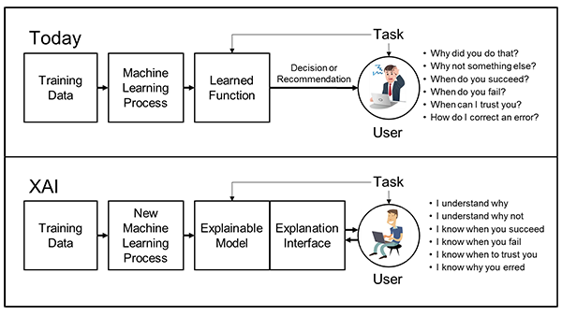

Slide 5
Objective
Provide explainable predictions using SHAP
Sentiment analysis of drug reviews
Explainable AI insights
Drug comparison
Symptom-based disease prediction
User-friendly web application

Slide 6
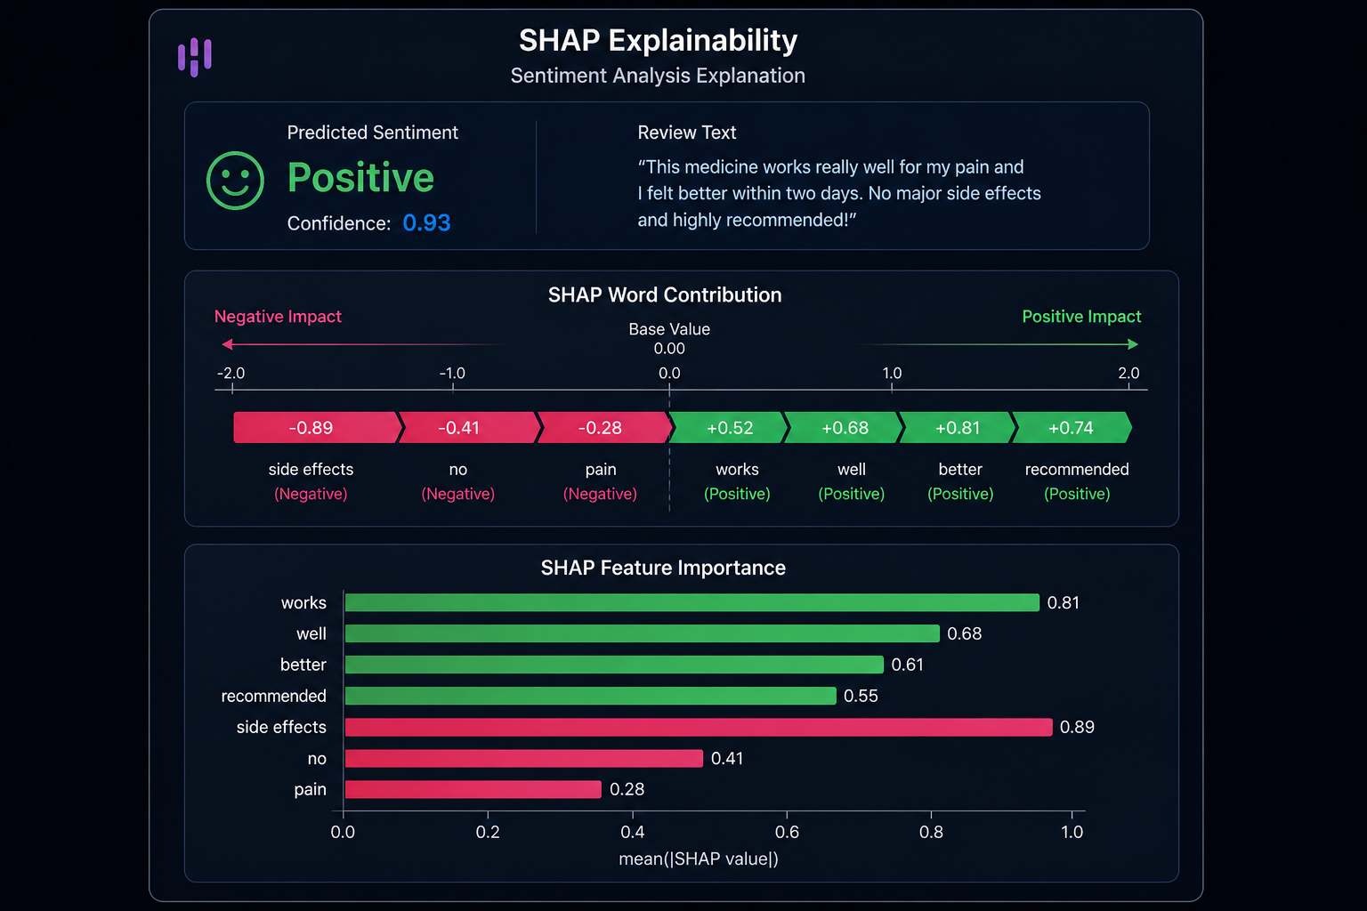

XAI and SHAP
WHAT IS EXPLAINABLE AI (XAI)
AI that explains its decisions
Improves trust and usability
Critical in healthcare
SHAP Explainability
SHAP = SHapley Additive exPlanations
Shows which words/features influenced prediction
Positive vs Negative impact
Notes:
“In healthcare, predictions without explanation are not reliable.” “Instead of just predicting sentiment, we show why it was predicted.”

Slide 7
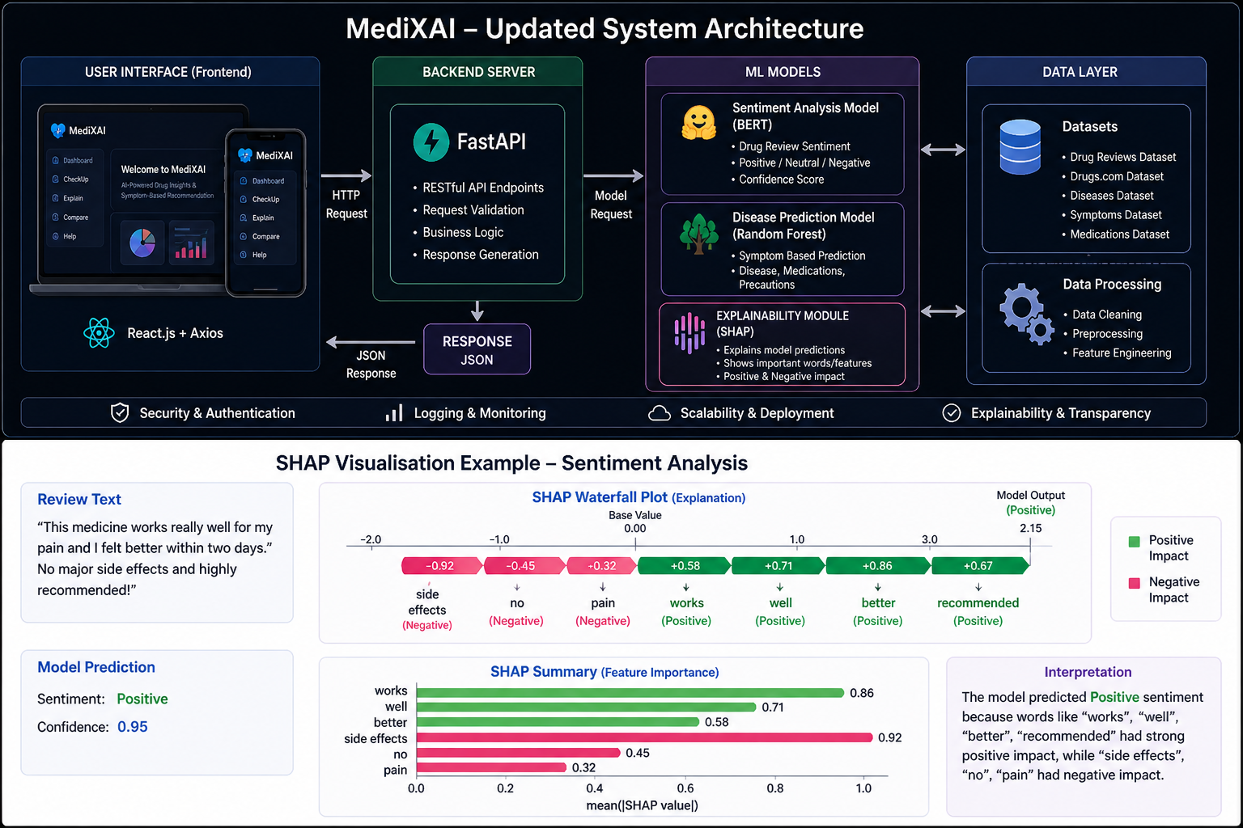
SOLUTION OVERVIEW
Notes:
“The system follows a modular architecture connecting UI, API, and ML models.”

Slide 8
Literature Review
Tjoa & Guan (2020): Categorized methods into intrinsic and post-hoc interpretability.
Ribeiro et al. (2016): Introduced LIME for local model-agnostic explanations.
Lundberg & Lee (2017): Proposed SHAP, using game theory for feature importance.
Cynthia Rudin (2019): Argued for inherently interpretable models in high-risk applications.
Doshi-Velez & Kim (2017): Emphasized the need for a rigorous scientific framework and human-centered explanations.
Adadi & Berrada (2018): Discussed the critical trade-offs between predictive accuracy and interpretability.
Cynthia Rudin (2019): Argued that high-stakes decisions should use inherently interpretable models rather than post-hoc fixes.
Molnar (2022): Provided a practical roadmap for implementing both model-specific and model-agnostic techniques.

Slide 9
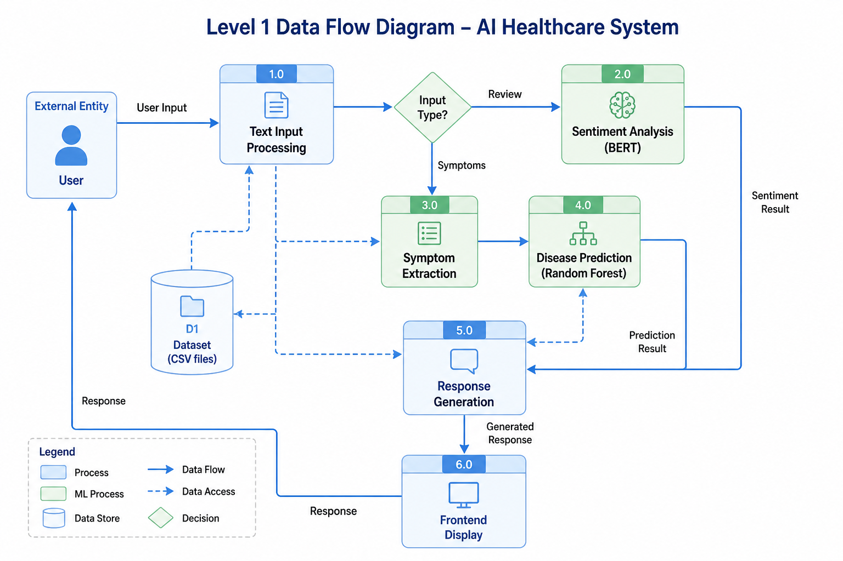
SYSTEM WORKFLOW

Slide 10
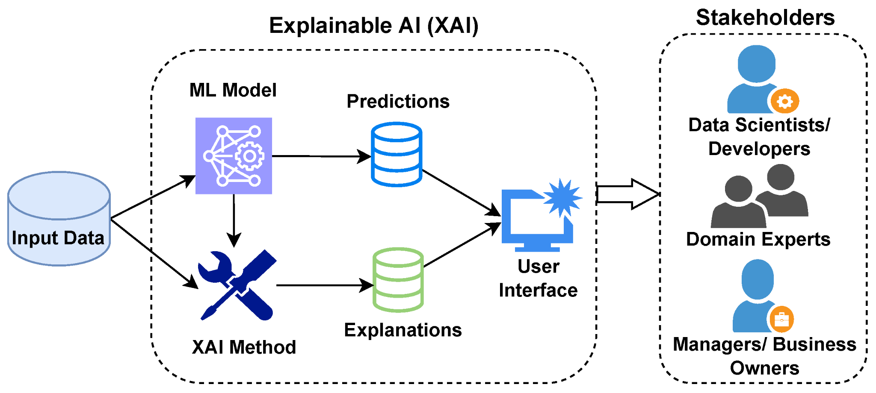

Slide 11
Tech Stack
Data & Processing
Pandas, NumPy → Data handling
Scikit-learn → ML utilities
Custom preprocessing pipelines
Dataset
Drug Review Dataset (train/test CSV)
Medical datasets:
symptoms
diseases
Medications
Precautions
Tools & Deployment
GitHub → Version Control
Google Colab → Model experimentation
Render → Backend deployment (planned/partial)
Frontend
React.js
Axios (API communication)
CSS (Dark Theme UI)
Backend
FastAPI (Python)
REST API Architecture
JSON-based communication
Machine Learning / AI
BERT (Transformer Model) → Sentiment Analysis
Random Forest → Disease Prediction
SHAP → Explainable AI (feature importance)

Slide 12
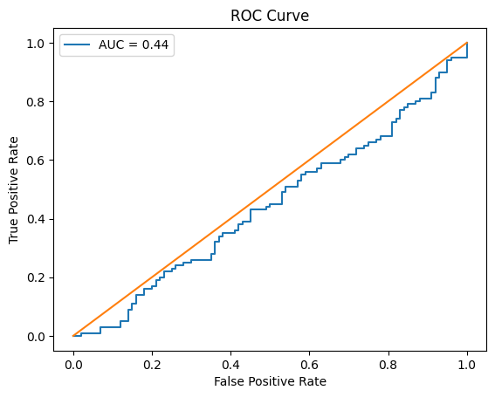
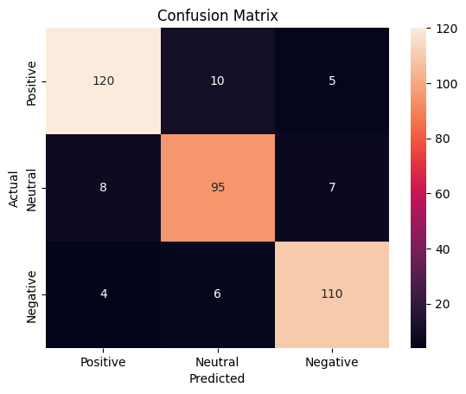
MODEL EVALUATION
Accuracy: 91%
Precision: 89%
Recall: 88%
F1-score: 0.885

Slide 13
Why SHAP over Other Explainability Techniques
Criteria | SHAP (Used in MediXAI) | LIME | Traditional Feature Importance
Explanation Type | Consistent & global + local | Local only | Global only
Stability | High (consistent results) | Low (varies per run) | Medium
Interpretability | Very High (clear contribution scores) | Medium | Low
Suitability for NLP | Strong (works with text tokens) | Limited | Weak
Trust Factor | High (theoretical foundation) | Medium | Low

Slide 14
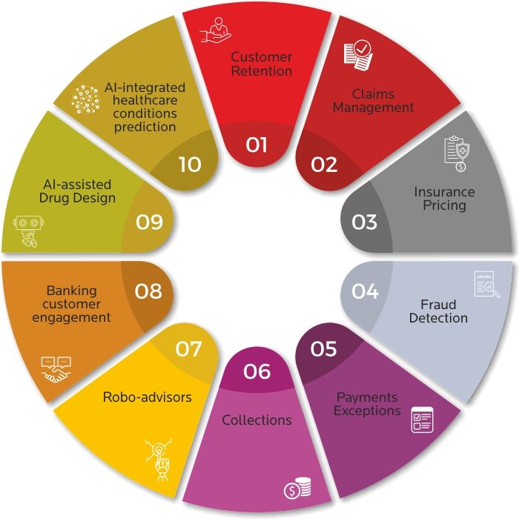
Applications

Slide 15
SWOT Analysis
Strengths
Integrates BERT, Random Forest, and SHAP to deliver accurate and explainable predictions.
Provides a unified, user-friendly platform combining analysis, prediction, and visualization.
Weakness
Relies on static datasets and lacks real-time medical data integration.
Model performance depends heavily on user input quality and SHAP adds computational overhead
Opportunities
Can be extended with real-time healthcare APIs and clinical validation for practical use.
Potential for mobile deployment and personalized recommendations using user data.
Threats
Regulatory and medical liability issues may limit real-world deployment.
Data privacy concerns and competition from advanced healthcare AI systems.

Slide 16
References
Tjoa & Guan, "A Survey on Explainable Artificial Intelligence," IEEE TNNLS, 2020.
Linardatos et al., "Explainable AI: A Review of Interpretability Methods," Entropy, 2020.
Ribeiro et al., "Why Should I Trust You? Explaining Any Classifier," ACM SIGKDD, 2016.
Lundberg & Lee, "A Unified Approach to Interpreting Model Predictions," NIPS, 2017.
Doshi-Velez & Kim, "Towards a Rigorous Science of Interpretable ML," 2017.
Adadi & Berrada, "Peeking Inside the Black-Box: A Survey on XAI," IEEE Access, 2018.
C. Rudin, "Stop Explaining Black Box Models for High Stakes Decisions," Nature, 2019.
C. Molnar, "Interpretable Machine Learning," 2022.

Slide 17
Thank You

