Slide 1

INTRODUCTION TO FOSS
FOSS stands for “FREE AND OPEN SOURCE SOFTWARE”

Slide 2
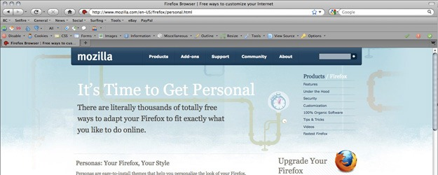
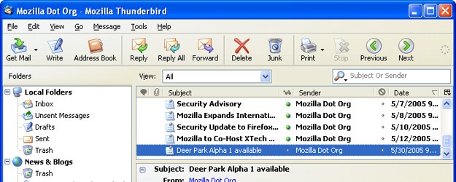
How many of you have used …..
MOZILLA FIREFOX
THUNDERBIRD

Slide 3
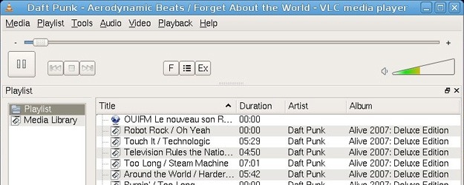
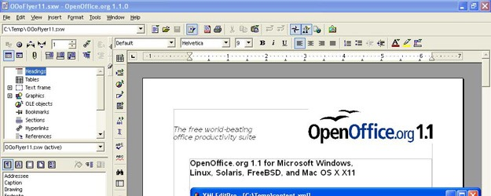
AND
VLC MEDIA PLAYER
OPEN OFFICE

Slide 4
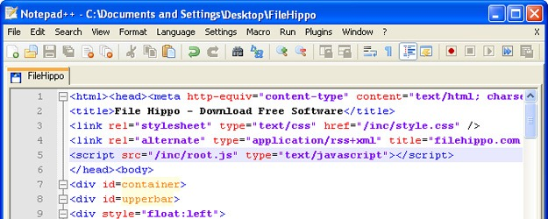
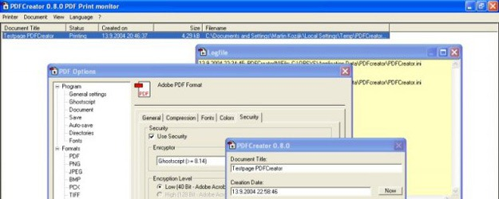
AND
NOTEPAD ++
PDF CREATOR

Slide 5
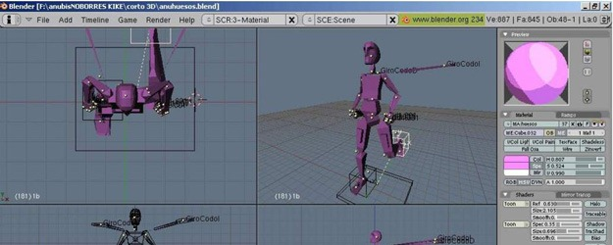
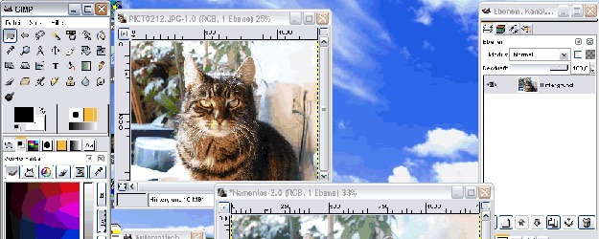
ALSO
BLENDER
GIMP

Slide 6

What is common in all of them ??
All of the Above are free and open source software.
SO WHAT DO YOU MEAN BY FREE AND OPEN SOURCE SOFTWARE???????

Slide 7

CONFUSED??????
LETS GO BACK IN HISTORY AND FIND OUT

Slide 8
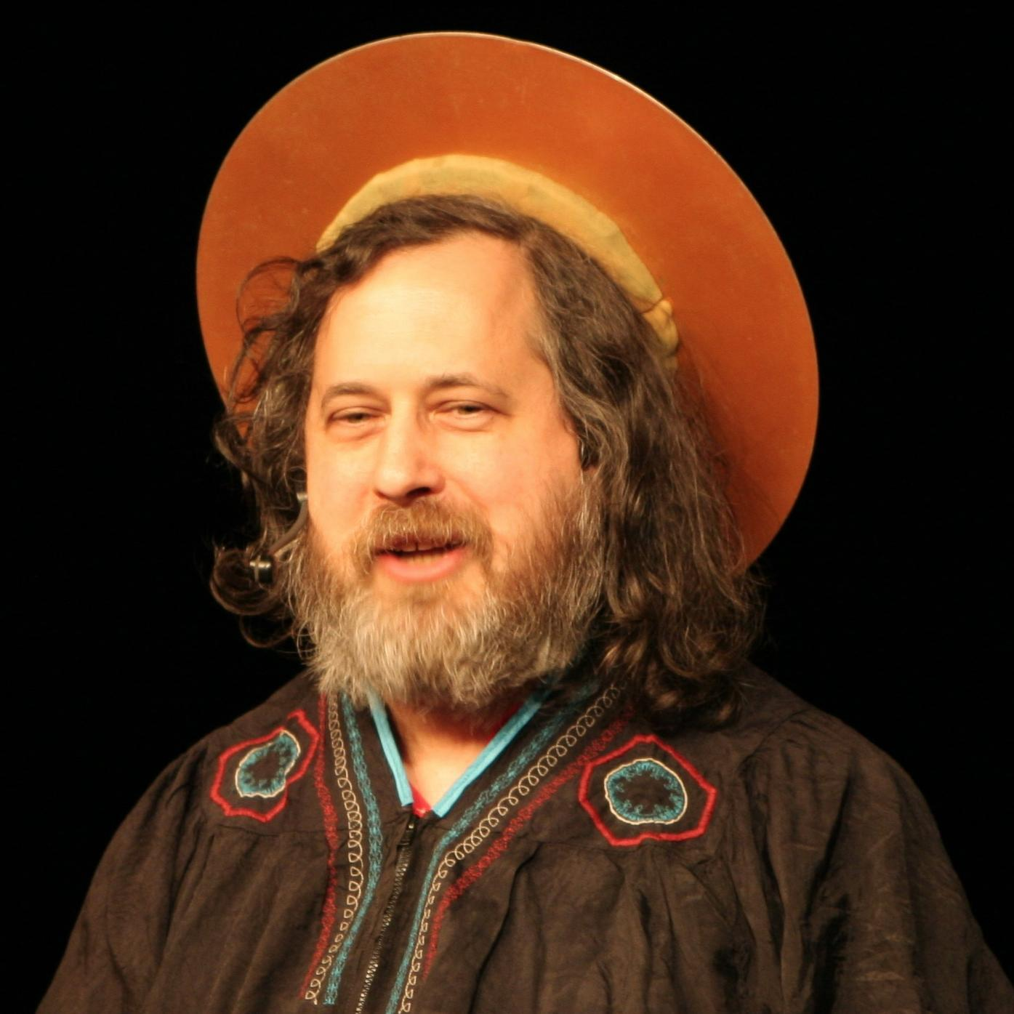
1985
In 1985 a man with a vision that “Free software is software that respects your freedom and the social solidarity of your community.” formed FREE SOFTWARE FOUNDATION (FSF).
He along with a group of like minded programmers started work in developing the tools needed to make a complete OS – like an editor (EMACS), a C compiler (GCC), Libraries and all associated generic unix tools like cat,ls,chmod etc
ANY GUESS???
RICHARD STALLMAN

Slide 9

1990
In 1990 a finnish student wrote KERNEL and released it under GPL (GNU Public License).
And , this kernel was known as LINUX .
LINUS TORVALD

Slide 10
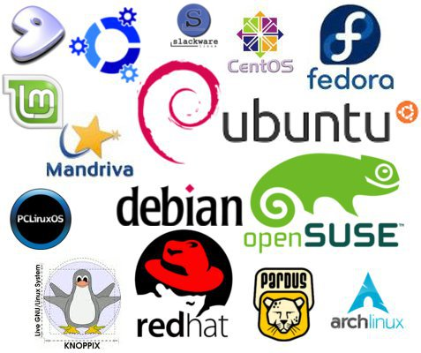
So, GNU toolchains + kernel == GNU/linux
What are various Distros??
A Linux distribution (often abbreviated as distro) is an operating system made from a software collection, which is based upon the Linux kernel and, often, a package management system. Linux users usually obtain their operating system by downloading one of the Linux distributions, which are available for a wide variety of systems ranging from embedded devices (for example, OpenWrt) and personal computers (for example, Linux Mint) to powerful supercomputers (for example, Rocks Cluster Distribution).

Slide 11
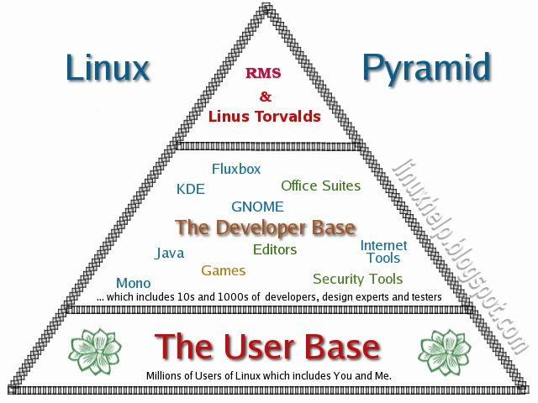
After 1997, a programming model other than the GPLed model emerged which is now popularly known as the Open Source Initiative.
The LINUX pyramid

Slide 12

So, the question is ………….
Why should I learn free & open source software, GNU/LINUX??
How and where to look for help??

Slide 13
Why should I learn free and open source software??
For your good and better knowledge about how things and technology work.
Exploring things .
Stand apart from MOB .
Be a part of something more than just I .
ALL OF THE BIGGEST TECH COMPANIES USE LINUX IN THEIR WORK ENVIRONMENT.
Linux OS is the most suitable OS for network testing and hacking purpose.
Better paid job?

Slide 14



How and where to look for help??
The linux Documentation project .(tldp.org)
Distribution /Software specific website .
GROUPS , like ILUG-D , Py-Delhi, etc.

Slide 15
But am not a coder
You can still help and be a part of the community
Localization
Documentation
Artwork
Bug Reporting
Mentoring

Slide 16

ANY QUESTIONS?????

Slide 17

FOR ANY QUERY , FEEL FREE TO DISTURB ME :-
MANAS KASHYAP, 9862791992
manaskashyaptech@gmail.com

