Slide 1


Analysis of Technology Trends
Name : Manas Khanduri
July 2021

Slide 2

OUTLINE
Executive Summary
Introduction
Methodology
Results
Visualization – Charts
Dashboard
Discussion
Findings & Implications
Conclusion
Appendix

Slide 3

EXECUTIVE SUMMARY
•Trends in programming
languages and databases
•Demographics survey
•Technological gap in countries
•Gender gap in jobs

Slide 4

INTRODUCTION
About : Analysing the patterns and trends in Technology field jobs.
Purpose of Analysis :
1)To understand the demands of job today and for future.
2) What are top Programming Languages.
3)Top databases in demand.
4) Most popular IDEs.
Audience : Anybody who wants to pursue
Technical field,IT departments.

Slide 5

METHODOLOGY
•Data Collection Sources
• Stack Overflow Developer 2019 Survey
• GitHub Job Postings
• Programming Languages Annual Salary
•Data Exploration
•Data Cleaning
•Data Visualization
•Presentation

Slide 6
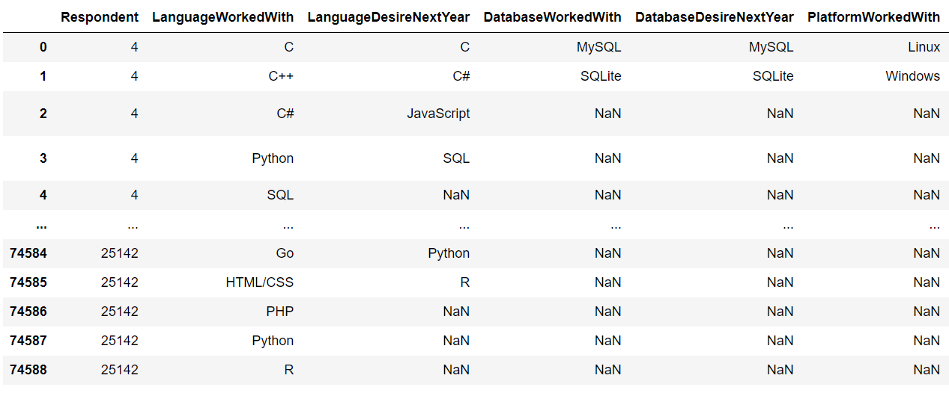
Results are based on this table:

Slide 7
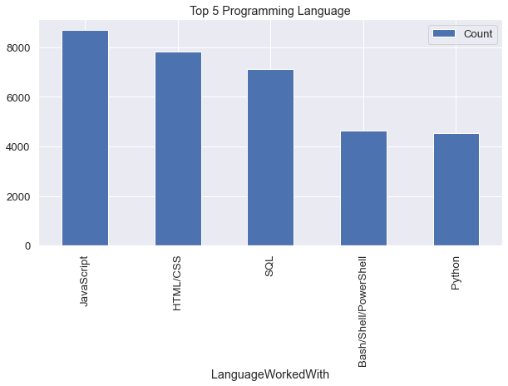
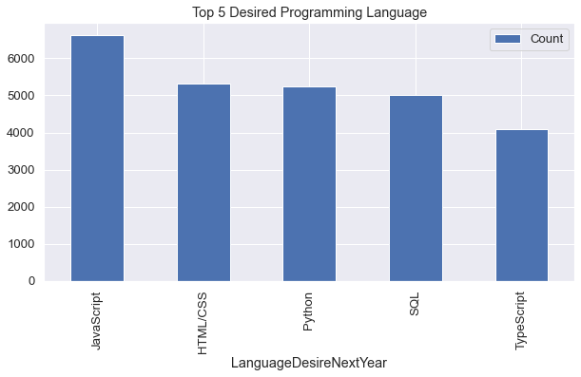
PROGRAMMING LANGUAGE TRENDS
Current Year
Next Year

Slide 8
PROGRAMMING LANGUAGE TRENDS - FINDINGS & IMPLICATIONS
Implications
Web development are still in high demand
Big Data technology in companies still requires SQL
With AI and ML in rising demand, Python is best choice
Findings
JavaScript, HTML/CSS, SQL are top 3 this year
Python and Typescript becoming popular next year
PowerShell edged out in next year

Slide 9
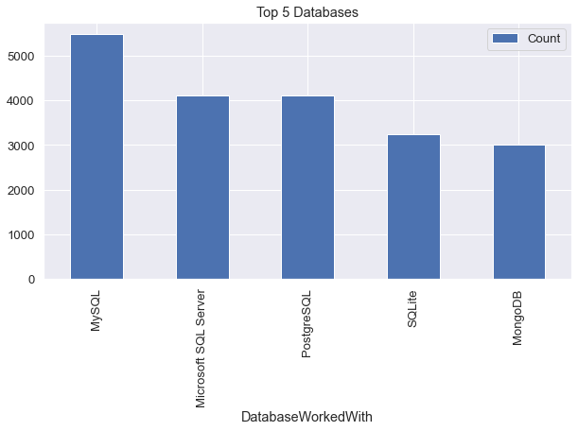
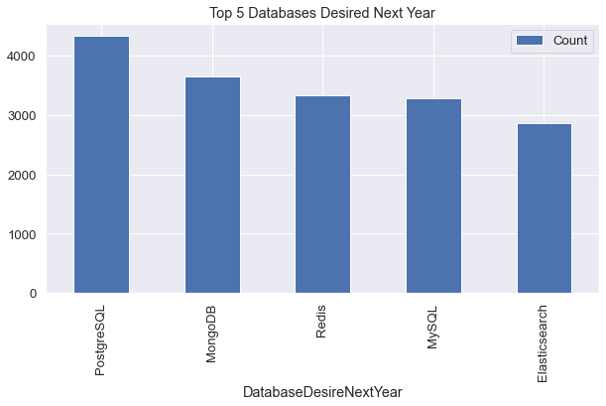
DATABASE TRENDS
Current Year
Next Year
< Bar chart of top 5 databases for the current year goes here >
< Bar chart of top 5 databases for the next year goes here.>

Slide 10
DATABASE TRENDS - FINDINGS & IMPLICATIONS
Implications
Open-source databases are still preferable in companies
NoSQL databases will make an impact for storing non-relational data
Redis supports abstract data types
Pre-tuned search to website, app, or ecommerce store
Findings
MySQL most popular
Behind is Microsoft SQL
MongoDB and Redis are upcoming favorites
New kid on the block: Elasticsearch

Slide 11

DASHBOARD
https://dataplatform.cloud.ibm.com/dashboards/b309fd3b-f932-43c8-ac59-71a9e0cf8a40/view/5703d87f32ae1ed471cae6e407cd25012b327708b5bbd75080857b490e327297f3604595c82e1e5ad3100730a2b8115e9c

Slide 12
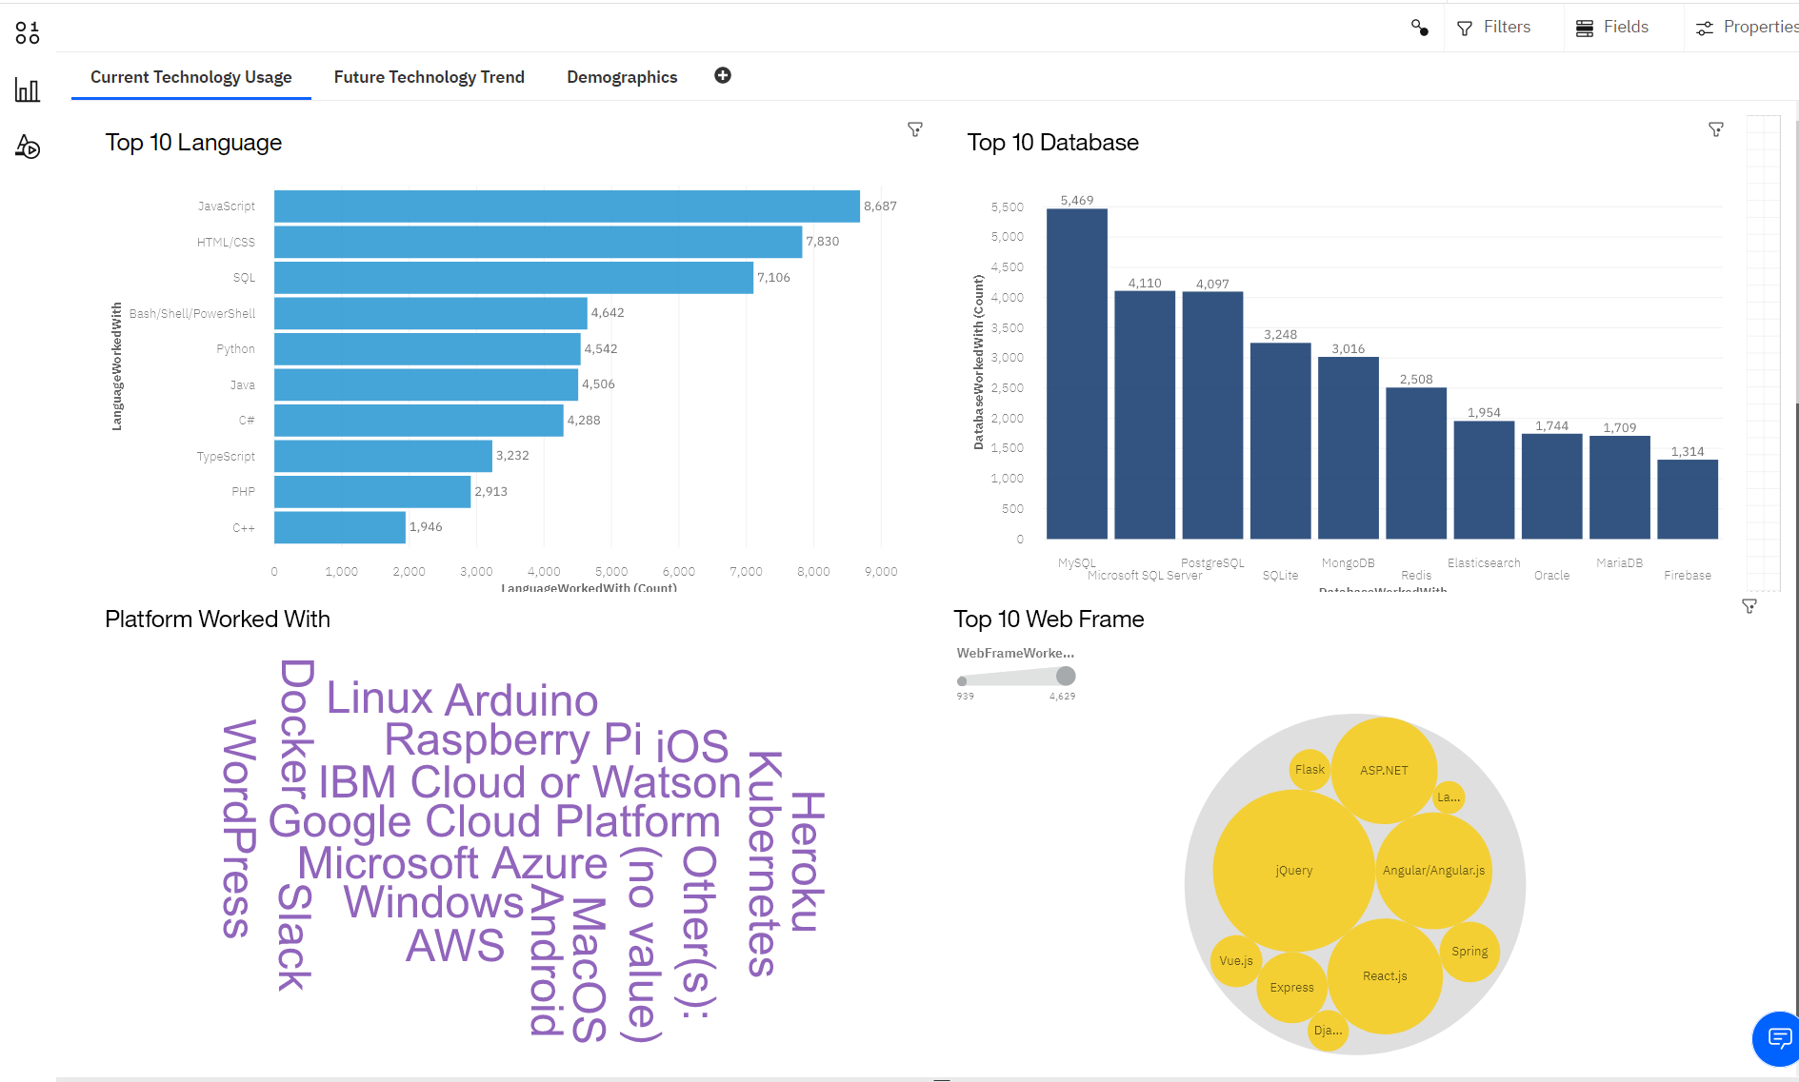
DASHBOARD TAB 1

Slide 13
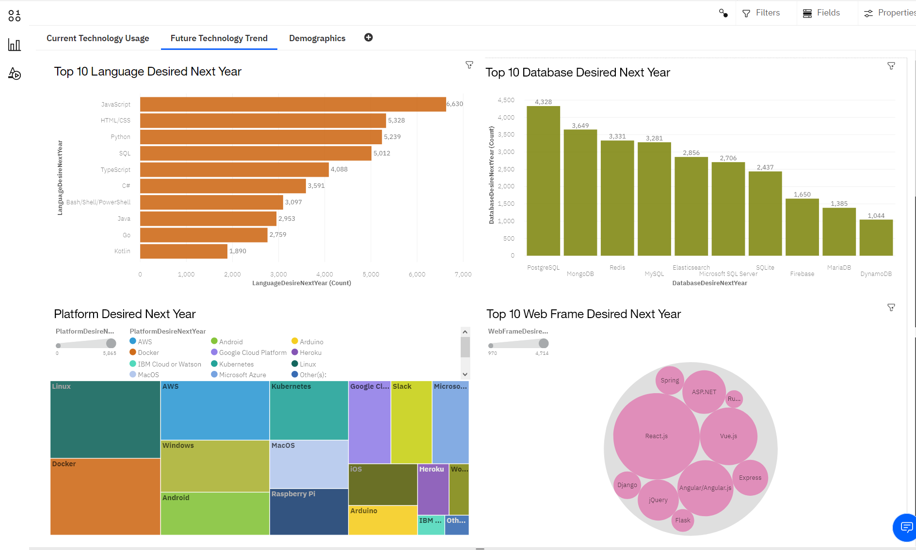
DASHBOARD TAB 2

Slide 14
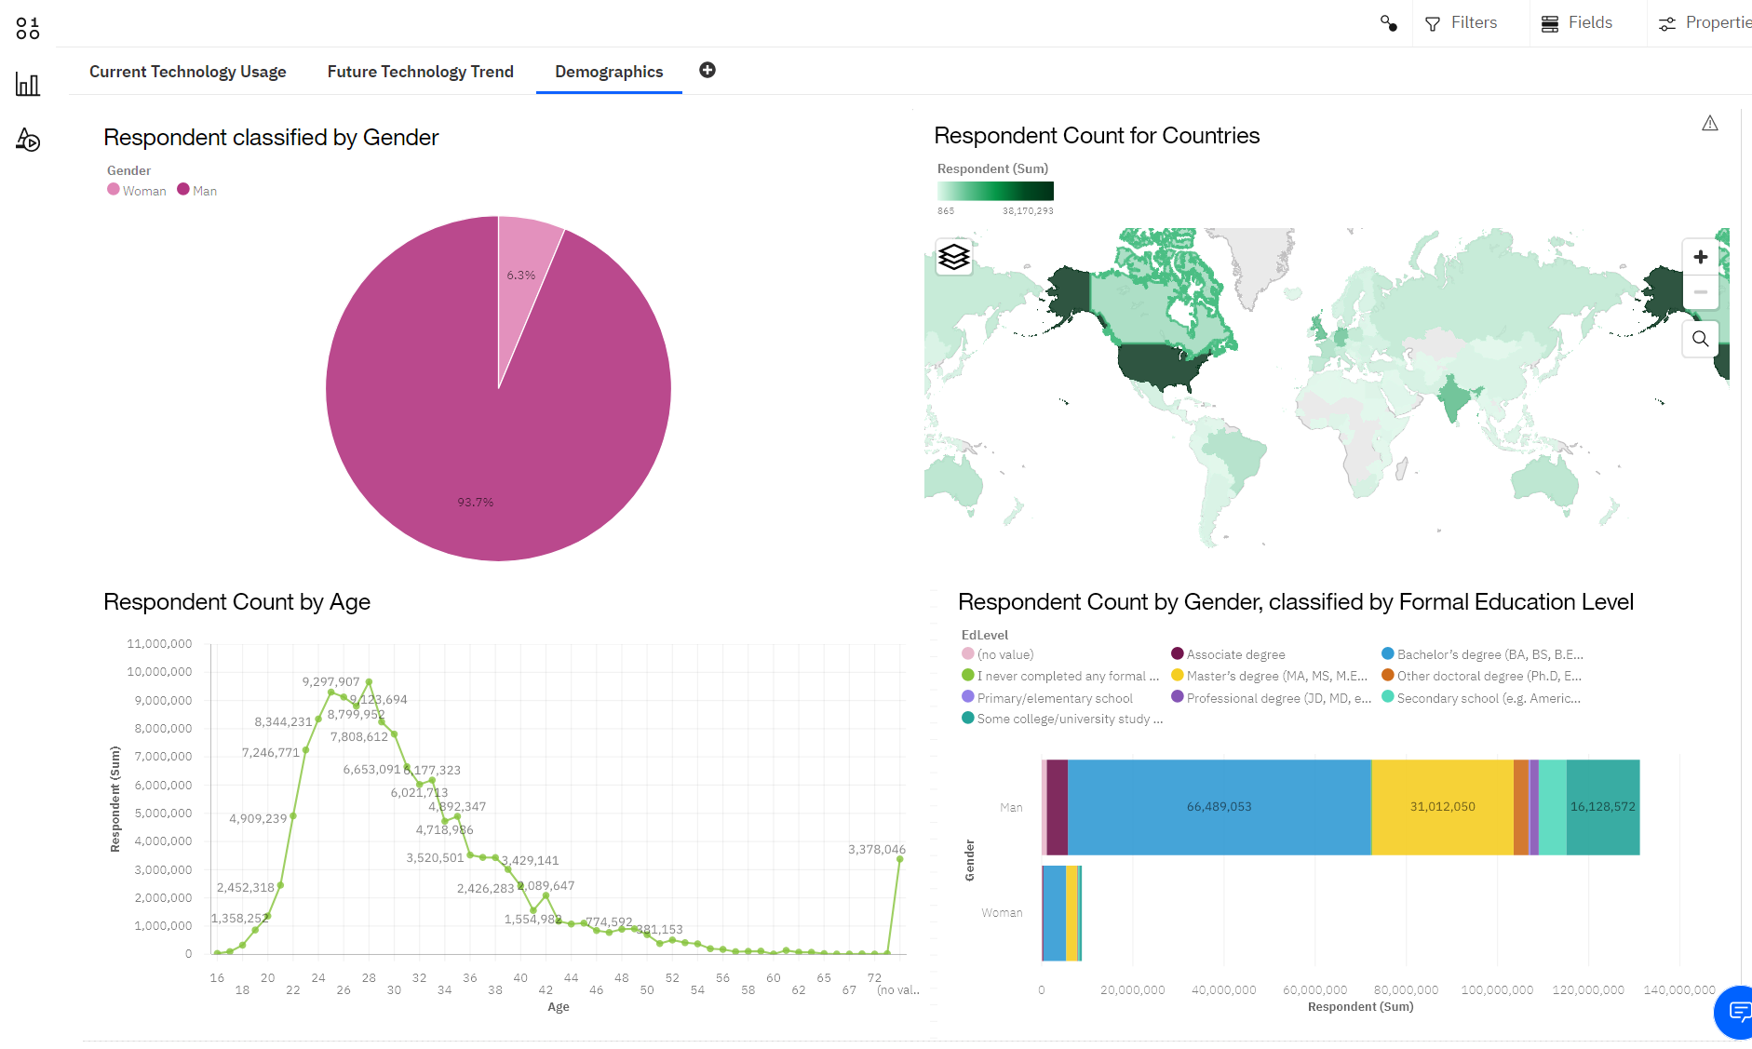
DASHBOARD TAB 3

Slide 15
DISCUSSION
Technology Trends now and future
Training and Reskilling workers
Females participation in Technology field
Bridge divide of technology gaps in developing countries
Eliminate age and education discrimination in employment

Slide 16
OVERALL FINDINGS & IMPLICATIONS
Implications
Companies need to be flexible and adjust to rapid changes
Need to spread technology out to lagging countries
Impact of job hiring’s
Shift to faster app deployments and cloud services in future
Findings
Fast changing technology every year
Concentration on several countries like USA and India
Gender gap in technology jobs
Platforms like Docker and AWS are growing

Slide 17

CONCLUSION
Technology Trends for current and next year
Programming Languages, Database and Platform overview
Demographics overview
Actions to be taken
In future, incorporate Machine Learning to predict trends and salaries

Slide 18

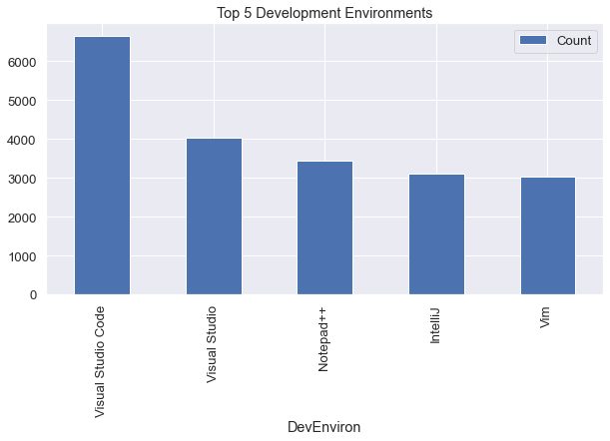
APPENDIX
Include any relevant additional charts, or tables that you may have created during the analysis phase.

Slide 19
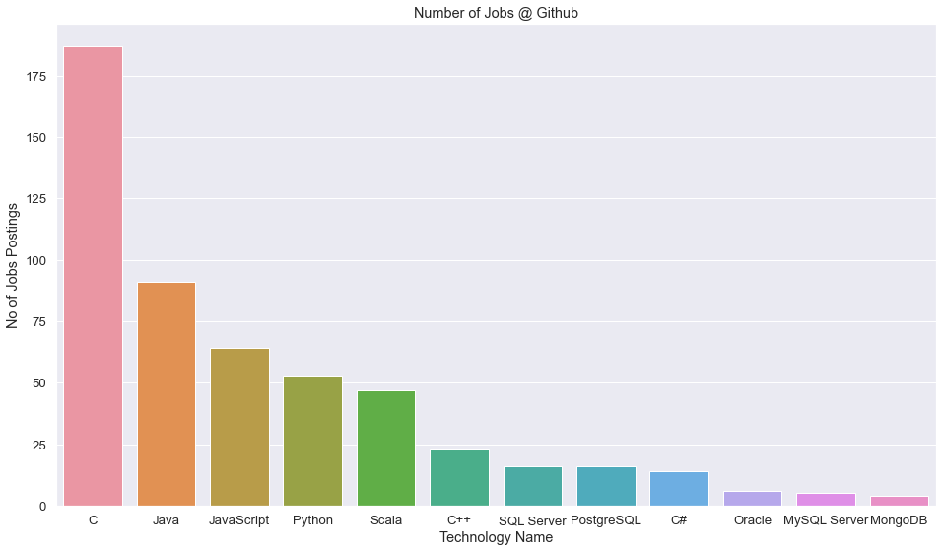
GITHUB JOB POSTINGS

Slide 20
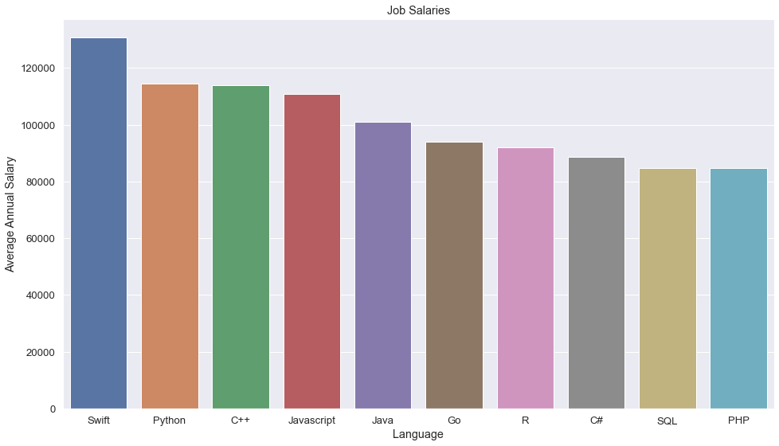
POPULAR LANGUAGES

