Slide 1
Manas Nighrunkar 111803144 Comp Div 2 T2 AI Mini-Project Stock price Prediction using LSTM

Slide 2
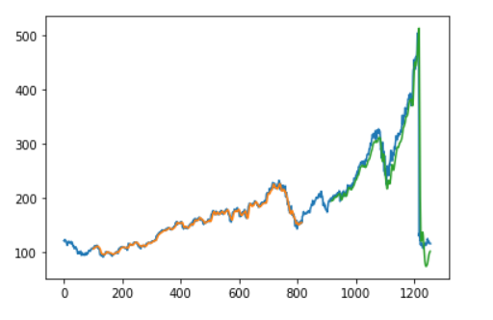
Stock Price Prediction (LSTM)

Slide 3

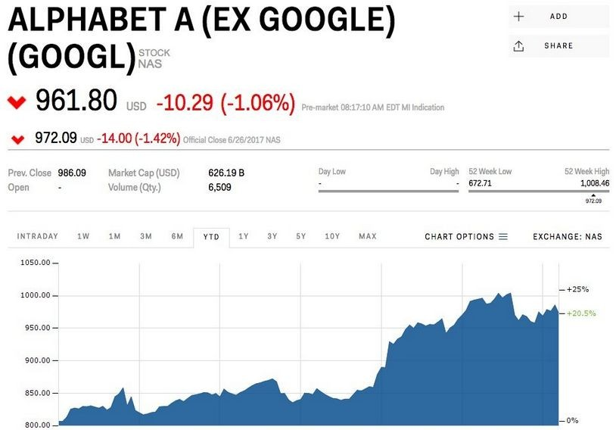
INTRODUCTION
A stock market is a public market for the trading of company stock.
Stock market allows us to buy and sell units of stocks (ownership) of a company.
If the company’s profits go up,then we own some of the profits and if they go down, then we lose profits with them.
●
If | more | sellers |  | than | buyers, stock
prices tend to fall. Conversely, when
more buyers than sellers, stock prices
tend to rise

Slide 4
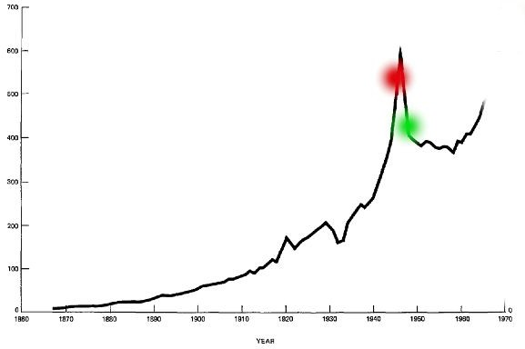
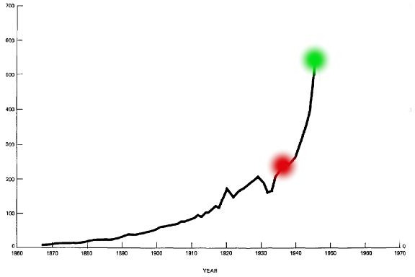
INTRODUCTION
Loss
Profit
Red is purchased stock Green is sold stock

Slide 5

HOW TO READ A STOCK TABLE?
Date- day on which the stock is traded
High- high is the highest price at which a stock traded during the course of the day
Close- refers to the last price at which a stock trades during a regular trading session
Open- price of the
first trade for any listed stock is its daily opening price.
Low- lowest price at which a stock trades over the course of a trading day.
Volume- the number
of shares or contracts traded in a security or an entire market during a given period of time

Slide 6
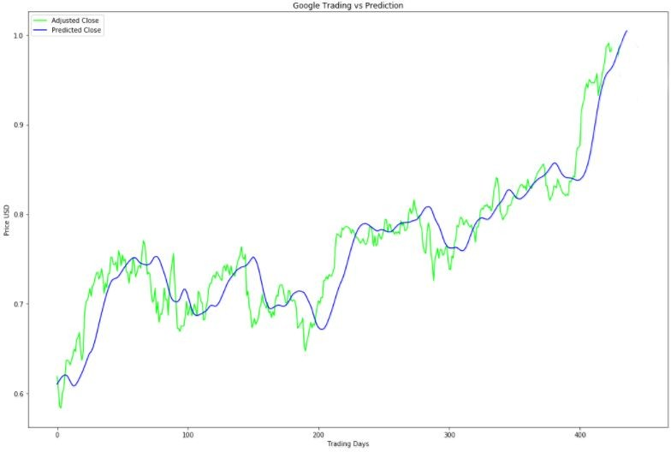


PROBLEM STATEMENT
Predicted Close price of Next day
To accurately predict the
future closing value of a given stock across a given period of time in the future.
Today’s Close price
Use LSTM method and plot Graph
also Compare to real values
Actual Close
Predicted Close
5

Slide 7
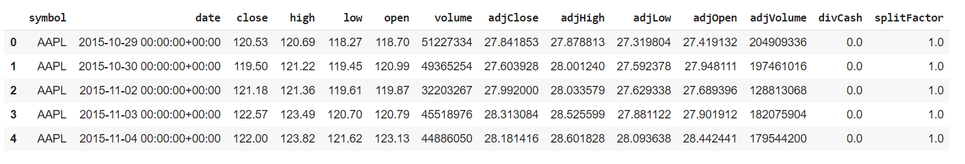
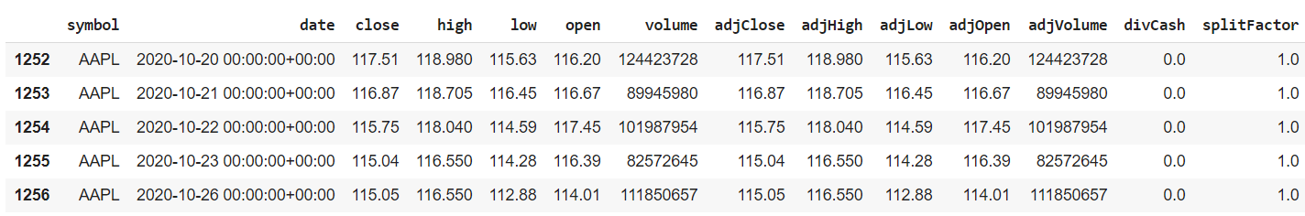
DATASET
The data used in this project is of the Apple Company from October 29, 2015 to October 26, 2020, this is a series of data points indexed in time order or a time series. Our goal was to predict the closing price for a given time span of future
6

Slide 8
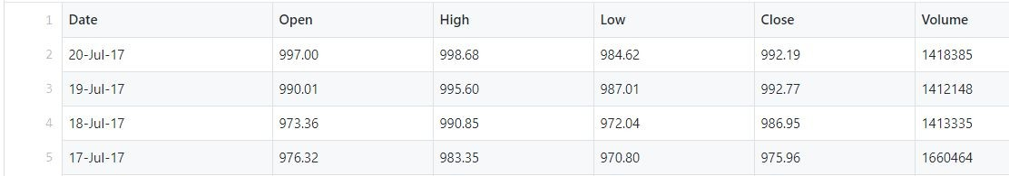
FEATURE IMPORTANCE
Process of selecting a subset of relevant features for use in model construction.
Feature selection methods include and exclude attributes present in the data without changing them.
Here, in our case ‘Date’,‘High’ , ‘open’, ‘volume’ and ‘Low’ attributes are dropped.
basically we only predicted Close values
Dropped
7

Slide 9


SO, WHAT ARE THE DIFFERENT MODELS AVAILABLE?
10

Slide 10
APPROACHES TO SOLVE
Linear Regression
Recurrent Neural Network + LSTM
11

Slide 11
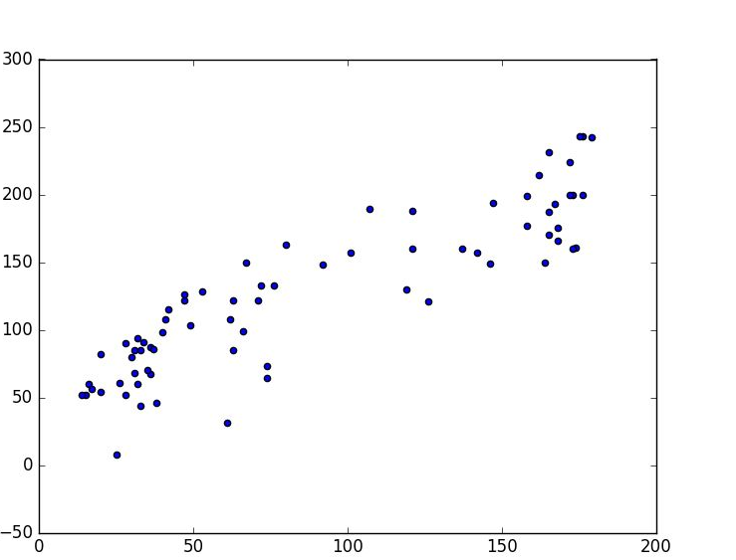

LINEAR REGRESSION
Now, you can predict Closing price along this line
Linear regression is an
approach for predictive modeling to showcase the relationship between a scalar dependent variable ‘Y’, (in our case, we have ‘Close’ attribute) and one or more independent variables ‘X’ (‘Trading day’ attribute).
Close
trading days
12

Slide 12
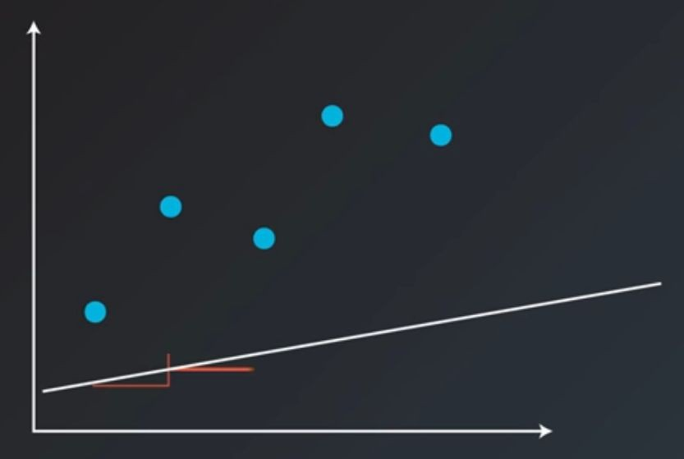
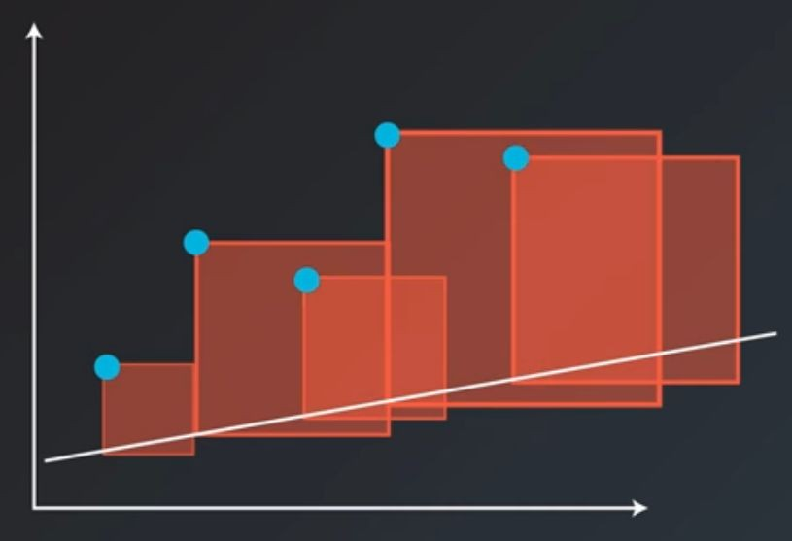
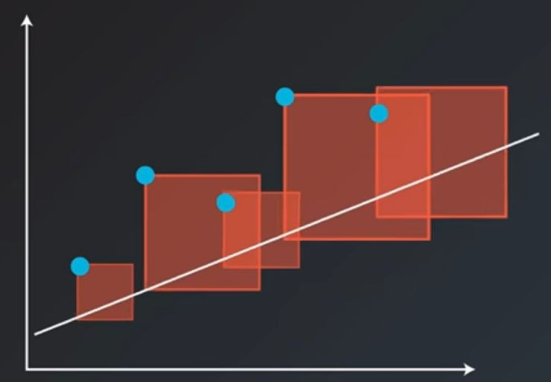




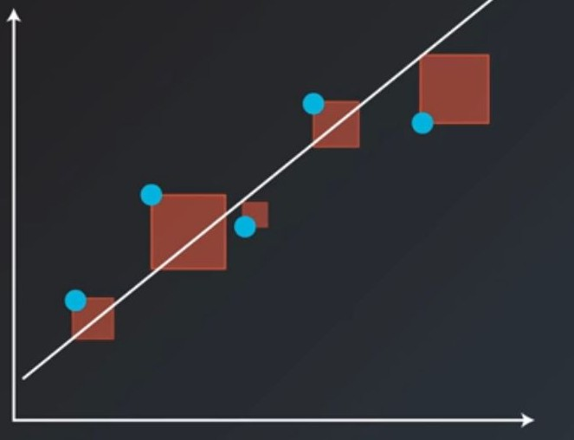
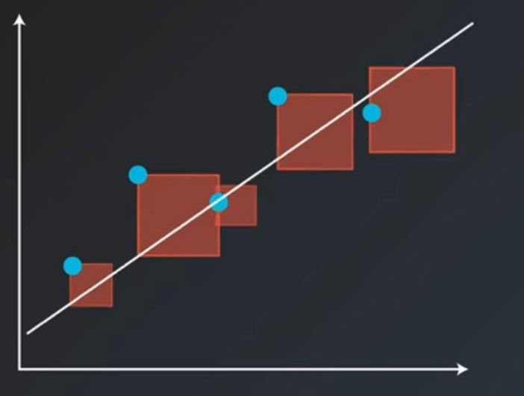
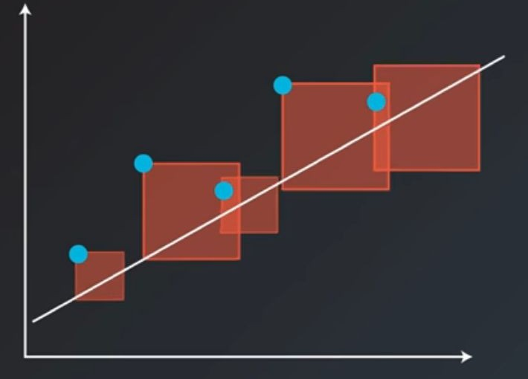

LINEAR REGRESSION

Slide 13
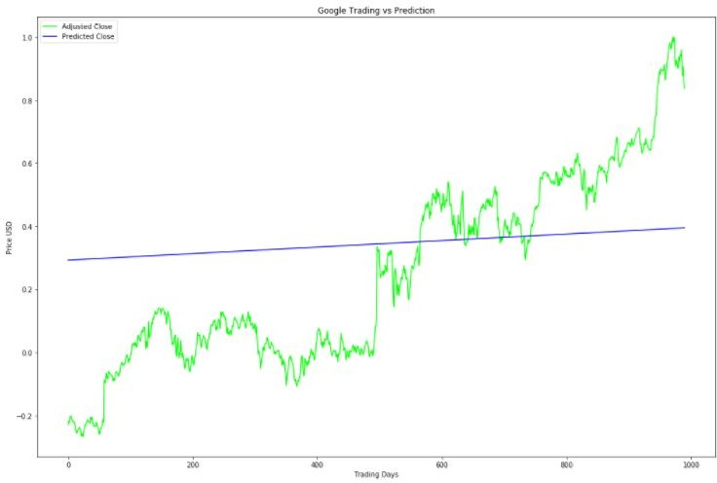
LINEAR REGRESSION

Slide 14

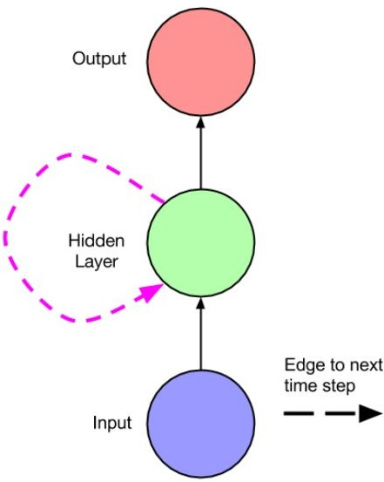
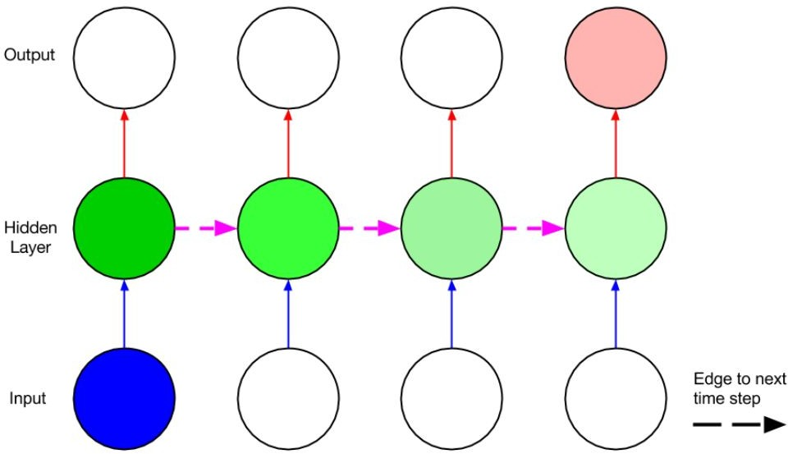
Recurrent Neural Networks (RNNs)
Networks with feedback loops (recurrent edges)
Output at current time step depends on current input as well as previous state (via recurrent edges)
UNFOLD

Slide 15
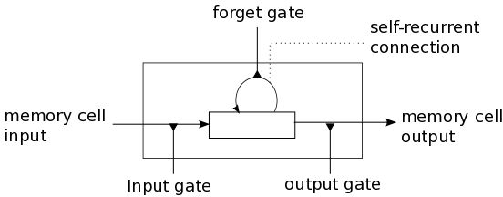
Long Short-Term Memory networks (LSTMs)
A type of RNN architecture that addresses the vanishing/exploding gradient problem and allows learning of long-term dependencies
Central Idea: A memory cell (interchangeably block) which can maintain its state over time, consisting of an explicit memory (aka the cell state vector) and gating units which regulate the information flow into and out of the memory.
LSTM Memory Cell
MEMORY

Slide 16
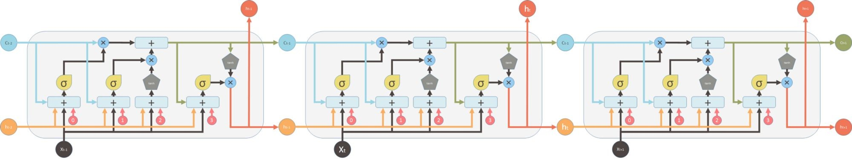
Deep LSTMs/ Stacked LSTMs
Deep LSTMs can be created by stacking multiple LSTM layers vertically, with the output sequence of one layer forming the input sequence of the next (in addition to recurrent connections within the same layer)
Increases the number of parameters - but given sufficient data, performs significantly better than single-layer LSTMs (Graves et al. 2013)
Dropout usually applied only to non-recurrent edges, including between layers

Slide 17
Graph-> Close value vs Day in data set
Blue -> original dataset graph
Orange-> predicted Train dataset
Green-> Predicted Test data set

Slide 18
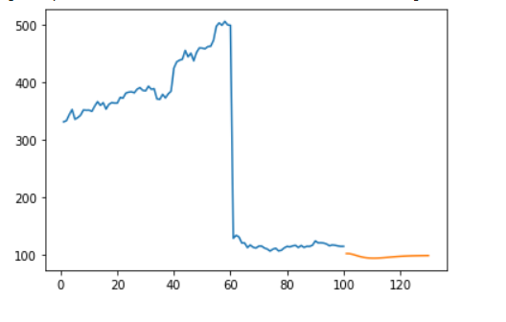
CONCLUSION
Stock price prediction is a complex problem and
difficult to predict only on one value i.e “close”
Recurrent Neural Network + LSTM

Slide 19
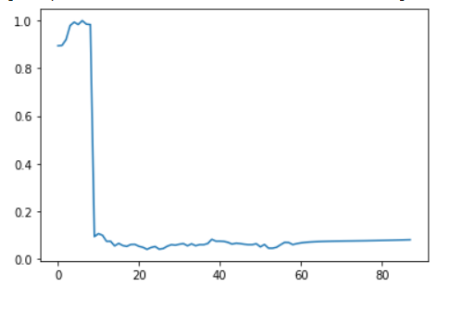
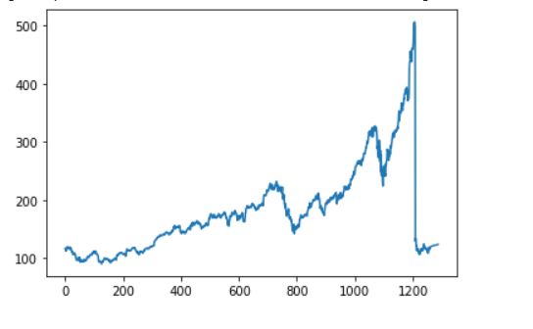

Slide 20
THANK YOU!
30

