Slide 1
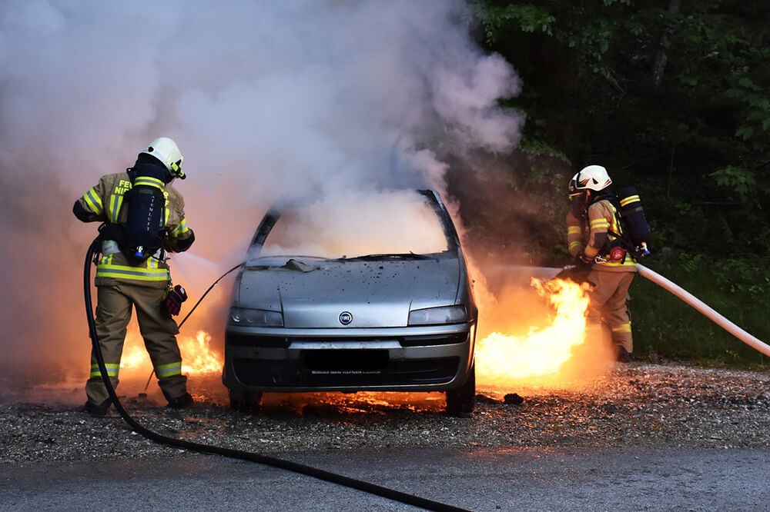
“ONE IN FIVE
CAR CRASHES
RESULTS IN
A FIRE
AFTER IMPACT.”
-AutoExtinguish

Slide 2
PROBLEM
SOLUTION
Slow Response Time: Precious seconds are lost pulling over, grabbing the extinguisher, and aiming it effectively.
Human error: Panic and inconsistency inhalation can hinder the ability to use a fire extinguisher properly.
Limited coverage: Existing fire suppression systems are not integrated, leaving critical areas unprotected.
Automated Firefighting: The system automatically detects and extinguishes fires, eliminating reliance on human response time.
Strategically integrating with airbag sensors reduces costs, maximizing efficiency.
Networked Pipelines: Extinguishing agents are efficiently distributed throughout critical fire prone zones via a network of pipes.
Manual Override: Drivers retain control with a user-friendly interface for manual system activation.

Slide 3
USE CASE
TECH STACK
The vehicle's temperature sensors detect flames of fire, indicating a potential fire hazard.
Upon detecting the fire, the system activates the fire suppression mechanism, triggering fire extinguishing.
The suppression system quickly disperses the extinguishing agents, suppressing the fire and preventing its spread.
The system alerts vehicle occupants to the fire incident through visual and auditory alarms, prompting a safe evacuation.
The system sends an emergency notification to nearby emergency services, providing real time assistance.
Hardware Components:
Microcontrollers (Arduino, Raspberry Pi),
Sensors (temperature, smoke),
Actuators (solenoid valves)
Software Development:
Programming Languages: C/C++, Python
Embedded Systems Development
IoT Connectivity (MQTT, CoAP)
Data Processing (Python with NumPy, Pandas)
User Interface (HTML, CSS, JavaScript)
Mobile Application Development (Java/Kotlin, Swift)
Networking and Communication:
Wireless Communication (Wi-Fi, Bluetooth Low Energy)
Vehicle Area Network (CAN bus, LIN bus)

Slide 4
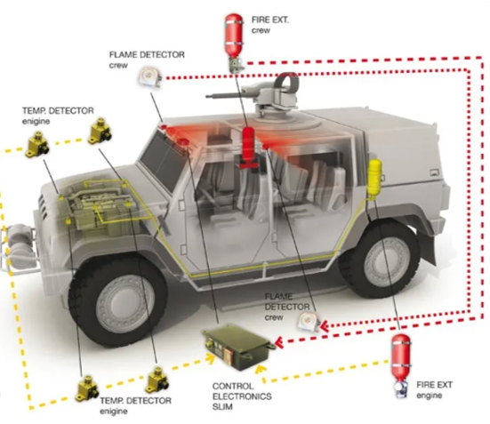
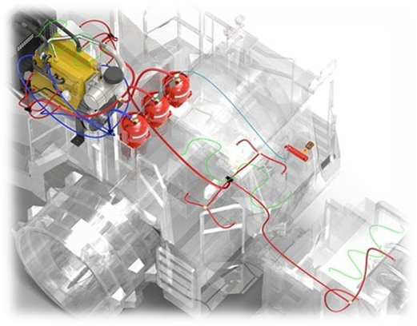
FIRE
SUPPRESSION
SYSTEM

Slide 5
IMPACT
FUTURE SCOPE
Significantly reduces fire-related fatalities and injuries in vehicles by ensuring a swift and effective fire suppression response.
Provides peace of mind to drivers and passengers by offering an additional layer of safety and protection.
Sets a new standard for automotive safety by integrating cutting-edge fire suppression technology into vehicles.
Connectivity and remote intervention: Develop systems that can connect to emergency services and allow for remote intervention in case of a fire.
Expansion to other vehicle types: adapt the technology for use in trucks, buses, and other transportation modes.
In-cabin suppression systems: explore the possibility of extinguishing fires within the passenger compartment for enhanced occupant safety.

