Slide 1
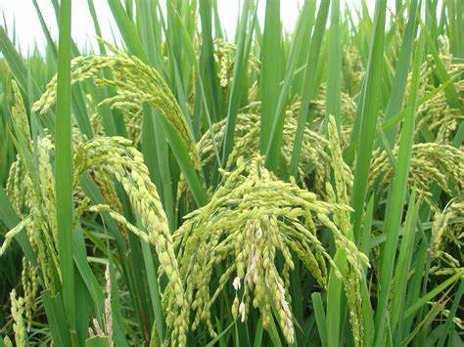

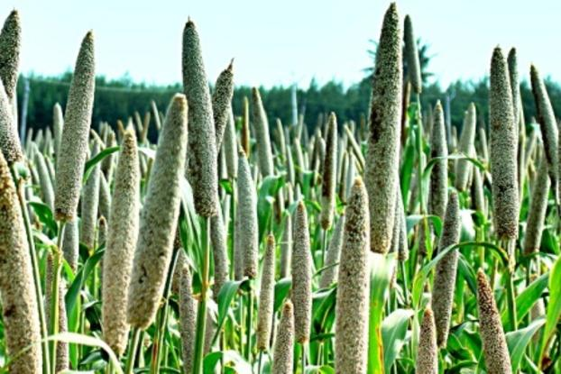
NATIONAL CONFERENCE ON AGRICULTURE
(KHARIF CAMPAIGN-2022)
19th April, 2022
KHARIF PROSPECTS AND STRATEGIES
Dr. A. K. Singh
Agriculture Commissioner
Department of Agriculture & Farmers Welfare,
Ministry of Agriculture & Farmers Welfare

Slide 2
AREA AND PRODUCTION OF CROPS IN 2021-22 (2nd Adv. Est.)
Second estimates
Crops | Area (Million hectare) |  |  | Production (Million ton)
 | Kharif | Rabi | Total | Kharif | Rabi | Total
Rice | 41.58 | 5.20 | 46.78 | 109.54 | 18.39 | 127.93
Wheat | - | 30.95 | 30.95 | - | 111.32 | 111.32
Sorghum | 1.48 | 2.38 | 3.86 | 1.58 | 2.73 | 4.31
Bajra | 7.05 | - | 7.05 | 9.22 | - | 9.22
Maize | 8.00 | 1.86 | 9.86 | 22.59 | 9.83 | 32.42
Ragi | 1.13 | - | 1.13 | 1.67 | - | 1.67
Small millets | 0.41 | - | 0.41 | 0.33 | - | 0.33
Barley | - | 0.68 | 0.68 | - | 1.90 | 1.90
Total Coarse cereals cum Nutri Cereals | 18.06 | 4.92 | 22.98 | 35.39 | 14.47 | 49.86
Total Pulses | 14.03 | 16.34 | 30.37 | 8.61 | 18.34 | 26.95
Total food grains | 73.67 | 57.41 | 131.08 | 153.54 | 162.52 | 316.06
Total Oil seeds | 19.75 | 9.01 | 28.76 | 23.82 | 13.33 | 37.15

Slide 3
RAINFALL – RABI & SUMMER SEASON (mm)
METEOROLOGICAL SUBDIVISIONS | POST-MONSOON, 2021 (01.10.21 to 31.12.21) |  |  | WINTER - 2022 (01.01.22 to 28.02.22) |  |  | MARCH, 2022 ONWARD (01.03.22 to 06.04.22)
 | ACTUAL | NORMAL | % DEP. | ACTUAL | NORMAL | % DEP. | ACTUAL | NORMAL | % DEP.
EAST & NORTH EAST INDIA | 186.3 | 166.7 | 12% | 73.4 | 52.1 | 41% | 85.9 | 85.0 | 1%
NORTH WEST INDIA | 80.5 | 55.9 | 44% | 108.3 | 78.9 | 37% | 5.2 | 53.5 | -90%
CENTRAL INDIA | 106.4 | 76.0 | 40% | 26.6 | 15.2 | 75% | 1.4 | 10.2 | -87%
SOUTH PENINSULA | 444.6 | 277.1 | 60% | 24.2 | 16.2 | 49% | 15.6 | 19.5 | -20%
COUNTRY AS A WHOLE | 177.7 | 123.8 | 44% | 58.7 | 40.8 | 44% | 18.8 | 37.3 | -50%
Post monsoon rainfall : was (+) 44%
Rabi 2022 rainfall winter : was (+) 44%
Rabi: Western disturbances rains coupled with cold wave condition benefitted Rabi crops (wheat, mustard and gram)
Normal Forecast for Kharif - 2022

Slide 4
STATUS OF AREA SOWN FOR SUMMER CROP as on 08.04.2022
Sl. No. | Crops | Area Sown (LAKH HA) |  | Increase/ Decrease over last year
 |  | 2021-22 | 2020-21
1 | Rice | 28.22 | 30.16 | -1.94
2 | Pulses | 9.32 | 8.48 | 0.84
a | Greengram | 6.12 | 6.38 | -0.26
b | Blackgram | 2.84 | 1.82 | 1.02
c | Other Pulses | 0.36 | 0.28 | 0.08
3 | Coarse Cereals | 8.78 | 8.72 | 0.06
a | Jowar | 0.17 | 0.08 | 0.09
b | Bajra | 2.97 | 2.49 | 0.47
c | Ragi | 0.22 | 0.17 | 0.05
d | Maize | 5.42 | 5.98 | -0.56
4 | Oilseeds | 9.45 | 9.11 | 0.33
a | Groundnut | 4.83 | 5.20 | -0.37
b | Sunflower | 0.36 | 0.49 | -0.14
c | Sesamum | 3.62 | 3.34 | 0.28
d | Other Oilseeds | 0.64 | 0.07 | 0.56
Total |  | 55.76 | 56.47 | -0.71

Slide 5
TENTATIVE REQUIREMENT & AVAILABILITY OF SEEDS FOR MAJOR CROPS KHARIF-2022
Crops Group | Crop | Requirement (in Quintals) | Availability (in Quintals) | Surplus/Deficit (in Quintals)
1. Cereals | Paddy | 7599868 | 8873767 | 1273899
 | Maize | 1065256 | 1061094 | -4162
2. Nutri-Cereals | Bajra | 234869 | 260447 | 25578
 | Jowar | 95577 | 108191 | 12614
 | Millets | 7590 | 8767 | 1177
3. Pulses | Arhar | 269831 | 302295 | 32464
 | Urd | 227903 | 237105 | 9202
 | Moong | 196480 | 217806 | 21326
 | Cowpea | 27111 | 29044 | 1933
 | Moth | 25000 | 28668 | 3668
4. Oilseeds | Groundnut | 2131597 | 2188249 | 56652
 | Soybean | 3721005 | 3502563 | -218442
 | Sunflower | 12588 | 16071 | 3483
 | Sesame | 18909 | 20598 | 1689
 | Castor | 49165 | 52622 | 3457
*Based on tentative information provided by the states in ZSRM Kharif-2022, the deficiency shows will be met from Farm Saved Seed, NSC & Private Seed Companies as informed by States.

Slide 6
REQUIREMENT & SALES OF FERTILIZERS IN 2021 AND REQUIRMENT IN KHARIF -2022
(Lakh Tonnes)
Fertilizers | KHARIF: 2021 |  | KHARIF: 2022
 | Assessed requirement | Total sales | Assessed requirement
Urea | 177.53* | 154.02 | 179.01**
DAP | 65.18 | 41.90 | 58.82
MOP | 20.24 | 11.23 | 19.82
NPK | 61.87 | 62.03 | 63.72
SSP | 26.46 | 25.62 | 33.19
*Reserve Allocation- 2.85 LMT (Total Allocation- 180.38 LMT) ** Reserve Allocation – 0 LMT (Total Allocation – 179.01 LMT) Use of Bio-fertilizers, Neem Coated urea, Use of Micro-nutrients Source: INM & FMS, DAC, GOI

Slide 7
National Crop Production Targets for 2022-23
(In Million Tonnes)
Crop | Season
 | Kharif | Rabi | Total
Rice | 112.00 | 18.50 | 130.50
Wheat |  | 112.00 | 112.00
Maize | 23.10 | 10.10 | 33.20
Barley |  | 2.25 | 2.25
Total Coarse Cereals | 23.10 | 12.35 | 35.45
Jowar | 3.00 | 3.00 | 6.00
Bajra | 11.30 |  | 11.30
Ragi | 2.50 |  | 2.50
Small Millets | 0.70 |  | 0.70
Total Nutri Cereals | 17.50 | 3.00 | 20.50
Tur (Arhar) | 4.55 |  | 4.55
Gram | 13.50 |  | 13.50
Urad | 2.70 | 1.00 | 3.70
Moong | 2.50 | 1.50 | 4.00
Other Kharif Pulses | 0.80 |  | 0.80
Other Rabi Pulses |  | 3.00 | 3.00
Total Pulses | 10.55 | 19.00 | 29.55
Total Foodgrains | 163.15 | 164.85 | 328.00
Total Oilseed | 26.89 | 14.45 | 41.34
Sugarcane | 415.00 |  | 415.00
Cotton* | 37.00 |  | 37.00
Jute** | 10.00 |  | 10.00
Mesta** | 0.50 |  | 0.50
Jute & Mesta** | 10.50 |  | 10.50
* Production in Million bales of 170 kg for Cotton, ** Production in Million bales of 180 kg for Jute & Mesta.

Slide 8
Pulses Scenerio
In Million Tonnes
Pulses | Present Status | Target | Projections
 | 2020-21 | 2021-22 | 2028-29 | 2029-30 | 2030-31
Demand | 28.18 | 29.26 | 31.83 | 32.64 | 35.23
Production | 25.72 | 26.96* | 29.79 | 30.75 | 33.95
Import Requirement | 2.46 | 2.30 | 2.04 | 1.89 | 1.28
Dependency on Import | 9% | 8% | 6% | 5.7% | 3.6%
*2nd Advance Estimates
Source: Working Group recommendations on Final Projections, Niti Ayog
Dependency on import can easily be neutralized by little additional production of 1.5-2.0 million tonnes than the target
Import Substitution
Rs. 28523.90 crore in 2016-17
to Rs.11937.59 crore from 6.6 Mt in 2016-17 to 2.46 Mt in 2020-21

Slide 9
Trends of area, production and yield of Pulses in India (2015-16 to 2021-22)
* 2nd Advance Estimates; Source: Ministry of Agriculture & Farmers Welfare, Govt. of India
Self-sufficiency in Pulses: a Saga of Success
Year | 2015-16 | 2017-18 | Increase in 2017-18 over 2015-16
 |  |  | Net increase | %
Production (Mt) | 16.32 | 25.42 | + 9.10 | 55.8
Area (Mha) | 24.91 | 29.81 | + 4.90 | 19.7
Yield (Kg/ha) | 655 | 853 | + 198 | 30.2

Slide 10
Sustaining Self-sufficiency in Pulses
Closing the yield gaps
(Presently yield gaps ranges from 17.1% in Lentil to 196.8% in Mothbean)
Area expansion
(Additional potential area: 6.2 million ha)
Productivity enhancement
(From 817 kg/ha to 1000 kg/ha)

Slide 11
Source: DAC&FW and IISR, Mau

Slide 12
Edible Oils: Demand-Supply Gap Widening
The gap between demand and supply for edible oils has widened in India over the years
- as the per capita consumption of edible oils has increased from 15.8 kg/year in 2012-13 to 18.8 kg/year in 2019-20
- and there has been 2.48% annual growth in the per capita consumption
Increasing productivity and acreage under oilseeds are the two pronged approach along with the strategies/action plans, similar to that of pulses, for marching towards the self -sufficiency in edible oils.

Slide 13

Edible Oil Sector
Year | Edible oil for available for consumption (MT) | Domestic Production (MT) | Imports (MT) | Value of import (Rs. in crore) | Dependency on imports (%) | Per capita Consumption (kg/yr)
1986-87 | 5.34 | 3.87 | 1.47 | 700 | 28.0 | 6.2
1994-95 | 7.54 | 7.19 | 0.35 | 300 | 5.0 | 7.3
2014-15 | 21.36 | 8.63 | 12.73 | 64,894 | 59.6 | 18.3
2019-20 | 25.06 | 10.60 | 14.46 | 68,576 | 57.7 | 18.7
2020-21 | 25.82 | 12.47 | 13.35 | 79,190 | 54.9 | 18.2
Source: Department of Sugar & Vegetable Oils; DG, CI&S, Dept. of Commerce, Kolkata
ICMR recommendation i.e. 30 g/person /day : 12 kg/person/annum
Total import of edible oils: 13.35 million tons
(Palm oil (56%), Soybean oil (27%), Sunflower oil (16%), Others (1%)

Slide 14
Trends of area, production and yield of Oilseeds in India (2015-16 to 2021-22)
* 2nd Advance Estimates; Source: Ministry of Agriculture & Farmers Welfare, Govt of India

Slide 15
Reducing Yield Gap in Edible Oilseeds
Crop | Existing yield gap (%) | Target for 2025-26 for minimizing yield gap (%) up to
Soybean | 50 | 20
Rapeseed-Mustard | 27 | 15
Groundnut | 40 | 15
Sesame | 22 | 10
Sunflower | 160 | 20
Safflower | 81 | 45
Niger | 40 | 15
Average | 60 | 20
The average yield gap in edible oilseeds is about 60%.
Reducing the yield gap to 20% in the next five years may lead to 13-14 Mt additional production of edible oilseeds (~ 3-4 Mt edible oils) without bringing any additional area under them.

Slide 16
State-wise APY of Sunflower and gap over the period
Area (lakh ha), Production (lakh tonnes) & Yield (kg/ha)
States | 1993-94 |  |  | 2020-21* |  |  | APY gap & % between 2020-21 and 1993-94
 | Area | Production | Yield | Area | Production | Yield | Area | Production | Yield
Karnataka | 14.69 | 4.75 | 323 | 1.2 | 1.08 | 898 | -13.49 (92%) | -3.67 (77%) | 575
A.P. | 3.9 | 2.17 | 556 | 0.12 | 0.08 | 692 | -3.78 (97%) | -2.09 (96%) | 136
Maharashtra | 5.72 | 3.54 | 619 | 0.26 | 0.12 | 466 | -5.46 (95%) | -3.42 (97%) | -153
Haryana | 0.4 | 0.65 | 1625 | 0.11 | 0.25 | 2004 | -0.29 (73%) | -0.40 (62%) | 379
Punjab | 0.85 | 1.46 | 1718 | 0.02 | 0.04 | 1870 | -0.83(98%) | -1.42 (97%) | 152
T.N. | 0.4 | 0.33 | 825 | 0.06 | 0.03 | 545 | -0.34 (85%) | -0.30 (91%) | -280
U.P. | 0.36 | 0.43 | 1194 | 0.04 | 0.05 | 1372 | -0.32 (89%) | -0.38 (88%) | 178
Other | 0.36 | 0.15 | 417 | 0.45 | 0.63 | 1400 | 0.16 (44%) | 0.52 (347%) | 983
All India | 26.68 | 13.48 | 505 | 2.26 | 2.28 | 1011 | -24.42 (92%) | -11.20 (83%) | 506
* As per final estimate of DES

Slide 17
Strategy for Sunflower
Area expansion: Targeting area expansion in traditional and non-traditional areas with quality seed supply.
Productivity improvement: Achieving higher productivity through technology (BMPs) adoption and reducing yield gap.
Profitability improvement: Integrating secondary agriculture and value addition opportunities through apiary, oil extraction, thalamus utilization, mechanization, etc.
Capacity Development: Training farmers, extension agencies and technical manpower on full lifecycle supply and value chain opportunity and entrepreneurship development.

Slide 18
Cotton – State specific challenges and interventions
State |  | Area | Production | Yield | Challenges | Interventions
Punjab Haryana Rajasthan |  | 17.5 (13.4%) | 13.4 (17.1%) | 585 | Whitefly Leaf curl Virus Pink boll worm (PBW) Soil crusting | Use of virus tolerant hybrids Monitoring/ mating disruption technique for PBW near ginneries/ oil extraction units ETL based neem & pesticide Application (pheromone traps 2/ac, ETL 10% flower damage or boll damage)
Gujarat |  | 23.9 (18.4%) | 81.7 (23.1%) | 577 | Pink boll worm | Use of early maturing hybrids PBW management Promotion of Herbaceum cotton in north Gujarat
MP |  | 6.0 (4.7%) | 14.9 (4.3%) | 416 | Sustain the organic cotton value chain | Certification & quality input supply Promotion of ELS cotton
Maharashtra |  | 44.1 (33.8%) | 80.9 (23.0%) | 312 | Boll rot Pink bollworm Low productivity in rainfed shallow soils Poor soil health | High density planting system (compact Bt varieties/hybrids) Boll rot management (between 60- 90 days, prophylactic) IPM/IRM of Jassid & PBW Promotion of long linted desi cotton varieties
 | APY figures are average of three years (2019-20, 20- 21, 21-22), % share in total, Area in lakh ha, Production in lakh bales and Yield in Kg lint/ha

Slide 19
Cotton – State specific challenges and interventions
State | Area | Production | Yield | Challenges | Interventions
Telangana | 21.8 (16.7%) | 64 (18.2%) | 500 | Low productivity in red soils Thrips (dry spells) & boll rot (excess rains) | High Density planting system in shallow to medium soils Crop window & ETL based sprays for boll rot & PBW
 |  |  |  | Pink bollworm | Timely sowing and crop termination
Andhra Pradesh | 6.0 (4.5%) | 19.1 (5.4%) | 542 | Late season rains/cyclones Sucking pests, TSV disease Pink bollworm | HDPS in rainfed shallow soils, ICM in heavy soils IDM boll rot, leaf spots and IRM for PBW
Tamil Nadu | 1.3 (1.0%) | 3.2 (0.9%) | 400 | Stem weevil, tea mosquito bug, Thrips Low productivity of ELS cotton | ETL based sucking pest management Mulch cum drip fertigation technique for ELS cotton
Karnataka | 7.8 (6.0%) | 21.6 (6.2%) | 473 | Mirid bug, PBW Leaf reddening | Sucking pest management Nutrient management Mating disruption for PBW
Odisha | 1.8 (1.4%) | 6.0 (1.7%) | 570 | Non-Bt seeds | Quality seed production
APY figures are average of three years (2019-20, 20-21, 21-22), % share in total, Area in lakh ha, Production in lakh bales and Yield in Kg lint/ha

Slide 20
Rice: Performance of major 10 Varieties (75% HHs) in Bihar and Eastern Uttar Pradesh

Slide 21
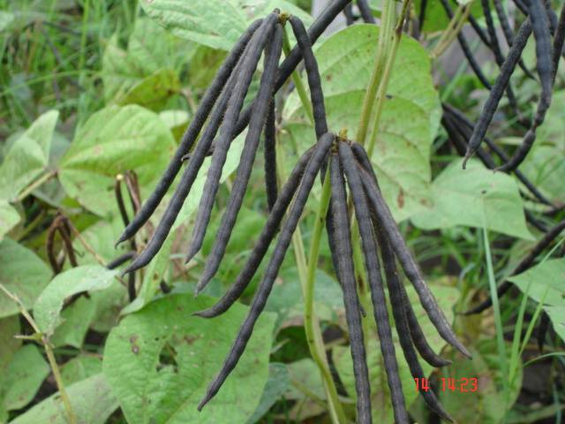
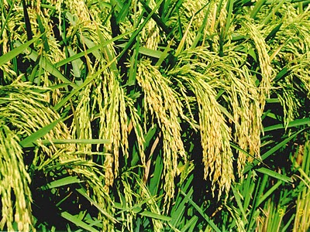
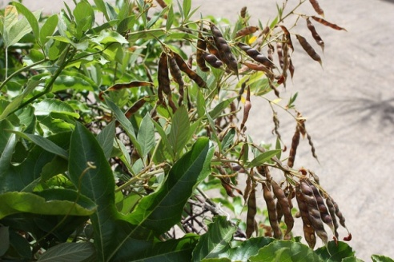
LET US STRATEGISE ACCORDINGLY
Timely arrangement of inputs
Mobilizing extension staff for field deployment
Implementation & monitoring
Cluster approach for crop productivity enhancement
Cropping system centric interventions : Focus on Pulse, Oil seeds, Nutricereals
Utilization of rice fallow, intercropping, rainfed areas, summer season
Increasing Seed Replacement Rate and Varietal Replacement
Increasing water and nutrient use efficiency
Large scale adoption of improved technologies

Slide 22
THANK YOU

