Slide 1


National Conference
On
Agriculture For Kharif Campaign 2022
19 April 2022
Directorate of Agriculture
Gujarat State

Slide 2

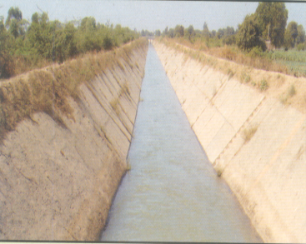
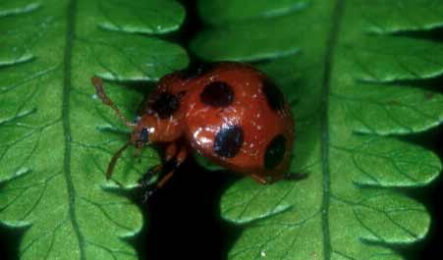
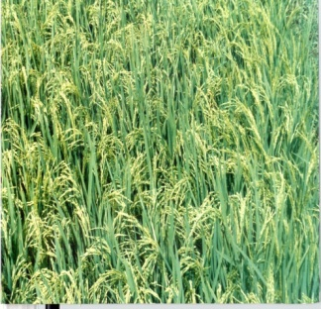
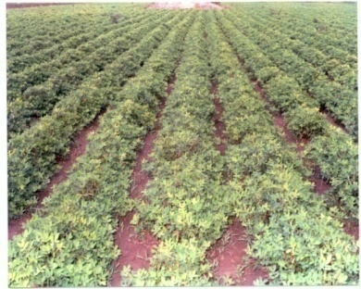
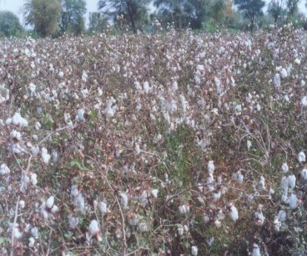
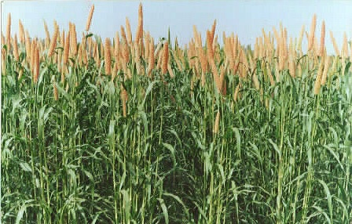
ADVANTAGE GUJARAT
1600 Km Long Coastal Belt
Diversified Crops And Cropping Systems
Climatic Diversities
Good Transport Facilities - Ports & Airports
Strong Agriculture Marketing System
Agro Based Industries & Co-operatives
Enterprising Farmers Having Business Instincts

Slide 3
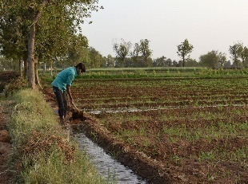









Net Irrigated Area : 44.32 Lakh Ha.
98
20+
Lakh Ha.
Field Crops
Operational Area
work area
53.20
Lakh
Land Holders
Av. Land holding : 1.88 Ha.
Semi Medium
classification
Marginal
Small
Medium
Large
Landholding wise
20.18 Lakh
(38%)
16.16 Lakh
(30%)
11.50 Lakh
(22%)
4.96 Lakh
(9%)
0.40 Lakh
(1%)

Slide 4
PRIDE OF GUJARAT
Mango
“ Gir Kesar” mango, having GI status
Datepalm
“Kutcchi” Date, monopoly of the state
Groundnut
47% production of the country
21.63 lakh ha. Area & 41.28 MT Production
Cotton
77% production in country
1/3 production of the country
Castor
12.22 Lakh MT Production from 1.66 lakh ha.
1.84 Lakh MT Production with yield of 9.30 MT/ha.
22.70 lakh ha. & 72.70 lakh bales production
6.51 lakh ha. & 13.46 lakh MT Production.

Slide 5
PRIDE OF GUJARAT
Cumin
Fennel
Isubgul
Potato
Onion
Identity of the Gujarat spices.
Production-4.00 Lakh MT, Area- 4.74 lakh ha. Yield- 845 kg/ha.
76 % Production of country
Monopoly crop, India’s pride
Highest productivity (26.00 MT/Ha.)in the country
Highest productivity (28.56 MT /ha.)
Production – 0.76 Lakh MT, Area- 0.42 lakh ha., Yield- 1800 kg/ha
Production – 0.13 Lakh MT, Area- 0.10 lakh ha., Yield- 749 kg/ha.
production 19.60 Lakh MT, area- 0.67 lakh ha.
Highest Dehydration units (80 %) of the country
World Record of potato productivity (87 MT/Ha.)
39.13 Lakh MT Production in 1.25 lakh ha.

Slide 6
Production scenario of last 5 year
Area in lakh ha. & Production. In lakh Tones; Cotton production. in lakh bales
Crops/ Year | 2017-18 |  | 2018-19 |  | 2019-20 |  | 2020-21 |  | 2021-22
 | Area | Production | Area | Production | Area | Production | Area | Production | Area | Production
Cereals | 28.27 | 68.26 | 25.33 | 61.33 | 32.55 | 85.14 | 31.82 | 83.24 | 30.24 | 82.49
Pulses | 9.08 | 9.43 | 6.62 | 6.79 | 9.02 | 10.58 | 13.97 | 19.68 | 17.44 | 27.01
Oilseed | 27.54 | 61.70 | 25.45 | 37.38 | 28.64 | 66.52 | 34.39 | 62.30 | 34.11 | 69.75
Cotton | 26.26 | 101.13 | 26.60 | 63.03 | 26.55 | 86.24 | 22.71 | 72.17 | 22.46 | 75.57
2020-21 data As Per Final Estimate & 2021-22 data As per 3rd Adv. Estimate.

Slide 7
Crop-wise Projections for Kharif 2022
CROP | Area (lakh ha.) |  | Production (lakh MT) |  | Productivity (Kg/ha)
 | Normal | 2022-23 | Normal | 2022-23 | Normal | 2022-23
Rice | 8.32 | 8.50 | 18.59 | 20.40 | 2234 | 2400
Jowar | 0.31 | 0.25 | 0.45 | 0.40 | 1435 | 1500
Bajra | 1.75 | 1.80 | 2.73 | 3.00 | 1560 | 1700
Maize | 2.99 | 3.00 | 4.79 | 5.00 | 1599 | 1700
Other cereals | 0.12 | 0.10 | 0.12 | 0.10 | 932 | 1000
Total cereals | 13.50 | 13.65 | 26.67 | 28.90
Tur (Arhar) | 2.36 | 2.50 | 2.68 | 3.10 | 1135 | 1250
Moong | 0.82 | 1.00 | 0.39 | 0.50 | 478 | 550
Math | 0.13 | 0.25 | 0.047 | 0.15 | 365 | 500
Udad | 0.97 | 1.50 | 0.60 | 1.00 | 616 | 700
Other pulses | 0.03 | 0.05 | 0.021 | 0.05 | 592 | 700
Total pulses | 4.32 | 5.30 | 3.74 | 4.80
Total food grains | 17.82 | 18.95 | 30.41 | 33.70

Slide 8
Crop-wise Projections for Kharif 2022
CROP | Area lakh ha. |  | Production lakh MT |  | Productivity Kg/ha
 | Normal | 2022-23 | Normal | 2022-23 | Normal | 2022-23
Groundnut | 17.66 | 20.00 | 35.46 | 46.00 | 2008 | 2300
Castor | 6.37 | 6.50 | 12.41 | 13.60 | 1947 | 2100
Sesamum | 1.11 | 1.30 | 0.40 | 0.60 | 361 | 450
Soybean | 1.29 | 2.50 | 1.76 | 4.00 | 1373 | 1600
Total oilseeds | 26.42 | 30.30 | 50.03 | 64.02
Cotton | 25.28 | 24.00 | 73.81 | 91.74 | 496 | 650
Tobacco | 0.52 | 0.40 | 1.00 | 0.80 | 1946 | 1950
.
**Cotton prod. In lakh bales

Slide 9
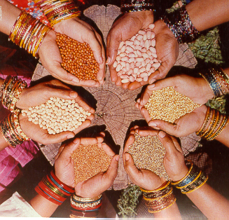
PREPAREDNESS FOR
KHARIF 2022
9

Slide 10
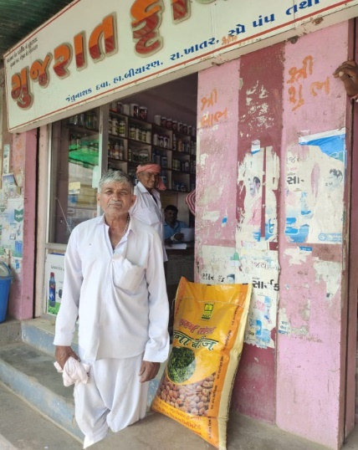
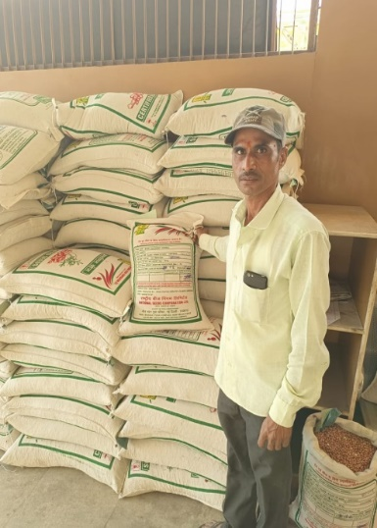
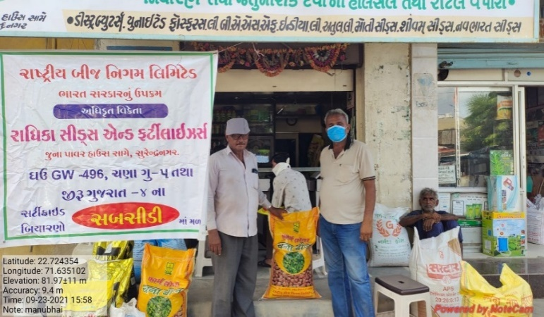
REQUIREMENT AND AVILABILITY OF CERTIFIED/QUALITY SEEDS FOR KHARIF 2022
Sr. No. | Crop | Requirement (in quintals) | Availability (in quintals) | Surplus (in quintals)
1 | Maize | 60000 | 60695 | 695
2 | Bajara | 6000 | 6750 | 750
3 | Castor | 32500 | 33648 | 1148
4 | Cotton Hy.+ variety | 63000 | 63974 | 974
5 | Paddy | 123000 | 128420 | 5420
6 | Black gram | 10000 | 10253 | 253
7 | Green gram | 10000 | 10406 | 406
8 | Pigeonpea | 22081 | 22481 | 400
9 | Groundnut | 868000 | 872617 | 4617
10 | Seasamum | 2500 | 2587 | 87
11 | Soyabean | 88500 | 88782 | 282
 | TOTAL | 12,85,581 | 13,00,613 | 15,033

Slide 11
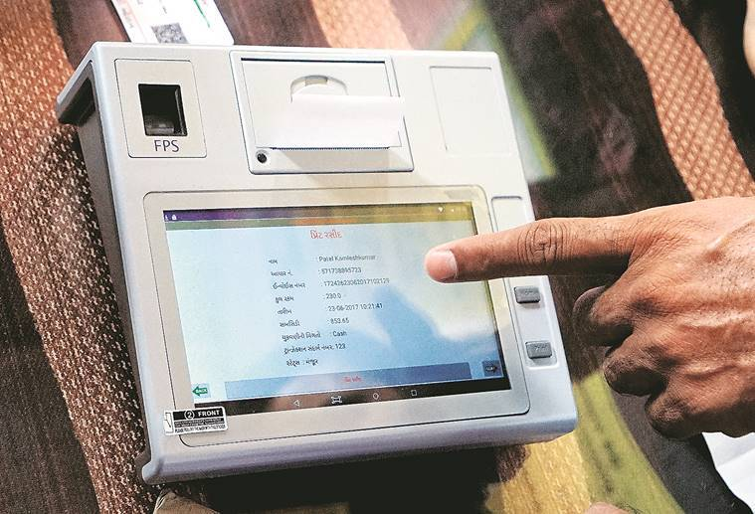
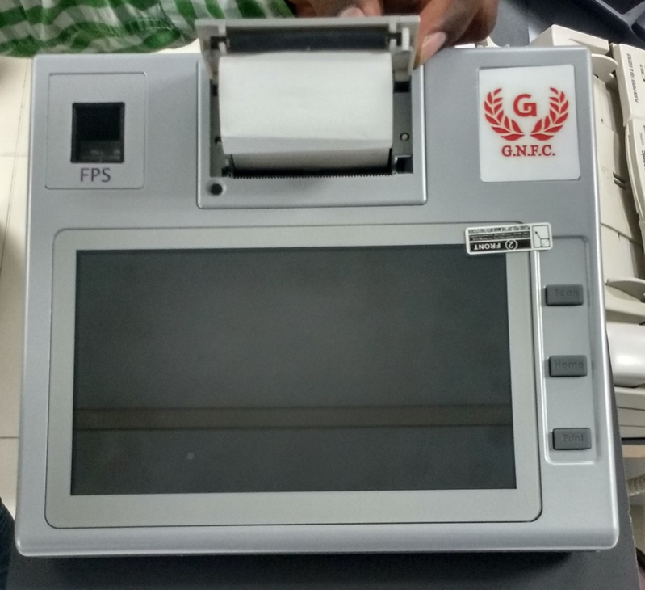
Product wise Fertilizer Allocation for 2022 (In MT)
POS Machine – selling of Fertilizer under DBT scheme from February, 2018
Product | Kharif : 2021 |  |  | Demand Sanctioned for Kharif 2022
 | Requirement | Allocation | Supply
Urea | 11,50,000 | 11,77,319 | 10,00,790 | 11,50,000
DAP | 2,50,000 | 2,59,030 | 2,69,092 | 3,00,000
MOP | 60,000 | 63,280 | 48,886 | 55,000
NPK | 3,10,000 | 3,37,550 | 3,15,661 | 3,10,000

Slide 12
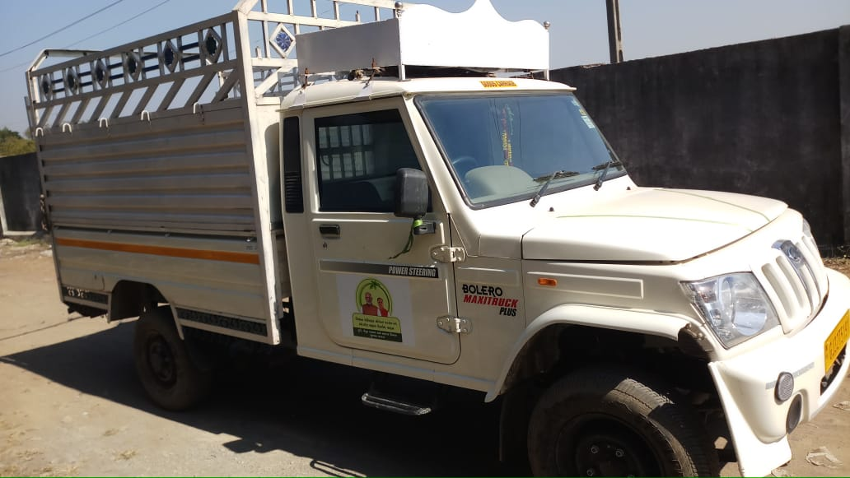
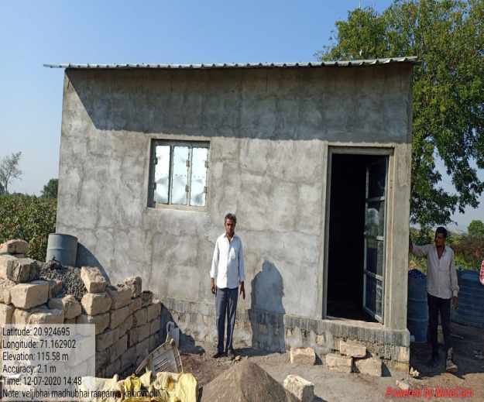
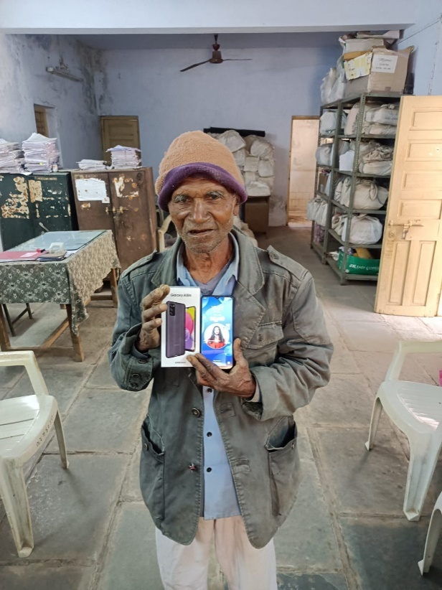
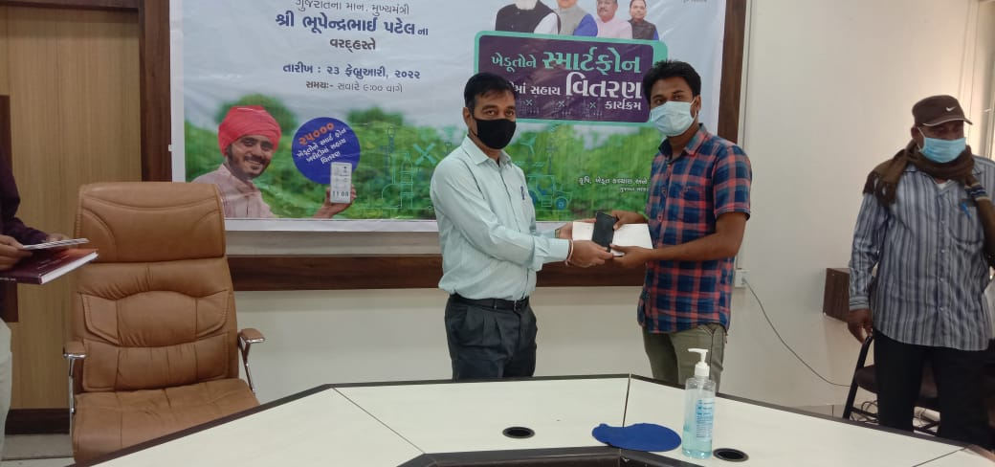
New Initiatives
(already Implemented)

Slide 13
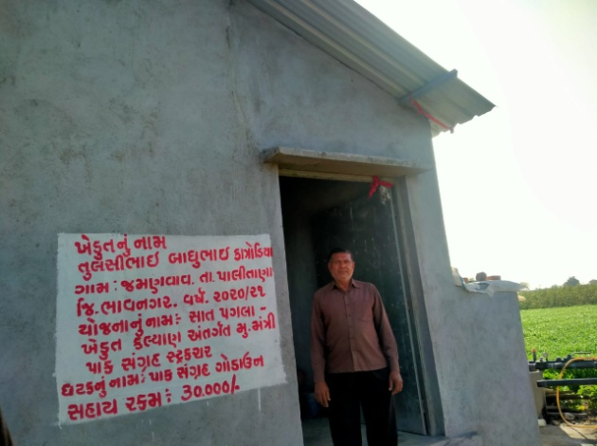
On Farm Storage Structure Scheme
Scheme Implementation
Objectives of Scheme:
Farmers can protect their produce from rains, storms, etc. after harvest.
Storing and selling at a good price can get them more returns.
Total Online Application : 1,06,383
Construction Time: 150 Days
Construction Verification: 15 Days after receiving subsidy claim documents
Subsidy payment to farmer’s account
Scheme Detail:
Small storage structure on farm.
Minimum size of storage structure is
330 square feet.
Unit Cost : Rs. 1.00 lakh
Subsidy : 50% or Rs. 50,000/-
Financial Provision : Rs. 142.40 Crore
Physical Target : 28480

Slide 14
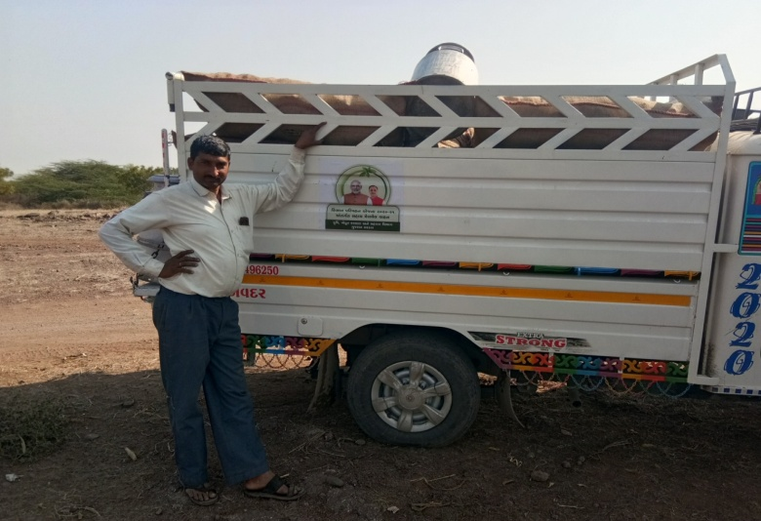
Financial Assistance on Purchase of Medium Size Goods Carriage Vehicles for Transport of Agricultural Products under Kisan Parivahan Scheme
Objectives of Scheme:
Kisan Parivahan Yojana as a link between Kisan Udan and Kisan Rail Yojana
Farmers will be able to deliver their produce to other markets timely and get higher returns
Scheme Implementation
Total Online Application : 4795
Beneficiaries purchase vehicle and submit documents to office Within 60 days of presaction date
Verification Work: 15 Days after receiving subsidy claim documents
Subsidy payment to farmer’s account
Scheme Detail:
loading capacity from 600 kg to 1500 kg
Subsidy Amount : 25 to 35%
  General & Other farmers-
  25% Or Rs.50000/-
  Small, Marginal, Women, ST, SC farmers- 35% or Rs.75000/-
Financial Provision : Rs. 15 Crore
Physical Target : 2500

Slide 15
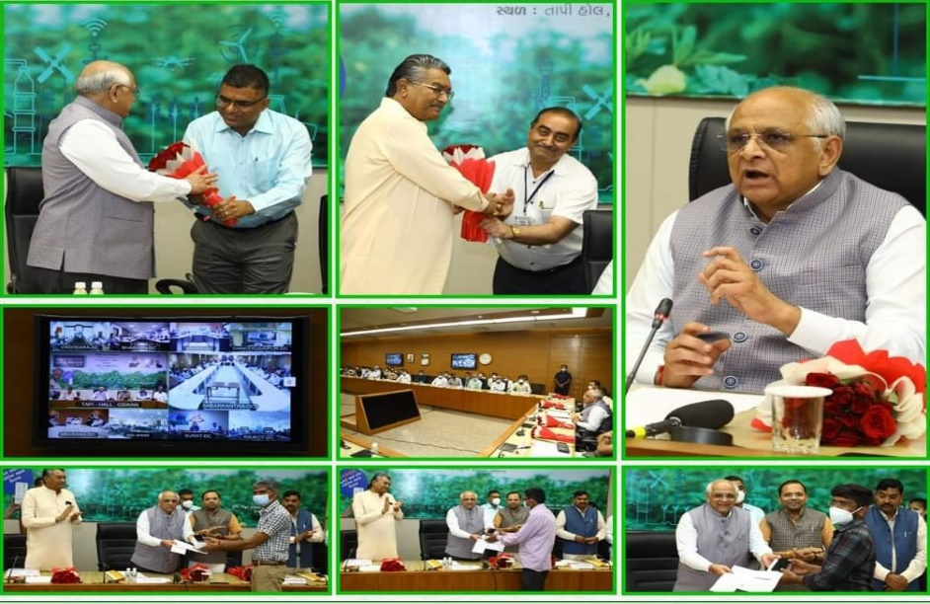
Scheme for providing Assistance on Purchase of Smartphone by the farmers
Objectives of Scheme:
Benefits to Farmers:
Weather forecast & Rain forecast information
Potential pest infestation information
Latest farming methods information
Techniques of pest & disease control
Information regarding agriculture department schemes
Online application for getting assistance in different Agriculture schemes by farmers.
Smartphone Distribution Programme
Scheme Detail:
Assistance Rate: 40% assistance on the purchase price of smartphone or Rs. 6000/- whichever is less
Financial Provision : Rs.10 crore for 16,667 Smartphone
Total No. of Applications received :-33,079

Slide 16
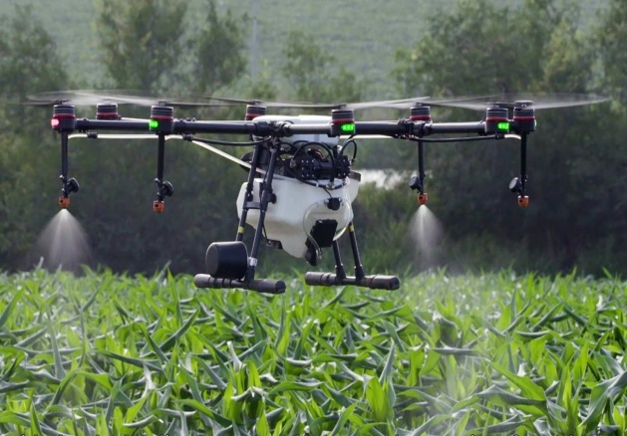
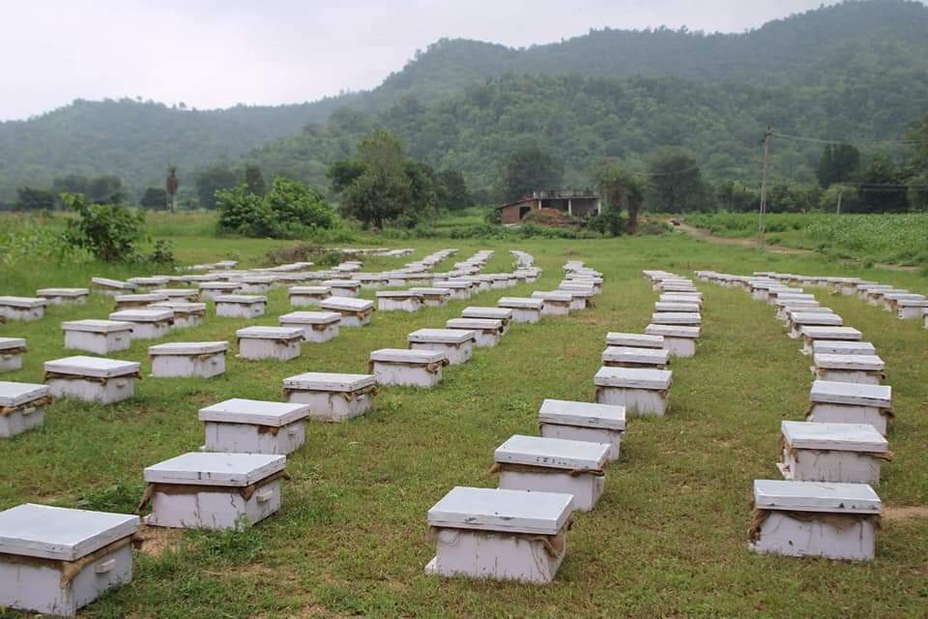
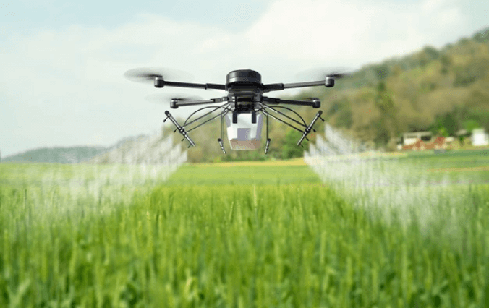
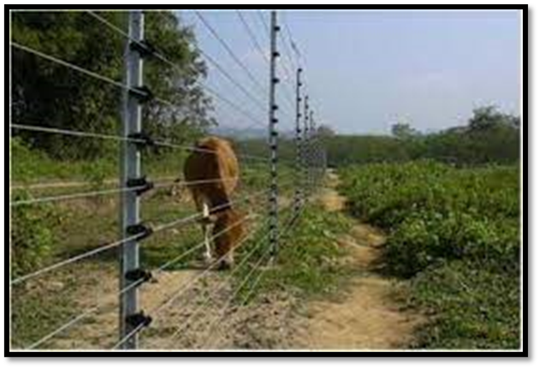
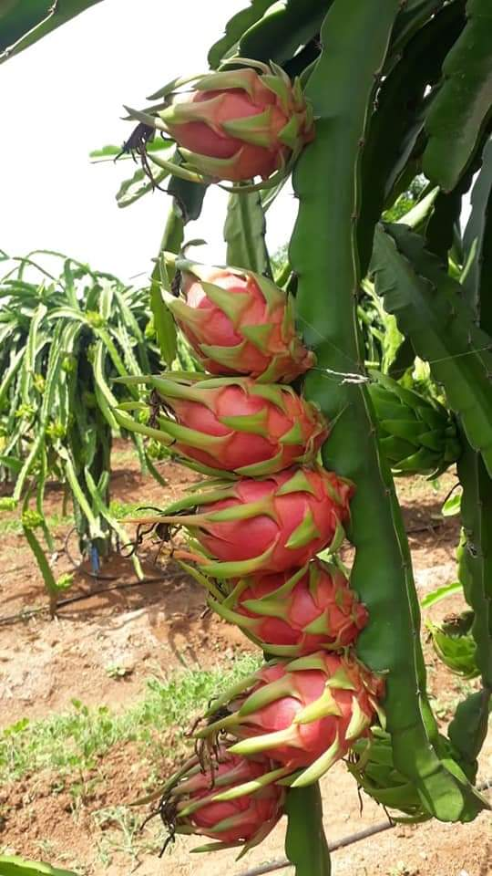
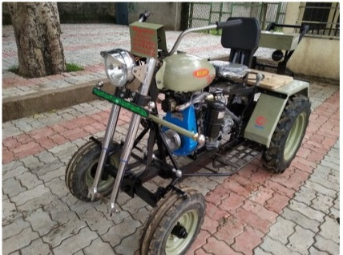
New Initiatives
(To be implemented)

Slide 17
To assist farmers in purchasing "SANEDO-Agricultural equipment”
“VOCAL FOR LOCAL”
Scheme Implementation
Objectives of Scheme:
Multipurpose vehicle for different farm operations.
Farmers who have less land cannot afford to purchase tractors, encourage to use Sanedo
Beneficiaries purchase vehicle and submit documents to office Within 60 days of pre saction
Verification Work: 15 Days after receiving subsidy claim documents
Subsidy payment to farmer’s account
Scheme Detail:
10 horse power engine.
Used for various operations such as intercropping, sowing, spraying etc
Subsidy Amount : 25 % or Rs. 25,000/-
Financial Provision : Rs. 10 Crore
Physical Target : 4,000

Slide 18
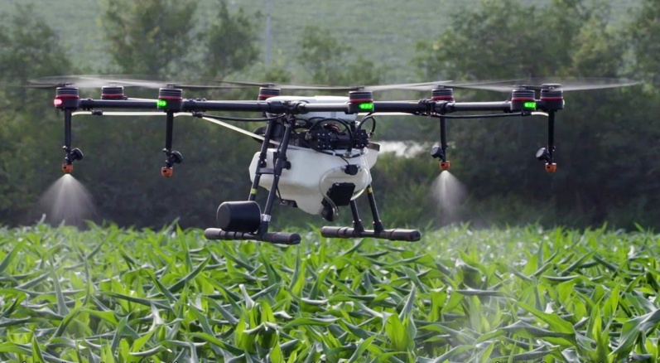
Use of Drone Technology (Krushi Viman) in Agriculture
Objective:
To save time, water, crop protection chemicals and
To resolve the problem of farm labour shortage
Brief about scheme:
1 ha of land can be sprayed only in 20 minutes with 25 litre of water and farm chemicals can be used effectively.
Assistance for five time spray in one acre
Rate of Assistance : 90% or Rs. 500 whichever is less per spray (Max Rs. 2500/- per acre)
Budget Provision: Rs. 35.00 crore
Physical Target: 1,40,000 acres

Slide 19
Assistance for Solar Power Unit/Kit
Objective:
To prevent agricultural crop damage caused by wild/Stray animals
Brief about scheme:
Rate of Assistance : 50% of purchase cost of Solar Power Unit/Kit (Maximum upto Rs. 15,000/-)
Farmer will erect wire fence on his own cost according to need and local situation
Budget Provision : Rs. 20 crore
No. of Beneficiary Farmers : Approx. 13,000

Slide 20
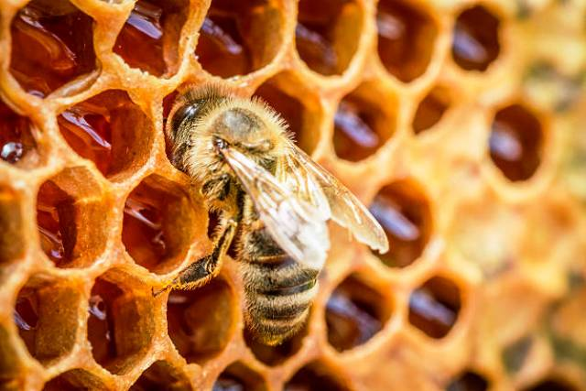
Name of scheme : Mission Honeybee
Scheme Implementation
Objective:
Promotion of bee keeping.
To Increase horticulture production through high pollination through bee keeping.
Supplementary income.
The beneficiaries of the scheme : Registered farmer group, FPO, FPC, “A” grade co-operative societies, private institutions, horticulture department / agriculture department / all four agricultural universities / KVKs of the state as well as individual beneficiaries.
Brief about scheme:
Subsidy on honey bee colony / Hives, honey extractor
Support for processing, packaging, cold room unit
Seminars and training as well as bee support establish bee clinic, Management support.
Project base proposal has to be submitted
Financial Provision : Rs. 10 crore

Slide 21
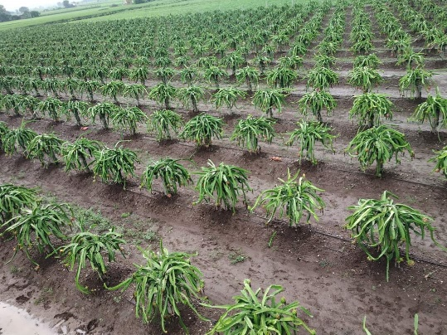
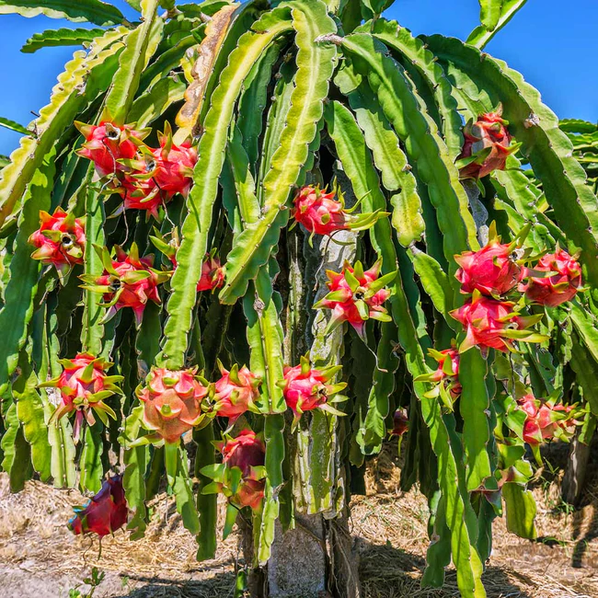
Name of scheme : Mission Kamlam
Scheme Implementation
Objective:
To promote the plantation of Kamalam (Dragon fruit) as it has nutritive values, medicinal and antioxidant qualities to control many diseases.
To increase the export.
Project based scheme including New plantation, irrigation, farm mechanization, on farm pack house/collection unit, vermi compost unit, GAP certificate, mulching for horticulture crops.
Brief about scheme:
Unit cost: 6 lakh/ha
Subsidy : 50 % - Max 3 lakh/ha (General - up to 1 ha),
75% Max 4.5 lakh/ha (SC/ ST - up to 1 ha)
Financial Provision : Rs. 10 crore
Physical Target : 444 ha

Slide 22


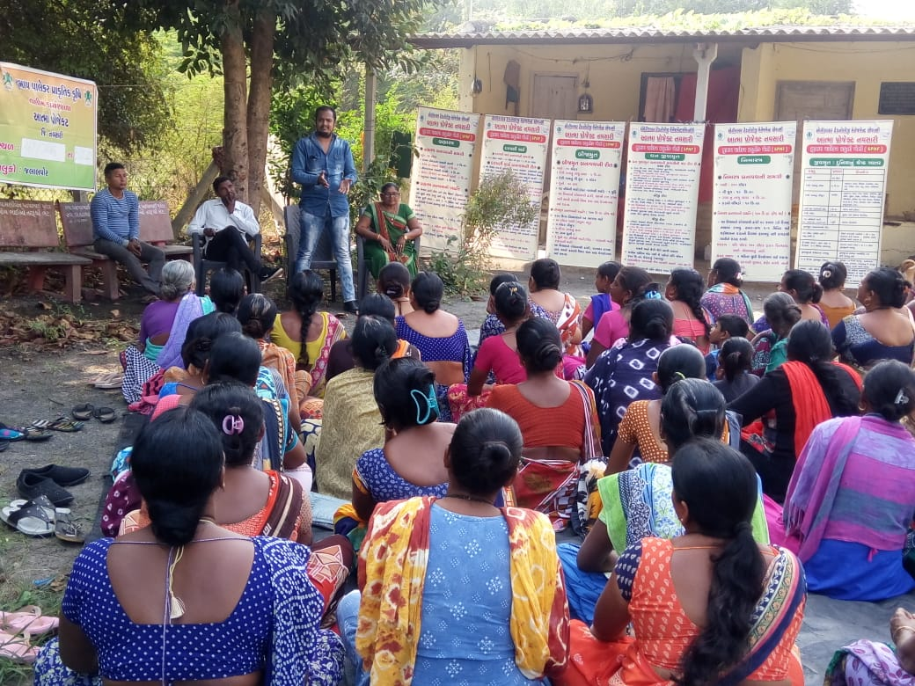
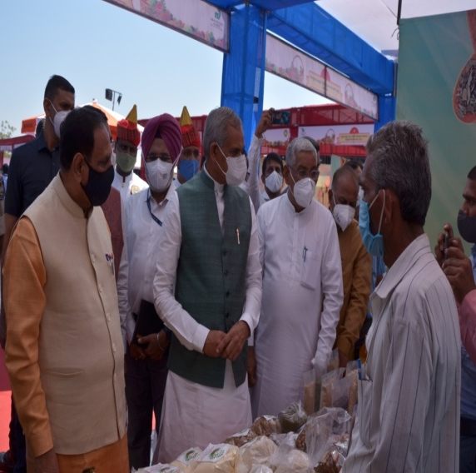
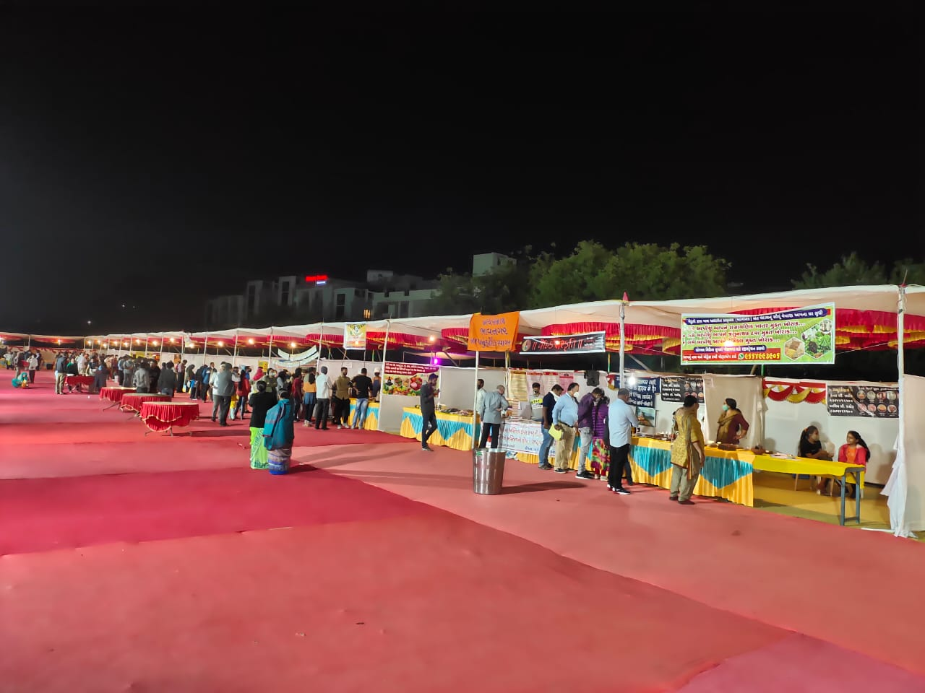
Natural Farming in Gujarat state
Extension Activities
Workshop: 5 workshops for promotion of Natural Farming
Trainings : For Farmers, Farmers’ Friend, Master Trainers & Extension workers
Publicity Campaign: Book, Success stories, Hand bill, Films, Quickies, Calendar etc.
Events, Exhibition & Market support
Amrut Aahar Mahotsav: Organized in all districts from 25-31/12/2020
767 Farmers participated, 516 stall and sale: Rs. 48.64 lakh
Farm Fresh Festival: In Ahmedabad on Dated 7-9/03/21
selling of natural produce of Rs. 49.30 lakh by 74 farmers
Formation of 85 FPOs for market of Natural Farming products
Gram Hat under Rural development department are developed for marketing of Natural produce and sell by FPOs

Slide 23
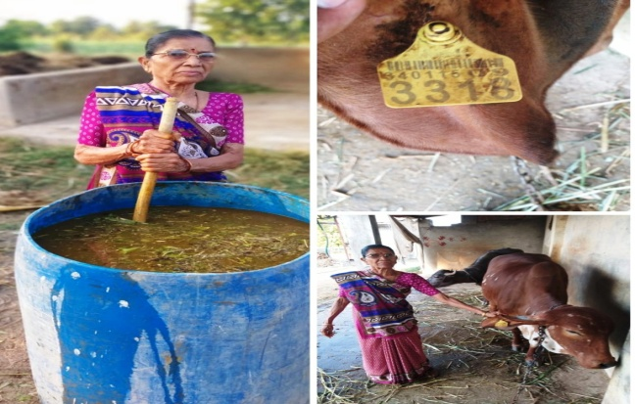
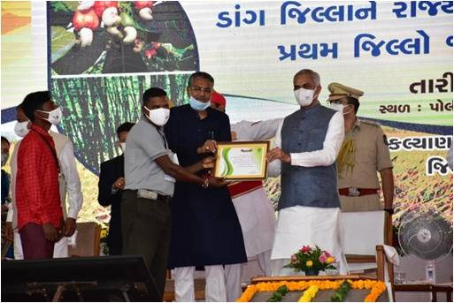
Natural Farming in Gujarat state.
Government Incentives
Scheme for maintenance of indigenous cow for Natural Farming
Financial Assistance of Rs. 900/- per month (Rs.10,800/- per annum) for the maintenance of one indigenous cow to farm family who are doing natural farming.
Budget provision : Rs. 213 Crore for FY 2022-23
Special scheme for Dang district for 100% Chemical free Natural Farming district
Financial Assistance of Rs. 10,000/- per farmer per ha for first two year for natural farming.
Provision for establishment of marketing structure – Rs. 1.5 crore
Help for certification of natural products- Rs. 10 crore
Budget provision : Rs. 31.50 Crore for FY 2022-23
New Initiatives
    The Dangs District – Declared as “100% Chemical Free & Natural Farming District” – Special scheme for farmers of Dang district.
    Formation of “Gujarat Prakrutik Krushi Vikas Board”
    Formation of committee to develop syllabus & curriculum on Natural Farming
    Establishment of Gujarat Organic University

Slide 24
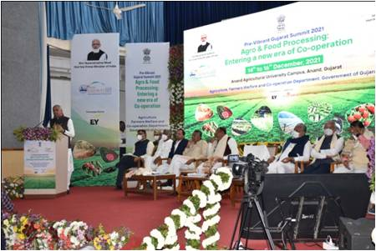
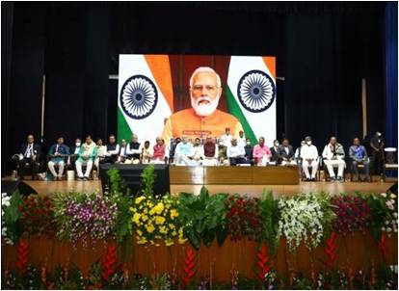
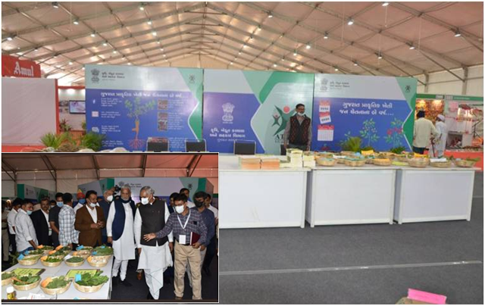
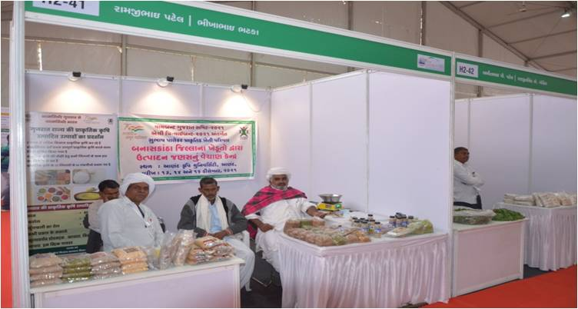
Pre- Vibrant & National Conclave on Natural Farming
Inauguration Ceremony under chairmanship of the Hon. Governor & Hon. Union Minister of Animal Husbandry
14th December, 2021, Anand Agriculture University.
National Conclave at Amul, Anand on Natural Farming with virtual presence of the Hon. Prime Minister on 16th December, 2021 Hon. Union Home Minister, Hon. Governor, Hon. Union Minister of Agri., Hon. Chief Minister, Ministers & distinguished dignitaries were remained present.
Natural Farming Theme Pavilion
Special information on natural farming and success stories of farmers engaged in natural farming as well as farm products were displayed.
Natural Farming Stall
About 20 stalls of farmers engaged in natural farming were set up in which about 40 farmers had displayed and sold their farm produce.
14th to 16th December, 21 - Approximately 34,500 progressive farmers visited from all districts

Slide 25
Formation of “Gujarat Prakrutik Krushi Vikas Board”
Objectives :
Increase area under Natural Farming.
Provide continuous guidance for natural farming system
Provide incentives to farmers for natural farming
Strengthen the marketing structure for natural farming products.
Help for certification of natural farming products.
Scheme Implementation
Formation of Gujarat Prakrutik Krushi Vikas Board
State level Apex body headed by Hon. Chief Minister
State level Task Force headed by Hon. Chief Secretary
Detail:
Training & Exposure visit are main component
Develop Model Farms
Publicity campaign
Conclave & Mega seminars
Marketing structure for Natural farming
Natural farming Certification & Hand holdings
Pesticide residue testing for Agricultural products
Total Financial Provision : Rs. 100 Crore

Slide 26


Thank You

