Slide 1



National Conference on Agriculture for Kharif - 2023
Place- NASC, Pusa Complex, ICAR, New Delhi
Date- 03 May,2023
Department of Agriculture
Government of Maharashtra

Slide 2
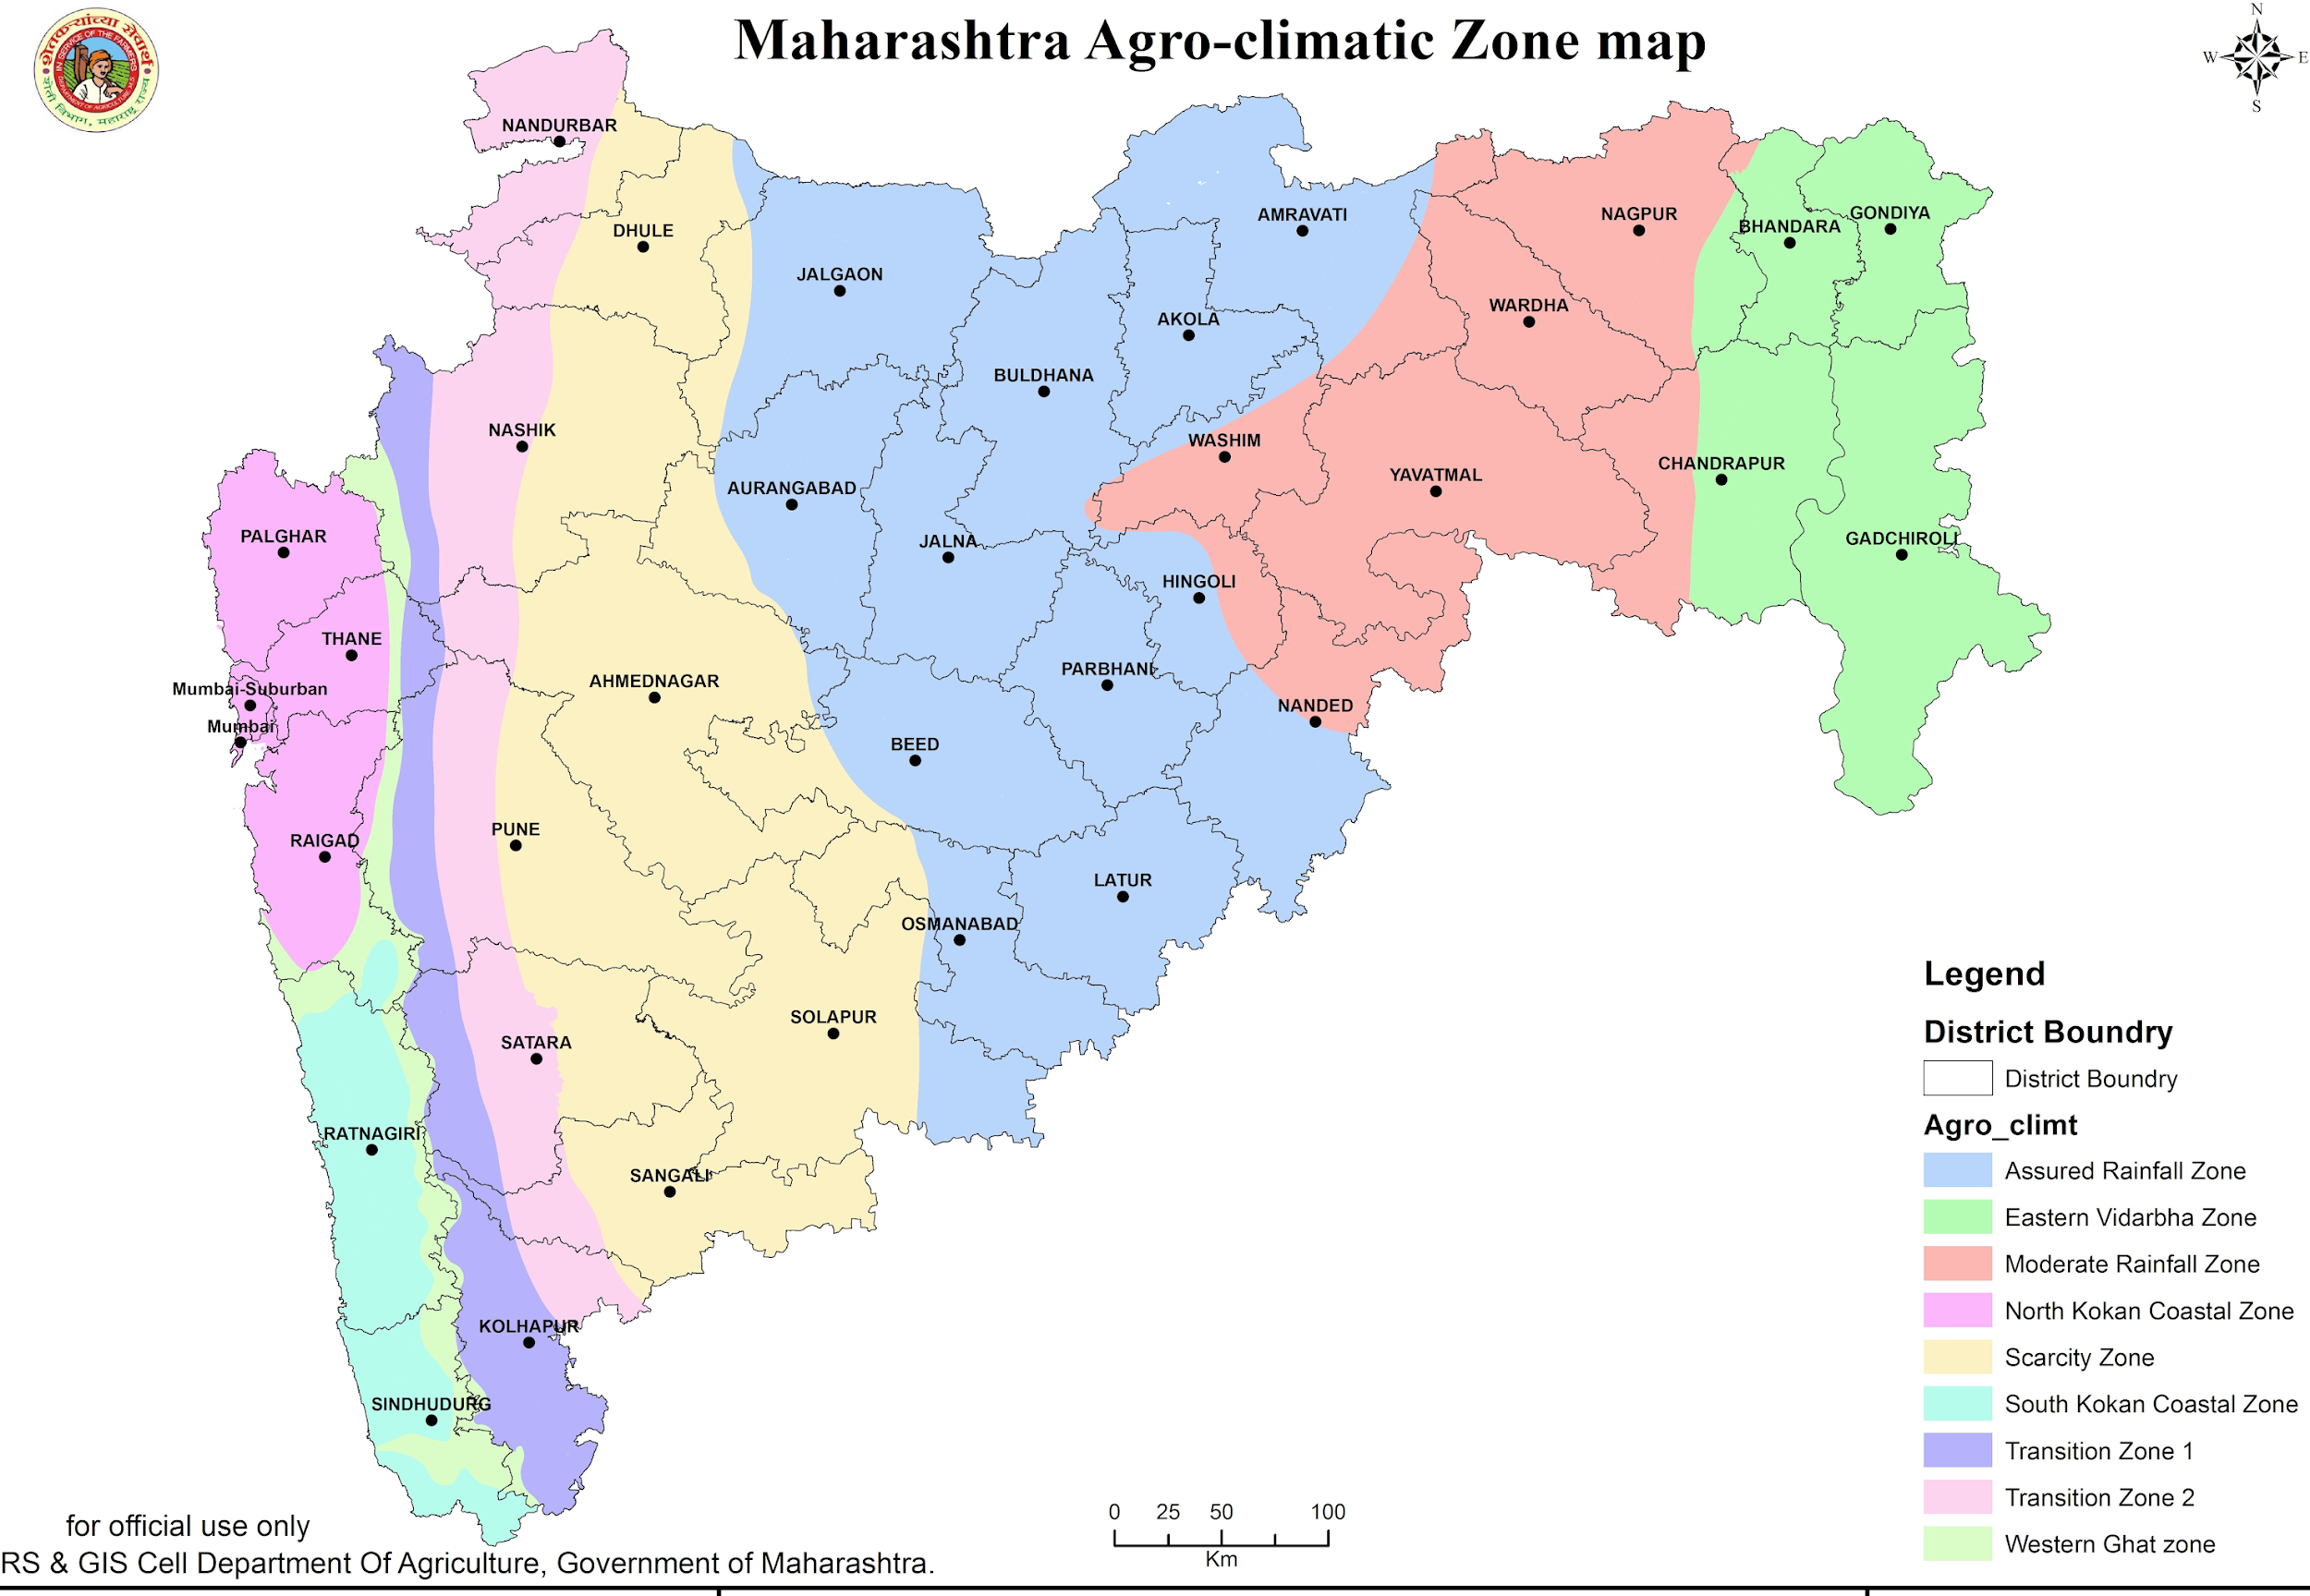

Slide 3
Maharashtra Agriculture at a Glance
Geographical Information –
Agro climatic Zones : 9
Geographical area : 307.58 lakh ha.
Net sown area : 166.50 lakh ha.
Number of operational holdings ( Agri.census 2015-16) : 153.00 lakh
Avg. size of operational holding : 1.34 ha.
Cropping Pattern (Normal 2014-15 to 2018-19)
Normal Sown Area of Kharif crops (incl. Sugarcane) : 151.33 lakh ha.
Normal Sown Area of Rabi : 53.01 lakh ha.
Major crops
Kharip – Paddy , Jawar, Bajara, Cotton, Sugarcane, Soyabean ,Tur
Rabi- Jawar, Wheat, Bengal gram ,
Summer - Groundnut , Soybean, Maize , Paddy

Slide 4
Maharashtra -Rainfall 2022 and prediction 2023
Sr. NO | Month | Rainfall (mm) |  | % to normal
 |  | Normal | Actual
1 | June 2022 | 207.6 | 148.2
2 | July 2022 | 330.9 | 483.2 | 146.0
3 | August 2022 | 286.0 | 260.4 | 91.0
4 | September 2022 | 179.6 | 254.5 | 141.6
5 | October 2022 | 71.1 | 141.6 | 199.2
6 | 1stJune to 31st October 2022 | 1075.3 | 1287.9
IMD Prediction :- 11-Apr-2023
71.4%
IMD Predicts 'Normal' Monsoon for Fifth Consecutive Year! 2023's Seasonal Rain to be of Long-Term Average.
96%
120%
Sr. No | Month | No. of Tahsils according to rainfall intensity |  |  |  |  | Total No.of tahsils
 |  | Below 25 | 25 to 50 | 50 to 75 | 75 to 100 | Above 100
1 | 2 | 3 | 4 | 5 | 6 | 7 | 8
1 | June 2022 | 9 | 74 | 107 | 79 | 86 | 355
2 | July 2022 | 0 | 0 | 4 | 29 | 322 | 355
3 | August 2022 | 6 | 54 | 71 | 73 | 151 | 355
4 | September 2022 | 0 | 1 | 11 | 42 | 301 | 355
5 | October 2022 | 0 | 5 | 5 | 17 | 328 | 355
6 | 1stJune to 31st October 2022 | 0 | 0 | 3 | 49 | 303 | 355
Talukas below 75% rainfall are Mahabaleshwar, Sangamashwar, Radhanagari

Slide 5
Final Kharif sown area of principal crops 2022
Sr. No | Crops | Normal Area (2016-17 to 2020-21) | Kh-2021 Sown Area | Kh-2022 Sown area | % to Normal Area | % to Kh-21 Area
1 | 2 | 3 | 4 | 5 | 6 (4/3) | 7(5/4)
1 | Paddy | 1518439 | 1545908 | 1555318 | 102 | 101
2 | Jowar | 316551 | 208929 | 142487 | 45 | 68
3 | Bajara | 675105 | 504379 | 407562 | 60 | 81
4 | Ragi | 75316 | 73369 | 68612 | 91 | 94
5 | Maize | 888569 | 872768 | 880723 | 99 | 101
6 | Other cereals (Foxtail millet, Little millet, Barnyard millet, Kodo millet, Proso millet) | 43561 | 45665 | 40663 | 93 | 89
8 | Tur | 1299905 | 1332408 | 1175759 | 90 | 88
9 | Mung | 404923 | 377882 | 269939 | 67 | 71
10 | Udid | 379423 | 435590 | 358048 | 94 | 82
12 | Groundnut | 197340 | 202626 | 160564 | 81 | 79
16 | Soyabean | 4143382 | 4605133 | 4909853 | 118 | 107
18 | Cotton | 4211293 | 3957155 | 4229213 | 100 | 107
 | Total kh. Crops (Excluding sugarcane) | 14288418 | 14270448 | 14309606 | 100 | 100
Increased Area :- Oilseed by 16%, Cotton by 7%
Decreased Area :- Jowar, Bajara, Mung , Groundnut
We are trying to increase area under Nutri cereals

Slide 6
Kharif 2022-23 : Area, Production and Productivity of principal crops
Sr. | Crops | Area in Lakh ha |  |  | Production in "Lakh" tonnes |  |  | Productivity kg/ha
 |  | Normal (2016-17 to 2020-21) | 2022-23 3rd Adv. Est | % (+ or - ) to Normal | Normal (2016-17 to 2020-21) | 2022-23 3rd Adv. Est | % (+ or - ) to Normal | Normal (2016-17 to 2020-21) | 2022-23 3rd Adv. Est | % (+ or - ) to Normal
1 | 2 | 3 | 4 | 5(4/3) | 6 | 7 | 8(7/6) | 9 | 10 | 11(10/9)
1 | Rice | 15.08 | 15.55 | 3 | 30.59 | 34.54 | 13 | 2028.02 | 2220.66 | 9
2 | Kh.Jowar | 2.89 | 1.42 | -51 | 2.71 | 1.36 | -50 | 939.78 | 952.71 | 1
3 | Bajra | 6.69 | 4.08 | -39 | 5.97 | 4.45 | -25 | 891.71 | 1090.73
4 | Ragi | 0.78 | 0.69 | -12 | 0.88 | 0.91 | 4 | 1124.11 | 1326.63
5 | Maize | 8.86 | 8.81 | -1 | 22.97 | 27.12 | 18 | 2594.03 | 3079.54
7 | Tur | 12.96 | 11.76 | -9 | 12.58 | 9.26 | -26 | 971.31 | 787.31
8 | Mung | 3.94 | 2.70 | -31 | 1.78 | 1.70 | -4 | 451.83 | 631.51 | 40
9 | Udid | 3.70 | 3.58 | -3 | 1.75 | 2.26 | 29 | 472.29 | 629.87 | 33
11 | Groundnut | 1.92 | 1.61 | -16 | 2.11 | 1.91 | -9 | 1100.29 | 1188.54 | 8
15 | Soyabean | 41.50 | 49.10 | 18 | 48.80 | 66.05 | 35 | 1175.84 | 1345.29 | 14
18 | Cotton (Lint) | 42.01 | 42.29 | 1 | 79.12 | 84.13 | 6 | 320.16 | 338.19 | 6
Total Kharif sown area |  | 152.97 | 157.97 | 3
22
18
19
-19
14
Increased Productivity :-
            Cereals – 21%
            Oilseed - 14%,
            Pulses – Mung-40%, Udid- 33%
            Cotton - 6%

Slide 7
Maharashtra :- Seed
S. No | Crop |  | Targeted SRR | Requirement 2023 | Availability | Surplus /Deficit
1 | 2 |  | 3 | 4 | 5 | 6
1 | Jowar |  | 100 | 26100 | 26255 | 155
2 | Bajra |  | 100 | 18500 | 18854 | 354
3 | Paddy |  | 48 | 223200 | 225211 | 2011
4 | Maize |  | 100 | 135000 | 135200 | 200
Total Cereals |  |  |  | 402800 | 405520 | 2720
5 | Tur |  | 35 | 58406 | 58737 | 331
6 | Mung |  | 21 | 13530 | 13933 | 403
7 | Udid |  | 35 | 21000 | 21331 | 331
Total Pulses |  |  |  | 92936 | 94001 | 1065
8 | Groundnut |  | 4 | 12600 | 13400 | 800
9 | Sesame |  | 55 | 275 | 330 | 55
10 | Soybean |  | 35 | 1312500 | 1316491 | 3991
Total Oilseeds |  |  |  | 1325375 | 1330221 | 4846
11 |  | Cotton | 100 | 77400 | 97880 | 20480
Total Kharif |  |  |  | 1898511 | 1927622 | 29111
102% seed is available
Total Seed requirement = 18.99 lakh Qtls,
Total Seed Availability = 19.28 lakh Qtls

Slide 8
Maharashtra – Seed Replacement rate
S. No | Crop | GOI Target | SRR Achievement |  |  | Remarks | Target For Kh-2023
 |  |  | 2020 | 2021 | 2022
1 | 2 | 3 | 4 | 5 | 6 | 7 | 8
1 | Kh. Jowar | 100 | 100 | 100 | 100 | Achieved | 100
2 | Kh. Bajra | 100 | 100 | 100 | 100 | Achieved | 100
3 | Paddy | 33 | 48 | 48 | 48 | Achieved | 48
4 | Maize | 50 | 100 | 100 | 100 | Achieved | 100
5 | Tur | 33 | 35 | 34 | 35 | Achieved | 35
6 | Mung | 33 | 21 | 22 | 22 | Not Achieved | 21
7 | Udid | 33 | 37 | 39 | 38 | Achieved | 35
8 | Groundnut | 33 | 3 | 3 | 3 | Not Achieved | 4
9 | Sesame | 33 | 50 | 53 | 53 | Achieved | 55
10 | Soybean | 33 | 35 | 34 | 34 | Achieved | 33
11 | Hy/BTCotton | 100 | 100 | 100 | 100 | Achieved | 100
Except Mung and Groundnut all SRR are achieved 100%

Slide 9
Fertilizer Kharif – 2023 Figures in lakh MT
Sr.No. | Grade | Consumption in last 3 Kh seasons |  |  |  | Kh-23 Demand | Kh-23 Sanctioned | Stock as on 01 /04/2023
 |  | 2020 | 2021 | 2022 | Average
1 | 2 | 3 | 4 | 5 | 6(3+4+5/3) | 7 | 8 | 9
1 | Urea | 15.31 | 14.15 | 13.94 | 14.45 | 17 | 13.735 | 5.33
2 | DAP | 5.55 | 3.43 | 4.11 | 4.35 | 6 | 4.5 | 2.15
3 | MOP | 2.47 | 2.29 | 0.74 | 1.84 | 4 | 1.9 | 0.29
4 | NPK Complexes | 17.12 | 16.68 | 11.67 | 15.13 | 18 | 15.5 | 8.39
5 | SSP | 6.49 | 6.97 | 7.22 | 6.89 | 7 | 7.5 | 5.15
 | Total | 46.94 | 43.52 | 37.68 | 42.66 | 52 | 43.135 | 21.31
Year | N P K consumption Kg / ha
2018-19 | 126.0
2019-20 | 113.0
2020-21 | 129.3
2021-22 | 119.3
2022-23 | 121.2
Enhancing fertilizer use efficiency
Integrated nutrient management
Promoting use of Bio-Fertilizers
Promoting use of Liquid fertilizers
Promoting Foliar application
Crop rotation by leguminous crops
Average Fertilizer consumption last 5 years = 121.76 kg/ha

Slide 10
Centrally Sponsored Programmes
S. N. | Scheme Name
1 | National Food Security and Nutrition Mission: Food Grains(Rice, Wheat, Pulses, Coarse Cereals Maize and Nutri – Cereals)
2 | Food and Nutrition Security-CC-Cotton Development Program
3 | Food and Nutrition Security-CC-Sugarcane Development Program
4 | NFSM - Oilseed and Oil Palm (OS&OP)
5 | Rashtriya Krishi Vikas Yojana (RKVY) - Cafeteria
6 | Horticulture Plantation under MREGS Scheme
7 | Sub-Mission on Agroforestry (SMAF)Under National Mission for Sustainable Agriculture (NMSA)
8 | Agriculture Mechanization & Sub-Mission on Agriculture Mechanization
9 | Rainfed Area Development under Rashtriy Krishi Vikas Yojana (RKVY)-RAFTAAR
10 | Support to State Extension Programmes for Extension Reforms (ATMA)
11 | Agriculture Infrastructure Fund Scheme
12 | Prime Minister Formalisation of Micro Food Processing Enterprises (PMFME)
13 | Maharashtra State Small Farmers Agri-Business Consortium (SFAC)
14 | Formation and Promotion of 10,000 Farmer Producer Organizations

Slide 11
State Initiatives
S. N. | Scheme Name
1 | Horticulture Plant Protection Scheme
2 | Rashtriy Krishi Vikas Yojana - Punyashlok Ahilyadevi Holkar Nursery Scheme
3 | Plant Protection ( CROPSAP & HORTSAP)
4 | Chief Minister Agriculture and Food Processing Scheme
5 | Implementation of Group Farming Scheme
6 | Dr. PanjabraoDeshmukhJaivikSheti Mission
7 | Vikel te Pikel abhiyan­– A State Initiative for sustainable income to farmers
8 | MahaAGRITECH
9 | Hon. Balasaheb Thackeray Agribusiness and Rural Transformation (SMART) Project
10 | Project on Climate Resilient Agriculture in Maharashtra (PoCRA) (Nanaji Deshmukh Krushi Sanjeevani Prakalp)
11 | Chief Minister Sustainable Agriculture Irrigation Scheme
12 | Hon. Balasaheb Thackeray Haridra (Turmeric) Research and Training Centre
13 | State Sponsored Integrated Cotton, Soybean and other oilseed Crop Productivity Enhancement and Value Chain Development Scheme
14 | Gopinath Munde Shetkari Apghat Suraksha Sanugrah Anudan Yojana

Slide 12
Maharashtra – New Initiatives
Universal Crop Insurance @ Rs.1 to farmers
PMFBY Technological yield estimation in Paddy, Soyabean and Cotton
Gopinath Munde Shetkari Apghat Suraksha Sanugrah Anudan
State Mission for Nutri Cereals (200 crores)
Increasing area under Oilseed and pulses
Integrated Cotton Productivity Enhancement and Value Chain Development Scheme
Oilseed Productivity Enhancement and Value Chain Development Scheme.

Slide 13
Maharashtra – Issues
NHM ( 2014-15) norms to be revised
Every bag of fertilizer must be printed with Batch number, lot number, month & year of packing for traceability
Guidelines and programe for National mission on natural farming need to be issued earliest. So, that it will be implemented in Kharif .
ATMA :-
    Annual allocation is decreasing constantly. So, very little amount is available for new initiatives .
    BTM/ ATM remuneration limit is not revised since 2018
Year | Demand Rs.in Cr | Sanctioned Rs.in Cr
2022-23 | 60.00 | 38.00
2023-24 | 90.00 | 28.87

Slide 14

Thank you

