Slide 1


Issues related to Fertilizers
Kharif Conference -2023
Department of Fertilizers

Slide 2
Summary of presentation
Fertilizer supply in Rabi 2022-23 &plan for Kharif
Promotion of alternate fertilizers
  Nano urea, nano DAP potash derived from molasses
  Bio & organic fertilizers
New initiatives
  PM Kisan Samrudhi Kendras (PMKSK)
  One Nation One Fertilizer (ONOF)
  PMPRANAM
  Market development Assistance Scheme (MDA)
Expectations from states

Slide 3
AVAILABILITY OF FERTILIZER DURING RABI 2022-23
<FIGURES IN LMT>
RABI 2022-23
PRODUCT GROUP | SEASONAL REQUIREMENT | AVAILABILTY | DBT SALES | Opening Stock for Kharif 2023 (% of Kharif requirement)
UREA | 180.18 | 243.20 | 184.64 | 58.56 (34 %)
DAP | 55.38 | 79.33 | 53.71 | 25.62 (47%)
MOP | 14.35 | 12.42 | 9.19 | 3.23 (22%)
NPKS | 56.97 | 86.08 | 55.24 | 30.84 (49%)
SSP | 33.64 | 44.48 | 23.75 | 20.73 ( 63%)

Slide 4
MONTH WISE REQUIREMENT OF FERTILIZERS KHARIF 2023
Based on the requirement received from DA&FW, Movement Division issues Agreed Monthly Supply Plan
<FIGURES IN LMT>
PRODUCT GROUP | APR 23 | MAY 23 | JUNE 23 | JULY 23 | AUG 23 | SEP 23 | GRAND TOTAL
UREA | 22.19 | 26.37 | 30.58 | 36.50 | 33.57 | 21.47 | 170.68
DAP | 8.72 | 9.89 | 11.08 | 10.85 | 7.47 | 7.18 | 55.19
MOP | 2.07 | 2.41 | 2.73 | 2.83 | 2.49 | 2.50 | 15.03
NPKS | 7.63 | 9.03 | 12.51 | 13.55 | 10.58 | 9.41 | 62.71
SSP | 4.34 | 4.86 | 6.74 | 6.15 | 5.83 | 5.85 | 33.77
NANO UREA REQUIREMENT (KHARIF 2023) – 1.78 Cr Bottles= 89 lakh bags of urea=4 LMT

Slide 5
AVAILABILITY OF FERTILIZER DURING ONGOING KHARIF 2023 (TILL APRIL 2023)
<FIGURES IN LMT>
PRODUCT GROUP | SEASONAL REQ | PRO RATA REQ TILL 30.04.2023 | AVAILABILITY TILL 30.04.2023 | SALES TILL 30.04.2023 | CLOSING STOCK/ (% of total requirement)
UREA | 170.67 | 22.19 | 81.63 | 11.77 | 69.86 ( 41%)
DAP | 55.19 | 8.72 | 32.69 | 3.02 | 29.67 ( 54%)
MOP | 15.02 | 2.07 | 3.38 | 0.50 | 2.88 ( 19%)
NPKS | 62.71 | 7.63 | 38.36 | 2.62 | 35.74 ( 57%)
SSP | 33.76 | 4.34 | 23.00 | 1.66 | 21.34 (63%)

Slide 6
Movement Plan
Movement plans as per requirement –cushion of 30% of total requirement ensured
Lead Fertilizer Agencies (LFA) to look at internal supply deficit
Control Room &Flying squad at DoF level
Nano urea supply plan- 1.78 Crore bottles issued (4 LMT of conventional urea)
Weekly monitoring/ Whatsapp groups- states, railways
Additional rakes for quick movement in peak season

Slide 7
Action by Flying Squad
Surprise inspections on 289 fertilizer / related units in 14 States
169 Mixture units, 114 urea using units and 6 SSP units- (Since October 2022)
Recommended for deauthorization of around 94 mixture manufacturers
28 FIRs/ complaints registered for diversion of urea
Many show cause notices issued for mismatch in procurement, production & sales data
Seized 66276 bags of suspected urea from Gujarat, Kerala, Haryana, Rajasthan, Karnataka etc.

Slide 8
Expectations from states
Micro-planning and monitoring of fertilizer movement – use of IFMS , DoF
Quick unloading of rakes at rake points
Coordination with fertilizer companies for targeted delivery of fertilizers
Limited share of cooperative sector- States to internally decide for more allocation to cooperative sector
Support to Flying squad from GoI- control diversion, quality assurance
Action against diversion of urea , hoarding of fertilizers - EC Act, PBM act , CrPC
Quick action on control room information

Slide 9
Nano urea- Benefit to Farmers
Environmental
Benefits
Higher Crop Yield
Increase in range of 3% to 16% (Average 8%)
Use Efficiency
Nano Urea : More than 80%
Easy Transportation
Nano Bottles can be carried easily to Field
Additional Income : Rs 2400 to 5700 Per Acre
Conventional Urea : 30 to 40%
Replacement of Top Dressing
Nano Urea replaces Conventional Urea by 50%
Conventional Urea Bags require a Tractor

Slide 10
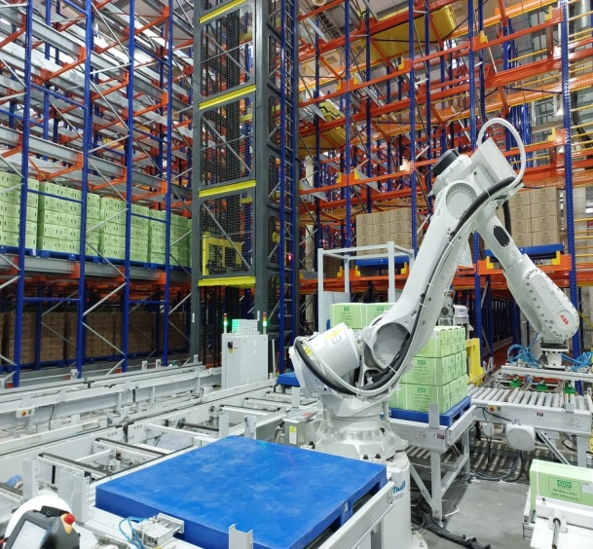
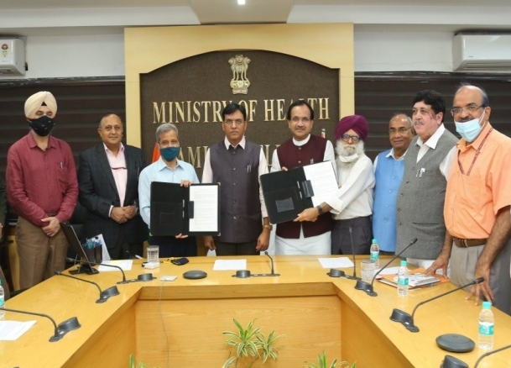
Scaling Up Production of Nano Urea
Location | Nano Urea Production Capacity Bottles Per Year (in Crore) | Commercial Production
IFFCO Kalol Gujarat | 5.0 | August 2021
IFFCO Phulpur UP | 6.0 | Sept 2022
IFFCO Aonla UP | 6.0 | April 2023
IFFCO Bengaluru, Kar | 6.0 | March 2024
RCF Trombay Maharashtra | 5.0 | March 2024
NFL Nangal Punjab | 5.0 | July 2024
IFFCO Deoghar Jharkhand | 6.0 | Nov 2024
IFFCO Assam | 5.0 | Nov 2025
Total Capacity by 2025 | 44.0 Crore Bottles 500 ml= 1 bag urea 44cr bottles = 200 LMT
Nano Urea Kalol Plant
Technology Transfer to NFL & RCF

Slide 11
Promotion of Innovative/ alternate fertilizers
Nano urea:
  5 cr bottles to 3 crore farmers -1 bottle nano= 45 kg urea bag
  Present capacity – 3 plants at kalol, Phulpur, Aonla - ( equal to 75.6 LMT of conventional Urea)
  8 plants with 44 crore bottle capacity by 2025 (200LMT of conventional Urea)
Nano DAP :
  Nano DAP by IFFCO and CIL – approved
  Promotion of nano DAP – Aatma Nirbhar Bharat
New fortified urea combinations
  Enriched Urea = Urea Gold (Urea + Sulphur)
  Single Super Phosphate (SSP + Urea) Complex promotion instead of DAP
Promotion of Organic/ bio fertilizers
Promotion of Phosphate derived from Molasses (PDM)

Slide 12
Expectations From States
Promoting Use of Nano Urea, nano DAP – large demonstrations at state agri farms
Nano Urea at all PMKSKs- monitoring needed
Awareness among Farmers to increase use of Alternative Fertilizers- ATMA, KVKS, Krishi Sakhi, Pasusakhi , AC&ABC
Assessing impact of nano urea used in last season
Monitoring the use of nano urea under supply plan
Extension work at regional level - kisan sammelans, FFS, Radio/DD Kisan, training module; use of PMKSK , Kisan Call Centres for extension

Slide 13
PMPRANAM – PM Programme for Restoration, Awareness generation, Nourishment and Amelioration of Mother –Earth
Budget Announcement 2023
Benefits:
Restoring fertility of soil- protect health of Mother Earth
Reducing ground water contamination due to leaching of fertilizers
Improving Fertilizer Response Ratio
  Objective- “Incentivising the States/UTs adopting mechanism for reduced use of chemical fertilizers to protect the health of “Mother Earth””
Mechanisms
Organic/ natural farming
Resource conservation technologies
Use of alternate fertilizers
Integrated nutrient Management practices

Slide 14
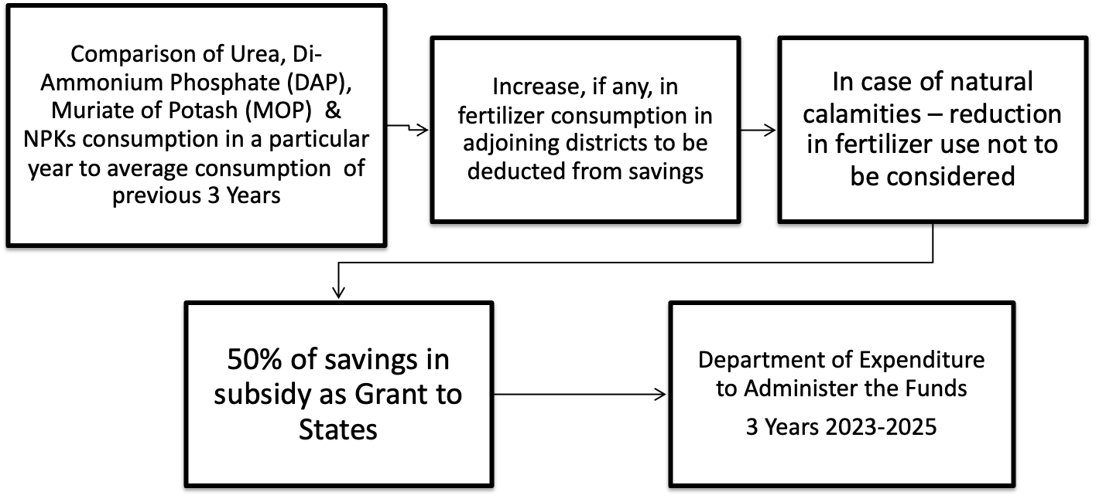
PMPRANAM- Proposal

Slide 15
PMPRANAM - Use of Grant
Budget from savings of Urea Subsidy Scheme and Nutrient Based Subsidy Scheme
Grant
95% -States
5 % Government of India
Information, Education & Communication activities that promote health of soil & alternate fertilizers
65% Capex projects
30% untied funds for state specific activities

Slide 16
Prime Minister Kisan Samridhi Kendras(PMKSK)
Conversion of fertilizer retail shops ( active 2.6 lakh) into “One stop shop “
One Stop Shop
  All inputs- seeds, fertilizers, pesticides. Machinery
  Testing - soil, seed, fertilizer testing facilities/ connection to facilities
  Advisory-new technologies for smart agriculture ; agriculture practices such as IFS, INM, IPM, Natural/ organic farming
  provide information regarding various Government schemes – insurance, loans, marketing
  Ensure regular capacity building of retailers at block/ district level outlets

Slide 17
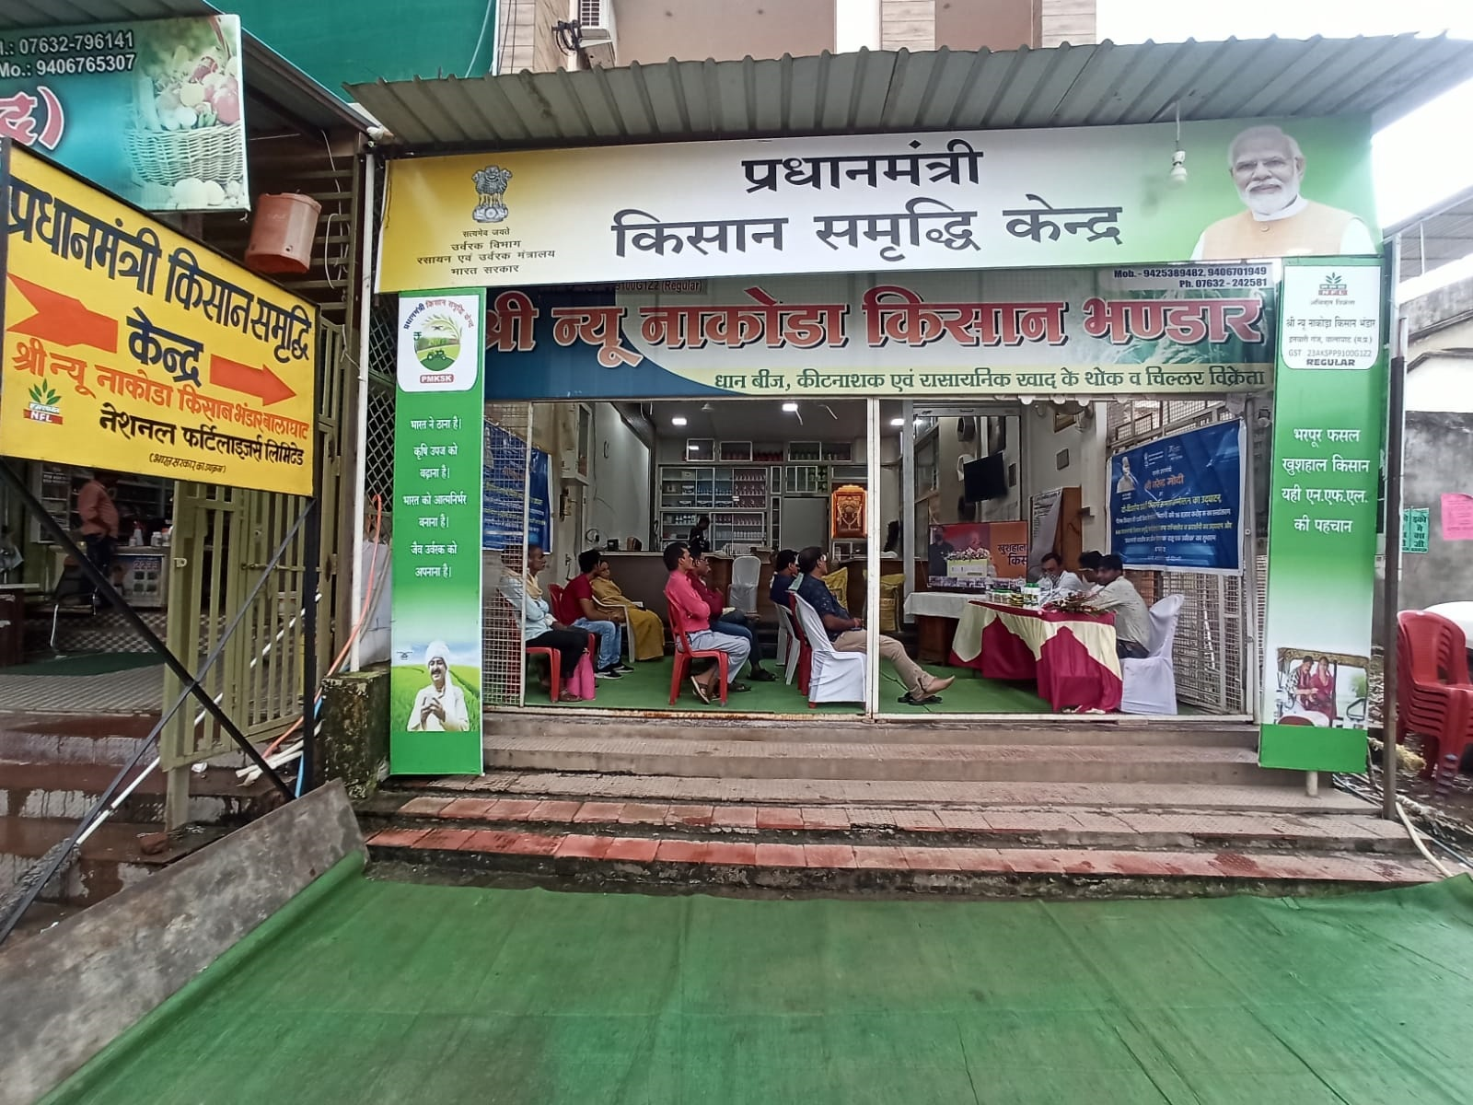
PMKSK
Fertilizer companies given targets in consultation with States
Inauguration of 600 PMKSK by Hon’ble PM on 17th October.
PMKSKs as on date- 63,901

Slide 18


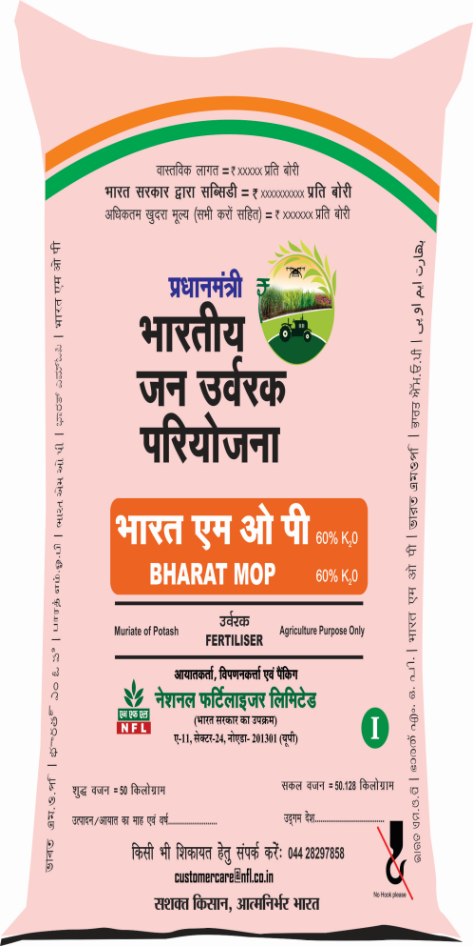
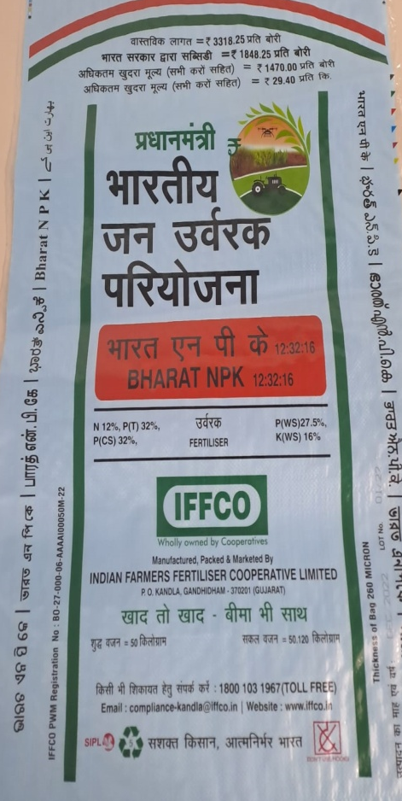
One Nation One Fertilizer
Brand preference inspite of same nutrient content
Criss cross movement
More freight subsidy
UREA, DAP, MOP AND NPKS – BHARAT brand
MULTICOLOR LOGO

Slide 19
Market Development Assistance: Background
Budget Announcement 2023- market support to manure produced in Gobardhan Schemes
SATAT Scheme: MoP&NG
    Present- 40 CBG plants
    MoP&NG
GOBARdhan Scheme
Convert agri-waste to wealth - setting up of bio-gas plants
Present- 400 plants
DDWS & MNRE
Fermented Organic Manure (FOM): by-product of the CGB / BG plants - important source of revenue
NPK nutrient potential: 1.2%-12kg/MT;
Organic Carbon- 14%-140kg/MT

Slide 20
Market Development Assistance -Proposal
Objective: Level playing field for organic fertilizers& popularising
Proposal:
Rs.1500/MT MDA for FOM/PROM
New MDA Scheme
    Financial Implications ( 2023-24 to 2025-26)
    MDA for FOM for 400 CBG plants: Rs.1013 Crore
    MDA for FOM for 700 GOBARdhan plants: Rs.78.84 Crore
    Corpus (gap funding/research, etc.): Rs.360 Crore
    TOTAL: Rs.1452 Crore
Cabinet Note under Submission

Slide 21
Expectations from States
Monitoring the progress of PMKSK, ONOF
Adoption of practices for successful implementation of PMPRANAM
  Natural/ Organic Farming
  Promotion of innovative / alternate fertilizers: nano /bio &organic fertilizer etc.
  Ensuring 100 % production of capacity: biofertilizers in state/ private units
coordination& helping units of SATAT/ GOBARdhan for quality testing
Extension activity for FOM/ PROM promotion
Soil test based nutrient integrated use in 4:2:1

Slide 22
Thank You

