Slide 1


Digital Agriculture
03rd May 2023

Slide 2
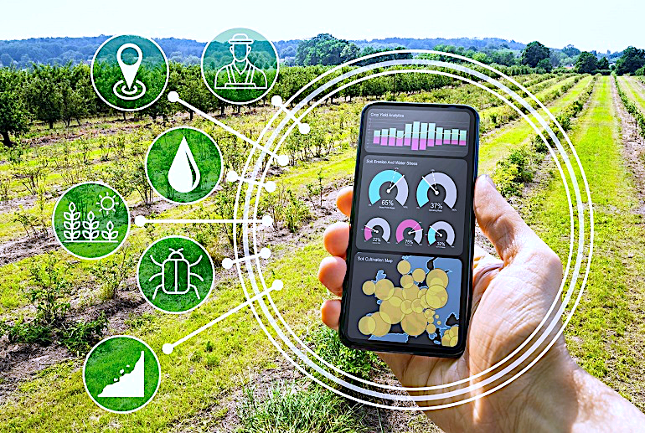
Digital Public Infrastructure for Agriculture
Digital Crop Survey
Krishi Mapper
NeGPA
Agenda

Slide 3
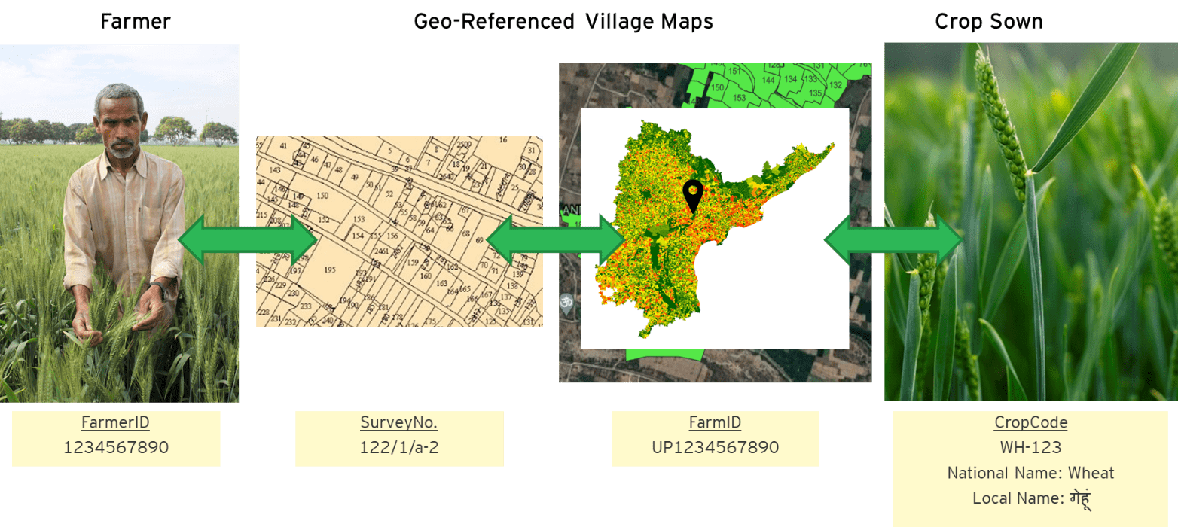

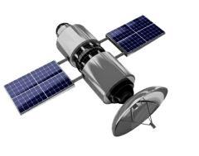
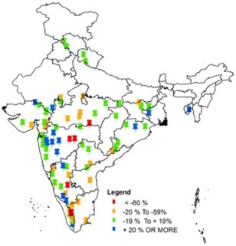
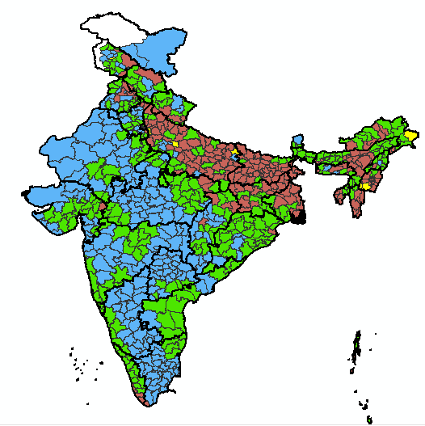
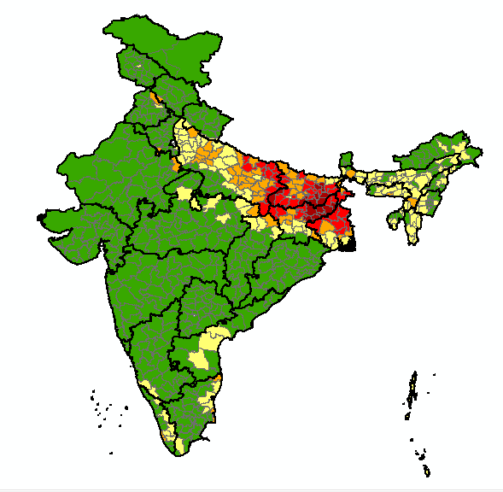
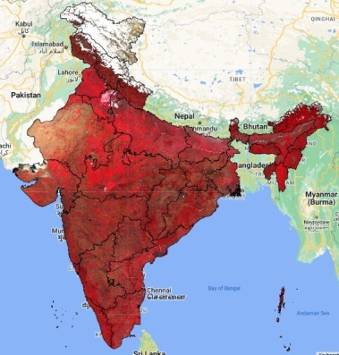
Digital Public Infrastructure for Agriculture
3 Core Registries
Krishi-DSS
Geospatial Decision Support System
One Nation- One Geospatial DSS for Agriculture

Slide 4
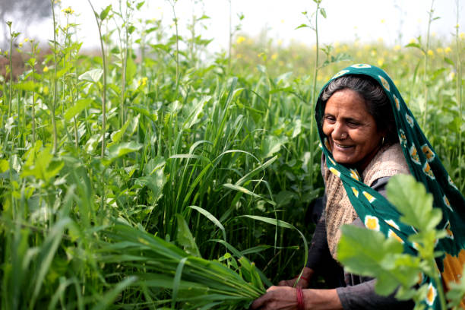
Who is Shanti?
Unable to check for the quality of pesticide / fertilizers purchased
Borrows money at high interest rate to buy inputs like seeds, fertilizers and pesticides
Needs to spend ~5000 Rs just to get a Kisan Credit Card
Is unable to grow any crop other than wheat, as that is all she has grown till date and all she knows how to,.
Sometimes faces challenges due to post harvest losses
Has to repeatedly submit forms & documents to apply for various Govt. schemes
A farmer
52 years old
Owns her agricultural land on which she grows wheat, and raises cattle
Her son helps her out in carrying out the daily activities in the farm
Is illiterate
Owns a basic android Smartphone.

Slide 5

DIGITAL ASSETS
What I have as a farmer:
My land, my crop
DIGITAL IDENTITIES
Who I am
Verifiable and non-repudiable
Digitally Authenticable
Electronic data & credentials,
Electronic signatures
Aadhaar and Farmer ID,
Electronic Farmer Registry,
Authentication, SSO, eKYF
DIGITAL TRANSACTIONS
What I do
Unlocking opportunities via open networks such as ONDC, JanSamarth
Access Markets, Inputs, Credit, Advisory and Schemes

Slide 6
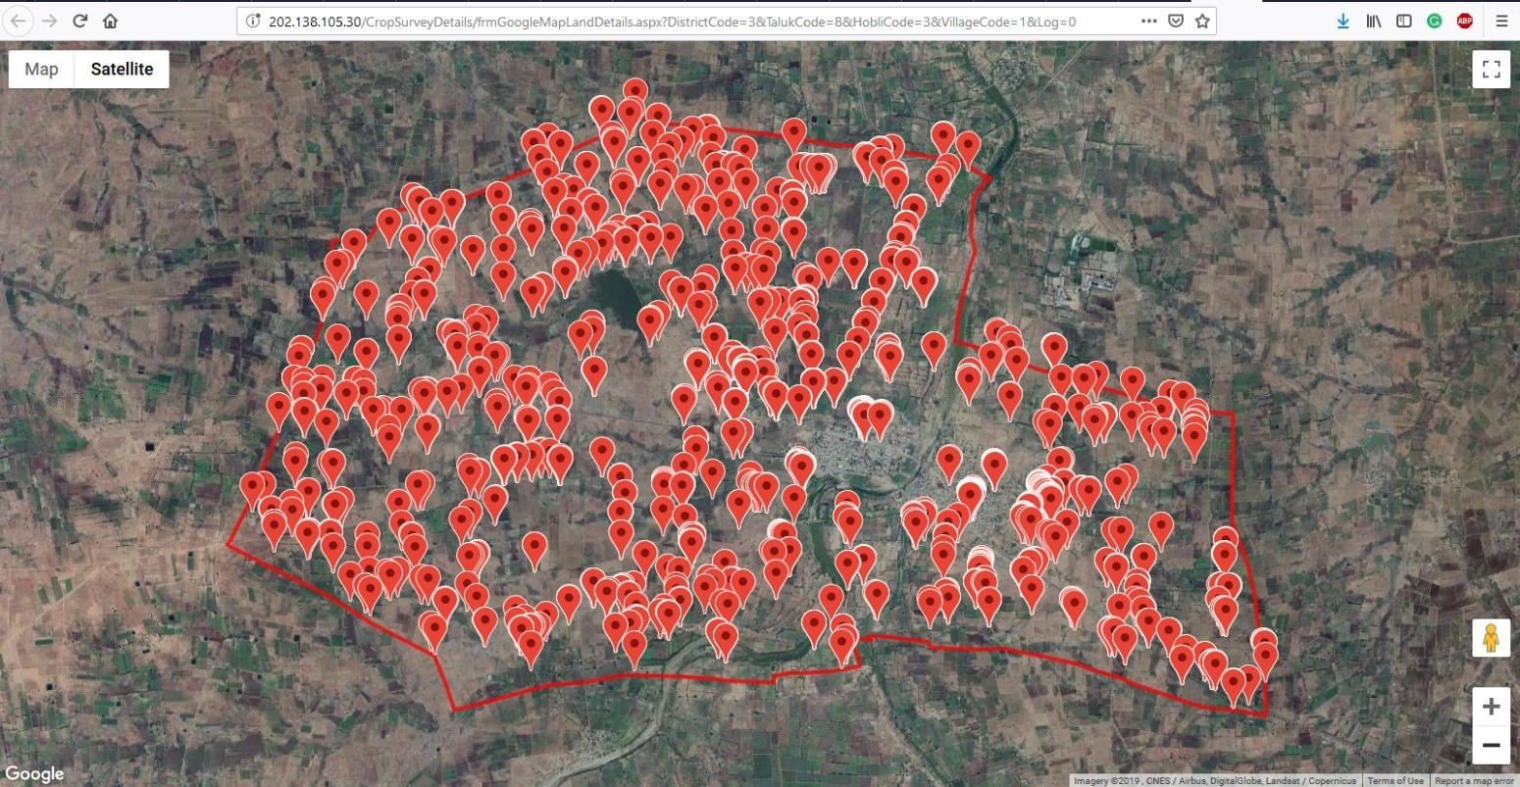
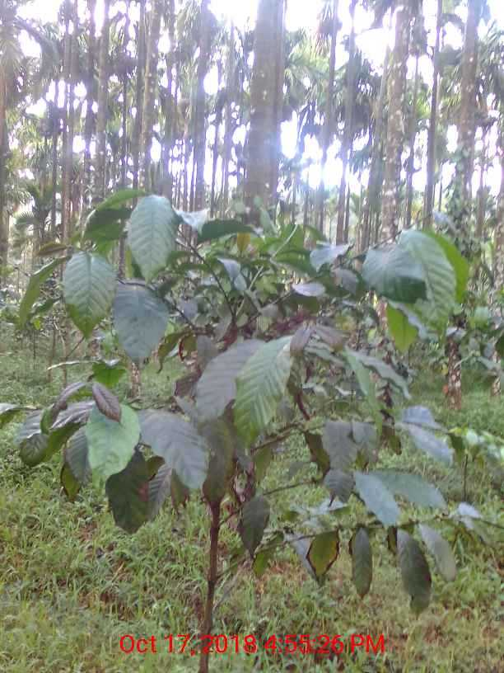
Crop Sown Registry enabled by Digital Crop Survey
The Central Government is launching a Centrally Sponsored Scheme for Digital Crop Survey
Plot-level crop grown data for every season
Coffee
with Physical inspection and verification
and Proofs – Geotagged photographs
Single Source of Truth
Data available for ecosystem as Crop Sown Registry in Agri Stack
Utilize for various purposes – Schemes, Policy Decisions, Advisory etc.

Slide 7
Digital Crop Survey – Rollout Plan by Kharif 2023 (As a Centrally Sponsored Scheme)
PoC to be conducted in the month of May 2023 in 1 village in each state (Karnataka, Kerala, Uttar Pradesh, Madhya Pradesh)
Pilot in 100% districts
  Maharashtra
  Madhya Pradesh
  Andhra Pradesh
  Telangana
  Karnataka
Pilot in 20% districts
  Assam
  Odisha
  Rajasthan
  Tamil Nadu
  Uttar Pradesh

Slide 8
Digital Crop Survey – Status & Asks
Status
Asks from States
Status of Digital Crop Survey:
Digital Crop Survey Reference application is being finalised
UAT is completed on ground in Karnataka & Uttar Pradesh
Completed | Partial | Not Started
8 States | 12 States | 16 States
Gujarat Jharkhand Karnataka Madhya Pradesh Maharashtra Odisha Punjab Sikkim | Andhra Pradesh Bihar Chhattisgarh Haryana Himachal Pradesh Kerala Rajasthan Tamil Nadu Telangana Uttar Pradesh West Bengal Assam | Goa Uttarakhand Arunachal Pradesh Manipur Meghalaya Mizoram Nagaland Tripura Andaman and Nicobar Islands Chandigarh Dadra and Nagar Haveli and Daman and Diu Delhi Jammu and Kashmir Ladakh Lakshadweep Puducherry
Geo-referencing of village maps is an essential requirement for the digital crop survey as the survey requires geo tagged photos to be taken from within the field

Slide 9

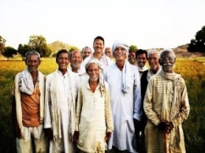
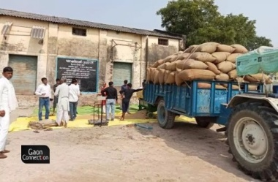
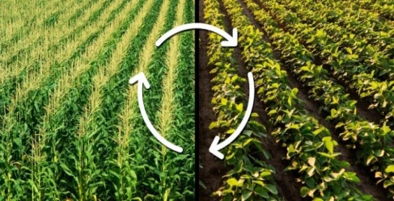

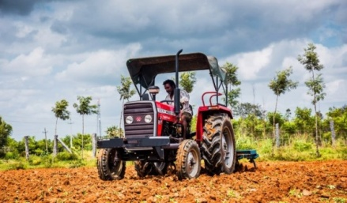
Advantages of Digital Crop Survey for the Government
For Ministry of Agriculture & Farmers Welfare –
  Near real time crop area estimation
  Reduce premiums in PMBFY by identifying true insurances
  Facilitate Customized Advisories for farmers for – Crop they grow, Pest that might affect them and other related advisories
For Ministry of Consumer Affairs, Food and Public Distribution -
  Accurate area, Production and Price Forecasting
  Faster verification of genuine farmers without needing crop certificate
  All middlemen can be completely avoided and therefore, reducing the MSP fund requirement.
For Department of Financial Services
  To work out credit requirement at the bank level using historical Crop Survey data.
  To check, post sanction of loan, whether loan has been used for intended purpose by the loanee farmer.
For NABARD
  Efficient generation of credit need estimate for all PACS in the country.
  Farm machinery and post harvest infrastructure.
  Effective farm advisories by FPOs & Holistic long term planning by NABARD

Slide 10
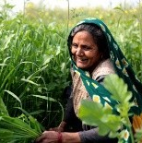
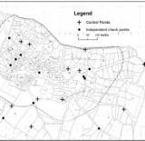

Supporting Registries/Master Databases in Agri Stack
Core Registries
Farmer Registry
Geo-Referenced Village Maps
Crop Sown Registry
Supporting Registries
Crop Registry
Seed Dealers
Seeds
Fertilizers
Fertilizer Manufacturers
Fertilizer Warehouses
Fertilizer Whole seller
Fertilizer Retailers
Fertilizer Importers
Pesticides
Pesticide Manufacturers
Pesticide Wholesalers
Pesticide Dealers
Pesticides testing laboratories
Pesticides importers
Central Insecticide laboratories
Insecticide testing laboratories
Krishi Vigyan Kendras
NBFCs
Banks
Common Service Centres
Farmer Producer Organisations (FPOs)
Farmer Producer Companies (FPCs)
Service Providers (For inputs)
Enabling Data Standardisation
Catalysing Interoperability
Accelerating Ecosystems

Slide 11































*
*
Transforming the Agriculture Ecosystem
Use-cases
Easier access to FINANCE
Access to Higher quality INPUTS
Digital Crop Loan/ KCC
Insurance
Farm Mechanization Loan
Drip Irrigation Loan
Dairy Loan
Poultry Loan
Agri clinic and Agri business Centre Loan
Interest Subvention
Agriculture Term Loan
Agricultural Gold Loan
Seeds
Fertilizers
Pesticides
Machinery
Irrigation
**
AePS
NPCI
JanSamarth
OCEN
ONDC
**
ONDC
iFMS
iPMS
Seednet
Aadhaar
REGISTRIES
Farmer
Crop Sown
Geo-Ref. Village Maps
*
**
ONDC
UPI
AePS
*
ONDC
ICAR
**
CONSENT
Alerts and ACTIONABLE ADVISORY
Access to Wider MARKETS
Crop Advisory
Weather Advisory
Market Advisory
Pesticide Advisory
Disaster Advisory and Response
Connecting to local buyers
Connecting to International buyers
Selling produce
Warehousing
UFSI
Legend
* | Indicative list of Agri Stack Authorized Service Providers
** | Indicative list of APIs/Technologies to be used

Slide 12

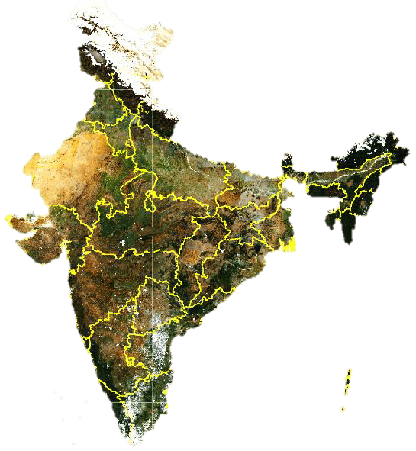
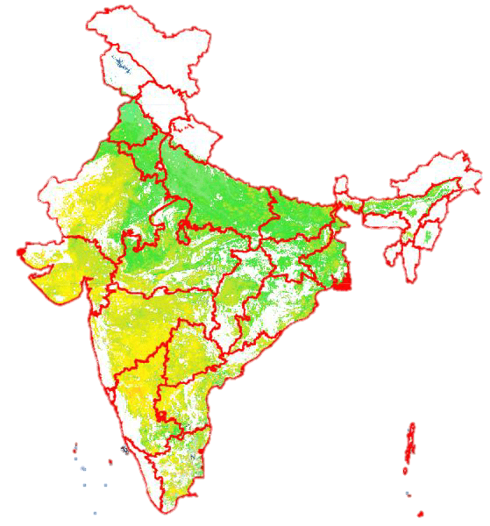
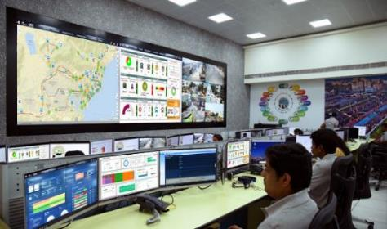
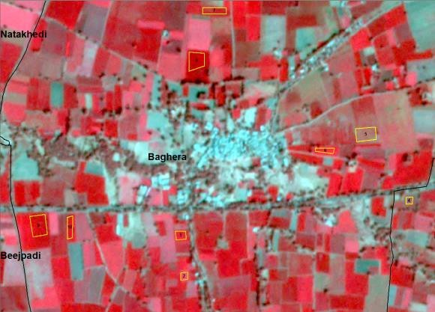
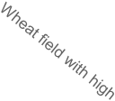



Krishi-DSS
Geospatial Decision Support System
(ONE NATION ONE GEO-SPATIAL DSS)
Integrated Command and Control
Standing
crop/vegetation
in Dec 2022
Land surface
temperature
Dec 2022
High
Low
0.8
Data analytics based on
  Geospatial Data from VEDAS of Dept of Space
  Crop Survey and Crop Estimates
  Unified Soil Information System
  Weather Data
  Central Pest Monitoring System
  Market Intelligence Systems
Data driven decision support system
0.7
0.6
0.5
NDVI
0.4
0.3
0.2
0.1
jan25
jan29
feb01
feb03
feb12
feb17
feb24
feb27
mar01
mar06
mar14
mar23
mar25
mar29
mar30
0
nov14
nov15
nov26
dec10
Date of Pass

Slide 13






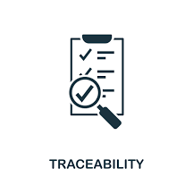



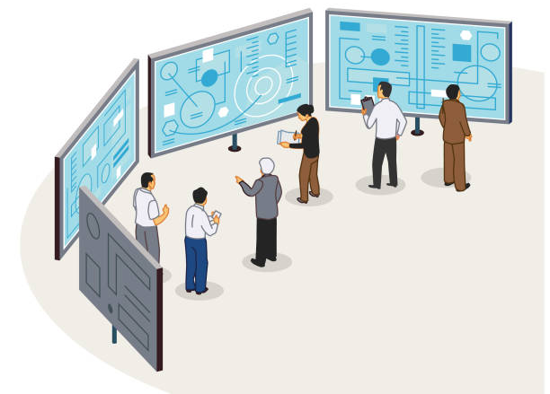

Enabling solutions across the agriculture value chain
Various solutions areas that can be implemented using DPIs of Agriculture
IoT enabled Smart Farming
Quality Assaying
Market linkages
Soil Health Monitoring
Crop Identification
Logistics Service Providers
Traceability
Geo-spatial interventions
Pest Surveillance
Remote Sensing Solution
Post-harvest
Markets
Production/Harvest
Pre-harvest
Krishi-DSS
Geospatial Decision Support System
ICCC
Integrated Command & Control Centre

Slide 14

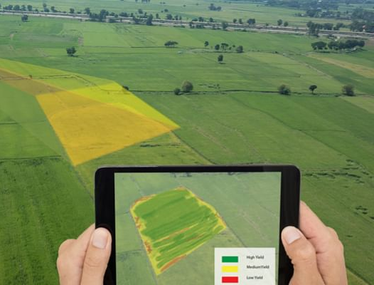


Krishi MApper
From Kharif 2023, mandatory use of Mobile App to geotag the farms and capture data on crop grown and assets (with their pics).
Will help in the easier and more transparent implementation of land-intervention-based schemes/programs
  Near Real-time assessment and processing of claims.
  Geo-spatial-temporal monitoring of the schemes.
Schemes - Examples
Natural Farming
Crop Survey
Insurance
NFSM
Seed Production
Krishi MAppr
Unified data gathering at the field level across seasons, across schemes

Slide 15
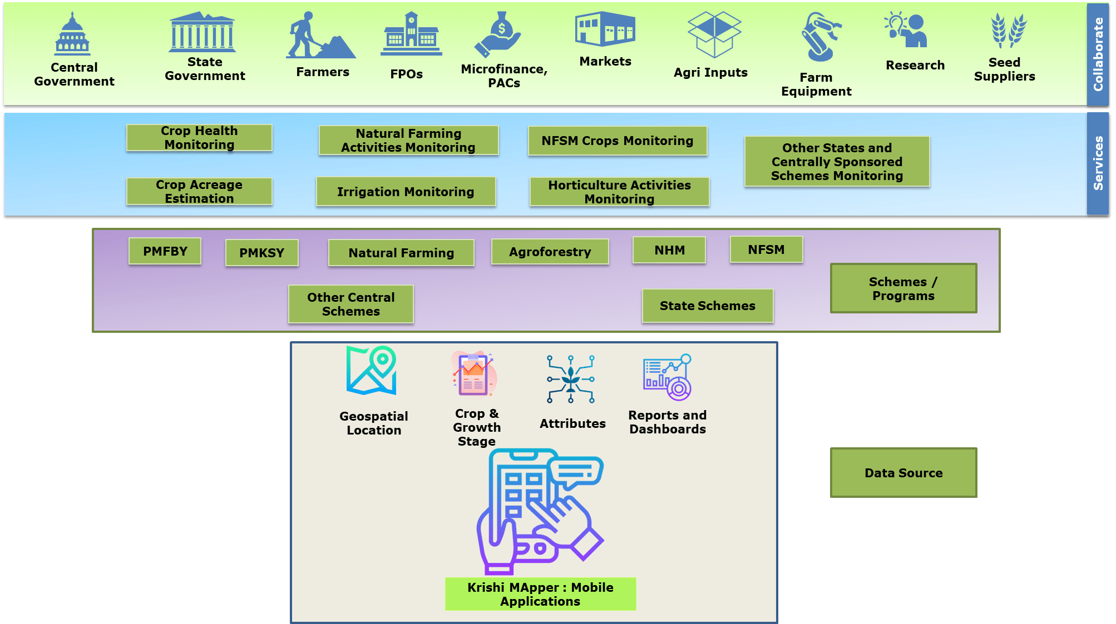
Overview of Krishi MApper

Slide 16
National e-Governance Plan in Agriculture
(NeGPA)

Slide 17
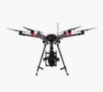
National e-Governance Plan in Agriculture (NeGP-A)
  Under the scheme, funds are released to the States/Union Territories for the projects involving the use of modern digital & emerging technologies on Agriculture.
  Funds were released to 10 States in 2020-21, 10 States in 2021-22, and 3 States in 2022-23.
Technology | Probable use cases
Remote Sensing & GIS | Digital crop survey, Crop advisories, Mapping all data to Land, Yield assessment
Data Analytics | Monitoring, Real time Information system, Planning
AI, Machine Learning | Pest surveillance, Pest Detection
Internet of Things & Sensors | Soil health, Soil moisture, Pest surveillance
Robotics | Weeding Robots, Seeding Robots, Autonomous farm machineries
Drones | Pesticide spraying, Crop health monitoring, Yield assessment

Slide 18
Project Sanction under National e-Governance Plan in Agriculture(NeGPA) during the last 3 years and the Utilization by the State
S.No | State | Name of the Project | Year of Sanction | Total Project Cost | Amount released (Rs. In lakhs) | Utilization as per the UC received w.r.t. released amount ( %) | Remarks
1 | Arunachal Pradesh | Resilient Supply Chain for Agricultural Crops | 2020-21 | 81 | 81 | 100 | Project Completed
 |  | Developing a resilient Agriculture /Farm Produce Supply Chain System Leveraging Digitalization in Arunachal Pradesh | 2021-22 | 270 | 68 | 100 | Project Completed
2 | Bihar | Digital Package of Practices for Major Crops and Automation Technique in Irrigation in State Seed Multiplication Farms | 2020-21 | 354 | 354 | 0 | UCs/Progress report not submitted
3 | Meghalaya | Crop Pest Surveillance and Advisory Project (CROPSAP) | 2020-21 | 63 | 63 | 100 | Project Completed
 |  | Creation of Farmers database | 2021-22 | 33 | 8 | 0 | UCs/Progress report not submitted
4 | Uttar Pradesh | UAV for Agriculture Applications, Soil Health Monitoring Integrated system and Automated Fire Alert System for Crop Residue Burning | 2020-21 | 121 | 121 | 71 | Partially UCs received
5 | Telangana | (i)Crop Monitoring(ii)Automated irrigation Systems(iii) Fertilizer Calculation(iv)Automated Farm Operation (v)Traceability from seeds | 2020-21 | 186 | 186 | 100 | Project Completed
6 | Odisha | Creation of Farmer Database | 2020-21 | 178 | 178 | 100 | Project Completed
 |  | Phase II of Krushak database | 2021-22 | 165 | 41 | 0 | UCs/Progress report not submitted
7 | Punjab | (i)Development of Crop and Soil Digital Algorithms for Crop Growth Monitoring (ii)Precision irrigation in major cropping systems | 2020-21 | 52 | 52 | 58 | Partially UCs received
 |  | Estimation of Groundwater Unit Draft and Water Budgeting in Different Agro-climatic Regions of Puniab | 2021-22 | 205 | 51 | 0 | UCs/Progress report not submitted
8 | Assam | e-project on ML based Crop Health Check up for paddy crops. | 2020-21 | 134 | 134 | 50 | Partially UCs received
9 | Andhra Pradesh | Gap Analysis & proposed solution to overcome the gaps in existing system for integration digital transformation & seamless process flow | 2020-21 | 426 | 426 | 100 | Project Completed
 |  | Gap Analysis & proposed solution to overcome the gaps in existing system | 2021-22 | 2667 | 667 | 100 | UCs submitted for central share only. State has been requsted to transfer the state share for release of next installment.

Slide 19
Project Sanction under National e-Governance Plan in Agriculture(NeGPA) during the last 3 years and the Utilization by the State (contd..)
S.No. | State | Name of the Project | Year of Sanction | Total Project Cost | Amount released (Rs. In lakhs) | Utilization as per the UC received ( %) | Remarks
10 | Madhya Pradesh | (i)Precision Farming and (ii)Ground water Availability | 2020-21 | 283 | 191 | 57 | Partial UCs received
11 | Sikkim | Sikkim Agriculture Resource and Management System (ARMS) | 2021-22 | 251 | 155 | 43 | UCs for 3rd installment not received
12 | Uttarakhand | 1.computerize reporting of Agricultural Statistics Land Use Statistics and Area under different crops right from village level to State level | 2021-22 | 228 | 57 | 0 | UCs/Progress report not submitted
13 | Nagaland | Soil & Water Resource Management, Meteorological Analysis & Forecasting System using Remote Sensing, GIS mapping, Drone and Emerging Technologies. | 2021-22 | 1097 | 452 | 41 | Partially UCs received
14 | Tamil Nadu | creation of Unified Farmers Database and building layers or solutions over the Farmers Database | 2021-22 | 257 | 161 | 100 | Release of 3rd installment is in process.
15 | Mizoram | Geospatial Analytics & Decision Support for agriculture Development in Mizoram | 2021-22 | 122 | 36.08 | 0 | UCs/Progress report not submitted
16 | Haryana | Implementation of Emerging Technologies in Agriculture Sector in Haryana | 2021-22 | 497 | 127 | 0 | UCs/Progress report not submitted
17 | Himachal Pradesh | Project proposal for setup of ICT Infrastructure Requirements in the Department of Agriculture | 2022-23 | 1188 | 297 | 0 | UCs/Progress report not submitted
18 | Tripura | Centralized farmer database, Direct benefit transfer, Precision farming, Integrated Information Ecosystem, Use of AI/ ML and Blockchain technologies, Capacity Building of Employees, Digital Soil Health Card App, SSO Integrated Platform, Farmer Producer Organization (FPO) Portal etc. | 2022-23 | 756 | 189 | 0 | UCs/Progress report not submitted
19 | Puducherry | Project proposal for setup of Intelligent Agriculture Advisory System(i-AAS), Robotic Control Tissue culture(RCTC) and real time irrigation management system(RIMS) | 2022-23 | 225 | 40 | 0 | UCs/Progress report not submitted

Slide 20
Challenges in the implementation of NeGP-A
Delay in submission of proposals
Delay in completion of the approved projects in the same financial year
Delay in the transfer of state share to the SNA account and updating the same by the State PFMS team
Submission of new proposals by the State Govt without completing the already sanctioned proposals.
    As per the new directives, multiple proposals will only be considered provided the State has completed more than 75% of the work w.r.t the funds released for the project in the preceding year

Slide 21
Thank you.

Slide 22














Central Government Schemes
Easing Access to the
Centre and State Government Schemes
State Government Schemes
PM KISAN
PMFBY
AIF
KCC
Fertilizer subsidy
PMKSY
KALIA
Uttarakhand Farm Loan Scheme
Rythu Bandhu
Krishi Abhiyaana
GMKBY
REGISTRIES
Farmer
Crop Sown
Geo-Ref. Village Maps
CONSENT
Central Government Systems
State Government Systems
ICCC
Krishi DSS
eNAM
mKisan
IPMS
NPSS
Seed traceability system
Kisan Call Centre
UP FPO Shakti
FRUITS
i-Khedut
e-Karshak
e-Adangal
MahaDBT MahaAgriTech
ICCC Odisha
UFSI

Slide 23

Advantages for Farmers
Bhavantar Bhugtan Yojana – Madhya Pradesh –
  The Bhavantar Bhugtan Yojana (BBY) was launched in October 2017 in Madhya Pradesh to compensate farmers in the event of a price crash and to that extent hedge the price risk faced by them.
  The scheme faced challenges in identifying the how much crop was grown, in a particular land by a particular farmer.
    Digital Crop Survey can help:
      Identify the number of farmers growing MSP crop
      Identify crops being grown survey number wise
      During a procurement cycle, the government will know the farmers growing the MSP crop and its extent
      Further the government may implement AI/ML algorithms to identify the MSP price, and generate effective and efficient procurement plans
    This may help ensure that the intended benefits reach the right and needy beneficiaries

Slide 24
Guidelines for Digital Crop Survey (2/2)
Funding Pattern
Approval and Scheme Monitoring
Rs 10/- per owner plot is being provisioned for calculation of the total cost for the State/UTs
Funding pattern will be as below:
50% of the total amount will be released in advance after receiving the proposal,
The rest will be released after receiving the UCs for 75% expenditure of the released amount
The fund received from the Government of India will not be utilised to pay the salary of regular employees
    Approval of the project shall have to be taken in the State-level Steering Committee on Agri Stack chaired by the Chief Secretary
    The State-level Implementation Committee on Agri Stack will review the Pilots' implementation monthly
    The District-level Implementation Committee to monitor the Pilot fortnightly
    The Government of India will periodically monitor the implementation of the Pilot
North Eastern & Himalayan States | 90% Central and 10% State share
Other States | 60% Central and 40% State share
Union Territories | 100% Central and 0% State share

Slide 25
Technical Prerequisites for Digital Crop Survey
1
Complete Geo-Referencing of village maps for selected districts
2
Adhere to min. technology requirements shared by the Centre
4
Provision of hardware and IT infrastructure/ Cloud
3
Technical manpower for customization / implementation of Ref. Application

Slide 26

Key Stakeholders
Ministry of Agriculture & Farmers’ Welfare
Other Central Ministries/Departments
i.e. Fisheries, Animal Husbandry, Fertilizer, Food
State Agriculture Departments
Other State Government Departments
Private Sector
Other Government Agencies

Slide 27
Guidelines for Digital Crop Survey
Operational Mechanism
  Geo-referencing of Village maps is a pre-requisite for conducting Digital Crop Surveys
  Digital Crop Survey would be conducted owner plot-wise
  The survey will be conducted during all three seasons
  Geo-tagged data will be captured using the Digital Crop Survey Mobile App
  The Central Government shall provide reference application to the States to conduct the survey
  Data sharing between states and Central shall be governed by Agri Stack guidelines
  States can conduct the survey through State officials/Private Agencies/Private persons
  Principal Secretary will be the SPOC for States

