Slide 1


National Digital Platform for Agriculture Extension

Slide 2



National Digital Platform for Agriculture Extension
The Ministry of Agriculture & Farmers’ Welfare and Digital Green are building a national digital platform to strengthen the extension system. This will work with a vast network of extension workers across agriculture, horticulture, fisheries, livestock and rural livelihoods missions to build their digital capacities, and transform the accessibility of verified knowledge from lab-to-land at the farmer-level through audio-video advisories.
Fundamental to this digital unification and strengthening is a true model of convergence. The components of the platform include:
Content Management System that has components of audio/visual and reference reading materials on agriculture and allied sectors, govt. schemes.
Learning Management System of frontline extension workers through a self-paced, interesting easy to use modules
Feedback Management System that helps to collect timely feedback that can be analysed at all levels for strengthening the content and capacity for the extension system
Our aim is to strengthen the capacity of the Agriculture Extension System through a unified digital platform to achieve following objectives:
01
02
03
Skills and capacity enhancement of frontline extension system through a self-paced, interesting easy to use modules
Continuous data enrichment that forms the foundation for efficiency and impact of digital agriculture
A digital platform that has components of content management, capacity building & feedback mechanism

Slide 3
Program Plan
The Program is designed with the digital platform as its backbone and functions into the following implementation Streams -
01
02
03
04
Pool of National Level Master Trainers Who are capacitated to train content creators and mentor front line workers in support with the KVKs
A well trained and oriented unit of audio/video production with experts in script writing, production and editing, established at the district level in all states
Content library that is customised and contextualised for the needs of each district with a convergence from all agriculture and allied sectors to serve specific needs of the community
A progressive, self learning and certified courseware for the frontline workers to enhance their digital skills, mobilisation skills and farmer focussed approach to behavioural change

Slide 4

Content Management System
Key Components
FLW app for categorised and relevant advisory buckets
Additional materials for reference (audio, PDF documents, expert videos)
Search engine to pull advisory
Backend dashboards for approval and uploading for different content sources
01
02
03
Constitution of CWG (Content Working Group)
Decision & identification (commodity, geography, content source & FLWs)
Capacity & Infrastructure
(Training of MTs, Establishment of Video Production Units)
04
05
06
Content sourcing through CWG
Pool of advisory
(Repurposing, creation of generic videos & PoP videos)
Approvals & verification
07
08
09
Uploading on the platform
Quality assurances & feedback
Documentation of farmer innovations

Slide 5

Learning Management System
01
02
03
04
05
06
07
ASCI certified framework for FLW level courseware
Learning materials for courseware with assessments
MANAGE approves and launches LMS
Progressive, self-learning courseware
Incentivisation on course completion
Core components of courseware - regular updates
Feedback & Monitoring
Key Components
Courseware on Digital Training, Community Mobilisation, SBCC, Communication Skills, Conducting meetings and visits, Gender understanding, Climate Understanding, Govt. Schemes
User app for course consumption
Evaluations and exercises
Uploading photos and videos
Grading and incentive calculator
Dashboard for progress review of courseware

Slide 6
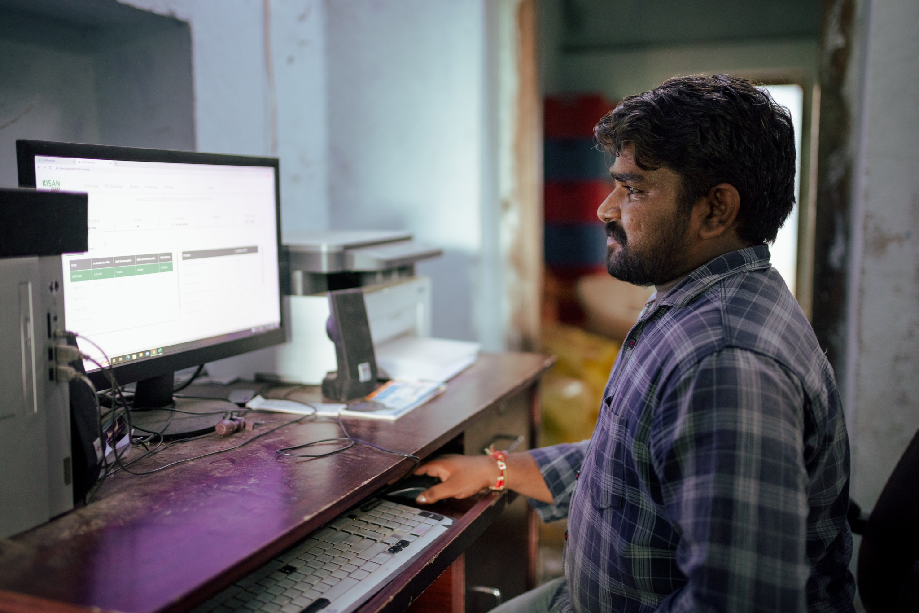
Feedback Management System
01
02
03
04
05
06
Content
(Relevance)
Outreach
Upcoming seasonal needs
Innovations & best practices
Barriers & Challenges
Availed government services & schemes
Key Components
KVK Level - quality check, approval and uploading of Videos onto the platform
State level - Dashboard on overall content creation and delivery performance of the platform (Program Management Committee with convergence)
Central (Institutional) Level - Periodic overview on dashboard to provide insights
FLW Level User App - for entering inputs for the FMS
User Authorisation- for each level for uploading, approval and tracking

Slide 7
Detailed timelines
May 2023
July 2023
FLW Courseware Framework with ASCI & MANAGE
Platform Architecture Design
Program Development update to all stakeholders
400 audio-visual advisories approved & uploaded on platform
Comms & Media Campaign initiates
Onboarding of 24 MTs
SoPs & Protocols developed, orientation of KVKs
Feb 2023
MOU Signing
Master Trainer (MT) ToT Framework
Empanelment ads for MTs
Consultative meeting with all Pr. Secretaries of ten states
National Workshop with states Director/Jt Director, Agriculture at MANAGE
Constitution of PMU & Steering and Working Committees
Identification of commodities, districts & FLWs (20 Districts, 3000-5000 FLWs for Launch)
FLW Courseware Outline
ToT Modules Design
International Conference on Digitalisation of Extension System
FLW Courseware completed - 5 modules (end to end)
Video Content uploading for platform testing begins
Platform testing
Platform Launch (4 States)
Master Trainers Training Begins
Onboarding of FLWs onto platform
August 2023
April 2023
June 2023

Slide 8


