Slide 1




National Conference on Agriculture for
Kharif Campaign, 2023
Department of Agriculture, Animal Husbandry & Cooperative
Government of Jharkhand
Date
Presented by -

Slide 2
Agriculture Profile of Jharkhand
State Agriculture Profile
Particulars | Area in Lakh Hec | %
Total Geographical Area | 79.71
Total Cultivable land | 38 | 48%
In Kharif ( Gross sown area) | 28
In Rabi ( Gross sown area) | 11
Current fallow land | 8.9 | 11%
Other fallow land | 7.6 | 10%
Forest land | 23.28 | 29%
Barrend lands | 5.74 | 7%
Non-Agriculture Use | 6.86 | 9%
Pasture and other grazing land | 1.97 | 2%
Cultivable waste | 2.74 | 3%
Cropping intensity | 126%
Average rainfall | 1200-1300mm
% of assured Irrigated Land | 20%
% of potential irrigated land | 30%
Fertilizer Uses (kg/Hec) | 92
Seed replacement rate | 15%
Source: Department of Forest & & Department of Agriculture, Husbandry & Cooperatives

Slide 3
Trend in Monsoon Rainfall for the past 2 years
Month | Normal Rainfall | 2022-23 |  | 2021-22
 | in mm | Actual | % | Actual | %
June | 196.6 | 81.6 | 41.51 | 281.5 | 143.18
July | 319.4 | 130.9 | 40.98 | 297.9 | 93.27
August | 276.2 | 277.2 | 100.36 | 183.4 | 66.40
Sep | 227.9 | 212.1 | 93.07 | 242.9 | 106.58
Total | 1020.1 | 701.8 | 68.80 | 1005.7 | 98.59
State has been experiencing significant deviation in distribution of rainfall in 2022 as compare to the pervious year and also overall deficit rainfall and affecting the sowing.

Slide 4
Drought situation
2022 Kharif Season was drought affected
Out of 24 districts, 22 districts drought declared
Out of 263 blocks , 226 block are drought affected
Crop coverage less than 50%
Paddy area reduced drastically to 8 lakh ha. against normal area of 18 lakh ha.
State submitted financial memorandum for Rs. 9681 cr for drought relief & assistance awaited
So far State has disbursed Rs 461 crore towards drought relief for 13.17 lakh farmers
Total numbers of farmers registered on drought relief portal is more than 30 lakhs

Slide 5
Major Crop Coverage and Target for Kharif 2023
S.No. | Crop | 2022 |  | 2023 | Comment
 |  | Target | Coverage | Target (Estimated)
1 | Paddy | 1800.00 | 855.084 | 1800.00
2 | Maize | 312.00 | 208.847 | 260.00
3 | Pulses | 612.00 | 323.991 | 612.00
4 | Oilseeds | 60.00 | 27.690 | 60.00
5 | Coarse Cereals | 42.00 | 15.997 | 93.45 | 51.41 thousand hectare more area coverage under the millet crop in 2023 Kharif season
 | Total | 2826.00 | 1431.61* | 2826.00
*For the 2022 Kharif season due to drought condition coverage have severely affected

Slide 6
Estimate of Area, Production & Yield of Food grains, Oilseeds and Other Crops for 2022-23
Crops | Area |  |  | Production |  |  | Yield
 | Kharif | Rabi | Total | Kharif | Rabi | Total | Kharif | Rabi | Total
Paddy | 795.628 | 0.00 | 798.628 | 2099.543 | 0.000 | 2099.543 | 2639 | 0.00 | 2639
Wheat |  | 180.061 | 180.061 | 0.000 | 379.781 | 379.781 | 0.00 | 2109 | 2109
Jowar | 13.585 | 0.00 | 13.585 | 32.744 | 0.000 | 32.744 | 2410 | 0.00 | 2410
Bajra | 0.231 | 0.00 | 0.231 | 0.130 | 0.000 | 0.130 | 562 | 0.00 | 562
Maize | 208.820 | 8.018 | 216.838 | 452.882 | 12.681 | 465.563 | 2169 | 1582 | 2147
Ragi | 26.062 | 0.00 | 26.062 | 31.950 | 0.000 | 31.950 | 1226 | 0.00 | 1226
Total | 1044.326 | 188.079 | 1232.405 | 2617.248 | 392.462 | 3009.710 | 2506 | 2087 | 2442
Crops | Area |  |  | Production |  |  | Yield
 | Kharif | Rabi | Total | Kharif | Rabi | Total | Kharif | Rabi | Total
Total Pulses | 346.502 | 331.758 | 678.260 | 367.240 | 393.944 | 761.184 | 1080 | 1187 | 1122
Total Food-grains | 1390.828 | 519.837 | 1910.665 | 2984.489 | 786.405 | 3770.894 | 2146 | 1513 | 1974
Total Oilseeds | 31.030 | 400.616 | 431.646 | 30.108 | 365.181 | 395.289 | 970 | 912 | 916

Slide 7
Fertilizer Stock received during Kharif & Rabi 2022-23 and Demand/Allocation for 2023
In MT
Kharif 2022
Product | UREA | DAP | NPKS | MOP | SSP | TOTAL
Demand | 280000.00 | 128000.00 | 55000.00 | 46000.00 | 20500.00 | 529500.00
Allocation | 170000.00 | 75000.00 | 30000.00 | 20000.00 | 10000.00 | 305000.00
Receipt | 136263.38 | 45535.95 | 30200.40 | 2610.50 | 4600.35 | 219210.58
RABI 2022-23
Product | UREA | DAP | NPKS | MOP | SSP | TOTAL
Demand | 122000.00 | 39000.00 | 26500.00 | 3300.00 | 4000.00 | 194800.00
Allocation | 90000.00 | 25000.00 | 15800.00 | 200.00 | 1000.00 | 132000.00
Receipt | 104996.16 | 31298.45 | 48414.90 | 1014.65 | 1091.80 | 186815.96
Kharif 2023
Product | UREA | DAP | NPKS | MOP | SSP | TOTAL
Demand | 225000.00 | 125000.00 | 50000.00 | 25000.00 | 18000.00 | 443000.00
Allocation | 170000.00 | 75000.00 | 30000.00 | 20000.00 | 10000.00 | 305000.00
Receipt | 24530.36 | 11691.60 | 1670.30 | 0.00 | 959.20 | 38851.46
Fertilizer Balance Stock as on date
In MT
UREA | DAP | NPKS | MOP | SSP
59201.14 | 21106.43 | 10542.84 | 575.88 | 1455.16

Slide 8
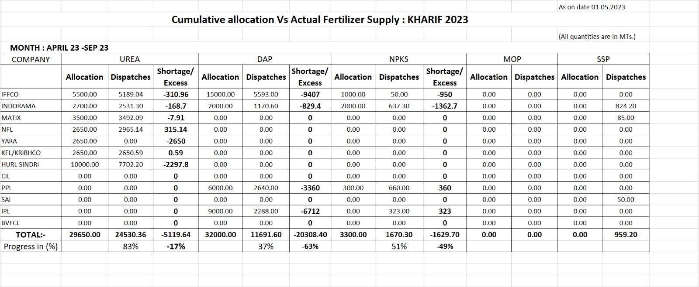
Fertilizer Requirement & Availability for Kharif 2023
Cumulative allocation vs Actual Fertilizer Supply for Kharif 2013
All qt is MT

Slide 9
Pradhan Mantri Kisan Samridhi Kendra
The name of Model Fertilizer Retail Shop would be “PRADHANMANTRI KISAN SAMRIDHI KENDRA” (PMKSK).
271 centres upgraded as District level(DHQ) PMKSK in state in all districts. Also 2023 No. of fertilizer selling points in Block & 2382 in Village level have been identiﬁed for upgradation in next phase.

Slide 10
Status on RKVY Annual Action Plan
Draft Annual Action Plan meeting had been convened on 20th March 2023 in the presences of Department of Agriculture, Animal Husbandry and Cooperative of the State and Ministry of Agriculture & Farmer Welfare Officials.
Detailed AAP was discussed in the meeting, intervention and changes were suggested by MoA&FW Officials.
Post the meeting, MoA&FW had proposed and replied with suggestive changes and comments on the AAP, the necessary changes duly received on 11th April,2023.
As per the directive Department of Agriculture, Animal Husbandry and Cooperative of Jharkhand, has incorporated the suggestive changes in the APP.
SLSC meeting file has been put up to Chief Secretary for Presentation.

Slide 11
Status on Digital Agricultural Mission in Jharkhand
Pilot survey work to be completed
Accordingly, to that Geo referencing completed for 33.50 lakh Farmer data base with their land details .
State has provisional budget of Rs. 5 cr. for Agri-Stack Project
Guidelines from GoI is awaited to take the Agri-Stack discussion forward

Slide 12
Request from Government of India
Release of Drought relief for Rs 9600 cr as soon as possible.
Increment of Pulses seed minikits under NFSM to mitigate drought challenges.
SOP for Agri Stack Project
Active participation of NAFED towards pulses procurement under MSP during ensuing season

Slide 13
Thank You

