Slide 1
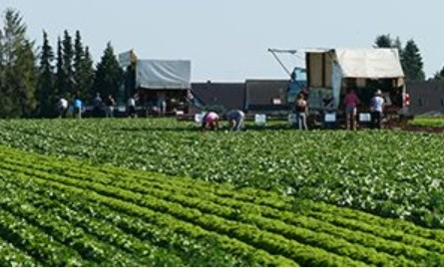

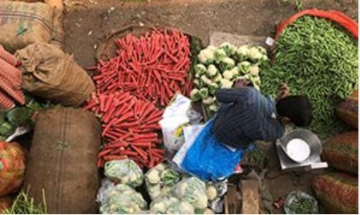
Climate change and food system sustainability
Challenges and solutions
Rob Vos
CGIAR/IFPRI
G20 Agricultural Working Group
Global Forum on Climate Smart Agriculture for Food Security
Indore, India, 13 February 2023

Slide 2
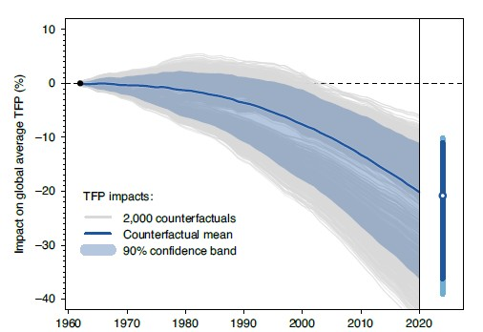
Food availability and sustainability challenges
Food production continues to outpace population growth
Agricultural productivity growth has slowed by > 20% because of climate change
  Impact is intensifying and hurting tropical agriculture the most

Slide 3
Food availability and sustainability challenges
Food systems generate one third of global GHG emissions
Future productivity growth (to 2050) must come from land intensification

Slide 4
Underinvestment in food system R&D
Agricultural research intensity under par for world and developing countries, 1960-2010
Investment in R&D too low for comfort
  Investment gap = $15bn per year for STI in CSA in LMICs
Growing portfolio of promising new sustainable technologies…
.. but many hurdles to widespread adoption and adaptation

Slide 5
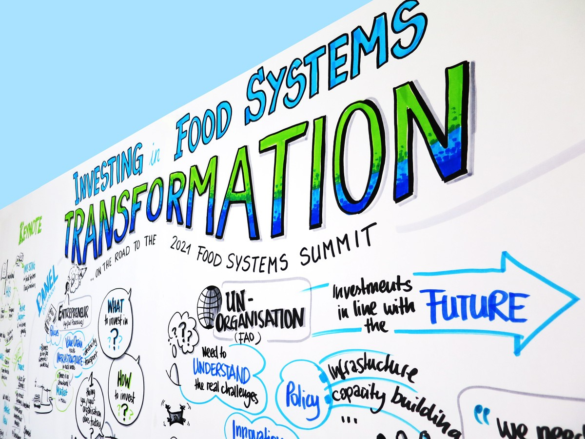
Solutions for food systems transformation
Investment, policies and incentives for climate-resilient and sustainable production practices along food value chains to:
  Facilitate adoption and adaptation of technologies
  Enable a shift to healthy diets
  Reduce food loss and waste
  Improve management of water, land, soils, and forests
  Reset market incentives to change producer and consumer behaviour

Slide 6
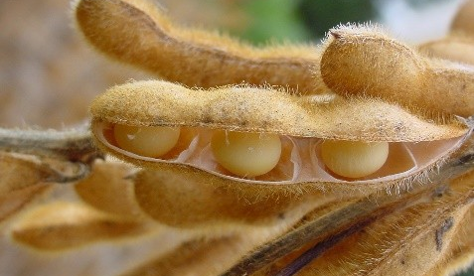
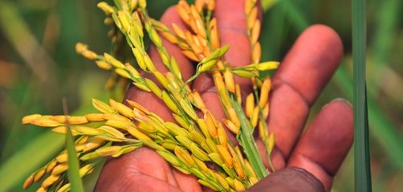
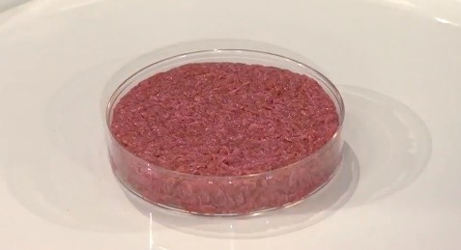
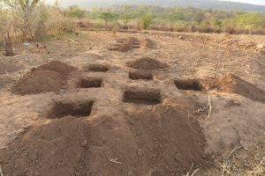
Reshaping food systems with innovations for multiple wins
Further develop and scale up new multiple-win technologies
Alternative proteins to reduce GHGs, environmental impact, health risks
  Emission-reducing animal feed
  Gene editing for climate-resilience & yield-enhancing seed improvements
  Precision agriculture and other digital technologies for agriculture
Support farmer-led and SME-led innovations
Improved soil management for productivity increases and carbon sequestration
Planting basins to conserve water and improve food safety
Bundled digital advisory provision (extension, credit, climate information, logics, early warning systems, insurance, etc.)
Solar-powered small-scale irrigation, storage and cold chain development
Inclusive certification schemes for food quality and sustainability standards
Photos: Ageitec, HarvestPlus, WEF, ICRAF
Picture sources: IRRI, New Agriculturist, and Zen Gardner

Slide 7
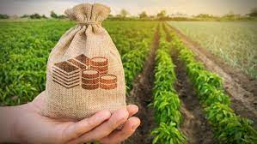
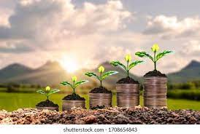
Reshaping finance and incentives
Change market incentives through reform agricultural support and innovative finance for STI in CSA
Repurpose agricultural support to more R&D in productivity enhancing and low emission-intensity production
Payments for eco-services and for adoption of improved climate-smart technologies
Repurposing of agricultural support needs international coordination ➔ role for G20
New financing mechanisms to de-risk investment in sustainable agriculture ➔ role for national and multilateral development banks
Photos: Ageitec, HarvestPlus, WEF, ICRAF
Picture sources: IRRI, New Agriculturist, and Zen Gardner

Slide 8
Issues for discussion
Collaborations in STI for Climate Resilient Agriculture and Food Systems.
Innovative Financing to Facilitate Climate Smart Agriculture Approaches
Agri-business Strategies for Climate-Smart Agriculture
Inclusive Policies for Tech-driven Climate-Smart Agriculture
Climate-Smart Agriculture for Livelihoods Protection and Opportunities

