Slide 1
Leveraging tech solutions for climate smart agriculture: the role of policies
G20 Agriculture working group
Indore, India, February 13, 2023
Guillaume Gruere, Ph.D.
Acting Head of Division
Agriculture and Resources Policies Division
OECD Trade and Agriculture Directorate

Slide 2
Climate smart agriculture: from objectives to solutions
Three joint objectives support food security and the environment & are necessary to progress on SDGs
  Consistent with OECD ag ministers’ productivity sustainability & resilience objectives
Not always in concert due to key differences for farmers:
  Adaptation and productivity are linked and related to private benefits for producers
  Mitigation is a public good offering public benefits
Productivity
Mitigation
Adaptation
CSA
As such, policies may support CSA with more or less emphasis and for different reasons
  Enhancing productivity for food security, livelihoods and resource efficiency (shared public/private)
  Fostering agriculture adaptation to sustain production and livelihoods under a changing climate (shared public/private)
  Encouraging a shift of production towards low GHG emission options for global welfare not directly impacting farms (public)
Clear calls for policy coherence with food system approach to policies, and common support for innovation and therefore technical and technological solutions (G20, OECD, GFFA, UNFSS)

Slide 3
How to leverage the use of these solutions?
From policies to outcome
POLICIES & REGULATIONS
–Macroeconomic environment & governance
-Economy-wide policies with impact on the Food and Agriculture System
-Agricultural policies
-Agricultural Innovation system
DRIVERS
- Research and development
- Information, skills and knowledge enhancement
- Incentives to adopt
IMPACT
Development and use of Climate smart agriculture tech solutions
OUTCOME
Climate Smart Agriculture

Slide 4
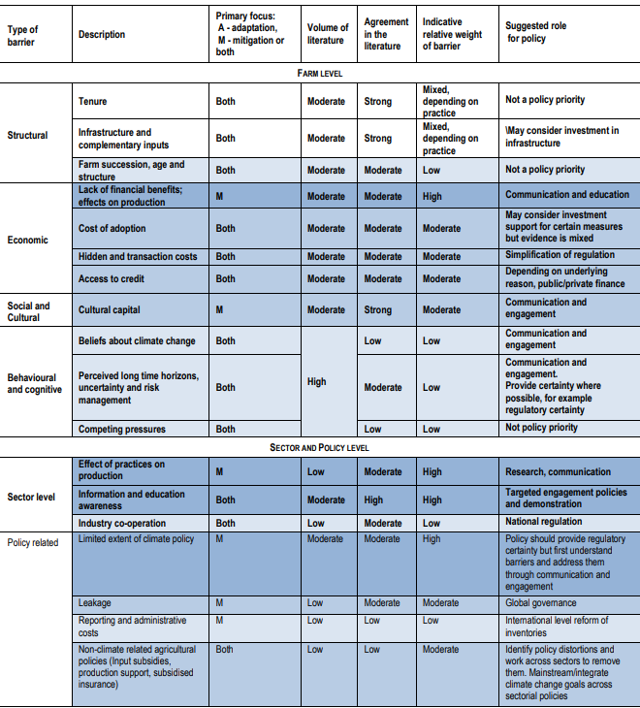
What are the barriers to the adoption of CSA tech solutions?
1/2- at the farm level

Slide 5
What are the barriers to the adoption of CSA tech solutions?
2/2- at the sector and policy level

Slide 6
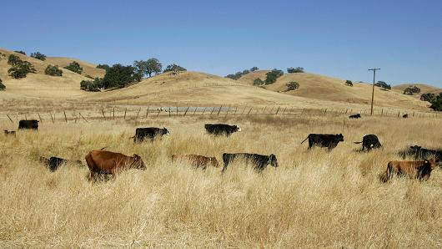
Three conclusions
Climate smart agriculture link important but different policy objectives (shared public/private vs public)
Multiple agriculture and non agriculture policy leverages to advance the development and use of tech solutions for climate smart agriculture
Need to identify and overcome the main farm, sector and policy barriers to ensure the adoption of these solutions

Slide 7

Thank you
Access all of the OECD’s research and analysis on agriculture at
www.oecd.org/agriculture
You can reach us via
e-mail by sending your message to the following address
tad.contact@oecd.org
We invite you to connect with us on Twitter by following
@OECDagriculture
Notes:
Contact us template 2

Slide 8
References
Guerrero, S., et al. (2022), "The impacts of agricultural trade and support policy reform on climate change adaptation and environmental performance: A model-based analysis", OECD Food, Agriculture and Fisheries Papers, No. 180, OECD Publishing, Paris, https://doi.org/10.1787/520dd70d-en . .
Lankoski, J., et al. (2018), "Modelling Policy Coherence Between Adaptation, Mitigation and Agricultural Productivity", OECD Food, Agriculture and Fisheries Papers, No. 111, OECD Publishing, Paris, https://doi.org/10.1787/ee62a5ae-en .
Lankoski, J., A. Ignaciuk and F. Jésus (2018), "Synergies and trade-offs between adaptation, mitigation and agricultural productivity: A synthesis report", OECD Food, Agriculture and Fisheries Papers, No. 110, OECD Publishing, Paris, https://doi.org/10.1787/07dcb05c-en .
OECD (2019), Innovation, Productivity and Sustainability in Food and Agriculture: Main Findings from Country Reviews and Policy Lessons, OECD Food and Agricultural Reviews, OECD Publishing, Paris, https://doi.org/10.1787/c9c4ec1d-en .
OECD (2020), “OECD Agro-Food Productivity-Sustainability-Resilience Policy Framework”, OECD, Paris https://one.oecd.org/document/TAD/CA/APM/WP(2019)25/FINAL/en/pdf
OECD (2022). OECD Agricultural Policy Monitoring and Evaluation: Reforming agricultural policies for climate change mitigation. OECD, Paris.
Wreford, A., A. Ignaciuk and G. Gruère (2017),“Overcoming barriers to the adoption of climate-friendly practices in agriculture”, OECD Food, Agriculture and Fisheries Papers, No. 101, OECD Publishing, Paris. http://dx.doi.org/10.1787/97767de8-en
OECD reviews of innovation, agricultural productivity and sustainability in G20 countries: Argentina, Australia, Brazil, Canada, China, Turkey, Japan, Korea, the United States, 4 EU member states (and forthcoming 2023 the European Union).

