Slide 1
Climate-Smart Agriculture for Livelihoods
Protection and Opportunities
Venkatachalam Anbumozhi
Director, Research Strategy and Innovations
G20 Global Forum on Climate Smart Agriculture for Food Security, Indore 13 February 2023
2023

Slide 2
Climate Risks and Inequality : A pre-requisite to the CSA approach by G20
G20 member Country | % of Agricultural GDP (2021) | % of Employment in Agriculture ILO Estimates (2021) | Prevalence of Undernourishment (% of population) 2019 | Gini Coefficient | Climate Risk Index Score (2019)
Argentina | 6,87 | 7,70 | 3,90 | 42.3 | 77.00
Australia | 2,27 | 2,40 | 2,50 | 34.3 | 4.,67
Brazil | 6,89 | 9,70 | 2,50 | 48.9 | 79.50
Canada | NA | 1,30 | 2,50 | 33.3 | 87,33
China | 7,26 | 23,99 | 2,50 | 38.2 | 56.33
France | 1,63 | 2,50 | 2,50 | 29.3 | 41.67
Germany | 0,80 | 1,30 | 2,50 | 30.9 | 38,17
India | 16.77 | 44,00 | 15,30 | 35.7 | 38.50
Indonesia | 13.28 | 29,00 | 6,50 | 37.6 | 74,00
Italy | 1,96 | 4,10 | 2,50 | 32.9 | 39,00
Japan | NA | 3,20 | 2,50 | 32.9 | 64,83
Mexico | 3,84 | 12,30 | 7,20 | 45.4 | 65,50
Korea, Rep. | 1,84 | 5,30 | 2,50 | 31.4 | 85,17
Russian Federation | 3,80 | 5,80 | 2,50 | 36.0 | 48,50
Saudi Arabia | 2,31 | 2,70 | 3,90 |  | 100.33
South Africa | 2,43 | 21,30 | 6,50 | 63.0 | 76,00
Turky | 5,65 | 17,10 | 2,50 | 43.4 | 111.83
United Kingdom | 0,60 | 1,00 | 2,50 | 33.5 | 65,00
United States | NA | 1,70 | 2,50 | 41.5 | 23.83
European Union | 1,63 | 4,14 | 2,53 | 30.1 | NA
Source: FAOSTAT, 2023; World Bank, 2022; GermanWatch, 2021

Slide 3
With Climate Change by 2050
Yield
  Rice 14-26%
  Wheat 32 – 44%
  Maize 2-5%
  Soybean 9 – 18%
Price
        Rice 29-37%
        Wheat 81-102%
        Maize 58-97%
        Soybean 14-49%

Slide 4

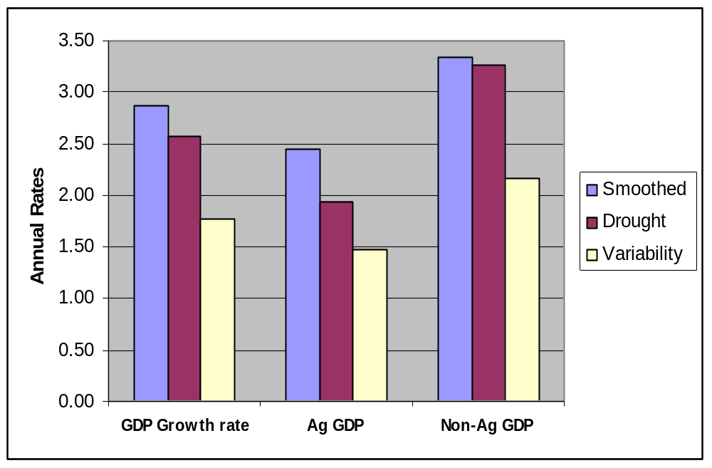
CSA gives a different picture of Livelihood Protection and Resilience Opportunities for Small Scale Farming Households
Adaptation Benefit |  | Temperature change
Yield change (%) | Rainfall | < 2 º C | 2 - 4 º C | > 4º C
 | Increase | 30 | 19 | 17
 | Decrease | 9 | 11 | 15
Source: After Ion 2007
Key CSA measures for Small Farmers
Change in crop varieties
Alterations in cropping pattern
Wider use of water harvesting technology
Improved drainage condition
Using climate forecasting systems
Source: ERIA, 2019

Slide 5
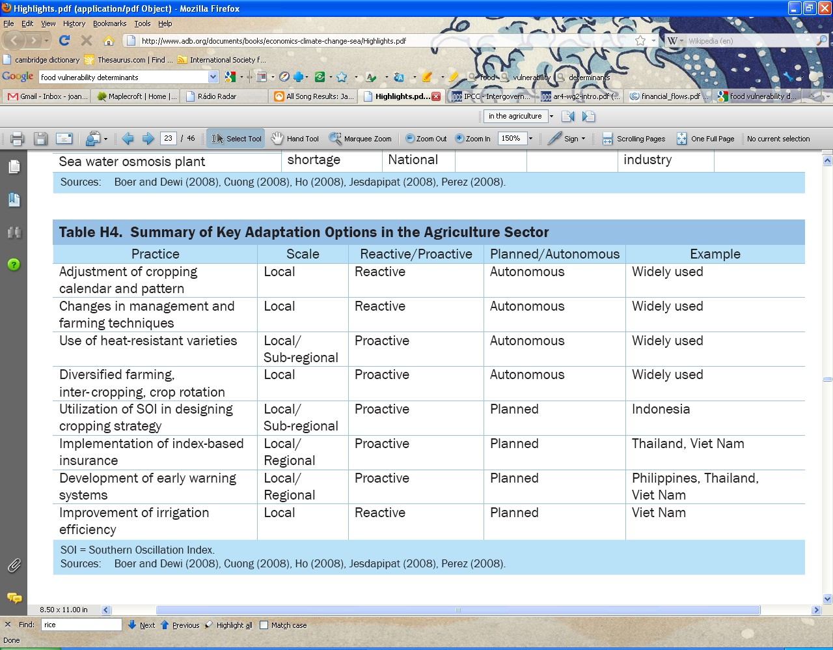
CSA In South East Asia – A reality check?
Source: ERIA, 2018
CSA is largely reactive & autonomous so-far! In ASEAN

Slide 6

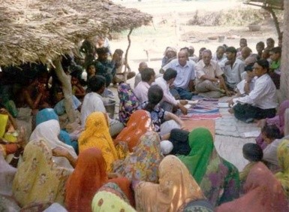


CSA Opportunity and Livelihood Opportunity – A continuum
CSA
focus
Vulnerability reduction Response to impacts
Benefit in the
absence of CC
100% 0%
Example
China: Providing farmers drought tolerant varieties & training for water saving methods
INDIA: Teaching officials to collect climate data and integrate in their planning decisions
BANGLADESH: Constructing shelters in response to frequent cyclones
FIJI: Coastal zone protection with vegetative buffers like mangroves
Type
Non-structural Structural

Slide 7
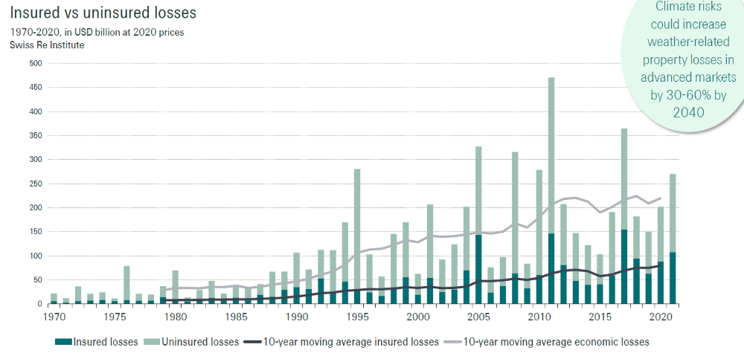
CSA and Livelihood Protection capacity Could be improved through Insurance Mechanisms

Slide 8
Steps in Building Decision Making Capacity
Stakeholders:
Policy Makers & Planners
Knowledge institutes
Community organizations
Private companies
Development partners
MAINSTREAMING
Step 4: Building lessons to policy
to make adaptation part of BAU
PILOT
INVESTMENTS
Step 3: Pilot activities involving
governments, private sectors &CBO
SECTORAL ADAPTIVE CAPACITY
TARGETTED
COMMUNICATION
Step 2: Targeted information & training for
Policy makers and planners
AWARNESS
RAISING
Step 1: Building Scientific understanding & Capacity
Year: 0 1 2 3 4 5 6 7

Slide 9
Barriers to Mainstreaming CSA for Livelihood Protection
Uncertainties in economic costs and CSA science
Limited public awareness
Limited structural & non-structural measures
Weak human resources
Weak public & private finance
Adapting to CSA is too costly
Knowledge Gap
Capacity Gap
Finance Gap

Slide 10
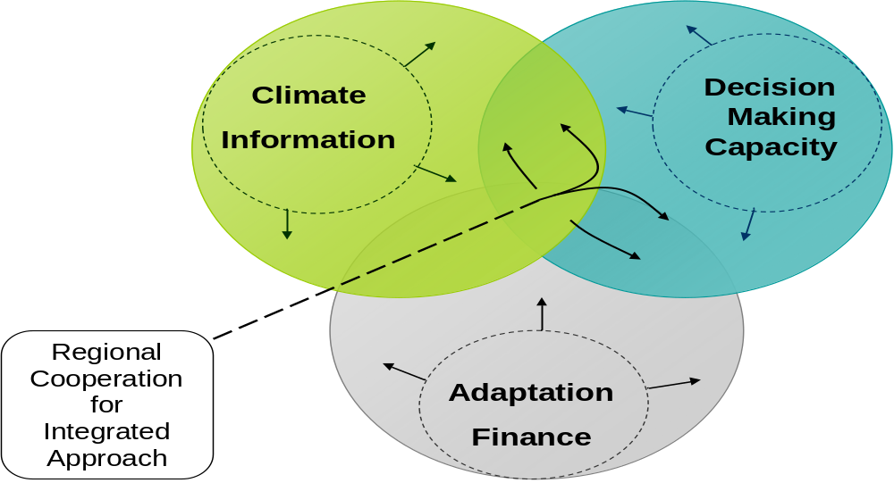
Improved CSA and Resilience is Built on Four Pillars
Down-scaled models,
Co-benefit Infrastructure
Targets & KPI settings
Implementing Guidelines
Digital Technologies
Inter–sector synergies
G20
Crowdfunding
Insurance mechanism

Slide 11

Thank you
Reach us at:
Economic Research Institute for ASEAN and East Asia
Sentral Senayan II 6F
Gelora Bung karno, Senayan
Jakarta Pusat 10270, Indonesia
Tel : 62-21-5797-4460 | Fax : 62-21-5797-4464
Email : v.anbumozhi@eria.org | Website : www.eria.org

