Slide 1




Tropical Agriculture Platform (TAP)
TAP Secretariat
Office of Innovation
Food and Agriculture Organization of the UN
Rome
First Agriculture Working Group Meeting
13-15 Feb, 2023; Indore, MP, India

Slide 2
Tropical Agriculture Platform (TAP)
TAP is a G20 initiative, established at the 1st MACS meeting in Mexico in 2012 to promote greater coherence and impact of Capacity Development (CD) and knowledge sharing to strengthen National Agricultural Innovation System (AIS).
TAP is a multilateral facilitation mechanism to promote greater coherence and impact of Capacity Development (CD) programs and knowledge sharing to strengthen Agricultural Innovation System (AIS) in the tropics and sub-tropics.
Governance includes Partners Assembly (PA), Steering Committee, and the Secretariat.
TAP-PA approved the TAP Action Plans:
  2014-2017 / 2018-2021 focused on developing and piloting the Common Framework on CD for AIS.
  2022-2025 focused on mainstream AIS approaches at the national, regional and global institutional and policy level.

Slide 3


















































TAP Partners

Slide 4
TAP Major Milestones
TAP Partners Assembly & cross-country learning event in Laos in Rwanda (2016) and Laos (2017)
Common Framework & TAPipedia approved
E-conference, symposium & other events to advocate for CD for AIS and TAPipedia (global & regional)
EU funds mobilized (CDAIS project by Agrinatura & FAO)
TAP Global Task Force & CD Expert Group launched
TAP Common Framework (CF) and TAPipedia developed
2012-2013
2014 - 2015
2016-2018
TAP launched at G20 MACS in Mexico
Regional needs assessments
1st TAP Partners Assembly (PA) in China
2019-2022
Implementation of TAP-AIS project initiated.
TAP CDEG re-launched.
Collaboration among TAP Partners strengthened (under the EU-DeSIRA initiative)
TAP AP 2022-2025 developed

Slide 5
Goal and main outcomes of the TAP Action Plan 2022-2025
Goal: Strengthen capacities (technical, functional, partnerships and resources) of stakeholders to integrate AIS approaches at the institutional and policy level with high commitment and inclusive bottom-up approaches into AIS.
Outcomes:
Innovation capacities are improved at country level by establishing effective AIS
Regional organizations (Education, Extension and Research) improve their capacities to support countries and their innovation capacities
TAP partners and stakeholders acknowledge the importance of CD for AIS, and advocate for more investments in AIS of countries to contribute to the G20 initiatives and attainment of the SDGs of the United Nations
TAP Secretariat and its governance improve its capacities to achieve its mandate

Slide 6
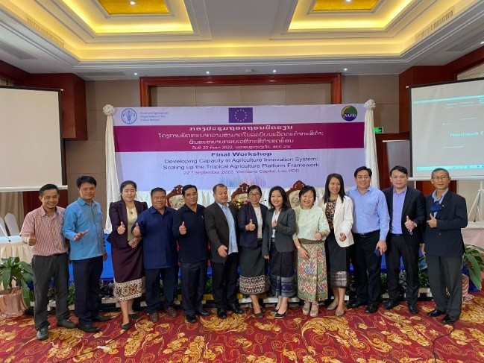
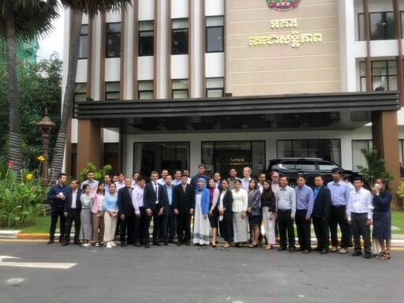
Outcome 1: Innovation capacities are improved at country level by establishing effective AIS
CDAIS initiative in El Salvador (February 2021) - The initiative supported agricultural innovation in four productive areas (coffee, beans, tomatoes and plantains).
“Developing capacities in agricultural innovation systems: scaling up the Tropical Agriculture Platform (TAP) Framework” (TAP-AIS) – funded by EC and implemented in 9 countries (Cambodia, Lao PDR, Pakistan, Burkina Faso, Senegal, Eritrea, Rwanda, Malawi and Colombia)
  AIS assessments conducted in eight of the nine countries of the TAP-AIS project.
  Capacity development activities of selected key organizations are being implemented in six of TAP-AIS countries.
  Policy dialogue and other bridging events (i.e., innovation fairs) are being facilitated in all TAP-AIS countries.
TAP-AIS Final Workshop in Lao PDR
Participants of the national policy dialogue in Phnom Penh, Cambodia

Slide 7
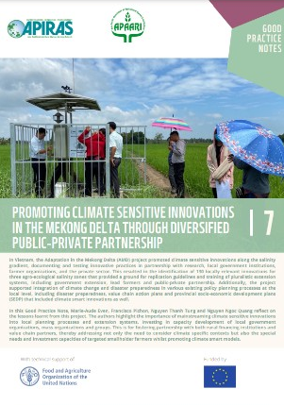
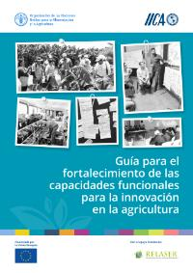
Outcome 2: Regional organizations (Education, Extension and Research) improve their capacities to support countries and their innovation capacities
FAO and RREOs: Training of trainers (ToT) on Strengthening agriculture innovation systems: TAP common framework and approaches.
APAARI: Developed a ToT refresher course on applying TAP tools in technical projects on Pesticide Residue Mitigation and Phytosanitary and Biopesticide in Asia.
APAARI and APIRAS: Two regional working groups on agroecology and biotechnology were facilitated.
IICA and RELASER: Operational guide on strengthening capacity to innovate with focus on functional capacities for Latin America.
AARINENA: Launched its Date Palm Innovation Platform in March 2022 at the 7th International Date Palm Conference in Abu Dhabi, and supported by the General Secretariat of the Khalifa International Award for Date Palm and Agricultural Innovation.
CATAS: Training courses facilitated in support on capacity strengthening in Republic of the Congo, Grenada and Guyana.
The World Vegetable Center (WorldVeg): Developed a new training course for vegetable seed producers in Africa to help improve the quality of seed production.

Slide 8



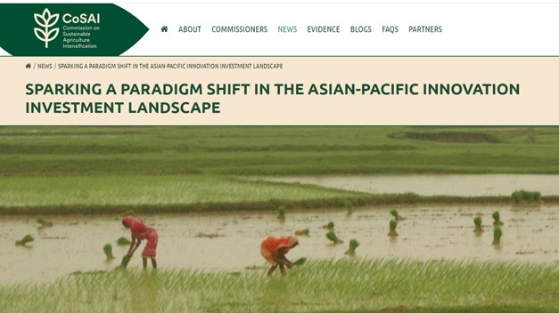
Outcome 3: TAP partners and stakeholders acknowledge the importance of CD for AIS, and advocate for more investments in AIS of countries to contribute to the G20 initiatives and attainment of the SDGs of the United Nations
TAP Stocktaking report and the video shared during the G20 - Agriculture Deputies meeting organized by the Ministry of Agricultural Food and Forestry Policies of Italy (April 2021).
TAP was represented at the G20 Agricultural Chief Scientists (MACS) in Indonesia (July 2022).
TAP’s work was highlighted during the “High-level dialogue on the Partnership in Action on Science, Technology and Innovation for SDGs Roadmaps”, (July 2021) organized by UNDESA.
Science Days of United Nations Food Systems Summit (UNFSS) 2021
  TAP organized a side event on “Capacity development for agricultural innovation systems - Lessons learned and future action of the TAP partnership”
APAARI and COSAI - hosted the dialogue focusing on the innovation investment landscape and future food systems in the Asia-Pacific (Sep 2021).

Slide 9
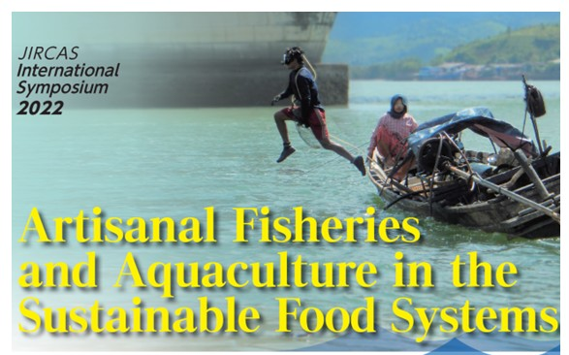
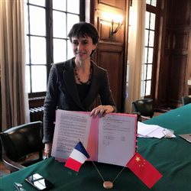
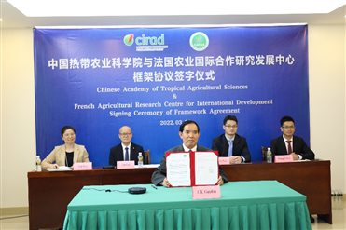
Outcome 3: Major events organized to raise awareness on agricultural innovation
FAO, APIRAS and APAARI: Organized a promotional event (21 June 2022) on “Strengthening capacities of agricultural research and extension organizations” to support agriculture innovation in Asia-Pacific.
JIRCAS: Organized the International Symposium 2022 - "Artisanal Fisheries and Aquaculture in the Sustainable Food Systems“ (November 2022), as a follow up of the 2021 UN Food Systems Summit, and on the occasion of the International Year of Artisanal Fisheries and Aquaculture (IYAFA 2022).
CATAS and CIRAD: Signed a New Framework Agreement for Scientific Cooperation (March 2022) to further expand the areas of cooperation to offer better solutions for the sustainable development of tropical agriculture.
CATAS / CIRAD New Framework Agreement
Signing Ceremony

Slide 10
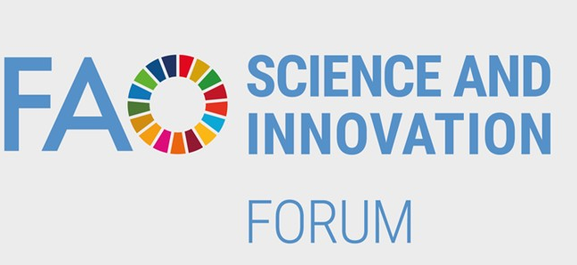
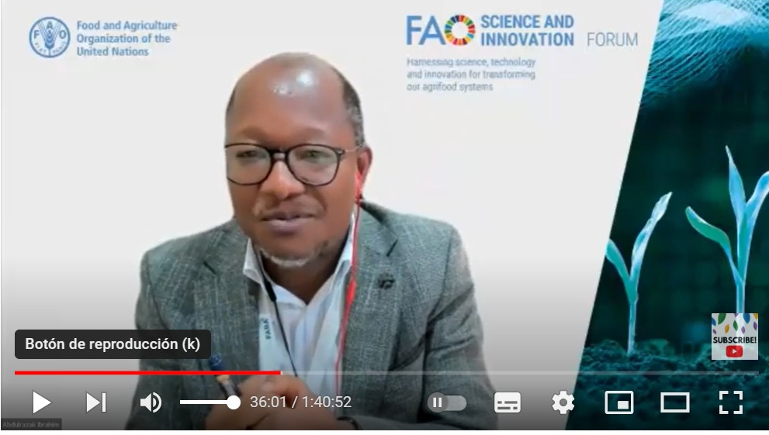
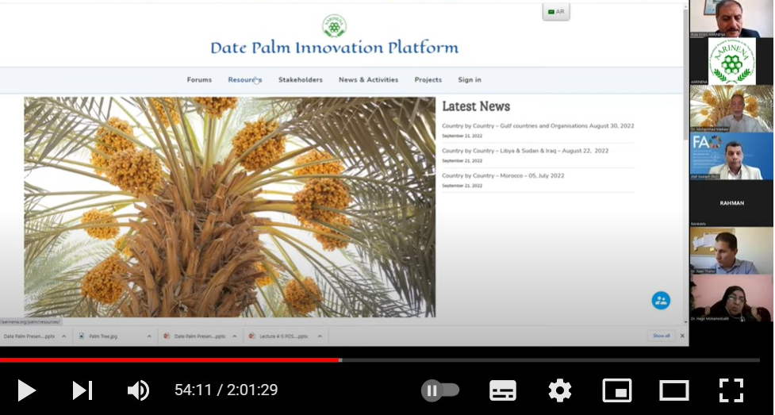
Outcome 3: Major events organized to raise awareness on agricultural innovation
TAP Partners organized several events during the FAO Science and Innovation Forum (October 2022).
  Capacity development for agricultural innovation systems (AIS) mainstreaming and investments through the Tropical Agriculture Platform by FAO, AFAAS, AGRINATURA, APAARI, EC, FARA, IICA and RELASER
  Creating Evidence on Extension and Advisory Services (EAS) by AFAAS, APIRAS, RELASER, FiBL and FAO
  Enhancing knowledge sharing in support of agricultural innovation “Date Palm Innovation Platform” by AARINENA
  Strengthening AIS: learning from past and present research interventions by DeSIRA LIFT project
  TAPipedia: Fostering knowledge sharing in support of agricultural innovation” by FAO, IICA, GFAR, GODAN and Ghent University, EU Farmbook platform
Intervention of FARA at the TAP side event
ARINENA´s side event at the FAO SIF 2022

Slide 11
Outcome 4: TAP Secretariat and its governance improve its capacities to achieve its mandate
The new TAP Steering Committee 2022-2024 was elected at the beginning in 2022.
Three Steering Committee met three times per year in 2021 and 2022.
A learning review of was completed and approved by the TAP SC in July 2022.
The revision of the TAP Common Framework was completed and approved by the TAP SC in July 2022.
A Working Group for the development of the TAP Engagement and Expansion Strategy was established and the first draft of the strategy has been produced.
The e-learning course on concepts, principles and approaches of the TAP Common Framework has been drafted and planned to launched in 2023.

Slide 12
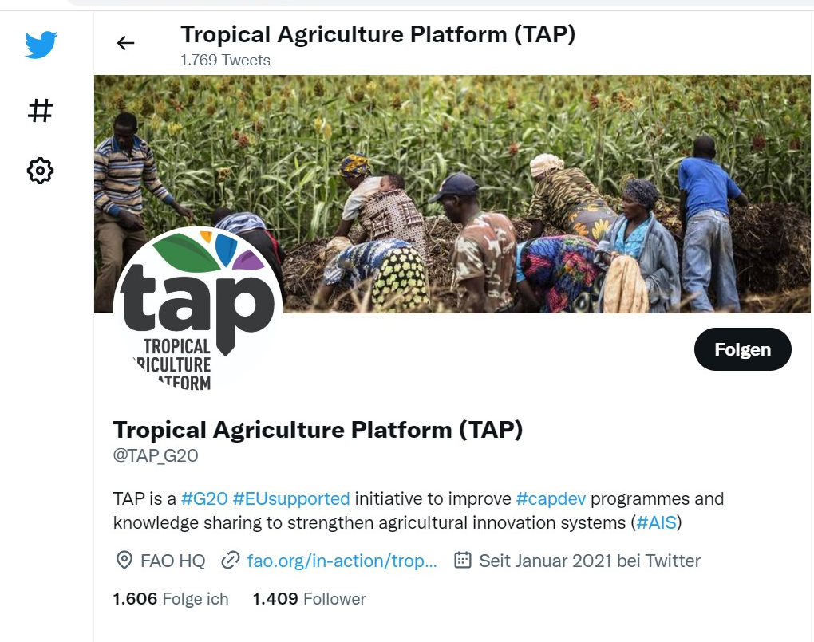
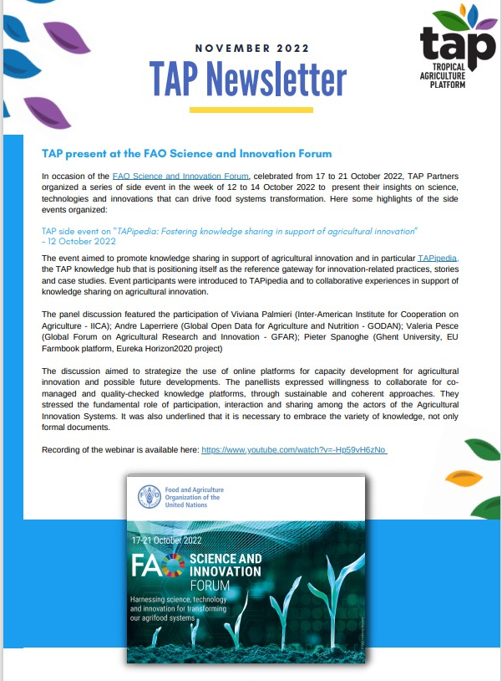
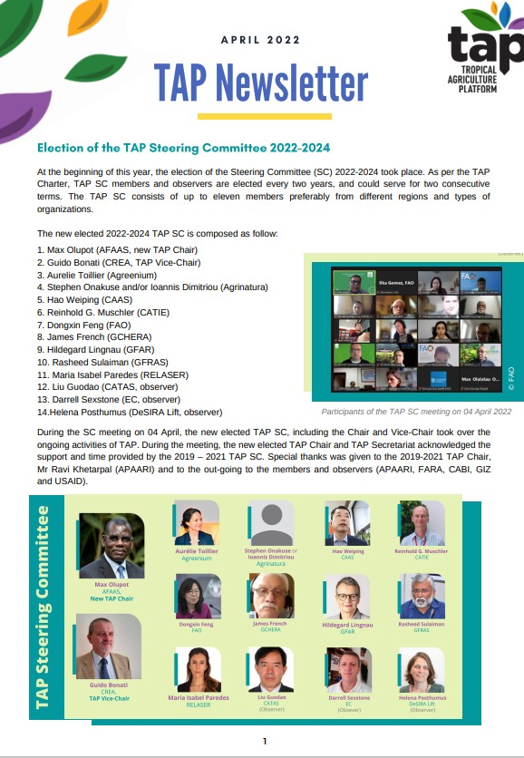
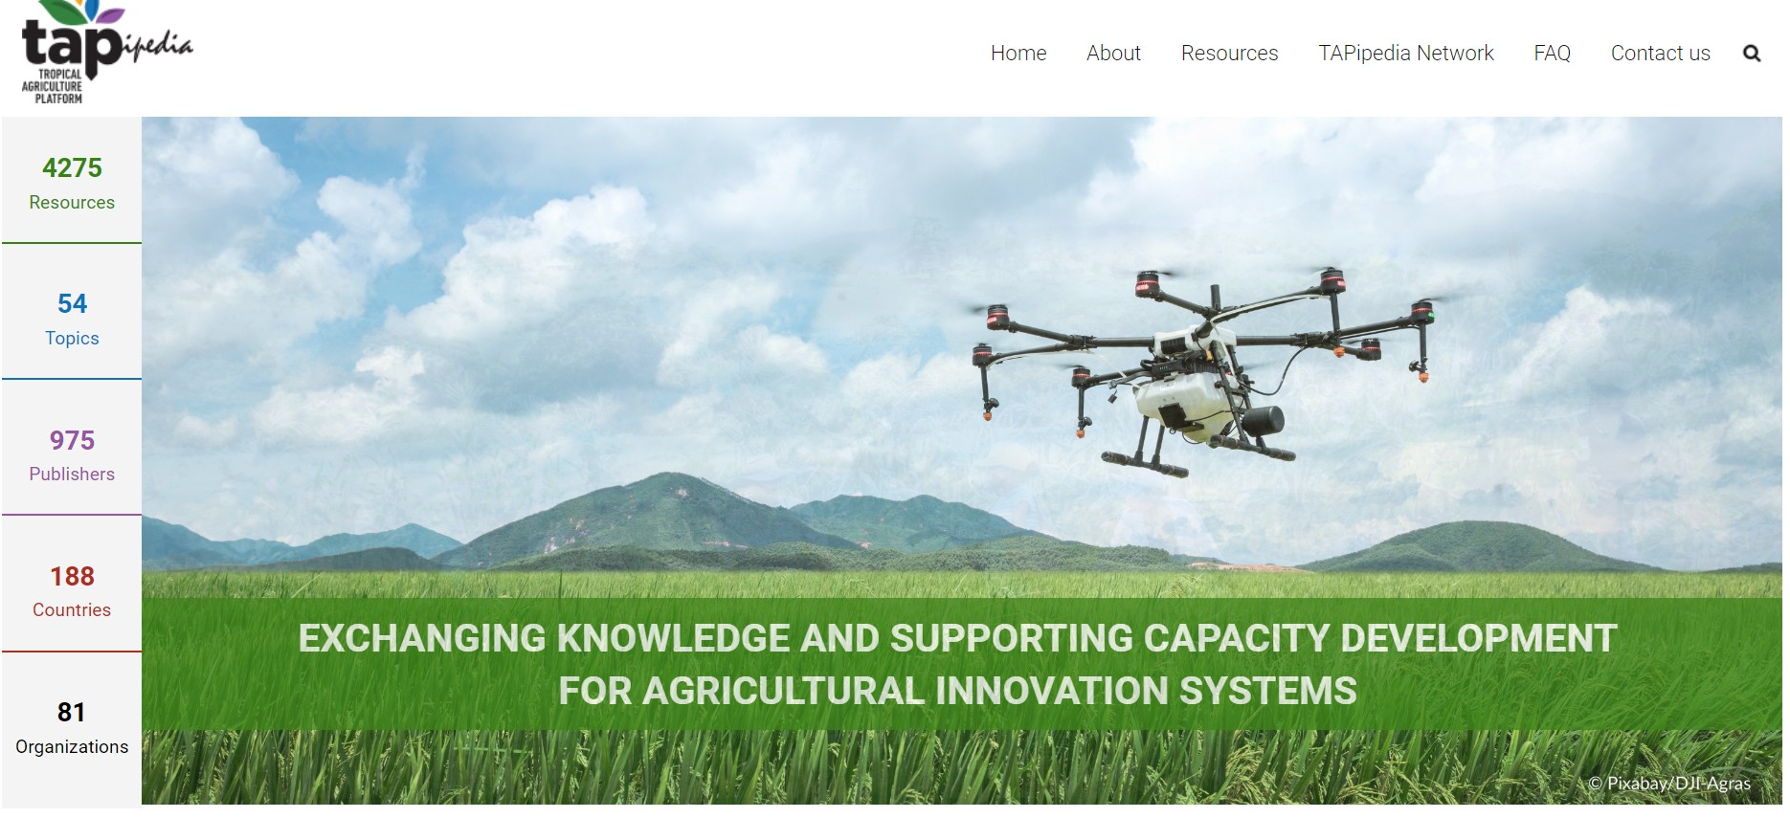
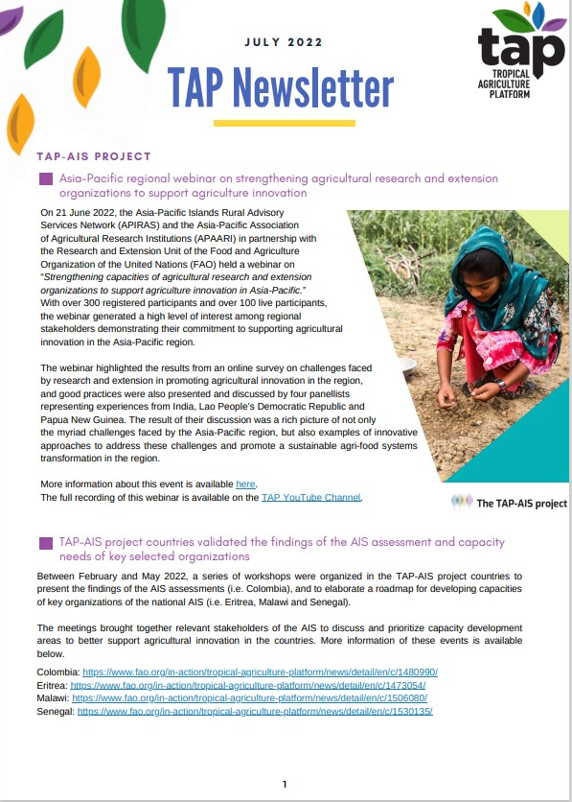
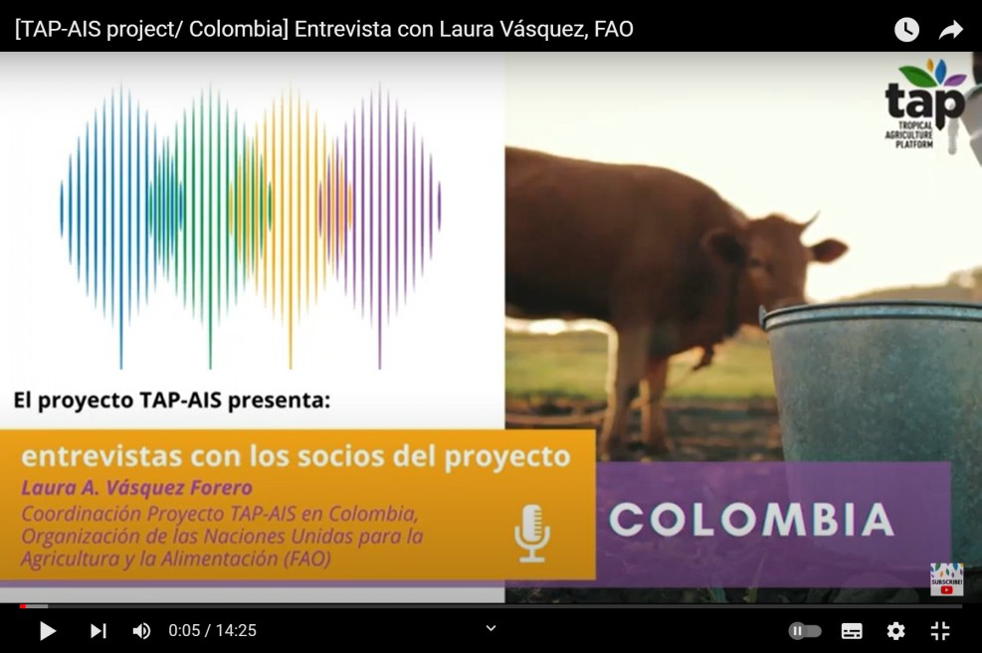
Outreach activities & TAPipedia
TAP Secretariat continues promoting the work of TAP and its partners, through:
  TAPipedia – outreach arm of TAP
  Quarterly TAP Newsleter (4 per year)
  Using a new Twitter account @TAP_G20
  New series of interviews to partners of the EU-funded TAP-AIS project are being collected

Slide 13
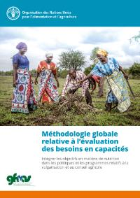
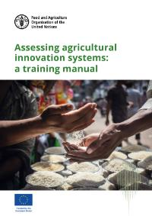
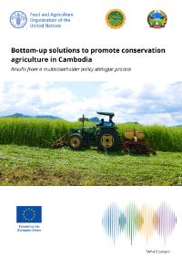
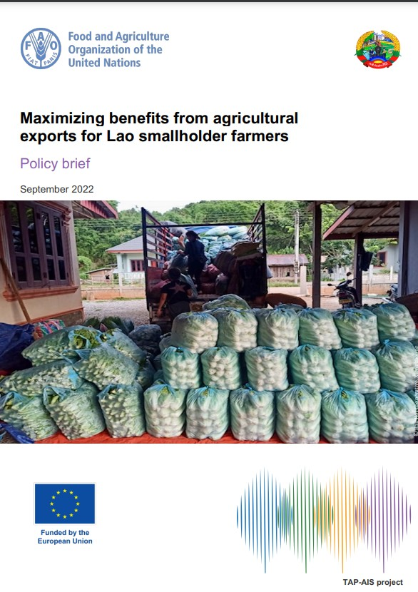
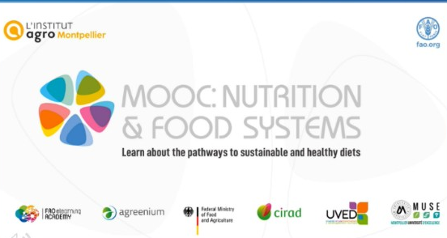
Knowledge Products and Tools
Assessing agricultural innovation systems: a training manual
Assessing agricultural innovation systems for action at country level. A preliminary framework
A preview of action-orientated assessment of agricultural innovation systems
Methodology on Global Capacity Needs Assessment (GCNA), Assessment of Agricultural Innovation Systems (AIS) – A Contribution to Develop STI Roadmaps for SDGs.
An assessment of capacity within agricultural extension and advisory services - FAO and GFRAS
NELK module on integrated pest management - GFRAS

Slide 14
THANK YOU
More information on TAP:
http://www.fao.org/in-action/tropical-agriculture-platform/en/
http://tapipedia.org/

