Slide 1
G20 India Presidency │ First Agriculture Working Group Meeting
Stock taking of G-20 initiatives in Agriculture │ February 13th, 2023
THE WHEAT INITIATIVE
John Spink
Chairman, Institutions Coordinating Committee Wheat Initiative

Slide 2
Wheat Initiative
Established in 2011
Hosted at the Julius Kühn Institute in Berlin, supported by the German Ministry for Food and Agriculture.
tasks:
Establish strategic priorities for wheat research in both developed and developing countries.
Foster communication between the research community, funders and policy makers.
Aims:
Encourage and support the development of a vibrant global wheat public-private research community sharing resources, capabilities, data and ideas to improve wheat productivity, quality and sustainable production.
Objectives:
Co-ordinate investments to meet wheat research and development goals.
Initiate and support communication and increase access for all to information, resources and technologies for wheat improvement.
Build capacity to address production challenges in an increasingly variable environment

Slide 3
Expert working groups
Adaptation of Wheat to Abiotic Stress
Control of Wheat Pathogens
Control of Wheat Pests
Wheat Breeding Methods and Strategies
Durum Wheat Genomics and Breeding New Chair
Global Wheat Germplasm Conservation and Use Community
Improving Wheat Quality for processing and health
Nutrient Use Efficiency in Wheat New Chair
Wheat Agronomy
Wheat Information System New Chair
Wheat Phenotyping to Support Wheat Improvement New Chair
New
New
468 scientists from 52 countries
Notes:
Essential backbone

Slide 4
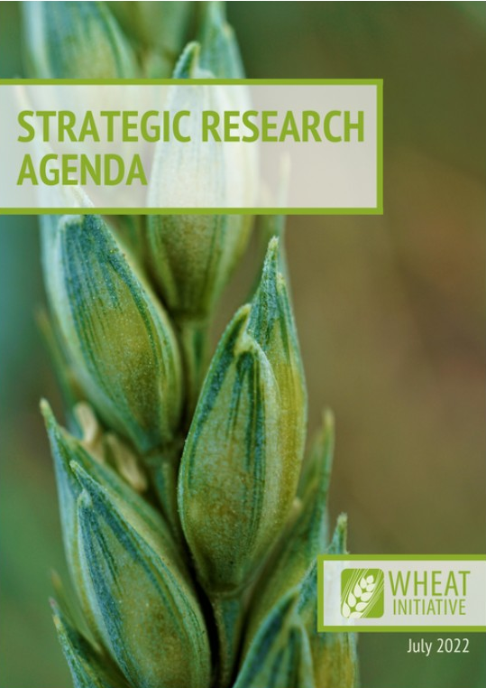
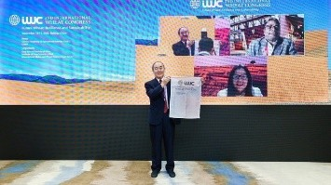
Progress Since 2021
Support from The German Ministry of Food and Agriculture
and the JKI renewed to 2027.
New Strategic Research Agenda (SRA) published.
The second International Wheat Congress
(IWC) was held in China as a hybrid model.
Early career research program to support young scientists.

Slide 5

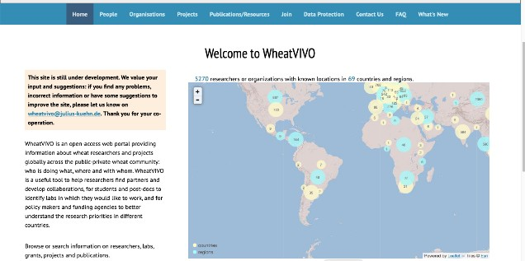

Progress Since 2021
Updated WheatIS – portal for genomics data.
WheatVIVO launched – database of researchers, organisations, projects, publications and more.
The Wheat Initiative Crop Health Alliance (WATCH-A) - A global disease diagnosis and monitoring system.
The Alliance for Wheat Adaptation to Heat and Drought (AHEAD) welcomed new members from UK, Switzerland, Egypt, France, Morocco, USA and Canada.

Slide 6
Reflections on questions
emerging priorities, opportunities, and challenges
P Coping with increasingly variable climate and rising costs of agricultural inputs.
O Improvements in crop breeding and production technologies.
O Sharing of resources, germplasm and capabilities needs to be expanded.
O Support systems to allow the research community to identify potential collaborators, training opportunities and resources.
C The increasing age of the agricultural workforce and the low intake of students.

Slide 7
Reflections on questions
achieve scale through coordination and partnerships
among G20 member nations and stakeholders?
Support multinational research activities, scientific exchanges
Combine research efforts to address challenges of global significance
What is an appropriate framework to capture the learning and exchange of ideas between the initiatives for successful outcomes?
The G20 MACS initiatives provide a good framework
But G20 members need to engage in the initiatives and provide support.

Slide 8
Reflections on questions
strengthening Capabilities for a result-driven delivery of
global initiatives?
Investing in staff and student training and supporting exchange of personnel.
Support international activities targeted to facilitating exchange of resources, particularly germplasm.
Actively participate in Wheat Initiative research alliances.
critical variables for Monitoring, Evaluation and Learning (MEL) to support the global initiatives?
Each initiative will have its own measures for assessing progress.
The Wheat Initiative seeks feedback and monitors membership and use of Expert Working Groups, Newsletters, Media Briefs, Twitter and web-based resources.

Slide 9
Reflections on questions
outputs of global initiatives aligned with the national
priorities of G20 member nations and AWG agenda?
Active participation from multiple government agencies in the activities to ensure the initiatives can address national priorities with strong engagement from members.
work towards a common goal in 2030 to align with SDGs?
Active engagement of members to define the specific outcomes from each initiative.
A mechanism for communication between initiatives to align goals and measures of performance.

Slide 10
Thank you!
wheatinitiative.org
@WheatInitiative
Wheat Initiative | Königin-Luise-Straße 19 | 14195 Berlin | Germany
E: wheat.initiative@julius-kuehn.de
W: www.wheatinitiative.org

