Slide 1
G20 | 1st Meeting of Agriculture Deputies
MANAGING RISKS TO IMPROVE FARMERS’ LIVELIHOODS AND ENSURE RESILIENT AGRICULTURAL SYSTEMS
Indore, 13-15 February 2023

Slide 2
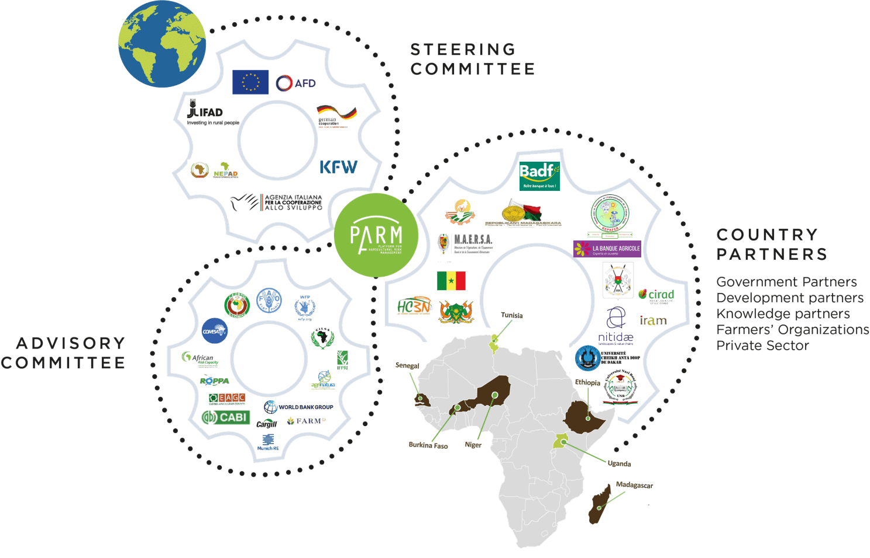
ABOUT PARM
The Platform
for Agricultural
Risk Management
The global partnership that can
connect the dots
PARM Mandate
Enable the integration of a holistic agricultural risk management (ARM) approach into policy planning, institutional capacities and investment to build resilience in the agricultural sector through value chains.

Slide 3


Turning risks into opportunities
Moving away from a culture of coping with disasters towards a smart management of risks
By reducing uncertainty, effective holistic agricultural risk management (ARM) creates a more predictable environment for investments and sustained rural sector growth.
Ag Risks
Opportunities
Climate
and weather
Environmental and biological
Market and price
Policy and institutional
Mitigating shocks to agriculture production
boosts productivity.
Diversifying production systems and improving stewardship of natural resources nurtures biodiversity.
Curbing production volatility protects rural jobs
and household food security.
Empowering women to manage risk
strengthens food security.
Holistic approach to
Agricultural Risk Management

Slide 4




OUR SERVICES
Assess
Design
Learn
Share
Bringing evidence to improve risk perception
Leveraging investments in agriculture
Building capacities to manage risks
Promoting knowledge exchanges and partnerships
Development of an innovative diagnostic methodology to assess risks in a holistic manner
Promoting private and public investments on agricultural risk management tools
Investing in human capital, enhancing skills and knowledge transfer on ARM
Providing spaces for ARM Practitioners to exchange knowledge & best practices
PARM works towards strengthening local stakeholders capacities and enhancing institutional capacities to manage agricultural risks, with a gender lens.
Through FARM-D Community of Practice, PARM facilitates the generation, access and exchange of knowledge and stimulates partnerships on ARM
PARM develops methodologies for risk analysis (holistic approach and value chains).
PARM facilitates the dialogue between public and private actors to identify the right set of tools to address the most pressing risks and attract new investments.

Slide 5




KEY RESULTS
2019 - 2022
2
GLOBAL PARTNERSHIPS
5
STUDIES
+18000
STAKEHOLDERS ENGAGED
Awareness and capacity on
ARM has been increased with over 300 national stakeholders taking part in national workshops, over 600 trained on ARM, more than 2100 international practitioners participating in webinars (FARM-D CoP), while over 15000 followers have been reached through social media (Facebook, Twitter, LinkedIn and Instagram).
InsuResilience Global Partnership Climate Risk Financing
Managing IFAD’s Insurance Facility (INSURED - funded by SIDA)
1 risk assessment study completed and published for Burkina Faso (holistic approach)
1 risk assessment study ongoing in Madagascar (value chains)
3 risks assessment studies conducted in Ethiopia, Senegal and Niger (holistic approach) – PARM Horizon 1
4
INVESTMENT PROJECTS DESIGNED
Investment projects/ programmes designed by governments and strategic partners with the support of PARM in Ethiopia, Burkina Faso, Senegal and Niger.
5
COUNTRIES WITH POLICY ENGANGEMENT
2
INSTITUTIONALI-SATION OF ARM
Pilot test to institutionalize
ARM into the curricula of
universities and practices of
the private sector (POs,
MFIs) for a lasting impact of
ARM Capacity Development
(Senegal & Burkina Faso).
Governments have developed policies and strategies to investing in ARM (Ethiopia, Burkina Faso, Senegal, Niger and Madagascar)

Slide 6


TAKE AWAY
ARM is a powerful tool to make farmers more resilient to different shocks.
ARM integration enables sustainable food systems and increased food security.
De-risking investment can contribute to make agricultural sector more attractive for PPP and boost rural investment.
PARM plays a key role as a knowledge broker among the global and local communities of practice by facilitating the generation, access, exchange of knowledge and stimulating partnerships on ARM.

Slide 7


Partner with us!
Let’s turn risk into opportunities.
parm@ifad.org
www.parm.org

