Slide 1

Technical Platform on the Measurement and Reduction of Food Loss and Waste
Rosa S. Rolle, PhD
Senior Officer
Food and Nutrition Division

Slide 2
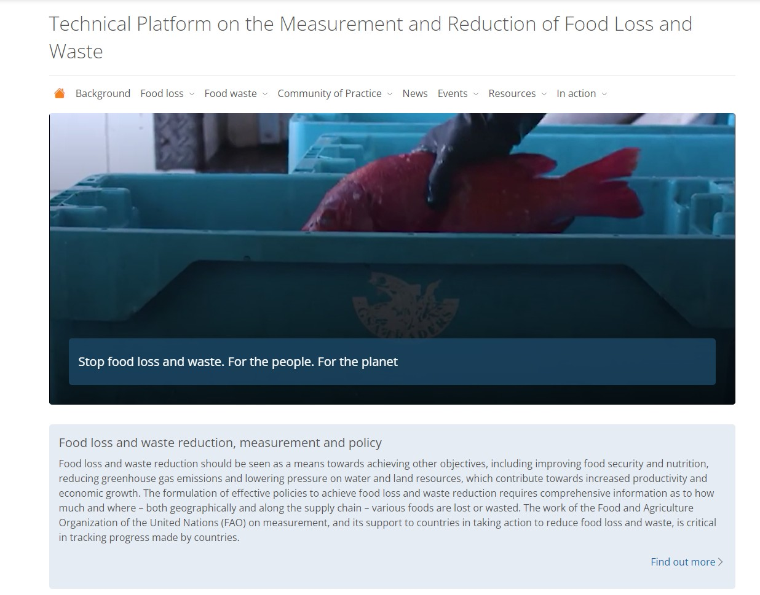


  Established by FAO and IFPRI in 2015 under the Turkish Presidency of G20 Agriculture Ministers.
  Merged with the FAO Community of Practice on FLW reduction in 2020 and re-launched.
https://www.fao.org/platform-food-loss-waste/en

Slide 3




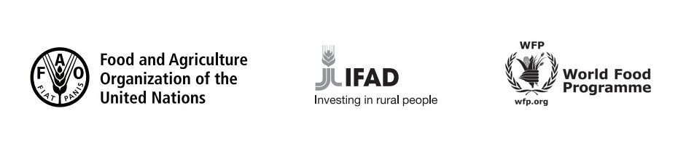
Technical Platform on Food Loss and Waste Reduction and Measurement (TPFLW): Partners
Rome-based UN agencies:

Slide 4

AIM
To strengthen collective efforts to prevent and reduce FLW toward achieving SDG target 12.3.
      SDG 12.3: By 2030, halve per capita global food waste at the retail and consumer levels and reduce food losses along production and supply chains, including post-harvest losses

Slide 5
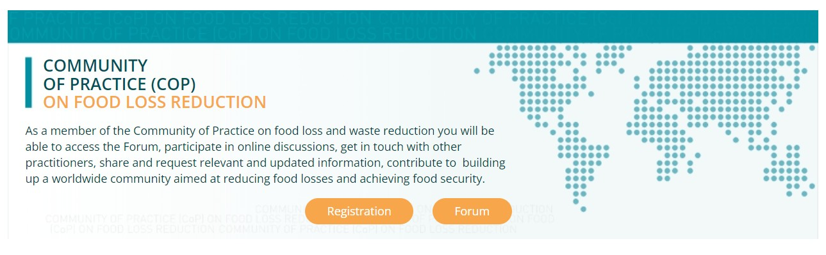
TPFLW Actions
Consolidates a broad spectrum of resources that address the complexity of the drivers and impacts of FLW.
Provides a mechanism for collective learning and capability strengthening.
Promotes awareness raising.
Facilitates networking and communication through a Community of Practice (CoP).

Slide 6
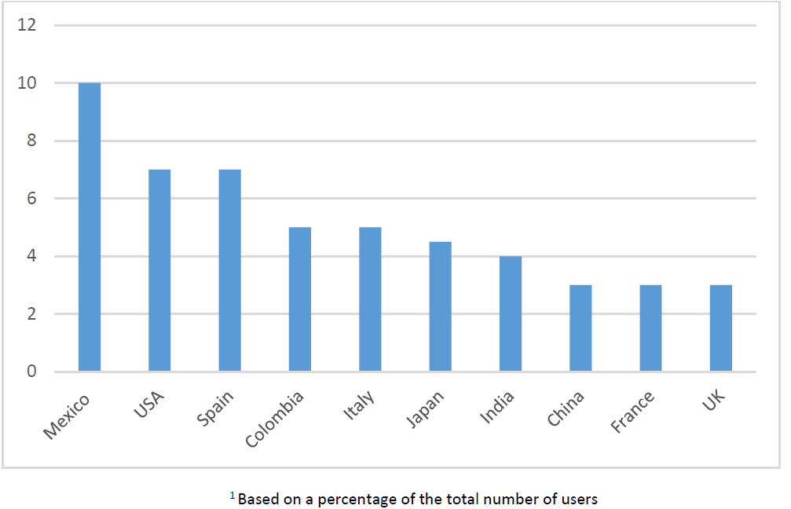
TPFLW Users (2021 & 2022)
Top 10 User Countries of the TPFLW
G20 countries constitute a majority of TPFLW users.
A 110 % increase in the number of countries using the TPFLW - from 100 countries in 2021 to 210 in Dec 2022.

Slide 7
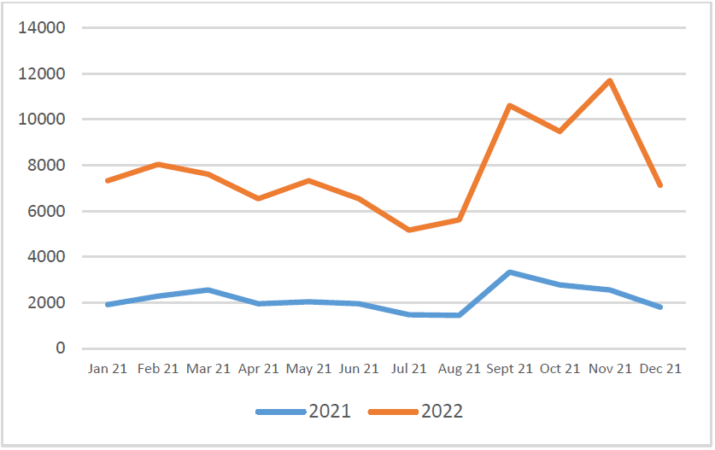
Returning Users : 2021 & 2022)
Profile of the number of returning users
A 12 % increase in the number of returning users.
User feedback highlights:
  Appreciation for open access to data and information that is relevant,
  useful and timely.

Slide 8
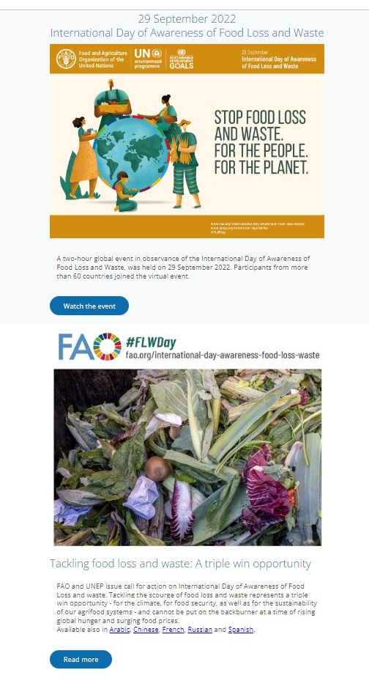
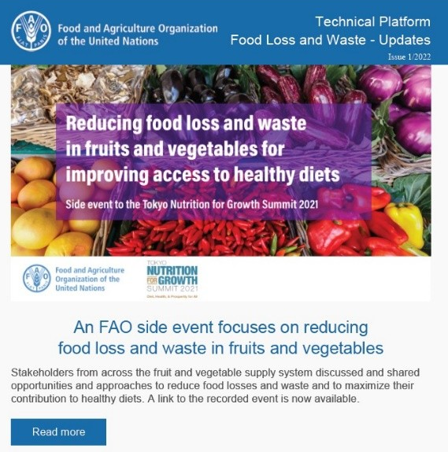
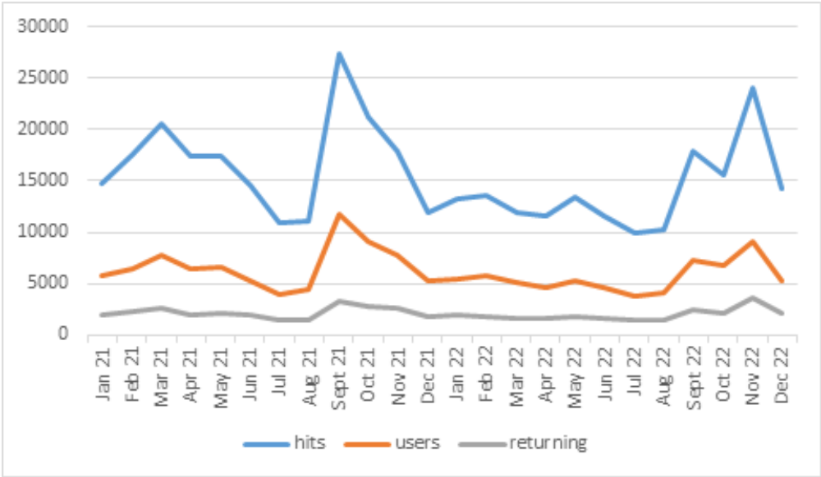
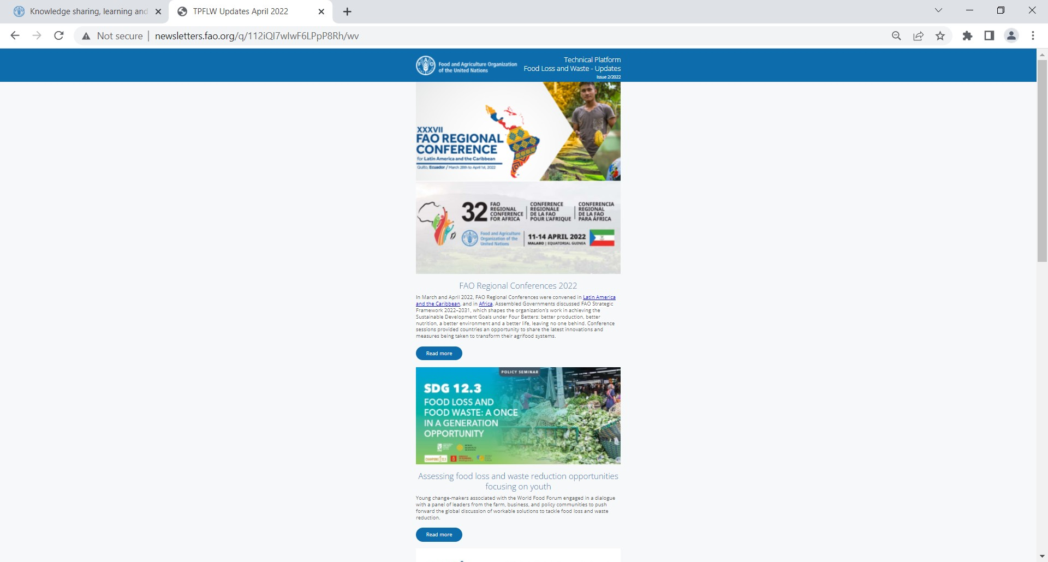
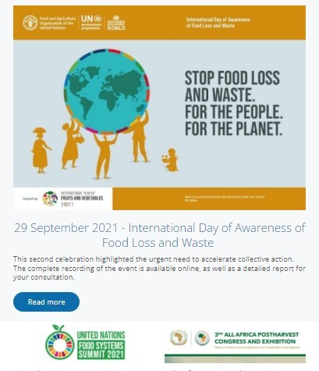
Website Traffic (2021 & 2022)
IDAFLW
COP27
N4G
IDAFLW

Slide 9
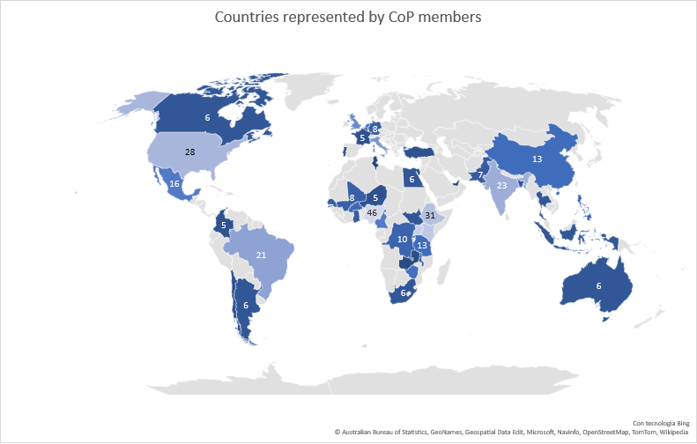
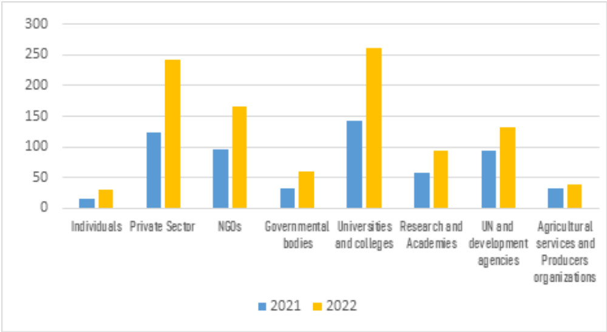
Community of Practice
CoP Member Affiliations
Countries with CoP Membership (Dec - 2022)
Positive pattern of membership among G20 Countries

Slide 10
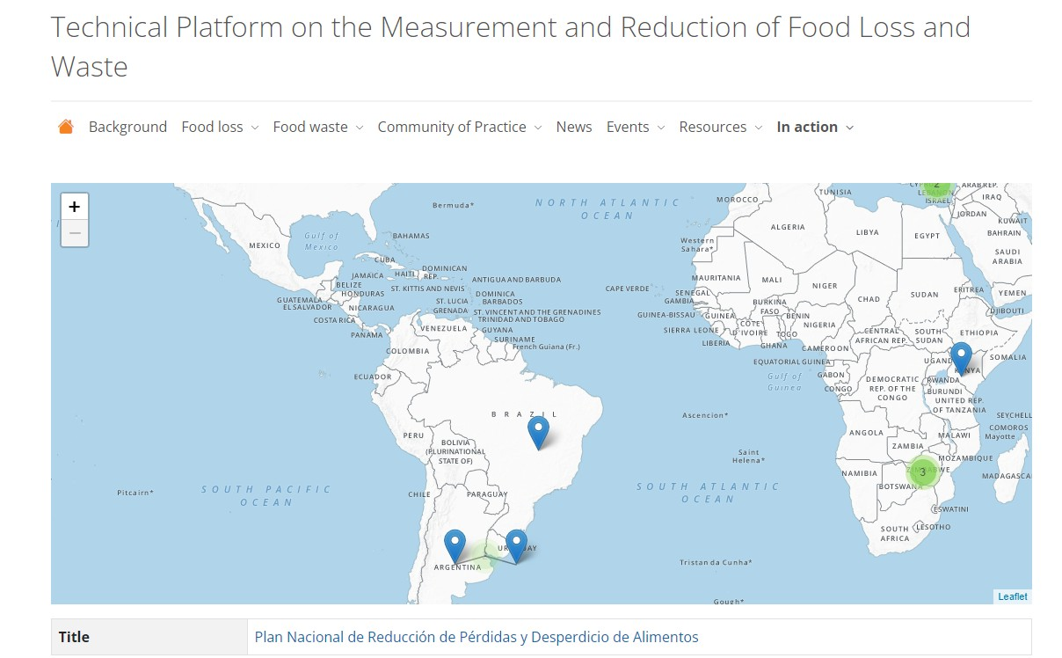
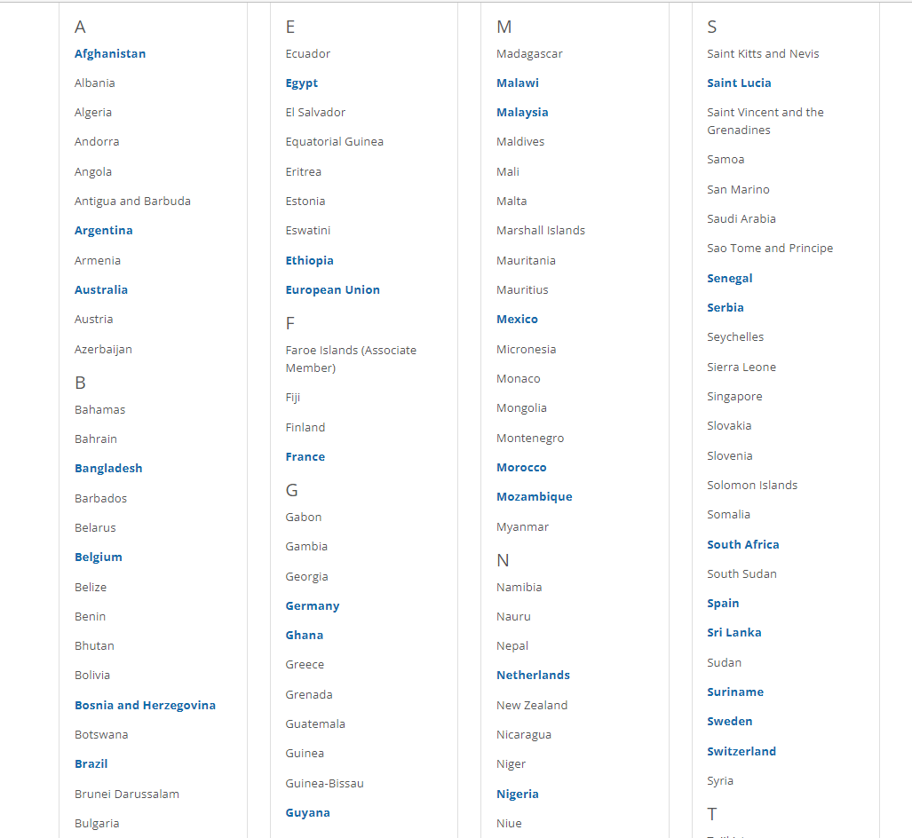
“In action”- Interactive Map on FLW Legislation, Projects, Initiatives and Programmes

Slide 11
Next Steps
Continue to broaden and increase the user base of the TPFLW and to scale up TPFLW actions.
Solicit engagement from G20 countries on TPFLW Actions, in particular, to:
  Increase the user base of the TPFLW.
  Make periodic contributions (six-monthly) on progress toward achieving SDG target 12.3, to the “In-action” country pages.

Slide 12
Thank you for your attention! www.fao.org/platform-food-loss-waste/en

