Slide 1
Innovative Financing Mechanisms for Climate-smart Agriculture
February 2023

Slide 2

Overview
ADB’s approach to financing climate-smart agriculture
Develop food security investment pipeline with developing member countries that simultaneously supports ADB’s climate and food security ambitions
Support policy reforms essential for developing member countries to effectively adopt climate-smart practices
Design innovative financing mechanisms that address the climate change-food-nature nexus
Stimulate private sector participation in climate-smart agriculture through novel approaches
Develop carbon markets that are especially sensitive to smallholders, inclusive, address economic and social contexts of member countries and scale well.

Slide 3
ADB is Committed to be Asia and the Pacific's Climate Bank
2015: ADB made a commitment to double climate financing from its own resources to $6 billion annually by 2020
2021: ADB announced it is elevating its climate finance ambition to $100 billion from 2019-2030
2018
2022
2015
2021
2021: ADB commits to full alignment of sovereign operations with the goals of the Paris Agreement by 1 July 2023, and of non-sovereign operations to 85% by 1 July 2023, and fully by 1 July 2025.
2018: ADB committed to ensuring at least 75% of the total number of its operations support climate action and its own climate finance resources reach at least a cumulative $80 billion by 2030

Slide 4
ADB has Announced its Ambition to Address Food Insecurity
Sep 2022: ADB announced plans to provide at least $14 billion over 2022–2025 in a comprehensive program of support to ease a worsening food crisis in Asia and the Pacific
2023
ADB’s ambition for food security 2022-2025
In September 2022, ADB announced plans to provide $14 billion over 2022-2025 to address food insecurity
Addressing climate-smart agriculture and the broader issue of climate change- food- nature nexus is a major priority
Nearly half of all targeted investments are targeting climate-smart agriculture and broader climate adaptation and mitigation goals
May 2022: ADB, along with other MDBs, co-developed the “IFI Action Plan to address food insecurity”
2022
2019: ADB announced Strategy 2030, which address food security as a key operational priority
2019

Slide 5
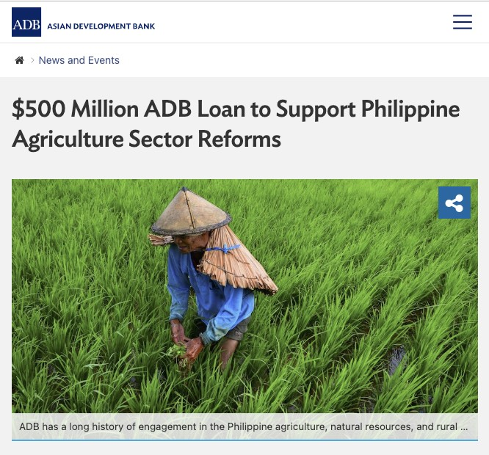
Financing Policy Reforms in Agriculture Sector is Essential for Climate Resilience in the Developing World
Several developing countries face structural issues at the nexus of agriculture and climate change.
ADB’s Policy-based lending (PBL) is an important mechanism of financing developing member country’s needs while supporting policy reform.
PBL are envisioned to be especially effective in supporting policy reforms at the nexus of climate change and agriculture.
PBL provide financial resources to help meet a country’s financing needs while supporting policy reforms that promote growth and poverty reduction. Funds are disbursed when evidence of the fulfillment of policy actions is provided.
Competitive and Inclusive Agriculture Development Program
Through trade policy and regulatory framework reforms, the PBL will support Philippines attain food security by building a competitive and inclusive agriculture sector that is characterized by improved efficiency, enhanced diversity, strengthened climate resilience, and higher farm incomes.

Slide 6
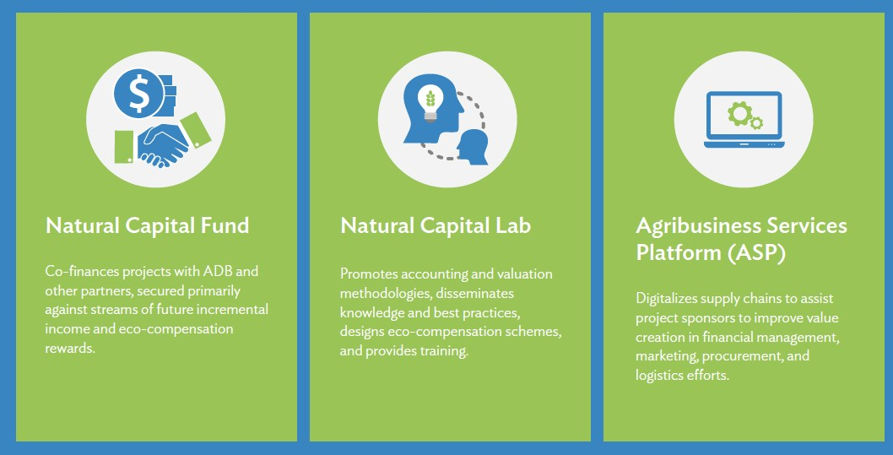
Innovative Natural Capital Financing Facility (INCFF): Addressing the Food-Climate-Nature Nexus
INCFF is a catalytic green blended finance facility designed to support projects with natural capital components in Asia and the Pacific. It has three main pillars.
Natural capital (natural assets like land, forests, water, minerals, biodiversity and living things) accounts for over half of global GDP,
40% of the natural capital has eroded over the past 20 years with food systems as the primary driver.
Asian Development Bank (ADB) recognizes the need for technical, financial, and institutional solutions to address these challenges.
Investment in nature positive solutions is needed to scale solutions that preserve and promote natural capital and create climate-resilient food systems.

Slide 7
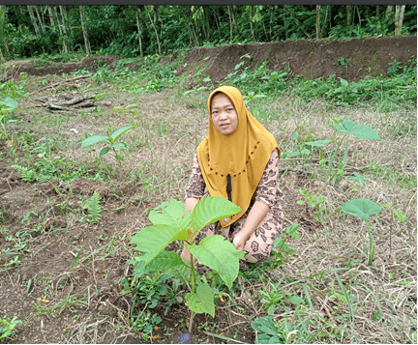
Stimulate Private Sector Participation in Promoting Climate-smart Agriculture Practices
Sustainability-Linked Loans (SLL) aim to facilitate and support environmentally and socially sustainable economic activity and growth.
SLLs enable a discount on the interest rate margin if the borrower achieves certain pre-determined annual sustainability objectives. A SLL may also include a margin penalty if milestones are missed – as negotiated between the lender and the borrower.
The borrower and the lender agree on Key Performance Indicators (KPIs) that address relevant environmental, social, and /or governance (ESG) challenges of the industry or sector.
The KPI should be ambitious, representing a material improvement in the respective KPIs and be beyond a “business as usual” trajectory.
DSNG Climate-Resilient Community-Based Agroforestry Value Chain Project
$15m Sustainability-Linked Loan to DSNG, Indonesian leader in wood products and sustainable palm oil, to finance the expansion of DSNG’s processing capacity and increased procurement of sengon and jabon timber cultivated by smallholder farmers in agroforestry systems in Java.
KPIs:
  FSC forest management certification for farmers, requiring DSNG to support farmers to attain certifications that are highly aligned with climate resilience.
  Farmer extension services aims to create farmer training in climate-smart agriculture into DSNG’s ongoing operations.
  Water conservation seeks to prepare the farmers for the future challenge of reduced water supply.

Slide 8
Develop carbon markets that are tailored for region’s needs and sensitive to smallholder farmers
Framing the ideal carbon market for Asia and the Pacific
Smallholder farmers
Solutions must bring maximum social, environmental and economic benefits by leveraging VCMs, following fair and equitable benefit-sharing principle
Solutions must be farmer-centric, versatile to integrate other externalities & innovations, and forward-thinking
Contribute to strengthening agricultural supply chains & fostering rural development
Provide additional economic opportunities in the rural economy.
$
Carbon Markets
Potential for Voluntary Carbon Markets (VCM)
Global VCM is valued at ~USD 2 Bn in 2021
Quadrupled in market value from 2020, driven by increased volume and value of NBS credits
Over issuance and retirement is on rise, triggered by the global economic uncertainty
Issuances Retirement
$
354
279
37
34
63
44
76
53
143
70
187
96
162
156
Investors, Offtakers ..

Slide 9
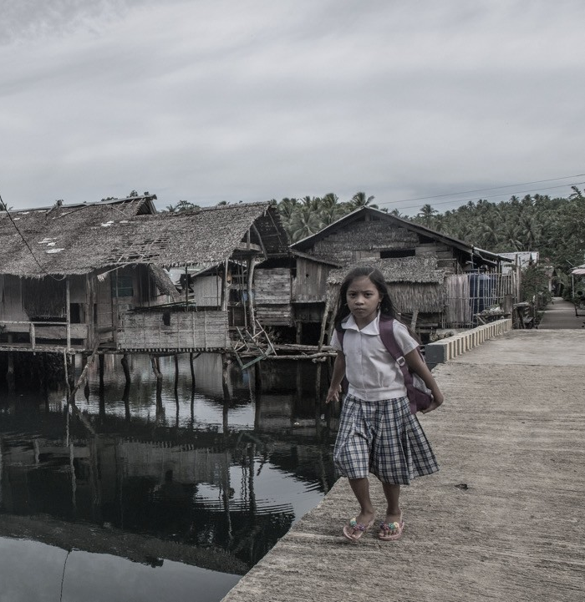
Community Resilience Partnership Program: A Bottom-up Approach
Partnership program to strengthen climate resilience by scaling up climate adaptation measures at the community level, that explicitly address the nexus between climate, poverty and gender.
Objectives
Strengthen climate policies and plans to support financing for community-led adaptation
Mobilize large-scale public investments in poverty reduction to support community-led adaptation
Achieve meaningful participation for poor women and men in resilience-related decision-making
How will the program support climate-smart agriculture?
Provide grants and technical assistance related support for
Action research and knowledge work to identify investment opportunities for resilience building
Building capacity of local institutions and communities to lead community-level adaptation measures
Support governments in preparation of large-scale investment projects
Pilots to demonstrate innovative approaches and solutions

Slide 10
Thank you

